Slide 1
AZ-140T00A Configuring and Operating Azure Virtual Desktop

Slide 2
Azure Virtual Desktop Architecture
Notes:
Azure Virtual Desktop is a desktop and application virtualization service that runs in the Azure cloud. Azure Virtual Desktop works across devices (Windows, Mac, iOS, Android, and Linux) with apps that you can use to access remote desktops and apps.
This section helps Desktop Infrastructure Architects, Cloud Architects, Desktop Administrators, or System Administrators explore Azure Virtual Desktop and build virtualized desktop infrastructure (VDI) solutions at enterprise scale. Enterprise-scale solutions generally cover 1,000 virtual desktops and above.
Learning objectives
After completing this section, you'll be able to:
Compare Azure Stack Hub, Azure Stack HCI, and Azure Stack Edge.
Explain how to integrate hybrid cloud scenarios using Azure Stack Hub.
Provide an overview of the Azure Stack Hub systems.
Explain how Azure Stack Hub is managed.
Identify the key resource providers for Azure Stack Hub.
Prerequisites
Conceptual knowledge of Azure compute solutions.
Working experience with virtual machines, containers, and app service.

Slide 3
Introduction
Azure Virtual Desktop for the enterprise
Azure Virtual Desktop components
Personal and pooled desktops
Service updates for Azure Virtual Desktop
Azure limitations for Azure Virtual Desktop
VM sizing
Azure Virtual Desktop pricing
Summary
AZ-140: Plan an Azure Virtual Desktop architecture (10-15%)
Design the Azure Virtual Desktop architecture
Conceptual knowledge of Azure compute solutions.
Working experience with virtual machines, virtual networks, and app service.
Notes:
https://docs.microsoft.com/en-us/learn/certifications/exams/az-140
Prerequisites
Conceptual knowledge of Azure compute solutions.
Working experience with virtual machines, virtual networks, and app service.

Slide 4

Azure Virtual Desktop for the enterprise

Slide 5
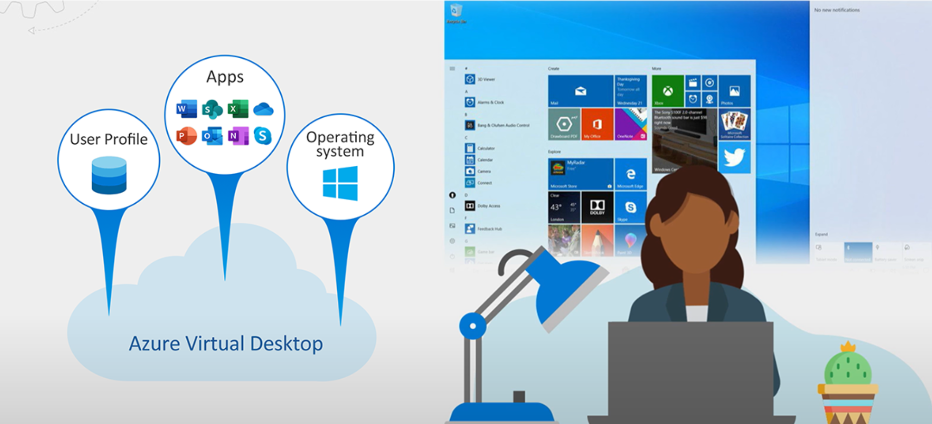
Azure Virtual Desktop is a desktop and application virtualization service that runs in Azure.
Common use cases:
Security and regulation applications: financial services, healthcare, and government.
Elastic workforce: remote workers, contractors, and partner access.
Employees: bring your own device (BYOD), mobile users, call centers, and branch workers.
Specialized workloads: design and engineering, legacy apps, and software development test.
Notes:
Azure Virtual Desktop is a desktop and application virtualization service that runs in the Azure cloud. Azure Virtual Desktop works across devices (Windows, Mac, iOS, Android, and Linux) with apps that you can use to access remote desktops and apps.
You can also use most modern browsers to access Azure Virtual Desktop-hosted experiences.
This training helps Desktop Infrastructure Architects, Cloud Architects, Desktop Administrators, or System Administrators explore Azure Virtual Desktop and build virtualized desktop infrastructure (VDI) solutions. Enterprise-scale solutions generally cover 1,000 virtual desktops and above.

Slide 6
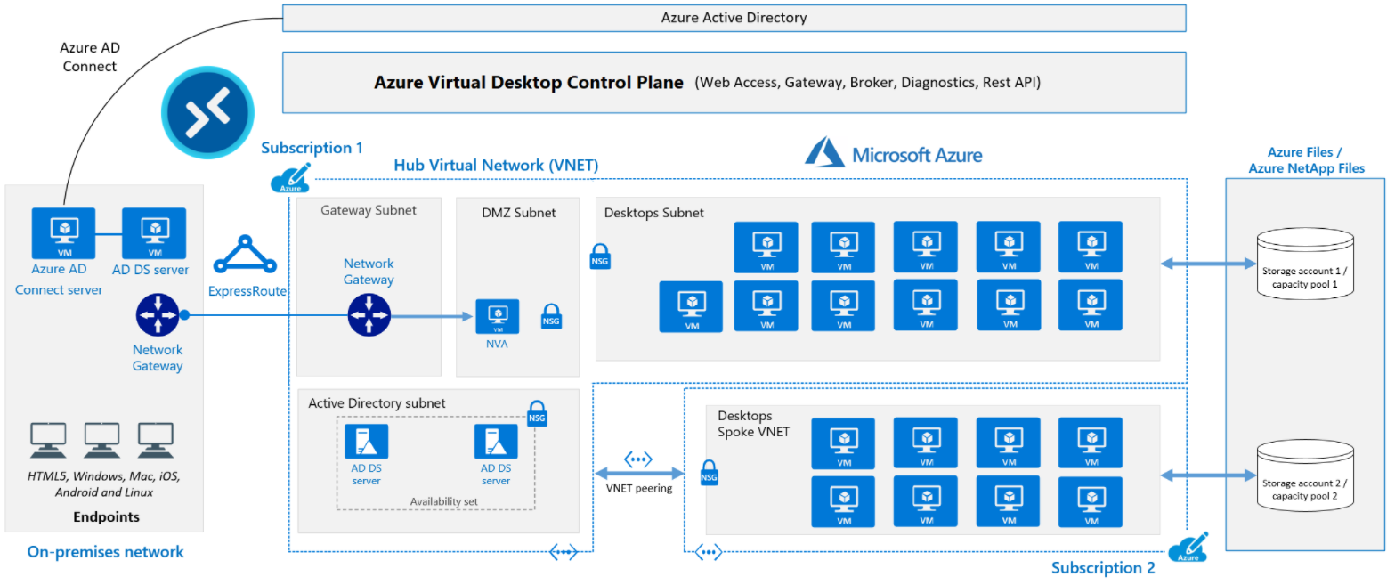
Azure Virtual Desktop for the enterprise
Notes:
The diagram shows a typical architectural setup for Azure Virtual Desktop.
The application endpoints are in the customer's on-premises network. ExpressRoute extends the on-premises network into the Azure cloud, and Azure AD Connect integrates the customer's Active Directory Domain Services (AD DS) with Azure Active Directory (Azure AD).
The Azure Virtual Desktop control plane handles Web Access, Gateway, Broker, Diagnostics, and extensibility components like REST APIs.
The customer manages AD DS and Azure AD, Azure subscriptions, virtual networks, Azure Files or Azure NetApp Files, and the Azure Virtual Desktop host pools and workspaces.
To increase capacity, the customer uses two Azure subscriptions in a hub-spoke architecture, and connects them via virtual network peering.

Slide 7

Azure Virtual Desktop components

Slide 8
Azure Virtual Desktop components (Azure managed)
Web Access: users access virtual desktops through an HTML5-compatible browser
Gateway: connects remote users to Azure Virtual Desktop apps and desktops from any internet-connected device
Connection Broker: manages user connections to virtual desktops and apps
Diagnostics: event-based aggregator that marks each user or administrator action
Extensibility components: manage Azure Virtual Desktop using Windows PowerShell or REST APIs
Notes:
Azure Virtual Desktop service architecture is similar to Windows Server Remote Desktop Services. Microsoft manages the infrastructure and brokering components, while enterprise customers manage their own desktop host virtual machines (VMs), data, and clients.
Microsoft manages the following Azure Virtual Desktop services as part of Azure:
Web Access: The Web Access service within Window Virtual Desktop lets users access virtual desktops and remote apps through an HTML5-compatible web browser as they would with a local PC, from anywhere on any device. You can secure Web Access using multifactor authentication in Azure Active Directory.
Gateway: The Remote Connection Gateway service connects remote users to Azure Virtual Desktop apps and desktops from any internet-connected device that can run an Azure Virtual Desktop client. The client connects to a gateway, which then orchestrates a connection from a VM back to the same gateway.
Connection Broker: The Connection Broker service manages user connections to virtual desktops and remote apps. The Connection Broker provides load balancing and reconnection to existing sessions.
Diagnostics: Remote Desktop Diagnostics is an event-based aggregator that marks each user or administrator action on the Azure Virtual Desktop deployment as a success or failure. Administrators can query the event aggregation to identify failing components.
Extensibility components: Azure Virtual Desktop includes several extensibility components. You can manage Azure Virtual Desktop using Windows PowerShell or with the provided REST APIs, which also enable support from third-party tools.

Slide 9
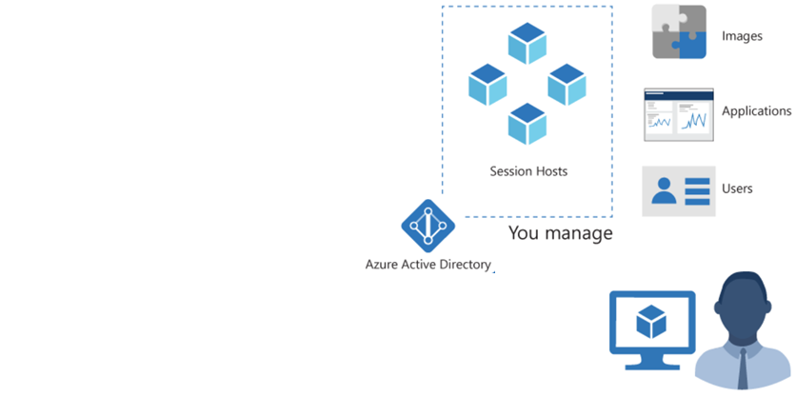
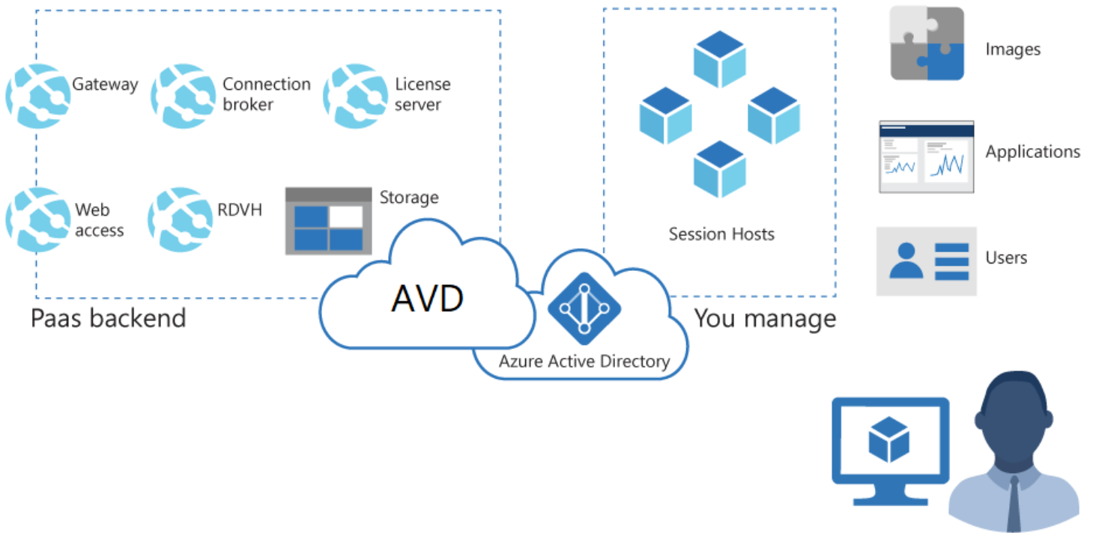
Azure Virtual Desktop components (Customer managed)
Azure Virtual Network: Connect an Azure Virtual Desktop to an on-premises network using a VPN or Azure ExpressRoute.
Azure AD: Azure Virtual Desktop uses Azure AD for identity and access management.
AD DS: Azure Virtual Desktop VMs must domain-join an AD DS service, and the AD DS must be in sync with Azure AD to associate users between the two services. You can use Azure AD Connect to associate AD DS with Azure AD.
Azure Virtual Desktop session hosts: A host pool can run the operating systems.
Notes:
Customers manage these components of Azure Virtual Desktop solutions:
Azure Virtual Network: Azure Virtual Network lets Azure resources like VMs communicate privately with each other and with the internet. By connecting Azure Virtual Desktop host pools to an Active Directory domain, you can define network topology to access virtual desktops and virtual apps from the intranet or internet, based on organizational policy. You can connect an Azure Virtual Desktop to an on-premises network using a virtual private network (VPN), or use Azure ExpressRoute to extend the on-premises network into the Azure cloud over a private connection.
Azure AD: Azure Virtual Desktop uses Azure AD for identity and access management. Azure AD integration applies Azure AD security features like conditional access, multi-factor authentication, and the Intelligent Security Graph, and helps maintain app compatibility in domain-joined VMs.
AD DS: Azure Virtual Desktop VMs must domain-join an AD DS service, and the AD DS must be in sync with Azure AD to associate users between the two services. You can use Azure AD Connect to associate AD DS with Azure AD.
Azure Virtual Desktop session hosts: A host pool can run the following operating systems:
Windows 7 Enterprise
Windows 10 Enterprise
Windows 10 Enterprise Multi-session
Windows Server 2012 R2 and above
Custom Windows system images with pre-loaded apps, group policies, or other customizations
Azure Virtual Desktop workspace: The Azure Virtual Desktop workspace or tenant is a management construct to manage and publish host pool resources.

Slide 10
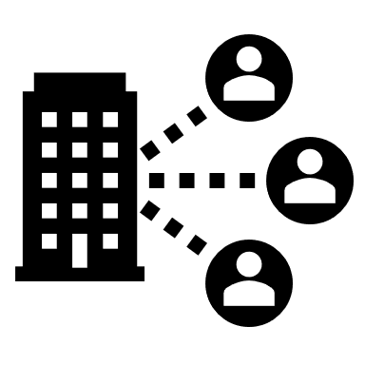
Personal and pooled desktops

Slide 11
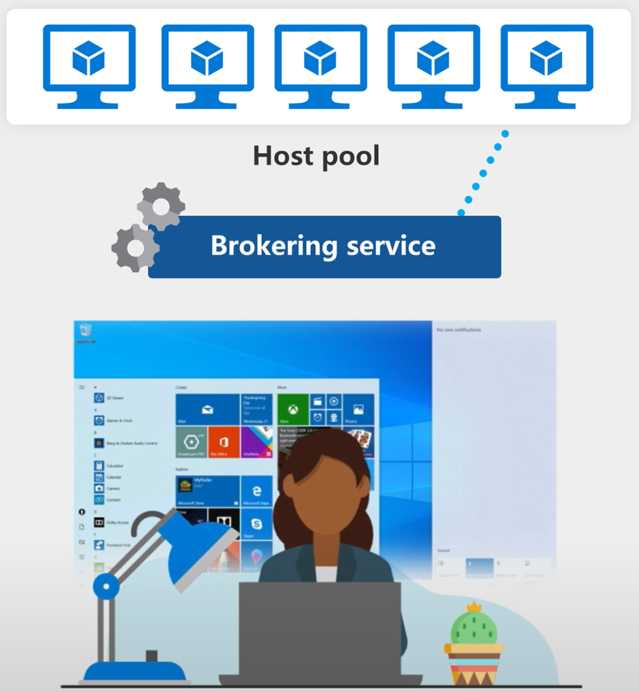
Host pools are a collection of one or more identical virtual machines (VMs) within Azure Virtual Desktop environments.
Personal desktop solutions (sometimes called persistent desktops) allow users to always connect to the same specific session host.
Users can modify their desktop experience to meet personal preferences and save files in the desktop environment.
Notes:
A host pool is a collection of Azure virtual machines that register to Azure Virtual Desktop as session hosts when you run the Azure Virtual Desktop agent. All session host virtual machines in a host pool should be sourced from the same image for a consistent user experience.
A host pool can be one of two types:
Personal, where each session host is assigned to individual users.
Pooled, where session hosts can accept connections from any user authorized to an app group within the host pool.
You can set additional properties on the host pool to change its load-balancing behavior, how many sessions each session host can take, and what the user can do to session hosts in the host pool while signed into their Windows Virtual Desktop sessions. You control the resources published to users through app groups.

Slide 12
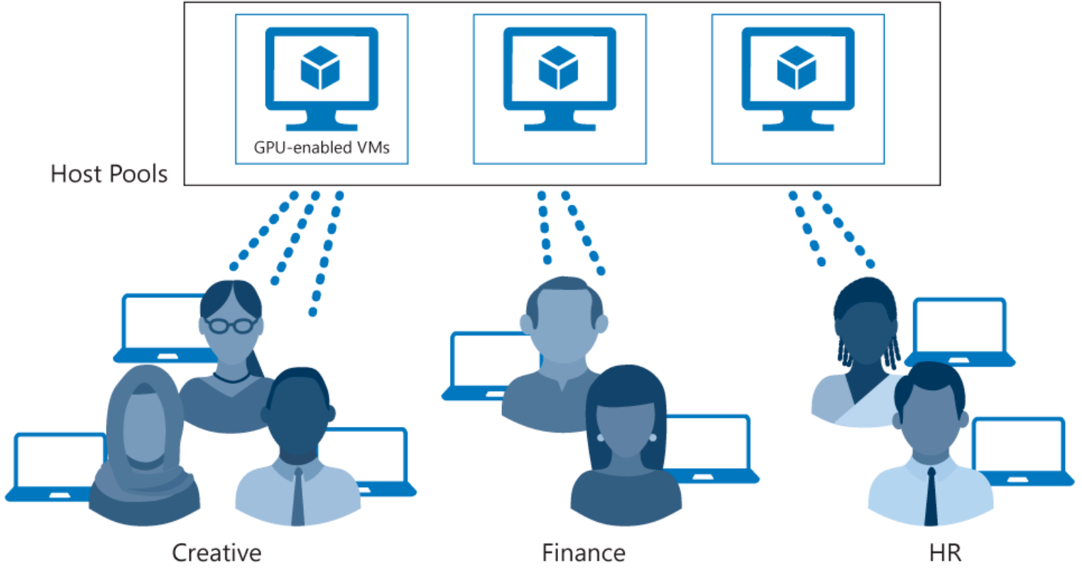
Each host pool can contain an app group that users can interact with as they would on a physical desktop.
Notes:
A host pool is a collection of Azure virtual machines that register to Azure Virtual Desktop as session hosts when you run the Azure Virtual Desktop agent. All session host virtual machines in a host pool should be sourced from the same image for a consistent user experience.
A host pool can be one of two types:
Personal, where each session host is assigned to individual users.
Pooled, where session hosts can accept connections from any user authorized to an app group within the host pool.
You can set additional properties on the host pool to change its load-balancing behavior, how many sessions each session host can take, and what the user can do to session hosts in the host pool while signed into their Windows Virtual Desktop sessions. You control the resources published to users through app groups.

Slide 13

Service updates for Azure Virtual Desktop

Slide 14
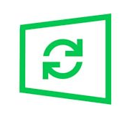
Options for updating Azure Virtual Desktop desktops:
Microsoft Endpoint Configuration Manager (MECM) updates server and desktop operating systems.
Windows Updates for Business updates desktop operating systems like Windows 10 multi-session.
Azure Update Management updates server operating systems.
Azure Log Analytics checks compliance.
Deploy a new (custom) image to session hosts every month for the latest Windows and applications updates. You can use an image from the Azure Marketplace or a custom Azure managed image.

Slide 15

Azure limitations for Azure Virtual Desktop

Slide 16
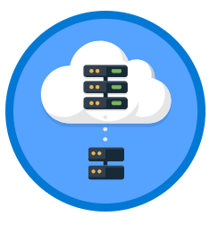
Azure Virtual Desktop limitations
Azure Virtual Desktop object | Per Parent container object | Service limit
Workspace | Azure Active Directory tenant | 1300
HostPool | Workspace | 400
Application group | Azure Active Directory tenant | 500*
RemoteApp | Application group | 500
Role assignment | Any Azure Virtual Desktop object | 200
Session host | HostPool | 10,000
For the most recent limitations, see: https://learn.microsoft.com/en-us/azure/architecture/example-scenario/wvd/windows-virtual-desktop, and https://learn.microsoft.com/en-us/azure/azure-resource-manager/management/azure-subscription-service-limits
Notes:
Azure Virtual Desktop, much like Azure, has certain service limitations that you need to be aware of. To avoid having to make changes in the scaling phase, it's a good idea to address some of these limitations during the design phase.
*If you require more than 500 application groups, submit a support ticket via the Azure portal.
We recommend that you deploy no more than 5,000 VMs per Azure subscription per region. This recommendation applies to both personal and pooled host pools, based on Windows Enterprise single and multi-session. Most customers use Windows Enterprise multi-session, which allows multiple users to log in to each VM. You can increase the resources of individual session-host VMs to accommodate more user sessions.
For automated session-host scaling tools, the limits are around 2,500 VMs per Azure subscription per region, because VM status interaction consumes more resources.
To manage enterprise environments with more than 5,000 VMs per Azure subscription in the same region, you can create multiple Azure subscriptions in a hub-spoke architecture and connect them via virtual network peering (using one subscription per spoke). You could also deploy VMs in a different region in the same subscription to increase the number of VMs.
Azure Resource Manager (ARM) subscription API throttling limits don't allow more than 600 Azure VM reboots per hour via the Azure portal. You can reboot all your machines at once via the operating system, which doesn't consume any Azure Resource Manager subscription API calls. For more information about counting and troubleshooting throttling limits based on your Azure subscription, see Troubleshoot API throttling errors.
You can currently deploy up to 132 VMs in a single ARM template deployment in the Azure Virtual Desktop portal. To create more than 132 VMs, run the ARM template deployment in the Azure Virtual Desktop portal multiple times.
Azure VM session-host name prefixes can't exceed 11 characters, due to auto-assigning of instance names and the NetBIOS limit of 15 characters per computer account.
By default, you can deploy up to 800 instances of most resource types in a resource group. Azure Compute doesn't have this limit.
For more information about Azure subscription limitations, see Azure subscription and service limits, quotas, and constraints.

Slide 17

Virtual machine (VM) sizing

Slide 18
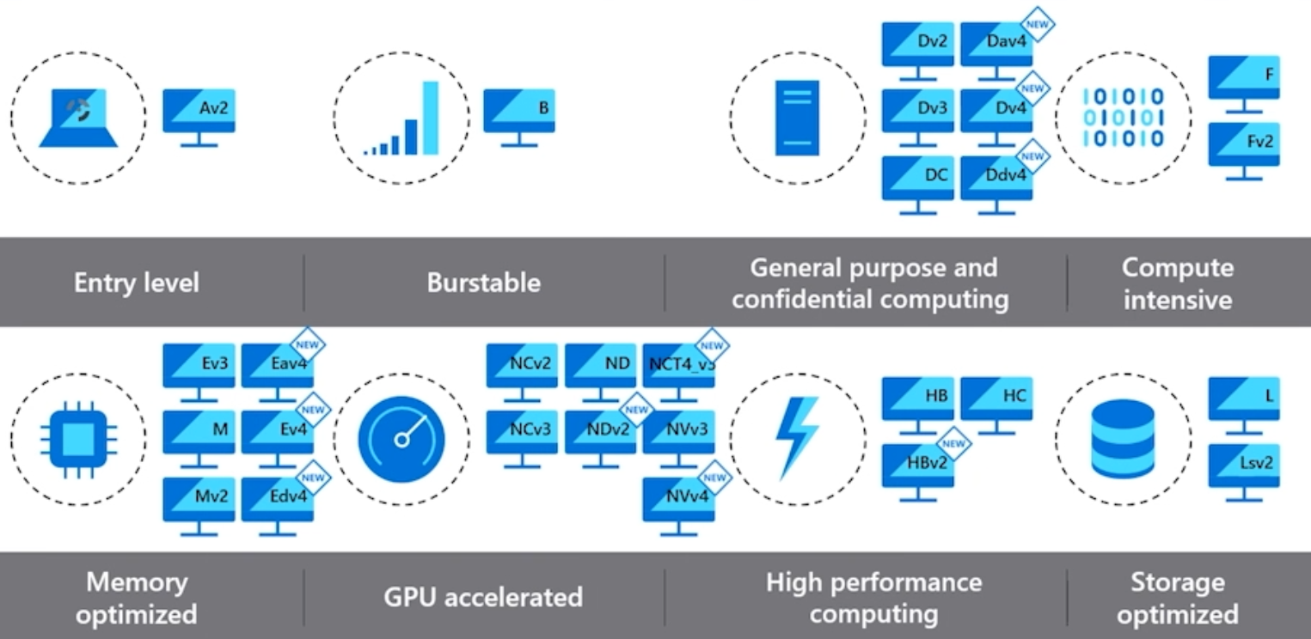
Use the virtual machine sizing guidelines for the maximum suggested number of users per virtual central processing unit (vCPU) and minimum VM configurations.

Slide 19
Azure Virtual Desktop pricing

Slide 20
Pricing
Windows 10 multi-session: By delivering a multi-session desktop experience for users that have identical compute requirements, you can let more users log onto a single VM at once, resulting in considerable cost savings.
Azure Hybrid Benefit: If you have Software Assurance, you can use Azure Hybrid Benefit for Windows Server to save on the cost of your Azure infrastructure.
Azure Reserved Instances: You can prepay for your VM usage and save money. Combine Azure Reserved Instances with Azure Hybrid Benefit for up to 80 percent savings over list prices.
Session host load-balancing: When setting up session hosts, Breadth-first is the standard default mode, which spreads users randomly across session hosts. Depth-first mode fills up a session host server with the maximum number of users before it moves on to the next session host. You can adjust this setting for maximum cost benefits.
Notes:
Windows 10 multi-session: By delivering a multi-session desktop experience for users that have identical compute requirements, you can let more users log onto a single VM at once, resulting in considerable cost savings.
Azure Hybrid Benefit: If you have Software Assurance, you can use Azure Hybrid Benefit for Windows Server to save on the cost of your Azure infrastructure.
Azure Reserved Instances: You can prepay for your VM usage and save money. Combine Azure Reserved Instances with Azure Hybrid Benefit for up to 80 percent savings over list prices.
Session host load-balancing: When setting up session hosts, Breadth-first is the standard default mode, which spreads users randomly across session hosts. Depth-first mode fills up a session host server with the maximum number of users before it moves on to the next session host. You can adjust this setting for maximum cost benefits.

Slide 21
Summary
Check your knowledge
What you learned:
Explain the Azure Virtual Desktop components.
Describe the Azure Virtual Desktop architecture.
Choose between personal and pooled desktops.
Identify the Azure limitations for Azure Virtual Desktop.
Describe the options for Azure Virtual Desktop pricing.
Notes:
What you learned:
Explain the Azure Virtual Desktop components.
Describe the Azure Virtual Desktop architecture.
Choose between personal and pooled desktops.
Identify the Azure limitations for Azure Virtual Desktop.
Describe the options for Azure Virtual Desktop pricing.

Slide 22
Lab - Prepare for deployment of Azure Virtual Desktop (Azure AD DS)
Note: this lab is a prerequisite for fulfilling other labs for this course where Azure AD DS is required.
Estimated time: 60 minutes , where provisioning of an Azure AD DS takes involves about 90-minute wait time.
Lab - Prepare for deployment of Azure Virtual Desktop (Azure AD DS).

Slide 23
Lab - Prepare for deployment of Azure Virtual Desktop (AD DS)
Note: this lab is a prerequisite for fulfilling other labs for this course where Azure AD DS is required.
Estimated time: 60 minutes
Lab - Prepare for deployment of Azure Virtual Desktop (AD DS).

Slide 24

End of presentation

