Slide 1
AZ-140T00A Configuring and Operating Azure Virtual Desktop

Slide 2
Design the Azure Virtual Desktop architecture
Notes:
The amount of available network bandwidth greatly impacts the quality of your experience. Various applications and display resolutions require different network configurations, so it's important to make sure your network is configured to meet your needs. This section shows you how to optimize network and operating system configurations to maximize performance.
The stress put on a network depends on both app workload's output frame rate and display resolution. If either the frame rate or display resolution increases, the bandwidth requirement will also rise. For example, a light workload with a high-resolution display requires more available bandwidth than a light workload with regular or low resolution.
Other scenarios can have their bandwidth requirements change depending on how you use them, such as:
Voice or video conferencing
Real-time communication
Streaming 4K video
Learning objectives
After completing this section, you'll be able to:
Assess network capacity and speed requirements for Azure Virtual Desktop.
Determine the connection round-trip time (RTT) from a location through the Azure Virtual Desktop service.
Recommend an operating system for an Azure Virtual Desktop implementation.
Describe the two load-balancing methods for Azure Virtual Desktop.
Recommendation subscriptions and management groups for Azure Virtual Desktop.
Recommend a configuration for performance requirements.
Prerequisites
Conceptual knowledge of Azure compute solutions.
Working experience with virtual machines, containers, and app service.

Slide 3
Introduction
Assess network capacity and speed requirements for Azure Virtual Desktop.
Determine the connection round-trip time (RTT) from a location through the Azure Virtual Desktop service.
Recommend an operating system for a Azure Virtual Desktop implementation.
Describe the two load-balancing methods for Azure Virtual Desktop.
Recommendation subscriptions and management groups for Azure Virtual Desktop.
Recommend a configuration for performance requirements.
Knowledge check and Summary
AZ-140: Plan an Azure Virtual Desktop architecture (10-15%)
Design the Azure Virtual Desktop architecture
Conceptual knowledge of Azure compute solutions.
Working experience with virtual machines, virtual networks, and app service.
Notes:
https://docs.microsoft.com/en-us/learn/certifications/exams/az-140
Prerequisites
Conceptual knowledge of Azure compute solutions.
Working experience with virtual machines, virtual networks, and app service.

Slide 4
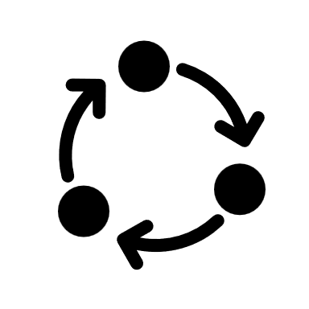
Assess network capacity and speed requirements for Azure Virtual Desktop

Slide 5
Minimum recommended bandwidths for a smooth user experience for using applications:
Workload type | Recommended bandwidth
Light | 1.5 Mbps
Medium | 3 Mbps
Heavy | 5 Mbps
Power | 15 Mbps
Bandwidth recommendations for a smooth user experience for display resolutions:
Typical display resolutions at 30 fps | Recommended bandwidth
About 1024 × 768 px | 1.5 Mbps
About 1280 × 720 px | 3 Mbps
About 1920 × 1080 px | 5 Mbps
About 3840 × 2160 px (4K) | 15 Mbps
Notes:
When using a remote Windows session, your network's available bandwidth greatly impacts the quality of your experience. Different applications and display resolutions require different network configurations, so it's important to make sure your network is configured to meet your needs.
The following recommendations apply to networks with less than 0.1% loss. These recommendations apply regardless of how many sessions you're hosting on your virtual machines (VMs).
Applications
The first table lists the minimum recommended bandwidths for a smooth user experience.
Keep in mind that the stress put on your network depends on both your app workload's output frame rate and your display resolution. If either the frame rate or display resolution increases, the bandwidth requirement will also rise. For example, a light workload with a high-resolution display requires more available bandwidth than a light workload with regular or low resolution.
Display resolutions
Different display resolutions require different available bandwidths. The following table lists the bandwidths we recommend for a smooth user experience at typical display resolutions with a frame rate of 30 frames per second (fps). These recommendations apply to single and multiple user scenarios. Keep in mind that scenarios involving a frame rate under 30 fps, such as reading static text, require less available bandwidth.

Slide 6

Azure Virtual Desktop Experience Estimator

Slide 7
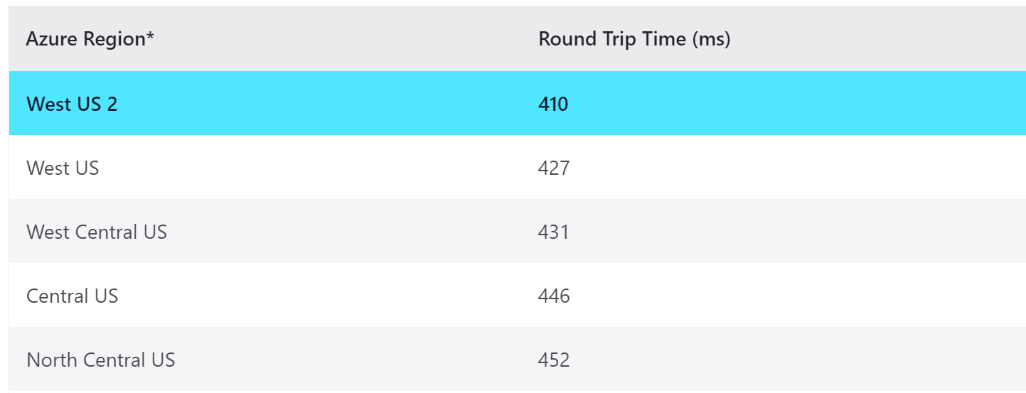
Use the Azure Virtual Desktop Experience Estimator to determine the connection RTT from your location to each Azure region you can deploy VMs
Connection round trip time from your current location
Azure region in which you can deploy virtual machines
Through the Azure Virtual Desktop service
Notes:
Use the Azure Virtual Desktop Experience Estimator to determine the connection round trip time (RTT) from your current location, through the Azure Virtual Desktop service, to each Azure region in which you can deploy virtual machines.
The highlighted Azure region is the one with the lowest connection RTT from your current location. The times displayed are estimates intended to help assess end user experience quality for your Azure Virtual Desktop deployment. The actual experience will vary depending on network conditions, end user device, and the configuration of the deployed virtual machines.

Slide 8
Recommend an operating system for an Azure Virtual Desktop implementation

Slide 9
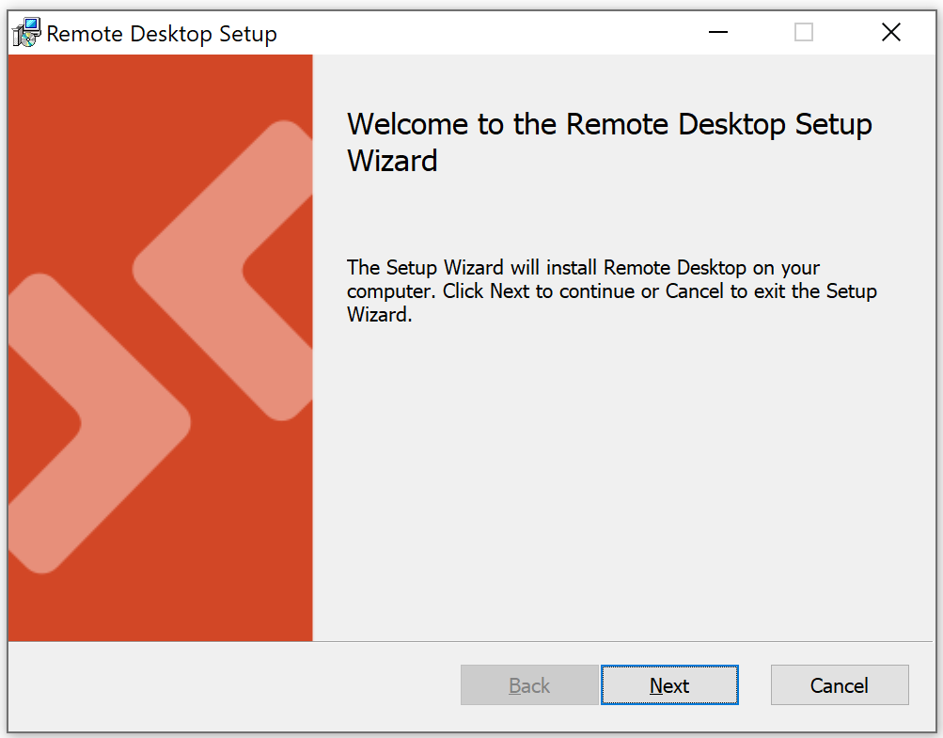
Access Azure Virtual Desktop resources on devices with Windows 10, Windows 10 IoT Enterprise, and Windows 7 using the Windows Desktop client.
Choose the client that matches your version of Windows:
Windows 64-bit
Windows 32-bit
Windows ARM64
NOTE: The client doesn't support Windows 8 or Windows 8.1.
Notes:
Once installed, the client can be launched from the Start menu by searching for Remote Desktop.
Azure Virtual Desktop doesn't support the RemoteApp and Desktop Connections (RADC) client or the Remote Desktop Connection (MSTSC) client.

Slide 10

Balancing host pools

Slide 11
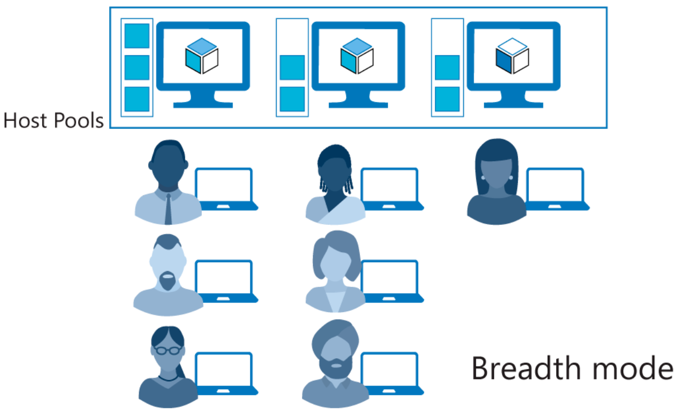
Breadth-first load-balancing method
Ideal for providing the best experience for users connecting to their pooled virtual desktop environment.
Notes:
Azure Virtual Desktop supports two load-balancing methods. Each method determines which session host will host a user's session when they connect to a resource in a host pool.
The following load-balancing methods are available in Azure Virtual Desktop:
Each host pool can only configure one type of load-balancing specific to it. However, both load-balancing methods share the following behaviors no matter which host pool they're in:
If a user already has a session in the host pool and is reconnecting to that session, the load balancer will successfully redirect them to the session host with their existing session. This behavior applies even if that session host's AllowNewConnections property is set to False.
If a user doesn't already have a session in the host pool, then the load balancer won't consider session hosts whose AllowNewConnections property is set to False during load balancing.
Breadth-first load-balancing methodBreadth-first load balancing allows you to evenly distribute user sessions across the session hosts in a host pool.
Depth-first load balancing allows you to saturate a session host with user sessions in a host pool. Once the first session reaches its session limit threshold, the load balancer directs any new user connections to the next session host in the host pool until it reaches its limit, and so on.
The breadth-first load-balancing method allows you to distribute user connections to optimize for this scenario. This method is ideal for organizations that want to provide the best experience for users connecting to their pooled virtual desktop environment.
The breadth-first method first queries session hosts that allow new connections. The method then selects a session host randomly from half the set of session hosts with the least number of sessions. For example, if there are nine machines with 11, 12, 13, 14, 15, 16, 17, 18, and 19 sessions, a new session you create won't automatically go to the first machine. Instead, it can go to any of the first five machines with the lowest number of sessions (11, 12, 13, 14, 15).

Slide 12
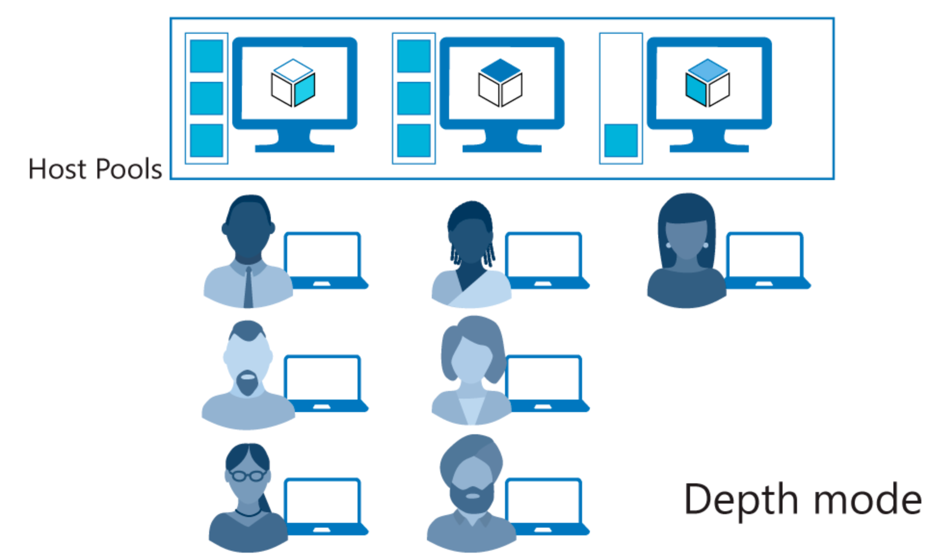
Depth-first load-balancing method
Ideal for cost-conscious organizations that want more granular control on the number of virtual machines they've allocated for a host pool.
Notes:
The depth-first method first queries session hosts that allow new connections and haven't gone over their maximum session limit. The method then selects the session host with highest number of sessions. If there's a tie, the method selects the first session host in the query.
The depth-first load balancing algorithm distributes sessions to session hosts based on the maximum session host limit. This parameter is required when you use the depth-first load balancing algorithm. For the best possible user experience, make sure to change the maximum session host limit parameter to a number that best suits your environment.

Slide 13
Recommendations for using subscriptions and management groups

Slide 14
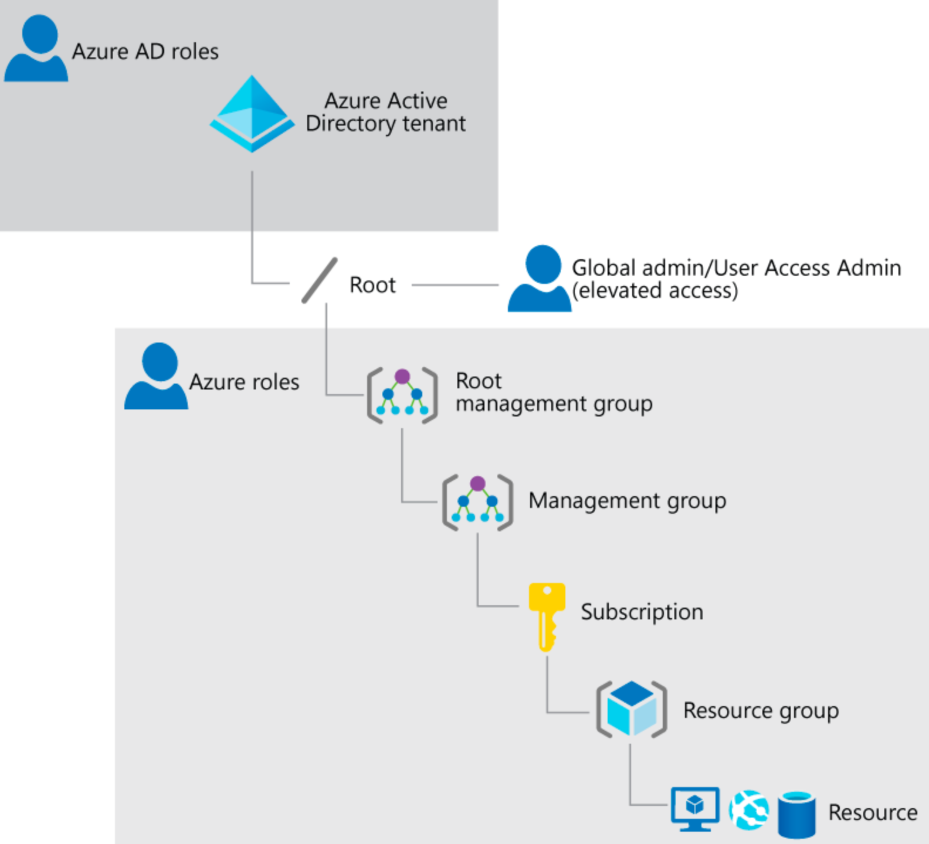
A Global Administrator in Azure AD may need to elevate access to access subscriptions and management groups, such as:
Regain access to an Azure subscription or management group when a user has lost access
Grant another user access to an Azure subscription or management group
See all Azure subscriptions or management groups in an organization
Allow an automation app to access all Azure subscriptions or management groups
Notes:
Some Azure Virtual Desktop procedures, such as installing Office on a master VHD image, assume you have elevated access on the VM, whether it's provisioned in Azure or Hyper-V Manager.
As a Global Administrator in Azure Active Directory (Azure AD), you might not have access to all subscriptions and management groups in your directory. Below are methods to elevate access to all subscriptions and management groups.
Why would you need to elevate your access?
Global Administrators should consider the following scenarios for elevating access.
Regain access to an Azure subscription or management group when a user has lost access.
Grant another user or yourself access to an Azure subscription or management group.
See all Azure subscriptions or management groups in an organization.
Allow an automation app (such as an invoicing or auditing app) to access all Azure subscriptions or management groups.

Slide 15

Configure a location for the Azure Virtual Desktop metadata

Slide 16
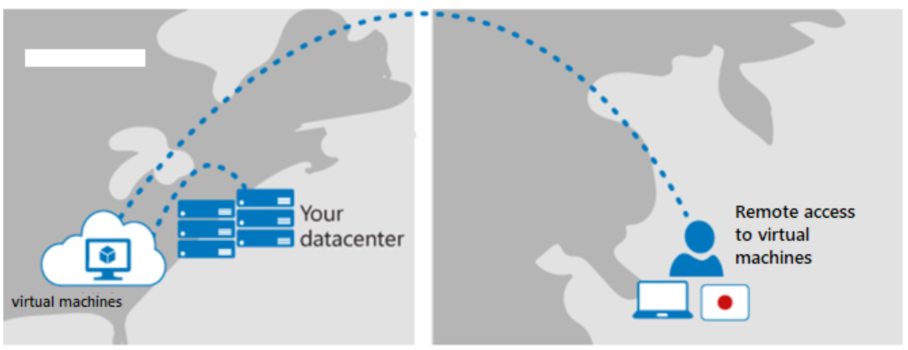
Azure Virtual Desktop metadata
Azure Virtual Desktop stores global metadata information (tenant names, host pool names, app group names, and user principal names) in a datacenter.
Whenever a customer creates a service object, they must enter a location for the service object
The location entered determines where the metadata for the object will be stored
The customer will choose an Azure region and the metadata will be stored in the related geography
Currently support for storing metadata in the following geographies:
United States (US) (generally available)
Europe (EU) (generally available)
United Kingdom (UK) (public preview)
Notes:
Azure Virtual Desktop is currently available for all geographical locations. Administrators can choose the location to store user data when they create the host pool virtual machines and associated services, such as file servers.
Microsoft doesn't control or limit the regions where you or your users can access your user and app-specific data.
Azure Virtual Desktop stores global metadata information like tenant names, host pool names, app group names, and user principal names in a datacenter. Whenever a customer creates a service object, they must enter a location for the service object. The location they enter determines where the metadata for the object will be stored. The customer will choose an Azure region and the metadata will be stored in the related geography.
There is currently support for storing metadata in the following geographies:
United States (US) (generally available)
Europe (EU) (generally available)
United Kingdom (UK) (public preview)
The stored metadata is encrypted at rest, and geo-redundant mirrors are maintained within the geography. All customer data, such as app settings and user data, resides in the location the customer chooses and isn't managed by the service. More geographies will become available as the service grows.
Service metadata is replicated within the Azure geography for disaster recovery purposes.
When you're selecting a region to create Azure Virtual Desktop service objects in, you'll see regions under both US and EU geographies.

Slide 17

Recommend a configuration for performance requirements

Slide 18
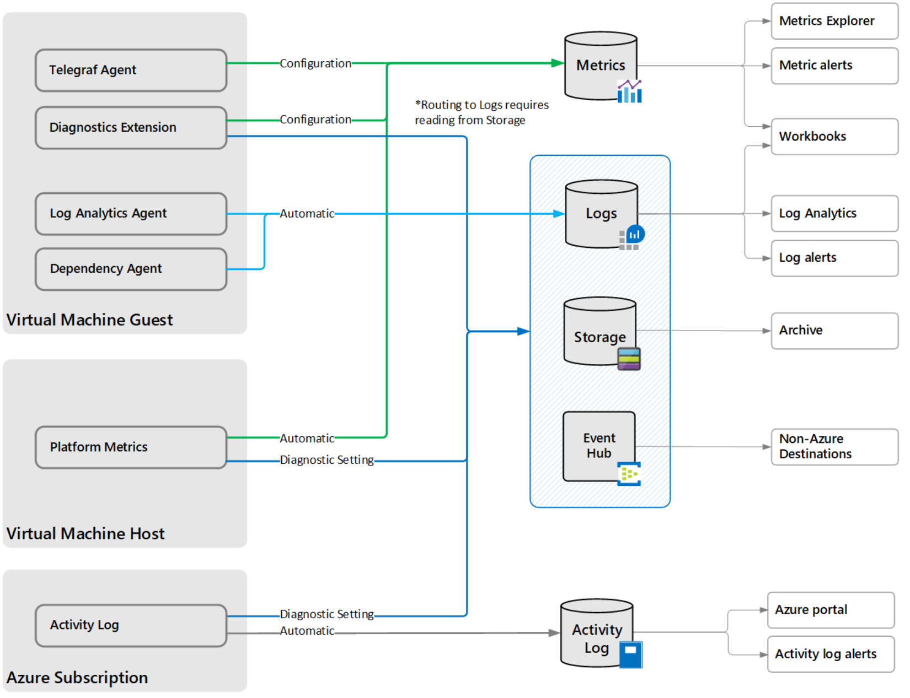
Platform metrics are collected automatically for the virtual machine host
You need an agent to collect performance data from the guest operating system
Use an agent to collect log data from the guest operating system
You can create diagnostic settings for a virtual machine to send platform metrics to other destinations
Notes:
Virtual machines can be monitored for availability and performance with Azure Monitor like any other Azure resource. However, they're unique from other resources since you also need to monitor the guest operating and system and the workloads that run in it.
Differences from other Azure resources
You can collect and act on the same monitoring data from Azure virtual machines as you would monitoring Azure resources with Azure Monitor with the following differences:
Platform metrics are collected automatically for virtual machines but only for the virtual machine host. You need an agent to collect performance data from the guest operating system.
Virtual machines don't generate resource logs to provide insight into operations performed within an Azure resource. You use an agent to collect log data from the guest operating system.
You can create diagnostic settings for a virtual machine to send platform metrics to other destinations such as storage and Event Hubs, but you can't configure these diagnostic settings in the Azure portal.
Virtual machine host
Virtual machines in Azure provide information for the virtual machine host as described in Monitoring data.
Platform metrics - Numerical values that are automatically collected at regular intervals and describe some aspect of a resource at a particular time. Platform metrics are collected for the virtual machine host, but you require the diagnostics extension to collect metrics for the guest operating system.
Activity log - Provides insight for each Azure resource in the subscription from the outside (the management plane). For a virtual machine, such information as when it was started and any configuration changes.
Guest operating system
To collect data from the guest operating system of a virtual machine, and agent running on each virtual machine sends data to Azure Monitor. Agents are available for Azure Monitor with each collecting different data and writing data to different locations.
Log Analytics agent - Available for virtual machines in Azure, other cloud environments, and on-premises. Collects data to Azure Monitor Logs. Supports Azure Monitor for VMs and monitoring solutions. The same agent used for System Center Operations Manager.
Dependency agent - Collects data about the processes running on the virtual machine and their dependencies. Relies on the Log Analytics agent to transmit data into Azure and supports Azure Monitor for VMs, Service Map, and Wire Data 2.0 solutions.
Azure Diagnostic extension - Available for Azure Monitor virtual machines only. Can collect data to multiple locations but primarily used to collect guest performance data into Azure Monitor Metrics for Windows virtual machines.
Telegraf agent - Collect performance data from Linux VMs into Azure Monitor Metrics.

Slide 19
Knowledge check and Summary
Check your knowledge
What you learned:
Assess network capacity and speed requirements for Azure Virtual Desktop.
Determine the connection round-trip time (RTT) from a location through the Azure Virtual Desktop service.
Recommend an operating system for an Azure Virtual Desktop implementation.
Describe the two load-balancing methods for Azure Virtual Desktop.
Recommendation subscriptions and management groups for Azure Virtual Desktop.
Recommend a configuration for performance requirements.
Notes:
What you learned:
Assess network capacity and speed requirements for Azure Virtual Desktop.
Determine the connection round-trip time (RTT) from a location through the Azure Virtual Desktop service.
Recommend an operating system for an Azure Virtual Desktop implementation.
Describe the two load-balancing methods for Azure Virtual Desktop.
Recommendation subscriptions and management groups for Azure Virtual Desktop.
Recommend a configuration for performance requirements.

Slide 20

End of presentation

