Slide 1
AZ-140T00A Designing Azure Infrastructure Solutions

Slide 2

Design for user identities and profiles
Notes:
Organizations are a mixture of on-premises and cloud applications. Users require access to those applications both on-premises and in the cloud. You use the Remote Desktop client for Windows Desktop to access Windows apps and desktops remotely from a different Windows device.
Learning objectives
After completing this section, you'll be able to:
Select a licensing model for Azure Virtual Desktop.
Describe personal and multi-session desktop scenarios.
Plan a storage solution storing FSLogix profile containers
Plan for a Desktop client deployment
Deploy Windows Desktop client to multiple devices.
Describe Hybrid Identity for Azure Virtual Desktop.
Prerequisites
Conceptual knowledge of governance policies, resource organization, and subscription management.
Working experience with organizing resources, applying governance policies, and enforcing compliance requirements.
Working experience with virtual machines, containers, and app service.

Slide 3
Introduction
Select an appropriate licensing model for Azure Virtual Desktop based on requirements
Personal and multi-session desktop scenarios
Recommend an appropriate storage solution
Plan for a Desktop client deployment
Plan for Azure Virtual Desktop client deployment - Remote Desktop Protocol (RDP)
Windows Desktop client to multiple devices
Hybrid Identity with Azure Active Directory
Plan for Azure AD Connect for user identities
Knowledge check and Summary
AZ-140: Plan an Azure Virtual Desktop architecture (10-15%)
Design the Azure Virtual Desktop architecture
Conceptual knowledge of Azure compute solutions.
Working experience with virtual machines, virtual networks, and app service.
Notes:
https://docs.microsoft.com/en-us/learn/certifications/exams/az-140
Prerequisites
Conceptual knowledge of Azure compute solutions.
Working experience with virtual machines, virtual networks, and app service.

Slide 4
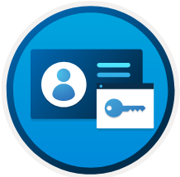
Select an appropriate licensing model for Azure Virtual Desktop based on requirements

Slide 5
Licensing for Azure Virtual Desktop
Access Windows 10 Enterprise and Windows 7 Enterprise desktops and apps at no additional cost if you have an eligible Windows or Microsoft 365 license
Access to desktops powered by Windows Server Remote Desktop Services desktops and apps at no additional cost if you are an eligible Microsoft RDS and Client Access License (CAL) customer
TYPE | DESCRIPTION | ELIGIBILITY
Virtualize Windows 10 and Windows 7 | Access Windows 10 Enterprise and Windows 7 Enterprise desktops and apps at no additional cost if you have an eligible Windows or Microsoft 365 license. Get free Extended Security Updates until January 2023 for your Windows 7 virtual desktop—offering more options to support legacy apps while you transition to Windows 10. | You are eligible to access Windows 10 and Windows 7 with Azure Virtual Desktop if you have one of the following per user licenses: Microsoft 365 E3/E5 Microsoft 365 A3/A5/Student Use Benefits Microsoft 365 F3 Microsoft 365 Business Premium** Windows 10 Enterprise E3/E5 Windows 10 Education A3/A5 Windows 10 VDA per user
Virtualize Windows Server | Access desktops powered by Windows Server Remote Desktop Services desktops and apps at no additional cost if you are an eligible Microsoft Remote Desktop Services (RDS) Client Access License (CAL) customer. | You are eligible to access Windows Server 2012 R2 and newer desktops and apps if you have a per-user or per-device RDS CAL license with active Software Assurance (SA).
Notes:
You can access Windows 10 Enterprise and Windows 7 Enterprise desktops and apps at no extra cost if you have an eligible Windows or Microsoft 365 license.
Windows Server Remote Desktop Service is available at no cost if you have an eligible Microsoft Remote Desktop Services (RDS) Client Access License (CAL).
Reserved Virtual Machine Instances are flexible and can be exchanged or returned.
Multi-session provides the greatest flexibility and cost savings by:
Sharing the desktop infrastructure, preserving the state of your OS image by operating in a pooled environment.
User data and settings retention.
Accessed using FSLogix.
Personal desktops are typically chosen for the following reasons:
Users needing administrative rights to modify the operating system and it retained after a virtual machine restart.
Users running applications not compatible with multi-session.
Listed below are the Azure components that factor into the price of an Azure Virtual Desktop deployment.
Virtual machines and operating system (OS) storage
Data disk (personal desktop only)
User profile storage
Networking
Azure Virtual Desktop session host virtual machines (VMs) including Citrix Cloud and VMW Horizon Cloud on Azure deployments are charged at Linux compute rates for Windows 10 single, Windows 10 multi-session and Windows Server.

Slide 6

Personal and multi-session desktop scenarios

Slide 7
Use case scenarios for single users accessing a persistent virtual desktop:
EXAMPLE WORKLOADS | NUMBER OF USERS IN SCENARIO | TYPE OF USER | VCPUS | RAM | EAST US PRICING | WEST EUROPE PRICING | SOUTHEAST ASIA PRICING
Graphics Workstation | 100 | Engineers and graphic designers with 3D modeling, simulations, and CAD workloads. Users spend 5-6 hours a day requiring workstation capability. | 12 | 112 GB | See estimate | See estimate | See estimate
Microsoft Office | 1000 | Standard knowledge workers making use of Microsoft Office products. Users work 8-10 hour days. | 2 | 4 GB | See estimate | See estimate | See estimate
Use case scenarios for multiple users sharing a pooled (non-persistent) virtual desktop:
EXAMPLE WORKLOADS | NUMBER OF USERS IN SCENARIO | TYPE OF USER | USER DENSITY | EAST US PRICING | WEST EUROPE PRICING | SOUTHEAST ASIA PRICING
Microsoft Office | 1000 | Standard knowledge workers making use of Microsoft Office products. 24/7 RI is used to avoid need for management of virtual machines. | 2 per vCPU | See estimate | See estimate | See estimate
Call center/data entry | 1000 | Call center users with low intensity workloads, primarily engaged in data entry. Users operate in three 8-hour shifts, making a 24/7 RI instance the most cost effective option. | 6 per vCPU | See estimate | See estimate | See estimate
Notes:
You can access Windows 10 Enterprise and Windows 7 Enterprise desktops and apps at no additional cost if you have an eligible Windows or Microsoft 365 license.
Access to desktops powered by Windows Server Remote Desktop Services desktops and apps are available at no additional cost if you are an eligible Microsoft Remote Desktop Services (RDS) Client Access License (CAL) customer.
Reserved Virtual Machine Instances are flexible and can be exchanged or returned.
For most applications, multi-session provides the greatest flexibility and cost savings by sharing the desktop infrastructure, preserving the state of your OS image by operating in a pooled environment, and allowing user data and settings to be saved and accessed using FSLogix.
Personal desktops are typically chosen for the following reasons:
Users that require administrative rights to modify the operating system and want those changes to be retained if the VM is restarted
Users which run applications that are not compatible with multi-session.

Slide 8
Recommend an appropriate storage solution

Slide 9
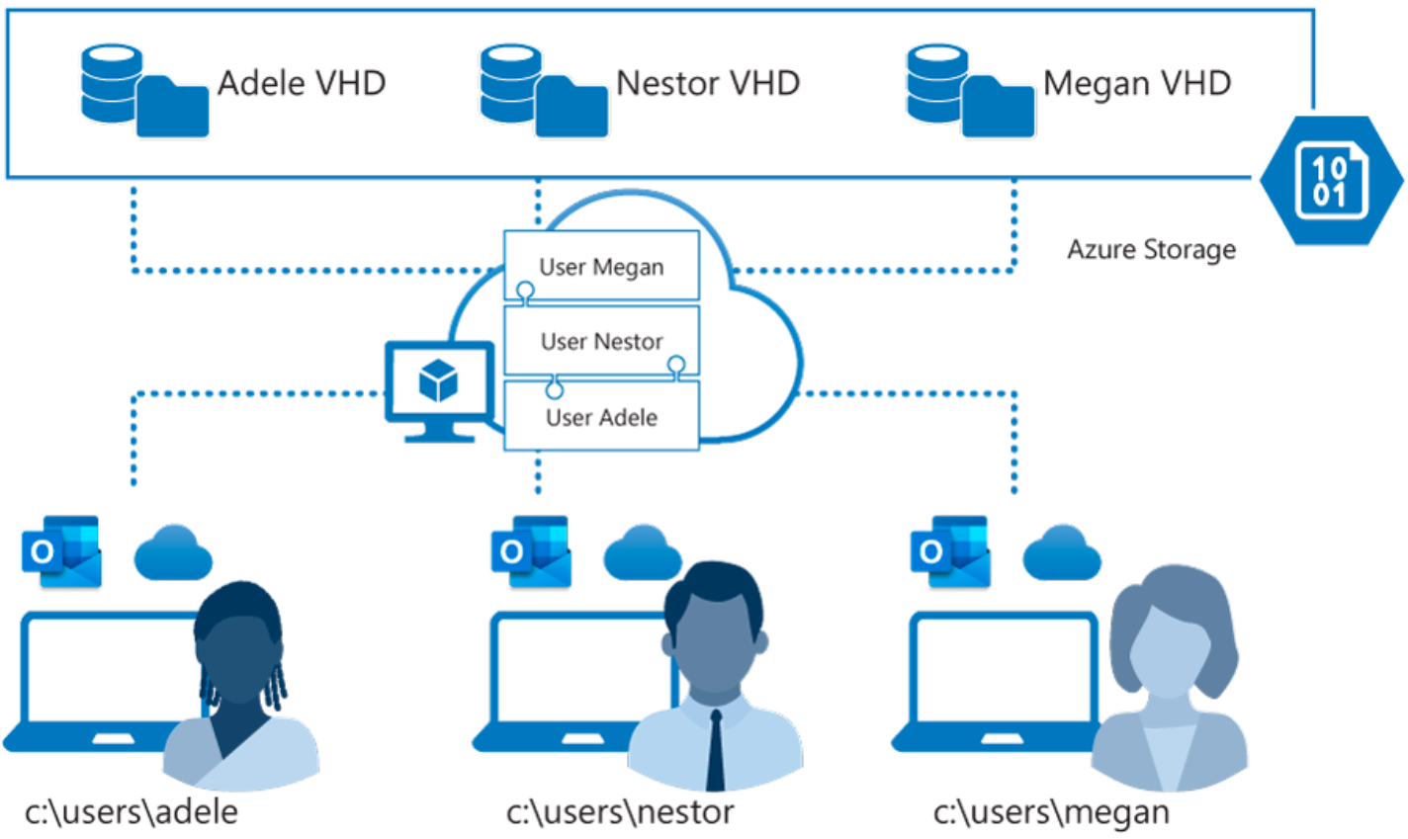
FSLogix is designed to roam profiles in remote computing environments, such as Azure Virtual Desktop
At sign-in, a container is dynamically attached to the computing environment using a natively supported VHD and a VHDX
The user profile is immediately available and appears in the system exactly like a native user profile
Notes:
Azure offers multiple storage solutions that you can use to store your FSLogix profile container. This topic compares storage solutions that Azure offers for Azure Virtual Desktop FSLogix user profile containers.
We recommend storing FSLogix profile containers on Azure Files for most of our customers.
Azure Virtual Desktop offers FSLogix profile containers as the recommended user profile solution. FSLogix is designed to roam profiles in remote computing environments, such as Azure Virtual Desktop.
At sign-in, this container is dynamically attached to the computing environment using a natively supported Virtual Hard Disk (VHD) and a Hyper-V Virtual Hard Disk (VHDX). The user profile is immediately available and appears in the system exactly like a native user profile.

Slide 10

Plan for a Desktop client deployment

Slide 11
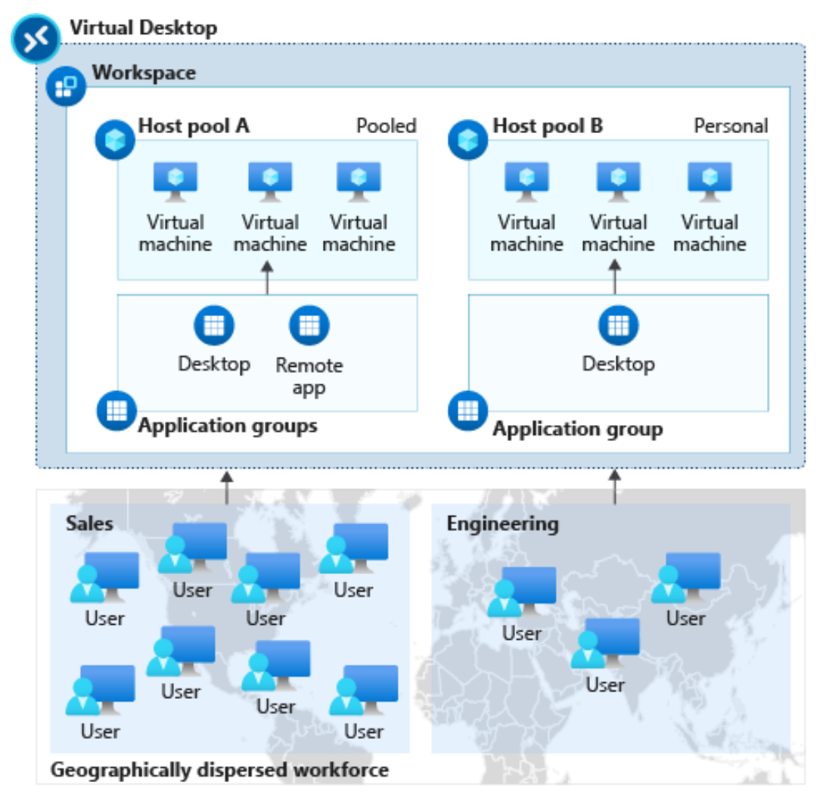
The diagram below shows an Azure Virtual Desktop workspace with two host pools:
Host pool A has two application groups: Desktop and RemoteApp. These resources are shared (pooled) across the sales team.
Host pool B has a Desktop application group with personal desktops available to an engineering team.
Notes:
Remote Desktop client for Windows Desktop
You use the Remote Desktop client for Windows Desktop to access Windows apps and desktops remotely from a different Windows device.
NOTE: This topic is not intended for the Remote Desktop Connection (MSTSC) client that ships with Windows. This topic is for the new Remote Desktop (MSRDC) client.
The Remote Desktop client (MSRDC) supports:
Windows 10
Windows 10 IoT Enterprise
Windows 7 client devices
Choose the client that matches the version of Windows.
Windows 64-bit
Windows 32-bit
Windows ARM64
You launch it from the Start menu by searching for Remote Desktop.
Workspaces
Get the list of managed resources you can access, such as apps and desktops, by subscribing to the Workspace your admin provided you. When you subscribe, the resources become available on your local PC. The Windows Desktop client currently supports resources published from Azure Virtual Desktop.
The diagram in the slide shows an Azure Virtual Desktop workspace with two host pools.
Host pool A has two application groups: Desktop and RemoteApp. These resources are shared (pooled) across the sales team.
Host pool B has a Desktop application group with personal desktops available to an engineering team.

Slide 12
Plan for Azure Virtual Desktop client deployment - Remote Desktop Protocol (RDP)

Slide 13
Remote Desktop web client uses a compatible web browser to access remote resources (apps and desktops) published to you by your admin.
For access to remote apps and desktops, users need:
A domain
Username
Password
URL (provided by the admin)
A supported web browser
Notes:
The Remote Desktop web client lets you use a compatible web browser to access your organization's remote resources (apps and desktops) published to you by your admin. You'll be able to interact with the remote apps and desktops like you would with a local PC no matter where you are, without having to use another desktop computer.
Once your admin sets up your remote resources all you need are your domain, user name, password, the URL your admin sent you, and web browser.
The web client doesn't currently have mobile OS support.
What you'll need to use the web client:
For the web client, you'll need a PC running Windows, macOS, ChromeOS, or Linux.
A modern browser like Microsoft Edge, Internet Explorer 11, Google Chrome, Safari, or Mozilla Firefox (v55.0 and later).
The URL your admin sent you.
Using the Remote Desktop client
To sign into the client, go to the URL your admin sent you. At the sign in page, enter your domain and user name in the format DOMAIN\username, enter your password, and then select Sign in.
After you sign in, the client will take you to the All Resources tab, which contains all items published to you under one or more collapsible groups, such as the "Work Resources" group. You'll see several icons representing the apps, desktops, or folders containing more apps or desktops that the admin has made available to the work group. You can come back to this tab at any time to launch additional resources.
To start using an app or desktop, select the item you want to use, enter the same user name and password you used to sign in to the web client if prompted, and then select Submit.
You might also be shown a consent dialog to access local resources, like clipboard and printer. You can choose to not redirect either of these, or select Allow to use the default settings.
Wait for the web client to establish the connection, and then start using the resource as you would normally.

Slide 14
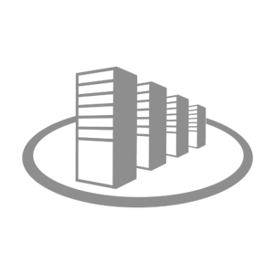
Windows Desktop client to multiple devices

Slide 15
Deploying using group policies or the Microsoft Endpoint Configuration Manager lets you run the installer silently using a command line.
Per-device installation, run:
msiexec.exe /i <path to the MSI> /qn ALLUSERS=1
Per-user installation, run:
msiexec.exe /i `<path to the MSI>` /qn ALLUSERS=2 MSIINSTALLPERUSER=1
Notes:
Your users can install the client directly after downloading it. If you're deploying to multiple devices, you may want to also deploy the client to them through other means. Deploying using group policies or the Microsoft Endpoint Configuration Manager lets you run the installer silently using a command line. Run the following commands to deploy the client per-device or per-user.
Configure update notifications
The client notifies you whenever there's an update and automatically updates itself when the client is closed and has no active connections. Even with no active connections, the msrdc.exe process runs in the background to allow you to reconnect quickly when you reopen the client. You can stop msrdc.exe by right-clicking on the Azure Virtual Desktop icon in the system tray area and selecting Disconnect all sessions in the drop-down menu.
Insider group
The Insider group is for early validation, and consists of admins and their selected users. The Insider group serves as a test run to detect any issues in the update that can impact performance before it's released to the Public group.
It’s a good idea for each organization to have some users in the Insider group to test updates and catch issues early.
In the Insider group, a new version of the client is released to the users on the second Tuesday of each month for early validation. If the update doesn't have issues, it gets released to the Public group two weeks later. Users in the Insider group will receive update notifications automatically whenever updates are ready.
Public group
This group is for all users and is the most stable version. You don't need to do anything to configure this group.
The Public group receives the version of the client that was tested by the Insider group every fourth Tuesday of each month. All users in the Public group will receive an update notification if that setting is enabled.

Slide 16

Hybrid Identity with Azure Active Directory

Slide 17
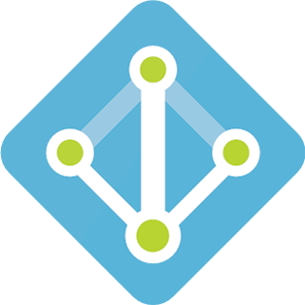
Hybrid Identity with Azure Active Directory
You can use the following authentication methods to implement hybrid identity with Azure AD
Password hash synchronization (PHS)
Pass-through authentication (PTA)
Federation (AD FS)
Notes:
rganizations are a mixture of on-premises and cloud applications. Users require access to those applications both on-premises and in the cloud.
Microsoft identity spans on-premises and cloud-based capabilities. These solutions create a common user identity for authentication and authorization to all resources, regardless of location. We call this hybrid identity. Using hybrid identity to Azure AD and hybrid identity management these scenarios possible.
To achieve hybrid identity with Azure AD, one of three authentication methods can be used, depending on your scenarios. The three methods are:
Password hash synchronization (PHS)
Pass-through authentication (PTA)
Federation (AD FS)
These authentication methods also provide single-sign on capabilities. Single-sign on automatically signs your users in when they are on their corporate devices, connected to your corporate network.

Slide 18
I need to: | PHS and SSO1 | PTA and SSO2 | AD FS3
Sync new user, contact, and group accounts created in my on-premises Active Directory to the cloud automatically. | Yes | Yes | Yes
Set up my tenant for Office 365 hybrid scenarios. | Yes | Yes | Yes
Enable my users to sign in and access cloud services using their on-premises password. | Yes | Yes | Yes
Implement single sign-on using corporate credentials. | Yes | Yes | Yes
Ensure no password hashes are stored in the cloud. |  | Yes | Yes
Enable cloud-based multifactor authentication solutions. | Yes | Yes | Yes
Enable on-premises multifactor authentication solutions. |  |  | Yes
Support smartcard authentication for my users. |  |  | Yes
Display password expiry notifications in the Office Portal and on the Windows 10 desktop. |  |  | Yes
Common hybrid identity and access management scenarios with recommendations for hybrid identity options.

Slide 19
Plan for Azure AD Connect for user identities

Slide 20
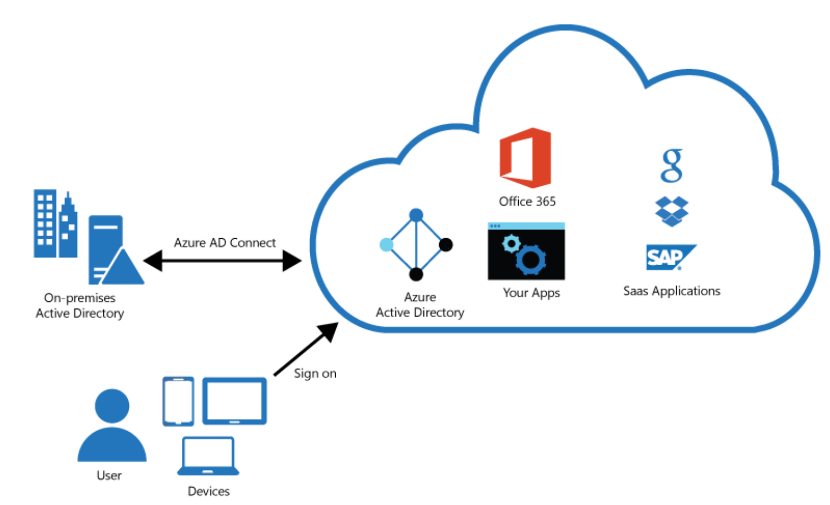
Plan for Azure AD Connect for user identities
Integrating on-premises directories with Azure AD provides a common identity for accessing both cloud and on-premises resources.
Users can use a single identity to access on-premises applications and cloud services such as Office 365.
Single tool to provide an easy deployment experience for synchronization and sign-in.
Azure AD Connect replaces older versions of identity integration tools such as DirSync and Azure AD Sync.
Notes:
To keep Windows Server Active Directory in sync with Azure Active Directory, you can configure Azure AD Connect (for hybrid organizations).
Azure Virtual Desktop supports hybrid identities through Azure Active Directory (AD), including those federated using Active Directory Federation Services (ADFS).
Since users must be discoverable through Azure AD, Azure Virtual Desktop doesn't support standalone Active Directory deployments with ADFS.
Azure Virtual Desktop currently doesn't support Active Directory Federation Services (ADFS) for SSO.
The only way to avoid being prompted for your credentials for the session host is to save them in the client. We recommend you only do this with secure devices to prevent other users from accessing your resources.
Windows 10 Enterprise multi-session is currently supported to be hybrid Azure AD-joined. After Windows 10 Enterprise multi-session is domain-joined, use the existing Group Policy Object to enable Azure AD registration.

Slide 21
Plan for Azure AD Connect for user identities (Cont)
Password hash synchronization - A sign-in method that synchronizes a hash of a users on-premises AD password with Azure AD.
Pass-through authentication - A sign-in method that allows users to use the same password on-premises and in the cloud but doesn't require the additional infrastructure of a federated environment.
Federation integration - Is used to configure a hybrid environment using an on-premises AD FS infrastructure. It also provides AD FS management capabilities such as certificate renewal and additional AD FS server deployments.
Synchronization - Responsible for creating users, groups, and other objects. As well as, making sure identity information for your on-premises users and groups is matching the cloud.
Health Monitoring - Azure AD Connect Health can provide robust monitoring and provide a central location in the Azure portal to view this activity.

Slide 22
Knowledge check and Summary
Check your knowledge
What you learned:
Select a licensing model for Azure Virtual Desktop.
Describe personal and multi-session desktop scenarios.
Plan a storage solution storing FSLogix profile containers
Plan for a Desktop client deployment
Deploy Windows Desktop client to multiple devices.
Describe Hybrid Identity for Azure Virtual Desktop.
Notes:
What you learned:
Select a licensing model for Azure Virtual Desktop.
Describe personal and multi-session desktop scenarios.
Plan a storage solution storing FSLogix profile containers
Plan for a Desktop client deployment
Deploy Windows Desktop client to multiple devices.
Describe Hybrid Identity for Azure Virtual Desktop.

Slide 23

End of presentation

