Slide 1
AZ-140T00A Configuring and Operating Azure Virtual Desktop

Slide 2

Implement and manage networking for Azure Virtual Desktop
Notes:
Organizations want to monitor and repair health of their Azure Virtual Desktop including virtual machines, virtual networks, application gateways, and load balancers.
Learning objectives
After completing this section, you'll be able to:
Recommend a solution for Azure Virtual Desktop network connectivity.
Implement Azure virtual network connectivity for Azure Virtual Desktop.
Describe network security for Azure Virtual Desktop.
Configure Azure Virtual Desktop session hosts using Microsoft Bastion.
Monitor communication between a virtual machine and an endpoint.
Prerequisites
Working experience with enterprise networking.
Conceptual knowledge of software defined networking and hybrid connectivity.

Slide 3
Introduction
Implement Azure virtual network connectivity
Manage connectivity to the internet and on-premises networks
Understanding Azure Virtual Desktop network connectivity
Implement and manage network security
Configure Azure Virtual Desktop session hosts using Azure Bastion
Azure Network Watcher
Knowledge check and Summary
AZ-140: Implement an Azure Virtual Desktop infrastructure (25-30%)
Implement and manage networking for Azure Virtual Desktop
Conceptual knowledge of Azure compute solutions.
Working experience with virtual machines, virtual networks, and app service.
Notes:
https://docs.microsoft.com/en-us/learn/certifications/exams/az-140
Prerequisites
Conceptual knowledge of Azure compute solutions.
Working experience with virtual machines, virtual networks, and app service.

Slide 4
Implement Azure virtual network connectivity
Notes:
Organizations want to monitor and repair health of their Azure Virtual Desktop including virtual machines, virtual networks, application gateways, and load balancers.
Learning objectives
After completing this section, you'll be able to:
Recommend a solution for Azure Virtual Desktop network connectivity.
Implement Azure virtual network connectivity for Azure Virtual Desktop.
Describe network security for Azure Virtual Desktop.
Configure Azure Virtual Desktop session hosts using Microsoft Bastion.
Monitor communication between a virtual machine and an endpoint.
Prerequisites
Working experience with enterprise networking.
Conceptual knowledge of software defined networking and hybrid connectivity.

Slide 5
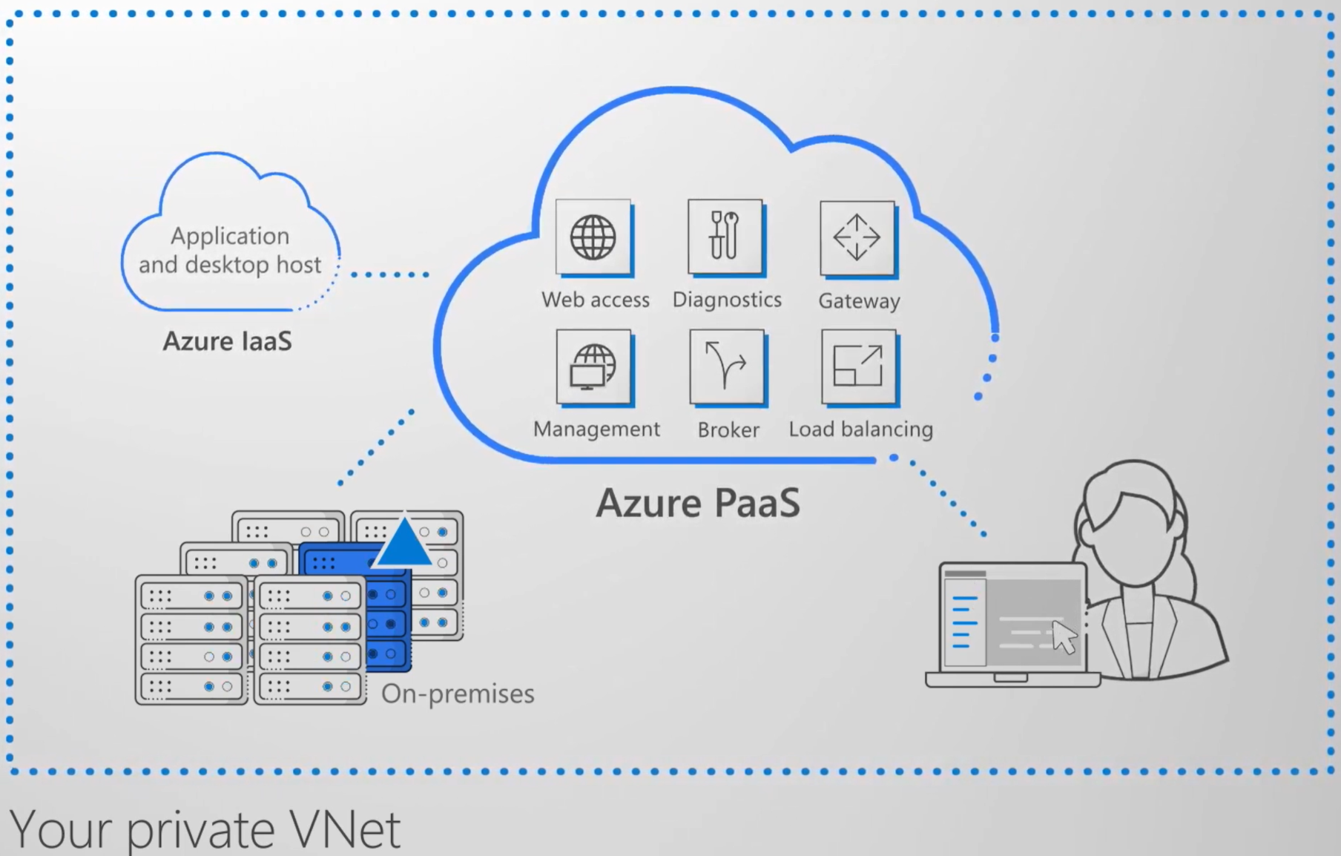
Communication between Azure resources is done by one of the following:
Through a virtual network: Deploy VMs, and several other types of Azure resources to a virtual network
Through a virtual network service endpoint: Extend your virtual network private address space and the identity of your virtual network to Azure service resources over a direct connection.
Through VNet Peering: Connect virtual networks to each other, enabling resources in either virtual network to communicate with each other, using virtual network peering
Notes:
Azure virtual network enables Azure resources to securely communicate with each other, the internet, and on-premises networks.
Key scenarios that you can accomplish using a virtual network include:
Communication of Azure resources with the internet
Communication between Azure resources
Communication with on-premises resources
Filtering network traffic
Routing network traffic
Integration with Azure services
Communicate with the internet
Resources in a VNet can communicate outbound to the internet, by default. You can communicate inbound to a resource by assigning a public IP address or a public Load Balancer. You can also use public IP or public Load Balancer to manage outbound connections.
When using only an internal Standard Load Balancer, outbound connectivity is not available until you define how you want outbound connections to work with an instance-level public IP or a public Load Balancer.
Communicate between Azure resources
Azure resources communicate securely with each other in one of the following ways:
Through a virtual network: You can deploy VMs, and several other types of Azure resources to a virtual network, such as Azure App Service Environments, the Azure Kubernetes Service (AKS), and Azure Virtual Machine Scale Sets.
Through a virtual network service endpoint: Extend your virtual network private address space and the identity of your virtual network to Azure service resources, such as Azure Storage accounts and Azure SQL Database, over a direct connection. Service endpoints allow you to secure your critical Azure service resources to only a virtual network.
Through VNet Peering: You can connect virtual networks to each other, enabling resources in either virtual network to communicate with each other, using virtual network peering. The virtual networks you connect can be in the same, or different, Azure regions.

Slide 6
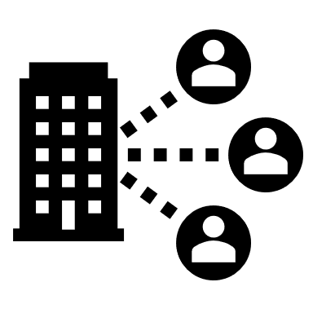
Manage connectivity to the internet and on-premises networks

Slide 7
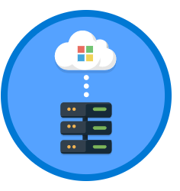
Point-to-site virtual private network (VPN):
Each computer that wants to establish connectivity with a virtual network must configure its connection.
The communication between a computer and a virtual network is sent through an encrypted tunnel over the internet.
Site-to-site VPN: Established between on-premises VPN device and an Azure VPN Gateway that is deployed in a virtual network.
Enables any on-premises resource that you authorize to access a virtual network.
The communication between an on-premises VPN device and an Azure VPN gateway is sent through an encrypted tunnel over the internet.
Azure ExpressRoute: Established between your network and Azure, through an ExpressRoute partner.
This connection is private.
Traffic does not go over the internet.
Notes:
Filter network traffic
You can filter network traffic between subnets using either or both of the following options:
Network security groups (NSGs): Network security groups and application security groups can contain multiple inbound and outbound security rules that enable you to filter traffic to and from resources by source and destination IP address, port, and protocol.
Network virtual appliance (NVA): A network virtual appliance is a VM that performs a network function, such as a firewall, WAN optimization, or other network function.
Route network traffic
Azure routes traffic between subnets, connected virtual networks, on-premises networks, and the Internet, by default. You can implement either or both of the following options to override the default routes Azure creates:
Route tables: You can create custom route tables with routes that control where traffic is routed to for each subnet.
Border gateway protocol (BGP) routes: If you connect your virtual network to your on-premises network using an Azure VPN Gateway or ExpressRoute connection, you can propagate your on-premises BGP routes to your virtual networks.
Virtual network integration for Azure services
Integrating Azure services to an Azure virtual network enables private access to the service from virtual machines or compute resources in the virtual network. You can integrate Azure services in your virtual network with the following options:
Deploying dedicated instances of the service into a virtual network. The services can then be privately accessed within the virtual network and from on-premises networks.
Using Private Link to access privately a specific instance of the service from your virtual network and from on-premises networks.
You can also access the service using public endpoints by extending a virtual network to the service, through service endpoints. Service endpoints allow service resources to be secured to the virtual network.

Slide 8
Understanding Azure Virtual Desktop network connectivity

Slide 9
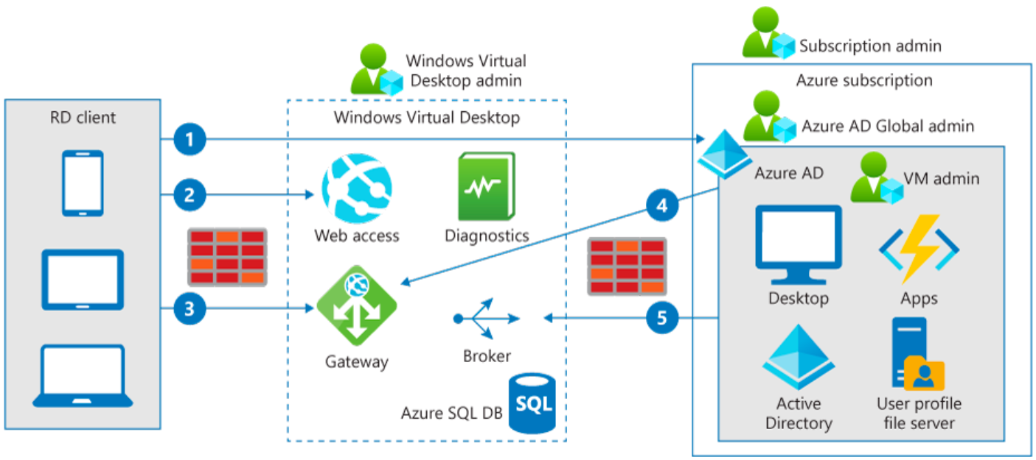
1. When authenticated in Azure Active Directory, a token is returned to the Remote Desktop Services client.
2. The gateway checks the token with the connection broker.
3. The broker queries the Azure SQL database for resources assigned to the user.
4. The gateway and the broker select the session host for the connected client.
5. The session host creates a reverse connection to the client by using the Azure Virtual Desktop gateway.
Notes:
Azure Virtual Desktop uses Remote Desktop Protocol (RDP) to provide remote display and input capabilities over network connections.
The connection data flow for Azure Virtual Desktop starts with a DNS lookup for the closest Azure datacenter.
The image above shows the five-step connection process for Azure Virtual Desktop running in Azure.
The inbound ports are not opened and the gateway is acting as an intelligent reverse proxy. The gateway manages all session connectivity.
Azure Virtual Desktop hosts the client on the session hosts running on Azure. Microsoft manages portions of the services on the customer's behalf and provides secure endpoints for connecting clients and session hosts. The diagram below gives a high-level overview of the network connections used by Azure Virtual Desktop.

Slide 10
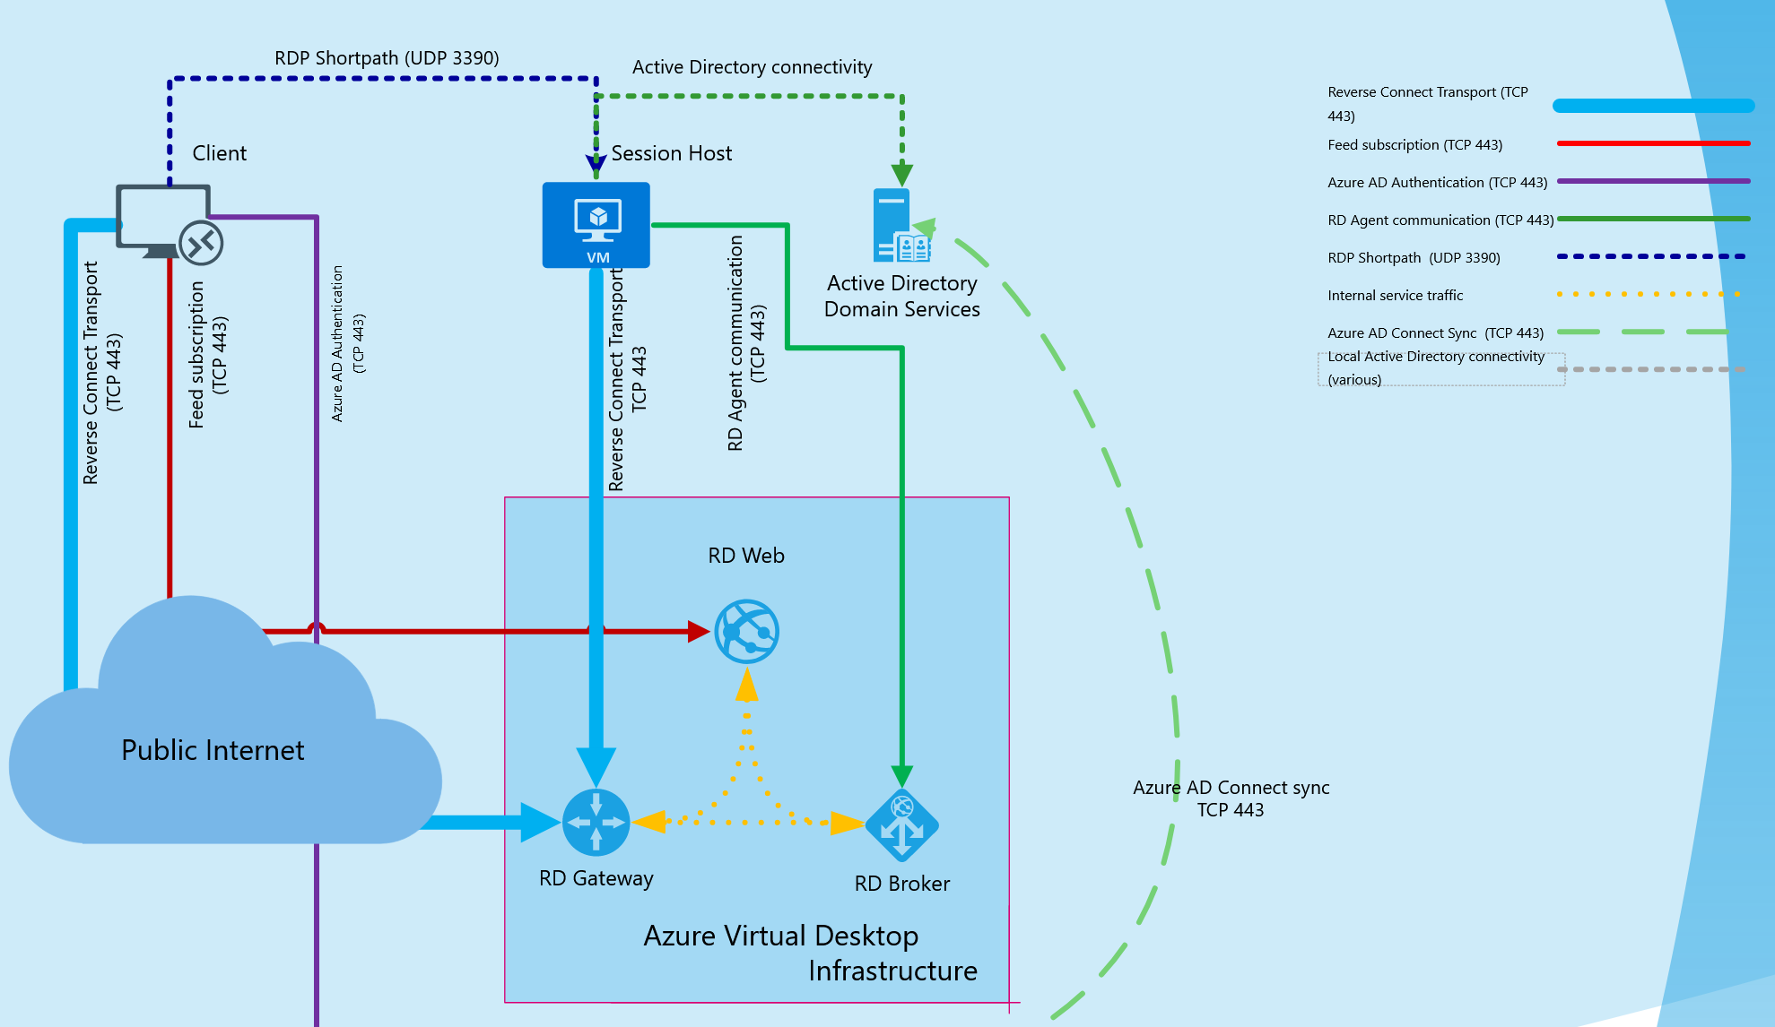
Azure Virtual Desktop RDP Shortpath for managed networks
Notes:
RDP Shortpath for managed networks is a feature of Azure Virtual Desktop that establishes a direct UDP-based transport between Remote Desktop Client and Session host. RDP uses this transport to deliver Remote Desktop and RemoteApp while offering better reliability and consistent latency.
RDP Shortpath transport is based on the Universal Rate Control Protocol (URCP). URCP enhances UDP with active monitoring of the network conditions and provides fair and full link utilization. URCP operates at low delay and loss levels as needed by Remote Desktop. URCP achieves the best performance by dynamically learning network parameters and providing protocol with a rate control mechanism.
RDP Shortpath establishes the direct connectivity between the Remote Desktop client and the session host. Direct connectivity reduces dependency on the Azure Virtual Desktop gateways, improves the connection's reliability, and increases available bandwidth for each user session.
The removal of extra relay reduces round-trip time, which improves user experience with latency-sensitive applications and input methods.
RDP Shortpath brings support for configuring Quality of Service (QoS) priority for RDP connections through Differentiated Services Code Point (DSCP) marks
RDP Shortpath transport allows limiting outbound network traffic by specifying a throttle rate for each session.
Here's how the session host negotiates multi-transport capabilities:
The session host sends the list of its private and public IPv4 and IPv6 addresses to the client.
The client starts the background thread to establish a parallel UDP-based transport directly to one of the host's IP addresses.
While the client is probing the provided IP addresses, it continues the initial connection establishment over the reverse connect transport to ensure no delay in the user connection.
If the client has a direct line of sight, the client establishes a secure TLS connection with the session host.
After establishing the Shortpath transport, RDP moves all Dynamic Virtual Channels (DVCs), including remote graphics, input, and device redirection, to the new transport.
If a firewall or network topology prevents the client from establishing direct UDP connectivity, RDP continues with a reverse connect transport.

Slide 11
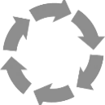
Implement and manage network security

Slide 12
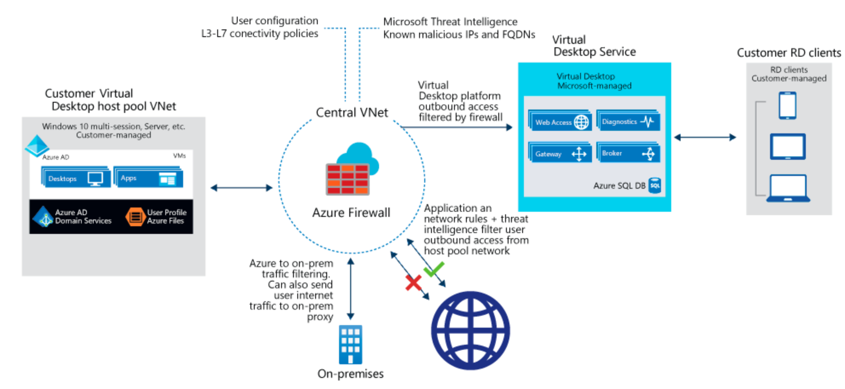
A host pool is a collection of Azure virtual machines that register to Azure Virtual Desktop as session hosts.
These virtual machines run in your virtual network and are subject to the virtual network security controls.
They need outbound Internet access to the Azure Virtual Desktop service to operate properly and might also need outbound Internet access for end users.
Azure Firewall can help you lock down your environment and filter outbound traffic.
Notes:
The Azure virtual machines you create for Azure Virtual Desktop must have access to several Fully Qualified Domain Names (FQDNs) to function properly. Azure Firewall provides an Azure Virtual Desktop FQDN Tag to simplify this configuration. Use the following steps to allow outbound Azure Virtual Desktop platform traffic:
Deploy Azure Firewall and configure your Azure Virtual Desktop host pool subnet User Defined Route (UDR) to route all traffic via the Azure Firewall. Your default route now points to the firewall.
Create an application rule collection and add a rule to enable the WindowsVirtualDesktop FQDN tag. The source IP address range is the host pool virtual network, the protocol is https, and the destination is WindowsVirtualDesktop.
The set of required storage and service bus accounts for your Azure Virtual Desktop host pool is deployment-specific. It isn't captured in the WindowsVirtualDesktop FQDN tag.
Create a network rule collection add the following rules:
Allow DNS – allow traffic from your ADDS private IP address to * for TCP and UDP ports 53.
Allow KMS – allow traffic from your Azure Virtual Desktop virtual machines to Windows Activation Service TCP port 1688.
Some deployments may not need DNS rules, for example Azure Active Directory Domain controllers forward DNS queries to Azure DNS at 168.63.129.16.

Slide 13
Configure Azure Virtual Desktop session hosts using Azure Bastion

Slide 14
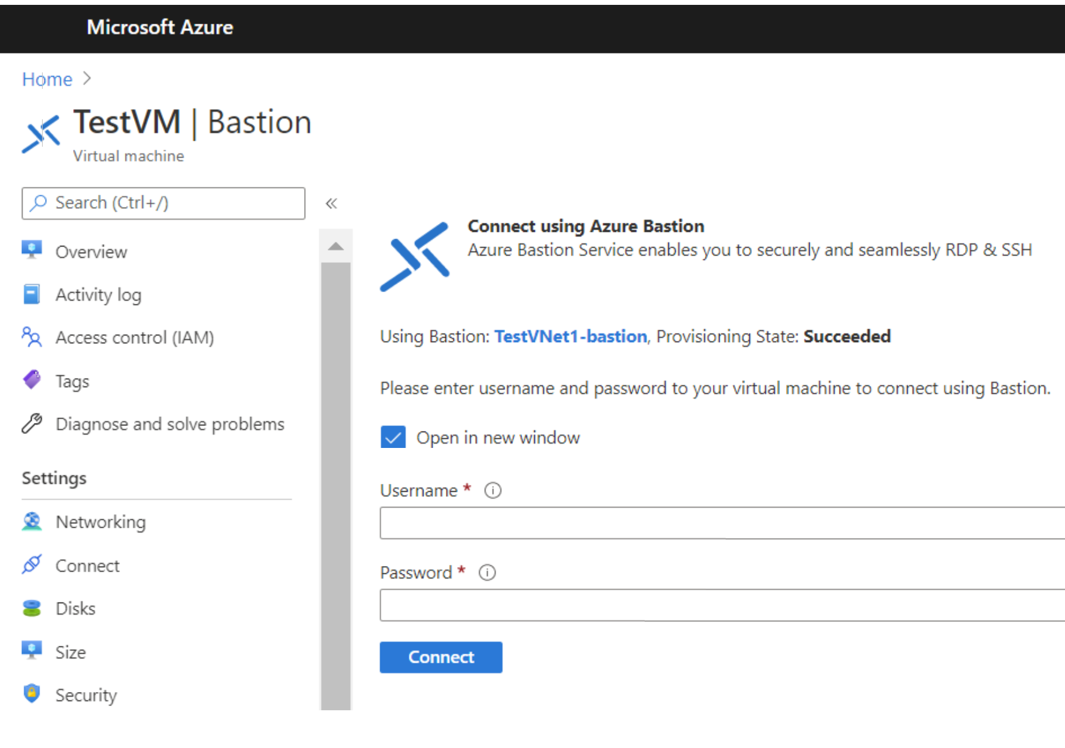
Microsoft Bastion provides secure connectivity to all VMs in a virtual network in which it is provisioned.
Using Microsoft Bastion protects your virtual machines from exposing RDP/SSH ports to the outside world, while still providing secure access using RDP/SSH.
Notes:
Microsoft Bastion provides secure connectivity to all VMs in a virtual network in which it is provisioned. Using Azure Bastion protects your virtual machines from exposing RDP/SSH ports to the outside world, while still providing secure access using RDP/SSH.
Before you begin, verify that you have met the following criteria:
A VNet with the Bastion host already installed. Make sure that you have set up an Azure Bastion host for the virtual network in which the VM is located. Once the Bastion service is provisioned and deployed in your virtual network, you can use it to connect to any VM in the virtual network.
A Windows virtual machine in the virtual network.
The following required roles:
Reader role on the virtual machine.
Reader role on the NIC with private IP of the virtual machine.
Reader role on the Azure Bastion resource.

Slide 15

Azure Network Watcher

Slide 16
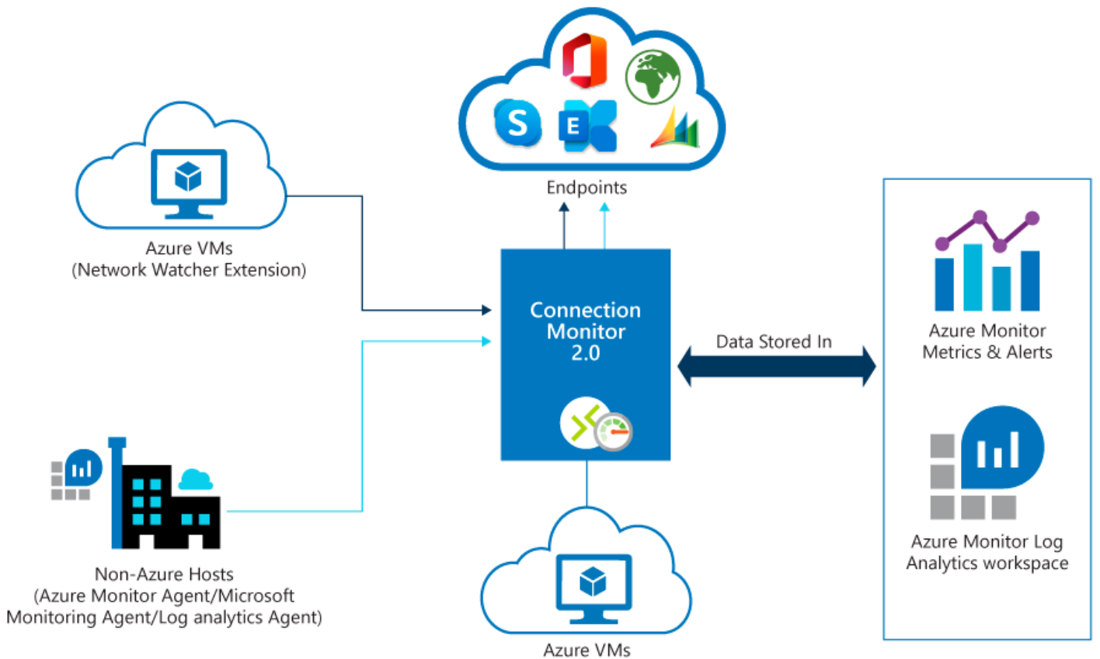
Azure Network Watcher provides tools to monitor, diagnose, view metrics, and enable or disable logs for resources in an Azure virtual network.
Connection Monitor 2.0 monitors communication at a regular interval and informs you of reachability, latency, and network topology changes between the VM and the endpoint.
If an endpoint becomes unreachable, connection troubleshoot informs you of the reason.
Hi Ashlee, looks great. Thanks
Notes:
Azure Network Watcher provides tools to monitor, diagnose, view metrics, and enable or disable logs for resources in an Azure virtual network.
Network Watcher is designed to monitor and repair the network health of IaaS (Infrastructure-as-a-Service) including virtual machines, virtual networks, application gateways, and load balancers.
Monitor communication between a virtual machine and an endpoint
Endpoints can be another virtual machine (VM), a fully qualified domain name (FQDN), a uniform resource identifier (URI), or IPv4 address.
Connection Monitor 2.0 monitors for availability, latency, and network topology changes between the virtual machine and the endpoint.
If an endpoint becomes unreachable, Connection Monitor informs you. Potential issues are DNS name resolution problems, CPU, memory, or firewall within the operating system of a virtual machine.

Slide 17
Plan and implement Remote Desktop Protocol Short path

Slide 18
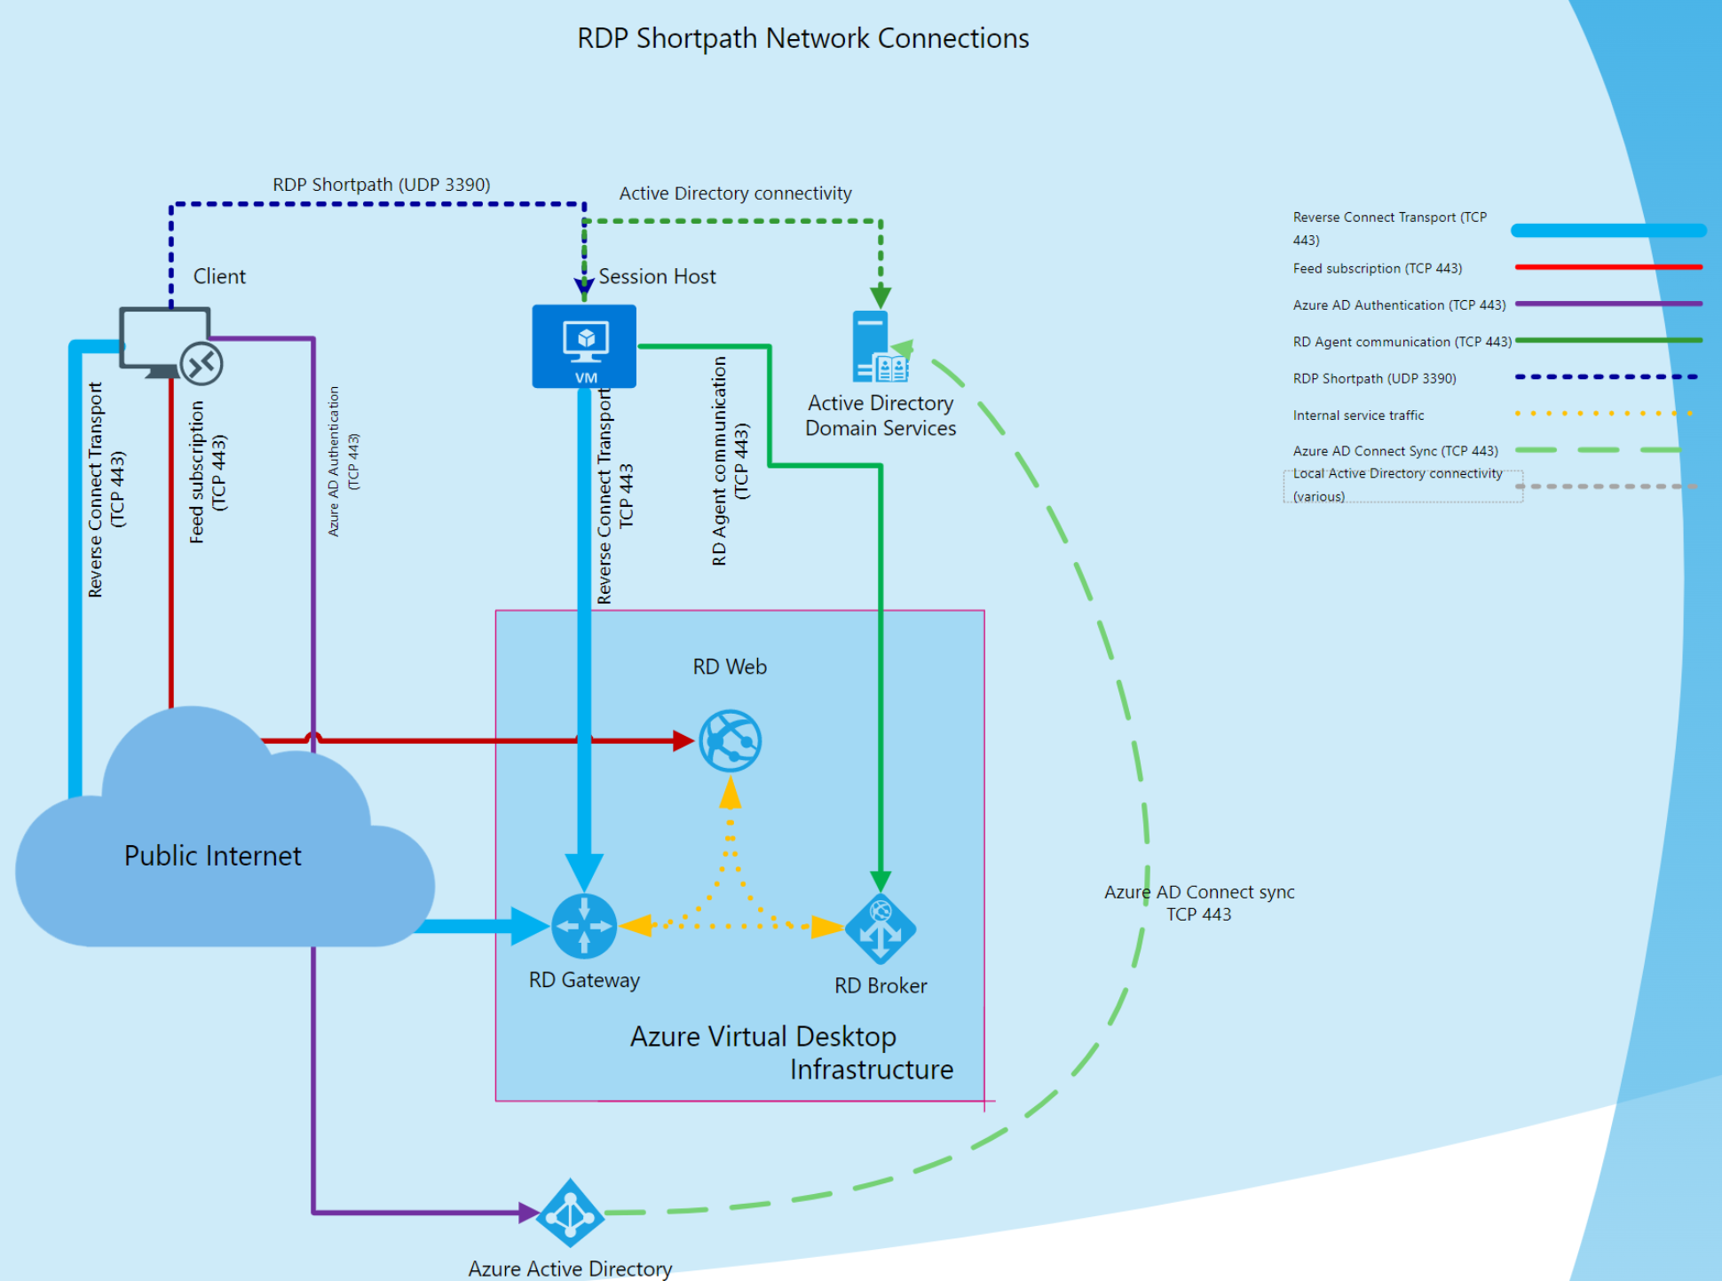
The session host sends the list of its private and public IPv4 and IPv6 addresses to the client.
The client starts the background thread to establish a parallel UDP-based transport directly to one of the host's IP addresses.
Initial connection establishment over the reverse connect transport to ensure no delay in the user connection.
If the client has a direct line of sight, the client establishes a secure TLS connection with the session host.
RDP moves all Dynamic Virtual Channels (DVCs).
If a firewall or network topology prevents the client from establishing direct UDP connectivity, RDP continues with a reverse connect transport.
Notes:
After establishing the reverse connect transport, the client and session host starts the RDP connection and negotiates the multi-transport capabilities.
The session host negotiates multi-transport capabilities:
The session host sends the list of its private and public IPv4 and IPv6 addresses to the client.
The client starts the background thread to establish a parallel UDP-based transport directly to one of the host's IP addresses.
While the client is probing the provided IP addresses, it continues the initial connection establishment over the reverse connect transport to ensure no delay in the user connection.
If the client has a direct line of sight, the client establishes a secure TLS connection with the session host.
After establishing the Shortpath transport, RDP moves all Dynamic Virtual Channels (DVCs), including remote graphics, input, and device redirection, to the new transport.
If a firewall or network topology prevents the client from establishing direct UDP connectivity, RDP continues with a reverse connect transport.

Slide 19
Configure Remote Desktop Protocol Shortpath for managed networks

Slide 20
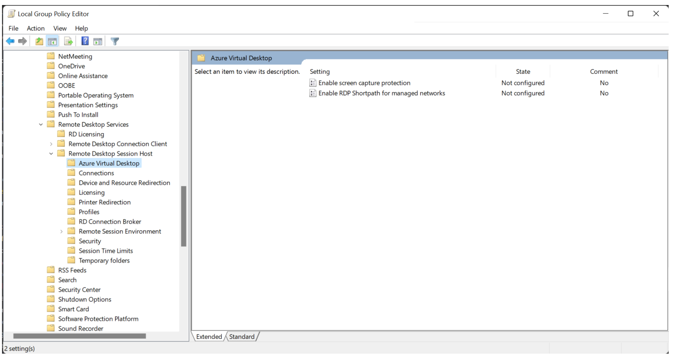
To enable RDP Shortpath for managed networks, you enable the RDP Shortpath listener on the session host.
Notes:
To enable the RDP Shortpath listener:
Install administrative templates that add rules and settings for Azure Virtual Desktop. Download the Azure Virtual Desktop policy templates file (AVDGPTemplate.cab) and extract the contents of the .cab file and .zip archive.
Copy the terminalserver-avd.admx file, then paste it into the %windir%\PolicyDefinitions folder.
Copy the en-us\terminalserver-avd.adml file, then paste it into the %windir%\PolicyDefinitions\en-us folder.
To confirm the files copied correctly, open the Group Policy Editor and go to Computer Configuration, select Administrative Templates, select Windows Components, select Remote Desktop Services, select Remote Desktop Session Host, and select Azure Virtual Desktop.
You should see one or more Azure Virtual Desktop policies.
Open the Enable RDP Shortpath for managed networks policy and set it to Enabled. If you enable this policy setting, you can also configure the port number that the Azure Virtual Desktop session host will use to listen for incoming connections. The default port is 3390.

Slide 21
Configure Windows Defender Firewall with Advanced Security for RDP Short path

Slide 22
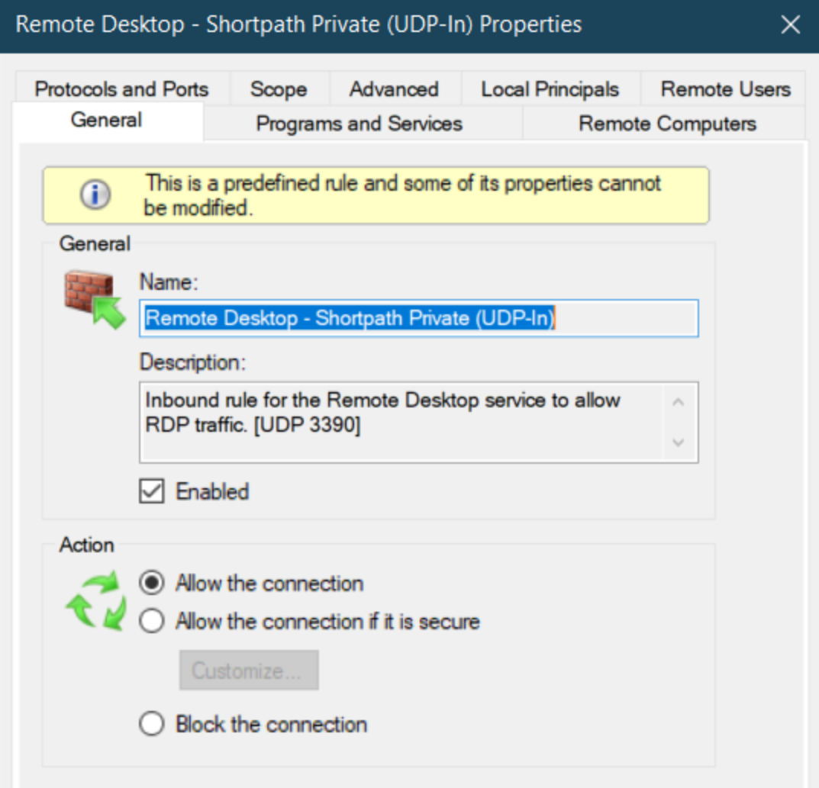
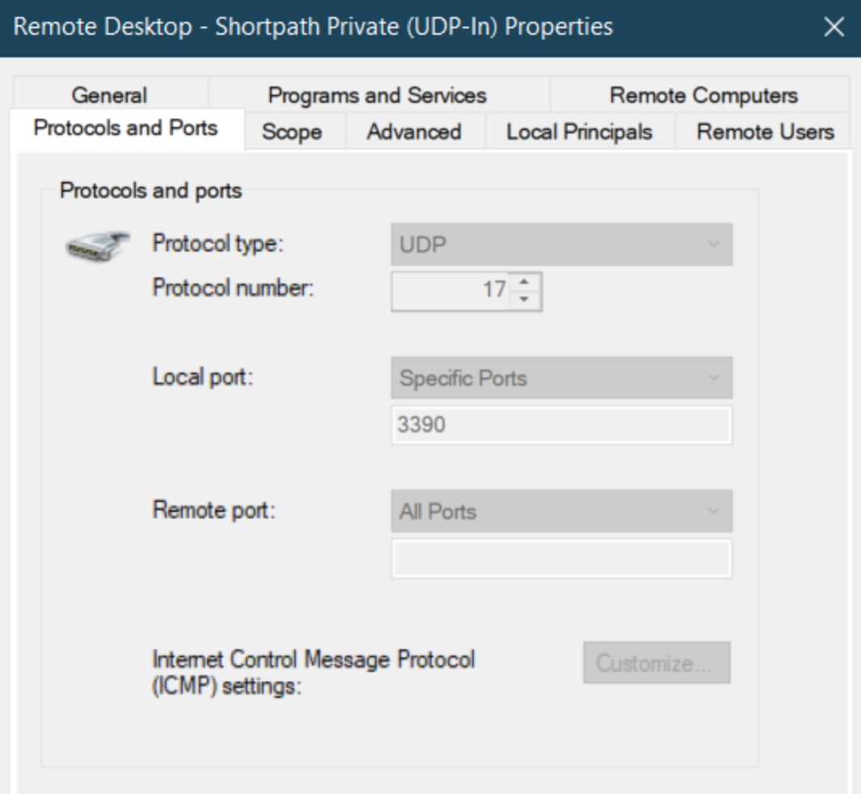
To allow inbound network traffic for RDP Shortpath, use the Microsoft Defender Firewall with Advanced Security node in the Group Policy Management MMC snap-in to create firewall rules.
Notes:
To allow inbound network traffic for RDP Shortpath, use the Microsoft Defender Firewall with Advanced Security node in the Group Policy Management MMC snap-in to create firewall rules.
Open the Group Policy Management Console to Microsoft Defender Firewall with Advanced Security.
In the navigation pane, select Inbound Rules.
Select Action, and then select New rule.
On the Rule Type page of the New Inbound Rule Wizard, select Custom, and then select Next.
On the Program page, select This program path, enter %SystemRoot%\system32\svchost.exe, then select Next.
On the Protocol and Ports page, select the UDP protocol type. In the Local port, select Specific ports and enter the configured UDP port. If you've left the default settings on, the port number will be 3390.
On the Scope page, you can specify that the rule applies only to network traffic to or from the IP addresses entered on this page. Configure as appropriate for your design, and then select Next.
On the Action page, select Allow the connection, and then select Next.
On the Profile page, select the network location types to which this rule applies, and then select Next.
On the Name page, enter a name and description for your rule, then select Finish.

Slide 23
Plan and implement Quality of Service for Azure Virtual Desktop

Slide 24
RDP Shortpath for managed networks enables configuration of Quality of Service (QoS) policies for the RDP data.
QoS in Azure Virtual Desktop allows real-time RDP traffic that's sensitive to network delays to "cut in line" in front of traffic that's less sensitive.
QoS uses Windows Group Policy Objects to identify and mark all packets in real-time streams and help your network to give RDP traffic a dedicated portion of bandwidth.
Without some form of QoS, you might see the following issues:
Jitter – RDP packets arriving at different rates, which can result in visual and audio glitches.
Packet loss – packets dropped, which results in retransmission that requires another time.
Delayed round-trip time (RTT) – RDP packets taking a long time to reach their destinations, which result in noticeable delays between input and reaction from the remote application.
Notes:
Quality of Service implementation checklist
At a high level, do the steps listed to implement QoS:
Make sure your network is ready.
Make sure that RDP Shortpath for managed networks is enabled - QoS policies aren't supported for reverse connect transport.
Implement insertion of DSCP markers on session hosts.
As you prepare to implement QoS, keep the guidelines listed below in mind:
The shortest path to session host is best.
Any obstacles in between, such as proxies or packet inspection devices, aren't recommended.

Slide 25
Knowledge check and Summary
Check your knowledge
What you learned:
Recommend a solution for Azure Virtual Desktop network connectivity.
Implement Azure virtual network connectivity for Azure Virtual Desktop.
Describe network security for Azure Virtual Desktop.
Configure Azure Virtual Desktop session hosts using Microsoft Bastion.
Monitor communication between a virtual machine and an endpoint.
Notes:
What you learned:
Recommend a solution for Azure Virtual Desktop network connectivity.
Implement Azure virtual network connectivity for Azure Virtual Desktop.
Describe network security for Azure Virtual Desktop.
Configure Azure Virtual Desktop session hosts using Microsoft Bastion.
Monitor communication between a virtual machine and an endpoint.

Slide 26

End of presentation

