Slide 1
AZ-140T00A Designing Azure Infrastructure Solutions

Slide 2

Implement and manage storage for Azure Virtual Desktop
Notes:
Azure Virtual Desktop service recommends FSLogix profile containers as a user profile solution. FSLogix roams profiles in remote computing environments, such as Azure Virtual Desktop. You set up a FSLogix profile container share for a host pool using a virtual machine-based file share.
Learning objectives
After completing this section, you'll be able to:
Choose appropriate storage for FSLogix components.
Configure storage for FSLogix components.
Configure storage accounts for Azure Files.
Configure a new managed data disk to a Windows virtual machine for Azure Virtual Desktop.
Create file shares for a storages account for Azure Virtual Desktop.
Prerequisites
Conceptual knowledge of storage accounts, blobs, files, disks, and data protection.
Working experience with creating and securing storage systems.

Slide 3
Introduction
Storage for FSLogix components
Configure storage for FSLogix components
Configure storage accounts
Configure disks
Create file shares
AZ-140: Implement an Azure Virtual Desktop infrastructure (25-30%)
Implement and manage networking for Azure Virtual Desktop
Conceptual knowledge of Azure compute solutions.
Working experience with virtual machines, virtual networks, and app service.
Notes:
https://docs.microsoft.com/en-us/learn/certifications/exams/az-140
Prerequisites
Conceptual knowledge of Azure compute solutions.
Working experience with virtual machines, virtual networks, and app service.

Slide 4
Storage for FSLogix components

Slide 5
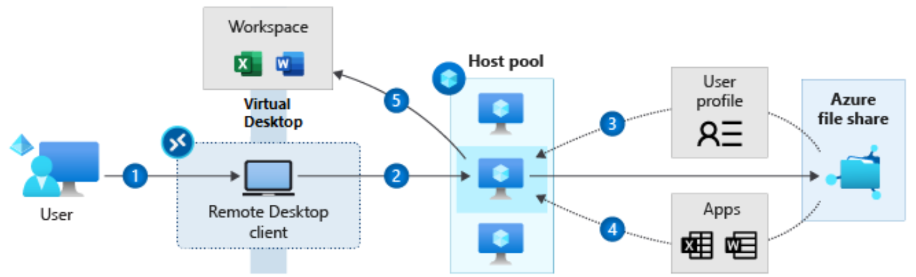
The process of accessing a user profile after signing into a RD client
User signs into the Remote Desktop client
User gets assigned to a session host virtual machine (VM)
VM gets the user profile from the Azure file share
If MSIX app attach configured, apps are dynamically delivered to the session host VM. MSIX app attach uses FSLogix storage concepts, but for applications
User gets their Azure Virtual Desktop workspace populated with their assigned app(s) or session desktop
Notes:
Azure Virtual Desktop service recommends FSLogix profile containers as a user profile solution. FSLogix is designed to roam profiles in remote computing environments, such as Azure Virtual Desktop. It stores a complete user profile in a single container.
At sign in, this container is dynamically attached to the computing environment using natively supported Virtual Hard Disk (VHD) and Hyper-V Virtual Hard disk (VHDX).
The VHD or VHDX files are stored to this location and attached to users the next time they sign in.
The following diagram shows the process of getting the user profile after a user signs into the Remote Desktop client.
User signs into the Remote Desktop client
User gets assigned to a session host virtual machine (VM)
VM gets the user profile from the Azure file share
(Preview) If you have MSIX app attach configured, apps are dynamically delivered to the session host VM. MSIX app attach uses FSLogix storage concepts, but for applications
User gets their Azure Virtual Desktop workspace populated with their assigned app(s) or session desktop
The user profile is immediately available and appears in the system exactly like a native user profile.

Slide 6
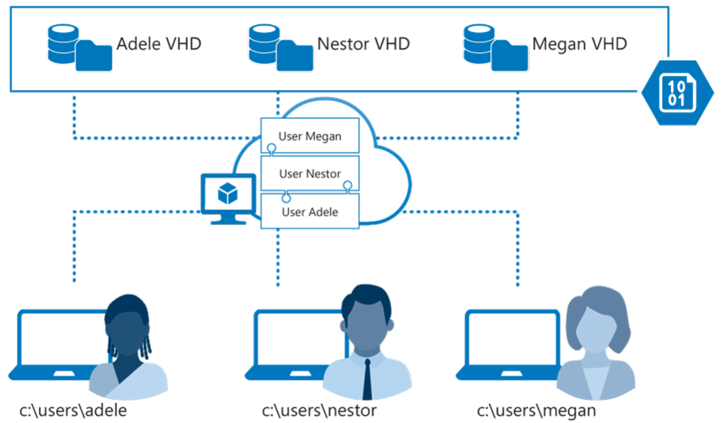
User Profiles and FSLogix components
FSLogix profile containers are the Azure Virtual Desktop user profile solution.
FSLogix is designed to roam profiles in remote computing environments.
It stores a complete user profile in a single container.
At sign in, this container is dynamically attached to the computing environment using natively supported VHD and VHDX.
The VHD or VHDX files are stored to this location and attached to users the next time they sign in.
Notes:
User profiles
A user profile contains data elements including desktop settings, persistent network connections, and application settings. By default, Windows creates a local user profile that is tightly integrated with the operating system.
A remote user profile provides a partition between user data and the operating system. It allows the operating system to be replaced or changed without affecting the user data. In Remote Desktop Session Host (RDSH) and Virtual Desktop Infrastructures (VDI), the operating system may be replaced for the following reasons:
An upgrade of the operating system
A replacement of an existing Virtual Machine (VM)
A user being part of a pooled (non-persistent) RDSH or VDI environment
Microsoft products operate with several technologies for remote user profiles, including these technologies:
Roaming user profiles (RUP)
User profile disks (UPD)
Enterprise state roaming (ESR)
UPD and RUP are the most widely used technologies for user profiles in Remote Desktop Session Host (RDSH) and Virtual Hard Disk (VHD) environments.

Slide 7
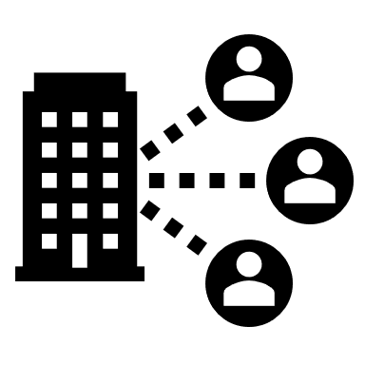
Configure storage for FSLogix components

Slide 8
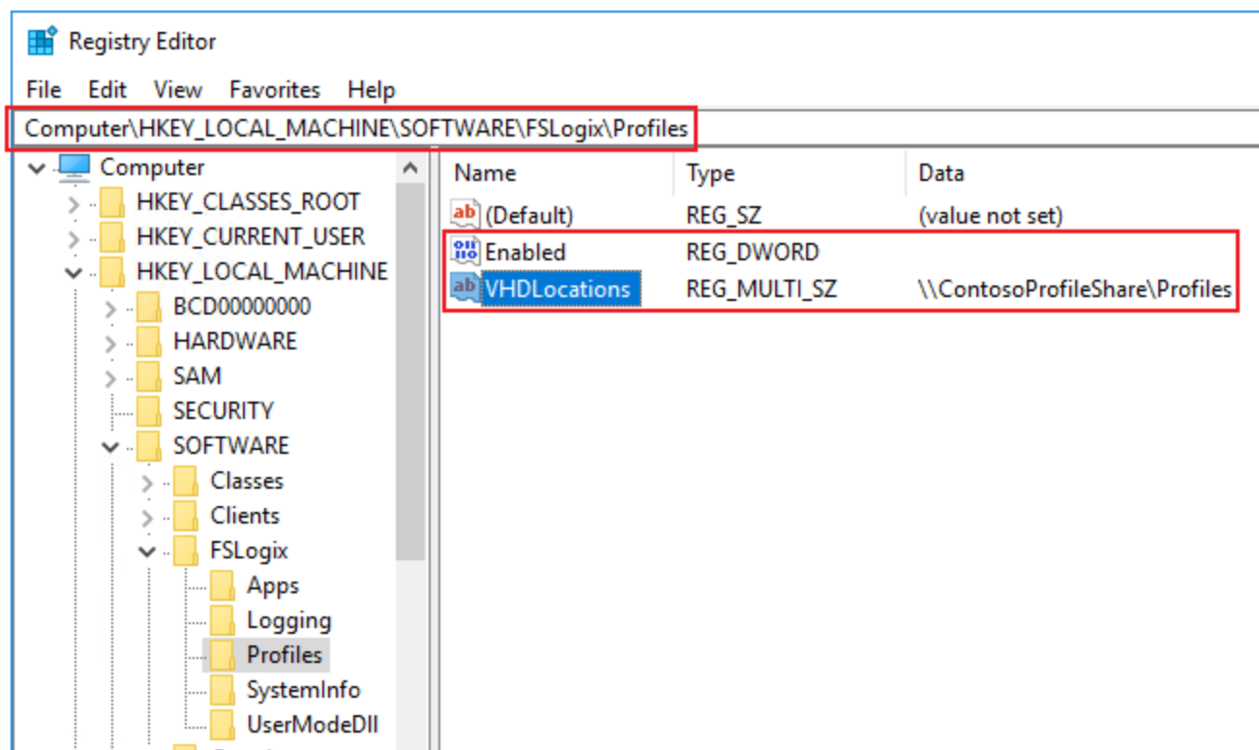
To configure the virtual machines with the FSLogix software, do the following on each machine registered to the host pool:
Connect to the virtual machine with the credentials you provided when creating the virtual machine.
Launch an internet browser and navigate to download the FSLogix agent.
Navigate to either \Win32\Release or \X64\Release in the .zip file and run FSLogixAppsSetup to install the FSLogix agent.
Navigate to Program Files > FSLogix > Apps to confirm the agent installed.
From the start menu, run RegEdit as an administrator. Navigate to Computer\HKEY_LOCAL_MACHINE\software\FSLogix
Create a key named Profiles.
Create the following values for the Profiles key:
Name | Type | Data/Value
Enabled | DWORD | 1
VHDLocations | Multi-String Value | "Network path for file share"
Notes:
The Azure Virtual Desktop service offers FSLogix profile containers as the recommended user profile solution. We don't recommend using the User Profile Disk (UPD) solution, which will be deprecated in future versions of Azure Virtual Desktop.

Slide 9

Configure storage accounts

Slide 10
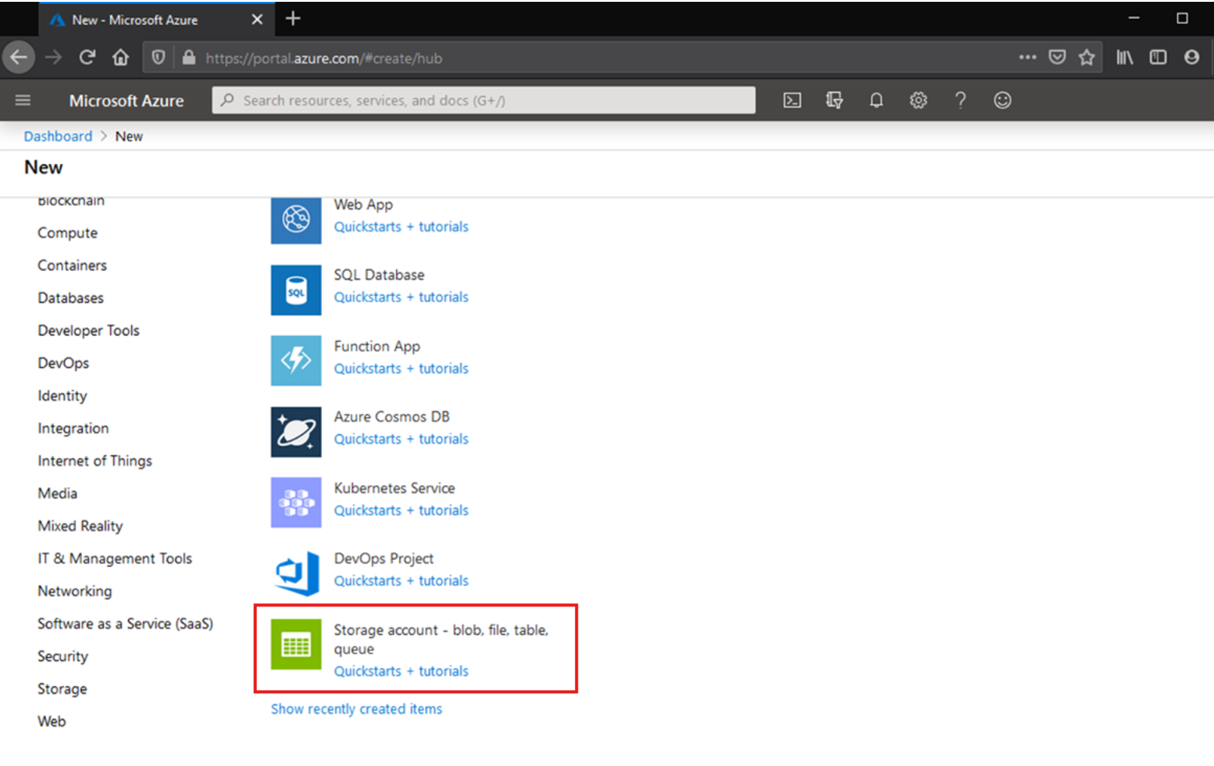
Azure supports multiple types of storage accounts for different storage scenarios.
There are two main types of storage accounts for Azure Files.
General purpose version 2 (GPv2) storage accounts: Allow you to deploy Azure file shares on standard/hard disk-based (HDD-based) hardware.
In addition to storing Azure file shares, GPv2 storage accounts can store other storage resources such as blob containers, queues, or tables.
File shares can be deployed into the transaction optimized (default), hot, or cool tiers.
FileStorage storage accounts: FileStorage storage accounts allow you to deploy Azure file shares on premium/solid-state disk-based (SSD-based) hardware.
FileStorage accounts can only be used to store Azure file shares; no other storage resources (blob containers, queues, tables, etc.) can be deployed in a FileStorage account.
Notes:
There are two primary types of storage accounts for Azure Files. Which storage account type you need to create depends on whether you want to create a standard file share or a premium file share:
General purpose version 2 (GPv2) storage accounts: GPv2 storage accounts allow you to deploy Azure file shares on standard/hard disk-based (HDD-based) hardware. GPv2 storage accounts can store other storage resources such as blob containers, queues, or tables. File shares can be deployed into the transaction optimized (default), hot, or cool tiers.
FileStorage storage accounts: FileStorage storage accounts allow you to deploy Azure file shares on premium/solid-state disk-based (SSD-based) hardware. FileStorage accounts store Azure file shares. Storage resources, such as blob containers or queues, cannot be deployed in a FileStorage account.

Slide 11

Create file shares

Slide 12
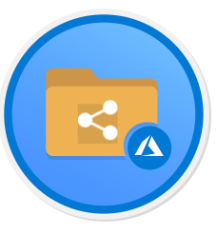
Once you've created a storage account, all that is left is to create your file share.
The process is the same for a premium file share or a standard file share.
You should consider the following differences:
Standard file shares may be deployed into one of the standard tiers:
transaction optimized (default)
Hot
Cool
This is a per file share tier that is not affected by the blob access tier of the storage account.
You can change the tier of the share at any time after it has been deployed.
Premium file shares cannot be directly converted to standard file shares in any standard tier.
You can move file shares between tiers within GPv2 storage account types (transaction optimized, hot, and cool).
Notes:
Once you've created a storage account, you can create a file share. Standard file shares may be deployed into one of the standard tiers: transaction optimized (default), hot, or cool. This is a per file share tier that is not affected by the blob access tier of the storage account.
You can change the tier of the share at any time after it has been deployed. Premium file shares cannot be directly converted to standard file shares in any standard tier.
You can move file shares between tiers within GPv2 storage account types (transaction optimized, hot, and cool).
quota means something slightly different between premium and standard file shares:
For standard file shares, it's an upper boundary of the Azure file share. The primary purpose for quota for a standard file share is budgetary: "I don't want this file share to grow beyond this point."
If a quota is not specified, standard file share can span up to 100 TiB.
For premium file shares, quota is overloaded to mean provisioned size. The provisioned size is the amount that you will be billed. Consider the following when configuring a premium file share:
The future growth of the share from a space utilization perspective
The IOPS required for your workload. Every provisioned GiB allows reserved and burst IOPS.

Slide 13
Configure disks

Slide 14
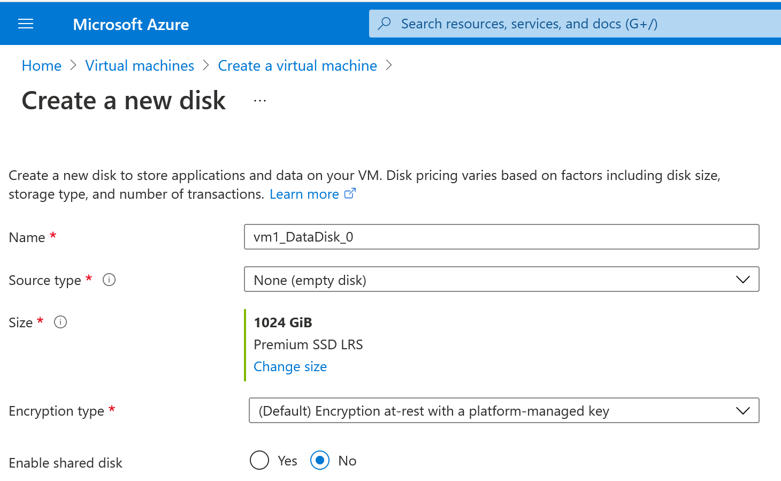
Add a data disk
Go to the Azure portal to add a data disk. Search for and select Virtual machines.
Select a virtual machine from the list.
On the Virtual machine page, select Disks.
On the Disks page, select Add data disk.
In the drop-down for the new disk, select Create disk.
In the Create managed disk page, type in a name for the disk and adjust the other settings as necessary. When you're done, select Create.
In the Disks page, select Save to save the new disk configuration for the VM.
After Azure creates the disk and attaches it to the virtual machine, the new disk is listed in the virtual machine's disk settings under Data disks.

Slide 15
Knowledge check and Summary
Check your knowledge
What you learned:
Choose appropriate storage for FSLogix components.
Configure storage for FSLogix components.
Configure storage accounts for Azure Files.
Configure a new managed data disk to a Windows virtual machine for Azure Virtual Desktop.
Create file shares for a storages account for Azure Virtual Desktop.
Notes:
What you learned:
Choose appropriate storage for FSLogix components.
Configure storage for FSLogix components.
Configure storage accounts for Azure Files.
Configure a new managed data disk to a Windows virtual machine for Azure Virtual Desktop.
Create file shares for a storages account for Azure Virtual Desktop.

Slide 16
Lab - Implement and manage storage for AVD (Azure AD DS)
Lab prerequisites:
A Microsoft account or an Azure AD account with the Global Administrator role in the Azure AD tenant associated with the Azure subscription and with the Owner or Contributor role in the Azure subscription
The completed lab Prepare for deployment of Azure Virtual Desktop (Azure AD DS).
Estimated time: 30 minutes
Lab - Implement and manage storage for AVD (Azure AD DS)

Slide 17
Lab - Implement and manage storage for AVD (AD DS)
Lab prerequisites:
A Microsoft account or an Azure AD account with the Owner or Contributor role in the Azure subscription you will be using in this lab and with the Global Administrator role in the Azure AD tenant associated with that Azure subscription.
The completed lab Prepare for deployment of Azure Virtual Desktop (AD DS).
Estimated time: 30 minutes
Lab - Implement and manage storage for AVD (AD DS)

Slide 18

End of presentation

