Slide 1
AZ-140T00A Configuring and Operating Azure Virtual Desktop

Slide 2

Create and manage session host images
Notes:
A Shared Image Gallery simplifies custom image sharing across your organization. Custom images are like marketplace images, but you create them yourself. Custom images can be used to bootstrap deployment tasks like preloading applications, application configurations, and other OS configurations.
Learning objectives
After completing this section, you'll be able to:
Create a managed VM image for an Azure Virtual Desktop-specific configuration.
Modify a session host image.
Plan for image update and management.
Create and use a Shared Image Gallery (SIG) for Azure Virtual Desktop.
Install language packs in Azure Virtual Desktop.
Prerequisites
Conceptual knowledge of Azure compute solutions.
Working experience with virtual machines, containers, and app service.

Slide 3
Introduction
Create a managed VM image
Modify a session host image
Plan for image update and management
Create and use a Shared Image Gallery (SIG) using the portal
Install language packs in Azure Virtual Desktop
AZ-140: Implement an Azure Virtual Desktop infrastructure (25-30%)
Create and manage session host images
Conceptual knowledge of Azure compute solutions.
Working experience with virtual machines, virtual networks, and app service.
Notes:
https://docs.microsoft.com/en-us/learn/certifications/exams/az-140
Prerequisites
Conceptual knowledge of Azure compute solutions.
Working experience with virtual machines, virtual networks, and app service.

Slide 4

Create a managed VM image

Slide 5
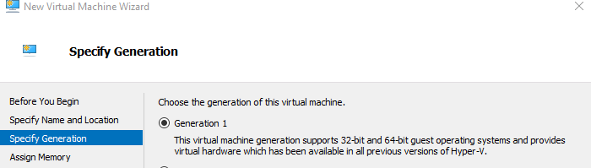
You can use an image from the Azure Image Gallery.
Local image creation
Windows 10 Enterprise multi-session is available in the Azure Image Gallery.
There are two options for customizing the image:
The first option is to provision a virtual machine (VM) in Azure
The second option is to create the image locally by downloading the image, provisioning a Hyper-V VM, and customizing it to suit your needs
Once you've downloaded the image to a local location, open Hyper-V Manager to create a VM with the VHD you copied. To create a VM with the copied VHD:
Open the New Virtual Machine Wizard.
On the Specify Generation page, select Generation 1.
Under Checkpoint Type, disable checkpoints by unchecking the check box.
Notes:
This unit shows you how to prepare a master virtual hard disk (VHD) image for upload to Azure including how to create virtual machines. These instructions are for an Azure Virtual Desktop-specific configuration that can be used with your organization's existing processes.
We recommend you use an image from the Azure Image Gallery. However, if you do need to use a customized image, make sure you don't already have the Azure Virtual Desktop Agent installed on your device. Using a customized image with the Azure Virtual Desktop Agent can cause problems with the image.
Create a virtual machine
Windows 10 Enterprise multi-session is available in the Azure Image Gallery. There are two options for customizing this image.
The first option is to provision a virtual machine in Azure (See: Create a virtual machine from a managed image).
The second option is to create the image locally by downloading the image, provisioning a Hyper-V virtual machine, and customizing it to suit your needs.
Create a virtual machine from a managed image
You can create multiple virtual machines from an Azure managed virtual machine image using the Azure portal or PowerShell. A managed virtual machine image contains the information necessary to create a virtual machine, including the OS and data disks. The virtual hard disks (VHDs) that make up the image, including both the OS disks and any data disks, are stored as managed disks.
Before creating a new virtual machine, create a managed virtual machine image to use as the source image and grant read access on the image to any user who should have access to the image.
One managed image supports up to 20 simultaneous deployments. Attempting to create more than 20 virtual machines concurrently, from the same managed image, may result in provisioning timeouts due to the storage performance limitations of a single VHD. To create more than 20 virtual machines concurrently, use a Shared Image Galleries image configured with 1 replica for every 20 concurrent virtual machine deployments.

Slide 6
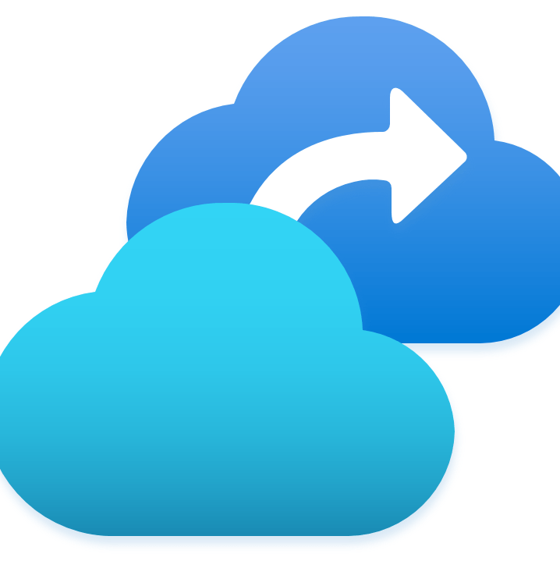
Modify a session host image

Slide 7
To disable Automatic Updates via local Group Policy, run:
reg add "HKLM\SOFTWARE\Policies\Microsoft\Windows\WindowsUpdate\AU" /v NoAutoUpdate /t REG_DWORD /d 1 /f
Run this command to specify a Start layout for Windows 10 PCs, run:
reg add "HKLM\SOFTWARE\Microsoft\Windows\CurrentVersion\Explorer" /v SpecialRoamingOverrideAllowed /t REG_DWORD /d 1 /f
To redirect time zones, run this command on the master image:
reg add "HKLM\SOFTWARE\Policies\Microsoft\Windows NT\Terminal Services" /v fEnableTimeZoneRedirection /t REG_DWORD /d 1 /f

Slide 8

Plan for image update and management

Slide 9
Plan for image update and management
If you have many images that you need to maintain and would like to make them available throughout your company, you can use a Shared Image Gallery as a repository.
The Shared Image Gallery feature has multiple resource types:
Resource | Description
Image source | This is a resource that can be used to create an image version in an image gallery. An image source can be an existing Azure VM that is either generalized or specialized, a managed image, a snapshot, a VHD or an image version in another image gallery.
Image gallery | Like the Azure Marketplace, an image gallery is a repository for managing and sharing images, but you control who has access.
Image definition | Image definitions are created within a gallery and carry information about the image and requirements for using it internally. This includes whether the image is Windows or Linux, release notes, and minimum and maximum memory requirements. It is a definition of a type of image.
Image version | An image version is what you use to create a VM when using a gallery. You can have multiple versions of an image as needed for your environment. Like a managed image, when you use an image version to create a VM, the image version is used to create new disks for the VM. Image versions can be used multiple times.
Notes:
Make your images highly available
Azure Zone Redundant Storage (ZRS) provides resilience against an Availability Zone failure in the region. With the general availability of Shared Image Gallery, you can choose to store your images in ZRS accounts in regions with Availability Zones.
You can also choose the account type for each of the target regions. The default storage account type is Standard_LRS, but you can choose Standard_ZRS for regions with Availability Zones. Check the regional availability of ZRS here.
Replication
Shared Image Gallery also allows you to replicate your images to other Azure regions automatically. Each Shared Image version can be replicated to different regions depending on what makes sense for your organization. One example is to always replicate the latest image in multi-regions while all older versions are only available in one region to save on storage costs for Shared Image versions.
The regions a Shared Image version is replicated to can be updated after creation time. The time it takes to replicate to different regions depends on the amount of data being copied and the number of regions the version is replicated to. While the replication is happening, you can view the status of replication per region. Once the image replication is complete in a region, you can then deploy a VM or scale-set using that image version in the region.
Access
The Shared Image Gallery, Image Definition, and Image version are resources that are shared using the built-in native Azure role-based access control (RBAC) controls. Using Azure role-based access control (RBAC) you can share these resources to other users, service principals, and groups. You can even share access to individuals outside of the tenant they were created within. Once a user has access to the Shared Image version, they can deploy a VM or a Virtual Machine Scale Set.

Slide 10

Create and use an Azure Compute Gallery using the Azure portal

Slide 11
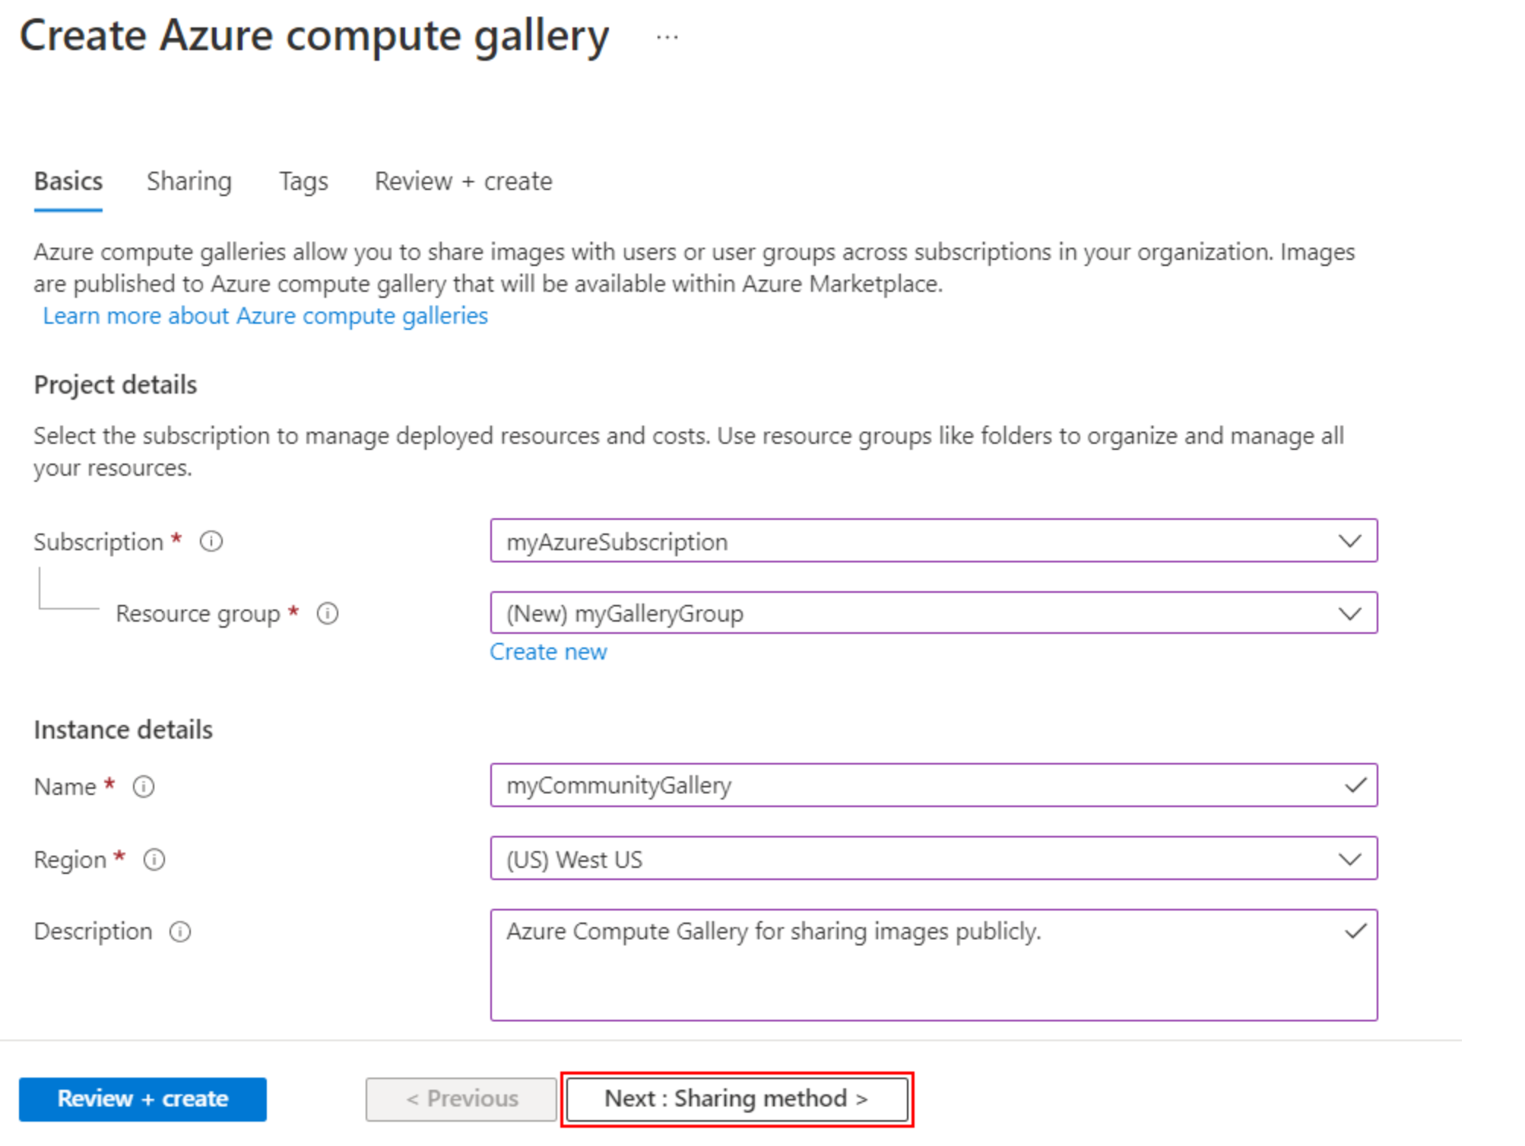
An Azure Compute Gallery simplifies sharing resources, like images and application packages, across your organization.
The Azure Compute Gallery lets you share custom VM images and application packages with others in your organization.
Choose what you want to share, which regions you want to make them available in, and who you want to share them with.
You can create multiple galleries so that you can logically group resources.
Notes:
Create a private gallery
Sign in to the Azure portal at https://portal.azure.com.
Type Azure Compute Gallery in the search box and select Azure Compute Gallery in the results.
In the Azure Compute Gallery page, click Add.
On the Create Azure Compute Gallery page, select the correct subscription.
In Resource group, select a resource group from the drop-down or select Create new and type a name for the new resource group.
In Name, type a name for the name of the gallery.
Select a Region from the drop-down.
You can type a short description of the gallery, like My gallery for testing. and then click Review + create.
After validation passes, select Create.
When the deployment is finished, select Go to resource.
Create a direct shared gallery
Sign in to the Azure portal at https://portal.azure.com.
Type Azure Compute Gallery in the search box and select Azure Compute Gallery in the results.
In the Azure Compute Gallery page, click Add.
On the Create Azure Compute Gallery page, select the correct subscription.
Complete all of the details on the page.
At the bottom of the page, select Next: Sharing method.
On the Sharing tab, select RBAC + share directly.
When you're done, select Review + create.
After validation passes, select Create.
When the deployment is finished, select Go to resource.

Slide 12

Create an Azure Virtual Desktop image by using VM Image Builder

Slide 13
You can distribute the image to an Azure Compute Gallery, where you can replicate it to other regions, control the scale, and share the image within and beyond your organization.
You can create an Azure Virtual Desktop image with these customizations:
FSLogix setup
Azure Virtual Desktop optimization
Microsoft Teams installation
Windows Restart customizer
Windows Update customizer
To build the image, run the scripts below.
Start-AzImageBuilderTemplate -ResourceGroupName $imageResourceGroup -Name $imageTemplateName -NoWait

Slide 14
Install Microsoft 365 Apps on a master Virtual Hard Disk image

Slide 15
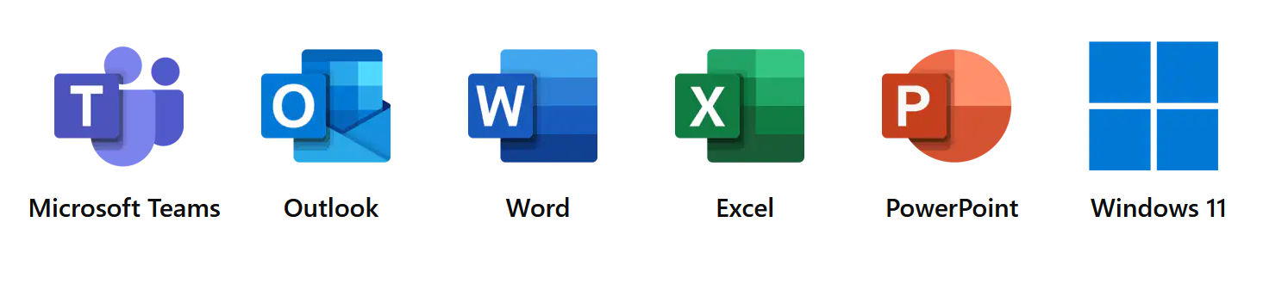
You can install Microsoft 365 Apps for enterprise, OneDrive, and other common applications on a master virtual hard disk (VHD) image for upload to Azure.
Shared computer activation allows deployment of Microsoft 365 Apps for enterprise to a computer that is accessed by multiple users.
Use the Office Deployment Tool to install Office.
Windows 10 Enterprise multi-session only supports the following versions of Office:
Microsoft 365 Apps for enterprise
Microsoft 365 Apps for business that comes with a Microsoft 365 Business Premium subscription

Slide 16
Install language packs in Azure Virtual Desktop

Slide 17
You need the following to customize a Windows 10 Enterprise multi-session images for adding multiple languages:
An Azure virtual machine (VM) with Windows 10 Enterprise multi-session.
The Language ISO, Feature on Demand (FOD) Disk 1, and Inbox Apps ISO of the OS version the image uses.
An Azure Files Share or a file share on a Windows File Server Virtual Machine
To create a custom Windows 10 Enterprise multi-session image manually:
Deploy an Azure VM, then go to the Azure Gallery and select the current version of Windows 10 Enterprise multi-session you're using.
After you've deployed the VM, connect to it using RDP as a local admin.
Make sure your VM has all the latest Windows Updates.
Connect to the language package, FOD, and Inbox Apps file share repository and mount it to a letter drive (for example, drive E).
Notes:
You want your users be able to customize which language their Windows 10 Enterprise multi-session image displays.
There are two ways you can accommodate the language needs of your users:
Build dedicated host pools with a customized image for each language.
Have users with different language and localization requirements in the same host pool, but customize their images to ensure they can select whichever language they need.
The latter method is a lot more efficient and cost-effective. However, it's up to you to decide which method best suits your needs.
This unit will show you how to customize languages for your images.
You need the following to customize Windows 10 Enterprise multi-session images to add multiple languages:
An Azure virtual machine (VM) with Windows 10 Enterprise multi-session.
The Language ISO, Feature on Demand (FOD) Disk 1, and Inbox Apps ISO of the OS version the image uses.
An Azure Files Share or a file share on a Windows File Server Virtual Machine
The file share (repository) must be accessible from the Azure VM you plan to use to create the custom image.
Create a custom Windows 10 Enterprise multi-session image manually
To create a custom Windows 10 Enterprise multi-session image manually:
Deploy an Azure VM, then go to the Azure Gallery and select the current version of Windows 10 Enterprise multi-session you're using.
After you've deployed the VM, connect to it using RDP as a local admin.
Make sure your VM has all the latest Windows Updates. Download the updates and restart the VM, if necessary.
Connect to the language package, FOD, and Inbox Apps file share repository and mount it to a letter drive (for example, drive E).
Finish customizing your image
After you've installed the language packs, you can install any other software you want to add to your customized image.
Once you're finished customizing your image, you'll need to run the system preparation tool (sysprep).
To run sysprep:
Open an elevated command prompt and run the following command to generalize the image:
C:\Windows\System32\Sysprep\sysprep.exe /oobe /generalize /shutdown Stop the VM, then capture it in a managed.
You can now use the customized image to deploy an Azure Virtual Desktop host pool.

Slide 18
Knowledge check and Summary
Check your knowledge
What you learned:
Create a managed VM image for an Azure Virtual Desktop-specific configuration.
Modify a session host image.
Plan for image update and management.
Create and use a Shared Image Gallery (SIG) for Azure Virtual Desktop.
Install language packs in Azure Virtual Desktop.
Notes:
What you learned:
Create a managed VM image for an Azure Virtual Desktop-specific configuration.
Modify a session host image.
Plan for image update and management.
Create and use a Shared Image Gallery (SIG) for Azure Virtual Desktop.
Install language packs in Azure Virtual Desktop.

Slide 19

End of presentation

