Slide 1
AZ-140T00A Configuring and Operating Azure Virtual Desktop

Slide 2

Manage security for Azure Virtual Desktop
Notes:
The Windows client for Azure Virtual Desktop integrates Azure Virtual Desktop with your local machine. However, when you configure your Azure Virtual Desktop account into the Windows client, there are certain actions you'll need to take to keep your users safe.
Learning objectives
After completing this section, you'll be able to:
Plan and implement Conditional Access policies for connections to Azure Virtual Desktop.
Plan and implement multifactor authentication (MFA) in Azure Virtual Desktop.
Understand Conditional Access policy components.
Manage security by using Microsoft Defender for Cloud.
Understand Microsoft Defender for Cloud antivirus for session hosts.
Prerequisites
Working experience creating, assigning, and securing corporate identities.
Conceptual knowledge of identity assignment solutions, role-based access control, and identity protection methods.

Slide 3
Introduction
AZ-140: Manage access and security (10-15%)
Manage security
Conceptual knowledge of Azure compute solutions.
Working experience with virtual machines, virtual networks, and app service.
Plan and implement Conditional Access policies for connections to Azure Virtual Desktop
Understand Conditional Access policy components
Plan and implement MFA in Azure Virtual Desktop
Manage security by using Azure Security Center
Microsoft Defender Antivirus for session hosts
Notes:
https://docs.microsoft.com/en-us/learn/certifications/exams/az-140
Prerequisites
Conceptual knowledge of Azure compute solutions.
Working experience with virtual machines, virtual networks, and app service.

Slide 4

Plan and implement Conditional Access policies for connections to Azure Virtual Desktop

Slide 5
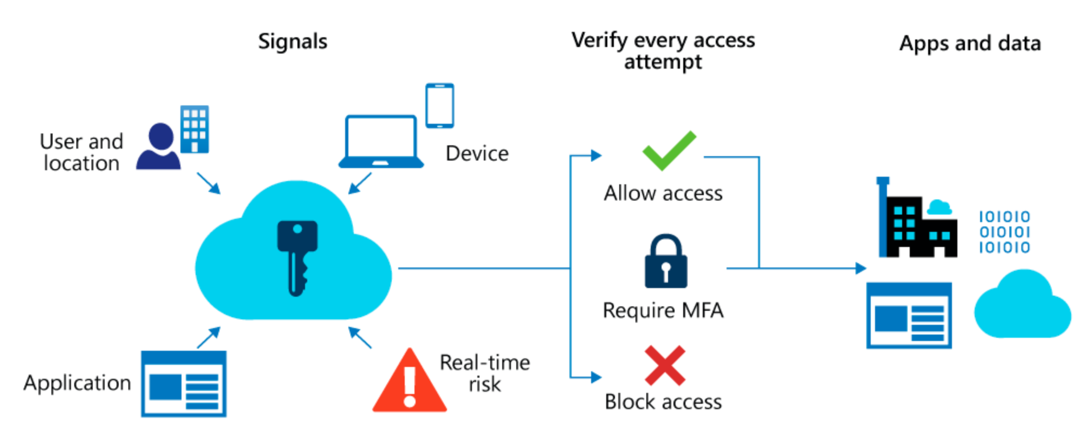
Azure Active Directory (Azure AD) Conditional Access analyses signals to automate decisions and enforce organizational access policies for resource.
Conditional Access policies to apply access controls like multifactor authentication (MFA).
Conditional Access policies allow you to prompt users for MFA when needed.
Notes:
Planning your Conditional Access deployment is critical to achieving your organization's access strategy for apps and resources.
Azure Active Directory (Azure AD) Conditional Access analyses signals such as user, device, and location to automate decisions and enforce organizational access policies for resource. You can use Conditional Access policies to apply access controls like multifactor authentication (MFA). Conditional Access policies allow you to prompt users for MFA when needed for security, and stay out of users’ way when not needed.

Slide 6

Plan and implement MFA in Azure Virtual Desktop

Slide 7
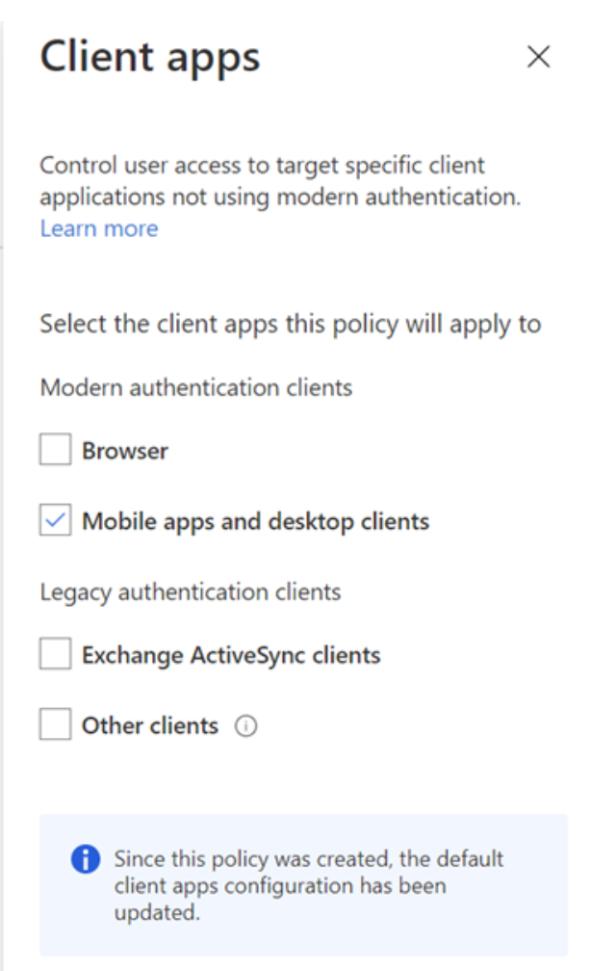
Plan MFA in Azure Virtual Desktop
When you first sign in, the client asks for your username, password, and Azure multifactor authentication.
The next time you sign in, the client will remember your token from your Azure Active Directory (AD) Enterprise Application.
When you select Remember me on the prompt for credentials for the session host, your users can sign in after restarting the client without needing to reenter their credentials.
Notes:
The Windows client for Azure Virtual Desktop integrates Azure Virtual Desktop with your local machine. However, when you configure your Azure Virtual Desktop account into the Windows client, there are certain actions you'll need to take to keep your users safe.
When you first sign in, the client asks for your username, password, and Azure Active Directory Multi-Factor Authentication. The next time you sign in, the client will remember your token from your Azure Active Directory (AD) Enterprise Application.
When they select Remember me on the prompt for credentials for the session host, your users can sign in after restarting the client without needing to reenter their credentials.
While remembering credentials is convenient, it can also make deployments on Enterprise scenarios or personal devices less secure. To protect your users, you can make sure the client keeps asking for Azure Active Directory Multi-Factor Authentication credentials more frequently.

Slide 8

Understand Conditional Access policy components

Slide 9
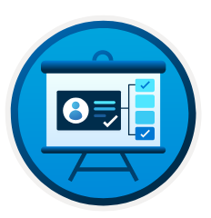
Common questions about assignments, access controls, and session controls:
Users and Groups: Which users and groups will be included in or excluded from the policy? Does this policy include all users, specific group of users, directory roles, or external users?
Cloud apps or actions: What application(s) will the policy apply to? What user actions will be subject to this policy?
Session controls: Do you want to control access to cloud apps by implementing requirements such as app enforced permissions or Conditional Access App Control?
Conditions: Which device platforms will be included in or excluded from the policy? What are the organization’s trusted locations?
Access controls: Do you want to grant access to resources by implementing requirements such as MFA, devices marked as compliant, or hybrid Azure AD joined devices?
Notes:
Conditional Access policies are if-then statements: If an assignment is met, then apply these access controls.
When configuring Conditional Access policies, conditions are called assignments. Conditional Access policies allow you to enforce access controls on your organization’s apps based on certain assignments.
Assignments define the following:
Users and groups to be affected by the policy.
Cloud apps or actions to which the policy will apply.
Conditions under which the policy will apply.
Access controls settings determine how to enforce a policy:
Grant or Block access to cloud apps.
Session controls enable limited experiences within specific cloud apps.
Ask the right questions to build your policies
Policies answer questions about who should access your resources, what resources they should access, and under what conditions. Policies can be designed to grant access, or to block access. Be sure to ask the right questions about what your policy is trying to achieve.
Document the answers to questions for each policy before building it out.

Slide 10

Manage security by using Microsoft Defender for Cloud

Slide 11
Security requisites the customer is responsible for in an Azure Virtual Desktop deployment:
Security | Customer responsibility
Identity | Yes
User devices (mobile and PC) | Yes
App security | Yes
Session host OS | Yes
Deployment configuration | Yes
Network controls | Yes
Virtualization control plane | No
Physical hosts | No
Physical network | No
Physical datacenter | No
Enable Microsoft Defender for Cloud for:
Subscriptions
Virtual machines
Key vaults
Storage accounts
Notes:
One thing that makes cloud services different from traditional on-premises virtual desktop infrastructures (VDIs) is how they handle security responsibilities.
When you use Azure Virtual Desktop, it’s important to understand that while some components come already secured for your environment, you'll need to configure other areas yourself to fit your organization’s security needs.
The security needs the customer isn't responsible for are handled by Microsoft.
Microsoft recommends enabling Microsoft Defender for Cloud for subscriptions, virtual machines, key vaults, and storage accounts.
With Microsoft Defender for Cloud Standard, you can:
Manage vulnerabilities.
Assess compliance with common frameworks like Payment Card Industry (PCI).
Strengthen the overall security of your environment.

Slide 12

Microsoft Defender Antivirus for session hosts

Slide 13
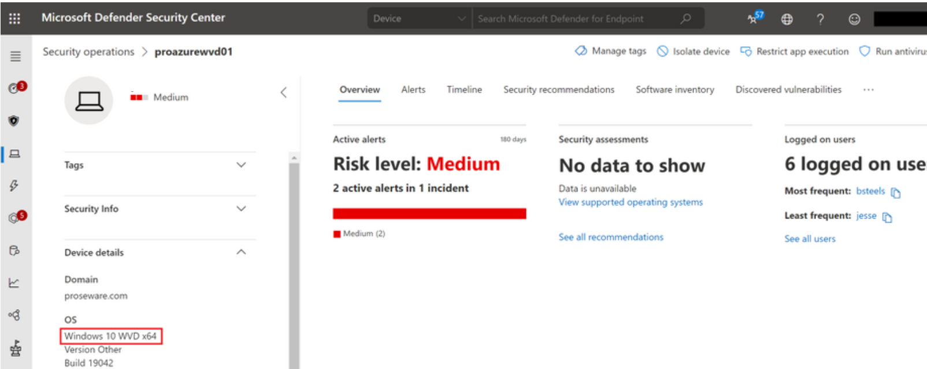
Microsoft Defender Antivirus for session hosts
Works with virtual desktops running in Azure Virtual Desktop in Azure or on a physical Windows 10 Endpoint.
Supports Azure Virtual Desktop with up to 50 concurrent user connections for Windows 10 Enterprise multi-session.
Single session scenarios on Windows 10 Enterprise is supported for onboarding Azure Virtual Desktop machines into Defender for Endpoint.
Notes:
Microsoft Defender for Endpoint is an enterprise endpoint security platform to help businesses prevent, investigate, detect, and respond to threats. Microsoft Defender for Endpoint increases endpoint security for Azure Virtual Desktop and Windows 10 physical endpoints.
Defender for Endpoint allows up to 50 concurrent user connections for Windows 10 Enterprise multi-session running on Azure Virtual Desktop.
Single session scenarios on Windows 10 Enterprise are fully supported for onboarding your Azure Virtual Desktop machines into Defender for Endpoint.

Slide 14
Knowledge check and Summary
Check your knowledge
What you learned:
Plan and implement Conditional Access policies for connections to Azure Virtual Desktop.
Plan and implement multifactor authentication (MFA) in Azure Virtual Desktop.
Understand Conditional Access policy components.
Manage security by using Microsoft Defender for Cloud.
Understand Microsoft Defender Antivirus for session hosts.
Notes:
What you learned:
Plan and implement Conditional Access policies for connections to Azure Virtual Desktop.
Plan and implement multifactor authentication (MFA) in Azure Virtual Desktop.
Understand Conditional Access policy components.
Manage security by using Microsoft Defender for Cloud.
Understand Microsoft Defender Antivirus for session hosts.
.

Slide 15
Lab - Configure Conditional Access policies for connections to AVD (AD DS)
Lab prerequisites:
A Microsoft account or an Azure AD account with the Owner or Contributor role in the Azure subscription you will be using in this lab and with the Global Administrator role in the Azure AD tenant associated with that Azure subscription.
The completed lab Prepare for deployment of Azure Virtual Desktop (AD DS) or Prepare for deployment of Azure Virtual Desktop (Azure AD DS)
The completed lab Deploy host pools and session hosts by using the Azure portal (AD DS) or Deploy host pools and session hosts by using the Azure portal (Azure AD DS)
Estimated time: 60 minutes
Lab - Configure Conditional Access policies for connections to AVD (AD DS)

Slide 16

End of presentation

