Slide 1
AZ-140T00A Configuring and Operating Azure Virtual Desktop

Slide 2

Implement and manage FSLogix
Notes:
A user profile contains data elements about an individual, including configuration information like desktop settings, persistent network connections, and application settings. By default, Windows creates a local user profile that is tightly integrated with the operating system.
Learning objectives
After completing this section, you'll be able to:
Plan for FSLogix.
Recommend best practices for FSLogix profile containers and Azure files.
Install FXLogix.
Recommend storage options for FSLogix profile containers.
Configure Cloud Cache.
Configure Profile Containers.
Manage Rule Sets.
Prerequisites
Conceptual knowledge of storage accounts, blobs, files, disks, and data protection.
Working experience with creating and securing storage systems.

Slide 3
Introduction
AZ-140: Manage user environments and apps (20-25%)
Manage user environments and apps
Conceptual knowledge of Azure compute solutions.
Working experience with virtual machines, virtual networks, and app service.
Plan for FSLogix.
Recommend best practices for FSLogix profile containers and Azure files.
Install FSLogix.
Recommend storage options for FSLogix profile containers.
Configure Cloud Cache.
Configure Profile Containers.
Manage Rule Sets and application masking.
Notes:
https://docs.microsoft.com/en-us/learn/certifications/exams/az-140
Prerequisites
Conceptual knowledge of Azure compute solutions.
Working experience with virtual machines, virtual networks, and app service.

Slide 4

Plan for FSLogix

Slide 5
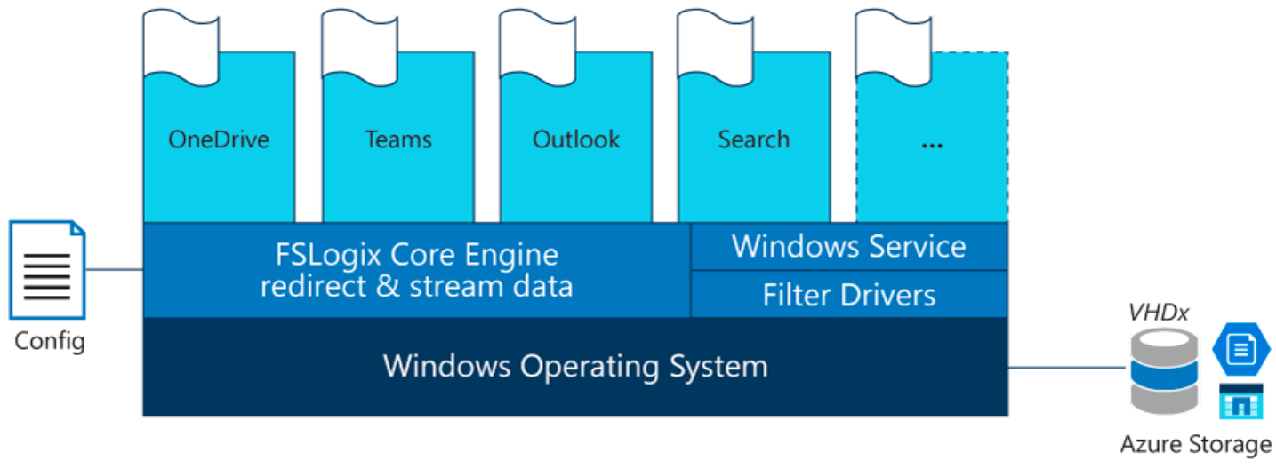
FSLogix profile containers
FSLogix is designed to roam profiles in remote computing environments, such as Azure Virtual Desktop.
Stores a complete user profile in a single container.
At sign in, this container is dynamically attached to the computing environment using natively supported Virtual Hard Disk (VHD) and Hyper-V Virtual Hard disk (VHDX).
The user profile is immediately available and appears in the system exactly like a native user profile.
Notes:
The Azure Virtual Desktop service recommends FSLogix profile containers as a user profile solution. FSLogix is designed to roam profiles in remote computing environments, such as Azure Virtual Desktop. It stores a complete user profile in a single container.
At sign in, this container is dynamically attached to the computing environment using natively supported Virtual Hard Disk (VHD) and Hyper-V Virtual Hard disk (VHDX). The user profile is immediately available and appears in the system exactly like a native user profile.
User profiles
A user profile contains data elements about an individual, including configuration information like desktop settings, persistent network connections, and application settings. By default, Windows creates a local user profile that is tightly integrated with the operating system.
A remote user profile provides a partition between user data and the operating system. It allows the operating system to be replaced or changed without affecting the user data. In Remote Desktop Session Host (RDSH) and Virtual Desktop Infrastructures (VDI), the operating system may be replaced for the following reasons:
An upgrade of the operating system
A replacement of an existing Virtual Machine (VM)
A user being part of a pooled (non-persistent) RDSH or VDI environment

Slide 6

Recommend best practices for FSLogix profile containers and Azure files

Slide 7
Performance: The FSLogix profile containers are high performance and resolve performance issues that have historically blocked cached exchange mode.
OneDrive: Without FSLogix profile containers, OneDrive for Business is not supported in non-persistent RDSH or VDI environments.
Additional folders: FSLogix provides the ability to extend user profiles to include additional folders.
FSLogix profile containers' performance and features take advantage of the cloud using Azure Files authentication with Azure Active Directory Domain Service (AD DS).
By addressing both cost and administrative overhead, Azure Files with Azure AD DS Authentication is the preferred solution for user profiles in the Azure Virtual Desktop service.
Notes:
FSLogix addresses many profile container challenges. Key among them are:
Performance: The FSLogix profile containers are high performance and resolve performance issues that have historically blocked cached exchange mode.
OneDrive: Without FSLogix profile containers, OneDrive for Business is not supported in non-persistent RDSH or VDI environments.
Additional folders: FSLogix provides the ability to extend user profiles to include additional folders.
Azure Files integration with Azure Active Directory Domain Service
FSLogix profile containers' performance and features take advantage of the cloud using Azure Files authentication with Azure Active Directory Domain Service (AD DS). By addressing both cost and administrative overhead, Azure Files with Azure AD DS Authentication is a premium solution for user profiles.
Azure Virtual Desktop offers full control over size, type, and count of VMs that are being used by customers.
To ensure your Azure Virtual Desktop environment follows best practices:
Azure Files storage account must be in the same region as the session host VMs.
Azure Files permissions should match permissions described in Requirements - Profile Containers.
Each host pool VM must be built of the same type and size VM based on the same master image.
Each host pool VM must be in the same resource group to aid management, scaling and updating.
For optimal performance, the storage solution and the FSLogix profile container should be in the same data center location.
The storage account containing the master image must be in the same region and subscription where the VMs are being provisioned

Slide 8
Install FSLogix

Slide 9
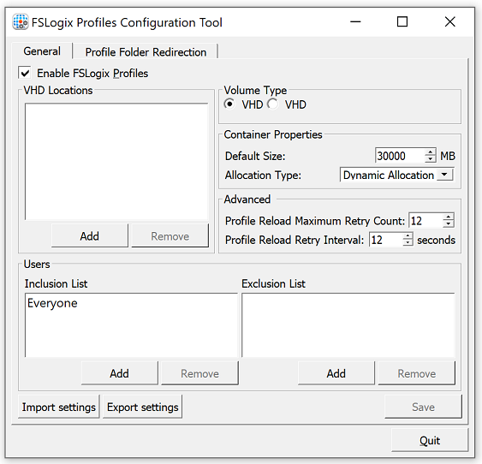
Microsoft FSLogix Apps installs the core drivers and components for all FSLogix solutions.
Any environment using FSLogix must install FSLogix Apps.
After installation configure Profile Container before using for profile redirection.
To install FSLogix Applications:
From the FSLogix download file, select 32 bit or 64 bit depending on your environment
Run FSLogixAppSetup.exe
Click Options to specify an installation folder
FSLogix is available for download here
Notes:
The FSLogix software no longer requires license keys. It is recommended that the latest version of FSLogix is downloaded and installed.
This unit describes how to download and install FSLogix tools.
Download FSLogix
FSLogix is available for download here.
Install Microsoft FSLogix components
The download for FSLogix includes three installers that are used to install the specific component(s) necessary for your use.
Microsoft FSLogix Apps Installation
Microsoft FSLogix Apps installs the core drivers and components for all FSLogix solutions. Any environment using FSLogix must install FSLogix Apps. After installation configure Profile Container before using for profile redirection.

Slide 10

Storage options for FSLogix profile containers

Slide 11
Storage options for FSLogix profile containers
Compare the storage solutions Azure Storage offers for Azure Virtual Desktop FSLogix profile container user profiles.
Features | Azure Files | Azure NetApp Files | Storage Spaces Direct
Use case | General purpose | Ultra performance or migration from NetApp on-premises | Cross-platform
Platform service | Yes, Azure-native solution | Yes, Azure-native solution | No, self-managed
Regional availability | All regions | Select regions | All regions
Redundancy | Locally redundant/zone-redundant/geo-redundant/geo-zone-redundant | Locally redundant | Locally redundant/zone-redundant/geo-redundant
Tiers and performance | Standard (Transaction optimized) Premium Up to max 100K IOPS per share with 10 GBps per share at about 3 ms latency | Standard Premium Ultra Up to 320k (16K) IOPS with 4.5 GBps per volume at about 1 ms latency | Standard HDD: up to 500 IOPS per-disk limits Standard SSD: up to 4k IOPS per-disk limits Premium SSD: up to 20k IOPS per-disk limits We recommend Premium disks for Storage Spaces Direct
Capacity | 100 TiB per share, Up to 5 PiB per general purpose account | 100 TiB per volume, up to 12.5 PiB per subscription | Maximum 32 TiB per disk
Required infrastructure | Minimum share size 1 GiB | Minimum capacity pool 4 TiB, min volume size 100 GiB | Two VMs on Azure IaaS (+ Cloud Witness) or at least three VMs without and costs for disks
Protocols | SMB 3.0/2.1, NFSv4.1 (preview), REST | NFSv3, NFSv4.1 (preview), SMB 3.x/2.x | NFSv3, NFSv4.1, SMB 3.1
Notes:
This slide compares storage solutions that Azure offers for Azure Virtual Desktop FSLogix user profile containers.
See: https://docs.microsoft.com/en-us/azure/virtual-desktop/store-fslogix-profile
It's best to store FSLogix profile containers on Azure Files.
FSLogix is designed to roam profiles in remote computing environments, such as Azure Virtual Desktop.
At sign-in, this container is dynamically attached to the computing environment using a natively supported Virtual Hard Disk (VHD) and a Hyper-V Virtual Hard Disk (VHDX).
The user profile is immediately available and appears in the system exactly like a native user profile.
The following tables compare the storage solutions Azure Storage offers for Azure Virtual Desktop FSLogix profile container user profiles.

Slide 12
Profile Container vs Office Container

Slide 13
Profile Container vs Office Container
Profile Container
Profile Container is used to redirect the full user profile.
Profile Container is used in non-persistent, virtual environments, such as Virtual Desktops.
When using Profile Container, the entire user profile, except for data that is excluded using the redirections.xml, is included in the profile container.
For users familiar with managing profiles in non-persistent environments, the function of Profile Container may be compared to Microsoft User Profile Disk, Microsoft Roaming Profiles, or Citrix UPM.
Office Container
Office Container is designed to improve the performance of Microsoft Office in non-persistent environments.
As opposed to Profile Container, Office Container redirects only the local user files for Microsoft Office.
When configuring Office Container, each Office component is independently included based on the selected settings to include data for specific office components.
When Office Container is used with other profile solutions, it's that those solutions are configured to exclude certain data.
Notes:
Office Container is a subset of Profile Container. Although all the benefits of Office Container are also delivered from Profile Container, there are times when it may be beneficial to use them together.
Profile Container and Office Container are configured differently. It's important to completely understand the configuration process, especially when using them together.
Profile Container
Profile Container is used to redirect the full user profile. Profile Container is used in non-persistent, virtual environments, such as Virtual Desktops. When using Profile Container the entire user profile, except for data that is excluded using the redirections.xml, is included in the profile container.
For users familiar with managing profiles in non-persistent environments, the function of Profile Container may be compared to Microsoft User Profile Disk, Microsoft Roaming Profiles, or Citrix UPM.
Office Container
Office Container is generally implemented with another profile solution, and is designed to improve the performance of Microsoft Office in non-persistent environments. As opposed to Profile Container, Office Container redirects only the local user files for Microsoft Office. When configuring Office Container, each Office component is independently included based on the selected settings to include data for specific office components.
When Office Container is used with other profile solutions, it's that those solutions are configured to exclude certain data.
The data contained in the Office Container can be re-created from various server locations. As an example, the .OST file is generated from the email server(S), if the file is lost or damaged it may be recovered.
Using Profile Container and Office Container together
There are several reasons why Profile Container and Office Container may be used together. The most common reasons are:
Discretion is wanted in the storage location for Office Data vs. other profile data
If the Office Container or Profile Container is damaged, the remaining data remains intact. Storage discretion is useful if there is a problem with Office Data, which can be recovered from the server as the Office Container can be deleted without impacting the rest of the user configuration.
Office Container may be used with Profile Container as a mechanism to specify which Office components will have their data included in the container

Slide 14
Configure Office Containers

Slide 15
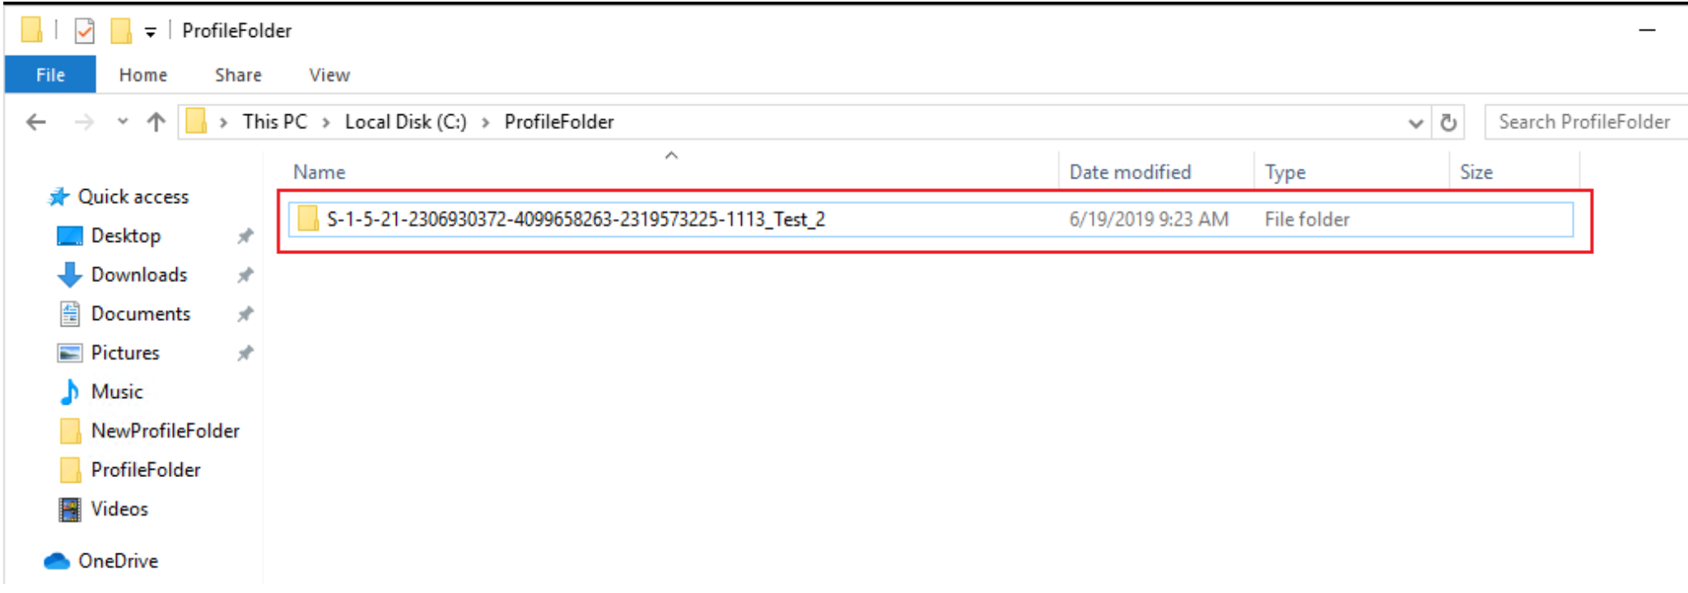
Configure Office Container
Applications and users see the portions of the profile managed by Office Container as if they're located on the local drive.
All benefits of Office Container are automatic when using Profile Container.
There's no need to implement Office Container if Profile Container is your primary solution for managing profiles.
Notes:
Using Office Container, both applications and users see the portions of the profile managed by Office Container as if they're located on the local drive.
All benefits of Office Container are automatic when using Profile Container.
There's no need to implement Office Container if Profile Container is your primary solution for managing profiles.
Office Container could optionally be used with Profile Container, to place Office Data in a location separate from the rest of the user's profile.
In this unit, learn how to:
Configure Office Container Registry settings.
Set up Include and Exclude User Groups.
Configure third party profile exclusions.

Slide 16
Installing Microsoft Office using FSLogix application containers

Slide 17
Install Microsoft Office quickly and efficiently by using an FSLogix application container as a template for the other VMs in your host pool.
Offloading your Office apps to an app container reduces the requirements for your C drive size.
Snapshots or backups of your VM takes less resources.
Having an automated pipeline through updating a single image makes updating your VMs easier.
You only need one image to install Office (and other apps) onto all the VMs in your Azure Virtual Desktop deployment.
Notes:
Using Office Container, both applications and users see the portions of the profile managed by Office Container as if they're located on the local drive.
All benefits of Office Container are automatic when using Profile Container.
There's no need to implement Office Container if Profile Container is your primary solution for managing profiles.
Office Container could optionally be used with Profile Container, to place Office Data in a location separate from the rest of the user's profile.
In this unit, learn how to:
Configure Office Container Registry settings.
Set up Include and Exclude User Groups.
Configure third party profile exclusions.

Slide 18
Configure Cloud Cache

Slide 19
Configure Cloud Cache
Cloud Cache is an optional add-on to Profile Container and Office Container.
Configure Cloud Cache for SMB (Profile Container)
All settings are applied to HKLM\SOFTWARE\FSLogix\Profiles.
Registry Value | Type | Value
CCDLocations | REG_SZ / MULTI_SZ | type=smb,connectionString=<\Location1\Folder1>;type=smb,connectionString=<\Location2\folder2>
Enabled | DWORD | 1
Configuring Cloud Cache for Office Container
All settings are applied to HKLM\SOFTWARE\FSLogix\ODFC
Registry Value | Type | Value
CCDLocations | REG_SZ / MULTI_SZ | type=smb,connectionString=<\Location1\Folder1>;type=smb,connectionString=<\Location2\folder2>
Enabled | DWORD | 1
Configuring Cloud Cache for Profile Container
Registry Value | Type | Value
CCDLocations | REG_SZ / MULTI_SZ | type=azure,connectionString="DefaultEndpointsProtocol=https;AccountName=;AccountKey=;EndpointSuffix="
Enabled | DWORD | 1
Notes:
Cloud Cache is an optional add-on to Profile Container and Office Container.
In this unit you will:
Configure Cloud Cache for Server Message Block (SMB).
Configure Cloud Cache for page blobs.
Below are required ahead of time.
Install FSLogix.
Verify that users have appropriate access to network file storage.
If using page blobs for Cloud Cache, verify that an appropriate Azure storage service is being used.

Slide 20

Configure Profile Containers

Slide 21
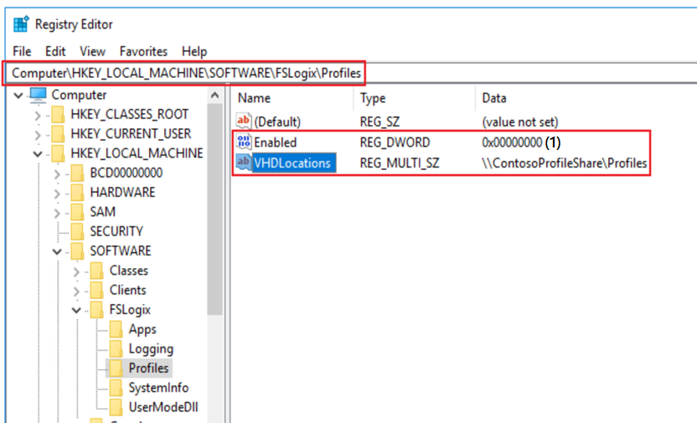
Profile Container is a full remote profile solution for non-persistent environments.
Profile Container redirects the entire user profile to a remote location.
Profile Container configuration defines how and where the profile is redirected.
Profile Container is inclusive of the benefits found in Office Container.
When using Profile Container, both applications and users see the profile as if it's located on the local drive.
Notes:
Profile Container is a full remote profile solution for non-persistent environments. Profile Container redirects the entire user profile to a remote location. Profile Container configuration defines how and where the profile is redirected.
Profile Container is inclusive of the benefits found in Office Container.
When using Profile Container, both applications and users see the profile as if it's located on the local drive.
In this unit, learn how to:
Configure Profile Container Registry Settings.
Set up Include and Exclude User Groups.

Slide 22
Create a profile container with Azure NetApp Files and capacity pool

Slide 23
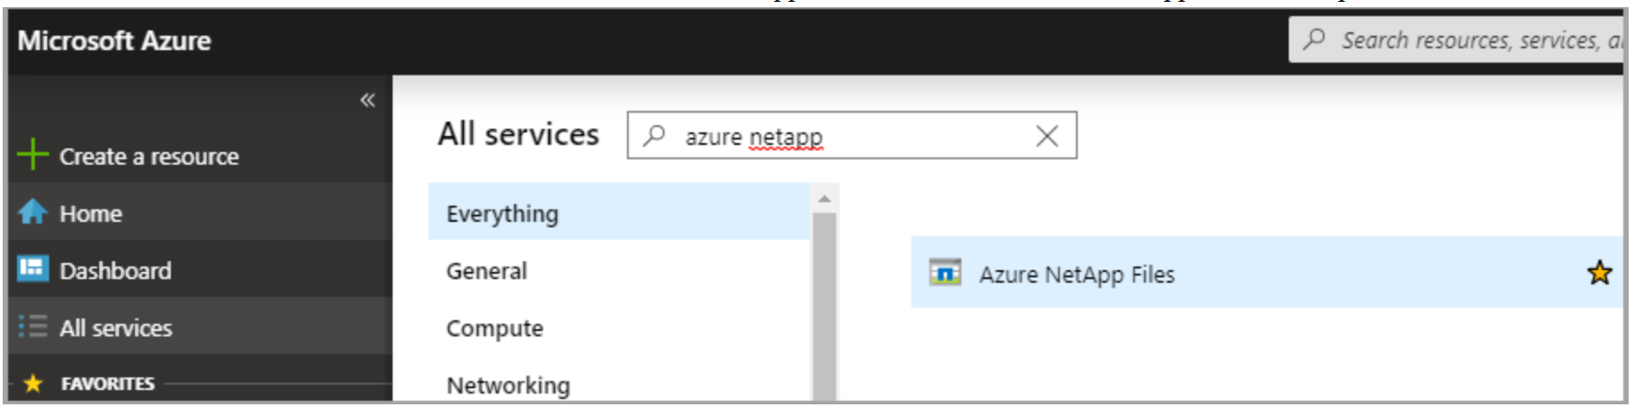
FSLogix profile containers store a complete user profile in a single container and are designed to roam profiles in non-persistent remote computing environments like Azure Virtual Desktop.
When you sign in, the container dynamically attaches to the computing environment using a locally supported virtual hard disk (VHD) and Hyper-V virtual hard disk (VHDX).
Advanced filter-driver technologies allow the user profile to be immediately available and appear in the system exactly like a local user profile.
You can create FSLogix profile containers using Azure NetApp Files, an Azure native platform service that helps customers quickly setup enterprise-grade SMB volumes for their Azure Virtual Desktop environments.

Slide 24

Manage Rule Sets and application masking

Slide 25
Application Masking manages access to Applications, Fonts, and other items based on criteria.
The Application Rules Editor is used to Describe the item, such as application, to be managed.
Things you can do with the Apps Rules Editor:
Create new Rule Sets
Edit existing Rule Sets
Manage the user and group assignments for Rule Sets
Temporarily test rule-sets
FSlogix supports four rule types:
Hiding Rule - hides the specified items using specified criteria
Redirect Rule - causes the specified item to be redirected as defined
App Container Rule - redirects the specified content into a VHD
Specify Value Rule - assigns a value for the specified item
Notes:
Application Masking manages access to Applications, Fonts, and other items based on criteria. The Application Rules Editor is used to Describe the item, such as application, to be managed. The Editor is also used to define criteria rules are managed by.
Things you can do with the Apps Rules Editor:
Create new Rule Sets.
Edit existing Rule Sets.
Manage the user and group assignments for Rule Sets.
Temporarily test rule-sets.
Before using the Application Rules Editor, FSLogix must be installed.

Slide 26
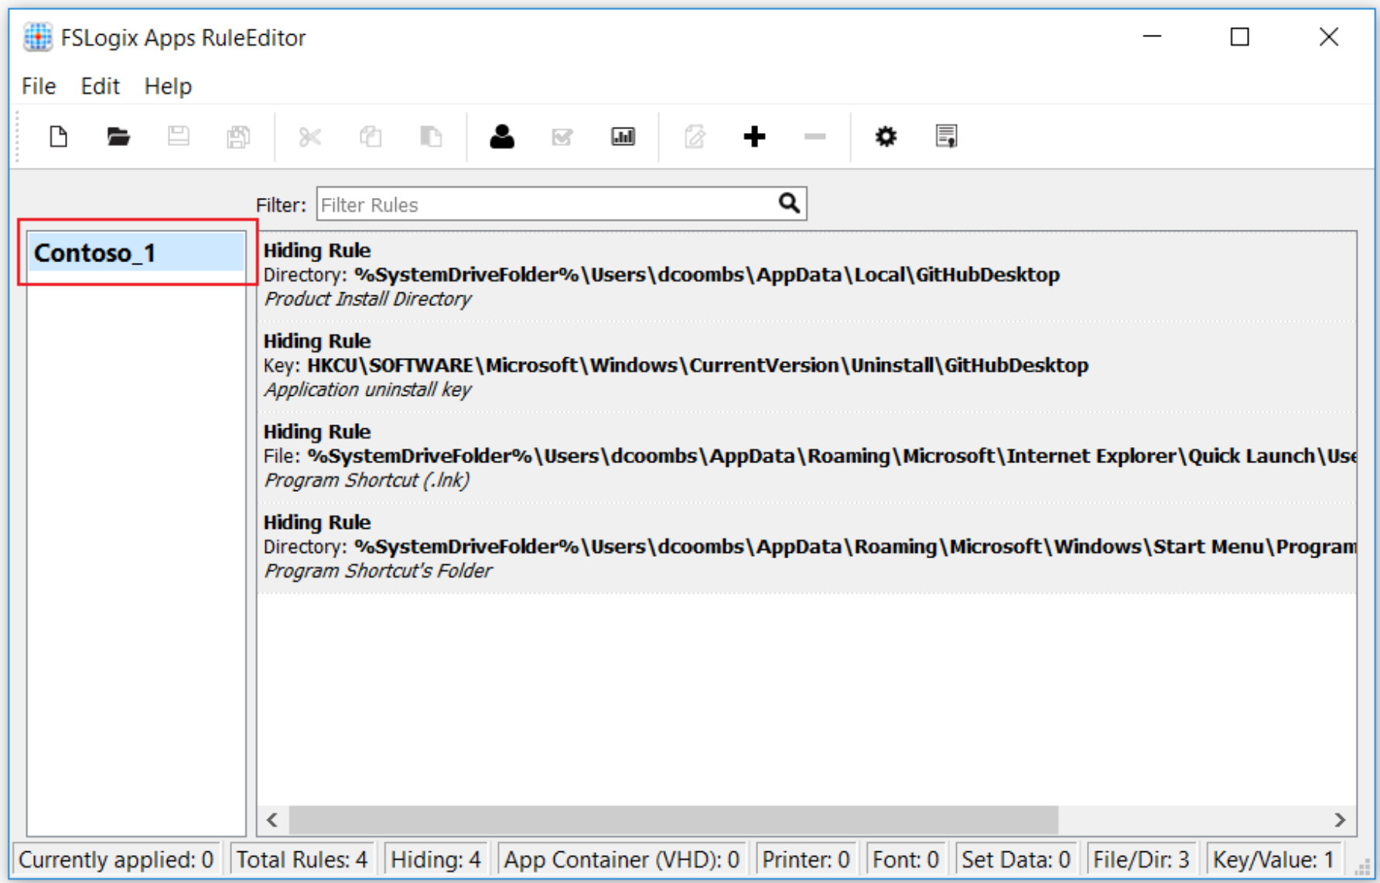
Manage Rule Sets and application masking (Cont.)
The Application Rules Editor is used to Describe the item, such as application, to be managed.
Use Application Masking to manage user access of installed components.
Application Masking may be used in both physical and virtual environments.
Application Masking is most often applied to manage non-persistent, virtual environments, such as Virtual Desktops.

Slide 27
Knowledge check and Summary
Check your knowledge
What you learned:
Plan for FSLogix.
Recommend best practices for FSLogix profile containers and Azure files.
Install FXLogix.
Recommend storage options for FSLogix profile containers.
Configure Cloud Cache.
Configure Profile Containers.
Manage Rule Sets and application masking.
Notes:
What you learned:
Plan for FSLogix.
Recommend best practices for FSLogix profile containers and Azure files.
Install FXLogix.
Recommend storage options for FSLogix profile containers.
Configure Cloud Cache.
Configure Profile Containers.
Manage Rule Sets and application masking.
.

Slide 28

End of presentation

