Slide 1
AZ-140T00A Configuring and Operating Azure Virtual Desktop

Slide 2

Configure user experience settings
Notes:
Persistent virtual desktop saves the operating system state in between reboots. Other software layers of the virtual desktop solution provide the users easy and seamless access to their assigned VMs, often with a single sign-on solution.
Learning objectives
After completing this section, you'll be able to:
Configure user settings through group policies for Azure Virtual Desktop.
Configure user settings through Endpoint Manager policies for Azure Virtual Desktop.
Configure session timeout properties for Azure Virtual Desktop.
Configure device redirections for Azure Virtual Desktop.
Configure Universal Print.
Troubleshoot user profile issues.
Prerequisites
Working experience with data integration solutions.
Conceptual knowledge of data integration solutions.

Slide 3
Introduction
Virtual desktop optimization principles
Persistent virtual desktop environments
Configure user settings through group policies
Configure user settings through Endpoint Manager policies
Configure session timeout properties
Configure device redirections
Configure Universal Print
Troubleshoot user profile issues
Troubleshoot Azure Virtual Desktop clients
AZ-140: Manage user environments and apps (20-25%)
Configure user experience settings
Conceptual knowledge of Azure compute solutions.
Working experience with virtual machines, virtual networks, and app service.
Notes:
https://docs.microsoft.com/en-us/learn/certifications/exams/az-140
Prerequisites
Conceptual knowledge of Azure compute solutions.
Working experience with virtual machines, virtual networks, and app service.

Slide 4

Virtual desktop optimization principles

Slide 5
Minimize graphic redraws, effects, and background activities that have no major benefit to the virtual desktop environment and reduce running processes to the bare minimum.
Use a "base" operating system image as the basis for the desktops:
Persistent: preserves changes to the virtual desktop operating system from one session to the next.
Non-persistent: does not preserve changes to the virtual desktop operating system from one session to the next.
Use a VM to build a VM:
State can be saved
Checkpoints can be set
Backups can be performed
A default OS installation is performed to the base VM
VM is then optimized by removing unneeded apps
Install Windows updates, delete temporary files, applying settings, etc...
Notes:
The guiding principles to optimize performance of Windows 10 in a virtual desktop environment are to minimize graphic redraws and effects, background activities that have no major benefit to the virtual desktop environment, and generally reduce running processes to the bare minimum.
A secondary goal is to reduce disk space usage in the base image to the bare minimum.
With virtual desktop implementations, the smallest possible base, or "gold" image size, can slightly reduce memory utilization on the host system, as well as a small reduction in overall network operations required to deliver the desktop environment to the consumer.
Optimization principles
Some implementations of virtual desktop environments use a "base" operating system image, which then becomes the basis for the desktops subsequently presented to the users for work. There are persistent and non-persistent base images.
The persistent type preserves changes to the virtual desktop operating system from one session to the next. The non-persistent type does not preserve changes to the virtual desktop operating system from one session to the next. To the user this desktop is little different than other virtual or physical device, other than it is accessed over a network.
The optimization settings could take place on a reference machine. A virtual machine (VM) would be an ideal place to build the VM, because state can be saved, checkpoints can be made, backups can be made, and so on. A default OS installation is performed to the base VM. That base VM is then optimized by removing unneeded apps, installing Windows updates, installing other updates, deleting temporary files, applying settings, and so on.
Updates
Windows 10 utilizes a monthly update rhythm. In some cases virtual desktop administrators control the process of updating through a process of shutting down VMs based on a "master" or "gold" image, unseal that image which is read-only, patch the image, then reseal it and bring it back into production. Therefore, there is no need to have virtual desktop devices checking Windows Update.
There is a set of scripts available at GitHub.com , that will do all the work items mentioned here.
The Internet URL for the optimization scripts can be found at https://github.com/The-Virtual-Desktop-Team/Virtual-Desktop-Optimization-Tool .

Slide 6

Persistent virtual desktop environments

Slide 7
Persistent virtual desktop is a device that saves operating system state in between reboots.
Traditional VMs, where the VM has its own virtual disk file, starts up normally, and saves changes from one session to the next.
Image-based persistent VMs, a base/gold image on one or more host servers.
Master/gold image, where updates are applied.
A non-persistent virtual desktop implementation is based on a base or "gold" image.
The base image is read-only.
When started, a copy of the base image is streamed to the VM.
All activity until the next reboot is redirected to a temporary location.
Users are provided network locations to store their data.
Notes:
Persistent virtual desktop saves the operating system state in between reboots. Other software layers of the virtual desktop solution provide the users easy and seamless access to their assigned VMs, often with a single sign-on solution.
There are several different implementations of persistent virtual desktop.
Traditional VMs, where the VM has its own virtual disk file, starts up normally, and saves changes from one session to the next. The difference is how the user accesses this VM. There may be a web portal the user signs in to that automatically directs the user to one or more virtual desktop devices (VMs) assigned to them.
Image-based persistent VMs, optionally with personal virtual disks (PVD). In this type of implementation, there is a base/gold image on one or more host servers. A VM is created, and one or more virtual disks are created and assigned to this disk for persistent storage.
When the VM is started, a copy of the base image is read into the memory space of that VM. At the same time, a persistent virtual disk assigned to that VM, with any previous OS deltas is merged through a complex process.
Changes such as event log writes and log writes are redirected to the read/write virtual disk assigned to that VM.
In this circumstance, OS and app servicing may operate normally, using traditional servicing software such as Windows Server Update Services, or other management technologies.
Master/gold image. The difference between a persistent virtual desktop device and a "normal" virtual desktop device is the relationship to the master/gold image. Eventually updates must be applied to the master. It is at this point where organizations decide how the user persistent changes are handled. In some cases, the disk with the user changes is discarded or reset. It may also be that the changes the user makes to the machine are kept through monthly Quality Updates, and the base is reset following a Feature Update.

Slide 8

Configure user settings through group policies

Slide 9
Configure user settings through group policies
Setting area | Setting | Recommended value
Background Intelligent Transfer Service (BITS)
 | Do not allow the BITS client to use Windows Branch Cache | Enabled
 | Do not allow the computer to act as a BITS Peercaching client | Enabled
 | Do not allow the computer to act as a BITS Peercaching server | Enabled
 | Allow BITS Peercaching | Disabled
BranchCache
 | Turn on BranchCache | Disabled
Hotspot Authentication
 | Enable Hotspot Authentication | Disabled
Microsoft Peer-to-Peer Networking Services
 | Turn off Microsoft Peer-to-Peer Networking Services | Enabled
Offline Files
 | Allow or Disallow use of the Offline Files feature | Disabled
Notes:
There are opportunities for you to refine the Windows 10 operating system specifically for your Azure Virtual Desktop environment.
Some recommendations might disable functionality that you would prefer to use, so you should consider the cost versus the benefit of adjusting any setting.
Creating the Windows 10 image
The first step is to install a reference image of Windows 10 on either a physical or virtual machine. Installing to a virtual machine is easy and allows you to save versions of the virtual hard-disk (VHD) file, in case you want to roll back to an earlier version.
During installation, you can choose either Express Settings or Customize. The settings offered during the Customize option are adjustable by using Group Policy, so the method of installing the base OS is not that important.

Slide 10

Configure user settings through Endpoint Manager policies

Slide 11
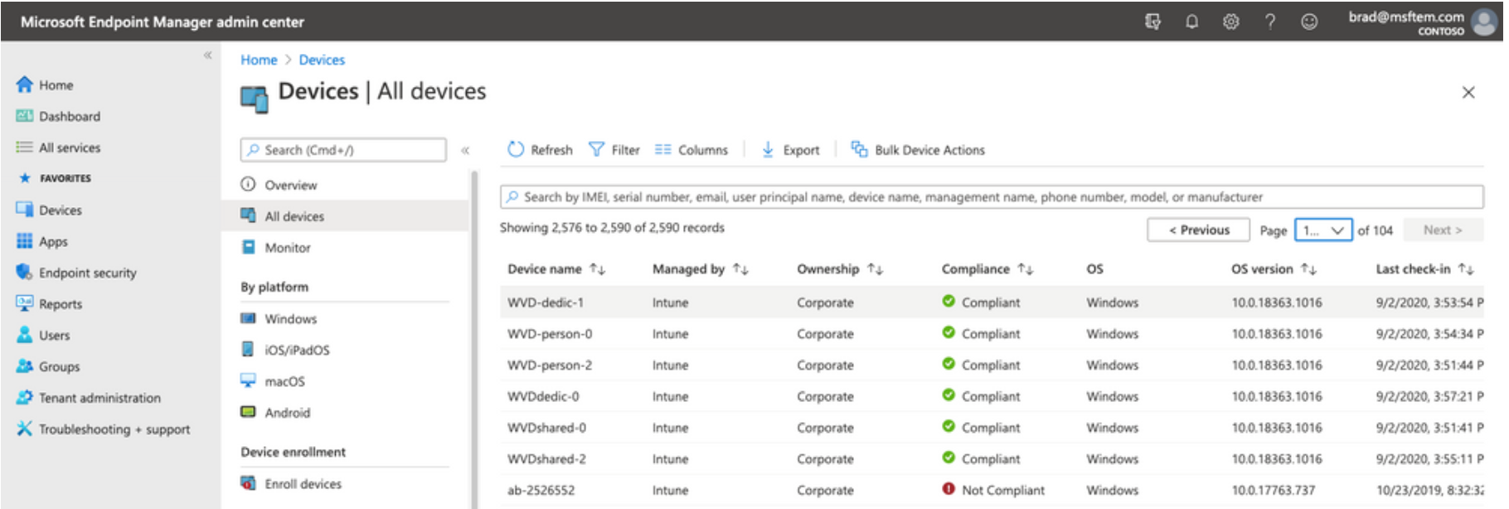
Enroll Azure Virtual Desktop VMs that are hybrid Azure AD joined with Microsoft Intune and manage them in the Microsoft Endpoint Manager admin center as you would physical devices.
Endpoint Manager integration is available for Windows 10 Enterprise desktops.
Notes:
Microsoft Endpoint Manager integrates with Azure Virtual Desktop to manage and operate deployments efficiently and establish a secure remote work solution.
You can enroll Azure Virtual Desktop Virtual Machines that are hybrid Azure AD joined (joined to your on-premises Active Directory and registered with your Azure Active Directory) with Microsoft Intune and manage them in the Microsoft Endpoint Manager admin center the same way as physical devices.
Microsoft Endpoint Manager simplifies management, provides a centralized view across both physical devices and virtual desktops and opens up new areas of collaboration. The Endpoint Manager integration is generally available for Windows 10 Enterprise desktops. Windows 10 Enterprise multi-session supports policies at device specific scope.

Slide 12

Configure session timeout properties

Slide 13
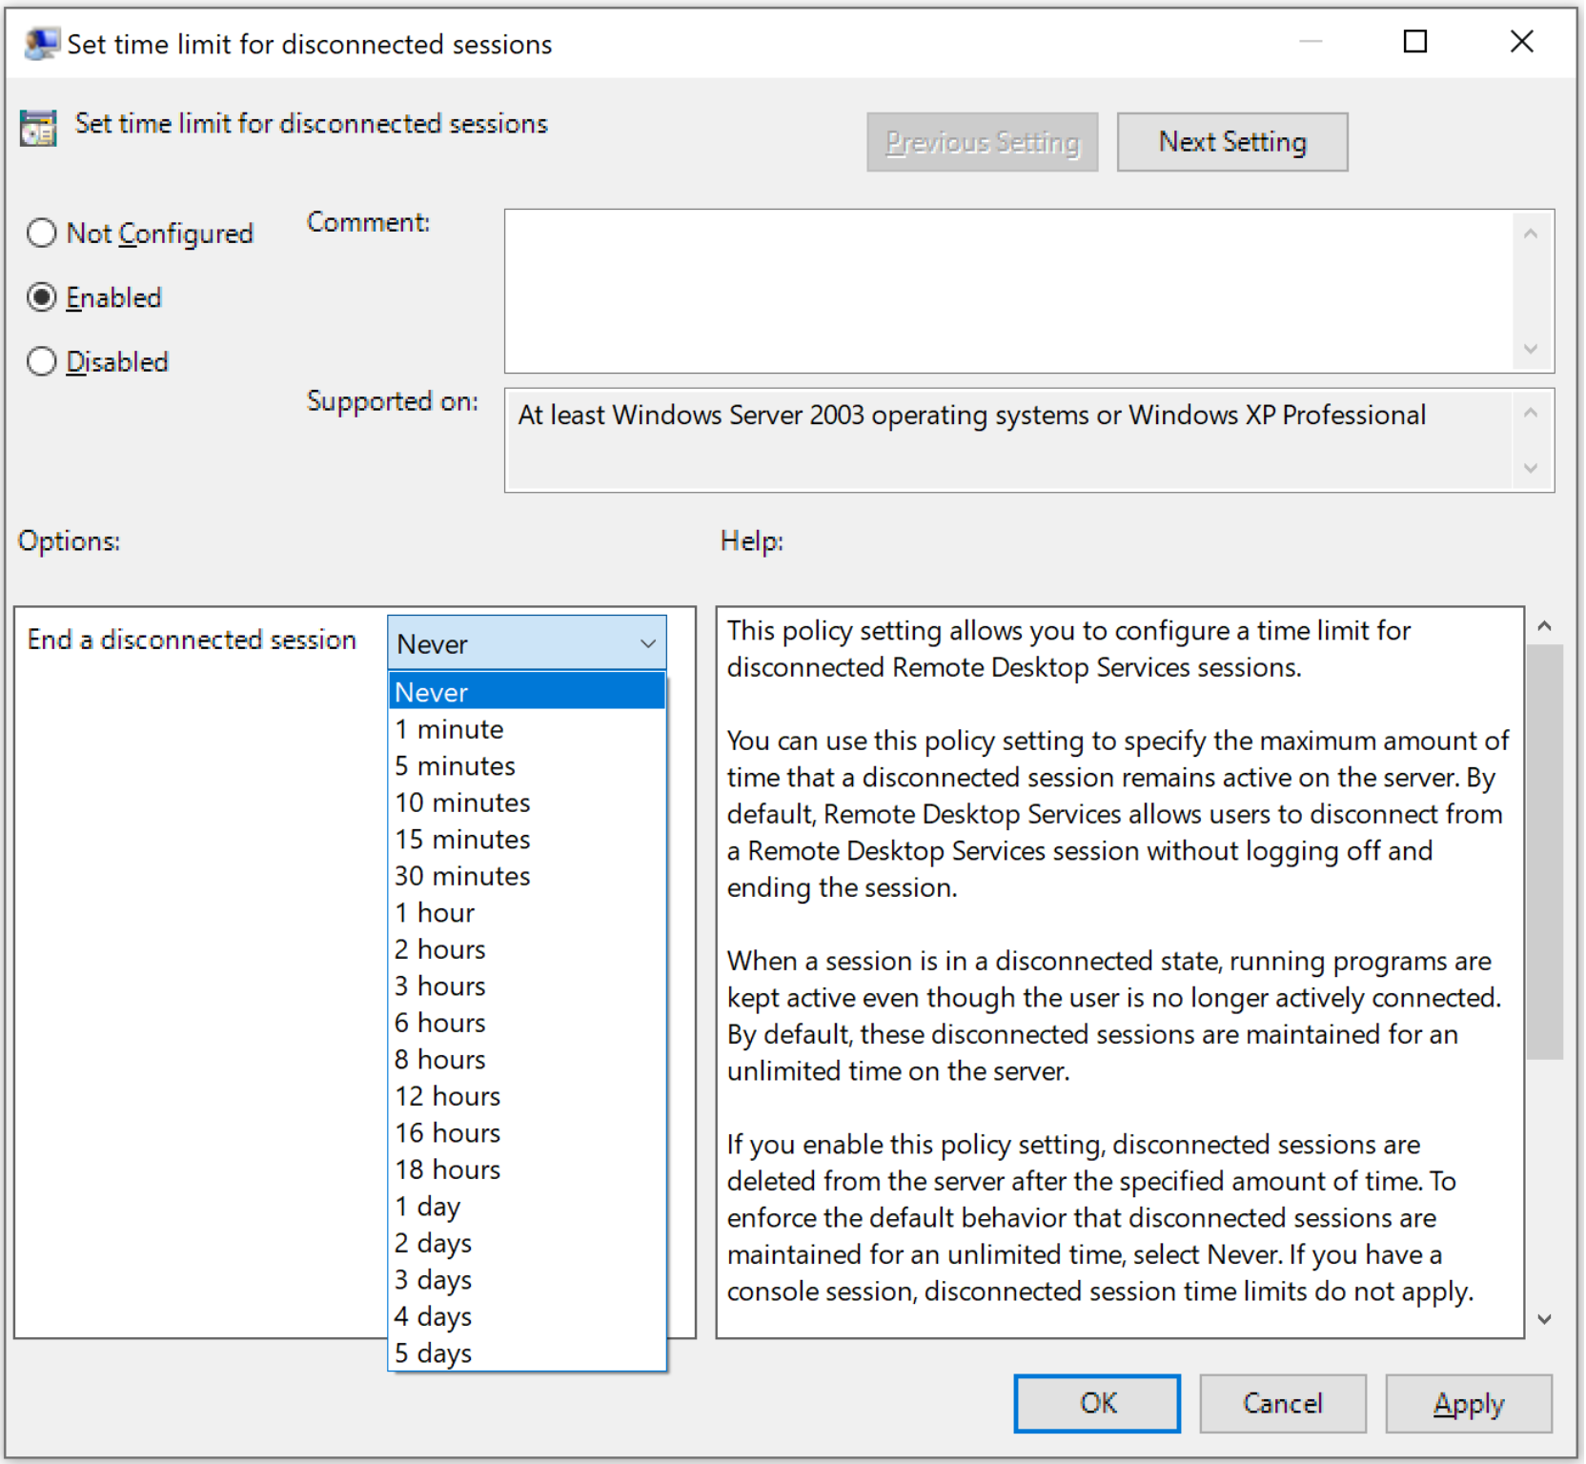
Configure session timeout properties
Signing users out when they're inactive preserves resources and prevents access by unauthorized users.
The timeout options for RDP is set on the servers in the Local Group Policy:
Set time limit for disconnected sessions
Set time limit for active but idle Remote Desktop Services sessions
Set time limit for active Remote Desktop Services sessions
End Session when time limits are reached

Slide 14

Configure device redirections

Slide 15
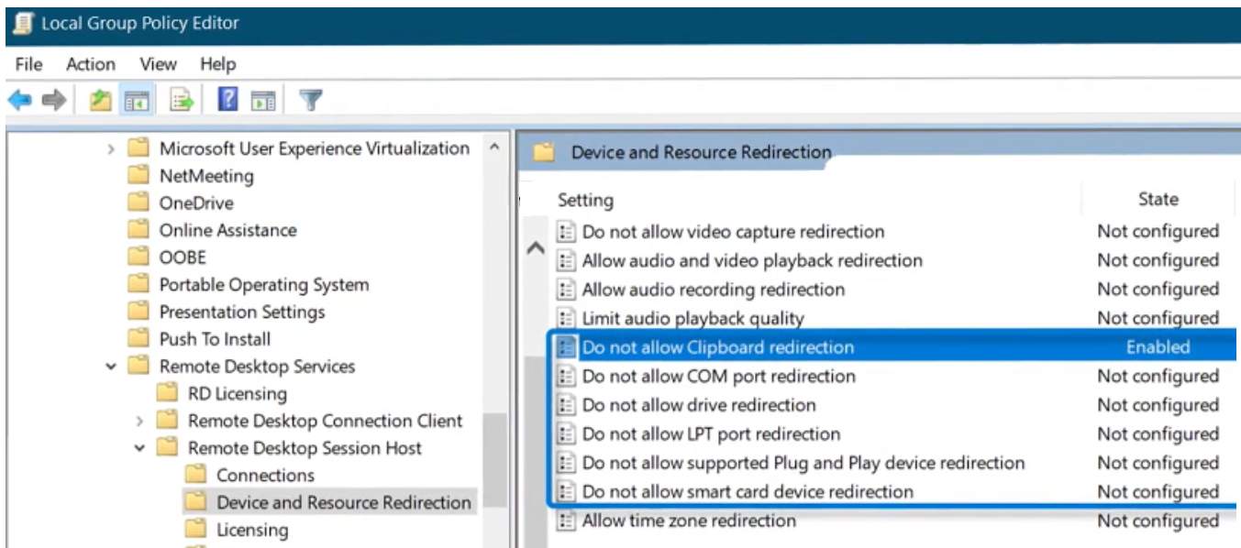
Configuring device redirections for your Azure Virtual Desktop environment allows you to use printers, USB devices, microphones and other peripheral devices in the remote session.
Clipboard redirection
redirectclipboard:i:1 enables clipboard redirection
redirectclipboard:i:0 disables clipboard redirection
COM port redirections
redirectcomports:i:1 enables COM port redirection
redirectcomports:i:0 disables COM port redirection
USB redirection
usbdevicestoredirect:s:* enables USB device redirection
usbdevicestoredirect:s: disables USB device redirection
Notes:
Configuring device redirections for your Azure Virtual Desktop environment allows you to use printers, USB devices, microphones and other peripheral devices in the remote session.
Some device redirections require changes to both Remote Desktop Protocol (RDP) properties and Group Policy settings.
Each client supports different device redirections.
Below give a quick mention of the types of redirections that can be configured.
Setup device redirections
You can use the following RDP properties and Group Policy settings to configure device redirections.
Audio input (microphone) redirection
Set the following RDP property to configure audio input redirection:
audiocapturemode:i:1 enables audio input redirection.
audiocapturemode:i:0disables audio input redirection.
Audio output (speaker) redirection
Set the following RDP property to configure audio output redirection:
audiomode:i:0enables audio output redirection.
audiomode:i:1 or audiomode:i:2 disable audio output redirection.
Camera redirection
Set the following RDP property to configure camera redirection:
camerastoredirect:s:* redirects all cameras.
camerastoredirect:s: disables camera redirection.
Clipboard redirection
Set the following RDP property to configure clipboard redirection:
redirectclipboard:i:1 enables clipboard redirection.
redirectclipboard:i:0 disables clipboard redirection.
COM port redirections
Set the following RDP property to configure COM port redirection:
redirectcomports:i:1 enables COM port redirection.
redirectcomports:i:0 disables COM port redirection.
USB redirection
First, set the following RDP property to enable USB device redirection:
usbdevicestoredirect:s:* enables USB device redirection.
usbdevicestoredirect:s: disables USB device redirection.
Plug and play device redirection
Set the following RDP property to configure plug and play device redirection:
devicestoredirect:s:* enables redirection of all plug and play devices.
devicestoredirect:s: disables redirection of plug and play devices.
You can also select specific plug and play devices using a semicolon-delimited list, such as devicestoredirect:s:root\*PNP0F08.
Local drive redirection
Set the following RDP property to configure local drive redirection:
drivestoredirect:s:* enables redirection of all disk drives.
Drivestoredirect:s: disables local drive redirection.
You can also select specific drives using a semicolon-delimited list, such as drivestoredirect:s:C:;E:;.
Printer redirection
Set the following RDP property to configure printer redirection:
redirectprinters:i:1 enables printer redirection.
redirectprinters:i:0 disables printer redirection.

Slide 16
Configure Universal Print

Slide 17
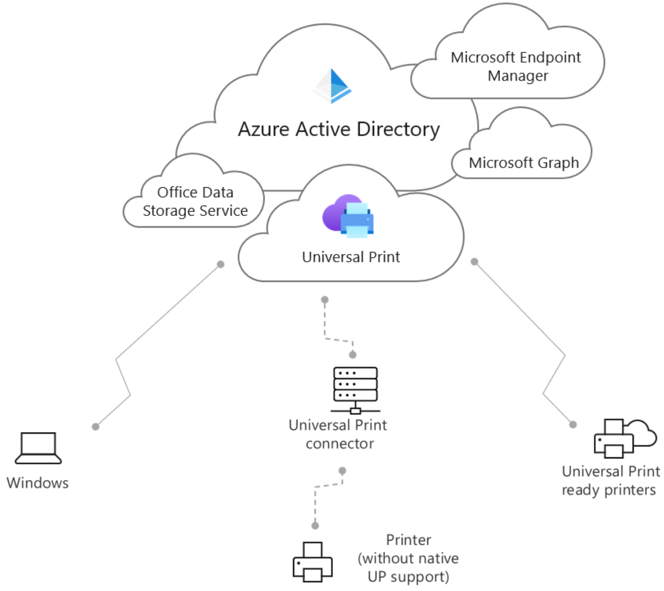
Universal Print manages print infrastructure through cloud services from Microsoft.
Universal Print runs entirely on Microsoft Azure.
With Universal Print–compatible printers, it doesn't require on-premises infrastructure.
A Microsoft 365 subscription-based service that centralizes print management through the Universal Print portal.
Integrated with Azure Active Directory and supports single sign-on scenarios.
Can be deployed with non-compatible printers by using Universal Print connector software.
Notes:
Universal Print is a modern print solution that organizations can use to manage their print infrastructure through cloud services from Microsoft.
Universal Print runs entirely on Microsoft Azure. When it's deployed with Universal Print–compatible printers, it doesn't require any on-premises infrastructure.
Universal Print is a Microsoft 365 subscription-based service that organizations use to centralize print management through the Universal Print portal. It's fully integrated with Azure Active Directory and supports single sign-on scenarios.
Universal Print can be deployed with non-compatible printers by using Universal Print connector software.

Slide 18
Implement the Start Virtual Machine on Connect feature

Slide 19
Start VM On Connect reduces costs by enabling end users to turn on their session host VMs only when they need them.
You can them turn off VMs when they're not needed.
You can configure Start VM on Connect for personal or pooled host pools using the Azure portal or PowerShell. Start VM on Connect is a host pool setting.
For personal host pools, Start VM On Connect will only turn on an existing session host VM that has already been assigned or will be assigned to a user.
For pooled host pools, Start VM On Connect will only turn on a session host VM when none are turned on.
More VMs will only be turned on when the first VM reaches the session limit.
You can only configure Start VM on Connect on existing host pools. You can't enable it at the same time you create a new host pool.

Slide 20
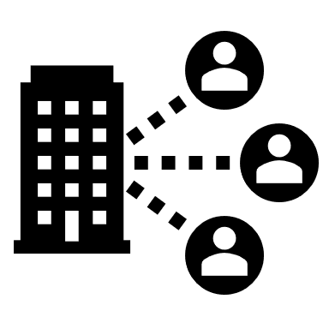
Troubleshoot user profile issues

Slide 21
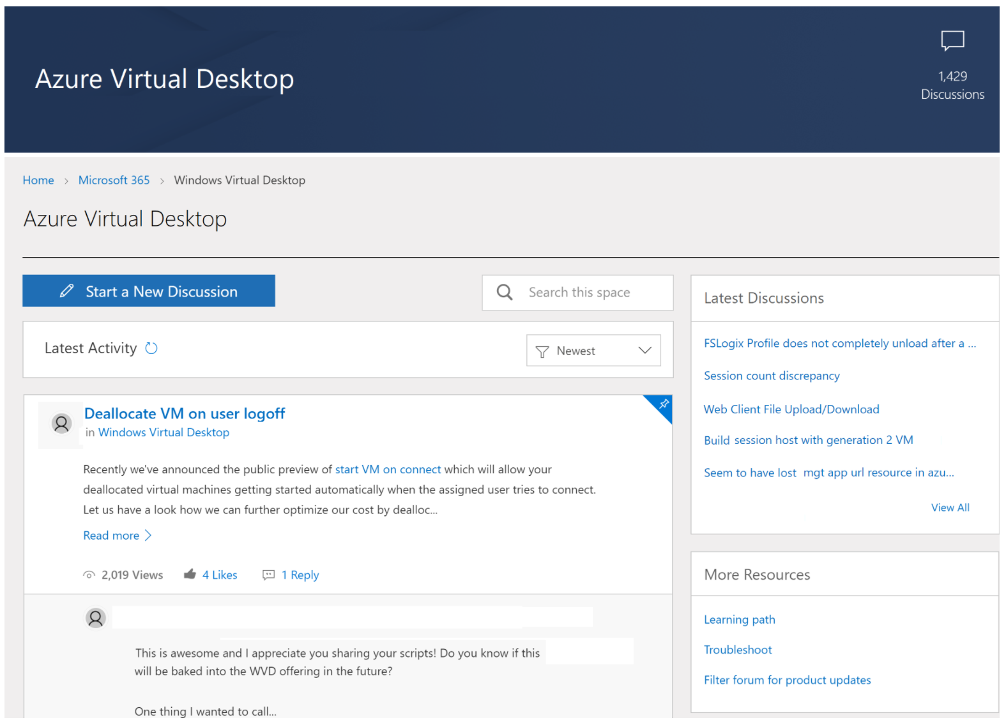
Troubleshoot user profile issues
To report issues or suggest features for Azure Virtual Desktop with Azure Resource Manager integration, visit the Azure Virtual Desktop Tech Community.
Use the Tech Community to discuss best practices or suggest and vote for new features.
When you make a post asking for help or propose a new feature, make sure you describe your topic in as much detail as possible.
Notes:
This unit provides an overview of the issues you may encounter when setting up an Azure Virtual Desktop environment and provides ways to resolve the issues.
Report issues
To report issues or suggest features for Azure Virtual Desktop with Azure Resource Manager integration, visit the Azure Virtual Desktop Tech Community.

Slide 22

Troubleshoot Azure Virtual Desktop clients

Slide 23
Troubleshoot Azure Virtual Desktop clients
Remote Desktop client for Windows 10 stops responding or cannot be opened
You can reset the user data from the About page or using a command.
Use the following command to remove your user data, restore default settings and unsubscribe from all Workspaces.
msrdcw.exe /reset [/f]
Web client won't open
First, test your internet connection by opening another website in your browser.
Use nslookup to confirm DNS can resolve the FQDN:
nslookup rdweb.WVD.microsoft.com
Try connecting with another client (eg, Remote Desktop client for Windows 10) to see if you can open the web client.
Web client keeps prompting for credentials
If the Web client keeps prompting for credentials, follow these instructions:
Confirm the web client URL is correct.
Confirm that the credentials you're using are for the Azure Virtual Desktop environment tied to the URL.
Clear browser cookies.
Clear browser cache.
Open your browser in Private mode.
Notes:
This unit describes common issues with the Remote Desktop client and how to fix them.

Slide 24
Knowledge check and Summary
Check your knowledge
What you learned:
Configure user settings through group policies for Azure Virtual Desktop.
Configure user settings through Endpoint Manager policies for Azure Virtual Desktop.
Configure session timeout properties for Azure Virtual Desktop.
Configure device redirections for Azure Virtual Desktop.
Configure Universal Print.
Troubleshoot user profile issues.
Notes:
What you learned:
Configure user settings through group policies for Azure Virtual Desktop.
Configure user settings through Endpoint Manager policies for Azure Virtual Desktop.
Configure session timeout properties for Azure Virtual Desktop.
Configure device redirections for Azure Virtual Desktop.
Configure Universal Print.
Troubleshoot user profile issues.

Slide 25

End of presentation

