Slide 1
AZ-140T00A Configuring and Operating Azure Virtual Desktop

Slide 2

Install and configure apps on a session host
Notes:
MSIX app attach is a way to deliver MSIX applications to both physical and virtual machines. MSIX app attach is different from regular MSIX because it’s specifically for Azure Virtual Desktop.
Learning objectives
After completing this section, you'll be able to:
Describe MSIX app attach for Azure Virtual Desktop.
Explain how MSIX app attach works.
Set up a file share for MSIX app attach.
Use the OneDrive sync app on Azure Virtual Desktops.
Use Microsoft Teams on Azure Virtual Desktop.
Publish built-in apps in Azure Virtual Desktop.
Prerequisites
Working experience with data integration solutions.
Conceptual knowledge of data integration solutions.

Slide 3
Introduction
MSIX app attach
How MSIX app attach works
Set up a file share for MSIX app attach
How MSIX app attach works
Using the OneDrive sync app on virtual desktops
Using Microsoft Teams on Azure Virtual desktop
Publish built-in apps in Azure Virtual Desktop
Troubleshoot application issues for Azure Virtual Desktop
AZ-140: Manage user environments and apps (20-25%)
Install and configure apps on a session host
Conceptual knowledge of Azure compute solutions.
Working experience with virtual machines, virtual networks, and app service.
Notes:
https://docs.microsoft.com/en-us/learn/certifications/exams/az-140
Prerequisites
Conceptual knowledge of Azure compute solutions.
Working experience with virtual machines, virtual networks, and app service.

Slide 4

MSIX app attach

Slide 5
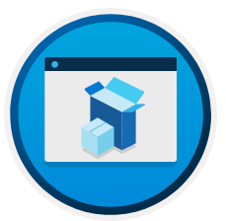
MSIX app attach
The MSIX package format preserves the functionality of existing app packages and/or install files in addition to enabling new, modern packaging and deployment features to Win32, WPF, and Windows Forms apps.
MSIX app attach is a way to deliver MSIX applications to both physical and virtual machines.
MSIX app attach is different from regular MSIX because it's made especially for Azure Virtual Desktop.
In an Azure Virtual Desktop deployment, MSIX app attach can:
Create separation between user data, the OS, and apps by using MSIX containers.
Remove the need for repackaging when delivering applications dynamically.
Reduce the time it takes for a user to sign in.
Notes:
MSIX is a Windows app package format that provides a modern packaging experience to all Windows apps. The MSIX package format preserves the functionality of existing app packages and/or install files in addition to enabling new, modern packaging and deployment features to Win32, WPF, and Windows Forms apps.
MSIX app attach is a way to deliver MSIX applications to both physical and virtual machines. However, MSIX app attach is different from regular MSIX because it's made especially for Azure Virtual Desktop.
Application delivery options in Azure Virtual Desktop
You can deliver apps in Azure Virtual Desktop through one of the following methods:
Put apps in a master image
Use tools like SCCM or Intune for central management
Dynamic app provisioning (AppV, VMWare AppVolumes, or Citrix AppLayering)
Create custom tools or scripts using Microsoft and a third-party tool
What does MSIX app attach do?
In an Azure Virtual Desktop deployment, MSIX app attach can:
Create separation between user data, the OS, and apps by using MSIX containers.
Remove the need for repackaging when delivering applications dynamically.
Reduce the time it takes for a user to sign in.
Reduce infrastructure requirements and cost.

Slide 6

How MSIX app attach works

Slide 7
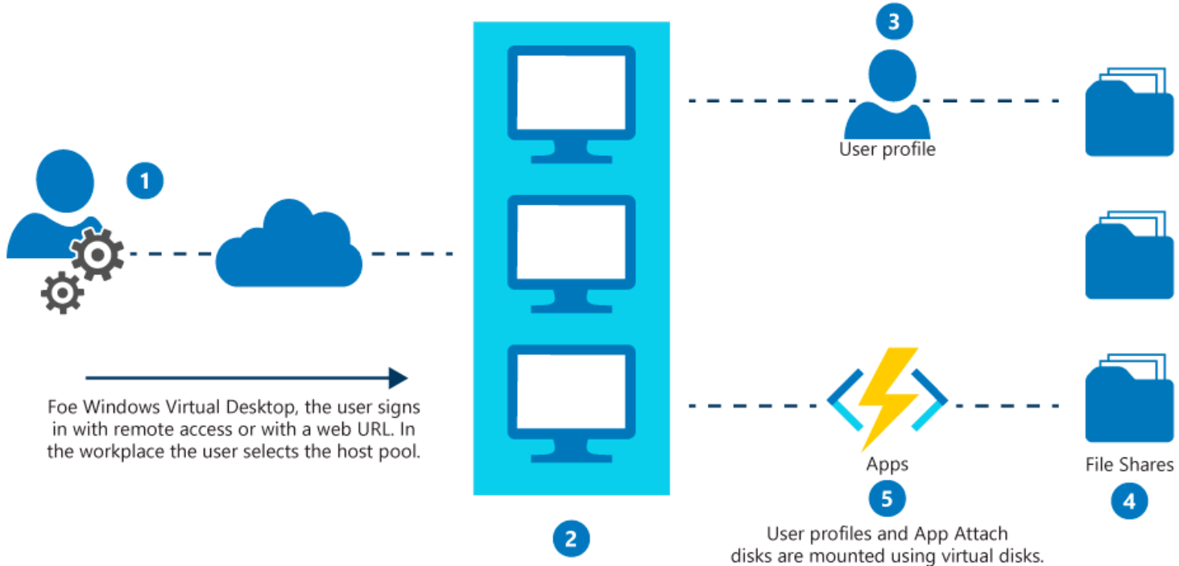
How MSIX app attach works
From the Azure Virtual Desktop client, you sign in and select the host pool for which you have access.
You're assigned a virtual machine within the host pool, on which a RemoteApp or Remote Desktop session is created.
If the user profile is configured, the FSLogix agent on the session host provides the user profile from the file share.
Applications that are assigned to you are read from Azure Virtual Desktop.
MSIX app attach applications are registered to the virtual machine for you, from the attached MSIX virtual disk.
Notes:
MSIX app attach stores application files in a separate virtual hard disk from the operating system. It registers the regular MSIX package on a device instead of on a physical download and installation. The registration uses existing Windows APIs and has minimal impact on user sign-in times, which enhances the user experience.
When you open MSIX app attach, the application files are accessed from a VHD. You're not even aware that the application isn't locally installed.
After you open MSIX app attach, you experience the following process:
From the Azure Virtual Desktop client, you sign in and select the host pool for which you have access. The process is similar to opening published RemoteApp programs from the Azure Virtual Desktop environment.
You're assigned a virtual machine within the host pool, on which a RemoteApp or Remote Desktop session is created. The Azure Virtual Desktop client interacts with that session.
If the user profile is configured, the FSLogix agent on the session host provides the user profile from the file share. The file share can be Azure Files, Azure NetApp Files, or an infrastructure as a service (IaaS) file server.
Applications that are assigned to you are read from Azure Virtual Desktop.
MSIX app attach applications are registered to the virtual machine for you, from the attached MSIX virtual disk. That virtual disk might be on an IaaS file share, Azure Files, or Azure NetApp Files.

Slide 8

Set up a file share for MSIX app attach

Slide 9
Set up a file share for MSIX app attach
To optimize MSIX app attach performance:
The storage for MSIX app attach should be in the same datacenter location as the session hosts.
To prevent bottlenecks, exclude the following VHD, VHDX, and CIM files from antivirus scans:
<MSIXAppAttachFileShare\>\*.VHD
<MSIXAppAttachFileShare\>\*.VHDX
\\storageaccount.file.core.windows.net\share*.VHD
\\storageaccount.file.core.windows.net\share*.VHDX
<MSIXAppAttachFileShare>.CIM
\\storageaccount.file.core.windows.net\share**.CIM
Separate the storage fabric for MSIX app attach from FSLogix profile containers.
All VM system accounts and user accounts must have read-only permissions to the file share.
Disaster recovery plans must include replicating the MSIX app attach file share in your secondary failover location.
Notes:
To optimize MSIX app attach performance:
The storage for MSIX app attach should be in the same datacenter location as the session hosts.
To prevent bottlenecks, exclude the following VHD, VHDX, and CIM files from antivirus scans:
<MSIXAppAttachFileShare\>\*.VHD
<MSIXAppAttachFileShare\>\*.VHDX
\\storageaccount.file.core.windows.net\share*.VHD
\\storageaccount.file.core.windows.net\share*.VHDX
<MSIXAppAttachFileShare>.CIM
\\storageaccount.file.core.windows.net\share**.CIM
Separate the storage fabric for MSIX app attach from FSLogix profile containers.
All VM system accounts and user accounts must have read-only permissions to the file share.
Disaster recovery plans must include replicating the MSIX app attach file share in your secondary failover location.

Slide 10
Upload MSIX images to Azure NetApp Files in Azure Virtual Desktop

Slide 11
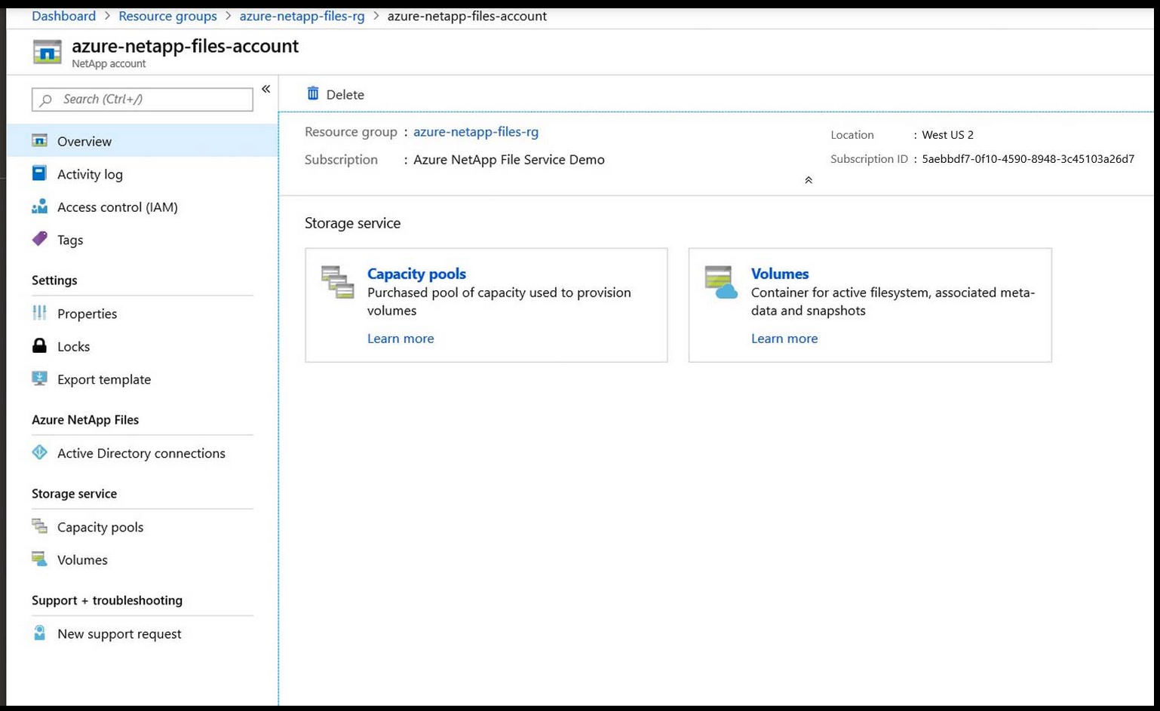
Before you can start uploading the images, you'll need to set up Azure NetApp Files.
To start using Azure NetApp Files:
Set up your Azure NetApp Files account.
Create a capacity pool.
Join an Azure Active Directory (Azure AD) connection.
Create a new volume.
Make sure your connection to the Azure NetApp Files share works.
Notes:
To start using Azure NetApp Files:
Set up your Azure NetApp Files account by following the instructions in Set up your Azure NetApp Files account.
Create a capacity pool by following the instructions in Set up a capacity pool.
Join an Azure Active Directory (Azure AD) connection by following the instructions in Join an Active Directory connection.
Create a new volume by following the instructions in Create a new volume and Configure volume access parameters.
Make sure your connection to the Azure NetApp Files share works by following the instructions in Make sure users can access the Azure NetApp Files share.
With Azure NetApp Files share setup, you can start uploading images to it.
To upload an MSIX image to your Azure NetApp Files share:
In each session host, install the certificate that you signed the MSIX package with. Make sure to store the certificates in the folder named Trusted People.
Copy the MSIX image you want to add to the Azure NetApps Files share.
Go to File Explorer and enter the mount path, then paste the MSIX image into the mount path folder.
Your MSIX image should now be accessible to your session hosts when they add an MSIX package using the Azure portal or PowerShell.

Slide 12

How to configure apps for users

Slide 13
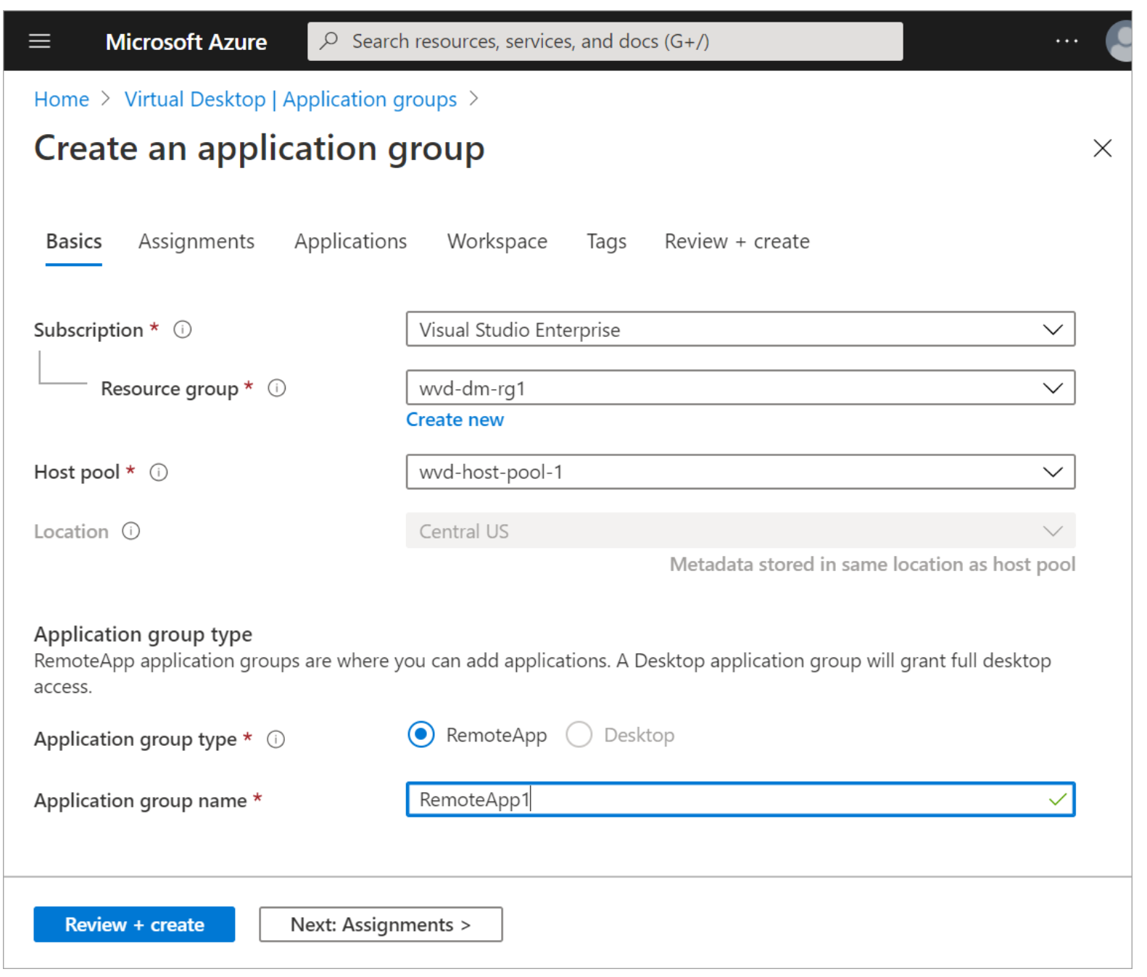
Configure apps for users
In this demonstration you see how to create a RemoteApp application group to share an application to a different user in the organization.
Step 1: Create a RemoteApp application group
Step 2: Add Azure AD users or user groups
Step 3: Add applications
Step 4: Register and create an application group
Step 5: Verify access to application
Notes:
In this unit, you see how to create a RemoteApp application group to share an application to a different user in the organization.
To complete the exercise, you'll need the credentials for a different non-administrative user account that's in Active Directory.

Slide 14

Using the OneDrive sync app on virtual desktops
Notes:
This unit will tell you how to publish apps, such as Microsoft Edge browser, in your Azure Virtual Desktop environment.

Slide 15
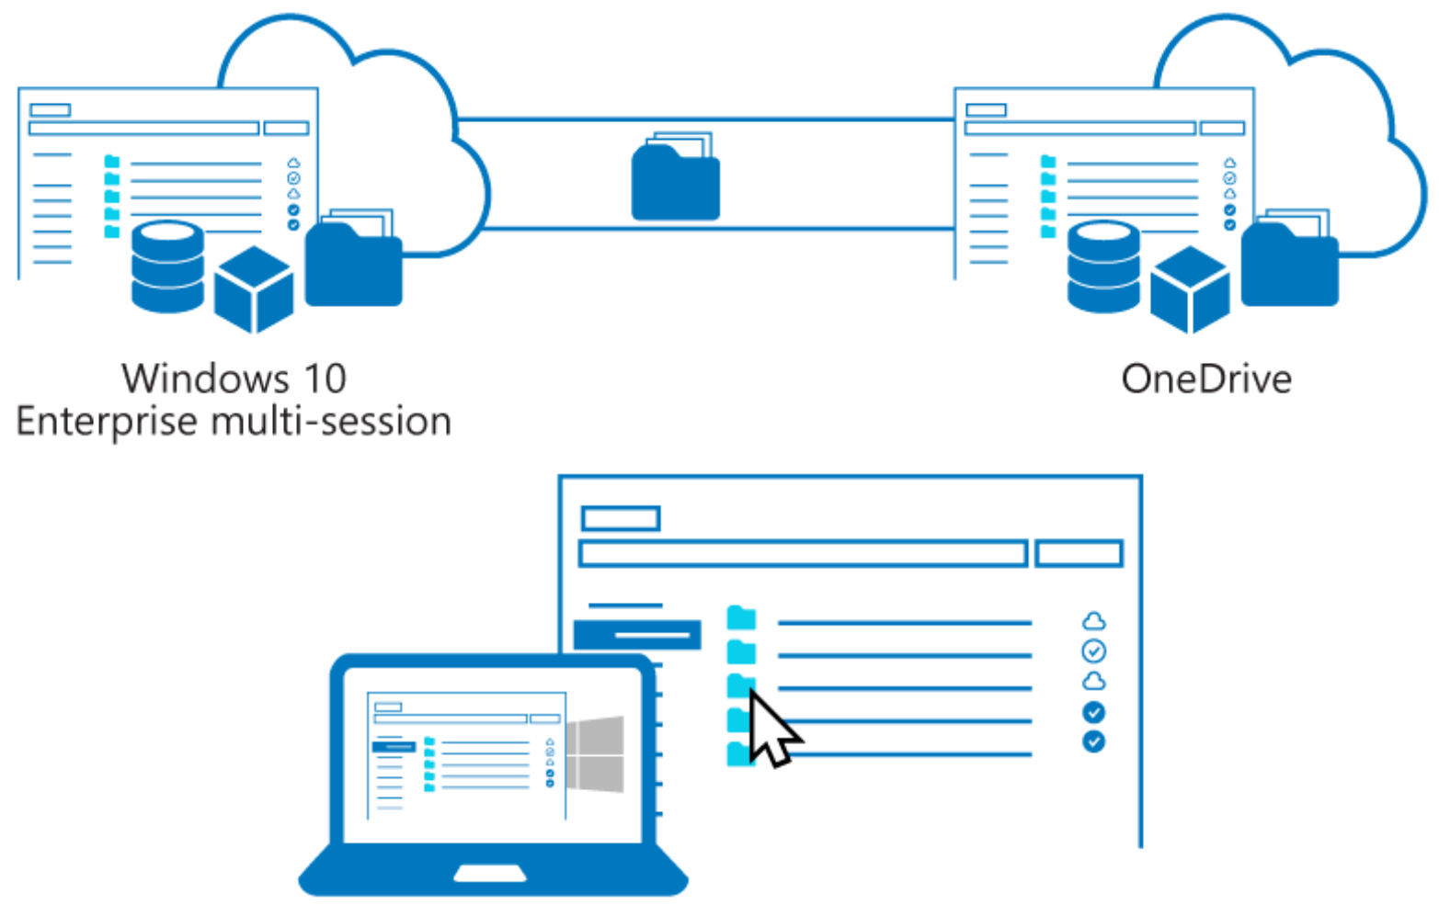
Using the OneDrive sync app on virtual desktops
The OneDrive sync per machine app provides:
Automatic transitioning from the previous OneDrive for Business sync app
Automatic conversion from per-user to per-machine
Automatic updates when a new version is available
Notes:
For all supported operating systems, the OneDrive sync app supports:
Virtual desktops that persist between sessions.
Non-persistent virtual desktops that use Azure Virtual Desktop .
Non-persistent virtual desktops that have FSLogix Apps or FSLogix Office Container , and a Microsoft 365 subscription for all of the following operating systems:
Windows 10, 32 or 64-bit (supports VHDX files)
Windows 7, 32 or 64-bit (supports VHD files)
Windows Server 2019 (supports VHDX)
Windows Server 2016 (supports VHDX)
Windows Server 2012 R2 (supports VHDX)
Windows Server 2008 R2 (supports VHD)
Install the OneDrive sync app per machine
By default, the OneDrive sync app installs per user, meaning OneDrive.exe needs to be installed for each user account on the PC under the %localappdata% folder. With the new per-machine installation option, you can install OneDrive under the Program Files (x86) or Program Files directory, meaning all profiles on the computer will use the same OneDrive.exe binary. Other than where the sync app is installed, the behavior is the same.
The new per-machine sync app provides:
Automatic conversion from per-user to per-machine
Automatic updates when a new version is available
The per-machine sync app supports syncing OneDrive files in Microsoft 365 and in SharePoint Server 2019.

Slide 16

Using Microsoft Teams on Azure Virtual desktop

Slide 17
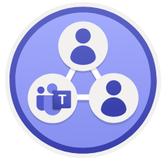
Using Microsoft Teams on Azure Virtual desktop
Media optimization for Microsoft Teams is only available for the Windows Desktop client on Windows 10 machines.
Microsoft Teams on Azure Virtual Desktop supports chat and collaboration.
With media optimizations, it also supports calling and meeting functionality.
With media optimization for Microsoft Teams, the Windows Desktop client handles audio and video locally for Teams calls and meetings.
You can still use Microsoft Teams on Azure Virtual Desktop with other clients without optimized calling and meetings.
Teams chat and collaboration features are supported on all platforms.
Notes:
Media optimization for Microsoft Teams is only available for the Windows Desktop client on Windows 10 machines.
Microsoft Teams on Azure Virtual Desktop supports chat and collaboration. With media optimizations, it also supports calling and meeting functionality.
With media optimization for Microsoft Teams, the Windows Desktop client handles audio and video locally for Teams calls and meetings. You can still use Microsoft Teams on Azure Virtual Desktop with other clients without optimized calling and meetings.
Teams chat and collaboration features are supported on all platforms. To redirect local devices in your remote session, check out Customize Remote Desktop Protocol properties for a host pool.
Before you can use Microsoft Teams on Azure Virtual Desktop:
Install the Windows Desktop client on a Windows 10 or Windows 10 IoT Enterprise.
Connect to a Windows 10 Multi-session or Windows 10 Enterprise virtual machine (VM).

Slide 18
Publish built-in apps in Azure Virtual Desktop

Slide 19
Publish built-in apps in Azure Virtual Desktop
To publish a built-in app:
Connect to one of the virtual machines in your host pool.
Get the PackageFamilyName of the app you want to publish by following the instructions in this article .
Run the following cmdlet with <PackageFamilyName> replaced by the PackageFamilyName you found in the previous step:
New-AzWvdApplication -Name <applicationname> -ResourceGroupName <resourcegroupname> -ApplicationGroupName <appgroupname> -FilePath "shell:appsFolder\<PackageFamilyName>!App" -CommandLineSetting <Allow|Require|DoNotAllow> -IconIndex 0 -IconPath <iconpath> -ShowInPortal:$true
Azure Virtual Desktop only supports publishing apps with install locations that begin with C:\Program Files\WindowsApps.
Notes:
This unit will tell you how to publish apps, such as Microsoft Edge browser, in your Azure Virtual Desktop environment.

Slide 20

Troubleshoot application issues for Azure Virtual Desktop

Slide 21
The User Input Delay counter can help identify the root cause for bad end user RDP experiences.
The counter measures how long any user input remains in the queue before it is picked up by a process.
The User Input Delay counter measures the max delta between the input being queued and when it's picked up by the app in a message loop.
Notes:
One of the most difficult problems to diagnose is poor application performance—the applications are running slow or don't respond.
You start your diagnosis by collecting CPU, memory, disk input/output, and other metrics and then use tools to figure out what's causing the problem. Unfortunately, in most situations this data doesn't help you identify the root cause because resource consumption counters have frequent and large variations.
The User Input Delay counter can help you quickly identify the root cause for bad end-user RDP experiences. This counter measures how long any user input (such as mouse or keyboard usage) stays in the queue before it is picked up by a process, and the counter works in both local and remote sessions.
The image shows a user input flow from client to application.

Slide 22
Knowledge check and Summary
Check your knowledge
What you learned:
Describe MSIX app attach for Azure Virtual Desktop.
Explain how MSIX app attach works.
Set up a file share for MSIX app attach.
Use the OneDrive sync app on Azure Virtual Desktops.
Use Microsoft Teams on Azure Virtual Desktop.
Publish built-in apps in Azure Virtual Desktop.
Notes:
What you learned:
Describe MSIX app attach for Azure Virtual Desktop.
Explain how MSIX app attach works.
Set up a file share for MSIX app attach.
Use the OneDrive sync app on Azure Virtual Desktops.
Use Microsoft Teams on Azure Virtual Desktop.
Publish built-in apps in Azure Virtual Desktop.

Slide 23
Lab - Implement and manage Azure Virtual Desktop profiles (Azure AD DS)
Lab Dependencies:
A Microsoft account or an Azure AD account with the Global Administrator role in the Azure AD tenant associated with the Azure subscription and with the Owner or Contributor role in the Azure subscription
An Azure Virtual Desktop environment provisioned in the lab Introduction to Azure Virtual Desktop (Azure AD DS)
Estimated time: 30 minutes
Lab - Implement and manage Azure Virtual Desktop profiles (Azure AD DS)

Slide 24
Lab - Package Azure Virtual Desktop applications (AD DS)
Lab Dependencies:
A Microsoft account or an Azure AD account with the Global Administrator role in the Azure AD tenant associated with the Azure subscription and with the Owner or Contributor role in the Azure subscription
The completed lab Prepare for deployment of Azure Virtual Desktop (AD DS) or Prepare for deployment of Azure Virtual Desktop (Azure AD DS)
The completed lab Azure Virtual Desktop profile management (AD DS) or Azure Virtual Desktop profile management (Azure AD DS)
Estimated time: 90 minutes
Lab - Package Azure Virtual Desktop applications (AD DS).

Slide 25

End of presentation

