Slide 1
AZ-140T00A Configuring and Operating Azure Virtual Desktop

Slide 2

Plan for disaster recovery
Notes:
You can replicate your virtual machines to the secondary location for Azure Virtual Desktop. You use Azure Site Recovery to manage replicating virtual machines in other Azure locations.
Learning objectives
After completing this section, you'll be able to:
Configure virtual machine replication for Azure Virtual Desktop.
Configure FSLogix for multiple profile locations.
Prerequisites
Conceptual knowledge of Azure compute solutions.
Working experience with virtual machines, containers, and app service.

Slide 3
Introduction
Disaster Recovery for Azure Virtual Desktop
Virtual Machine (VM) replication
FSLogix configuration
AZ-140: Monitor and maintain an Azure Virtual Desktop infrastructure (20-25%)
Plan and implement business continuity and disaster recovery
Conceptual knowledge of Azure compute solutions.
Working experience with virtual machines, virtual networks, and app service.
Notes:
https://docs.microsoft.com/en-us/learn/certifications/exams/az-140
Prerequisites
Conceptual knowledge of Azure compute solutions.
Working experience with virtual machines, virtual networks, and app service.

Slide 4

Disaster Recovery for Azure Virtual Desktop

Slide 5
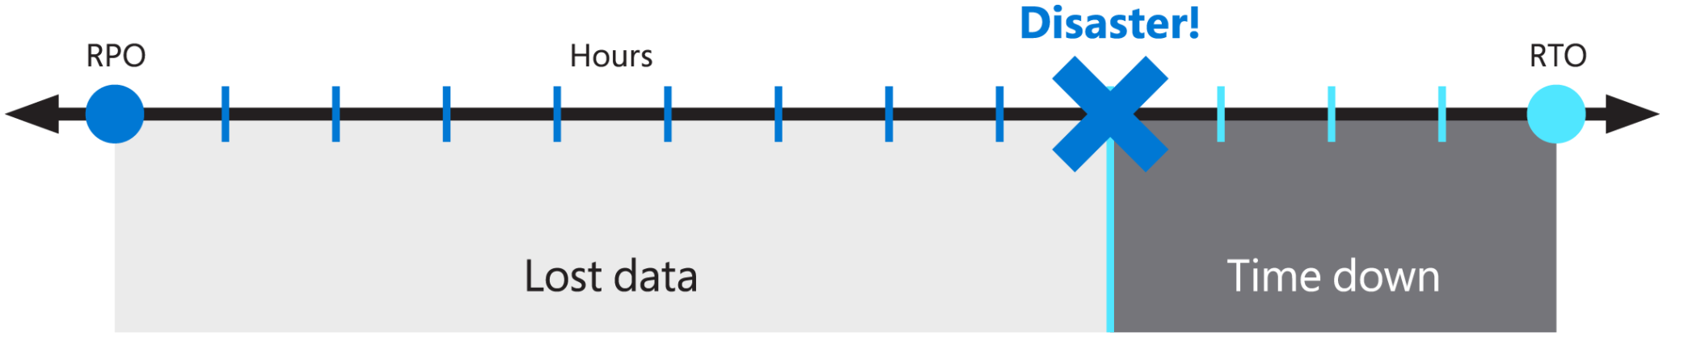
Disaster recovery for Azure Virtual Desktop
The Azure Virtual Desktop service offers BCDR to preserve customer metadata during outages.
When an outage occurs in an Azure region, the service infrastructure components will failover to a secondary location and continue functioning as expected.
For users can connect during an Azure region outage, you may need to replicate personal VMs to a different Azure region (the secondary location).
During outages, the primary region fails over to the replicated VMs in the secondary location.
Users can continue to access apps from the secondary location without interruption.
Notes:
To strengthen your organization’s Azure Virtual Desktop availability and to keep data safe, you should implement a business continuity and disaster recovery (BCDR) strategy. A good BCDR strategy keeps your apps and workloads up and running during planned and unplanned service or Azure outages. The graphic shows the recovery point objective (RPO) as the loss of data and the recovery time objective (RTO) as the time to recover from a disaster.
The Azure Virtual Desktop service offers BCDR to preserve customer metadata during outages. When an outage occurs in an Azure region, the service infrastructure components will failover to a secondary location and continue functioning as expected.
To make sure your users can still connect during an Azure region outage, you may need to replicate personal VMs to a different Azure region (the secondary location). During outages, the primary region fails over to the replicated VMs in the secondary location. Users can continue to access apps from the secondary location without interruption. In addition to VM replication, you’ll need to ensure user identities are accessible at the secondary location. Accessible identities can be achieved by using profile containers. You may also use multiple Pooled host pools with automated provisioning across regions as an alternative to VM replication.

Slide 6

Virtual Machine (VM) replication

Slide 7

VM replication
First, you'll need to replicate your VMs to the secondary location.
Options depend on how your VMs are configured:
You can configure all VMs for both pooled and personal host pools with Azure Site Recovery. You'll only need to set up one host pool and its related app groups and workspaces.
You can create a new host pool in the failover region while keeping all resources in your failover location turned off.
You need to set up new app groups and workspaces in the failover region, then use an Azure Site Recovery plan to turn host pools on.
You can create a host pool that's populated by VMs built in both the primary and failover regions while keeping the VMs in the failover region turned off.
Notes:
You'll need to replicate your VMs to the secondary location for Azure Virtual Desktop. Your options for doing so depend on how your VMs are configured:
You can configure all your VMs for both pooled and personal host pools with Azure Site Recovery. With this method, you'll only need to set up one host pool and its related app groups and workspaces.
You can create a new host pool in the failover region while keeping all resources in your failover location turned off.
You need to set up new app groups and workspaces in the failover region, then use an Azure Site Recovery plan to turn on host pools.
You can create a host pool that's populated by VMs built in both the primary and failover regions while keeping the VMs in the failover region turned off.
You only need to set up one host pool and its related app groups and workspaces.
You can use an Azure Site Recovery plan to power on host pools with this method.
Use Azure Site Recovery to manage replicating VMs in other Azure locations, as described in Azure-to-Azure disaster recovery architecture.
Set up Azure Site Recovery by replicating an Azure VM to a different Azure region directly from the Azure portal. Site Recovery is automatically updated with new Azure features as they’re released.

Slide 8

FSLogix configuration

Slide 9
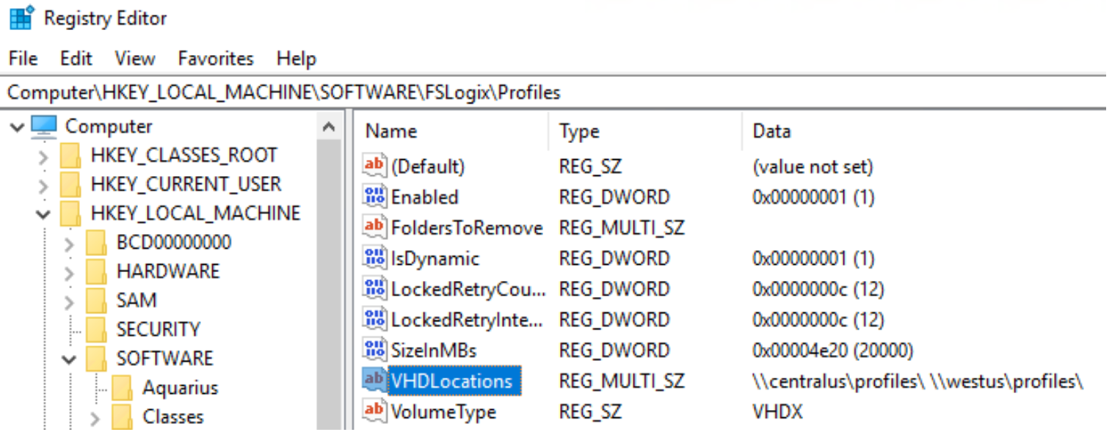
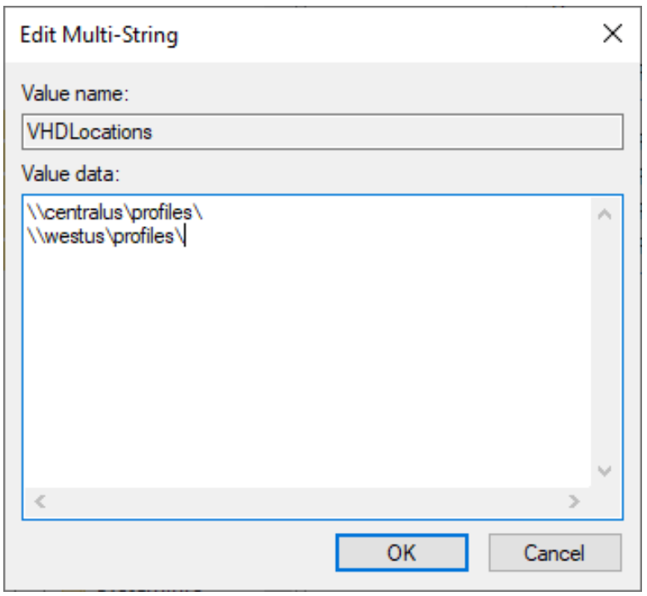
FSLogix configuration
The FSLogix agent can support multiple profile locations if you configure the registry entries for FSLogix.

Slide 10
Knowledge check and Summary
Check your knowledge
What you learned:
Configure virtual machine (VM) replication for Azure Virtual Desktop.
Configure FSLogix for multiple profile locations.
Notes:
What you learned:
Configure virtual machine (VM) replication for Azure Virtual Desktop.
Configure FSLogix for multiple profile locations.

Slide 11
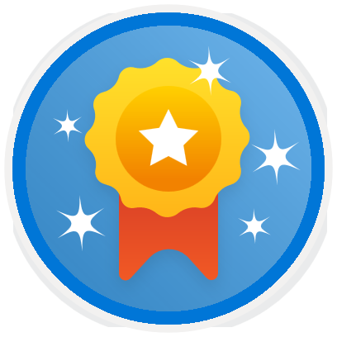
End of presentation

