Slide 1
AZ-140T00A Configuring and Operating Azure Virtual Desktop

Slide 2

Automate Azure Virtual Desktop management tasks
Notes:
Reduce Azure Virtual Desktop deployment costs by scaling virtual machines (VMs). This means shutting down and deallocating session host VMs during off-peak usage hours, then turning them back on and reallocating them during peak hours.
Learning objectives
After completing this section, you'll be able to:
Describe how to scale session hosts using Azure Automation.
Create or update an Azure Automation account.
Create an Azure Automation Run As account.
Create the Azure Logic App and execution schedule.
Prerequisites
Working experience with developing cloud applications.
Conceptual knowledge of messaging, events, API management, and app caching.

Slide 3
Introduction
Scale session hosts using Azure Automation
Create or update an Azure Automation account
Create or update an Azure Automation account
Create the Azure Logic App and execution
AZ-140: Monitor and maintain an Azure Virtual Desktop infrastructure (20-25%)
Automate Azure Virtual Desktop management tasks
Conceptual knowledge of Azure compute solutions.
Working experience with virtual machines, virtual networks, and app service.
Notes:
https://docs.microsoft.com/en-us/learn/certifications/exams/az-140
Prerequisites
Conceptual knowledge of Azure compute solutions.
Working experience with virtual machines, virtual networks, and app service.

Slide 4

Scale session hosts using Azure Automation

Slide 5
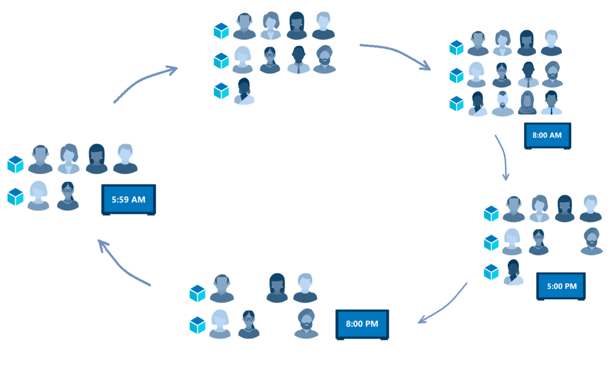

Scale session hosts using Azure Automation
Notes:
You can reduce your total Azure Virtual Desktop deployment cost by scaling your virtual machines. This means shutting down and deallocating session host VMs during off-peak usage hours, then turning them back on and reallocating them during peak hours.
As seen in graphic:
Early morning, employees arriving at work (5:59am) -> The scale threshold is met, increased VM allocation to meet demand -> Ideal optimization for VM allocation (8:00am) -> Workday winding down (5:00pm) -> Remaining workers begin leaving for home (8:00am)
How the scaling tool works
The scaling tool provides a low-cost automation option for customers who want to optimize their session host VM costs.
You can use the scaling tool to:
Schedule VMs to start and stop based on Peak and Off-Peak business hours.
Scale out VMs based on number of sessions per CPU core.
Scale in VMs during Off-Peak hours, leaving the minimum number of session host VMs running.
The scaling tool uses a combination of an Azure Automation account, a PowerShell runbook, a webhook, and the Azure Logic App to function. When the tool runs, Azure Logic App calls a webhook to start the Azure Automation runbook. The runbook then creates a job.
During peak usage time, the job checks the current number of sessions and the VM capacity of the current running session host for each host pool.
If the session host VMs can't support existing sessions, the job starts additional session host VMs in the host pool.
During the off-peak usage time, the job determines how many session host VMs should be shut down. The job will set the session host VMs to drain mode to prevent new sessions from connecting to the hosts.
The job will notify any currently signed in users to save their work, wait the configured amount of time, and then force the users to sign out.
Once all user sessions on the session host VM have been signed out, the job will shut down the VM.
After the VM shuts down, the job will reset its session host drain mode.

Slide 6

Create or update an Azure Automation account

Slide 7
Create or update an Azure Automation account
To download the script for creating the Azure Automation account, run:
New-Item -ItemType Directory -Path "C:\Temp" -Force
Set-Location -Path "C:\Temp"
$Uri = "https://raw.githubusercontent.com/Azure/RDS-Templates/master/AVD-templates/AVD-scaling-script/CreateOrUpdateAzAutoAccount.ps1"
# Download the script
Invoke-WebRequest -Uri $Uri -OutFile ".\CreateOrUpdateAzAutoAccount.ps1"
To execute the script and create the Azure Automation account, run:
$Params = @{
"AADTenantId" = "<Azure_Active_Directory_tenant_ID>" # Optional. If not specified, it will use the current Azure context
"SubscriptionId" = "<Azure_subscription_ID>" # Optional. If not specified, it will use the current Azure context
"UseARMAPI" = $true
"ResourceGroupName" = "<Resource_group_name>" # Optional. Default: "AVDAutoScaleResourceGroup"
"AutomationAccountName" = "<Automation_account_name>" # Optional. Default: "AVDAutoScaleAutomationAccount"
"Location" = "<Azure_region_for_deployment>"
"WorkspaceName" = "<Log_analytics_workspace_name>" # Optional. If specified, Log Analytics will be used to configure the custom log table that the runbook PowerShell script can send logs to
}
.\CreateOrUpdateAzAutoAccount.ps1 @Params
Note: To setup a standalone automation account and Run As account using the Azure portal, see Create a standalone Azure Automation account.
Notes:
You'll need an Azure Automation account to run the PowerShell runbook. The process this section describes is useful even if you have an existing Azure Automation account that you want to use to set up the PowerShell runbook.

Slide 8

Create an Azure Automation Run As account

Slide 9
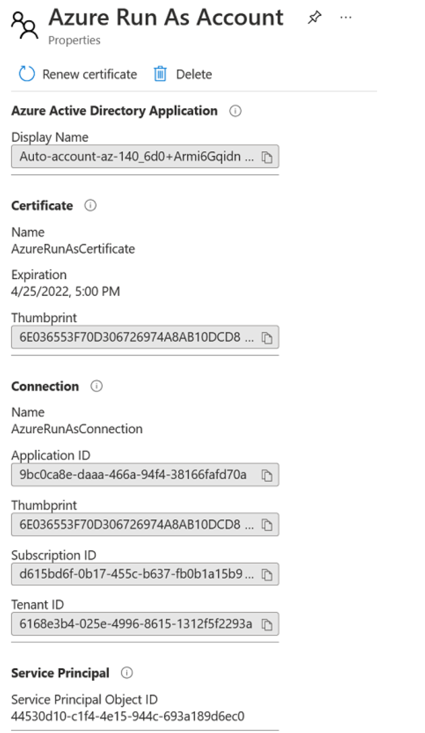
Create an Azure Automation account and Run As account
An Azure Automation Run As account provides authentication for managing resources in Azure with Azure cmdlets.
When you create a Run As account, it creates a new service principal user in Azure Active Directory and assigns the Contributor role to the service principal user at the subscription level.
An Azure Run As account allows you to authenticate securely with certificates and a service principal name without needing to store a username and password in a credential object.
Notes:
With an Automation account, you can authenticate runbooks by managing resources in either Azure Resource Manager or the classic deployment model. One Automation Account can manage resources across all regions and subscriptions for a given tenant.
When you create an Automation account in the Azure portal, the Run As account is automatically created. This account does the following tasks:
Creates a service principal in Azure Active Directory (Azure AD).
Creates a certificate.
Assigns the Contributor role, which manages Azure Resource Manager resources by using runbooks.
Complete procedure at: Scale session hosts Azure Automation Azure Virtual Desktop (classic) - Azure | Microsoft Docs

Slide 10

Create the Azure Logic App and execution

Slide 11
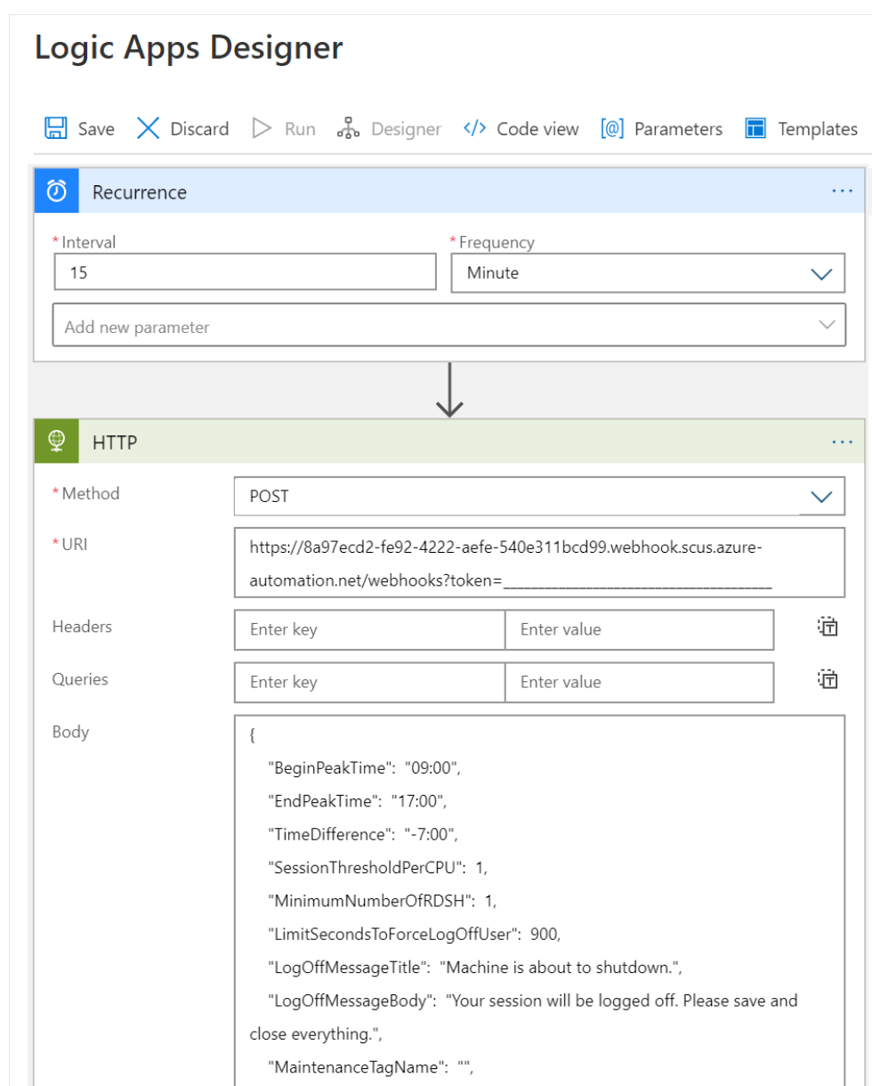
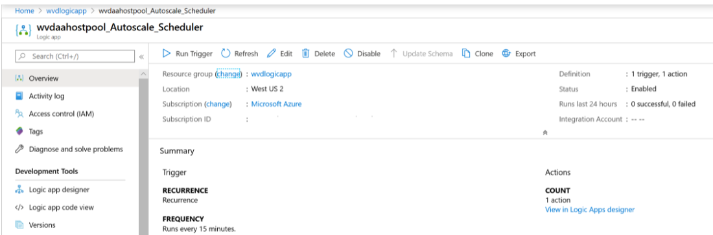
Create the Azure Logic App and execution schedule
Create the Azure Logic App and set up an execution schedule for your new scaling tool.
1. To create the Azure Logic App and execution schedule for a host pool using PowerShell, run the script located at Create the Azure Logic App and execution schedule.
2. To make changes to the execution schedule, open the Logic App and use the Logic Apps Designer.
Notes:
Procedure: Scale session hosts Azure Automation Azure Virtual Desktop (classic) - Azure | Microsoft Docs
You can reduce your total Azure Virtual Desktop deployment cost by scaling your virtual machines (VMs). This means shutting down and deallocating session host VMs during off-peak usage hours, then turning them back on and reallocating them during peak hours.
The scaling tool built with the Azure Automation account and Azure Logic App automatically scales session host VMs in your Azure Virtual Desktop environment.
To make changes to the execution schedule, such as changing the recurrence interval or time zone, go to the Azure Logic App autoscale scheduler and select Edit to go to the Azure Logic App Designer.
Progression:
Create an Azure Automation account
Create an Azure Automation Run As account
Create the Azure Logic App and execution schedule
When the tool runs, Azure Logic App calls a webhook to start the Azure Automation runbook. The runbook then creates a job.

Slide 12
Knowledge check and Summary
Check your knowledge
What you learned:
Describe how to scale session hosts using Azure Automation.
Create or update an Azure Automation account.
Create an Azure Automation Run As account.
Create the Azure Logic App and execution schedule.
Notes:
What you learned:
Describe how to scale session hosts using Azure Automation.
Create or update an Azure Automation account.
Create an Azure Automation Run As account.
Create the Azure Logic App and execution schedule.

Slide 13
Lab - Implement autoscaling in host pools (AD DS)
A Microsoft account or an Azure AD account with the Owner or Contributor role in the Azure subscription you will be using in this lab and with the Global Administrator role in the Azure AD tenant associated with that Azure subscription.
The completed lab Prepare for deployment of Azure Virtual Desktop (AD DS)
The completed lab Deploy host pools and session hosts by using the Azure portal (AD DS)
Estimated time: 60 minutes
Lab - Implement autoscaling in host pools (AD DS).

Slide 14

End of presentation

