Slide 1
AZ-140T00A Configuring and Operating Azure Virtual Desktop

Slide 2

Monitor and manage performance and health
Notes:
For Azure Virtual Desktop issues, check Azure Advisor first. Azure Advisor will give you directions for how to solve the problem, or at least point you towards a resource that can help.
Learning objectives
After completing this section, you'll be able to:
Describe how to monitor Azure Virtual Desktop by using Azure Monitor.
How to use Log Analytics workspace for Azure Monitor.
How to monitor Azure Virtual Desktop by using Azure Advisor.
How to resolve Azure Advisor recommendations.
How to diagnose graphics performance issues.
Prerequisites
Working experience with developing cloud applications.
Conceptual knowledge of messaging, events, and API management.

Slide 3
Introduction
Monitor Azure Virtual Desktop by using Azure Monitor
Log Analytics workspace for Azure Monitor
Monitor Azure Virtual Desktop by using Azure Advisor
How to resolve Azure Advisor recommendations
Diagnose graphics performance issues
AZ-140: Monitor and maintain an Azure Virtual Desktop infrastructure (20-25%)
Monitor and manage performance and health
Conceptual knowledge of Azure compute solutions.
Working experience with virtual machines, virtual networks, and app service.
Notes:
https://docs.microsoft.com/en-us/learn/certifications/exams/az-140
Prerequisites
Conceptual knowledge of Azure compute solutions.
Working experience with virtual machines, virtual networks, and app service.

Slide 4

Monitor Azure Virtual Desktop by using Azure Monitor

Slide 5
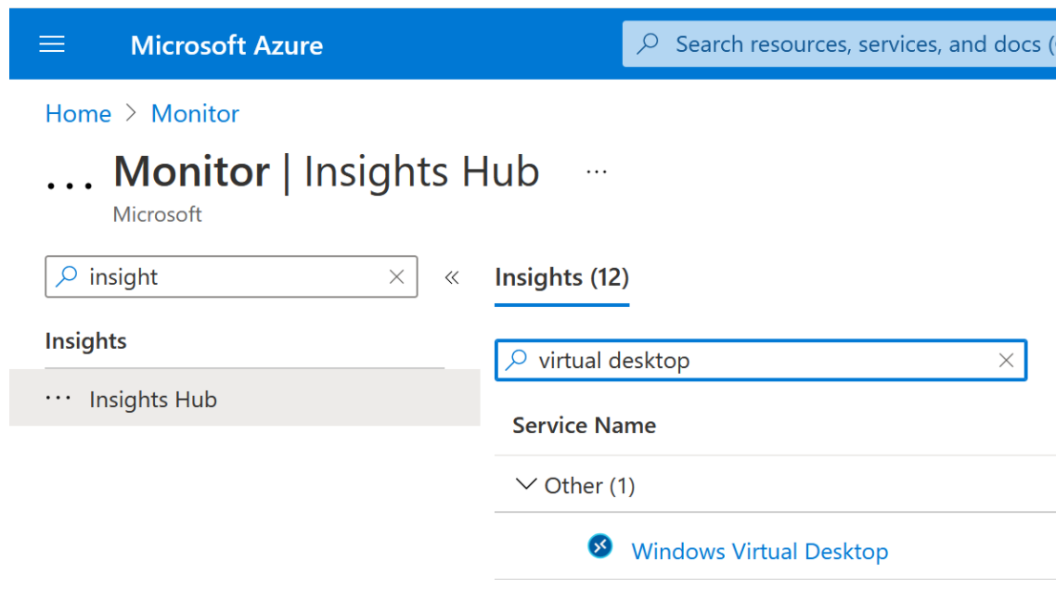
Monitor Azure Virtual Desktop by using Azure Monitor
You can open Azure Monitor for Azure Virtual Desktop by doing the following:
Go to the Azure portal.
Search for and select Monitor from the Azure portal. Select Insights Hub under Insights, then select Azure Virtual Desktop.
Once you have the page open, enter the Subscription, Resource group, Host pool, and Time range of the environment you want to monitor.
Notes:
Before you start using Azure Monitor for Azure Virtual Desktop, you'll need to set up the following things:
At least one configured Log Analytics Workspace. Use a designated Log Analytics workspace for your Azure Virtual Desktop session hosts to ensure that performance counters and events are only collected from session hosts in your Azure Virtual Desktop deployment.
Enable data collection for the following things in your Log Analytics workspace:
Diagnostics from your Azure Virtual Desktop environment
Recommended performance counters from your Azure Virtual Desktop session hosts
Recommended Windows Event Logs from your Azure Virtual Desktop session hosts
You can open Azure Monitor for Azure Virtual Desktop by doing the following:
Go to the Azure portal.
Search for and select Azure Monitor from the Azure portal.
Select Insights Hub under Insights, then select Azure Virtual Desktop.
Once you have the page open, enter the Subscription, Resource group, Host pool, and Time range of the environment you want to monitor.

Slide 6

Log Analytics workspace for Azure Monitor

Slide 7
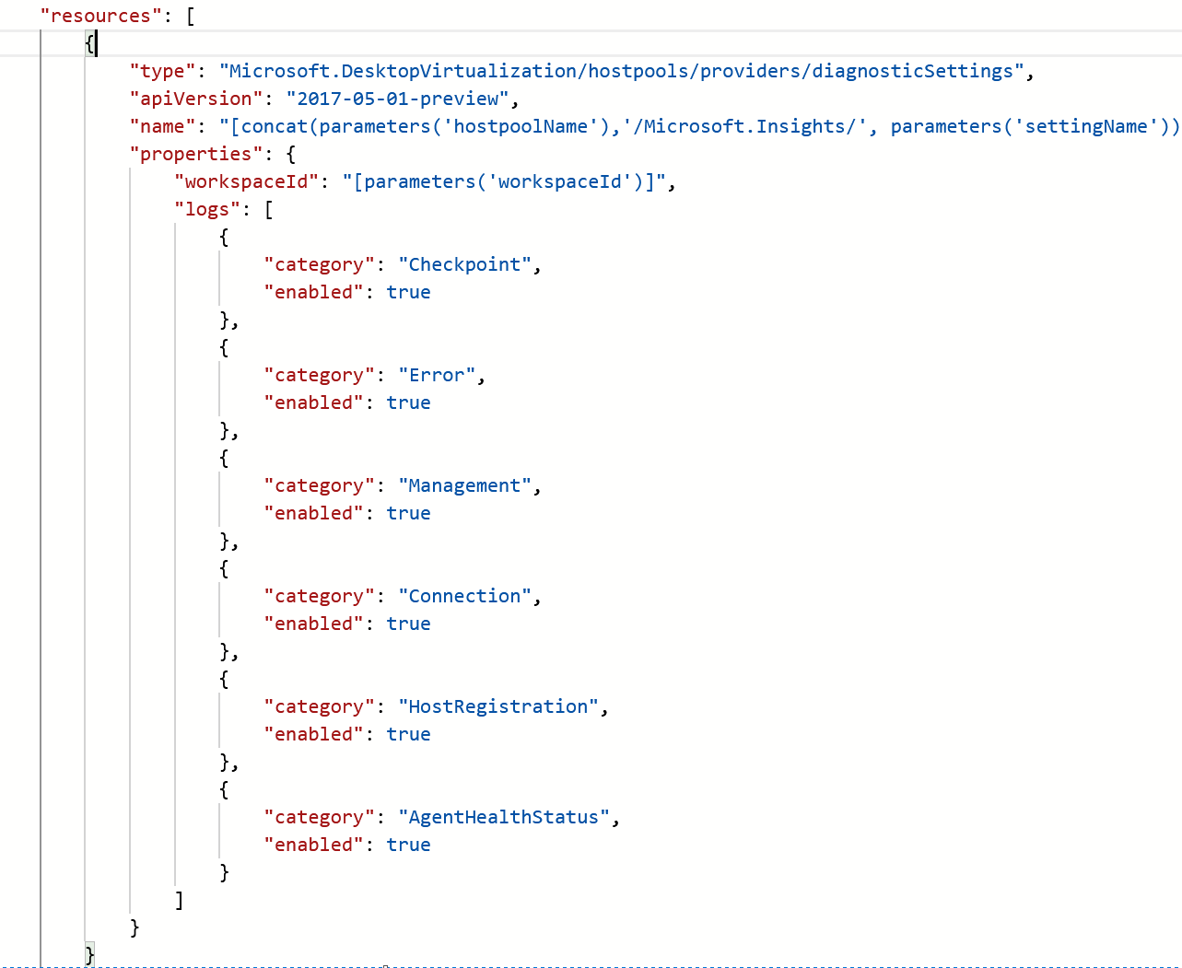
Log Analytics workspace for Azure Monitor
To set up host pool diagnostics using the resource diagnostic settings section in the configuration workbook:
You need to enable the following supported diagnostic tables:
Checkpoint
Error
Management
Connection
HostRegistration
AgentHealthStatus
Notes:
To start using Azure Monitor for Azure Virtual Desktop, you'll need at least one Log Analytics workspace. Use a designated Log Analytics workspace for your Azure Virtual Desktop session hosts to ensure that performance counters and events are only collected form session hosts in your Azure Virtual Desktop deployment.
If it's your first time opening Azure Monitor for Azure Virtual Desktop, you'll need set up Azure Monitor for your Azure Virtual Desktop environment. To configure your resources:
Open Azure Monitor for Azure Virtual Desktop in the Azure portal at aka.ms/azmonwvdi, then select configuration workbook.
Select an environment to configure under Subscription, Resource Group, and Host Pool.
The configuration workbook sets up your monitoring environment and lets you check the configuration after you've finished the setup process. It's important to check your configuration if items in the dashboard aren't displaying correctly, or when the product group publishes updates that require new settings.

Slide 8

Monitor Azure Virtual Desktop by using Azure Advisor

Slide 9
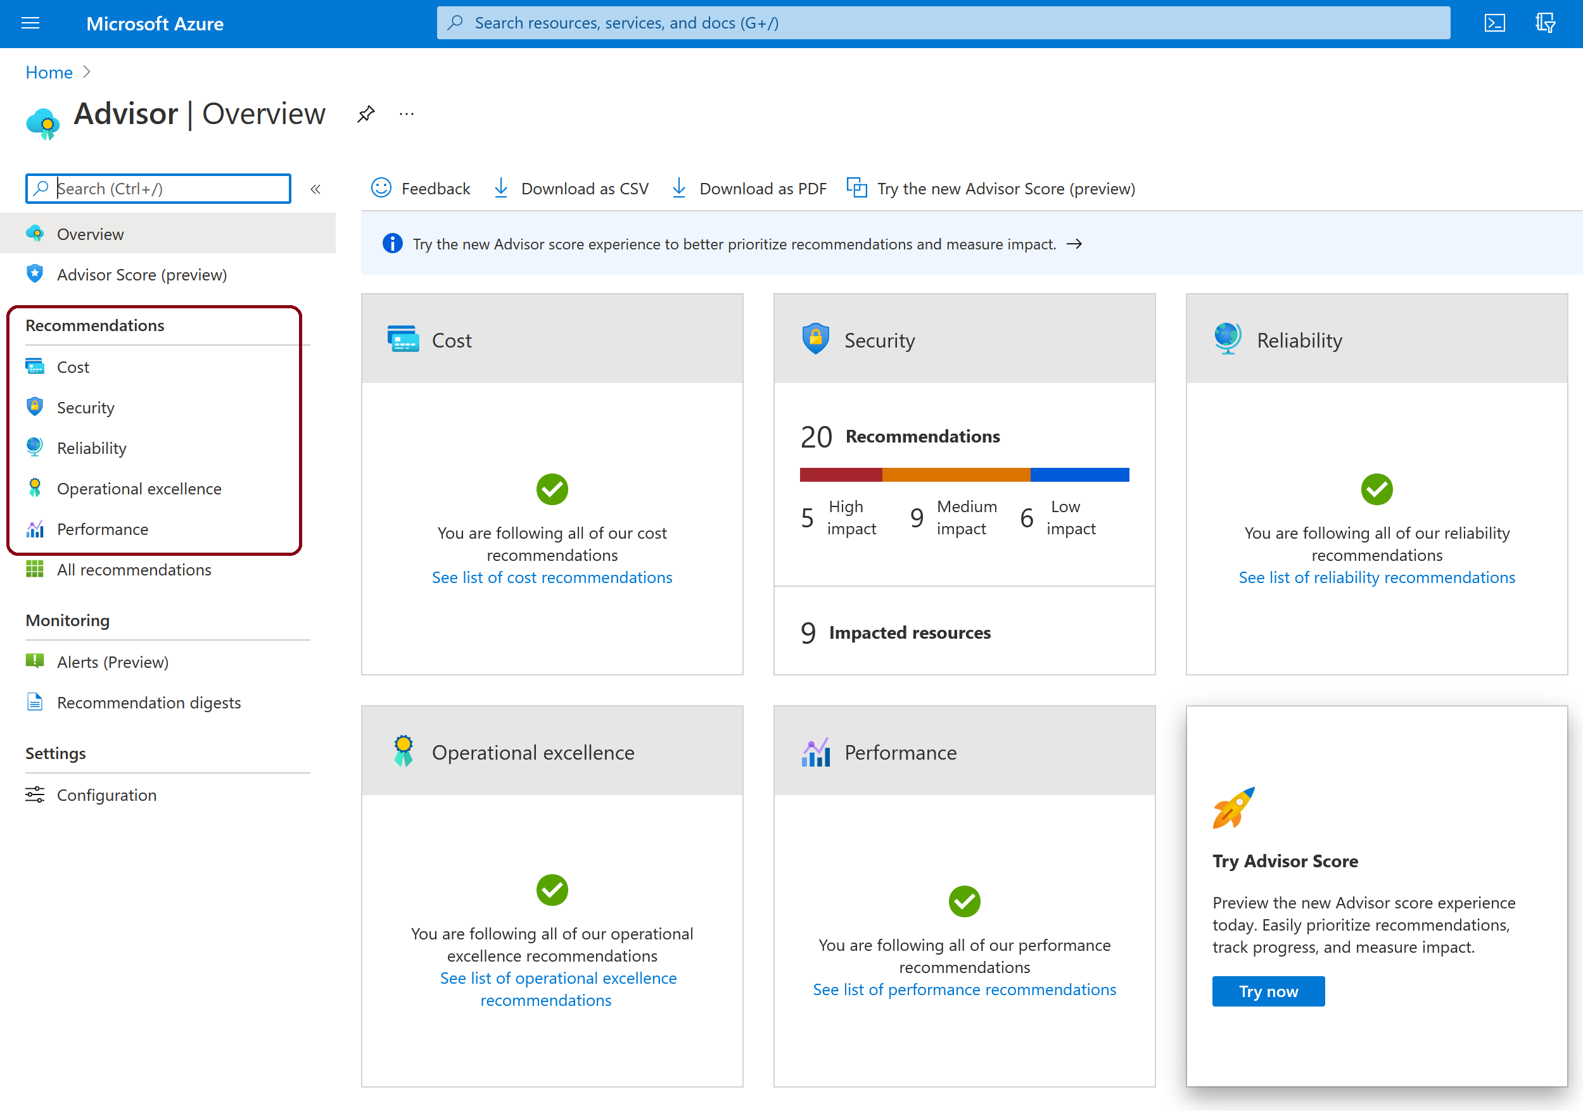
Monitor Azure Virtual Desktop by using Azure Advisor
When you open Azure Advisor, you'll see five categories:
Cost
Security
Reliability
Operational Excellence
Performance
Notes:
Whenever you come across an issue in Azure Virtual Desktop, always check Azure Advisor first. Azure Advisor will give you directions for how to solve the problem, or at least point you towards a resource that can help.

Slide 10

How to resolve Azure Advisor recommendations

Slide 11
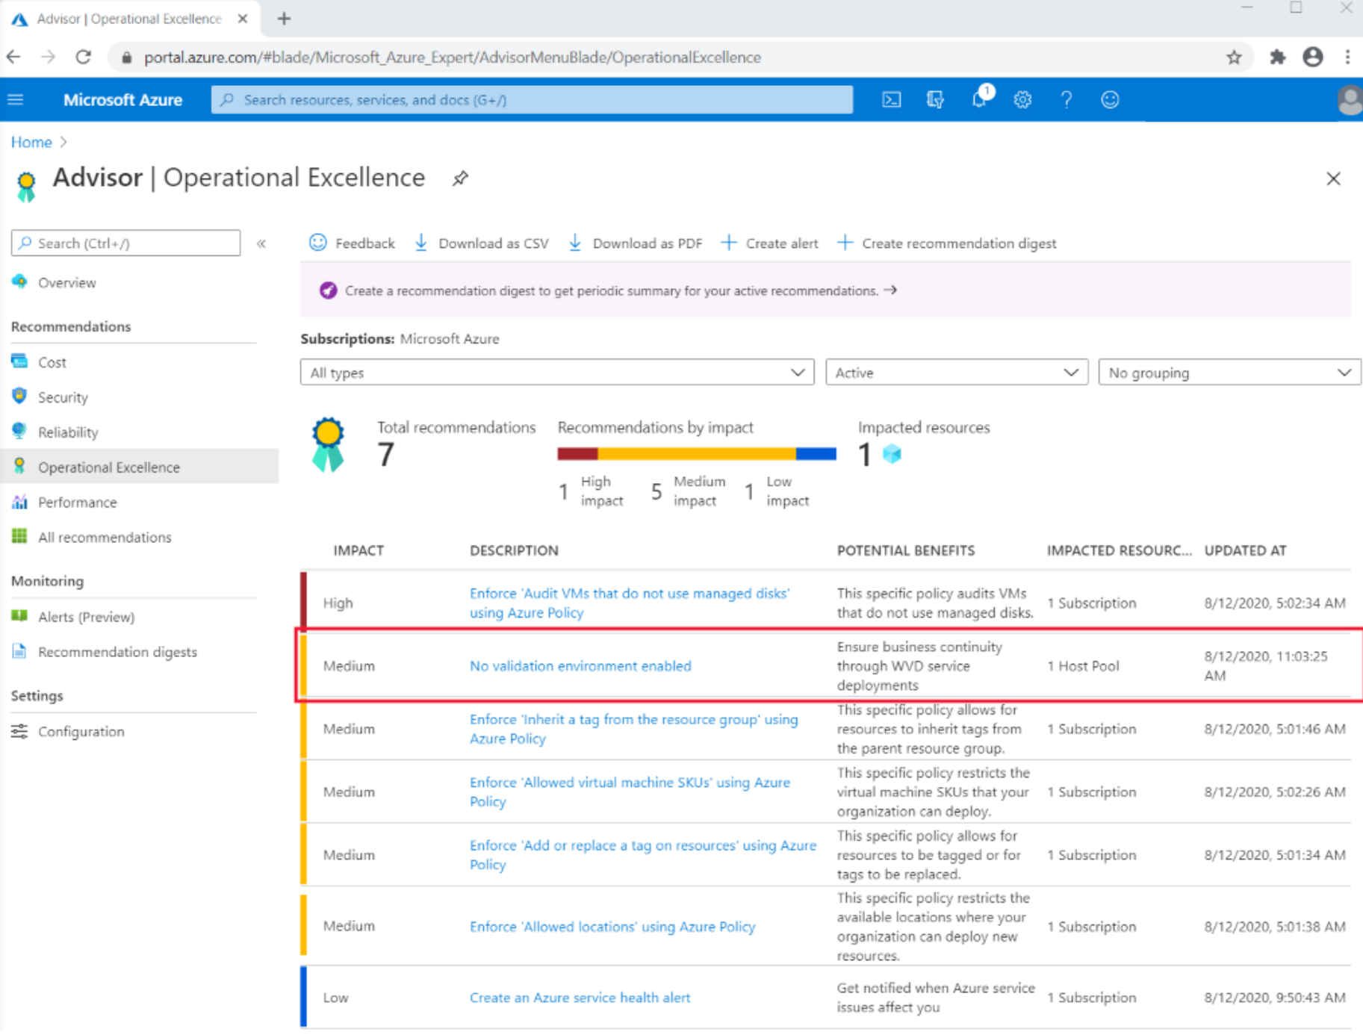
How to resolve Azure Advisor recommendations
Recommendations to be resolved can include:
No validation environment enabled
Not enough production (non-validation) environments enabled
Not enough links are unblocked to successfully implement your VM
Notes:
This slide describes how you can resolve recommendations that appear in Azure Advisor for Azure Virtual Desktop.
Common recommendations to be resolved can include:
No validation environment enabled
Not enough production (non-validation) environments enabled
Not enough links are unblocked to successfully implement your VM

Slide 12
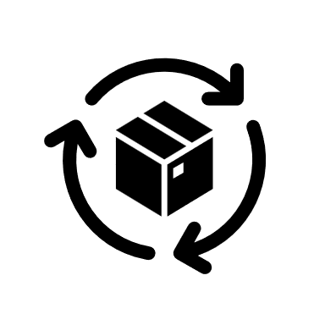
Diagnose graphics performance issues

Slide 13
Diagnose graphics performance issues
Graphics-related performance issues fall into four categories:
Low frame rate
Random stalls
High input latency
Poor frame quality
There are three types of Frames Skipped/Second counters:
Frames Skipped/Second (Insufficient Server Resources)
Frames Skipped/Second (Insufficient Network Resources)
Frames Skipped/Second (Insufficient Client Resources)
Notes:
To diagnose experience quality issues with your remote sessions, counters have been provided under the RemoteFX Graphics section of Performance Monitor. This unit helps you pinpoint and fix graphics-related performance bottlenecks during Remote Desktop Protocol (RDP) sessions using these counters.

Slide 14
Knowledge check and Summary
Check your knowledge
What you learned:
Describe how to monitor Azure Virtual Desktop by using Azure Monitor.
How to use Log Analytics workspace for Azure Monitor.
How to monitor Azure Virtual Desktop by using Azure Advisor.
How to resolve Azure Advisor recommendations.
How to diagnose graphics performance issues.
Notes:
What you learned:
Describe how to monitor Azure Virtual Desktop by using Azure Monitor.
How to use Log Analytics workspace for Azure Monitor.
How to monitor Azure Virtual Desktop by using Azure Advisor.
How to resolve Azure Advisor recommendations.
How to diagnose graphics performance issues.

Slide 15

End of presentation

Slide 16
Lab - Implement autoscaling in host pools (AD DS)
A Microsoft account or an Azure AD account with the Owner or Contributor role in the Azure subscription you will be using in this lab and with the Global Administrator role in the Azure AD tenant associated with that Azure subscription.
The completed lab Prepare for deployment of Azure Virtual Desktop (AD DS)
The completed lab Deploy host pools and session hosts by using the Azure portal (AD DS)
Estimated time: 60 minutes
Lab - Implement autoscaling in host pools (AD DS).

