Slide 1
AZ-140T00A Configuring and Operating Azure Virtual Desktop

Slide 2
Welcome
Thank you for joining us today
We’ve worked together with the Microsoft Partner Network and Microsoft IT Academies to bring you a world-class learning experience. At the end of class, please complete an evaluation of today’s experience. We value your feedback!
Microsoft Certified Trainers + Instructors
Your instructor is a premier technical and instructional expert who meets ongoing certification requirements
Customer Satisfaction Guarantee
Our partners offer a satisfaction guarantee, and we hold them accountable for it
Certification Exam Benefits
After training, consider pursuing a Microsoft Certification to help distinguish your technical expertise and experience. Ask your instructor about available exam promotions and discounts
We wish you a great learning experience and ongoing career success!

Slide 3
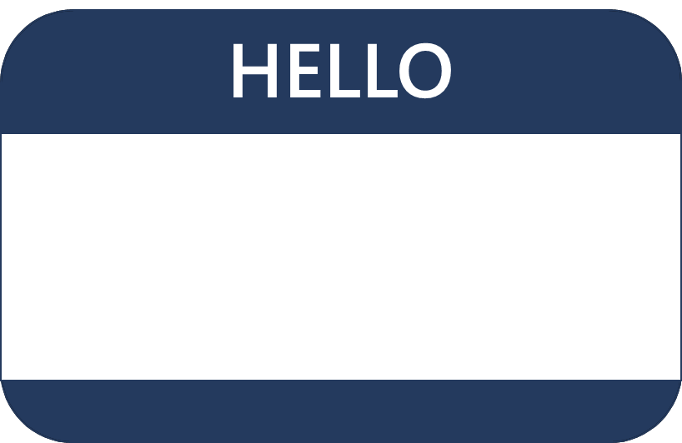
Hello! Instructor Introduction
Instructor: <Name>
<Title or other credentials, e.g., Microsoft Certified Trainer>
<Affiliation/Company>
<A few words about my technical and professional experience>

Slide 4
Hello! Student Introductions
Your name
Company affiliation
Title/function
Microsoft Azure experience
Your expectations for the course

Slide 5
Classroom experience (optional – adjust as needed)
Class hours
Messages
Virtual access
Smoking
Parking
Internet access
Restrooms
Recycling
Meals
Emergency procedures
Phones
Notes:
In the virtual classroom remove the items that aren’t appropriate. Demo the virtual experience including asking a question, chat, video ..

Slide 6
Azure Virtual Desktop administrators
Azure Virtual Desktop administrators have subject matter expertise in designing cloud and hybrid solutions that include compute, networking, storage, application services, data solutions, monitoring and security.
Working knowledge of networking technologies including connectivity services, application delivery services, and network architectures.
Working knowledge of compute technologies including virtual machines, containers, and PaaS compute solutions.
Understanding of on-premises virtualization technologies, including: VMs, virtual networking, and virtual hard disks.
Understanding of resilience and disaster recovery, including backup and restore operations..
Notes:
Be sure to ask your students about their level of experience. Have they taken AZ-104 (Admin) or another Microsoft course?
Microsoft Learn has a series of Fundamental modules for Azure, networking, and security. More modules are added every day and can help students ramp up on Azure basics. https://docs.microsoft.com/learn/browse/?term=fundamentals&terms=fundamentals&products=azure
There is also an AZ-104: Prerequisites for Azure administrators learning path - https://docs.microsoft.com/learn/paths/az-104-administrator-prerequisites/.

Slide 7
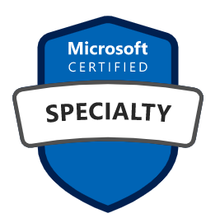
Microsoft Certifications
Certifications give you a professional edge by providing globally recognized industry endorsed evidence of skills mastery, demonstrating your abilities and willingness to embrace new technologies
Exam AZ-900: Microsoft Azure Fundamentals
Microsoft Certified: Azure Administrator Associate
Microsoft Certified: Azure Virtual Desktop Specialty
Designed for candidates looking to demonstrate foundational level knowledge of cloud services and how those services are provided
Designed for Azure Administrators who implement, monitor, and maintain compute, storage, network, and security
Designed for Azure Virtual Desktop administrators who create solutions for compute, network, storage, and security
Notes:
Use this slide to introduce the different exam levels – Fundamentals, Associate, and Specialty. Also, the difference between exams and certifications. Some certifications require you to pass more than one exam. Passing the Exam AZ-140: Configuring and Operating Microsoft Azure Virtual Desktop exam means you earn the Microsoft Certified: Azure Virtual Desktop Specialty.

Slide 8
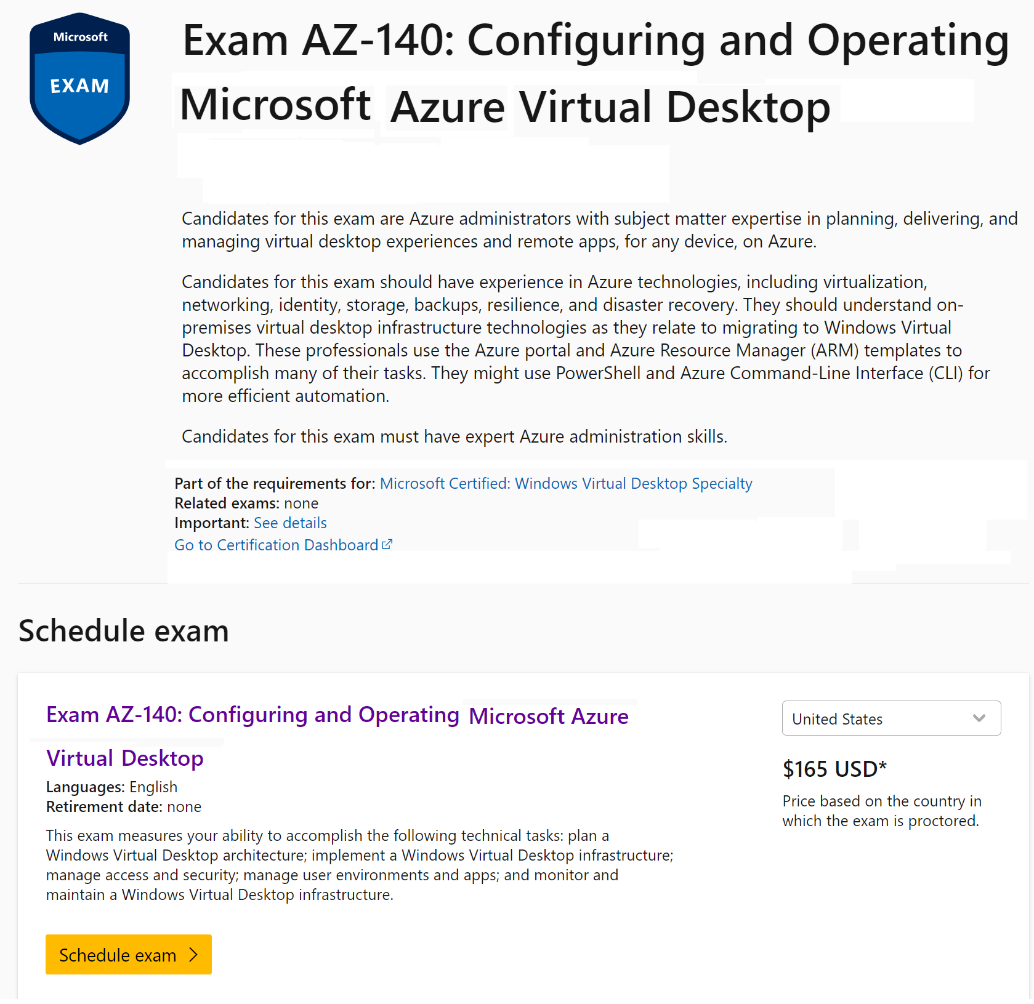

Slide 9
AZ-140 certification areas
Study Area | Percentage
Plan an Azure Virtual Desktop implementation | 10-15%
Implement an Azure Virtual Desktop infrastructure | 25-30%
Manage access and security | 10-15%
Manage user environments and apps | 20-25%
Monitor and maintain an Azure Virtual Desktop infrastructure | 20-25%
Percentages indicate the relative weight of each area on the exam
The higher the percentage, the more questions you are likely to see in that area

Slide 10
Student materials on Learn (optional)
https://aka.ms/AZ-140StudentMaterials
Learning Paths
Design identity, governance, and monitoring solutions
Design data storage solutions
Design business continuity solutions
Design infrastructure solutions
Exam AZ-140: Configuring and Operating Microsoft Azure Virtual Desktop
Notes:
Learn Collection - https://aka.ms/AZ-140StudentMaterials
A Learn Collection has been created for the course. Feel free to share the link with your students. This link provides direct access to the exam page, student content, the GitHub labs.
You can also view this content from the exam page or by searching the Learn content. This is only a small set of content that is available for Azure admins on Learn.
The course materials include a curated list of modules we think would be most helpful. These modules are listed on the last page, Summary and Resources. Students can search and find other modules. It is important to point out that additional study is needed for students to pass the exam.

Slide 11
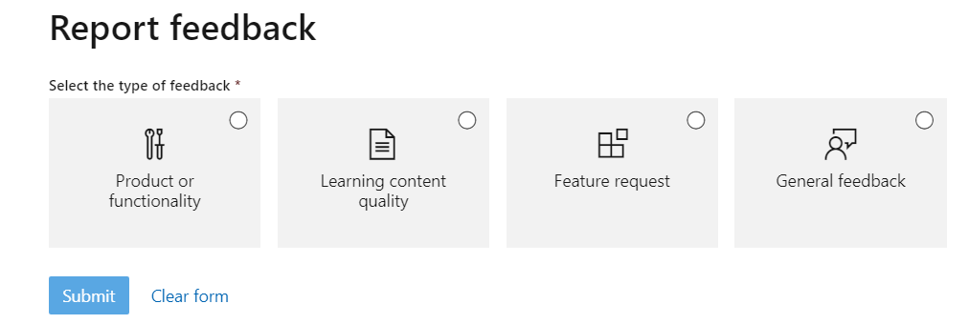
Student content feedback on Learn (optional)
Scroll to the bottom of the online page
Notes:
Emphasize this in only feedback for the Learn content. Discuss how to provide more general course feedback. Consider adding another slide for how general course feedback should be provided.

Slide 12
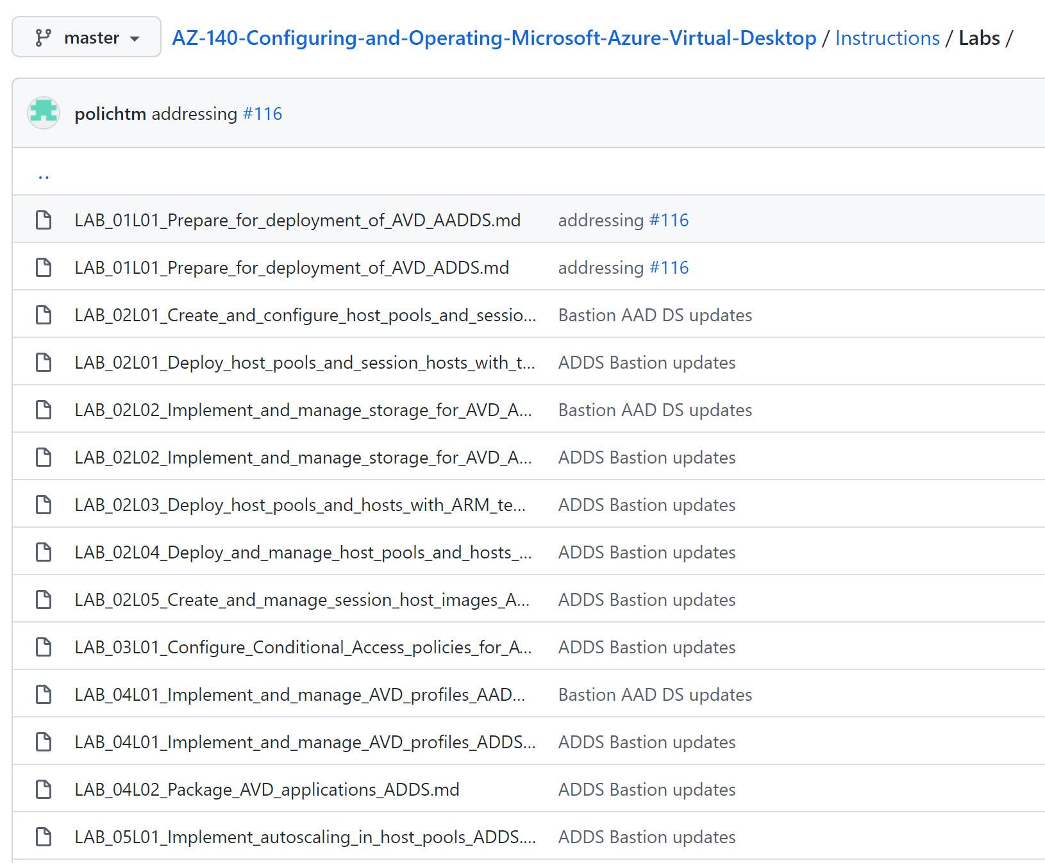
Hands-on labs
Hands-on labs reinforce the technical discussions.
The online lab procedures are located on GitHub at: AZ-140: Configuring and Operating Microsoft Azure Virtual Desktop.
Supplemental files, such as scripts and templates, are provided in the repository.
The labs comprise two separate tracks, depending on the identity provider you decide to use.
Active Directory Domain Services (AD DS)
Azure AD DS
Be aware of how much you are consuming and do not allow Microsoft Azure components to run overnight or for extended periods
Notes:
Be prepared to discuss how students should approach the hands-on labs. How will they participate? Will they be expected to present a solution?

Slide 13
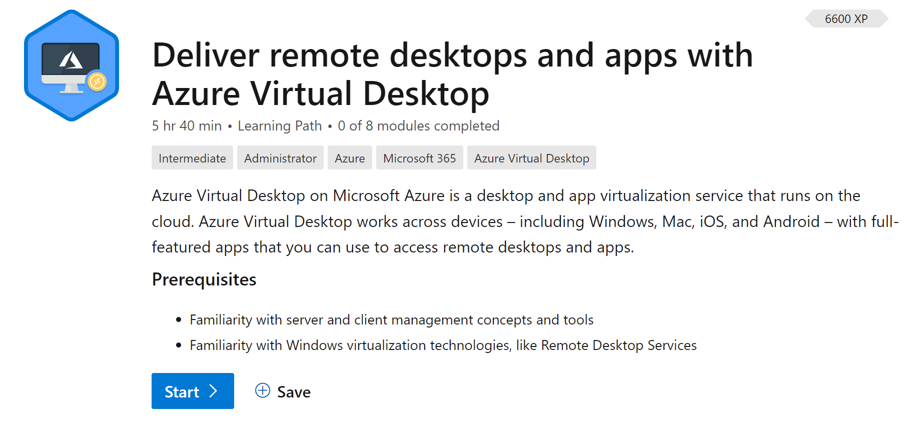
Additional Resources (Optional)
Microsoft Learn provides self paced skills training for Azure Virtual Desktop.
Visit the Deliver remote desktops and apps from Azure with Azure Virtual Desktop learning path for the following modules:
Introduction to Azure Virtual Desktop in Microsoft Azure
Prepare for Azure Virtual Desktop in Microsoft Azure
Deploy Azure Virtual Desktop in Microsoft Azure
Optimize Azure Virtual Desktop in Microsoft Azure
Secure an Azure Virtual Desktop deployment
Deploy applications by using MSIX app attach for Azure Virtual Desktop

Slide 14

End of presentation

