Slide 1
AZ-400.00 Learning Path 02: Development for enterprise DevOps

Slide 2
Learning Path overview

Slide 3
Learning Path overview
Module 01: Structure your Git Repo
Module 05: Plan foster inner source
Module 02: Manage Git branches and workflows
Module 06: Manage Git repositories
Module 03: Collaborate with pull requests in Azure Repos
Module 07: Identify technical debt
Labs & Learning Path review and takeaways
Module 04: Explore Git hooks

Slide 4
Learning objectives
After completing this Learning Path, students will be able to:
Explain how to structure Git Repos
Describe Git branching workflows
Leverage pull requests for collaboration and code reviews
Use GitHub Flow for collaboration

Slide 5
Module 01: Structure your Git Repo

Slide 6
Explore monorepo versus multiple repos
Monorepos – Source control pattern where all the source code is kept in a single repository.
Multiple repositories – Refer to organizing your projects each into their separate repository.
A repository is a place where the history of your work is stored.
Azure DevOps projects can contain multiple repositories. There are two philosophies on organizing your repos: Monorepo or Multiple repos.
The fundamental difference between the monorepo and multiple repos philosophies boils down to a difference about what will allow teams working together on a system to go fastest.
Notes:
Explain the difference between monorepo versus multiple repos.
There are two philosophies on organizing your repos: Monorepo or Multiple repos.
Monorepos is a source control pattern where all the source code is kept in a single repository. It's super simple to give all your employee's access to everything in one shot. Just clone it down and done.
Multiple repositories refer to organizing your projects each into their separate repository.
The fundamental difference between the monorepo and multiple repos philosophies boils down to a difference about what will allow teams working together on a system to go fastest.
The multiple repos view, in extreme form, is that if you let every subteam live in its repo.

Slide 7
Implement a change log
Track changes to a project over versions.
For each version, record:
New functionality
Changed functionality
Removed functionality
Can be manually created
Can be automatically populated
Can be a combination of both
Auto:
git log
gitchangelog
github_changelog_generator
Preference is to always avoid dumping log entries into a change log.
Logs are "noisy," and so it's easy to generate a mess that is not helpful.
git log [options] vX.X.X..vX.X.Y | helper-script > projectchangelogs/X.X.Y

Slide 8
Module 02: Manage Git branches and workflows

Slide 9
Explore branch workflow types
Feature branching – All feature development should take place in a dedicated branch instead of the main branch.
Forking Workflow – Every developer uses a server-side repository.
Evaluate the workflow:
Does this workflow scale with team size?
Is it easy to undo mistakes and errors with this workflow?
Does this workflow impose any new unnecessary cognitive overhead to the team?

Slide 10
Explore feature branch workflow
Create a branch
Add commits
Open a pull request
Discuss and review your code
Deploy
Merge
All feature development should take place in a dedicated branch instead of the main branch
Encapsulating feature development leverages pull requests, which are a way to initiate discussions around a branch.
Share a feature with others without touching any official code.

Slide 11
Explore Git branch model for continuous delivery
DEMO
Notes:
Take a moment to complete the demonstration, as defined in the student manual.

Slide 12
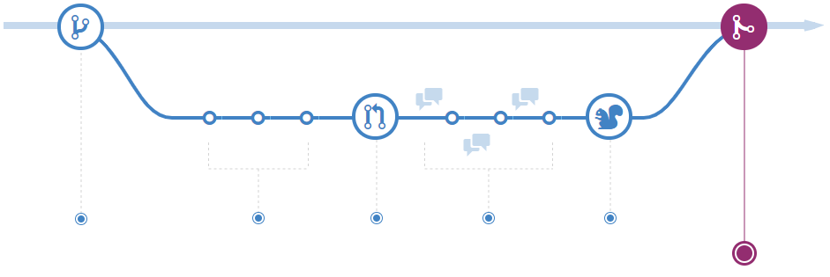
Explore GitHub flow
Make changes
Create a pull request
Delete your branch
Address review comments
Merge your pull request
Create a branch
GitHub Flow is a lightweight, branch-based workflow. The GitHub flow is useful for everyone, not just developers
Notes:
More details: https://docs.microsoft.com/en-us/learn/modules/manage-git-branches-workflows/5-explore-feature-branch-workflow and https://docs.github.com/en/get-started/quickstart/github-flow
Describe the GitHub flow and its steps. From above references:
GitHub is the best tool to enable collaboration in your projects. GitHub flow is a branch-based workflow suggested for GitHub.
To implement GitHub flow, you'll need a GitHub account and a repository. See https://github.com/signup and https://docs.github.com/en/get-started/quickstart/create-a-repo. You can complete all steps of GitHub flow through the GitHub web interface, command line, https://cli.github.com/, or https://desktop.github.com/.
The first step is to create a branch in your repository to work without affecting the default branch, and you give collaborators a chance to review your work. For more information, see https://docs.github.com/en/enterprise-server@3.1/pull-requests/collaborating-with-pull-requests/proposing-changes-to-your-work-with-pull-requests/creating-and-deleting-branches-within-your-repository.
Make any desired changes to the repository. If you make a mistake, you can revert or push extra changes to fix it.
Commit and push your changes to your branch to back up your work to remote storage, giving each commit a descriptive message. Each commit should contain an isolated, complete change making it easy to revert if you take a different approach.
Anyone collaborating with your project can see your work, answer questions, and make suggestions or contributions. Continue to create, commit, and push changes to your branch until you're ready to ask for feedback.
You can make a separate branch for each change to make it easy for reviewers to give feedback or for you to understand the differences. Once you're ready, you can create a pull request to ask collaborators for feedback on your changes. See https://docs.github.com/en/pull-requests/collaborating-with-pull-requests/proposing-changes-to-your-work-with-pull-requests/creating-a-pull-request.
Pull request review is one of the most valuable features of collaboration. You can require approval from your peers and team before merging changes. Also, you can mark it as a draft in case you want early feedback or advice before you complete your changes.
Describe the pull request as much as possible with the suggested changes and what problem you're resolving. You can add images, links, related issues, or any information to document your change and help reviewers understand the PR without opening each file. See https://docs.github.com/en/get-started/writing-on-github/getting-started-with-writing-and-formatting-on-github/basic-writing-and-formatting-syntax and https://docs.github.com/en/issues/tracking-your-work-with-issues/linking-a-pull-request-to-an-issue.
Another way to improve PR quality and documentation and explicitly point something out to the reviewers is to use the comment session area. Also, you can @mention or request a review from specific people or teams.
There are other Pull Requests configurations, such as automatically requesting a review from specific teams or users when a pull request is created or checks to run on pull requests. For more information, see https://docs.github.com/en/pull-requests/collaborating-with-pull-requests/collaborating-on-repositories-with-code-quality-features/about-status-checks and https://docs.github.com/en/repositories/configuring-branches-and-merges-in-your-repository/defining-the-mergeability-of-pull-requests/about-protected-branches.
After the reviewers' comments and checks validation, the changes should be ready to be merged, and they can approve the Pull Request. See https://docs.github.com/en/pull-requests/collaborating-with-pull-requests/incorporating-changes-from-a-pull-request/merging-a-pull-request.
If you have any conflicts, GitHub will inform you to resolve them. https://docs.github.com/en/pull-requests/collaborating-with-pull-requests/addressing-merge-conflicts
After a successful pull request merges, there's no need for the remote branch to stay there. You can delete your branch to prevent others from accidentally using old branches. For more information, see https://docs.github.com/en/repositories/configuring-branches-and-merges-in-your-repository/managing-branches-in-your-repository/deleting-and-restoring-branches-in-a-pull-request
GitHub keeps the commit and merges history if you need to restore or revert your pull request.

Slide 13

Explore fork workflow
Forking workflow gives every developer their own server-side repository
Each contributor has not one, but two Git repositories: a private local one and a public server-side one
Most often seen in public open-source projects
Contributions can be integrated without the need for everybody to push to a single central repository
Forked repositories use the standard git clone command

Slide 14
Module 03: Collaborate with pull requests in Azure Repos

Slide 15
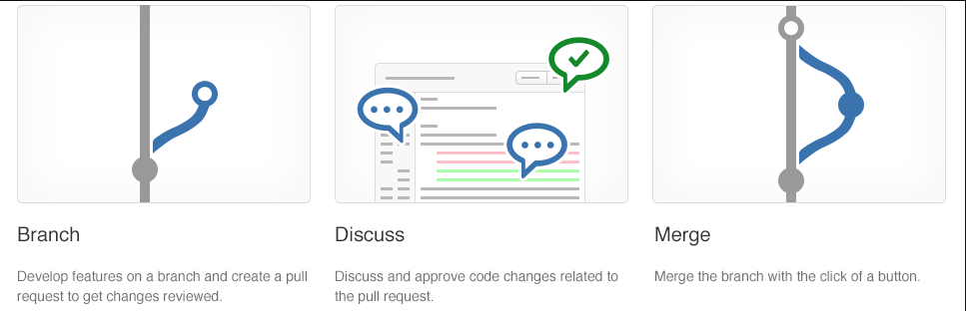
Collaborate with pull requests
Pull requests let you tell others about changes.
Collaboration using the Shared Repository Model
Review and merge your code in a single collaborative process.
Be sure to provide good feedback and protect branches with policies.

Slide 16
Azure Repos collaborating with pull requests
DEMO

Slide 17
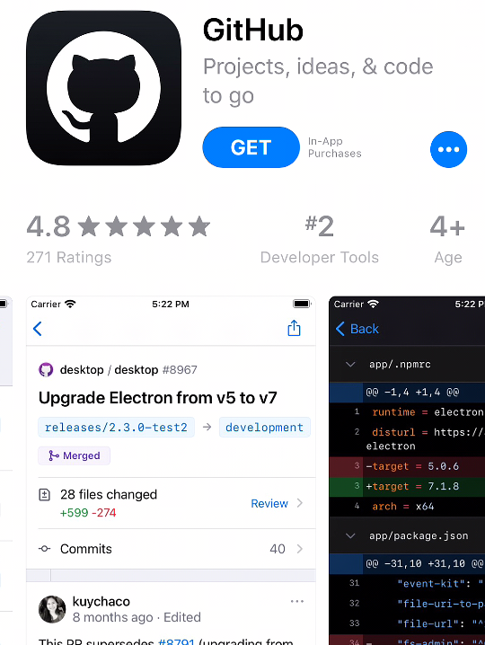
GitHub mobile for pull request approvals
App can render Markdown, images, PDF files
Manage pull requests directly within the app
Comments can be added (including using emoji short codes)

Slide 18
Module 04: Explore Git hooks

Slide 19
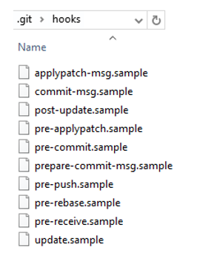
Introduction to Git hooks
A mechanism that allows arbitrary code to be run before, or after, certain Git lifecycle events occur
Use Git hooks to enforce policies, ensure consistency, and control your environment
Can be either client-side or server-side

Slide 20
Implement Git hooks
Will my code:
Break other code?
Introduce code quality issues?
Drop the code coverage?
Take on a new dependency?
Will the incoming code:
Break my code?
Introduce code quality issues?
Drop the code coverage?
Take on a new dependency?

Slide 21
Module 05: Plan foster inner source

Slide 22
Explore foster inner source
Fork-based pull request workflows allow anybody to contribute.
Inner source brings all the benefits of open-source software development inside your firewall.
We recommend the forking workflow for large numbers of casual or occasional committers.

Slide 23
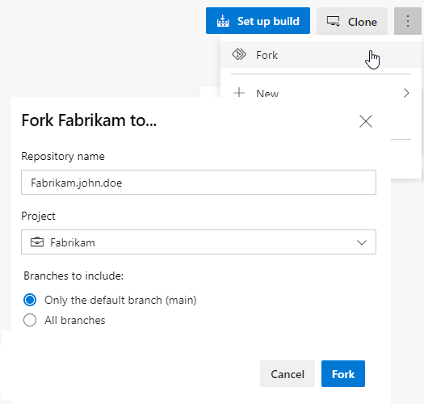
Implement the fork workflow
What’s in a fork?
Sharing code between forks
Choosing between branches and forks
The forking workflow:
Create a fork
Clone it locally
Make your changes locally and push them to a branch
Create and complete a PR to upstream
Sync your fork to the latest from upstream

Slide 24
Describe inner source with forks
DEMO
Notes:
Take a moment to complete the demonstration, as defined in the student manual.

Slide 25
Module 06: Manage Git repositories

Slide 26
Work with large repositories
Two common causes: long history and large binary files
Long history: use shallow clones git clone –depth [depth] [clone-url]
Large binary files: use Git Large File Storage (LFS)
Notes:
https://git-lfs.github.com/

Slide 27

Work with large repositories using Scalar
.NET Core application available for Windows and MacOS.
Maximizes Git command performance.
Register, Pause, Unregister: scalar [register][pause][unregister]
Run and Clone: scalar [run all], scalar [clone URL]
Notes:
Explain core concepts around Scalar and basic commands.
Scalar is a .NET Core application available for Windows and macOS with tools and extensions for Git to allow very large repositories to maximize your Git command performance.
If Azure Repos hosts your repository, you can clone a repository using the https://github.com/microsoft/VFSForGit/blob/master/Protocol.md. This is how Microsoft supports Windows and Office repositories.
Scalar is a tool that helps Git scale to some of the largest Git repositories. It achieves this by enabling some advanced Git features, such as:
Partial clone: reduces time to get a working repository by not downloading all Git objects right away.
Background prefetch: downloads Git object data from all remotes every hour, reducing the time for foreground git fetch calls.
Sparse-checkout: limits the size of your working directory.
File system monitor: tracks the recently modified files and eliminates the need for Git to scan the entire work tree.
Commit-graph: accelerates commit walks and reachability calculations, speeding up commands like git log.
Multi-pack-index: enables fast object lookups across many pack files.
Incremental repack: Repacks the packed Git data into fewer pack files without disrupting concurrent commands using the multi-pack-index.
Learn: https://docs.microsoft.com/en-us/learn/modules/manage-git-repositories/2-work-large-repositories
Scalar repository: https://github.com/microsoft/scalar
More details about Scalar: https://devblogs.microsoft.com/devops/introducing-scalar/

Slide 28
Purge repository data
Might need to delete files from repository:
- Reduce repository size
- Remove accidentally committed large file
- Remove committed file with sensitive data (passwords, keys)
Use:
- git filter-repo tool
- BFG Repo-Cleaner
Notes:
https://github.com/newren/git-filter-repo/
git filter-branch has a plethora of pitfalls that can produce non-obvious mangling's of the intended history rewrite (and can leave you with little time to investigate such problems since it has such abysmal performance). These safety and performance issues cannot be backward compatibly fixed and as such, its use is not recommended. Please use an alternative history filtering tool such as https://github.com/newren/git-filter-repo.
git filter-repo is a versatile tool for rewriting history, which includes https://github.com/newren/git-filter-repo#design-rationale-behind-filter-repo. It roughly falls into the same space of tool as https://git-scm.com/docs/git-filter-branch but without the capitulation-inducing poor performance, with far more capabilities, and with a design that scales usability-wise beyond trivial rewriting cases. git filter-repo is now recommended by the git project https://github.com/newren/git-filter-repo instead of git filter-branch.

Slide 29
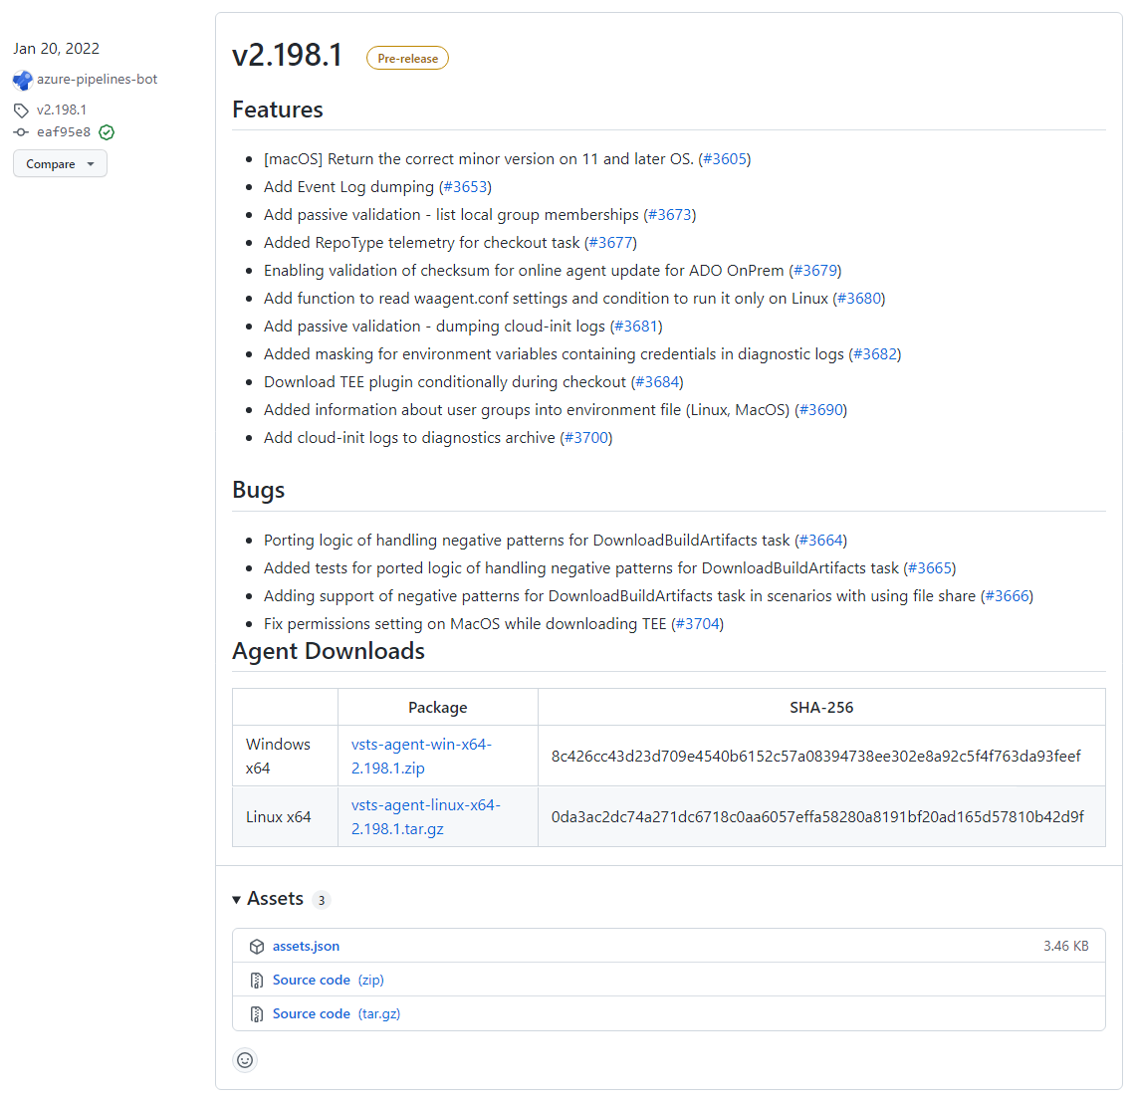
Manage releases with GitHub Repos
Releases in GitHub are based on Git tags.
Tag is a photo of your repository's current state.
Create a release tag: gh release create tag
To create a prerelease with the specified title and notes: gh release create v1.2.1 --title
Notes:
Explain what a release tag is and how to create using GitHub CLI and Web Browser.
https://docs.github.com/en/repositories/releasing-projects-on-github/about-releases
https://docs.github.com/en/repositories/releasing-projects-on-github/managing-releases-in-a-repository

Slide 30
Automate release notes with GitHub
DEMO
Notes:
Take a moment to complete the demonstration https://docs.github.com/en/repositories/releasing-projects-on-github/automatically-generated-release-notes.
Configuring automatically generated release notes template
You can customize the auto-generate release notes template by using the following steps.
Navigate to your repository and create a new file.
You can use the name .github/release.yml to create the release.yml file in the .github directory.
Specify in YAML the pull request labels and authors you want to exclude from this release. You can also create new categories and list the pull request labels in each. For more information about configuration options, see https://docs.github.com/en/repositories/releasing-projects-on-github/automatically-generated-release-notes.
Example configuration: YML # .github/release.yml changelog: exclude: labels: - ignore-for-release authors: - octocat categories: - title: Breaking Changes 🛠 labels: - Semver-Major - breaking-change - title: Exciting New Features 🎉 labels: - Semver-Minor - enhancement - title: Other Changes labels: - "*"Commit your new file.
Try to create a new release and click + Auto-generate release notes to see the template structure.

Slide 31
Module 07: Identify technical debt

Slide 32
Examine code quality
Short deadlines, a lack of coding standards, and poor technical skills can lead to code that is NOT:
Clear and readable
Maintainable
Documented
Extensible
Efficient
Secure

Slide 33
Examine complexity and quality metrics
A few of the most important complexity-related metrics:
Program vocabulary
Calculated program length
Volume
Difficulty
Effort

Slide 34
Introduction to technical debt
Technical Debt describes the future penalty that you incur today by making easy or quick choices in software development practices.

Slide 35


Measure and manage technical debt
Failed builds percentage
Failed deployments percentage
Ticket volume
Bug bounce percentage
Unplanned work percentage

Slide 36
Sources and impacts of technical debt
Common sources of technical debt are:
Lack of coding style and standards.
Lack of or poor design of unit test cases.
Ignoring or not understanding object orient design principles.
Monolithic classes and code libraries.
Poorly envisioned use of technology, architecture and approach.
Over-engineering code.
Insufficient comments and documentation.
Not writing self-documenting code.
Taking shortcuts to meet deadlines.
Leaving dead code in place

Slide 37


Using automated testing to measure technical debt
Technical debt:
Adds problems during development that makes it more difficult to add customer value
Saps productivity and frustrates development teams
Makes code both hard to understand and fragile
Increases the time to make changes, and to validate those changes
Starts small and grows over time
One way to minimize the accumulation of technical debt, is to use automated testing and assessment
Notes:
For more information, you can see:
SonarCloud - https://sonarcloud.io/about

Slide 38
Discussion: Code quality tooling
Azure DevOps can be integrated with a wide range of existing tooling that is used for checking code quality during builds
Which code quality tools do you currently use (if any)?
What do you or don't you like about the tools?

Slide 39
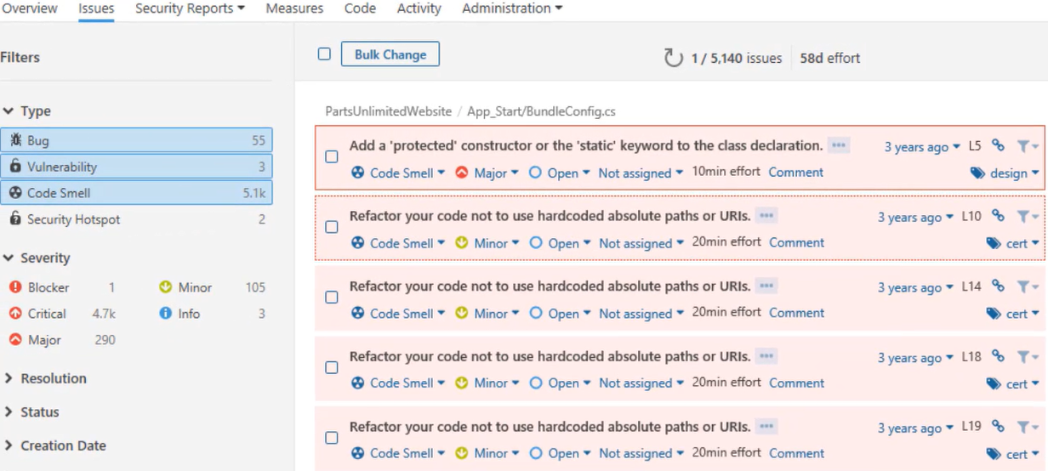
Measure and manage technical debt

Slide 40
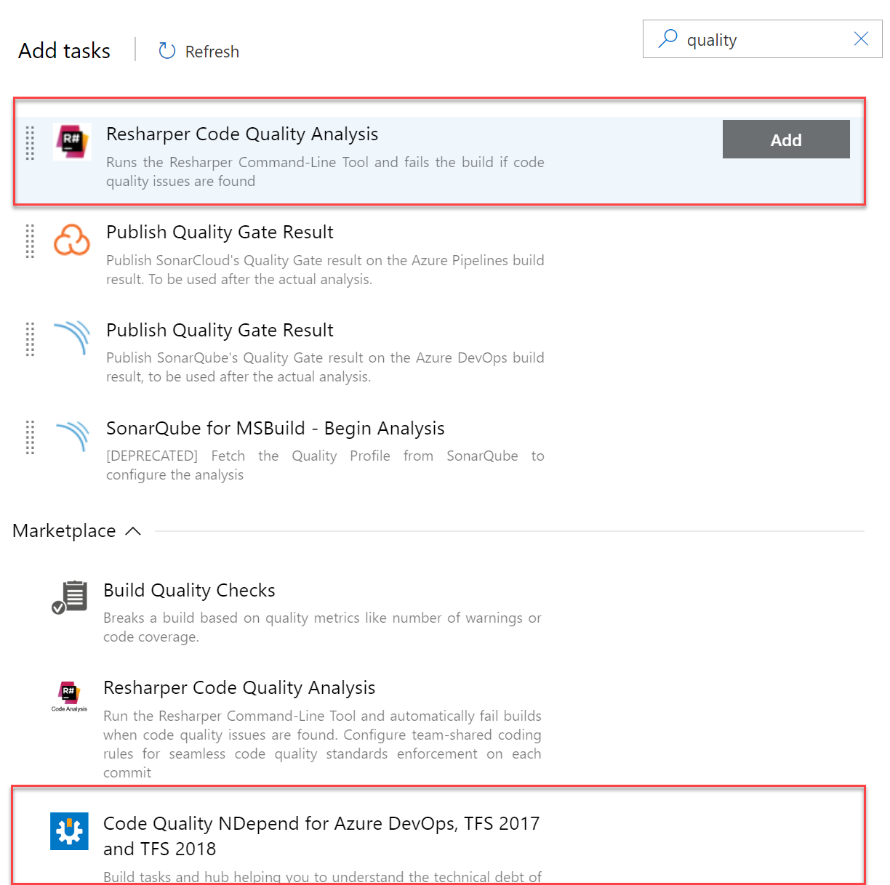
Integrate other code quality tools
NDepend is a Visual Studio extension that assesses the amount of technical debt that a developer has added during a recent development period, typically in the last hour.
Resharper Code Quality Analysis is a command line tool and can be set to automatically fail builds when code quality issues are found.
Notes:
For more information, you can see:
NDepend - https://www.ndepend.com
Visual Studio marketplace - https://marketplace.visualstudio.com/items?itemName=ndepend.ndependextension&targetId=2ec491f3-0a97-4e53-bfef-20bf80c7e1ea
Resharper Code Quality Analysis - https://marketplace.visualstudio.com/items?itemName=alanwales.resharper-code-analysis

Slide 41
Plan effective code reviews
Everyone is trying to achieve better code quality
Knowledge sharing

Slide 42
Labs

Slide 43
Lab: Version controlling with Git in Azure Repos
Lab overview:
In this lab you will establish and work with a local Git repository, and how to work with branches and repositories in Azure DevOps.
Objectives:
Clone an existing repository
Save work with commits
Review history of changes
Work with branches by using Visual Studio Code
Duration:
Notes:
The labs are updated on a regular basis. For the latest information please visit:
https://microsoftlearning.github.io/AZ400-DesigningandImplementingMicrosoftDevOpsSolutions/

Slide 44
Learning Path review and takeaways

Slide 45
What did you learn?
Explain how to structure Git Repos
Describe Git branching workflows
Leverage pull requests for collaboration and code reviews
Leverage Git hooks for automation
Use Git to foster inner source across the organization

Slide 46
Learning Path review questions
1
What are two types of branching?
2
What are Git hooks?
3
What are some best practices when working with files in Git? What do you suggest for working with large files?
Notes:
Q1 Answer: Trunk-based development and Forking workflow
Q2 Answer: A mechanism that allows arbitrary code to be run before, or after, certain Git lifecycle events occur. Use Git hooks to enforce policies, ensure consistency, and control your environment. Can be either client-side or server-side.
Q3 Answer: Best practices: use a package management system for DLLs, library files, and other dependent files, don't commit the binaries, logs, tracing output or diagnostic data from your builds, don't commit large, frequently updated binary assets, and use diffable plain text formats, such as JSON, for configuration information. For large files, use Git LFS.

