Slide 1
AZ-400.00 Learning Path 03: Implement CI with Azure Pipelines and GitHub Actions

Slide 2
Learning Path overview

Slide 3
Learning Path overview
Module 01: Explore Azure Pipelines
Module 06: Integrate with Azure Pipelines
Module 02: Manage Azure Pipeline agents and pools
Module 07: Introduction to GitHub Actions
Module 03: Describe pipelines and concurrency
Module 08: Learn continuous integration with GitHub Actions
Module 04: Explore Continuous integration
Module 09: Design a container build strategy
Module 05: Implement a pipeline strategy
Labs & Learning Path review and takeaways

Slide 4
Learning objectives
After completing this Learning Path, students will be able to:
Explain the role of Azure Pipelines and its components
Implement a container strategy including how containers are different from virtual machines
Configure agents for use in Azure Pipelines
Explain why continuous integration matters

Slide 5
Learning objectives (continued)
After completing this Learning Path, students will be able to:
Implement continuous integration using Azure DevOps
Create and work with GitHub Actions and workflows
Implement Continuous Integration with GitHub Actions

Slide 6
Module 01: Explore Azure Pipelines

Slide 7
Explore the concept of pipelines in DevOps
Build automation and continuous integration
Test automation
Deployment automation
A pipeline enables a constant flow of changes into production via an automated software production line
Pipelines create a repeatable, reliable and incrementally improving process for taking software from concept to customer
Pipelines require infrastructure, this infrastructure will have a direct impact on the effectiveness of the pipeline

Slide 8
Describe Azure Pipelines
Azure Pipelines is a cloud service that you can use to automatically build and test your code project and make it available to other users.
Works great with Continuous Integration and Continuous Delivery:
Work with any language or platform – Python, Java, PHP, Ruby, C#, and Go
Deploy to different types of targets at the same time
Integrate with Azure deployments – Container registries, virtual machines, Azure services, or any on-premises or cloud target (Microsoft Azure, Google Cloud, or AWS)
Build on Windows, Linux, or macOS machines
Integrate with GitHub
Work with open-source projects
Notes:
Review the Azure Pipelines Key terms in the student manual.

Slide 9
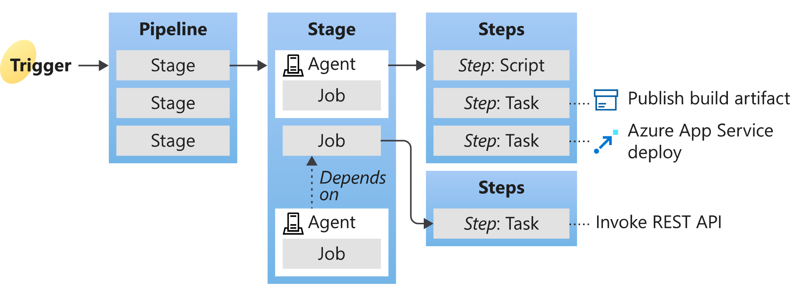
Understand Azure Pipelines key terms
Continuous Delivery (CD)
Continuous Integration (CI)
Deployment target
Notes:
Give a brief description and explain the terms to introduce students to what comes next in the course. We will cover in deeper details in the next Learning Paths.
Understanding the basic terms and parts of Azure Pipelines helps you further explore how it can help you deliver better code more efficiently and reliably.
Agent
When your build or deployment runs, the system begins one or more jobs. An agent is an installable software that runs a build or deployment job.
Artifact
An artifact is a collection of files or packages published by a build. Artifacts are made available for next tasks, such as distribution or deployment.
Build
A build represents one execution of a pipeline. It collects the logs associated with running the steps and the results of running tests.
Continuous delivery
Continuous delivery (CD) (also known as Continuous Deployment) is a process by which code is built, tested, and deployed to one or more test and production stages. Deploying and testing in multiple stages helps drive quality. Continuous integration systems produce deployable artifacts, which include infrastructure and apps. Automated release pipelines consume these artifacts to release new versions and fixes to existing systems. Monitoring and alerting systems constantly run to drive visibility into the entire CD process. This process ensures that errors are caught often and early.
Continuous integration
Continuous integration (CI) is the practice used by development teams to simplify the testing and building of code. CI helps to catch bugs or problems early in the development cycle, making them more accessible and faster to fix. Automated tests and builds are run as part of the CI process. The process can run on a set schedule, whenever code is pushed, or both. Items known as artifacts are produced from CI systems. The continuous delivery release pipelines use them to drive automatic deployments.
Deployment target
A deployment target is a virtual machine, container, web app, or any service used to host the application being developed. A pipeline might deploy the app to one or more deployment targets after the build is completed and tests are run.
Job
A build contains one or more jobs. Most jobs run on an agent. A job represents an execution boundary of a set of steps. All the steps run together on the same agent.
For example, you might build two configurations - x86 and x64. In this case, you have one build and two jobs.
Pipeline
A pipeline defines the continuous integration and deployment process for your app. It's made up of steps called tasks.
It can be thought of as a script that describes how your test, build, and deployment steps are run.
Release
When you use the visual designer, you create a release pipeline also to a build pipeline. A release is a term used to describe one execution of a release pipeline. It's made up of deployments to multiple stages.
Stage
Stages are the primary divisions in a pipeline: "build the app," "run integration tests," and "deploy to user acceptance testing" are good examples of stages.
Task
A task is the building block of a pipeline. For example, a build pipeline might consist of build tasks and test tasks. A release pipeline consists of deployment tasks. Each task runs a specific job in the pipeline.
Trigger
A trigger is something that's set up to tell the pipeline when to run. You can configure a pipeline to run upon a push to a repository at scheduled times or upon completing another build. All these actions are known as triggers.

Slide 10

Module 02: Manage Azure Pipeline agents and pools

Slide 11
Choose between Microsoft-hosted versus self-hosted agents
You generally need at least one agent to build or deploy your project.
An agent is installable software that runs one build or deployment job at a time.
Two types of agents:
Microsoft-hosted agents – Maintenance and upgrades are automatically done. Each time a pipeline is run, a fresh virtual machine (instance) is provided. There are time limits on jobs running on these agents.
Self-hosted agents – You take care of maintenance and upgrades. Give you more control to install dependent software needed. Can be installed on Linux, macOS, Windows machines, or in a Linux Docker container. There are no time limits on jobs running on these agents.

Slide 12
Explore job types
Four types of jobs:
Agent pool jobs – Jobs that run on an agent in an agent pool
Container jobs – Jobs that run in a container on an agent in an agent pool
Deployment group jobs – Jobs that run on systems in a deployment group
Agentless jobs – Jobs that run on the Azure DevOps server (also called Server Jobs)

Slide 13
Introduction to agent pools
Pool A
Pool B
Machine
Machine
Agent
Agent
Agent
Agent
Agent
You can organize agents into agent pools.
An agent pool defines the sharing boundary.
In Azure Pipelines, agent pools are scoped to the Azure DevOps organization; so, you can share an agent pool across projects.
Notes:
Use the student manual for some typical situations where you might want to create agent pools.

Slide 14
Explore predefined agent pool
Windows Server 2022 with Visual Studio 2022
Windows Server 2019 with Visual Studio 2019
Ubuntu 20.04
Ubuntu 18.04
macOS 11 Big Sur
macOS X Catalina 10.15
Notes:
https://docs.microsoft.com/azure/devops/pipelines/agents/agents

Slide 15
Understand typical situations for agent pools
You’re a member of a project and you want to use a set of machines owned by your team for running build and deployment jobs.
You’re a member of the infrastructure team and would like to set up a pool of agents for use in all projects.
You want to share a set of agent machines with multiple projects but not all of them.
Pool A
Pool B
Machine
Machine
Agent
Agent
Agent
Agent
Agent
Queue 1
Queue 2
Queue 1
Team Project Collection A
Team Project Collection B
Team Project A1
Team Project A2
Team Project B1
Job 1
Job 3
Job 1
Job 2
Job 4
Job 2

Slide 16
Communicate with Azure Pipelines
The agent determines which job it needs to run, report the logs, and job status.
Communication is always initiated by the agent.
All the messages from the agent to Azure Pipelines are over HTTPS.
Azure Pipelines
Port 443
Agent on an on-premises machine behind firewall
Agent on a machine in cloud

Slide 17
Communicate to deploy to target servers
Agent must have “line of sight” connectivity to servers.
Microsoft-hosted agent pools, by default, have connectivity to Azure websites and servers running in Azure.
You may need to manually configure connectivity.
Azure Pipelines service
Agent pools
Microsoft-hosted agents
Default
Hosted
1
2
3
4
Network firewall
X
No Line of Sight
Self-hosted agents
Target on-premises stages
1
2
3
4
Server1
Server2
Server3
Server4
Has line of sight, and so can deploy artifacts to these servers

Slide 18
Examine other considerations
Authentication
Personal Access Tokens
Interactive vs Service processes
Agent version and upgrades
Notes:
Do self-hosted agents have any performance advantages over Microsoft-hosted agents?
Can I install multiple self-hosted agents on the same machine?

Slide 19
Describe security of agent pools
Roles are defined on each agent pool, and membership in these roles governs what operations you can perform on an agent pool.
Role | Purpose
Reader | Members of this role can view the organization agent pool as well as agents. You typically use this to add operators that are responsible for monitoring the agents and their health.
Service Account | Members of this role can use the organization agent pool to create a project agent pool in a project. If you follow the guidelines above for creating new project agent pools, you typically do not have to add any members here.
Administrator | In addition to all the above permissions, members of this role can register or unregister agents from the organization agent pool. They can also refer to the organization agent pool when creating a project agent pool. Finally, they can also manage membership for all roles of the organization agent pool. The user that created the organization agent pool is automatically added to the Administrator role.

Slide 20
Module 03: Describe pipelines and concurrency

Slide 21
Understand parallel jobs
FabrikamFiber CI Build 102 (main)
1
FabrikamFiber Release 11
2
5
FabrikamFiber CI Build 101 (feature)
3
4
Queued build waiting for pipeline
Build running
Release waiting for pipeline
Release running
Release waiting for approval
This is a simple example of a Microsoft-hosted parallel job.
Users can collectively run only one build or release job at a time; additional jobs are queued.
A release consumes a parallel job only when it’s being actively deployed to a stage.

Slide 22
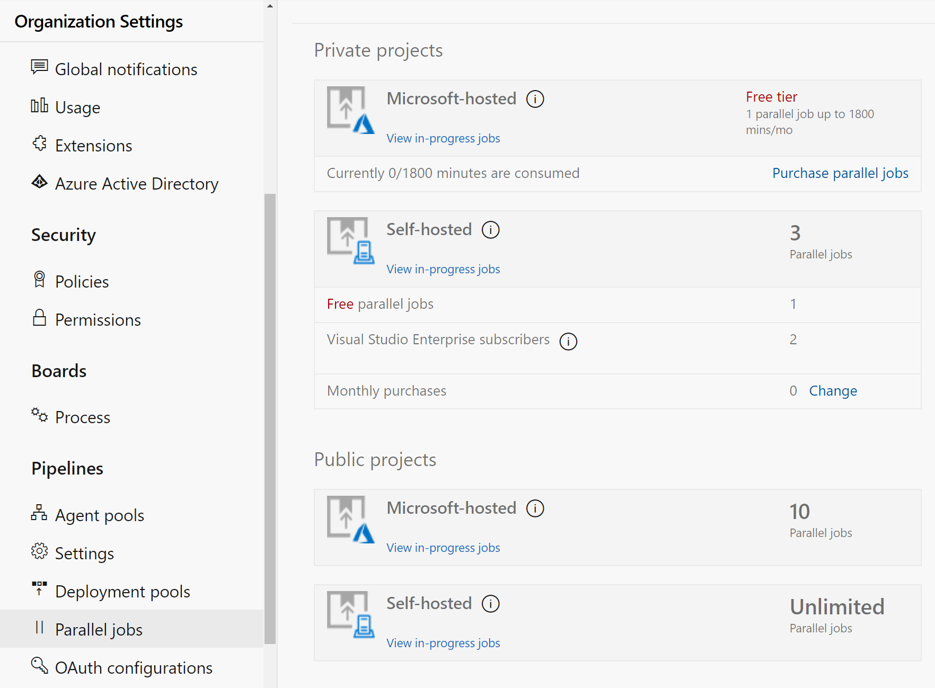
Estimate parallel jobs
Determine how many parallel jobs you need.
Simple estimates vs Detailed estimates
You can display all the builds and releases.
Parallel jobs are purchased at the organization level and are shared by all projects.

Slide 23
Describe Azure Pipelines and open-source projects
How do I qualify for the free tier of public projects?
The project must be a Public project and
Build a Public Repo
Are there limits on who can use Azure Pipelines?
Unlimited users – no per user cost
Users with Basic and Stakeholder access can author pipelines
Are there any limits on the number of builds and release pipelines that I can create?
No limits to the number of pipelines
Unlimited Self hosted Build Agents
10 Free parallel jobs
As a Visual Studio Enterprise subscriber, do I get additional parallel jobs for Azure Pipelines?
Subscribers will get one self-hosted parallel job in each organization
Notes:
How do I qualify for the free tier of Azure Pipelines for public projects?
Microsoft will automatically apply the free tier limits for public projects if you meet both conditions:
Your pipeline is part of an Azure Pipelines public project.
Your pipeline builds a public repository from GitHub or the same public project in your Azure DevOps organization.
Are there limits on who can use Azure Pipelines?
You can have as many users as you want when you're using Azure Pipelines. There's no per-user charge for using Azure Pipelines.
Users with both basic and stakeholder access can author as many builds and releases as they want.
Are there any limits on the number of builds and release pipelines that I can create?
No. You can create hundreds or even thousands of definitions for no charge. You can register any number of self-hosted agents for no cost.
As a Visual Studio Enterprise subscriber, do I get more parallel jobs for Azure Pipelines?
Yes. Visual Studio Enterprise subscribers get one self-hosted parallel job in each Azure DevOps Services organization where they're a member.
When you're using the per-minute plan, you can run only one job at a time.
If you run builds for more than 14 paid hours in a month, the per-minute plan might be less cost-effective than the parallel jobs model.
See https://azure.microsoft.com/en-us/pricing/details/devops/azure-devops-services/ for current pricing.

Slide 24
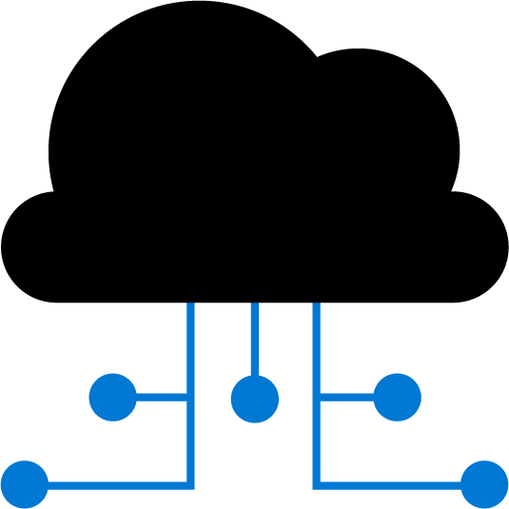

Explore Azure Pipelines and Visual Designer
Configure your pipelines with the Visual Designer
Continuous Integration
Continuous Deployment
Edit Code
Push to code repo
Build tasks
Test tasks
Create artifact
Release tasks
Deploy to target
Create and configure your build and release pipelines.
Push your code to your version control repository.
The build creates an artifact that’s used by the rest of your pipeline.
Your code is now updated, built, tested, and packaged.
Often referred to as "Classic Pipelines"

Slide 25

Describe Azure Pipelines and YAML
Configure your pipelines in a YAML file that exists alongside your code
Edit Code
Edit YAML file
Push to code repo
Azure Pipelines
Deploy to target
Configure Azure Pipelines to use your Git repo.
Edit your azure-pipelines.yml file to define your build.
Push your code to your version control repository.
Your code is now updated, built, tested, and packaged.
While more code-oriented, defining pipelines using YAML is preferred

Slide 26
Module 04: Explore Continuous integration

Slide 27
Introduction to continuous integration
Continuous integration (CI) is the process of automating the build and testing of code
CI encourages developers to share their code and unit tests by merging their changes into the shared version control repository
When a change is detected, it triggers an automated build system. The code is built using a build definition. Developers respond to any issues or bugs
CI keeps the main branch clean ensuring bugs are caught earlier in the development cycle, which makes them less expensive to fix

Slide 28
Learn the four pillars of continuous integration
Continuous integration
Version control system
Package management system
Continuous integration system
Automated build process
A version control system manages changes to your source code over time.
A package management system is used to install, uninstall, and manage software packages.
A continuous integration system merges all developer working copies to a shared mainline several times a day.
An automated build process creates a software build including compiling, packaging, and running automated tests.
Notes:
Cover the software examples shown in the student materials.

Slide 29
Explore benefits of continuous integration
Improving code quality based on rapid feedback
Triggering automated testing for every code change
Reducing build times for rapid feedback and early detection of problems (risk reduction)
Better management of technical debt and code analysis
Reducing long, difficult, and bug-inducing merges
Increasing confidence in codebase health long before production deployment
Rapid feedback to the developer
Notes:
✔️ Continuous integration also enables tracking metrics to assess code quality over time, such as unit test pass rates, code that breaks frequently, code coverage trends, and code analysis. It can be used to provide information on what has been changed between builds for traceability benefits, as well as for introducing evidence of what teams do in order to have a global view of build results.
For more information, you can see: What is Continuous Integration? - https://docs.microsoft.com/en-us/azure/devops/learn/what-is-continuous-integration

Slide 30
Discussion: continuous integration
Have you tried to implement continuous integration in your organization?
If you were successful, what lessons did you learn?
If you were not successful, what were the challenges?

Slide 31
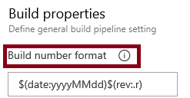
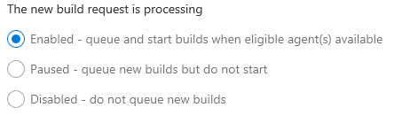
Describe build properties: Build number formatting and build status
Build number formatting
Build status (enabled, paused, disabled)

Slide 32
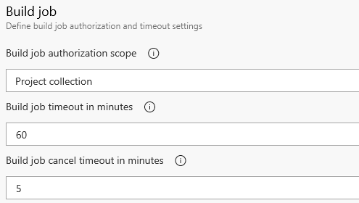

Describe build properties: Authorization and timeouts, and badges
Authorization and timeouts (scope, job timeout, cancel job timeout)
Badges
Notes:
For more information, you can see:
Build Pipeline Options - https://docs.microsoft.com/en-us/azure/devops/pipelines/build/options?view=vsts&tabs=yaml

Slide 33

Module 05: Implement a pipeline strategy

Slide 34
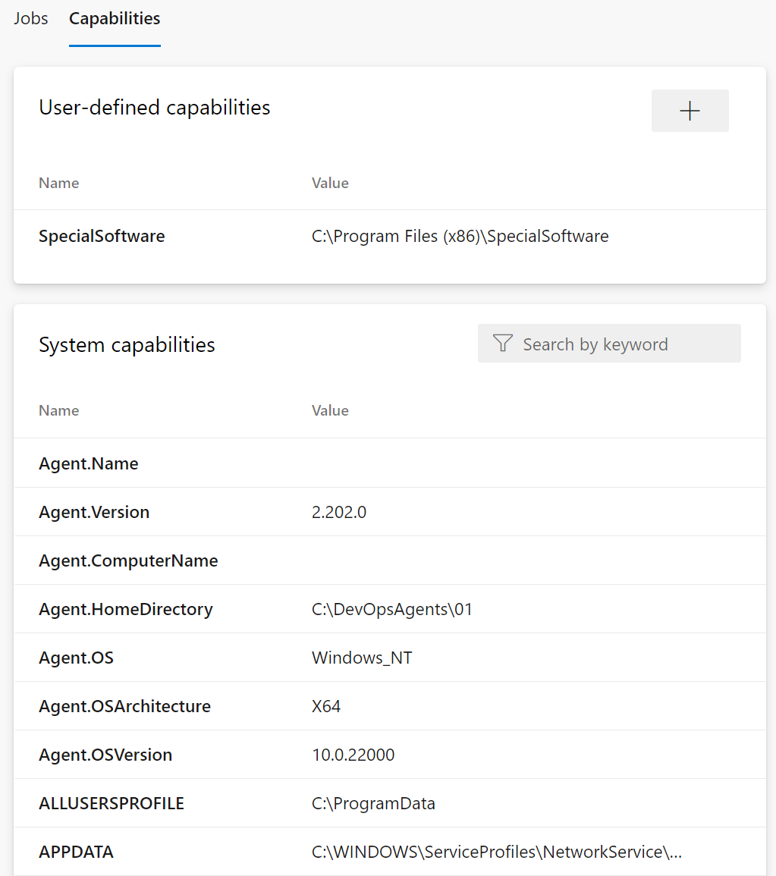
Configure agent demands
User-defined capabilities
System capabilities
Agents can have different authorization and timeout settings.
Notes:
For more information, you can see: Capabilities - https://docs.microsoft.com/azure/devops/pipelines/agents/agents

Slide 35
Explore multi-configuration and multi-agent
Multi-configuration: Run the same set of tasks on multiple configurations:
Run the release once with configuration setting A on WebApp A and setting B for WebApp B
Deploy to different geographic regions
Multi-agent: Run the same set of tasks on multiple agents using the specified number of agents:
Deploy same bits to a farm of servers

Slide 36

Implement multi-job builds
Adding multiple jobs to a pipeline lets you:
Break your pipeline into sections that need different agent pools, or self-hosted agents
Publish artifacts in one job and consume them in one or more subsequent jobs
Build faster by running multiple jobs in parallel
Enable conditional execution of tasks
You can configure the number of parallel jobs
Notes:
✔️ You can define a build as a collection of jobs, rather than as a single job. Each job consumes one of these parallel jobs that runs on an agent. If there aren't enough parallel jobs available for your organization, the jobs will be queued and run sequentially.

Slide 37
Discussion: build-related tooling
Azure DevOps can be integrated with a wide range of existing tooling that is used for builds or associated with builds
Which build-related tools do you currently use?
What do you like or don't like about the tools?
Notes:
Optional discussion. This Unit was merged into Implement multi-agent builds in Learn.

Slide 38
Explore source control types supported by Azure Pipelines
Repository types supported:
Repository Type | Azure Pipelines (YAML) | Azure Pipelines (Classic Editor)
Azure Repos Git | Yes | Yes
Azure Repos TFVC | No | Yes
Bitbucket Cloud | Yes | Yes
Other Git (Generic) | No | Yes
GitHub | Yes | Yes
GitHub Enterprise Server | Yes | Yes
Subversion | No | Yes

Slide 39
Module 06: Integrate with Azure Pipelines

Slide 40
Describe the anatomy of a pipeline
Name – Though often this is skipped (if it is skipped, a date-based name is generated automatically)
Trigger – More on triggers later, but without an explicitly trigger, there’s an implicit “trigger on every commit to any path from any branch in this repo”
Variables – These are “inline” variables (more on other types of variables later)
Job – Every pipeline must have at least one job
Pool – You configure which pool (queue) the job must run on
Checkout – The “checkout: self” tells the job which repository (or repositories if there are multiple checkouts) to checkout for this job
Steps – The actual tasks that need to be executed: in this case a "script" task (script is an alias) that can run inline scripts

Slide 41
Understand the pipeline structure
Pipeline – One or more stages that describe a CI/CD process
Stage – Collection of related jobs
Job – Collection of steps run by an agent on a server
Step – Linear sequence of operations that make up a job
Tasks – Building blocks of a pipeline
Notes:
In case you want to review the pipeline structure.

Slide 42
Detail YAML templates
Azure Pipelines supports 4 kinds of templates:
Stage
Job
Step
Variable

Slide 43

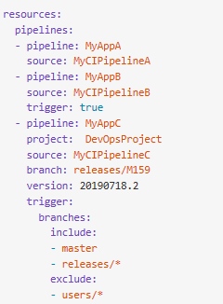
Explore YAML resources
Pipelines
Repositories
Containers

Slide 44
Use multiple repositories in your pipeline
Common for utilities used across more than one pipeline
Add additional checkout steps
Was not supported in earlier versions and artifacts were used as a workaround
Some pipelines might not need any repository
Build and validate pull requests and commits to your GitHub repository with Azure Pipelines
Notes:
Make sure you mention GitHub and its integration with Azure Pipelines for CI and Pull Request triggers.

Slide 45
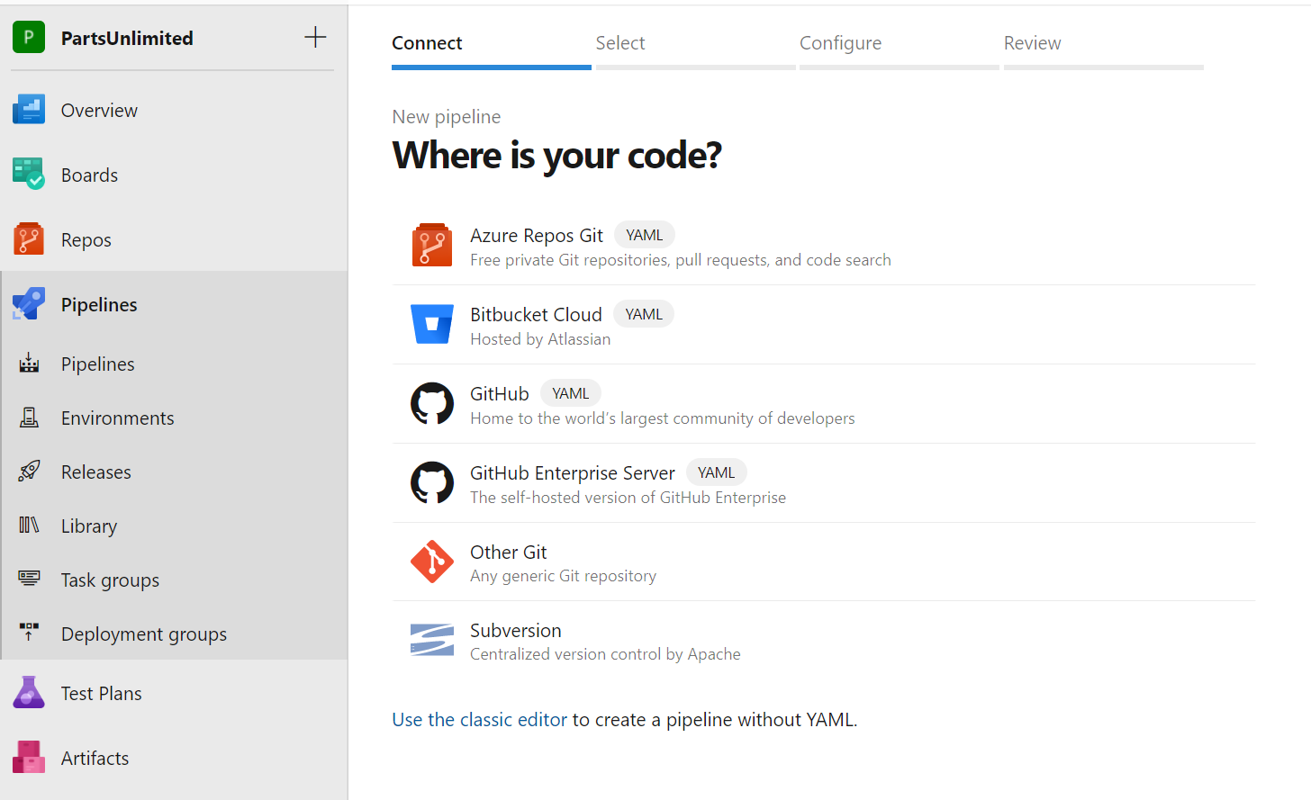
GitHub repository with Azure Pipelines
DEMO
Notes:
Take a moment to complete a demonstration based on https://docs.microsoft.com/azure/devops/pipelines/repos/github?view=azure-devops&tabs=yaml. Show how to create a new Azure Pipeline using GitHub repository source.

Slide 46
Module 07: Introduction to GitHub Actions

Slide 47
What are Actions?
Automations within the GitHub environment
Often used to build CI/CD implementations
Based on YAML files living within GitHub repositories
Executed on GitHub or self-hosted runners
Large number of existing actions in the GitHub Marketplace

Slide 48
Explore Actions flow
Events
Events trigger workflows:
- Schedule, code, etc.
Workflows contain jobs:
- May contain multiples
Jobs use actions:
- Configured within steps
Trigger
Workflows
Contain
Jobs
Use
Actions

Slide 49
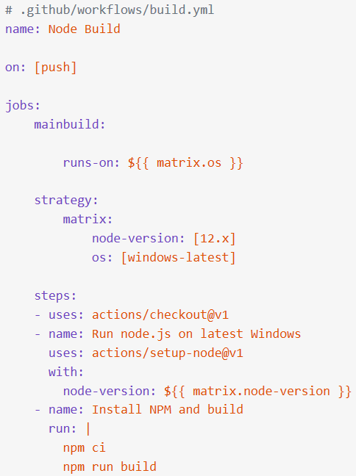
Understand Workflows
Define the required automation:
Events, Jobs
Written in YAML
Stored in .github/workflows
Starter workflows available

Slide 50
Describe standard workflow syntax elements
Name: the name of the workflow (optional but recommended)
On: the event that triggers the workflow
Jobs: the list of jobs to be executed
Runs-on: the target runner
Steps: the list of steps to execute
Uses: a predefined action to retrieve
Run: tells the job to execute a command on the runner

Slide 51
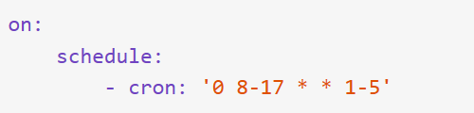


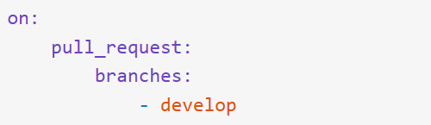

Explore Events
Defined by the on clause
Scheduled events
Code events
Manual events
Webhook events
External events

Slide 52
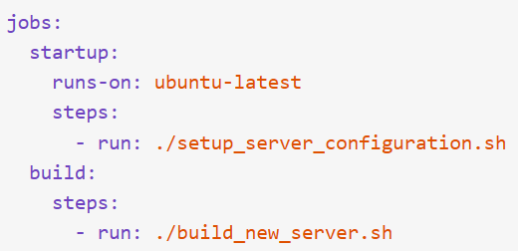
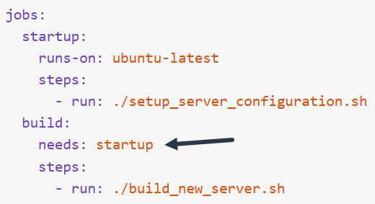
Explore Jobs
Workflows contain one or more jobs. Jobs contain a set of steps to execute in order.
Jobs run in parallel by default but can be configured with dependencies.

Slide 53
Explore Runners
Job steps execute on runners:
Shell scripts
Actions
For JavaScript code, Node.js hosted runners:
Windows
MacOS
Linux
For other languages or options:
Docker containers on Linux
Self-hosted – but do not use for public repos

Slide 54
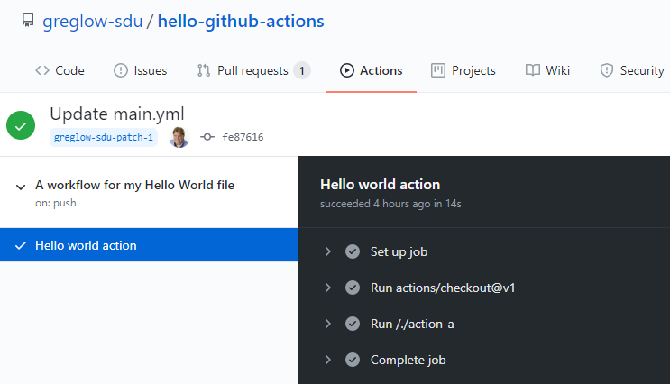
Console output from actions
Console output from actions is available directly in the GitHub UI

Slide 55


Examine release and test an action
Specific releases of actions can be requested:
Using tags
Using branches
Using SHA hashes

Slide 56
Testing an action
DEMO

Slide 57
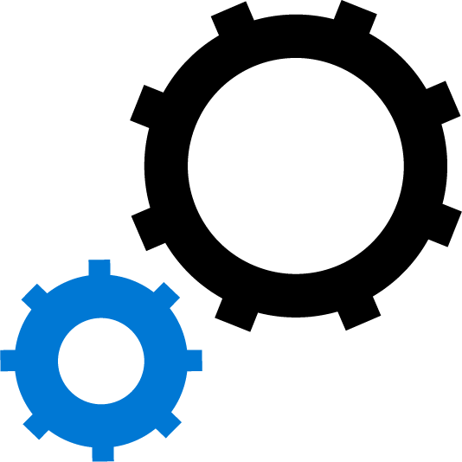
Module 08: Learn continuous integration with GitHub Actions

Slide 58
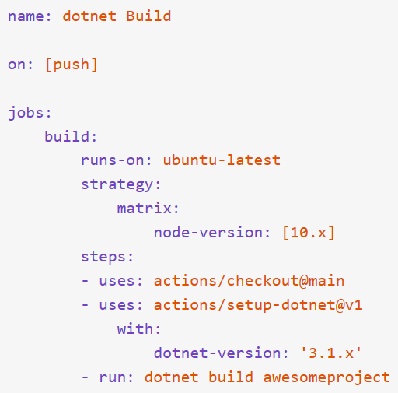
Describe continuous integration with actions
Example workflow shown:
executes when code is pushed
runs on latest ubuntu
uses Node.js version 10
Steps:
check out the code
set up dotnet
build the project

Slide 59
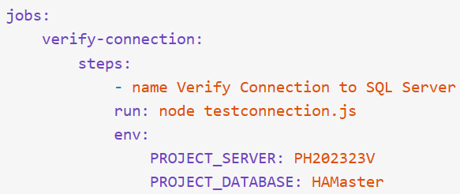
Examine environment variables
CI workflows usually need environment variables
GitHub default variables (GITHUB_ prefix)
Custom variables

Slide 60
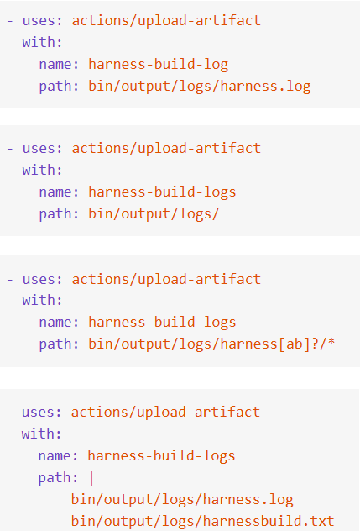
Share artifacts between jobs
CI workflows need to be able to pass artifacts between jobs. Standard actions:
upload-artifact
download-artifact
Can configure retention

Slide 61


Examine Workflow badges
Show status of a workflow within a repository
Typically added to README.md
Can be branch specific
Added via URLs
https://github.com/accountname/repositoryname/workflows/workflowname/badge.svg
Spaces in names must be encoded as %20

Slide 62
Describe best practices for creating actions
Create chainable actions – avoid monolithic actions
Version your actions like other code
Provide a latest label
Add appropriate documentation: like README.md
Add detailed action.yml metadata
Consider contributing to the marketplace

Slide 63
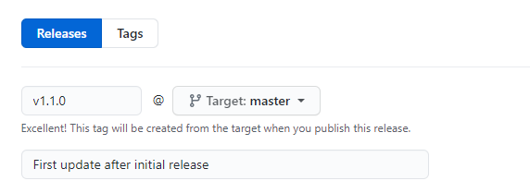
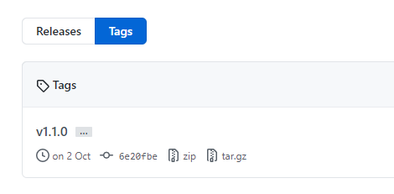
Mark releases with Git tags
Releases are based on Git tags
Mark a specific point in repository history
Tags are viewed in the repository history

Slide 64
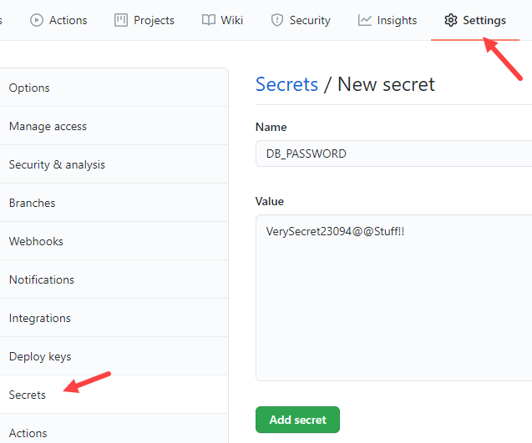
Create encrypted secrets
Like environment variable but encrypted
Created at repository or organization level
Created/assigned in the GitHub UI

Slide 65
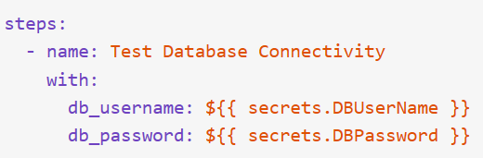
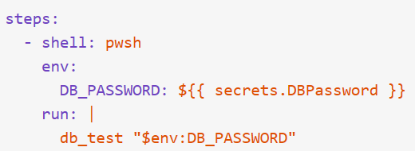
Use secrets in a workflow
Secrets not automatically passed to runners
Can be passed as inputs or as environment variables
Avoid passing secrets in command-line arguments

Slide 66
Module 09: Design a container build strategy

Slide 67
Why Containers?
Portable – run containers wherever Docker is supported
Consistent – know that developers are working with identical code
Lightweight – far less disk, CPU, and memory than VMs
Efficient – fast deployment, booting, patching, updates

Slide 68
Examine structure of containers
Server Hardware
VM1 Apps OS
Hypervisor
VM2 Apps OS
VM3 Apps OS
Host Operating System
Server Hardware
C1 Apps
Container Engine
C2 Apps
C3 Apps
Host Operating System
C4 Apps
C5 Apps
C6 Apps

Slide 69
Discussion: Containers versus Virtual Machines
In your development environment:
Do you currently use virtualization of any type?
Do you prefer to deploy containers or virtual machines?

Slide 70
Work with Docker containers
docker build – create the image
docker pull – retrieve an image from a container registry
docker run – run the image to create a container instance (will auto pull if not already pulled)

Slide 71
Understand Dockerfile core concepts
FROM ubuntu
LABEL maintainer="johndoe@contoso.com"
ADD appsetup /
RUN /bin/bash -c 'source $HOME/.bashrc; \
echo $HOME'
CMD ["echo", "Hello World from within the container"]
Dockerfiles are text files that contain the commands needed by docker build to assemble an image
Notes:
For more information, you can see: Dockerfile reference - https://docs.docker.com/engine/reference/builder/

Slide 72
Multi-stage Dockerfiles
Multi-stage builds give the benefits of the builder pattern without the hassle of maintaining separate files
The code progresses from one stage to the next
FROM mcr.microsoft.com/dotnet/core/aspnetcore:3.1 AS base WORKDIR /app EXPOSE 80 EXPOSE 443 FROM mcr.microsoft.com/dotnet/core/sdk:3.1 AS build WORKDIR /src COPY ["WebApplication1.csproj", ""] RUN dotnet restore "./WebApplication1.csproj" COPY . . WORKDIR "/src/." RUN dotnet build "WebApplication1.csproj" -c Release -o /app/build FROM build AS publish RUN dotnet publish "WebApplication1.csproj" -c Release -o /app/publish FROM base AS final WORKDIR /app COPY --from=publish /app/publish . ENTRYPOINT ["dotnet", "WebApplication1.dll"]

Slide 73
Considerations for multiple stage builds
Adopt container modularity
Avoid unnecessary packages
Choose an appropriate base
Avoid including application data
Notes:
For more information, you can see: Use multiple stage builds - https://docs.docker.com/develop/develop-images/multistage-build/

Slide 74
Explore Azure container-related services
Azure Container Instances let you focus on creating your applications rather than provisioning and management of the infrastructure
Azure Kubernetes Service is the de facto standard for container orchestration
Azure Container Registry lets you store and manage container images in a central registry
Azure Container Apps to build and deploy modern apps and microservices using serverless containers
Azure App Service provides a managed service for both Windows and Linux based web applications
Notes:
For more information, you can see:
Azure Container Instances - https://azure.microsoft.com/en-us/services/container-instances/
Azure Kubernetes Service - https://azure.microsoft.com/en-us/services/kubernetes-service/
Azure Container Registry - https://azure.microsoft.com/en-us/services/container-registry/
Azure Container Apps - https://azure.microsoft.com/en-us/services/container-apps/
Azure App Service - https://azure.microsoft.com/en-us/services/app-service/

Slide 75
Labs

Slide 76
Lab: Configuring Agent Pools and Understanding Pipeline Styles
Lab overview:
In this lab, you will step through the process of converting a classic pipeline into a YAML-based one and running it first by using a Microsoft-hosted agent and then performing the equivalent task by using a self-hosted agent.
Objectives:
Implement YAML-based pipelines
Implement self-hosted agents
Duration:
Notes:
The labs are updated on a regular basis. For the latest information please visit:
https://microsoftlearning.github.io/AZ400-DesigningandImplementingMicrosoftDevOpsSolutions/

Slide 77
Lab: Enabling continuous integration with Azure Pipelines
Lab overview:
In this lab, you will learn how to configure continuous integration (CI) and continuous deployment (CD) for your applications using Build and Release in Azure Pipelines.
Objectives:
Create a basic build pipeline from a template
Track and review a build
Invoke a continuous integration build
Duration:
Notes:
The labs are updated on a regular basis. For the latest information please visit:
https://microsoftlearning.github.io/AZ400-DesigningandImplementingMicrosoftDevOpsSolutions/

Slide 78
Lab: Integrating external source control with Azure Pipelines
Lab overview:
In this lab, you’ll see how easy it is to set up Azure Pipelines with your GitHub projects and how you can start seeing benefits immediately.
Objectives:
Install Azure Pipelines from the GitHub Marketplace
Integrate a GitHub project with an Azure DevOps
pipeline
Track pull requests through the pipeline
Duration:
Notes:
The labs are updated on a regular basis. For the latest information please visit:
https://microsoftlearning.github.io/AZ400-DesigningandImplementingMicrosoftDevOpsSolutions/

Slide 79
Lab: Implementing GitHub Actions for CI/CD
Lab overview:
In this lab, you will learn how to implement a GitHub Action workflow that deploys an Azure web app by using DevOps Starter.
Objectives:
Implement a GitHub Action workflow by using DevOps Starter
Explain the basic characteristics of GitHub Action workflows
Duration:
Notes:
The labs are updated on a regular basis. For the latest information please visit:
https://microsoftlearning.github.io/AZ400-DesigningandImplementingMicrosoftDevOpsSolutions/

Slide 80
Lab: Deploying Docker containers to Azure App Service web apps
Lab overview:
In this lab, you will learn how to use an Azure DevOps CI/CD pipeline to build a custom Docker image, push it to Azure Container Registry, and deploy it as a container to Azure App Service.
Objectives:
Build a custom Docker image by using a Microsoft hosted Linux agent
Push an image to Azure Container Registry
Deploy a Docker image as a container to Azure App Service by using Azure DevOps
Duration:
Notes:
The labs are updated on a regular basis. For the latest information please visit:
https://microsoftlearning.github.io/AZ400-DesigningandImplementingMicrosoftDevOpsSolutions/

Slide 81
Learning Path review and takeaways

Slide 82
What did you learn?
Explain the role of Azure Pipelines and its components
Implement a container strategy including how containers are different from virtual machines
Configure agents for use in Azure Pipelines
Explain why continuous integration matters

Slide 83
What did you learn? (continued)
Implement continuous integration using Azure DevOps
Create and work with GitHub Actions and workflows
Implement Continuous Integration with GitHub Actions

Slide 84
Learning Path review questions
1
What are some advantages of Azure Pipelines?
2
What is a pipeline, and why is it used?
3
What is the line continuation character in Dockerfiles?
4
What are the two types of agents and how are they different?
5
What is an agent pool, and why would you use it?
6
What are two ways to configure your Azure Pipelines?
Notes:
Q1 Answer: Work with any language or platform - Python, Java, PHP, Ruby, C#, and Go; deploy to different types of targets at the same time; integrate with Azure deployments - container registries, virtual machines, Azure services, or any on-premises or cloud target (Microsoft Azure, Google Cloud, or Amazon cloud services); build on Windows, Linux, or Mac machines; integrate with GitHub; work with open-source projects.
Q2 Answer: A pipeline enables a constant flow of changes into production via an automated software production line. Pipelines create a repeatable, reliable and incrementally improving process for taking software from concept to customer.
Q3 Answer: Lines can be broken and continued on the next line of a Dockerfile by using the backslash character.
Q4 Answer: Microsoft-hosted agents - Automatically take care of maintenance and upgrades. Each time you run a pipeline, you get a fresh virtual machine. The virtual machine is discarded after one use. Self-hosted agents – You take care of maintenance and upgrades. Give you more control to install dependent software needed. You can install the agent on Linux, macOS, Windows machines, or even in a Linux Docker container.
Q5 Answer: You can organize agents into agent pools. An agent pool defines the sharing boundary. In Azure Pipelines, agent pools are scoped to the Azure DevOps organization; so you can share an agent pool across projects.
Q6 Answer: YAML file and Visual Designer

Slide 85
Learning Path review questions (continued)
7
Name the four pillars of continuous integration.
You want to take your build server offline to make a configuration change. You want it to complete any build that it is currently processing, but you want to queue any new build requests. What should you do?
8
9
You want to set a maximum time that builds should not run for more than 5 minutes. What configuration change should you make?
Notes:
Q7 Answer: The four pillars of continuous integration are: a Version Control System, Packet Management System, Continuous Integration System, and an Automated Build Process.
Q8 Answer: You should pause the build. A paused build will not start new builds and will queue any new build requests.
Q9 Answer: You should change the build job timeout setting to 5 minutes. A blank value means unlimited.

Slide 86
Learning Path review questions (continued)
10
True or False: Self-hosted runners should be used with public repos.
11
Database passwords that are needed in a CI pipeline should be stored where?
12
The metadata for an action is held in which file?
13
How can the status of a workflow be shown in a repository ?
Notes:
Q10 Answer: False – they should never be used with public repos
Q11 Answer: Encrypted Secrets
Q12 Answer: action.yml
Q13 Answer: Using Badges

