Slide 1
AZ-400.00 Learning Path 05: Implement a secure continuous deployment using Azure Pipelines

Slide 2
Learning Path overview

Slide 3
Learning Path overview
Module 01: Introduction to deployment patterns
Module 05: Integrate with identity management systems
Module 02: Implement blue-green deployment and feature toggles
Module 06: Manage application configuration data
Module 03: Implement canary releases and dark launching
Labs & Learning Path review and takeaways
Module 04: Implement A/B testing and progressive exposure deployment

Slide 4
Learning objectives
After completing this Learning Path, students will be able to:
Describe deployment patterns
Manage application config and secrets
Implement blue-green deployment
Deploy to environment securely using a service connection
Implement canary release
Integrate Azure Key Vault with a pipeline
Implement progressive exposure deployment

Slide 5
Module 01: Introduction to deployment patterns

Slide 6
Introduction
Continuous delivery is more than release management
Deployment is only one step:
Testing
Safe coding
Architecture
Monoliths are hard to deliver because of all the dependencies:
Break up in smaller pieces
Microservices

Slide 7
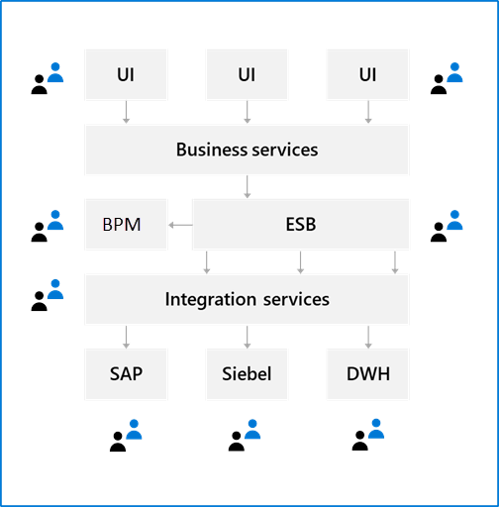
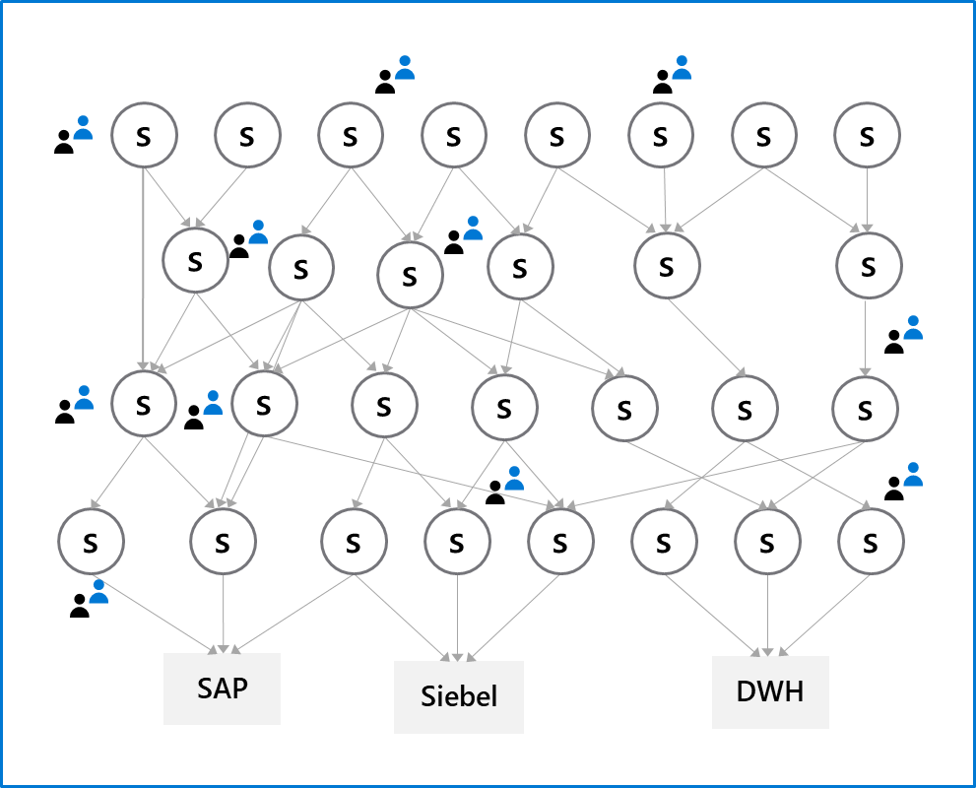
Explore microservices architecture

Slide 8
Examine classical deployment patterns
Dev
Test
Staging
Production

Slide 9

Understand modern deployment patterns
Blue-green deployments
Canary releases
Dark launching
A/B testing
Progressive exposure deployment/ring-based deployments
Feature toggles

Slide 10
Discussion: A critical look at your architecture
Are your architecture and the current state of your software ready for continuous delivery?
Topics you might want to consider are:
Is your software built as one big monolith or is it divided into multiple components?
Can you deliver parts of your application separately?
Can you guarantee the quality of your software when deploying multiple times, a week?
How do you test your software?
Do you run one or multiple versions of your software?
Can you run multiple versions of your software side-by-side?
What do need to improve to implement continuous delivery?

Slide 11
Module 02: Implement blue-green deployment and feature toggles

Slide 12
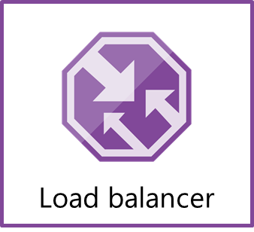
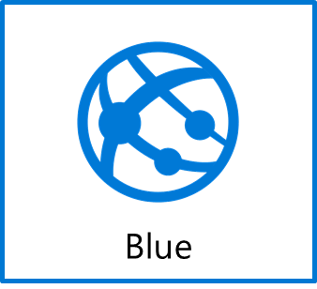

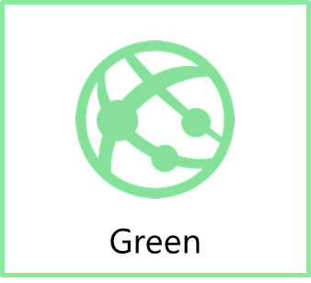
What is blue-green deployment?
www.production.com
Swap
www.temp.production.com

Slide 13
Explore deployment slots
What is it?
A way to set up multiple environments and swap between environments
Why do you need it?
When you want to deploy with zero downtime
When you need to test in production
When you want easy rollback
Swap
The swap process eliminates downtime when you deploy your app with seamless traffic redirection, and no requests are dropped because of swap operations.
Notes:
Explain Swap https://docs.microsoft.com/azure/app-service/deploy-staging-slots#what-happens-during-a-swap.

Slide 14
Demonstration: Set up a blue–green deployment
DEMO
Notes:
Take a moment to complete the demonstration, as defined in the student manual.

Slide 15
Introduction to feature toggles
What is it?
Mechanism to separate feature deployment from feature exposure
A.k.a. feature flippers, feature flags, feature switch, conditional feature, etc.
Why do you need it?
It enables you to give control back to the business on when to release the feature
Enables A/B testing, canary releases and dark launching
It provides an alternative to keeping multiple branches in version control
Enables change without redeployment

Slide 16
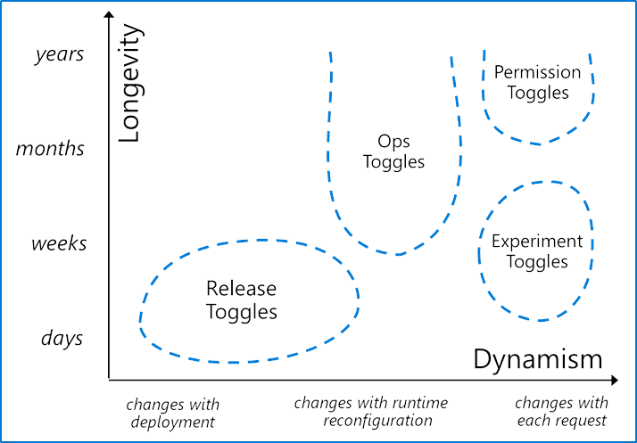
Describe feature toggle maintenance
Feature toggles need to be maintained
Remove them when you can
It is technical debt if you keep them around
Source: http://martinfowler.com/articles/feature-toggles.html

Slide 17

Module 03: Implement canary releases and dark launching

Slide 18

Explore canary releases
What is it?
Releasing a feature to a limited subset of end users
When you want to gradually roll out a feature to ensure success
How to implement it
Use a combination of feature toggles, traffic routing and deployment slots
Route traffic % to a deployment slot with the new feature enabled
Target specific user segment (via feature toggles)

Slide 19
Examine traffic manager
What is it?
Traffic manager provides the ability to control how requests from web clients are distributed to apps in Azure App Service. Within an app service, it routes traffic between deployment slots
Why do you need it?
It enables failover and load distribution capabilities
It enables you to deploy to a slot and then slowly move traffic over to the other slot
What does it offer?
It provides several options for how to distribute traffic, all based on availability

Slide 20
Understand dark launching
Like canary releases, but the aim is to assess response of users to new features
Testing of the back end is not the primary aim
Users are often not aware they are being used to test the new feature

Slide 21
Module 04: Implement A/B testing and progressive exposure deployment

Slide 22
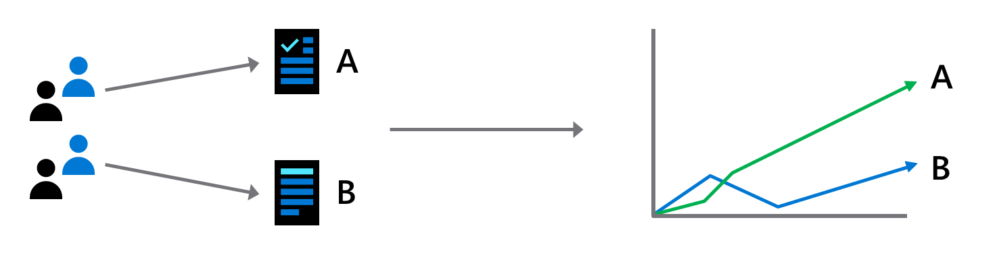
What is A/B testing?
A/B testing is an experiment where two or more variants are shown to users at random, and statistical analysis is used to determine which variation performs better for a given conversion goal

Slide 23
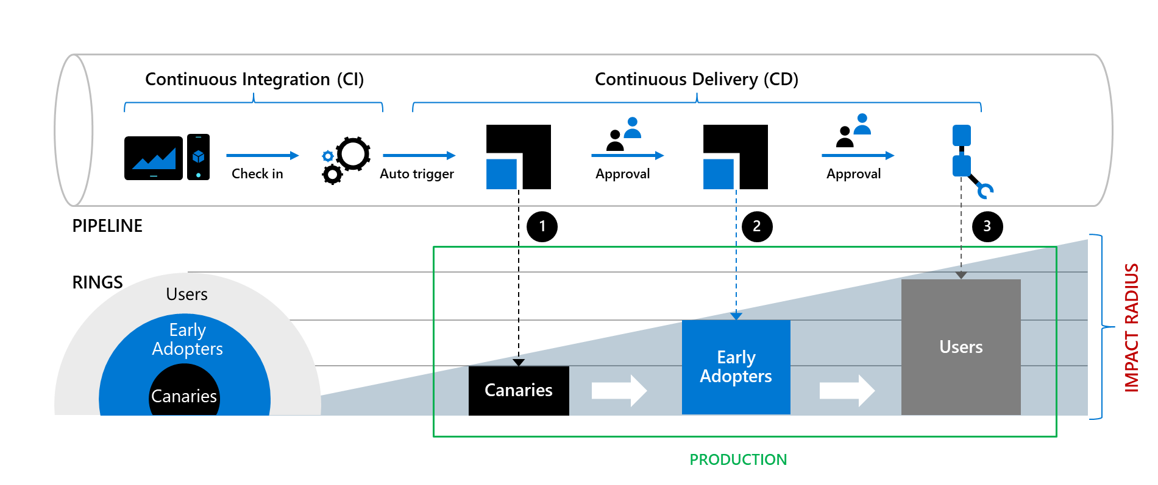
Explore CI/CD with ring-based deployment

Slide 24
Demonstration: Ring-based deployment
DEMO
Notes:
Take a moment to complete the demonstration, as defined in the student manual.

Slide 25
Module 05: Integrate with identity management systems

Slide 26
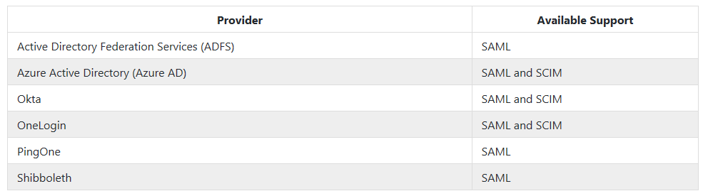
Integrate GitHub with single sign-on (SSO)
Connect identity provider to GitHub at organization level
Both SAML and SCIM support available

Slide 27
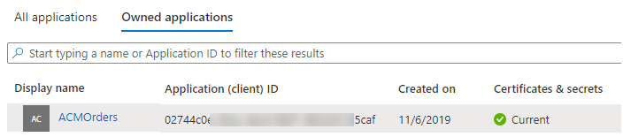
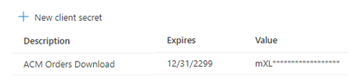
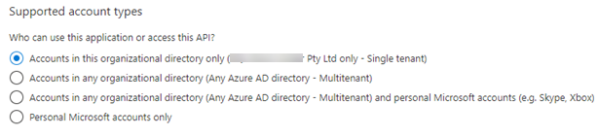
Explore service principals
Register an AD application
Create a client secret
Grant permissions to the identity
To connect, application presents: -
- TenantID
- Application ID
- Client Secret

Slide 28


Explore Managed Identity
Two types of managed identity:
System-assigned (many services expose these identities)
User-assigned (create a managed identity and assign it to services)
Identity to use?
Managed identities remove the need for the user to provide ongoing management of a credential.

Slide 29
Module 06: Manage application configuration data

Slide 30
Rethink application configuration data
Configuration information is stored in files
Changes can require downtime and administrative overhead
Challenging to manage changes to local configurations across multiple running instances of the application
Discussion: How will you secure this information?

Slide 31
Explore separation of concerns
Configuration custodian: Responsible for generating and maintaining the life cycle of configuration values
Configuration consumer: Responsible for defining the schema (loose term) for the configuration and then consuming the configuration values in the application or library code
Configuration store: The underlying store that is leveraged to store the configuration
Secret store: A separate store for persisting secrets

Slide 32
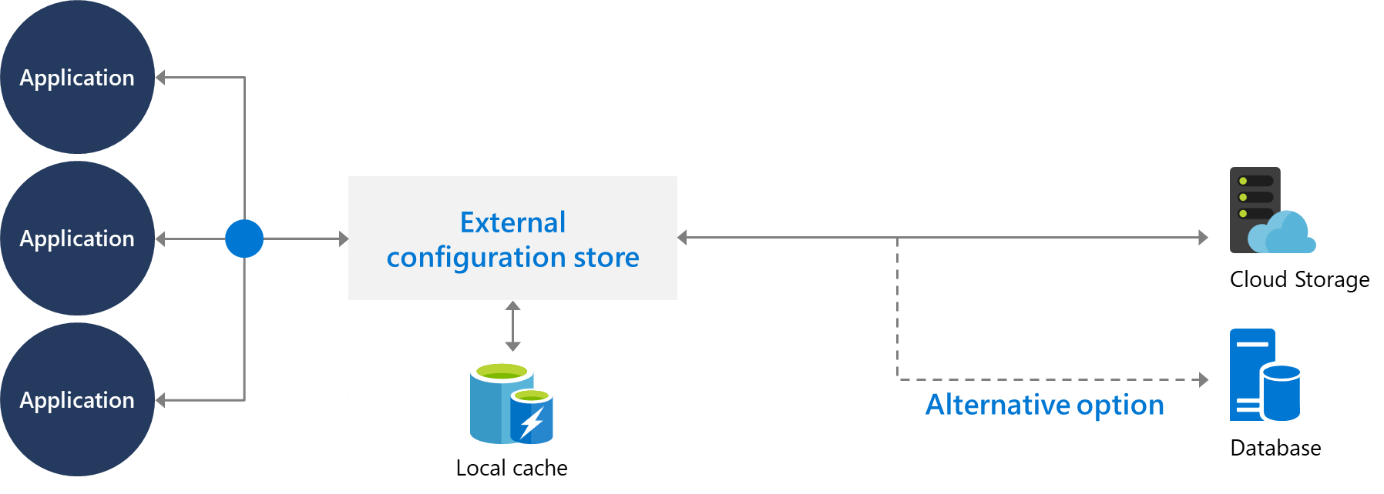
Understand external configuration store patterns
Store the configuration information in external storage.
Provide an interface to quickly and efficiently read and update.

Slide 33

Introduction to Azure App Configuration
Useful for most applications but particularly applicable to:
Distributed applications (particularly microservice applications)
Serverless applications
Centralize management and distribution of hierarchical configuration data for different environments and geographies
Dynamically change application settings without the need to redeploy or restart an application
Control feature availability in real-time

Slide 34
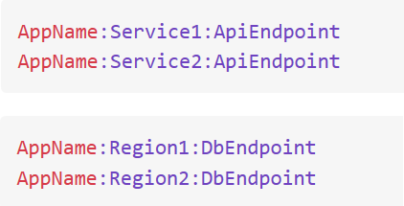
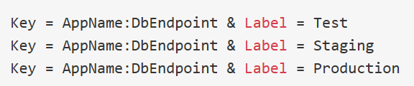
Examine Key-value pairs
Service stores key-value pairs
Keys and values are all Unicode strings
Recommend using hierarchical naming for keys
Labels can be used to store different values for a particular key
Labels can provide a way of versioning keys

Slide 35
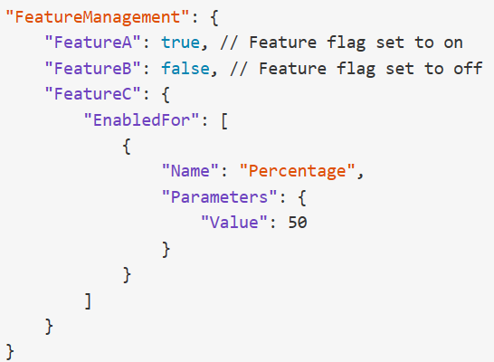
Examine App configuration feature management
Azure App Configuration can also act as a central repository for feature flags.
Feature flags have two parts:
Name
List of one or more filters
Filters are use cases for when an application feature should be enabled
Supports appsettings.json as a configuration source for feature flags

Slide 36
Integrate Azure Key Vault with Azure Pipelines
Azure Key Vault allows you to manage your organization’s secrets and certificates in a centralized repository.
Azure Key Vault stores secrets, keys, and certificates.

Slide 37
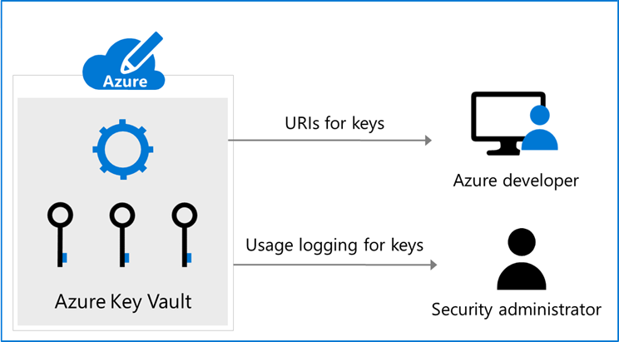
Manage secrets, tokens and certificates
Centralize application secrets
Securely store secrets and keys
Monitor access and use
Simplified administration of application secret
Integrate with other Azure services

Slide 38
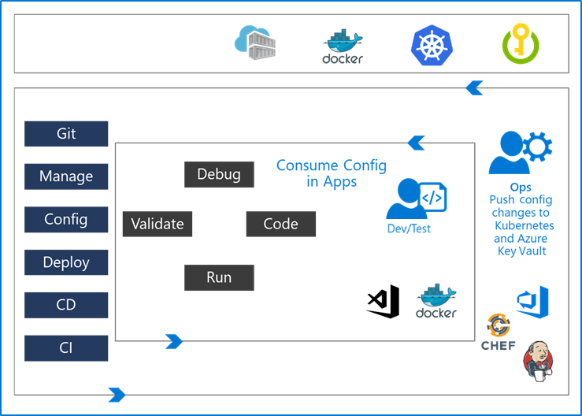
Examine DevOps inner and outer loop
The inner loop is focused on the developer teams iterating over their solution development.
Developer teams consume the configuration published by the outer loop.
The Ops Engineer governs the configuration management and pushes the changes.

Slide 39
Labs

Slide 40
Lab: Configuring pipelines as code with YAML
Lab overview:
Azure DevOps also provides default templates for popular project types, as well as a YAML designer to simplify the process of defining build and release tasks.
Objectives:
Configure CI/CD pipelines as code with YAML in Azure DevOps
Duration:
Notes:
The labs are updated on a regular basis. For the latest information please visit:
https://microsoftlearning.github.io/AZ400-DesigningandImplementingMicrosoftDevOpsSolutions/

Slide 41
Lab: Setting up and running functional tests
Lab overview:
In this lab, you will learn how to execute Selenium test cases on a C# web application, as part of the Azure DevOps Release pipeline.
Objectives:
Configure a self-hosted Azure DevOps agent
Configure release pipeline
Trigger build and release
Run tests in Chrome and Firefox
Duration:
Notes:
The labs are updated on a regular basis. For the latest information please visit:
https://microsoftlearning.github.io/AZ400-DesigningandImplementingMicrosoftDevOpsSolutions/

Slide 42
Lab: Integrating Azure Key Vault with Azure DevOps
Lab overview:
In this lab, you will see how you can integrate Azure Key Vault with an Azure DevOps pipeline.
Objectives:
Create an Azure Active Directory (Azure AD) service
principal
Create an Azure key vault
Track pull requests through the Azure DevOps pipeline
Duration:
Notes:
The labs are updated on a regular basis. For the latest information please visit:
https://microsoftlearning.github.io/AZ400-DesigningandImplementingMicrosoftDevOpsSolutions/

Slide 43
Lab: Enable Dynamic Configuration and Feature Flags
Lab overview:
Azure App Configuration provides a service to centrally manage application settings and feature flags. Use App Configuration to store all the settings for your application and secure their accesses in one place.
Objectives:
Enable dynamic configuration
Manage feature flags
Duration:
Notes:
The labs are updated on a regular basis. For the latest information please visit:
https://microsoftlearning.github.io/AZ400-DesigningandImplementingMicrosoftDevOpsSolutions/

Slide 44
Learning Path review and takeaways

Slide 45
What did you learn?
Describe deployment patterns
Manage application config and secrets
Implement blue-green deployment
Deploy to environment securely using a service connection
Implement canary release
Integrate Azure Key Vault with a pipeline
Implement progressive exposure deployment

Slide 46
Learning Path review questions
1
What is the easiest way to create a staging environment for an Azure WebApp?
2
What Azure-based tool can you use to divert a percentage of your web traffic to a newer version of an Azure website?
3
What characteristics make users suitable for working with canary deployments?
4
What is a potential disadvantage of using canary deployments?
5
Apart from the traffic routing method, what else does Azure Traffic Manager consider when making routing decisions?
6
What is the Azure Key Vault and why would you use it?
Notes:
Q1 Answer: Create a deployment slot.
Q2 Answer: Azure Traffic Manager
Q3 Answer: High tolerance for issues; Like working with bleeding-edge code.
Q4 Answer: Needing to look after multiple versions of code at the same time. Or, the users might not be the right ones to test changes in the particular deployment.
Q5 Answer: Availability of the end point. (It includes built-in endpoint monitoring and automatic endpoint failover)
Q6 Answer: Azure Key Vault is a cloud key management service which allows you to create, import, store & maintain keys and secrets used by your cloud applications. The applications have no direct access to the keys, which helps improving the security & control over the stored keys & secrets. Use the Key Vault to centralize application and configuration secrets, securely store secrets and keys, and monitor access and use.

