Slide 1
AZ-400.00 Learning Path 06: Manage infrastructure as code using Azure and DSC

Slide 2
Learning Path overview

Slide 3
Learning Path overview
Module 01: Explore infrastructure as code and configuration management
Module 05: Explore Azure Automation with DevOps
Module 02: Create Azure resources using Azure Resource Manager templates
Module 06: Implement Desired State Configuration (DSC)
Module 03: Implement Bicep
Labs & Learning Path review and takeaways
Module 04: Create Azure resources by using Azure CLI

Slide 4
Learning objectives
After completing this Learning Path, students will be able to:
Apply infrastructure and configuration as code principles
Deploy and manage infrastructure using Microsoft automation technologies such as ARM templates, Azure CLI, DSC and Azure Automation

Slide 5
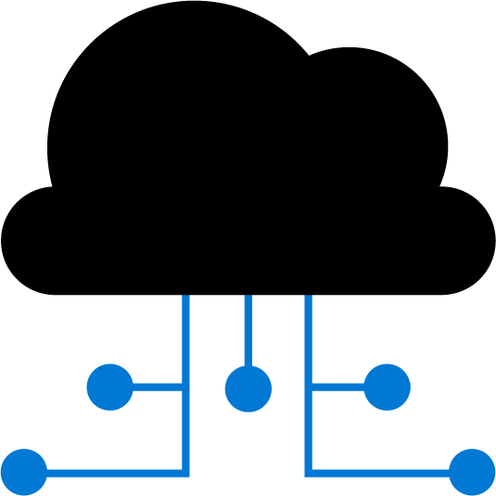
Module 01: Explore infrastructure as code and configuration management

Slide 6
Explore environment deployment
Manual deployment:
Snowflake servers
Deployment steps vary by environment
More verification steps and more elaborate manual processes
Increased documentation to account for differences
Deployment on weekends to allow time to recover from errors
Slower release cadence to minimize pain and long weekends
Infrastructure as code:
Consistent servers between environments
Environments created or scaled easily
Fully automate creation and updates of environments
Transition to immutable infrastructure
Use blue/green deployments
Treat servers as commodities, not pets
Notes:
Could highlight two items to ensure students understand the meaning:
Immutable means that the service is not updated. If a change is needed to an environment, a new one is deployed and the old one taken down.
blue/green deployments. This is a release methodology to minimize downtime, where two identical environments exist, one is live and the other is not. Updates are applied to the server that is not live, and when testing is verified and complete, it is switched to become the live environment and the previous live environment is no longer the live environment i.e. they are swapped. It can also be referred to as A/B deployment.
Common scenario for Infrastructure as Code: Server failure
Difficulty of reproducing steps for setting up a new machine from memory or disparate sources
Potential for human error when initializing machines
Severe implications if a machine crashes and must be immediately replaced
Solution: treat environments and infrastructure like code
Deployed from a single consistent definition
This is termed Infrastructure as Code
Maintain a consistent environment between development and production

Slide 7
Examine environment configuration
Manual configuration:
Configuration bugs difficult to Identify
Error prone
More verification steps and more elaborate manual processes
Increased documentation
Deployment on weekends to allow time to recover from errors
Slower release cadence to minimize requirement for long weekends
Configuration as code:
Bugs easily reproducible
Consistent configuration
Increase deployment cadence to reduce amount of incremental change
Treat environment and configuration as executable documentation
Notes:
Could discuss definitions and understanding of Configuration Management such as:
Automated management of configuration via scripts
Scripts define the configuration of an application, and the environment and infrastructure required to support it
Lighter-weight executable configurations
Enable the scripting and automation of environment configuration
Infrastructure as Code can describe both provisioning and configuration of environments
This model scales better across multiple servers than a manual deployment would

Slide 8
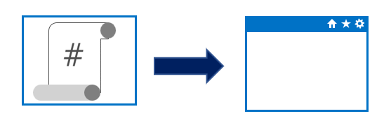
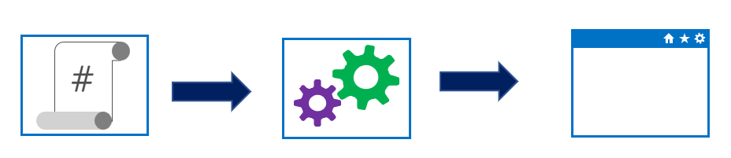
Understand imperative versus declarative configuration
Approaches to implementing infrastructure and configuration as code
Declarative:
Functional
Defines what the final state should be
Imperative:
Procedural
Defines how to achieve that final state
Notes:
Could mention that Imperative can also be known or called as procedural. And Declarative can sometimes be referred to as functional.
Declarative abstracts away the methodology of how a state is achieved.
A declarative approach would generally be the preferred option where ease of use is the main goal. Azure Resource Manager template files are an example of a declarative automation approach.
An imperative approach may have some advantages where there are complex scenarios where changes in the environment take place relatively frequently, which need to be accounted for in your code.
There is no absolute on which is the best approach to take, and individual tools may be able to be used in either declarative or imperative forms. The best approach for you to take will depend on your particular needs

Slide 9
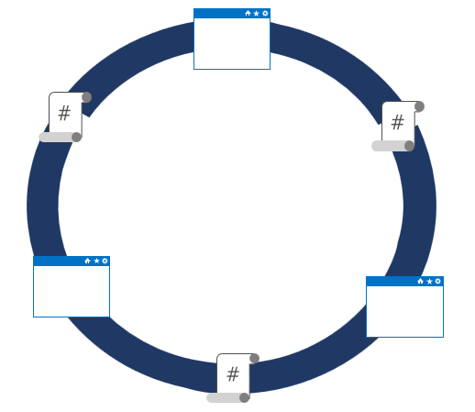
Understand idempotent configuration
Idempotence – definition:
Mathematical term used in the context of infrastructure and configuration as code
Ability to apply one or more operations against a resource, resulting in the same outcome
To attain idempotence:
Automatically configure and reconfigure an existing set of resources, or
Discard existing resources and spin up a fresh environment
Notes:
Idempotence – mathematical term used in the context of infrastructure and configuration as code, referring to the ability to apply one or more operations against a resource, resulting in the same outcome.
For more information about idempotence in general and in the context of Azure, see - https://www.wintellect.com/idempotency-for-windows-azure-message-queues/

Slide 10
Module 02: Create Azure resources using Azure Resource Manager templates

Slide 11
Why use Azure Resource Manager templates?
Make deployments faster and more repeatable
Improve consistency by providing a common language
Enable you to deploy multiple resources in the correct order by mapping out resource dependencies
Reduce manual, error-prone tasks
Templates can be linked together to provide a modular solution (might build on QuickStart Templates)
Notes:
Can discuss some of the benefits of using ARM templates when deploying and configuring resources in Azure.

Slide 12
Explore template components
JSON data stored as an object in text
Collection of key-value pairs
Templates can contain the following sections:
Parameters
Variables
Functions
Resources
Outputs
Notes:
Go over the examples provided in the student content of each different section in an ARM template.
JSON allows us to express data stored as an object (such as a virtual machine) in text. A JSON document is essentially a collection of key-value pairs.

Slide 13
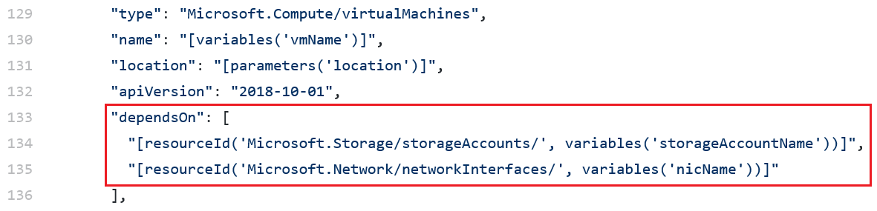
Manage dependencies
Some resources will depend on other resources before you can deploy them
Define this relationship by marking the dependency with the dependsOn element
Notes:
You can define this relationship by marking one resource as dependent on the other resource. You define a dependency with the dependsOn element. You can also use the reference function.
Mention troubleshooting circular reference problems, by either removing a dependency or moving a dependency into a child resource that is deployed after the resources that contained the problem dependency.

Slide 14
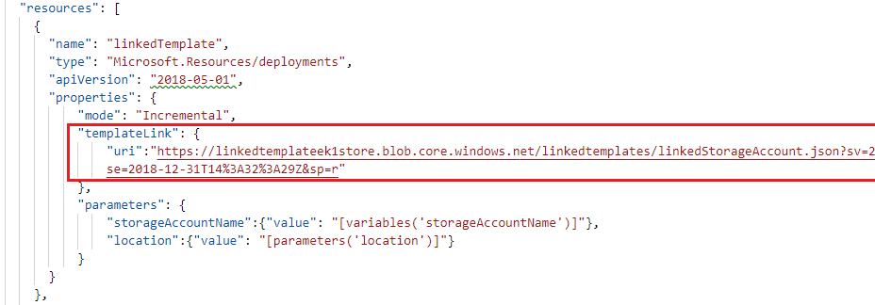
Modularize templates
Best practice: Modularize templates into individual components:
Use linked templates to break the solution into individual pieces
Reuse those elements across different deployments
Notes:
Also discuss using nested templates with the template property and syntax. You can refer students to the examples in the content.
Mention that while there are two deployment modes available that incremental mode is the default mode and it doesn’t remove or modify any resources not defined in the template.
Mention that it’s a best practice to use one resource group per deployment.
Also discuss securing an external template by adding the template to a private storage account and providing a SAS token to enable access during deployment.

Slide 15
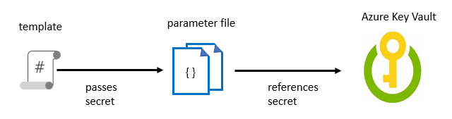
Manage secrets in templates
When passing a secure value (e.g., a password) as a parameter during deployment:
Create a key vault and secret using Azure CLI or PowerShell
Enable Azure Resource Manager access for template deployment
Reference the key pair in the parameter file, not the template
Enable access to the secret. Owner and Contributor roles grant access
Deploy the template and pass in the parameter file
Notes:
For more information about how to use Azure Key Vault to pass secure parameter value during deployment, see: https://docs.microsoft.com/en-us/azure/azure-resource-manager/resource-manager-keyvault-parameter
There also are details available on this page on how to reference a secret with a dynamic ID.
Discuss the example in the student content where a template is used to deploy a SQL database with an admin password. Outline the process of creating the key vault and secret and enabling access to the secret via permissions. Point out that the key vault ID is referenced in the parameter file, not the template, with the actual value never being exposed.
Note: we have not yet defined Azure CLI in the course, so you may need to tell students that it is a command line scripting interface for deployment and configuration of resources in Azure.

Slide 16
Module 03: Implement Bicep

Slide 17
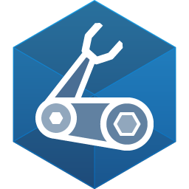
What is Bicep?
Azure Bicep is the next revision of ARM templates designed to solve some of the issues developers were facing when deploying their resources to Azure.
Code
param storageName string = 'stg${uniqueString(resourceGroup().id)}'
param location string = resourceGroup().location
resource storageaccount 'Microsoft.Storage/storageAccounts@2021-02-01' = {
name: 'name'
location: location
kind: 'StorageV2'
sku: {
name: 'Premium_LRS'
}
}
Note: Beware that when converting ARM templates to Bicep, there might be issues since it's still a work in progress.
Notes:
Azure Bicep is the next revision of ARM templates designed to solve some of the issues developers were facing when deploying their resources to Azure. It's an Open Source tool and, in fact, a domain-specific language (DSL) that provides a means to declaratively codify infrastructure, which describes the topology of cloud resources such as VMs, Web Apps, and networking interfaces. It also encourages code reuse and modularity in designing the infrastructure as code files.
The new syntax allows you to write less code compared to ARM templates, which are more straightforward and concise and automatically manage the dependency between resources. Azure Bicep comes with its command line interface (CLI), which can be used independently or with Azure CLI. Bicep CLI allows you to transpile the Bicep files into ARM templates and deploy them and can be used to convert an existing ARM template to Bicep.
There's also an excellent integration with Visual Studio Code that creates a superb authoring experience. Azure Bicep supports types that are used to validate templates at development time rather than runtime. The extension also supports linting, which can be used to unify the development experience between team members or across different teams.
For more information, see: https://docs.microsoft.com/en-us/learn/modules/implement-bicep/2-what-bicep and https://docs.microsoft.com/en-us/azure/azure-resource-manager/bicep/overview

Slide 18
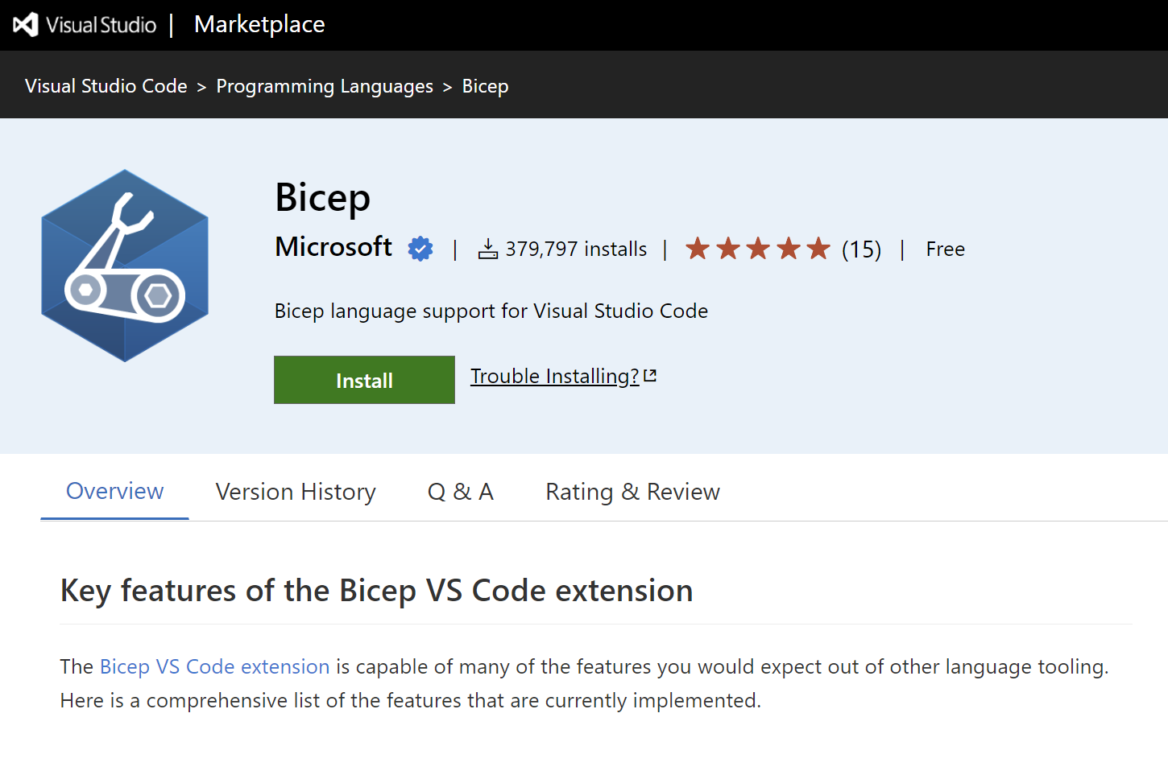
Install Bicep
Install the Bicep CLI or the Visual Studio Code Extension.
The extension provides language support, IntelliSense, and linting support.
az bicep install choco install bicep winget install -e --id Microsoft.Bicep bicep --help
Notes:
To start, install the Bicep CLI or the https://marketplace.visualstudio.com/items?itemName=ms-azuretools.vscode-bicep/. Having both installed will give you a great authoring experience.
The extension provides language support, IntelliSense, and linting support.
Installing Bicep CLI
You need to have Azure CLI version 2.20.0 or later installed to be able to install the Bicep CLI. When you're ready, run the install command:
Azure CLI:
az bicep install
You can upgrade the Bicep CLI by running the az bicep upgrade, and for validating the installation, use the az bicep version.
We deliberately avoided breaking down the installation for Windows, macOS, and Linux since Azure CLI is cross-platform, and the steps would be the same.
For more information, see: https://docs.microsoft.com/en-us/learn/modules/implement-bicep/3-install-bicep

Slide 19
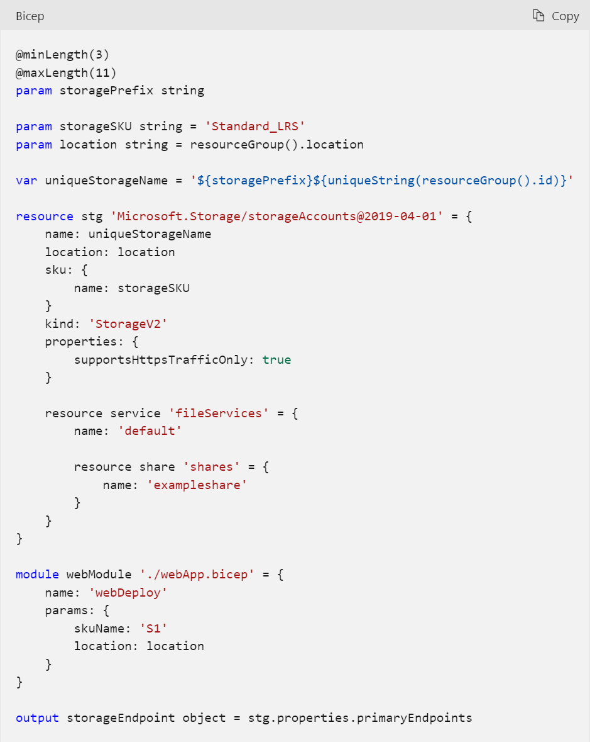
Understand Bicep file structure and syntax
Azure Bicep comes with its own syntax, however, it's easy to understand and follow:
Scope.
Parameters.
Variables.
Resources.
Modules.
Outputs.
Other features: loops, conditional deployment, multiline strings, referencing an existing cloud resource, and many more.
Notes:
Azure Bicep comes with its own syntax, however, it's easy to understand and follow. We won't go deep into the syntax and structure, but let's review the main concepts using an example.
Scope
By default, the target scope of all templates is set for resourceGroup, however, you can customize it by setting it explicitly. As other allowed values, subscription, managementGroup, and tenant.
Parameters
You've already used the parameters in the previous unit. They allow you to customize your template deployment at run time by providing potential values for names, location, prefixes, etc.
Parameters also have types that editors can validate and also can have default values to make them optional at deployment time. Additionally, you can see they can have validation rules to make the deployment more reliable by preventing any invalid value right from the authoring. For more information, see https://docs.microsoft.com/en-us/azure/azure-resource-manager/bicep/parameters/.
Variables
Similar to parameters, variables play a role in making a more robust and readable template. Any complex expression can be stored in a variable and used throughout the template. When you define a variable, the type is inferred from the value.
In the above example, the uniqueStorageName is used to simplify the resource definition. For more information, see https://docs.microsoft.com/en-us/azure/azure-resource-manager/bicep/variables/.
Resources
The resource keyword is used when you need to declare a resource in your templates. The resource declaration has a symbolic name for the resource that can be used to reference that resource later either for defining a subresource or for using its properties for an implicit dependency like a parent-child relationship.
There are certain properties that are common for all resources such as location, name, and properties. There are resource-specific properties that can be used to customize the resource pricing tier, SKU, and so on.
You can define subresources within a resource or outside by referencing the parent. In the above example, a file share is defined within the storage account resource.
Modules
If you want truly reusable templates, you can't avoid using a module. Modules enable you to reuse a Bicep file in other Bicep files. In a module, you define what you need to deploy, and any parameters needed and when you reuse it in another file, all you need to do is reference the file and provide the parameters. The rest is taken care of by Azure Bicep.
In the above example, you're using a module that presumably is deploying an App Service. For more information, see https://docs.microsoft.com/en-us/azure/azure-resource-manager/bicep/modules/.
Outputs
You can use outputs to pass values from your deployment to the outside world, whether it is within a CI/CD pipeline or in a local terminal or Cloud Shell. That would enable you to access a value such as storage endpoint or application URL after the deployment is finished.
Other features
There are many other features available within a Bicep file such as loops, conditional deployment, multiline strings, referencing an existing cloud resource, and many more. In fact, any valid function within an ARM template is also valid within a Bicep file.
For more information, see: https://docs.microsoft.com/en-us/learn/modules/implement-bicep/5-understand-bicep-file-structure-syntax

Slide 20
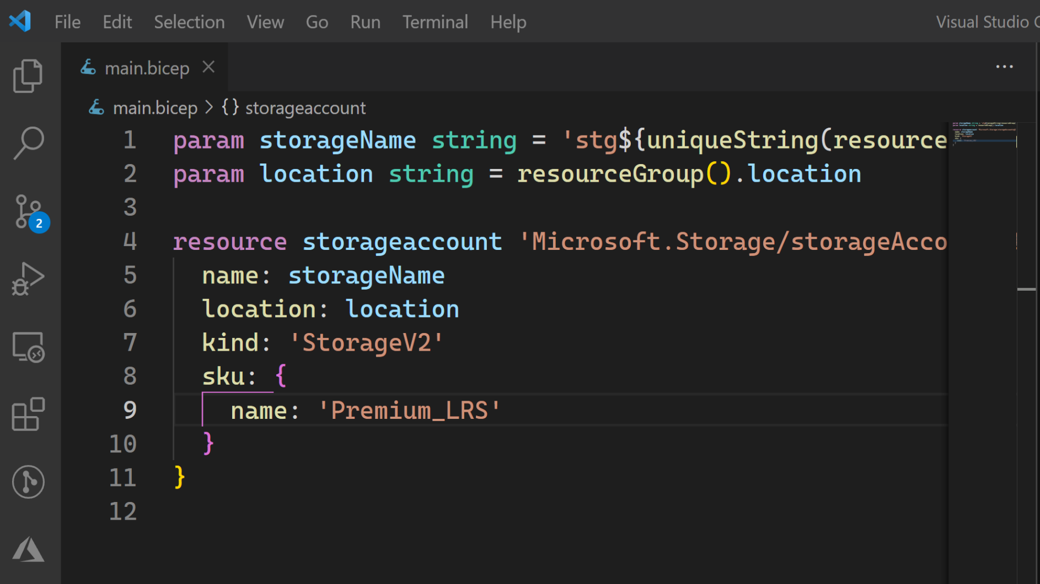
Demonstration: Create Bicep templates
DEMO
Notes:
Follow the steps: https://docs.microsoft.com/en-us/learn/modules/implement-bicep/4-exercise-create-bicep-templates

Slide 21
Demonstration: Deploy a Bicep file from GitHub workflows
DEMO
Notes:
Follow the steps: https://docs.microsoft.com/en-us/learn/modules/implement-bicep/7-exercise-deploy-bicep-file-github-workflows

Slide 22
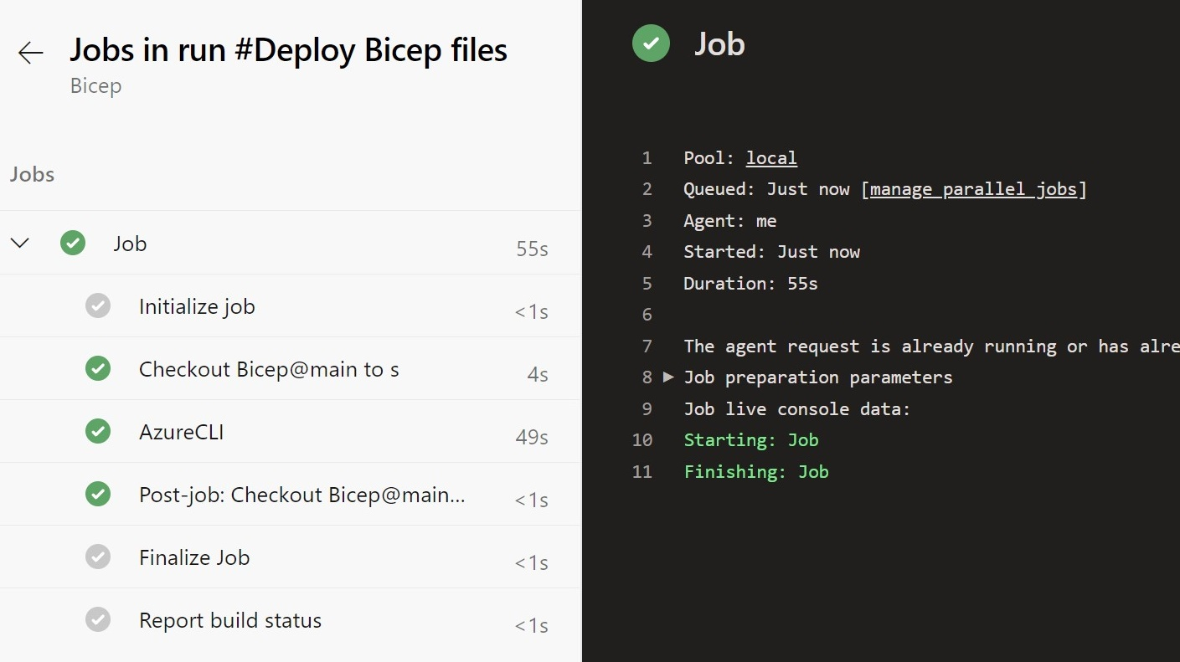
Demonstration: Deploy a Bicep file from Azure Pipelines
DEMO
Notes:
Optional. GitHub priority.
Follow the steps: https://docs.microsoft.com/en-us/learn/modules/implement-bicep/6-exercise-deploy-bicep-file-azure-pipelines

Slide 23

Module 04: Create Azure resources by using Azure CLI

Slide 24
What is Azure CLI?
Command-line program to connect to Azure (Azure Cloud Shell, PowerShell, or Bash)
Execute administrative commands on Azure resources through a terminal, command-line prompt, or script, instead of a web browser:
For example, to restart a VM use the command:
az vm restart -g MyResourceGroup -n MyVm
Can be installed on Linux, macOS, or Windows computers, and added as a module to PowerShell
Can be used interactively or scripted:
Interactive: Issue commands directly at the shell prompt
Scripted: Assemble the CLI commands into a shell script and then execute the script
Notes:
The Azure CLI is a command-line program to connect to Azure and execute administrative commands on Azure resources. It runs on Linux, macOS, and Windows and allows administrators and developers to execute their commands through a terminal or command-line prompt (or script!) instead of a web browser.
Mention the cross-platform command-line tools support for managing Azure resources, as well as the ability to access the CLI from the Cloud Shell.

Slide 25
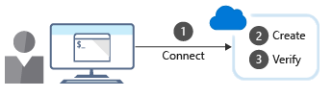
Work with Azure CLI
Commands in the CLI are structured in groups and subgroups:
Use az find to find commands you need az find blob
Use the help argument to get more detail about the command az storage blob --help
Creating a new Azure resource typically involves the following process:
Notes:
Discuss how CLI is organized into groups and subgroups.
Explain how to use the find and - -help arguments to locate commands and their syntax. Use the examples provided in the content to talk about creating a resource group using group create, and viewing resource details using the list sub-command.
Point out the difference between using the shell and PowerShell when running CLI commands in scripts.

Slide 26
Demonstration: Run templates using Azure CLI
Process to deploy and verify a sample Azure deployment template with custom script extension using Azure CLI
1
Create a resource group to deploy your resources to
2
Run curl to download the GitHub template
3
Validate the template
4
Deploy the resource
5
Obtain the IP address
6
Run curl to access your web server and verify the successful deployment and running of the custom script extension
Always remember to delete any resources you deployed when no longer needed to avoid incurring additional costs on them
Notes:
This unit is best presented by either running the template from the Cloud Shell as a demonstration or walking through the syntax. The steps in the process are listed on the slide as a high-level organizer.

Slide 27
Module 05: Explore Azure Automation with DevOps

Slide 28
What is Azure Automation?
An Automation service integrated with Microsoft Azure for automating and simplifying the creation, deployment, monitoring and maintenance of Azure resources and resources external to Azure
Azure Automation Capabilities include:
Manage Shared resources
State configuration
Integration with GitHub, Azure DevOps Git/TFVC
Update management
Can automate Windows or Linux environments
Can apply to any system that exposes an API over internet protocols

Slide 29
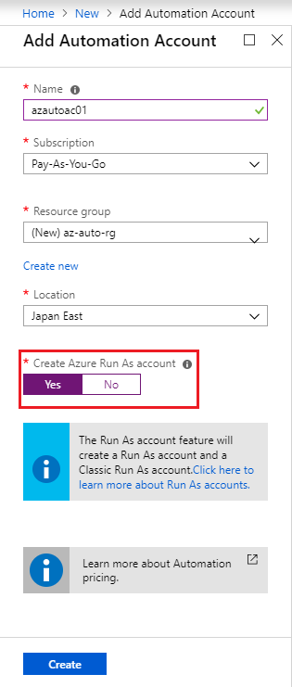
Create automation accounts
To use Azure Automation, you must create an Automation account
Automation account acts as a container in which you store, manage and use automation artifacts
Provides a way to separate your environments or further organize your Automation workflows and resources.
Requires subscription-owner level access as provides access to all Azure resources via an API
Need at least one automation account but should have multiple for access control
Run As account:
Creates a service principal in Azure AD which allows access to Azure resources when running automation
Notes:
Could create Azure Automation accounts for dev, test, production, security, or other elements in your pipeline for more granular auditing, cost analysis and general management, as well as increased security.
When you create a Run As account, it creates a new service principal user in Azure Active Directory and assigns the Contributor role to this user at the subscription level

Slide 30
What is a runbook?
A runbook is a set of tasks that perform some automated process in Azure Automation
Runbooks serve as repositories for your custom scripts and workflows
Can create your own or import and modify from community via Runbook Gallery
Runbook Types available:
Graphical runbook
PowerShell runbooks
PowerShell Workflow runbooks
Python runbooks
Notes:
They also typically reference Automation shared resources such as credentials, variables, connections, and certificates.
Runbooks can contain other runbooks, thereby allowing you to build more complex workflows. You can invoke and run runbooks either on demand, or according to a schedule by leveraging Automation Schedule assets
All the runbooks from Script Center in the Runbook gallery have been moved to Github. Note : Runbooks from Powershell Gallery will remain as-is without any changes.
Link: https://github.com/MicrosoftDocs/azure-docs/blob/main/articles/automation/automation-runbook-gallery.md
https://github.com/azureautomation
https://www.powershellgallery.com/

Slide 31
Understand automation shared resources
Azure Automation contains shared resources that are globally associated available to be used in, or with a runbook
Currently Eight Categories:
Schedules
Modules
Modules gallery
Python packages
Credentials
Connections
Certificates
Variables
Notes:
As a best practice, always try to create global assets so they can be used across your runbooks. This will save time and reduce the number of manual edits within individual runbooks.
Python 2 (version 2.7), or Python 3 (versions 3.5 and higher)

Slide 32
Explore runbook gallery
Can import pre-existing runbooks from the runbook repository at the Azure Automation GitHub
Runbooks provided to help eliminate the time it takes to build custom solutions
Already been built by Microsoft and the Microsoft community
Can be used with or without modification
Can review the code or a visualization of the runbook code on the gallery as well as see source projects, rating, etc.
Considerations:
Python runbooks are also available from the Azure Automation GitHub. To find them, filter by language and select Python
You cannot use PowerShell to import directly from the Runbook Gallery
Notes:
Could go to Runbook repository and show students the Azure Automation GitHub at the URL below:
https://github.com/azureautomation
Repo: https://github.com/azureautomation/runbooks
https://www.powershellgallery.com/

Slide 33
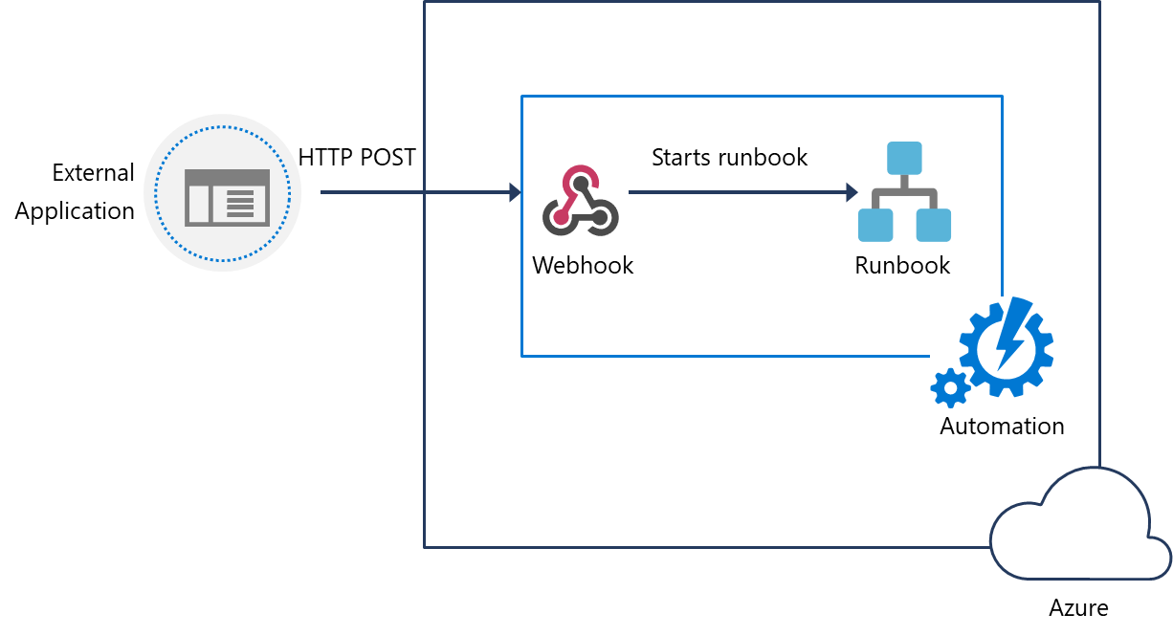
Examine webhooks
Automate the process of starting a runbook either by scheduling it, or by using a webhook.
Uses a HTTP request to start a runbook
Reduces complexity and allows external services such as Azure DevOps, GitHub, or custom applications to use webhooks
Webhook Syntax: http://< Webhook Server >/token?=< Token Value >
Notes:
Note: When creating a webhook, make sure you make a copy of the webhook URL when creating it, and then store it in a safe place. After you create the webhook, you cannot retrieve the URL again. This is for security purposes
Also, when creating a webhook if the runbook has mandatory parameters, you will need to provide these mandatory parameters during webhook creation. You are not able to create the webhook unless values are provided.

Slide 34
Explore source control integration
Azure Automation supports source control integration
Azure Automation supports the following source Control options:
Easier collaboration
GitHub
Increased auditing and traceability
Roll back to earlier versions of your runbooks
Azure DevOps (Git)
Can push code from Azure Automation to source control or pull your runbooks from source control to Azure Automation
Azure DevOps (TFVC)
Notes:
Allows you to sync different branches in source control to your development, test, or production Azure Automation accounts.
Source control sync jobs run under the user's Automation Account and are billed at the same rate as other Automation jobs.

Slide 35
Explore PowerShell workflows
Allows automation and orchestration of multi-environment tasks
Built on PowerShell and based on Windows Workflow Foundation
Characteristics:
Contain Activities – which are a core component of a workflow, specific tasks in a workflow
Tasks can be run in parallel
Can be long-running and repeated over and over (idempotent)
Be interrupted—can be stopped and restarted, suspended and resumed.
Continue after an unexpected interruption, such as a network outage or computer/server restart

Slide 36
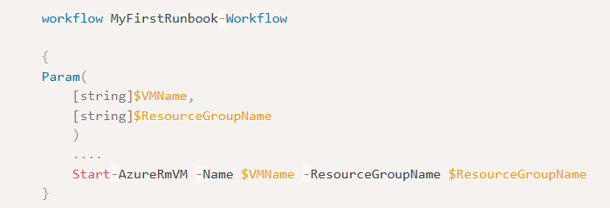
Create a workflow
There are syntax differences between PowerShell scripts and Workflows
Requires keyword workflow to identify a workflow command
Add parameter values using keyword Param
Notes:
A benefit of using PowerShell ISE is that it automatically compiles your code and allows you to save the artifact. Because the syntactic differences between scripts and workflows are significant, a tool that knows both workflows and scripts will save you significant coding and testing time.

Slide 37
Explore hybrid management
Hybrid Runbook Worker feature of Azure Automation allows you to run runbooks that manage local resources in your private datacenter, on machines located in your datacenter.
On-Premises
Azure
Hybrid Runbook
Worker group
Azure Automation
Local Server
Runbooks
Windows Hybrid Runbook Worker
TCP 443
Azure Resources
TCP 443
Linux Hybrid Runbook Worker
Local Resources
. . .
Notes:
Hybrid Runbook Worker workflow and characteristics
The following list are characteristics of the Hybrid Runbook Worker workflow:
You can designate one or more computers in your datacenter to act as a Hybrid Runbook Worker, and then run runbooks from Azure Automation.
Each Hybrid Runbook Worker is a member of a Hybrid Runbook Worker group, which you specify when you install the agent.
A group can include a single agent, but you can install multiple agents in a group for high availability.
There are no inbound firewall requirements to support Hybrid Runbook Workers, only Transmission Control Protocol (TCP) 443 is required for outbound internet access.
The agent on the local computer initiates all communication with Azure Automation in the cloud.
When a runbook is started, Azure Automation creates an instruction that is retrieved by the agent. The agent then pulls down the runbook and any parameters prior to running it.

Slide 38
Demonstration: Create and run a workflow runbook
This demonstration will create a new PowerShell workflow runbook, test, publish and then run the runbook
You can complete this walkthrough task by completing the steps outlined below, or you can simply read through them, depending on your available time
Notes:
Students can just read through the tasks and get a feel for how it works or actually step through it like a lab task.
Another option could be to complete the walkthrough at the end of the module, and complete all or some of the walkthroughs in the module together at that stage, like an end of module or even end of course lab.

Slide 39
Examine checkpoint and parallel processing
Checkpoints:
If a workflow ends in an error or is suspended, it will start from its last checkpoint the next time it runs
You can set a checkpoint in a workflow with the Checkpoint-Workflow activity
A checkpoint is a snapshot of the current state of the workflow
Parallel Processing:
Use the Parallel keyword to create a script block with multiple commands that run concurrently
Tasks within this script block will be run concurrently or in parallel
Can use For Each with Parallel keyword for more granular control on parallelism
Notes:
Can talk through this example of Parallel task and run order.
Parallel
{
Start-AzureRmVM -Name $vm0 -ResourceGroupName $rg
Start-AzureRmVM -Name $vm1 -ResourceGroupName $rg
}
Start-AzureRmVM -Name $vm2 -ResourceGroupName $rg
vm0 and vm1 VMs will be started concurrently, and vm2 will only start after vm0 and vm1 have started.

Slide 40
Module 06: Implement Desired State Configuration (DSC)

Slide 41
Understand configuration drift
Configuration drift:
Process whereby a set of resources change their state over time
Can occur from changes made by people, processes, or programs
Potential security risks introduced by configuration drift: Open ports that should have been closed
Inconsistent patching across environments
Software that doesn’t meet compliance requirements
Solutions that can help:
Windows PowerShell Desired State Configuration
Azure Policy
Many non-Microsoft solutions integrated with Azure

Slide 42
Explore Desired State Configuration (DSC)
Ensures that an environment is maintained in a state that you specify (defined state), to eliminate configuration drift, and no deviation from that defined state
Components:
Configurations: Idempotent declarative PowerShell scripts
Resources: PowerShell scripts compiled into .mof format files to ensure state
Local Configuration Manager (LCM): Client engine to ensure configuration
Methods of Implementing DSC:
Push mode: A user actively pushed put a configuration to environments
Pull mode: Clients get state from remote pull service automatically. Remote service is provided by a pull server, which acts as a central control and manager for the configurations
Notes:
not deviate from that defined state

Slide 43
Explore Azure Automation State configuration (DSC)
A cloud-based implementation of PowerShell DSC, available as part of Azure Automation
Characteristics:
Built-in pull server: Built-in pull server in Azure Automation eliminates the need to set up and maintain your own pull server
Management of all DSC artifacts: Manage all DSC configurations, resources, and target nodes in single instance in the Azure portal or PowerShell
Ability to Import Reporting Data directly into Azure Log Analytics: Can send this data to your Log Analytics workspace
Notes:
Could discuss how the general process for how Azure Automation State configuration works, which is as follows:
Create a PowerShell script with the configuration element
Upload the script to Azure Automation and compile the script into a MOF file. The file is transferred to the DSC pull server, which is provided as part of the Azure Automation service. (See Managed Object Format (MOF) file at https://docs.microsoft.com/en-us/windows/desktop/WmiSdk/managed-object-format--mof- for more information on MOF files.)
Define the nodes that will use the configuration, and then apply the configuration.

Slide 44
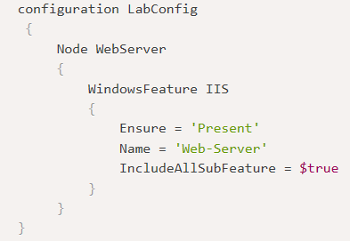
Examine DSC configuration file
DSC configurations are PowerShell scripts that define a special type of function.
Config File Elements:
Configuration block: Name of the configuration
Node block: Define nodes being configured e.g. VMs and servers
Resource blocks: Defines the actual configuration state for the nodes
Notes:
Configuration block. The Configuration block is the outermost script block. In this case, the name of the configuration is LabConfig. Notice the curly brackets to define the block.
Node block. There can be one or more Node blocks. These define the nodes (computers and VMs) that you are configuring. In this example, the node targets a computer called WebServer. You could also call it localhost and use it locally on any server.
Resource blocks. There can be one or more resource blocks. This is where the configuration sets the properties for the resources. In this case, there is one resource block called WindowsFeature. Notice the parameters that are defined. (You can read more about resource blocks at https://docs.microsoft.com/en-us/powershell/dsc/resources/resources)
Within a Configuration block, you can do almost anything that you normally could in a PowerShell function. You can also create the configuration in any editor, such as PowerShell ISE, and then save the file as a PowerShell script with a .ps1 file type extension.

Slide 45
Demonstration: Import and compile
This walkthrough will create a configuration file, will then import that configuration to Azure Automation State configuration (DSC) and then compile the configuration file to create the MOF file
You can complete this walkthrough task by completing the steps outlined below, or you can simply read through them, depending on your available time
Notes:
To do this programmatically you could use the PowerShell Start-AzAutomationDscCompilationJob cmdlet.

Slide 46
Demonstration: Onboarding machines for management
This walkthrough will follow on from the last walkthrough and will on-board virtual machines for management
You can complete this walkthrough task by completing the steps outlined below, or you can simply read through them, depending on your available time
Notes:
Important: Before you can complete this task you need to have provisioned virtual machine to Azure to allow you to onboard them. i.e. you will need to have deployed your VMs to Azure prior to starting:
If you do not have virtual machines available in Azure you can walk through the steps instead.
Note: You can also onboard on-premises virtual machines or virtual machines running in another cloud provider, such as AWS. For more information on onboarding on-premises VMs and non Azure cloud provider VMs, review the page https://docs.microsoft.com/en-us/azure/automation/automation-dsc-onboarding#physicalvirtual-windows-machines-on-premises-or-in-a-cloud-other-than-azureaws

Slide 47
Implement DSC and Linux Automation on Azure
The following Linux operating system versions are currently supported by both PowerShell DSC and Azure Automation DSC:
CentOS 6, 7, and 8 (x64)
Debian GNU/Linux 8, 9, and 10 (x64)
Oracle Linux 6 and 7 (x64)
Red Hat Enterprise Linux Server 6, 7, and 8 (x64)
SUSE Linux Enterprise Server 12 and 15 (x64)
Ubuntu Server 14.04 LTS, 16.04 LTS, 18.04 LTS, and 20.04 LTS (x64)
Notes:
Follow more specific, and up-to-date details are available at Get started with Desired State Configuration (DSC) for Linux.

Slide 48
Labs

Slide 49
Lab: Deployments using Azure Resource Manager templates
Lab overview:
In this lab, you will create an Azure Resource Manager template and modularize it by using a linked template. You will then modify the main deployment template to call the linked template and updated dependencies, and finally deploy the templates to Azure.
Objectives:
Create Resource Manager template
Create a Linked template for storage resources
Upload Linked Template to Azure Blob Storage and generate SAS token
Modify the main template to call Linked template
Modify main template to update dependencies
Deploy resources to Azure using linked templates
Duration:
Notes:
The labs are updated on a regular basis. For the latest information please visit:
https://microsoftlearning.github.io/AZ400-DesigningandImplementingMicrosoftDevOpsSolutions/

Slide 50
Learning Path review and takeaways

Slide 51
What did you learn?
Apply infrastructure and configuration as code principles
Deploy and manage infrastructure using Microsoft automation technologies such as ARM templates, Azure CLI, DSC and Azure Automation

Slide 52
Learning Path review questions
1
What benefits can you achieve by modularizing your infrastructure and configuration resources?
2
Which method of approach for implementing Infrastructure as Code states what the final state of an environment should be without defining how it should be achieved?
3
Which term defines the ability to apply one or more operations against a resource, resulting in the same outcome every time?
4
Which term is the process whereby a set of resources change their state over time from their original state in which they were deployed?
5
Which Resource Manager deployment mode only deploys whatever is defined in the template, and does not remove or modify any other resources not defined in the template?
Notes:
Q1 Answer: Easy to re-use across different environments, Easier to manage and maintain your code, Easier to troubleshoot, Easier to extend and add to your existing infrastructure definitions
Q2 Answer: Declarative
Declarative is the correct answer. The declarative approach states what the final state should be. When run, the script or definition will initialize or configure the machine to have the finished state that was declared, without defining how that final state should be achieved.
All other answers are incorrect. Scripted is not a methodology, and in the imperative approach, the script states the how for the final state of the machine by executing through the steps to get to the finished state. It defines what the final state needs to be, but also includes how to achieve that final state. Object-oriented is a coding methodology but does include methodologies for how states and outcomes are to be achieved.
Q3 Answer: Idempotency is the correct answer. It is a mathematical term that can be used in the context of Infrastructure as Code and Configuration as Code, as the ability to apply one or more operation against a resource, resulting in the same outcome.
Q4 Answer: configuration Drift. Configuration drift is the correct answer. It is the process whereby a set of resources change their state over time from the original state in which they were deployed.
Q5 Answer: Incremental is the correct answer.

Slide 53
Learning Path review questions
6
How are the dependencies defined in a .bicep file?
7
What is the behavior of the webAppName parameter for a team that created a template that contains this line: param webAppName string = 'mySite${uniqueString(resourceGroup().id)}'?
8
How can you reuse a Bicep template in other Bicep templates?
Notes:
Q6 Answer: Bicep uses implicit dependency using symbolic names and parent child properties.
Q7 Answer: The webAppName parameter will have a different value every time the template gets deployed.
Q8 Answer: By defining a module and referencing it in other files.

