Slide 1
AZ-400.00 Learning Path 07: Implement security and validate code bases for compliance

Slide 2
Learning Path overview

Slide 3
Learning Path overview
Module 01: Introduction to Secure DevOps
Module 05: OWASP and Dynamic Analyzers
Module 02: Implement open-source software
Module 06: Security Monitoring and Governance
Module 03: Software Composition Analysis
Labs & Learning Path review and takeaways
Module 04: Static analyzers

Slide 4
Learning objectives
After completing this Learning Path, students will be able to:
Define an infrastructure and configuration strategy and appropriate toolset for a release pipeline and application infrastructure
Implement compliance and security in your application infrastructure
Describe the potential challenges with integrating open-source software
Inspect open-source software packages for security and license compliance
Manage organizational security and compliance policies
Integrate license and vulnerability scans into build and deployment pipelines
Configure build pipeline to access package security and license ratings

Slide 5
Module 01: Introduction to Secure DevOps

Slide 6
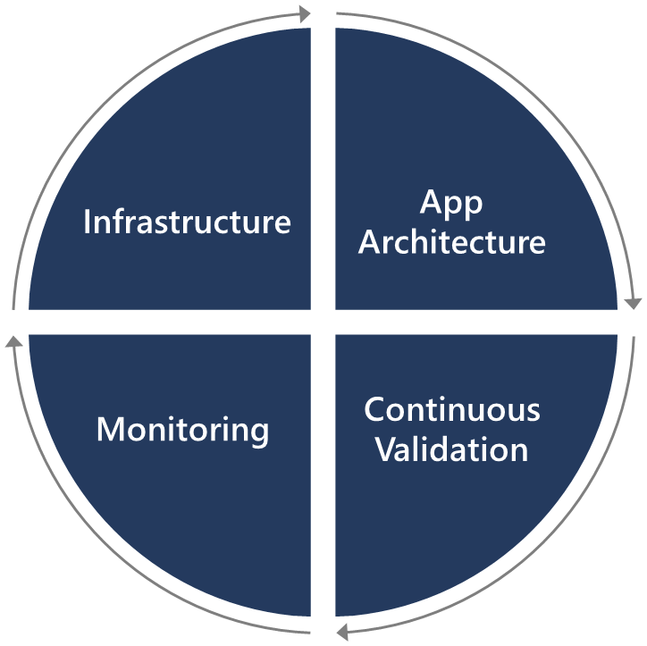
Introduction
Security is everyone’s responsibility.
Securing applications is a continuous process that encompasses the following:
Secure infrastructure
Designing an architecture with layered security
Continuous security validation
Monitoring for attacks

Slide 7
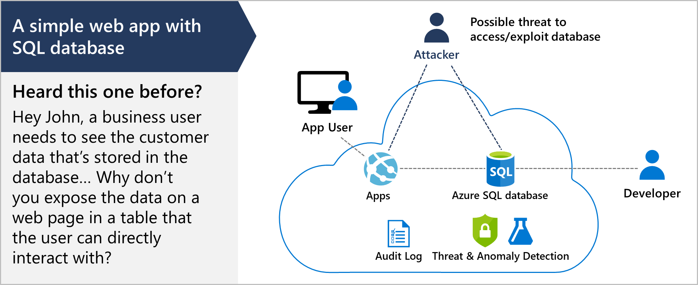
Describe SQL injection attack

Slide 8
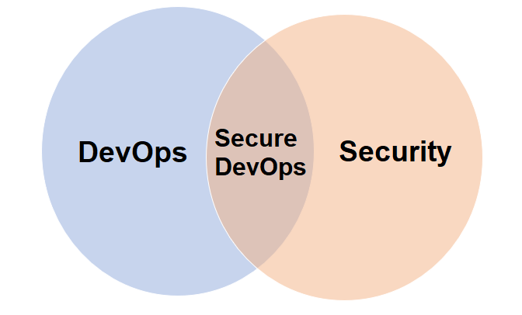
Understand DevSecOps
Secure DevOps is a set of practices designed to integrate DevOps and security
Secure DevOps is also sometimes referred to as DevSecOps
The goal is to enable development teams to work fast without introducing unwanted vulnerabilities
Security strategy includes access control, environment hardening, perimeter protection, and more
Notes:
Secure DevOps includes bigger questions such as:
Is my pipeline consuming third-party components, and if so, are they secure?
Are there known vulnerabilities within any of the third-party software we use?
How quickly can I detect vulnerabilities (time to detect)?
How quickly can I remediate identified vulnerabilities (time to remediate)?

Slide 9
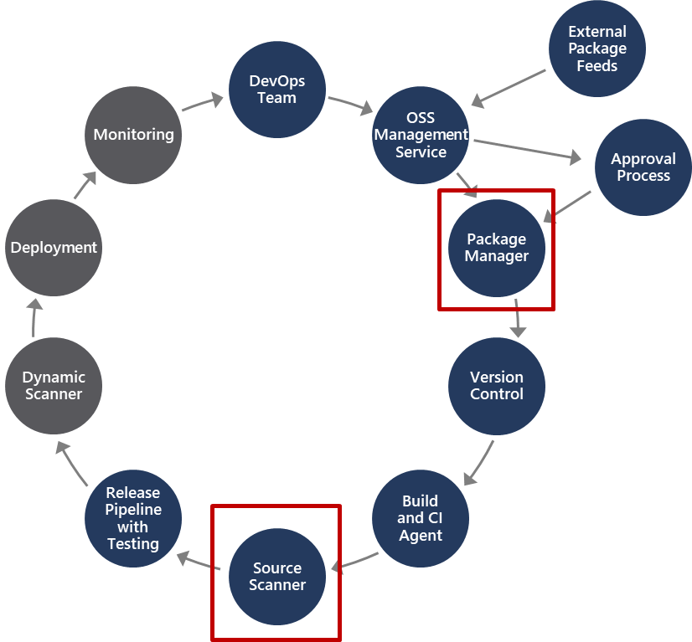
Explore Secure DevOps pipeline
Package management, and the approval process associated with it, accounts for how software packages are added to the pipeline, and the approval process they need to go through
Source scanner is for performing a security scan to verify certain security vulnerabilities are not present in our application source code
Notes:
There are two important areas in the pipeline that are part of Secure DevOps and not other DevOps pipelines. Notice these two areas are in different parts of the pipeline.

Slide 10
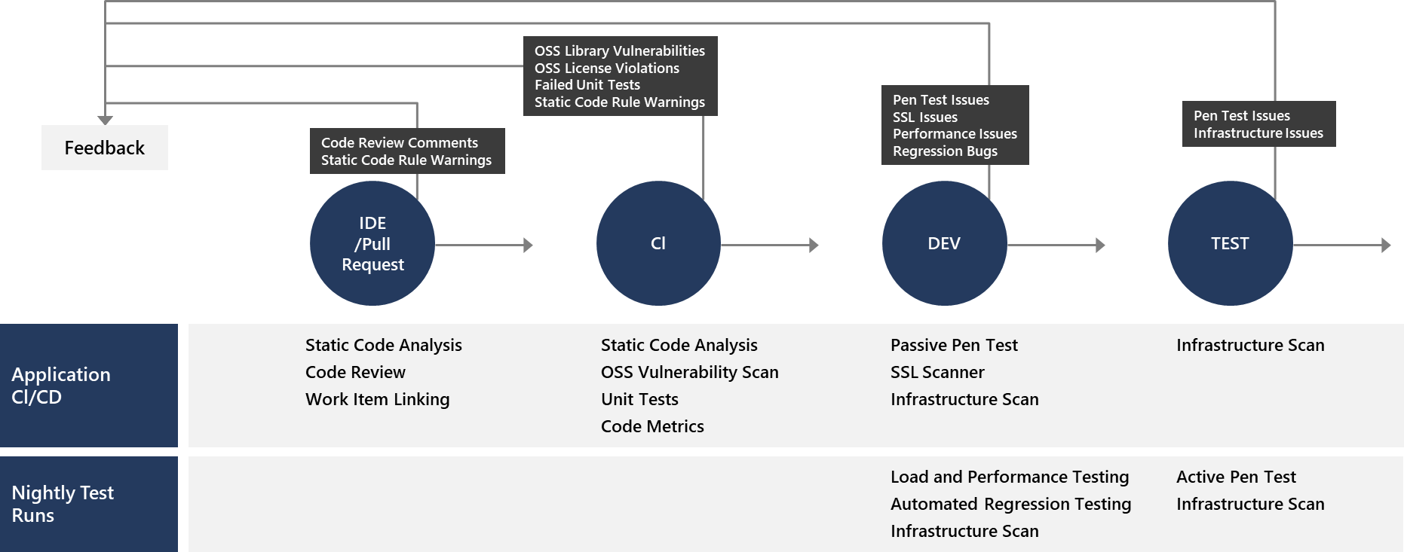
Explore key validation points
Continuous security validation should be added at each step from development through production

Slide 11
Explore continuous security validation
Coding
Build
QA & security
Production
$80/defect
$240/defect
$960/defect
$7,600/defect
Source: Ponemon Institute Research
Reduce cost by moving Secure DevOps to the left
Use automated tooling and processes to identify problems

Slide 12
Understand threat modeling
Define security requirements
2. Diagram
Create an application diagram
1. Define
3. Identify
Identify threats
Threat
modeling
Mitigate threats
5. Validate
4. Mitigate
Validate that threats have been mitigated

Slide 13
Threat modeling
DEMO

Slide 14
Module 02: Implement open-source software

Slide 15
Explore how software is built
Software based 80% on components:
Internal teams
Commercial 3rd party
Open-source community
Almost all software nowadays uses open-source software in some way, shape, or form

Slide 16


























What is open-source software?
“Open-source software is a type of computer software in which source code is released under a license in which the copyright holder grants users the rights to study, change, and distribute the software to anyone and for any purpose.”
Enable
open-source use cases in the cloud
Integrate
open-source technologies in our platform
Release
innovative technologies as open source
Contribute
to the open-source ecosystem
Draft
R Server
.NET Core
CNTK
Brigade
TypeScript
F#
PowerShell
ACS Engine
Graph Engine
Visual Studio Code
Office UI Fabric
SONiC
ECOSYSTEM
https://en.wikipedia.org/wiki/Open-source_software
Notes:
Discuss open-source and how we support it in Azure, GitHub and Azure DevOps.
https://azure.microsoft.com/en-us/overview/open-source
https://en.wikipedia.org/wiki/Open-source_software

Slide 17
Explore corporate concerns with open-source software components
It may have low quality:
This would impact maintainability, reliability, and performance of the overall solution
It may have no active maintenance:
The code would not evolve over time or be alterable without making a copy of the source code, effectively forking away from the origin
It could contain malicious code:
The entire system that includes and uses the code will be compromised. Potentially the entire company’s IT and infrastructure is affected
It may have security vulnerabilities:
The security of a software system is as good as its weakest part. Using source code with vulnerabilities makes the entire system susceptible to attack by hackers and misuse
It may have unfavorable licensing restrictions:
The effect of a license can affect the entire solution that uses the open-source software
Notes:
Make it clear that OSS is like all code. It could potentially have issues, but with active community support, it tends to resolve faster than others. You can emphasize both the benefits and challenges. It provides potential and capabilities. We need to make the DevOps teams aware about the challenges and know the potential risks.

Slide 18
Introduction to open-source licenses
According to the open-source definition of OpenSource.org a license should not:
Discriminate against persons or groups
Discriminate against fields of endeavor
Be specific to a product
Restrict other software

Slide 19
Explore common open-source licenses
Restrictive
ATTRIBUTION
BSD
MIT
Apache
DOWNSTREAM
MPL
EPL
MS-RL
COPYLEFT
GPL
LGPL
AGPL
Permissive

Slide 20
Examine license implications and ratings
Using a package implies following license requirements:
The license type may have a high, medium or low impact on distributed software including it
License rating indicates impact of use of packages:
Compliancy
Intellectual property
Exclusive rights

Slide 21
Module 03: Software Composition Analysis

Slide 22
Inspect and validate code bases for compliance
There are many aspects to building and deploying secure applications
General knowledge problem
Code is created correctly and securely implements the required features, and we need to make sure that the features were designed with security in mind in the first place
Complies with the rules and regulations that it is required to meet

Slide 23
Explore software composition analysis (SCA)
Package Management:
Unique source of binary components
Create a local cache of approved components
Use Azure Artifacts to share and organize your packages
Package types: NuGet, npm, Maven, Gradle, Universal, and Python
Open-Source Software (OSS) Components:
Reused dependencies can have security vulnerabilities
Ensure you have the latest version
Check for the correct binaries
Promptly address vulnerabilities
Analyzing the software to determine its composition can help mitigate potential vulnerabilities
Scanning tools discussed in the next Learning Path

Slide 24
Integrate Mend with Azure Pipelines
Mend is one such example of an extension available on the Azure DevOps Marketplace
If consuming external packages, the Mend extension specifically addresses the questions of open-source security, quality, and license compliance.
Continuously detect all open-source components in your software
Receive alerts on open-source security vulnerabilities
Automatically enforce open-source security and license compliance
Notes:
WhiteSource is now https://www.mend.io. WhiteSource Bolt is now Mend Bolt.
Refer to: https://marketplace.visualstudio.com/items?itemName=whitesource.whiteSource-bolt-v2

Slide 25
Implement GitHub Dependabot alerts and security updates
Check for updates
Alerts
Automated pull requests
Review and triage

Slide 26
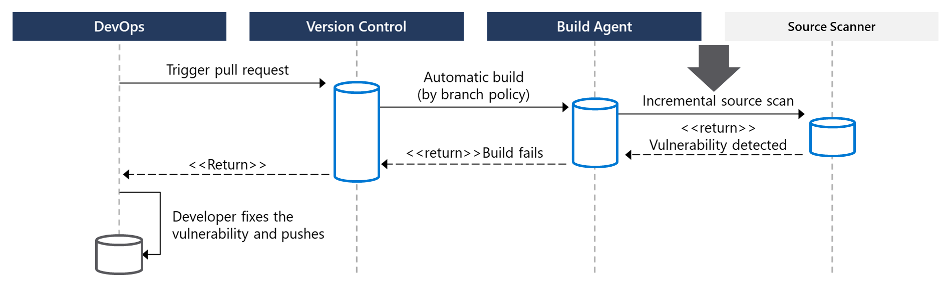
Integrate software composition analysis checks into pipelines
Pull requests are the way DevOps teams submit changes
Mend, Checkmarx, Veracode, and Black Duck by Synopsis can facilitate incremental scans
Integrate scanning into a team’s workflow at multiple points along the path

Slide 27
Examine tools for assess package security and license rate
Approach 1: Scan centralized artifact repository
Approach 2: Tooling during build in pipeline
Tool | Type
Artifactory | Artifact repository
SonarQube | Static code analysis tool
Mend Bolt | Build scanning

Slide 28
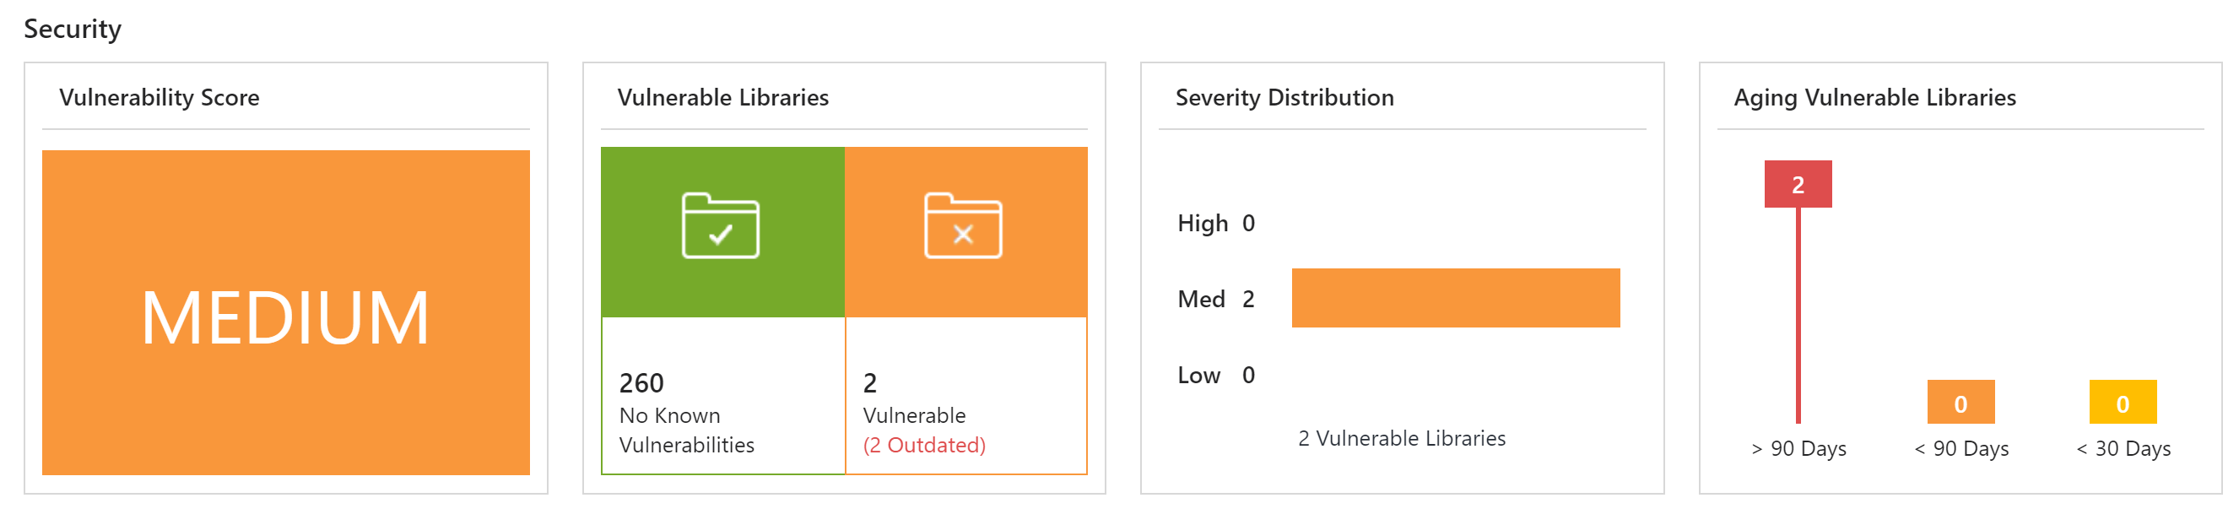
Interpret alerts from scanner tools
Report Contains:
Security vulnerabilities
License risks and compliancy
Outdated libraries
Aspects to keep in mind:
False positives
Security bug bar

Slide 29
Module 04: Static analyzers

Slide 30
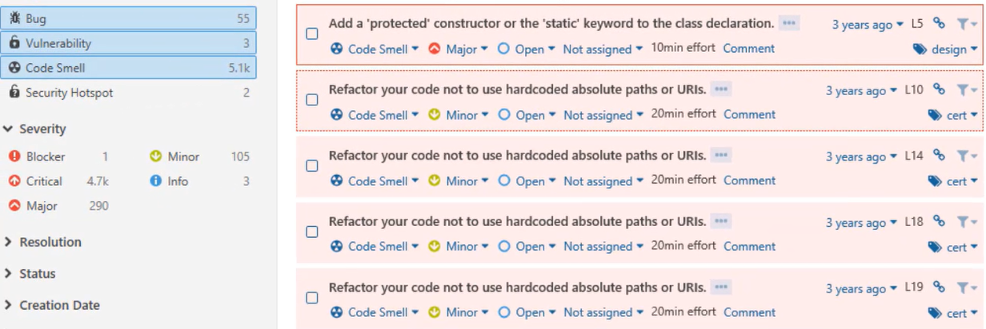
Explore SonarCloud
Open platform for managing code quality
Joint investments with Microsoft
Wide range of programming languages supported
Cloud-hosted version: SonarCloud

Slide 31
Explore CodeQL in GitHub
Action:
Steps:
Treats code like queryable data
Standard or custom analysis queries
Create a CodeQL database (based upon the code)
Run CodeQL queries against the database
Interpret the results
CodeQL CLI or CodeQL for Visual Studio Code

Slide 32
Module 05: OWASP and Dynamic Analyzers

Slide 33
Plan to Implement OWASP Secure Coding Practices
Start with secure coding practices
Open Web Application Security Project (OWASP) – A global charitable organization focused on improving the security of software
OWASP regularly publish a set of Secure Coding Practices
Notes:
See http://owasp.org

Slide 34
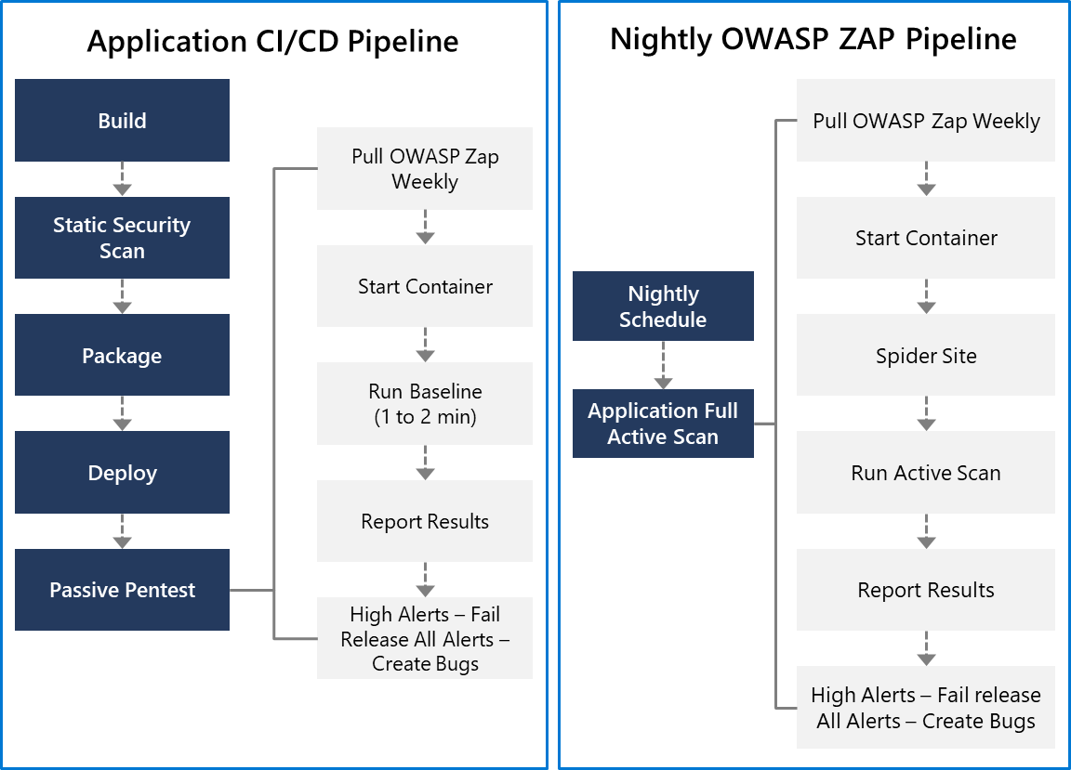
Explore OWASP ZAP penetration test
OWASP ZAP can be used for penetration testing
Testing can be active or passive
Conduct a quick baseline scan to identify vulnerabilities
Conduct nightly more intensive scans

Slide 35
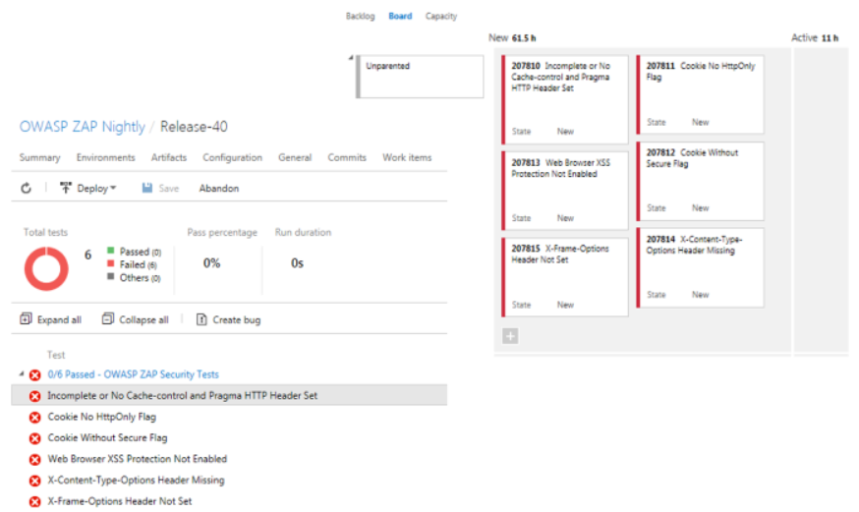
Explore OWASP ZAP results and bugs
OWASP ZAP provides a report with results
and bugs
Use a holistic and layered approach to security

Slide 36
Discussion: Security policy tooling
Azure DevOps can be integrated with a wide range of existing tooling that is used for checking security policy during builds
Which security policy tools do you currently use?
What do you like or don’t like about the tools?

Slide 37
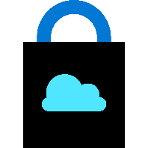
Module 06: Security Monitoring and Governance

Slide 38
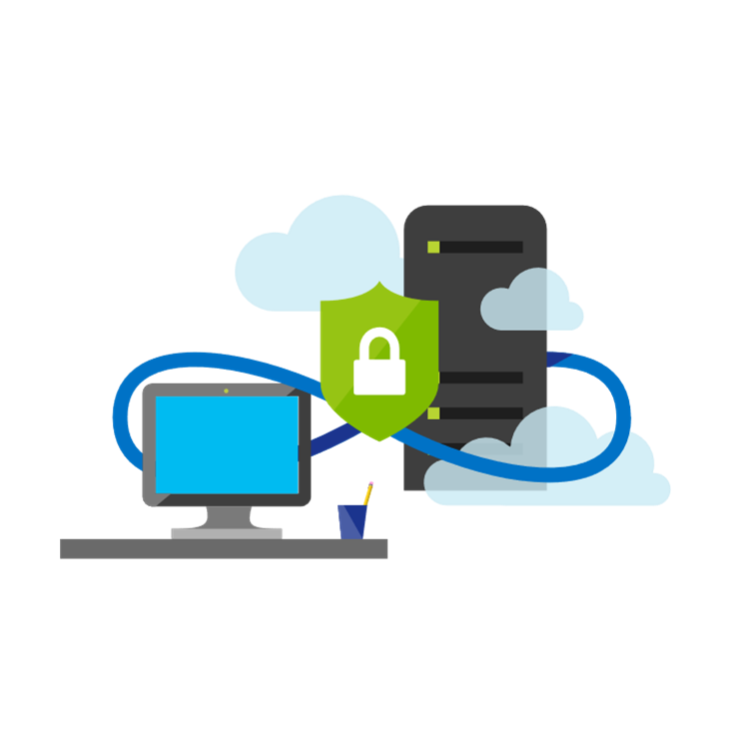
Implement pipeline security
Use traditional operational methods for protecting identities and assets
Authentication and Authorization: Use Multi-Factor Authentication and Just enough Admin (JEA)
Use the CI/CD release pipeline: Use immutable infrastructure and only using your pipeline
Manage Permissions: Secure the pipeline using RBAC
Dynamic Scanning: Test running apps, such as penetration testing
Notes:
To improve security in general use Azure Resource Manager templates, or other code-based configurations, and Infrastructure as Code best practices, such as only making changes in templates, thereby making them traceable and repeatable. Also, use provisioning and configuration technologies such as Desired State Configuration, Azure Automation, and other third-party tools and products that integrate seamlessly with Azure.

Slide 39

Explore Microsoft Defender for Cloud
Provide security recommendations
Monitor security settings
Monitor all your services
Use Azure Machine Learning
Analyze and identify potential attacks
Provide just-in-time (JIT) access control
Supports Windows and Linux operating systems
Available in two pricing tiers

Slide 40
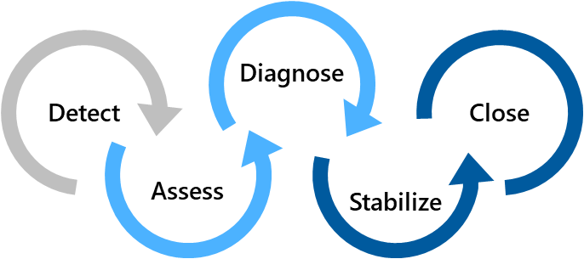
Examine Microsoft Defender for Cloud usage scenarios
Scenario 1
Use Security Center for an incident response
Scenario 2
Use Security Center recommendations to enhance security
Security Policy
Recommendations
Detect – Verify a high security alert was raised
Configure a security policy
Access – Obtain information about the alert
Implement the recommendations for the security policy
Diagnose – Follow the remediation steps
Notes:
Scenario 1:
Many organizations learn how to respond to security incidents only after suffering an attack. To reduce costs and damage, it’s important to have an incident response plan in place before an attack occurs. You can use Microsoft Defender for Cloud in different stages of an incident response.
You can use Security Center during the detect, assess, and diagnose stages.
- Detect: Review the first indication of an event investigation. Example: Use the Security Center dashboard to review the initial verification that a high-priority security alert was raised.
- Assess: Perform the initial assessment to obtain more information about the suspicious activity. Example: Obtain more information about the security alert.
- Diagnose: Conduct a technical investigation and identify containment, mitigation, and workaround strategies. Example: Follow the remediation steps described by Security Center in that particular security alert.
Scenario 2:
You can reduce the chances of a significant security event by configuring a security policy, and then implementing the recommendations provided by Microsoft Defender for Cloud.
A security policy defines the set of controls that are recommended for resources within that specified subscription or resource group. In Security Center, you define policies according to your company's security requirements.
Security Center analyzes the security state of your Azure resources. When Security Center identifies potential security vulnerabilities, it creates recommendations based on the controls set in the security policy. The recommendations guide you through the process of configuring the needed security controls

Slide 41


Explore Azure Policy
Is a service in Azure that you use to create, assign, and manage policies
Provides enforcement by using policies and initiatives
Runs evaluations on your resources and scans for those not compliant
Comes with several built-in policy and initiative definitions
Integrates with Azure DevOps by applying any continuous integration (CI) and continuous deployment (CD) pipeline policies
An example of an Azure policy that you can integrate with your DevOps pipeline is the Check Gate task
Notes:
Azure Policy Check Gate - https://docs.microsoft.com/en-us/azure/devops/pipelines/tasks/deploy/azure-policy-check-gate?view=vsts

Slide 42
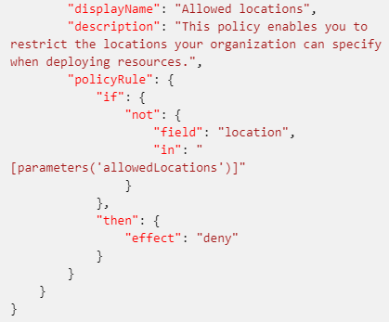
Understand policies
A policy definition expresses what to evaluate and what action to take
Policies are defined in JSON
Assign policies using Azure Portal, Azure CLI, or Azure PowerShell
Use remediation for non-compliant resources
The screenshot is a section of a policy file defining allowed locations
Notes:
A policy definition expresses what to evaluate and what action to take. For example, you could prevent VMs from deploying if they are exposed to a public IP address. You also could prevent a particular hard disk from being used when deploying VMs to control costs.
Every policy definition has conditions under which it is enforced, and an accompanying effect that takes place if the conditions are met.
The process of applying a policy to your resources consist of the following steps:
1. Create a policy definition.
2. Assign a definition to a scope of resources.
3. View policy evaluation results.

Slide 43
Explore initiatives
An initiative definition is a set of policy definitions
Helps track your compliance state for a larger goal
Assigned to a specific scope
Reduces the need for individual scope assignments
Initiative Example:
Create an Initiative named “Enable Monitoring In Microsoft Defender for Cloud.” This would provide the following policies:
Monitor unencrypted SQL Database policy definition
Monitor OS vulnerabilities policy definition
Monitor missing Endpoint Protection policy definition
Even if you have a single policy, we recommend using initiatives if you anticipate increasing the number of policies over time

Slide 44
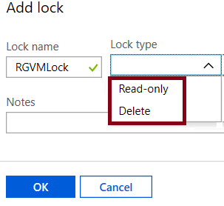
Explore resource locks
Prevent accidental deletion or modification of your Azure resources:
CanNotDelete – means authorized users can still read and modify a resource, but they can’t delete the resource
ReadOnly – means authorized users can read a resource, but they can't delete or update it. Applying this lock is like restricting all authorized users to the permissions granted by the Reader role
In the Azure portal, the locks are called Delete and Read-only respectively

Slide 45
Explore Azure Blueprints
Allows for the definition of a repeatable set of Azure resources that implement and adhere to an organization’s standards, patterns, and requirements
Can ensure a deployment meets an organization’s standards, patterns, and requirements
Is a declarative way to orchestrate deployment for various resource templates and other artifacts
Provides for traceability and auditing as well as adherence
The blueprint definition (what should be deployed) and the blueprint assignment (what is deployed) supports improved deployment tracking and auditing
1
2
3
Create an Azure blueprint
Assign the blueprint
Track the blueprint assignments
Discussion: How do Azure Blueprint policies differ from templates?
Notes:
Azure Blueprints is also useful in Azure DevOps scenarios where blueprints are associated with specific build artifacts and release pipelines, and can be tracked more rigorously.
Note: At the time of writing, Azure Blueprints is in preview and has not yet been released publicly.
Discussion: How to Azure Blueprint policies differ from templates?
Answer:
The blueprints in Azure Blueprints are different from Azure Resource Manager templates. When Azure Resource Manager templates deploy resources, they have no active relationship with the deployed resources (they exist in a local environment or in source control). By contrast, with Azure Blueprints, each deployment is tied to an Azure Blueprints package. This means that the relationship with resources will be maintained, even after deployment. In this way, maintaining relationships improves auditing and tracking capabilities.

Slide 46
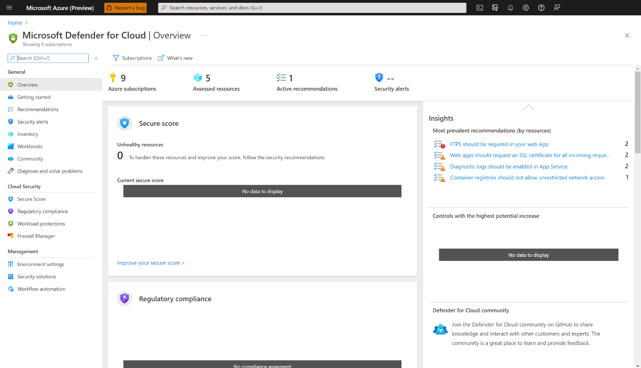
Understand Microsoft Defender for Identity
Identifies, detects, and helps you investigate advanced threats, compromised identities, and malicious insider actions
Microsoft Defender portal monitors and responds to suspicious activity
Microsoft Defender sensor monitors domain controller traffic
Microsoft Defender cloud service connects to Microsoft Intelligent Security Graph
Notes:
Microsoft Defender portal. Microsoft Defender has its own portal, through which you can monitor and respond to suspicious activity. The portal allows you to create your Microsoft Defender instance, and view the data received from Microsoft Defender sensors.
You can also use the portal to monitor, manage, and investigate threats in your network environment. You sign in to the Microsoft Defender portal at https://portal.atp.azure.com. However, note that you must sign in with a user account that is assigned to an Azure AD security group that has access to the Microsoft Defender portal.
Microsoft Defender sensor. Microsoft Defender sensors are installed directly on your domain controllers. The sensor monitors domain controller traffic without requiring a dedicated server or configured port mirroring.
Microsoft Defender cloud service. Microsoft Defender cloud service runs on the Azure infrastructure, and is currently deployed in the United States, Europe, and Asia. The cloud service is connected to Microsoft Intelligent Security Graph

Slide 47
Labs

Slide 48
Lab: Implement security and compliance in Azure Pipelines
Lab overview:
In this lab, we will create a new Azure DevOps project, populate the project repository with a sample application code, create a build pipeline. Next, we will install Mend Bolt from the Azure DevOps Marketplace to make it available as a build task, activate it, add it to the build pipeline, use it to scan the project code for security vulnerabilities and licensing compliance issues, and finally view the resulting report.
Objectives:
Create a Build pipeline
Install Mend Bolt from the Azure DevOps marketplace and activate it
Add Mend Bolt as a build task in a build pipeline
Run build pipeline and view Mend security and compliance report
Duration:
Notes:
The labs are updated on a regular basis. For the latest information please visit:
https://microsoftlearning.github.io/AZ400-DesigningandImplementingMicrosoftDevOpsSolutions/

Slide 49
Lab: Managing technical debt with SonarQube and Azure DevOps
Lab overview:
In this lab, you will learn how to setup SonarQube on Azure and integrate it with Azure DevOps.
Objectives:
Provision SonarQube server as an Azure Container Instance from the SonarQube Docker image
Set up a SonarQube project
Provision an Azure DevOps Project and configure CI pipeline to integrate with SonarQube
Analyze SonarQube reports
Duration:
Notes:
The labs are updated on a regular basis. For the latest information please visit:
https://microsoftlearning.github.io/AZ400-DesigningandImplementingMicrosoftDevOpsSolutions/

Slide 50
Learning Path review and takeaways

Slide 51
What did you learn?
Define an infrastructure and configuration strategy and appropriate toolset for a release pipeline and application infrastructure
Implement compliance and security in your application infrastructure
Describe the potential challenges with integrating open-source software
Inspect open-source software packages for security and license compliance
Manage organizational security and compliance policies
Integrate license and vulnerability scans into build and deployment pipelines
Configure build pipeline to access package security and license ratings

Slide 52
Learning Path review questions
1
Secure DevOps combines which two elements?
2
Which term broadly defines what security means in Secure DevOps?
What component in Azure DevOps can you use to store, organize and share access to packages, and integrate those packages them with your continuous integration and continuous delivery pipeline?
3
4
What describes the term software composition analysis?
5
From where can extensions be sourced from, to be integrated into Azure DevOps CI/CD pipelines and help provide security composition analysis?
Notes:
Q1 Answer: DevOps and Security
Q2 Answer: Securing the pipeline
With Secure DevOps, security is more about securing the pipeline, determining where you can add security to the elements that plug into your build and release pipeline. For example, it's about how and where you can add security to you automation practices, production environments, and other pipeline elements while attempt to gain the speed of DevOps.
Secure DevOps includes bigger questions such as: Is my pipeline consuming third-party components, and if so, are they secure? Are there known vulnerabilities within any of the third-party software we use? How quickly can I detect vulnerabilities (time to detect)? How quickly can I remediate identified vulnerabilities (time to remediate)?
Q3 Answer: Azure Artifacts
Q4 Answer: Analyzing open-source software (OSS) to identify potential security vulnerabilities and provide validation that the software meets a defined criteria to use in your pipeline
Q5 Answer: Azure DevOps Marketplace

Slide 53
Learning Path review questions (continued)
6
Which products are available as extensions in Azure DevOps Marketplace, and can provide either OSS or source code scanning as part of an Azure Pipeline?
7
Which Azure service is a monitoring service that can provide threat protection and security recommendations across all your services both in Azure and on-premises?
8
Which Azure service should you use from the below list to monitor all unencrypted SQL databases in your organization?
9
Which facility allows you to prevent accidental deletion of resources in Azure?
Notes:
Q6 Answer: Mend
Q7Answer: Microsoft Defender for Cloud
Q8 Answer: Azure Policy
Azure Policy is a service in Azure that you use to create, assign, and, manage policies. These policies enforce different rules and effects over your resources, which ensures they stay compliant with your corporate standards and service-level agreements (SLAs). A policy definition expresses what to evaluate and what action to take. For example, you could prevent VMs from deploying if they are exposed to a public IP address. You also could prevent a particular hard disk from being used when deploying VMs to control costs.
Q9 Answer: Locks
Locks help you prevent accidental deletion or modification of your Azure resources. You can manage these locks from within the Azure portal. To view, add, or delete locks, go to the SETTINGS section of any resource's settings blade. You may need to lock a subscription, resource group, or resource to prevent other users in your organization from accidentally deleting or modifying critical resources. You can set the lock level to CanNotDelete or ReadOnly.

Slide 54
Learning Path review questions (continued)
10
What issues are often associated with the use of open-source libraries?
11
How can an open-source library cause licensing issues if it is free to download?
12
What is open-source software?
Notes:
Q10 Answer: Bugs, security vulnerabilities, and licensing issues
Q11 Answer: Each library has usage restrictions as part of the licensing. These restrictions might not be compatible with your intended application use.
Q12 Answer: A type of software where users of code are permitted to study, change, and distribute the software. The open-source license type can limit the actions (such as sale provisions) that can be taken.

