Slide 1
Multi-Threading
Let’s Grow 22-06-2-22

Slide 2
Agenda
Task Async Programming model (TAP)
Task Cancellation
Parallel Processing (PLINQ, TPL)
Multiple threads, thread deadlocks
Long running tasks (IHostedService, BackgroundService)

Slide 3
Task-based asynchronous pattern (TAP)
In .NET, The task-based asynchronous pattern is the recommended asynchronous design pattern for new development. It is based on the Task and Task<TResult> types in the System.Threading.Tasks namespace, which are used to represent asynchronous operations.

Slide 4
Task-based asynchronous pattern (TAP)
TAP uses a single method to represent the initiation and completion of an asynchronous operation. This contrasts with both the Asynchronous Programming Model (APM or IAsyncResult) pattern and the Event-based Asynchronous Pattern (EAP).
APM requires Begin and End methods. EAP requires a method that has the Async suffix and also requires one or more events, event handler delegate types, and EventArg-derived types. Asynchronous methods in TAP include the Async suffix after the operation name for methods that return awaitable types, such as Task, Task<TResult>, ValueTask, and ValueTask<TResult>.
For example, an asynchronous Get operation that returns a Task<String> can be named GetAsync. If you're adding a TAP method to a class that already contains an EAP method name with the Async suffix, use the suffix TaskAsync instead. For example, if the class already has a GetAsync method, use the name GetTaskAsync. If a method starts an asynchronous operation but does not return an awaitable type, its name should start with Begin, Start, or some other verb to suggest that this method does not return or throw the result of the operation.

Slide 5
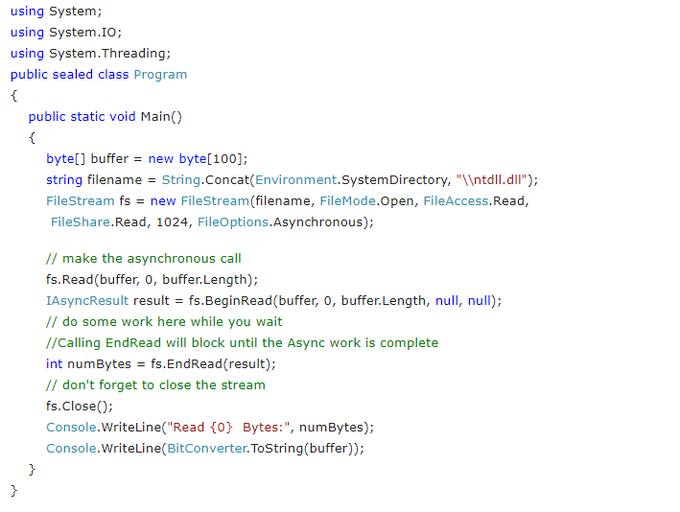
Asynchronous Programming Model (APM)

Slide 6
Task-based asynchronous pattern (TAP)
The async and await keywords in C# are the heart of async programming. By using those two keywords, you can use resources in .NET Framework, .NET Core, or the Windows Runtime to create an asynchronous method almost as easily as you create a synchronous method. Asynchronous methods that you define by using the async keyword are referred to as async methods.

Slide 7
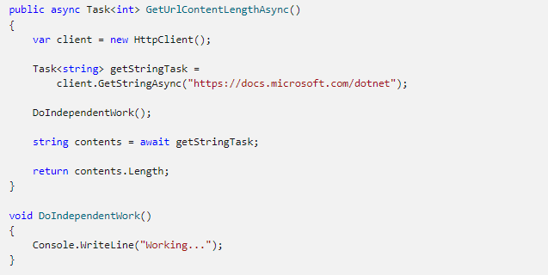
tAP

Slide 8
TAP
You can learn several practices from the preceding sample. Start with the method signature. It includes the async modifier. The return type is Task<int> (See "Return Types" section for more options). The method name ends in Async. In the body of the method, GetStringAsync returns a Task<string>. That means that when you await the task you'll get a string (contents). Before awaiting the task, you can do work that doesn't rely on the string from GetStringAsync.
Pay close attention to the await operator. It suspends GetUrlContentLengthAsync:
GetUrlContentLengthAsync can't continue until getStringTask is complete.
Meanwhile, control returns to the caller of GetUrlContentLengthAsync.
Control resumes here when getStringTask is complete.
The await operator then retrieves the string result from getStringTask.
The return statement specifies an integer result. Any methods that are awaiting GetUrlContentLengthAsync retrieve the length value.

Slide 9
If GetUrlContentLengthAsync doesn't have any work that it can do between calling GetStringAsync and awaiting its completion, you can simplify your code by calling and awaiting in the following single statement.

Slide 10
Example summary
The following characteristics summarize what makes the previous example an async method:
The method signature includes an async modifier.
The name of an async method, by convention, ends with an "Async" suffix.
The return type is one of the following types:
Task<TResult> if your method has a return statement in which the operand has type TResult.
Task if your method has no return statement or has a return statement with no operand.
void if you're writing an async event handler.
Any other type that has a GetAwaiter method (starting with C# 7.0).
The method usually includes at least one await expression, which marks a point where the method can't continue until the awaited asynchronous operation is complete. In the meantime, the method is suspended, and control returns to the method's caller. The next section of this topic illustrates what happens at the suspension point.

Slide 11
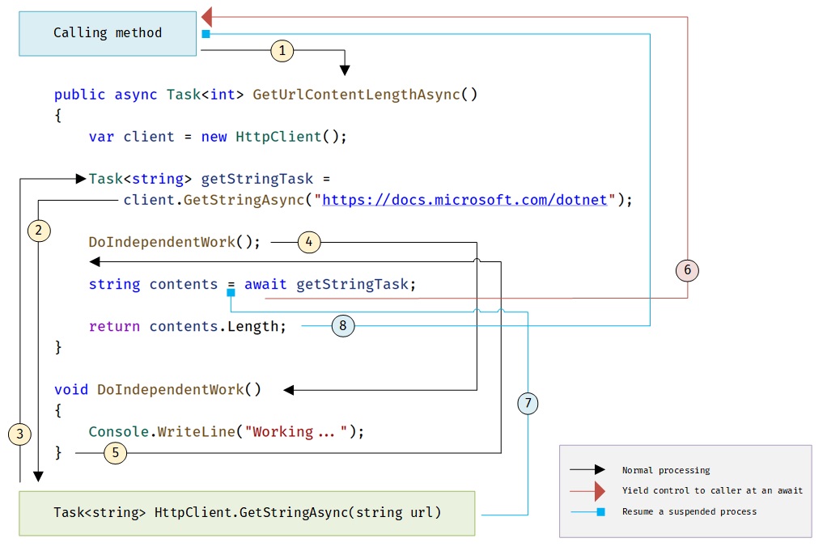

Slide 12
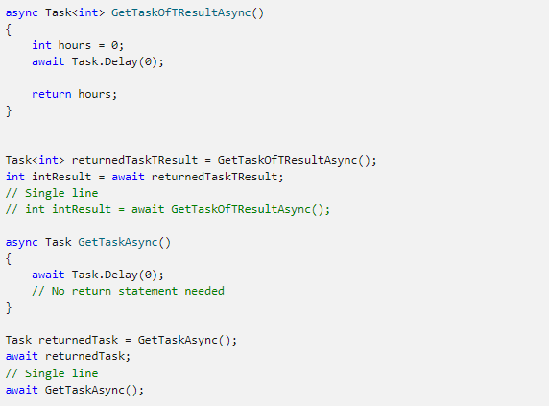
Return types

Slide 13
TAP
Each returned task represents ongoing work. A task encapsulates information about the state of the asynchronous process and, eventually, either the final result from the process or the exception that the process raises if it doesn't succeed.
An async method can also have a void return type. This return type is used primarily to define event handlers, where a void return type is required. Async event handlers often serve as the starting point for async programs.
An async method that has a void return type can't be awaited, and the caller of a void-returning method can't catch any exceptions that the method throws.
An async method can't declare in, ref or out parameters, but the method can call methods that have such parameters. Similarly, an async method can't return a value by reference, although it can call methods with ref return values.

Slide 14
Naming convention
By convention, methods that return commonly awaitable types (for example, Task, Task<T>, ValueTask, ValueTask<T>) should have names that end with "Async". Methods that start an asynchronous operation but do not return an awaitable type should not have names that end with "Async", but may start with "Begin", "Start", or some other verb to suggest this method does not return or throw the result of the operation.
You can ignore the convention where an event, base class, or interface contract suggests a different name. For example, you shouldn't rename common event handlers, such as OnButtonClick.

Slide 15
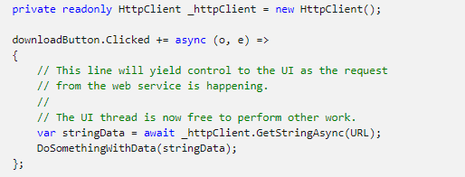
I/o Bound
You may need to download some data from a web service when a button is pressed but don't want to block the UI thread. It can be accomplished like this:

Slide 16
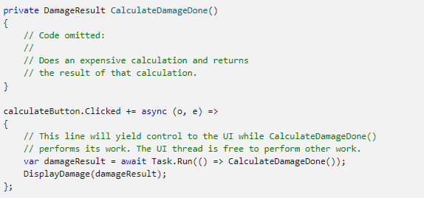
CPU-bound
Say you're writing a mobile game where pressing a button can inflict damage on many enemies on the screen. Performing the damage calculation can be expensive, and doing it on the UI thread would make the game appear to pause as the calculation is performed!

Slide 17
Key differences
Async code can be used for both I/O-bound and CPU-bound code, but differently for each scenario.
Async code uses Task<T> and Task, which are constructs used to model work being done in the background.
The async keyword turns a method into an async method, which allows you to use the await keyword in its body.
When the await keyword is applied, it suspends the calling method and yields control back to its caller until the awaited task is complete.
await can only be used inside an async method.

Slide 18
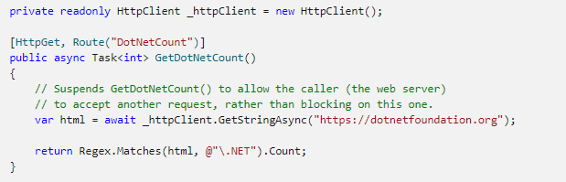
Example: extract data from a network
With ASP.NET web API

Slide 19
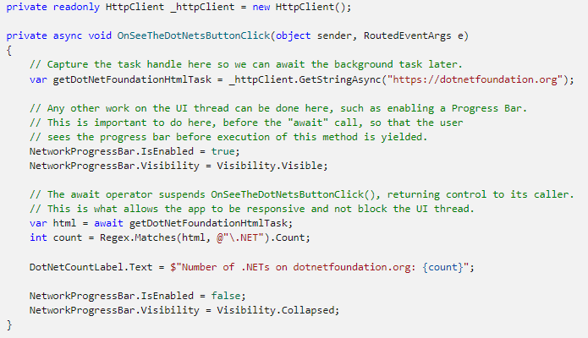
With universal windows app

Slide 20
exercise
Use a Windows Presentation Foundation (WPF) application to count the number of times the word “Microsoft” is used in https://nl.wikipedia.org/wiki/Microsoft
Extra: Is it actually possible to implement a progressbar? If so, how?

Slide 21
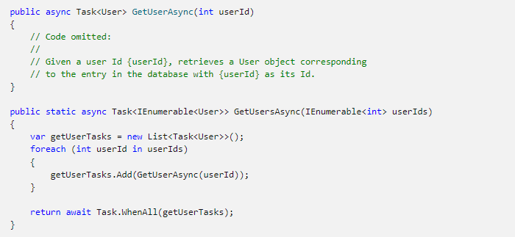
Multiple tasks

Slide 22
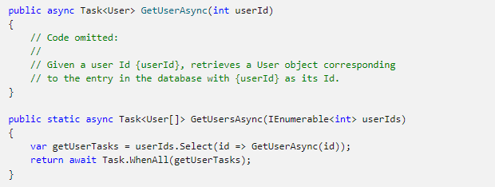
Multiple tasks

Slide 23
Task cancellation
Run(Func<Task>, CancellationToken)
Queues the specified work to run on the thread pool and returns a proxy for the task returned by function. A cancellation token allows the work to be cancelled if it has not yet started.

Slide 24

exercise
Make a WPF application that starts a Task when you push a start button. The task consists of 100 iterations, check the cancellation token in each iteration. Update the progressbar in each iteration
The tasks return a string like “1 2 3 4 …”
Remember to use the dispatcher to update the progressbar

Slide 25
Task parallel library (TPL)
Data parallelism refers to scenarios in which the same operation is performed concurrently (that is, in parallel) on elements in a source collection or array. In data parallel operations, the source collection is partitioned so that multiple threads can operate on different segments concurrently.
The Task Parallel Library (TPL) supports data parallelism through the System.Threading.Tasks.Parallel class. This class provides method-based parallel implementations of for and foreach loops (For and For Each in Visual Basic). You write the loop logic for a Parallel.For or Parallel.ForEach loop much as you would write a sequential loop. You do not have to create threads or queue work items. In basic loops, you do not have to take locks. The TPL handles all the low-level work for you.

Slide 26
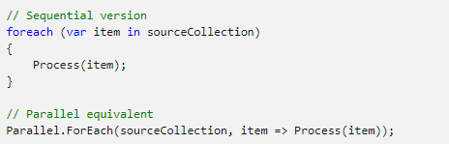
TPL example

Slide 27
Parellel.for loop
Demonstration parallel for

Slide 28
Parallel.foreach
demonstration

Slide 29
Cancel parallel loops
Use cancellation token
Demonstration

Slide 30
Exception in parallel loops
Demonstration TPLExceptions

Slide 31
TPL exercise
Use a combination of loops and parallel loops to Get all files in all folders starting from a base folder
Use a loop to get all the folders and within a folder use a parallel loop to get the files.
Limit it to folders in the base and files in those folders
Extra: Add functionality to make it possible to check multiple levels of folders and files

Slide 32
PLINQ
Parallel LINQ (PLINQ) is a parallel implementation of the Language-Integrated Query (LINQ) pattern. PLINQ implements the full set of LINQ standard query operators as extension methods for the System.Linq namespace and has additional operators for parallel operations. PLINQ combines the simplicity and readability of LINQ syntax with the power of parallel programming.

Slide 33
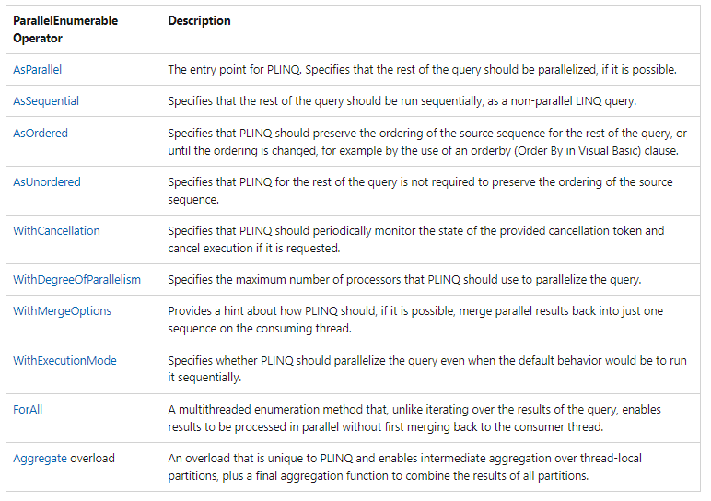
Parallelenumerable

Slide 34
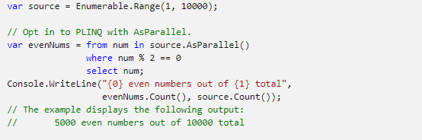
Opt-in model
When you write a query, opt in to PLINQ by invoking the ParallelEnumerable.AsParallel extension method on the data source, as shown in the following example.
The AsParallel extension method binds the subsequent query operators, in this case, where and select, to the System.Linq.ParallelEnumerable implementations.

Slide 35

Degree of parallelism
By default, PLINQ uses all of the processors on the host computer. You can instruct PLINQ to use no more than a specified number of processors by using the WithDegreeOfParallelism method. This is useful when you want to make sure that other processes running on the computer receive a certain amount of CPU time. The following snippet limits the query to utilizing a maximum of two processors.

Slide 36

Ordered vs unordered
In some queries, a query operator must produce results that preserve the ordering of the source sequence. PLINQ provides the AsOrdered operator for this purpose. AsOrdered is distinct from AsSequential. An AsOrdered sequence is still processed in parallel, but its results are buffered and sorted. Because order preservation typically involves extra work, an AsOrdered sequence might be processed more slowly than the default AsUnordered sequence. Whether a particular ordered parallel operation is faster than a sequential version of the operation depends on many factors.
The following code example shows how to opt in to order preservation.

Slide 37
Forall operator
In sequential LINQ queries, execution is deferred until the query is enumerated either in a foreach (For Each in Visual Basic) loop or by invoking a method such as ToList , ToArray , or ToDictionary. In PLINQ, you can also use foreach to execute the query and iterate through the results. However, foreach itself does not run in parallel, and therefore, it requires that the output from all parallel tasks be merged back into the thread on which the loop is running. In PLINQ, you can use foreach when you must preserve the final ordering of the query results, and also whenever you are processing the results in a serial manner, for example when you are calling Console.WriteLine for each element. For faster query execution when order preservation is not required and when the processing of the results can itself be parallelized, use the ForAll method to execute a PLINQ query. ForAll does not perform this final merge step. The following code example shows how to use the ForAll method.
System.Collections.Concurrent.ConcurrentBag<T> is used here because it is optimized for multiple threads adding concurrently without attempting to remove any items.

Slide 38
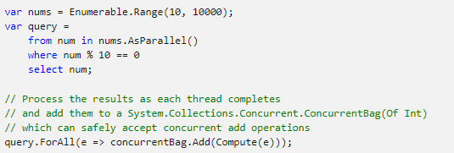
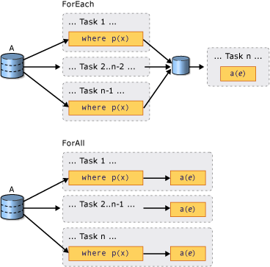

Slide 39
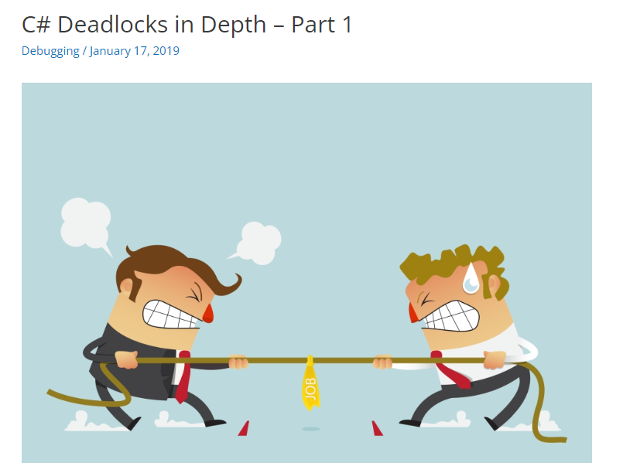
deadlocks
https://michaelscodingspot.com/c-deadlocks-in-depth-part-1/

Slide 40
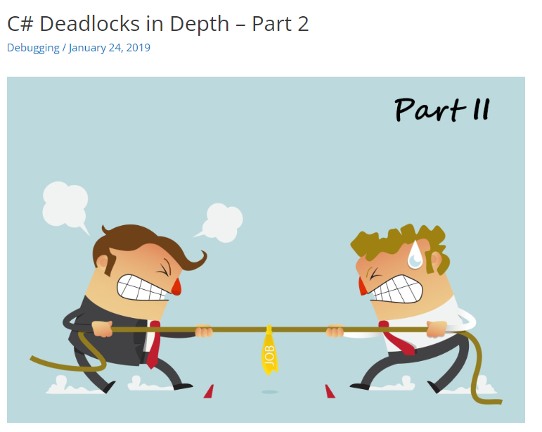
deadlocks
https://michaelscodingspot.com/c-deadlocks-in-depth-part-2/

Slide 41
Long running tasks
Backgroundworker
IHostedService

Slide 42
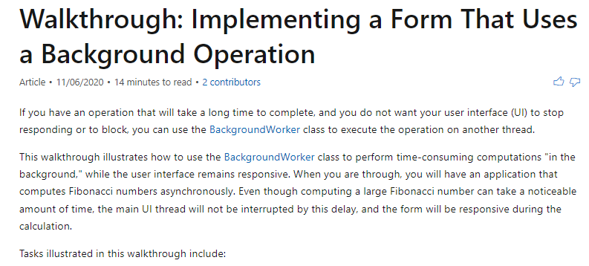
Walkthrough backgroundworker
https://docs.microsoft.com/en-us/dotnet/desktop/winforms/controls/walkthrough-implementing-a-form-that-uses-a-background-operation?view=netframeworkdesktop-4.8

Slide 43
IHostedservice
https://docs.microsoft.com/en-us/dotnet/core/extensions/timer-service

