Slide 1
Module 04: Develop solutions that use Cosmos DB storage

Slide 2
Topics
Azure Cosmos DB overview
Azure Cosmos DB data structure
Create and update documents by using code

Slide 3
Lesson 01: Azure Cosmos DB overview

Slide 4


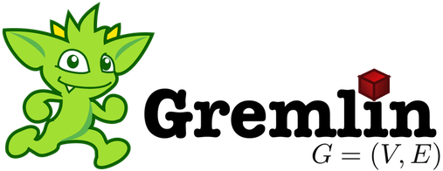



Azure Cosmos DB
Table API
MongoDB
Column family
Document
Key-value
Graph
Guaranteed low latency at the 99th percentile
Elastic scale-out
of storage and throughput
Five well-defined consistency models
Turnkey global distribution
Comprehensive SLAs
Notes:
Today’s applications must be highly responsive and always online.
One of the most obvious challenges when maintaining a relational database system is that most relational engines apply locks and latches to enforce strict atomicity, consistency, isolation, durability (ACID) semantics. This approach provides benefits in terms of ensuring a consistent data state within the database. However, there are heavy tradeoffs with respect to concurrency, latency, and availability.
To achieve low latency and high availability, you must deploy instances of a database engine in datacenters that are close to their users. Databases then need to respond in real time to significant amounts of changes in usage at peak hours, store ever-increasing volumes of data, and make this data available to users in milliseconds.
Microsoft Azure Cosmos DB is a database service native to Azure that focuses on providing a high-performance database regardless of your selected API or data model.
You can deploy Azure Cosmos DB worldwide across all Azure regions, which helps you overcome the previously mentioned challenges of maintaining a relational database system. Partition ranges can be dynamically subdivided to seamlessly grow a database in line with an application while simultaneously maintaining high availability.

Slide 5
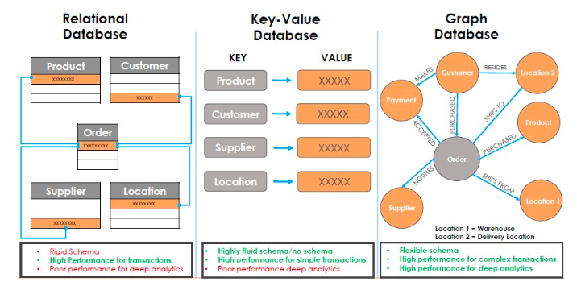
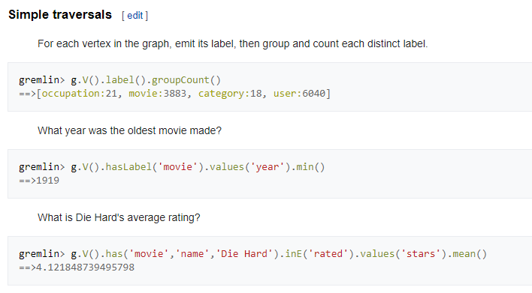

Slide 6
Core functionality
Global replication
Automatic and synchronous multi-region replication
Supports automatic and manual failover
Varied consistency levels
Offers five consistency models
Provides control over performance-consistency tradeoffs, backed by comprehensive SLAs
Low latency
Serve <10 ms read and <15 ms write requests at the 99th percentile
Elastic scale-out
Elastically scale throughput from 10 to 100s of millions of requests/sec across multiple regions
Support for requests/sec for different workloads
Notes:
Azure Cosmos DB has four core features that are the same regardless of which API you use.

Slide 7
Global Replication
Turnkey global distribution automatically replicates data to other Azure datacenters across the globe without the need to manually write code or build a replication infrastructure
Notes:
Azure Cosmos DB has a feature referred to as turnkey global distribution that automatically replicates data to other Azure datacenters across the globe without the need to manually write code or build a replication infrastructure.

Slide 8
Consistency levels
Azure Cosmos DB provides five consistency levels:
Strong
Bounded-stateless
Session
Consistent prefix
Eventual
Notes:
Azure Cosmos DB provides five consistency levels: strong, bounded-stateless, session, consistent prefix, and eventual. Bounded-stateless, session, consistent prefix, and eventual are referred to as relaxed consistency models, because they provide less consistency than strong, which is the most highly consistent model available.
Commercial distributed databases fall into two categories: databases that do not offer well-defined, provable consistency choices at all, and databases that offer two extreme programmability choices (strong versus eventual consistency). The former burdens application developers with the minutia of their replication protocols and expects them to make difficult tradeoffs among consistency, availability, latency, and throughput. The latter pressure them to choose one of the two extremes.

Slide 9
Consistency levels (continued)
Consistency Level | Description
Strong | When a write operation is performed on your primary database, the write operation is replicated to the replica instances. The write operation is committed (and visible) on the primary only after it has been committed and confirmed by all replicas.
Bounded Stateless | This level is similar to the Strong level with the major difference that you can configure how stale documents can be within replicas. Staleness refers to the quantity of time (or the version count) a replica document can be behind the primary document.
Session | This level guarantees that all read and write operations are consistent within a user session. Within the user session, all reads and writes are monotonic and guaranteed to be consistent across primary and replica instances.
Consistent Prefix | This level has loose consistency but guarantees that when updates show up in replicas, they will show up in the correct order (that is, as prefixes of other updates) without any gaps.
Eventual | This level has the loosest consistency and essentially commits any write operation against the primary immediately. Replica transactions are asynchronously handled and will eventually (over time) be consistent with the primary. This tier has the best performance, because the primary database does not need to wait for replicas to commit to finalize it's transactions.
Notes:
The consistency levels range from very strong consistency—where reads are guaranteed to be visible across replicas before a write is fully committed across all replicas—to eventual consistency, where writes are readable immediately, and replicas are eventually consistent with the primary.

Slide 10


APIs
MongoDB API
Acts as a massively scalable MongoDB service powered by the Azure Cosmos DB platform
Compatible with existing MongoDB libraries, drivers, tools, and applications
Table API
A key-value database service built to provide premium capabilities to existing Azure Table storage applications without making any app changes
Gremlin API
A fully managed, horizontally scalable graph database service
Easy-to-build and run applications that work with highly connected datasets supporting Open Graph APIs (based on the Apache TinkerPop specification, Apache Gremlin)
Notes:
Today, Azure Cosmos DB can be accessed by using five different APIs. The underlying data structure in Azure Cosmos DB is a data model based on atom record sequences that enabled Azure Cosmos DB to support multiple data models. Because of the flexible nature of atom record sequences, Azure Cosmos DB will be able to support many more models and APIs over time.
MongoDB API
The MongoDB API in Azure Cosmos DB acts as a massively scalable MongoDB service powered by the Azure Cosmos DB platform. It is compatible with existing MongoDB libraries, drivers, tools, and applications.
Table API
The Table API in Azure Cosmos DB is a key-value database service built to provide premium capabilities (for example, automatic indexing, guaranteed low latency, and global distribution) to existing Azure Table storage applications without making any app changes.
Gremlin API
The Gremlin API in Azure Cosmos DB is a fully managed, horizontally scalable graph database service that makes it easy to build and run applications that work with highly connected datasets supporting Open Graph APIs (based on the Apache TinkerPop specification, Apache Gremlin).

Slide 11

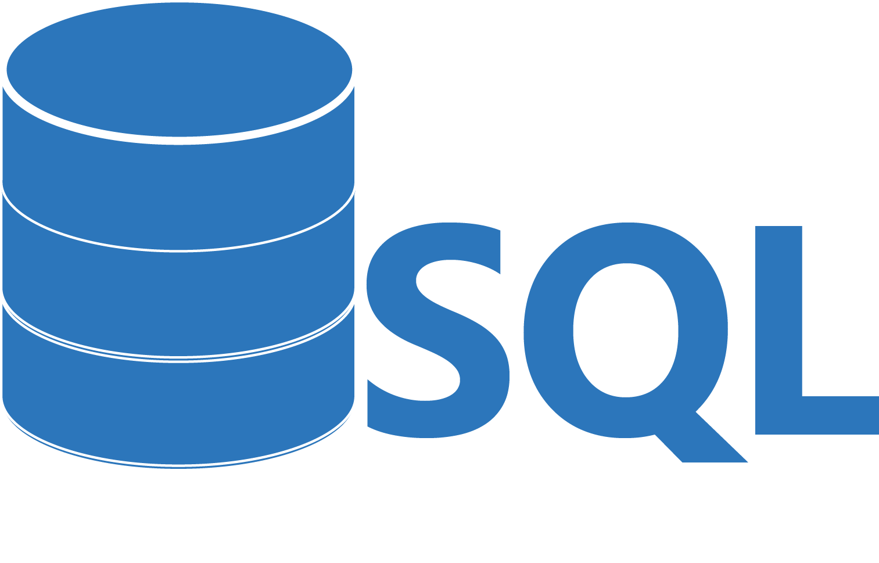
APIs (cont.)
Cassandra API
Globally distributed Apache Cassandra service powered by the Azure Cosmos DB platform
Compatible with existing Apache Cassandra libraries, drivers, tools, and applications
SQL API
JavaScript and JavaScript Object Notation (JSON) native API based on the Azure Cosmos DB database engine
Provides query capabilities rooted in SQL
Query for documents based on their identifiers or make deeper queries based on properties of the document, complex objects, or the existence of specific properties
Supports the execution of JavaScript logic within the database in the form of stored procedures, triggers, and user-defined functions
Notes:
Apache Cassandra API
The Cassandra API in Azure Cosmos DB is a globally distributed Apache Cassandra service powered by the Azure Cosmos DB platform. Compatible with existing Apache Cassandra libraries, drivers, tools, and applications.
SQL API
The SQL API in Azure Cosmos DB is a JavaScript and JavaScript Object Notation (JSON) native API based on the Azure Cosmos DB database engine. The SQL API also provides query capabilities rooted in the familiar SQL query language. By using SQL, you can query for documents based on their identifiers or make deeper queries based on properties of the document, complex objects, or even the existence of specific properties. The SQL API supports the execution of JavaScript logic within the database in the form of stored procedures, triggers, and user-defined functions.

Slide 12
Migrating from NoSQL
Many NoSQL database engines are simple to get started with, but they might cause problems as you scale, including:
Tedious setup and maintenance requirements for a multiple-server database cluster
Expensive and complex high-availability solutions
Challenges in achieving end-to-end security, including encryption at rest and in flight
Required resource overprovisioning and unpredictable costs to achieve scale
Azure Cosmos DB provides NoSQL-as-a-service for:
MongoDB
Cassandra
Gremlin
Notes:
To achieve a successful migration, it is important to keep a few tips in mind:
Instead of writing custom code, you should use native tools, such as the Cassandra shell, mongodump, and mongoexport.
Azure Cosmos DB containers should be allocated prior to the migration with the appropriate throughput levels set. Many of the tools will create containers for you with default settings that are not ideal.
Prior to migrating, you should increase the container’s throughput to at least 1,000 Request Units (RUs) per second so that the import tools are not throttled. The throughput can be reverted back to the typical values after the import is complete.

Slide 13
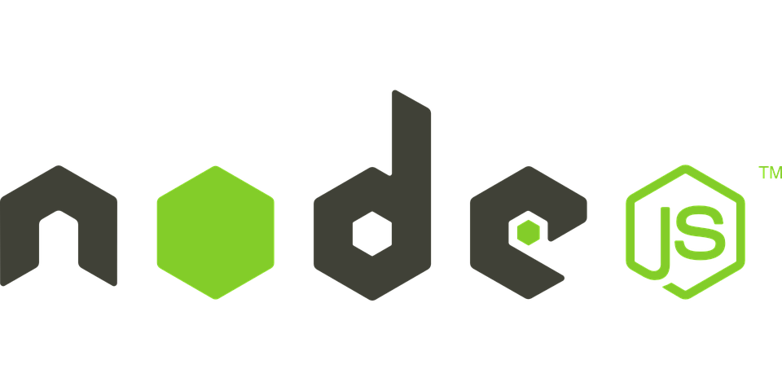


Migrating from NoSQL (continued)
NoSQL wire protocol
MongoDB
Azure Cosmos DB MongoDB API
NoSQL wire protocol
Azure Cosmos DB Cassandra API
Notes:
Azure Cosmos DB has a MongoDB API and a Cassandra API to provide a NoSQL service offering for two of the most popular NoSQL database platforms. Both APIs are protocol compatible with the Cassandra API supporting CQLv4 and the MongoDB API supporting MongoDB v5. Many applications can be “lifted and shifted” to Azure Cosmos DB without the need to rewrite code.

Slide 14
Lesson 02: Azure Cosmos DB data structure

Slide 15
Resource hierarchy
Account
Database
Database
Database
Database
=
Database
Container
Collection
Graph
Table
Database
Database
Sproc
Trigger
User-defined function
Conflict
Item
Notes:
The JSON documents stored in the Azure Cosmos DB SQL API are managed through a well-defined hierarchy of database resources. The Azure Cosmos DB hierarchical resource model consists of sets of resources under a database account, each addressable via a logical and stable URI. A set of resources is referred to as a feed.

Slide 16
Resource hierarchy (continued)
Resource | Description
Account | A set of databases
Database | Logical container for containers that can (optionally) share throughput across the containers
Collection (container) | A group of Items and programmatic resources usually related in some way
Document (item) | An arbitrary unit of content In many cases, this would be a JSON document
Stored procedure (sproc) | Application logic written in JavaScript executed within the database engine as a transaction
Trigger | Application logic written in JavaScript executed before or after either an insert, replace, or delete operation
User-defined function | Application logic written in JavaScript to extend the SQL API query language
Notes:
Account
A database account is associated with a set of databases and a fixed amount of large object (blob) storage for attachments. You can create one or more database accounts by using your Azure subscription.
Database
A database is a logical container of document storage partitioned across collections. It is also a users container.
Collection (container)
A collection is a container of JSON documents and the associated JavaScript application logic. Collections can span one or more partitions or servers and can scale to handle practically unlimited volumes of storage or throughput.
Document (item)
User-defined (arbitrary) JSON content. By default, no schema needs to be defined, nor do secondary indexes need to be provided for all the documents added to a collection.
Stored procedure (sproc)
Application logic written in JavaScript that is registered with a collection and executed within the database engine as a transaction.
Trigger
Application logic written in JavaScript executed before or after either an insert, replace, or delete operation.
User-defined function
Application logic written in JavaScript. User-defined functions enable you to model a custom query operator and thereby extend the core SQL API query language.

Slide 17



Containers
Database
500 RU/s
5000 RU/s
2000 RU/s
Containers
Notes:
In the Azure Cosmos DB SQL API, databases are essentially containers for collections. Collections are where you place individual documents. A collection is intrinsically elastic—it automatically grows and shrinks as you add or remove documents.
Each collection is assigned a throughput value, and that value dictates the maximum throughput for that collection and its corresponding documents. Alternatively, you can assign the throughput at the database level and share the throughput values among the collections in the database. If you have a set of documents that needs throughput beyond the limits of an individual collection, you can distribute the documents among multiple collections. Each collection has its own distinct throughput level.
If a particular collection is seeing spikes in throughput, you can manage its throughput level in isolation by increasing or decreasing the value. This change to the throughput level of a particular collection will not cause side effects for the other collections. This allows you to adjust to meet the performance needs of any workload in isolation.
You can also scale workloads across collections, if you have a workload that needs to be partitioned, you can scale that workload by distributing its associated documents across multiple collections. The SQL API for Azure Cosmos DB includes a client-side partition resolver that allows you to manage transactions and point them in code to the correct partition based on a partition key field.

Slide 18



Partitioning
Sharding logic:
Route requests for tenant 1 to shard …
…
Route request for tenant 44 to shard A
…
Route requests for tenant 227 to shard C
…
Route request for tenant N to shard …
Application instance
Application instance
Query: Find information for tenant 55
Query: Find information for tenant 27
. . .
Partition A
Partition B
Partition C
Partition N
Notes:
Azure Cosmos DB provides containers for storing data called collections (for documents), graphs, or tables. Containers are logical resources and can span one or more physical partitions or servers. The number of partitions is determined by Azure Cosmos DB based on the storage size and throughput provisioned for a container or set of containers.
If you are already familiar with the sharding pattern, the idea of dynamic partitioning is not very different.
A physical partition is a fixed amount of reserved solid-state drive (SSD) back-end storage combined with a variable amount of compute resources (CPU and memory). Each physical partition is replicated for high availability. A physical partition is an internal concept of Azure Cosmos DB, and physical partitions are transient. Azure Cosmos DB will automatically scale the number of physical partitions based on your workload.

Slide 19

Partitioning implementation
Partition Key: User ID
Azure Cosmos DB Container (for example, Collection)
Logical Partitioning Abstraction
Behind the scenes:
Physical partition sets
hash(User ID)
Psuedo-random distribution of data over the range of possible hashed values
Dharma
Andrew
…
Shireesh
Karthik
Mike
Bob
Rimma
…
Alice
…
Carol
Partition 1
Partition 2
Partition n
Frugal number of partitions based on actual storage and throughput needs
Notes:
A logical partition is a partition within a physical partition that stores all the data associated with a single partition key value. Partition ranges can be dynamically subdivided to seamlessly grow the database as the application grows while simultaneously maintaining high availability. When a container meets the partitioning prerequisites, partitioning is completely transparent to your application. Azure Cosmos DB handles distributing data across physical and logical partitions and routing query requests to the right partition.

Slide 20
Lesson 03: Create and update documents by using code

Slide 21


Manage collections and documents
Install the Microsoft.Azure.Cosmos package from NuGet:
dotnet add package Microsoft.Azure.Cosmos
Use the following namespaces:
Microsoft.Azure.Cosmos
Microsoft.Azure.Cosmos.Linq
Use the CosmosClient class
Notes:
To get started with the Azure Cosmos DB SQL API, you’ll need the Microsoft.Azure.Cosmos package from NuGet and to reference the appropriate namespaces.

Slide 22
Creating a CosmosClient instance by using .NET
using Microsoft.Azure.Cosmos;
using Microsoft.Azure.Cosmos.Linq;
string endpoint = "[endpoint]";
string key = "[key]";
CosmosClient client = new CosmosClient(endpoint, key);
AccountProperties account = await client.ReadAccountAsync();
Obtained from the account
Read account configuration
Notes:
First, you’ll need to add the using directives for the namespaces to your classes.
Then, you can create a CosmosClient instance by using the endpoint from your Azure Cosmos DB account and one of your keys.

Slide 23
Accessing a database by using .NET
CosmosClient client = new CosmosClient(endpoint, key);
string databaseName = "DemoDatabase";
Database database = client .GetDatabase(databaseName);
OR
Database database = await client .CreateDatabaseIfNotExistsAsync( databaseName,
throughput: 10000
);
Reference existing database
Create new database
Notes:
To reference any resource in the SDK, you’ll need the unique identifier.
This example illustrates how to reference an existing database or create a new database in Azure Cosmos DB.

Slide 24
Accessing a collection by using .NET
CosmosClient client = new CosmosClient(endpoint, key);
string collectionName = "ExampleCollection";
Database database = client .GetDatabase(databaseName);
OR
Database database = await client .CreateDatabaseIfNotExistsAsync( databaseName,
throughput: 10000
);
Reference existing container
Create new container
Notes:
To reference any resource in the SDK, you’ll need the unique identifier.
This example illustrates how to reference an existing container or create a new container (collection) in Azure Cosmos DB.

Slide 25
Demonstration: Managing Azure Cosmos DB by using .NET

Slide 26
Creating documents by using .NET
// Get container reference
CosmosClient client = new CosmosClient(endpoint, key);
Container container = client.GetContainer(databaseName, collectionName);
// create anonymous type in .NET
Product orangeSoda = new Product {
id = "7cc3212d-0e2c-4a13-b348-f2d879c43342",
name = "Orange Soda", group = "Beverages",
diet = false, price = 1.50m, quantity = 2000
};
// Upload document Product item = await container.CreateItemAsync(orangeSoda);
Product item = await container.UpsertItemAsync(orangeSoda);
Create new document
Create or replace document
Notes:
Now, you can use the CreateItemAsync method of the Container class to insert a C# object into the collection. You can use any C# type you want for your documents because the SDK doesn't require a specific base type.
Alternatively, you can use UpsertItemAsync to create or replace the document based on the unique identifier.

Slide 27
Reading documents by using .NET
// Get container reference
CosmosClient client = new CosmosClient(endpoint, key);
Container container = client.GetContainer(databaseName, collectionName);
// Get unique fields string id = "7cc3212d-0e2c-4a13-b348-f2d879c43342";
PartitionKey partitionKey = new PartitionKey("Beverages");
// Read document using unique id ItemResponse<Product> response = await container.ReadItemAsync<Product>( id,
partitionKey
);
// Serialize response Product item = response.Resource;
Notes:
You can access individual items (documents) by referencing their unique id property and their partition key.
In this example, you serialize a document into a specific C# type.

Slide 28
Querying documents by using .NET
// Get container reference
CosmosClient client = new CosmosClient(endpoint, key);
Container container = client.GetContainer(databaseName, collectionName);
// Use SQL query language
FeedIterator<Product> iteratorOld = container.GetItemQueryIterator<Product>(
"SELECT * FROM products p WHERE p.diet = false"
);
// Iterate over results
while (iterator.HasMoreResults)
{
FeedResponse<Product> batch = await iterator.ReadNextAsync();
foreach(Product item in batch)
{ }
}
Check for new batch of results
Get next batch of results
Notes:
If you want to query the database, you can perform SQL queries by using the GetItemQueryIterator method of the Container class.

Slide 29
Querying documents by using .NET (continued)
// Get container reference
CosmosClient client = new CosmosClient(endpoint, key);
Container container = client.GetContainer(databaseName, collectionName);
// Use LINQ query language
FeedIterator<Product> iterator = container.GetItemLinqQueryable<Product>()
.Where(p => !p.diet)
.ToFeedIterator();
// Iterate over results
while (iterator.HasMoreResults)
{
FeedResponse<Product> batch = await iterator.ReadNextAsync();
foreach(Product item in batch)
{ }
}
Translate LINQ expression to SQL
Notes:
Alternatively, you can use the language-integrated query (LINQ) feature of C# with the SDK.
You get the LINQ queryable with the GetItemLinqQueryable method of the Container class.
The LINQ expressions will be automatically translated into the appropriate SQL query.

Slide 30


JavaScript and Azure Cosmos DB
Stored procedures
User-defined functions
Triggers (pre/post)
Azure Cosmos DB
Notes:
JavaScript is the primary language for creating server-side logic for Azure Cosmos DB databases and can be used to write:
Stored procedures.
User-defined functions.
Triggers (pre/post).
The next set of slides will use examples of each programmatic feature. Let’s understand stored procedures first.

Slide 31

Stored procedures
In Azure Cosmos DB, JavaScript is hosted in the same memory space as the database
Requests made within stored procedures and triggers run in the same scope of a database session
Create new
document
Query collection
Update existing document
Delete existing document
Notes:
In a typical database, a transaction can be defined as a sequence of operations that are performed as a single, logical unit of work. Each transaction provides atomicity, consistency, isolation, and durability (ACID) guarantees. Let’s understand ACID in some detail.
ACID:
Atomicity guarantees that all the work done inside a transaction is treated as a single unit where either all of it is committed or none is.
Consistency makes sure that the data is always in a good internal state across transactions.
Isolation guarantees that no two transactions interfere with each other. Generally, most commercial systems provide multiple isolation levels that can be used as per the application needs.
Durability ensures that any change that is committed in the database will always be present.
Because requests made within stored procedures and triggers run in the same scope of a database session, the services guarantee ACID for all operations that are part of a single stored procedure trigger.
This diagram illustrates the process of running a stored JavaScript procedure on Azure Cosmos DB servers and common tasks that might run within the stored procedures’ scoped transaction, such as creating, querying, updating, or deleting documents.

Slide 32
Stored procedure in JavaScript
function createSampleDocument(documentToCreate) {
var context = getContext();
var collection = context.getCollection();
var accepted = collection.createDocument(
collection.getSelfLink(),
documentToCreate,
function (error, documentCreated) {
context.getResponse().setBody(documentCreated.id)
}
);
if (!accepted) return;
}
Notes:
This stored procedure takes an input parameter named documentToCreate. In this example, the parameter’s value is the body of a document to be created in the current collection.
All operations are asynchronous and depend on JavaScript function callbacks. The callback function has two parameters:
One for the error object in case the operation fails.
One for the created object.
Inside the callback, users can either handle the exception or throw an error. In case a callback isn’t provided and there’s an error, the Azure Cosmos DB runtime throws an error.
In the example on the slide, the callback throws an error if the operation fails. Otherwise, it sets the id of the created document as the body of the response to the client.

Slide 33
Stored procedure in JavaScript - refactored
function createSampleDocument(documentToCreate) {
var accepted = __.createDocument(
__.getSelfLink(),
documentToCreate,
(error, documentCreated) => {
getContext().getResponse().setBody(documentCreated.id)
}
);
if (!accepted) return;
}
Notes:
You can improve the stored procedure by taking advantage of a couple of language enhancements in the platform:
The double underscore (__) is a reference to getContext().getCollection() that simplifies multiple lines of code. This example uses it to call the createDocument() and the getSelfLink() functions.
You can take advantage of lambda expressions to make your code more concise.

Slide 34
Bounded execution
All Azure Cosmos DB operations must complete within a limited amount of time
Specifically, stored procedures have a limited amount of time to run on the server
All collection functions return a Boolean value that represents whether that operation will complete or not
True (Will complete)
Function <>
False (Roll back)
Notes:
All Azure Cosmos DB operations must complete within the server-specified request timeout duration.
If an operation doesn’t complete within this time limit, the transaction is rolled back.
All functions under the collection object (for create, read, replace, and delete documents and attachments) return a Boolean value that represents whether that operation will complete or not.
Next, let’s understand transaction continuation.

Slide 35
Transaction continuation
JavaScript functions can implement a continuation-based model to batch or resume execution
The continuation value can be any value of your choice
Your applications can then use this value to resume a transaction from a new starting point
Notes:
Functions can return any value. You can use this value to resume long-running functions after the server-specified time is over. For example, you might have a function to upload millions of documents. If the server-specified time is over before all documents upload, you can return a pointer to indicate how far your function progressed in the document upload. This will make it easier to resume processing in a new function iteration. The next slide depicts this with another example in a flow diagram.

Slide 36
Transaction continuation (cont.)
Bulk create documents
Each document
Try create
Observe
return
value
Done
Return a pointer to resume later
Notes:
This diagram depicts how the transaction continuation model can be used to repeat a server-side function until the function finishes its entire processing workload.
In this example, after the workflow begins, the return value is observed as each document is created. At some point, the document creation method will return false instead of true. At this point, a pointer will immediately be returned to the client that originally invoked the function. The client will then resume the function by starting at the appropriate point in the list of documents to process.

Slide 37
User-defined functions in JavaScript
var taxUdf = {
id: "tax",
serverScript: function tax(income) {
if (income == undefined)
throw 'no input';
if (income < 1000)
return income * 0.1;
else if (income < 10000)
return income * 0.2;
else
return income * 0.4;
}
}
Notes:
User-defined functions extend the Azure Cosmos DB SQL API’s query language grammar and implement custom business logic. User-defined functions can only be called from inside queries. They don’t have access to the context object and are meant to be used as compute-only code.
This example depicts a function that calculates the transaction amount, with tax included. The tax function has a single numerical parameter named income. That parameter is then used to calculate the final return value of the function.

Slide 38
User-defined functions in SQL queries
SELECT
*
FROM
TaxPayers t
WHERE
udf.tax(t.income) > 20000
Notes:
User-defined functions are available to use in SQL queries in a manner similar to built-in functions.
In this example, you use the tax function by fully qualifying it with the udf namespace and passing in a numeric value.
This slide marks the end of the first topic. The next two slides are about ETags.

Slide 39

Optimistic concurrency
The SQL API supports optimistic concurrency control through HTTP ETags
Every SQL API resource has an ETag system property
ETags can be used with the If-Match HTTP request header to allow the server to decide whether a resource should be updated
If-Match
Check
ETag
HTTP 412
Notes:
The ETag value is generated on the server every time a document updates.
If the ETag value stays constant, it means that no other process has updated the document. However, if the ETag value unexpectedly mutates, it means that another concurrent process has updated the document.

Slide 40
Controlling concurrency in .NET
try
{
var ac = new AccessCondition { Condition = readDoc.ETag, Type =
AccessConditionType.IfMatch };
await client.ReplaceDocumentAsync(readDoc, new RequestOptions {
AccessCondition = ac });
}
catch (DocumentClientException dce)
{
if (dce.StatusCode == HttpStatusCode.PreconditionFailed)
{
Console.WriteLine("Another process has updated the record");
}
}
Notes:
This sample code uses the AccessCondition class to take advantage of the ETag and avoid scenarios where the document updates on the server before the client finishes processing it.
If there’s an optimistic concurrency issue, the SDK will throw the DocumentClientException exception and will return the appropriate HTTP status code, which is Precondition Failed.

Slide 41

Lab: Constructing a polyglot data solution
Notes:
This lab is scheduled to take 45 minutes.

Slide 42

Lab sign-in information
Duration
Lab: Constructing a polyglot data solution
AZ204-SEA-DEV
Username: Admin
Password: Pa55w.rd
Notes:
Students will also have access to the following scenario description in their lab guide:
You’ve been assigned the task of updating your company’s existing retail web application to use more than one data service in Azure.
Your company’s goal is to take advantage of the best data service for each application component.
After conducting thorough research, you decide to migrate your inventory database from Azure SQL Database to Azure Cosmos DB.

