Slide 2


Slide 3


Slide 4

Installing numpy, pandas etc
python –m pip install numpy
python –m pip install pandas
python –m pip install matplotlib

Slide 5


NumPy

Slide 6
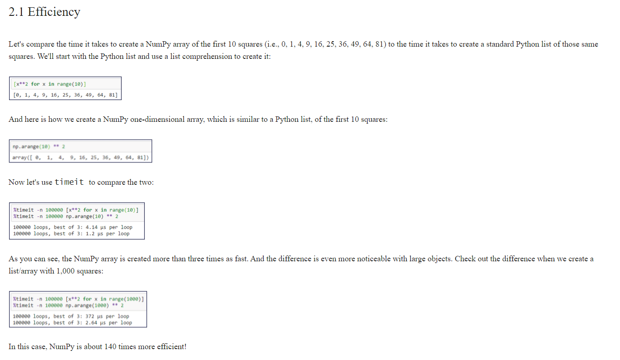

Slide 7
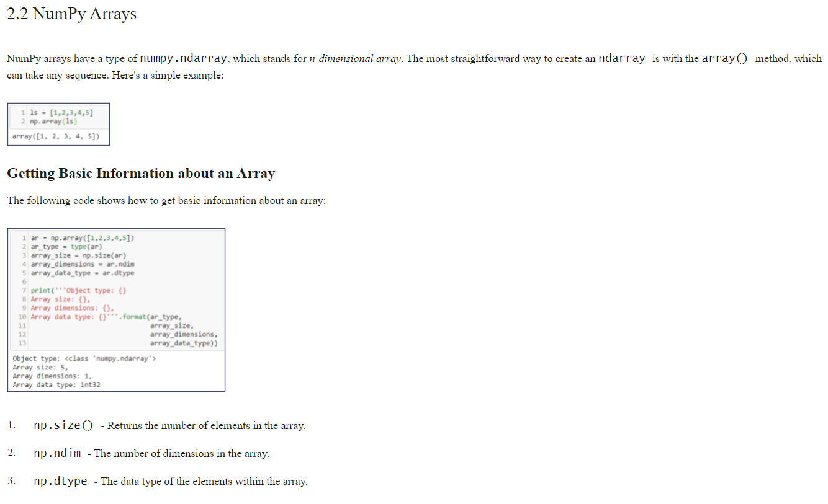

Slide 8
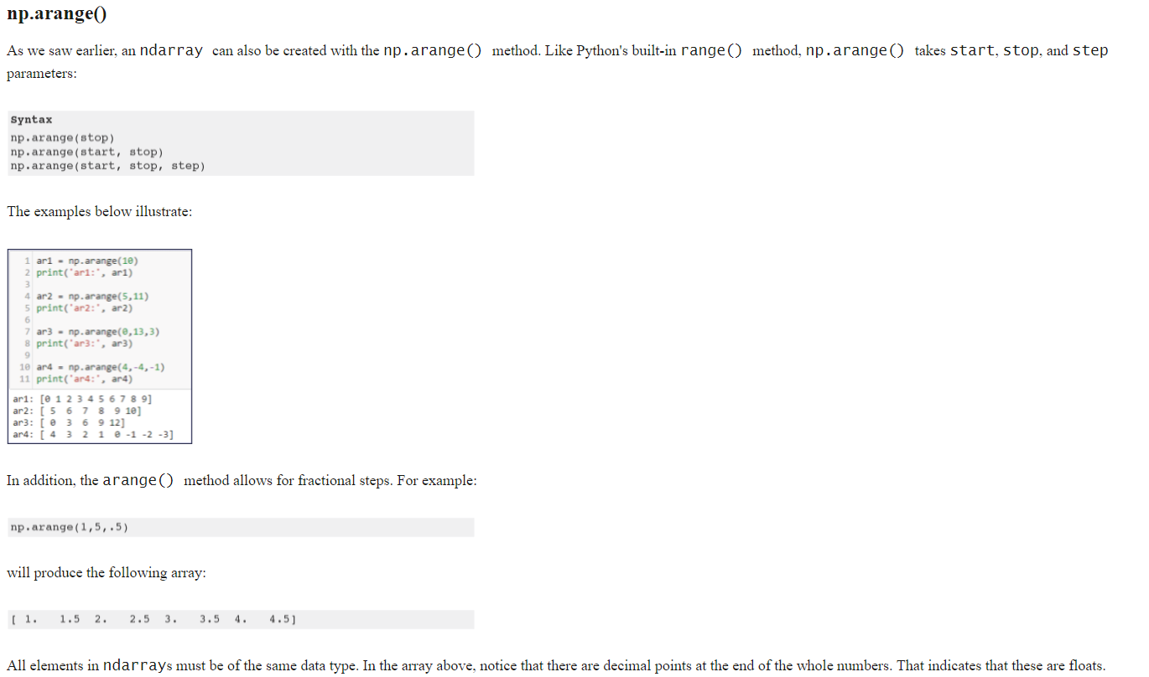

Slide 9
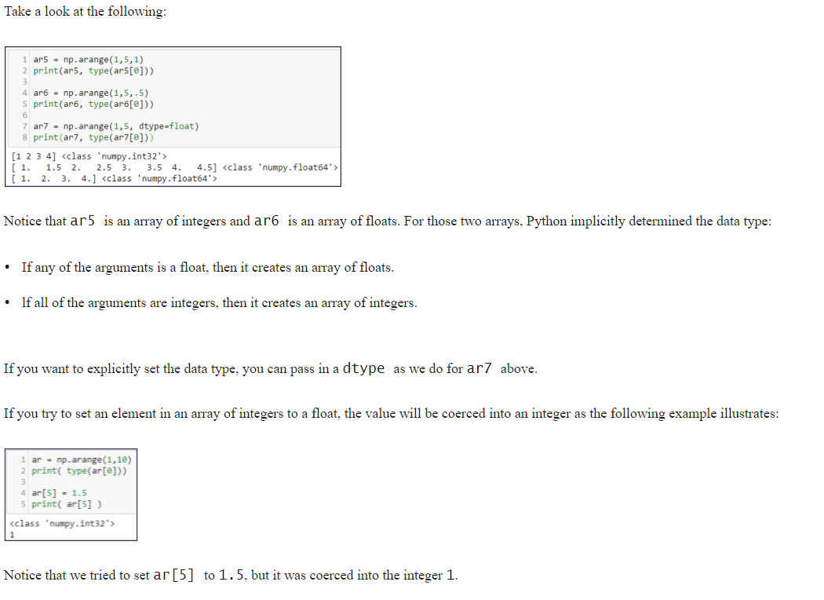

Slide 10
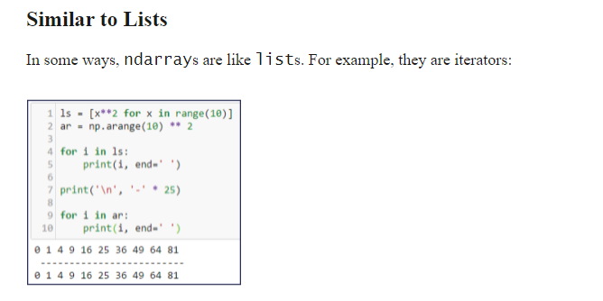

Slide 11
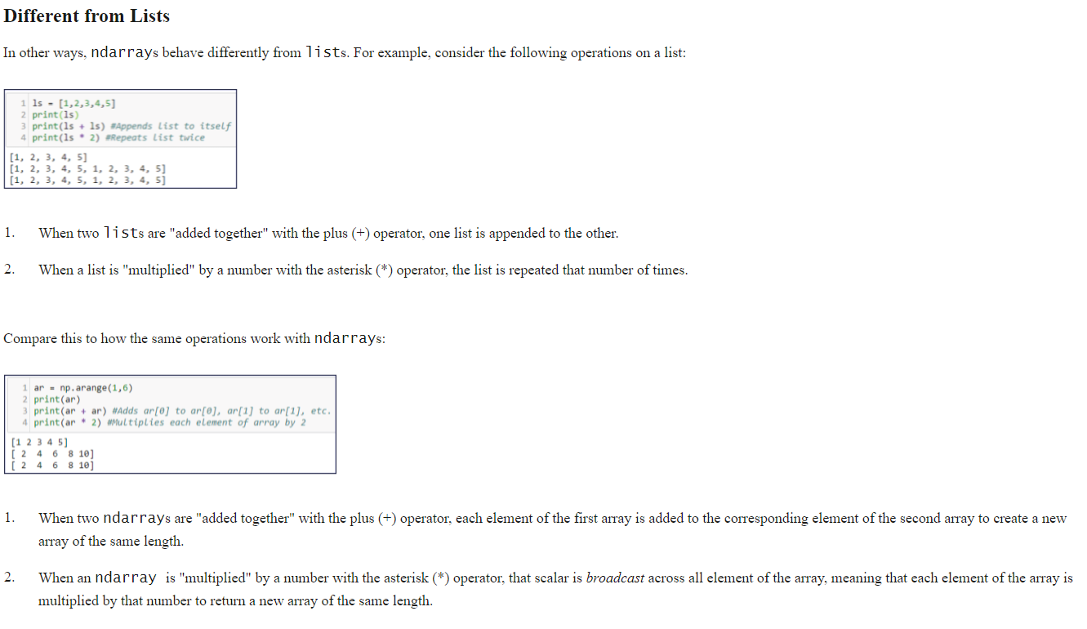

Slide 12
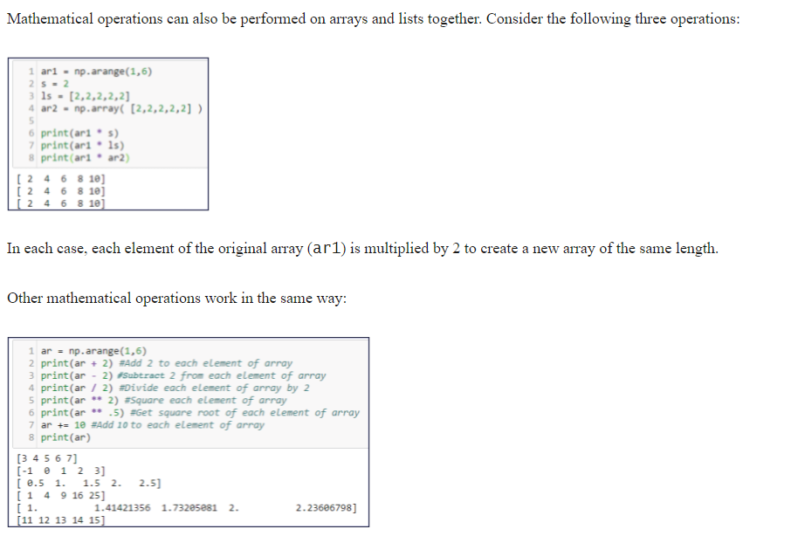

Slide 13
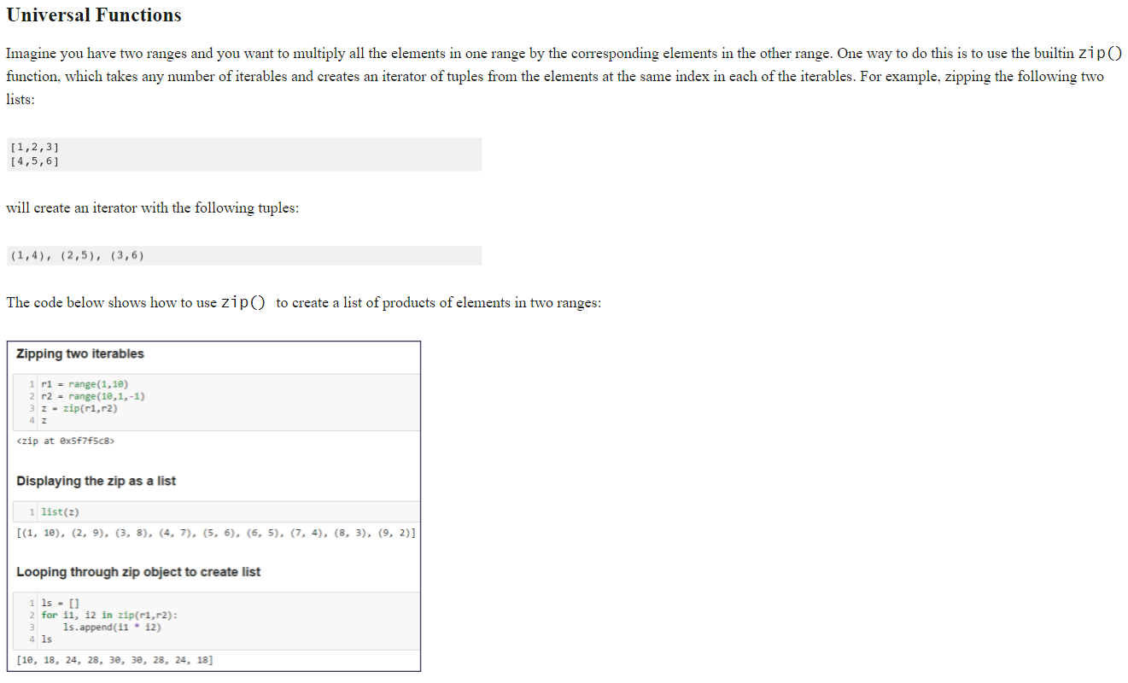

Slide 14


Slide 15
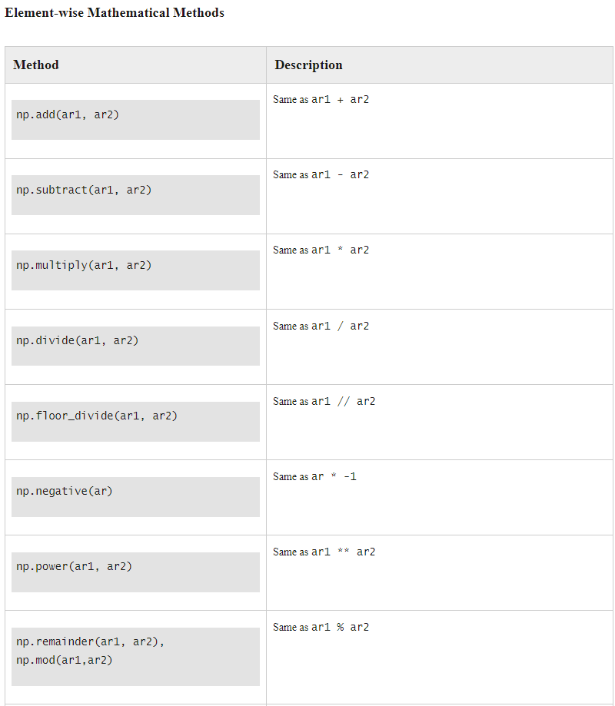
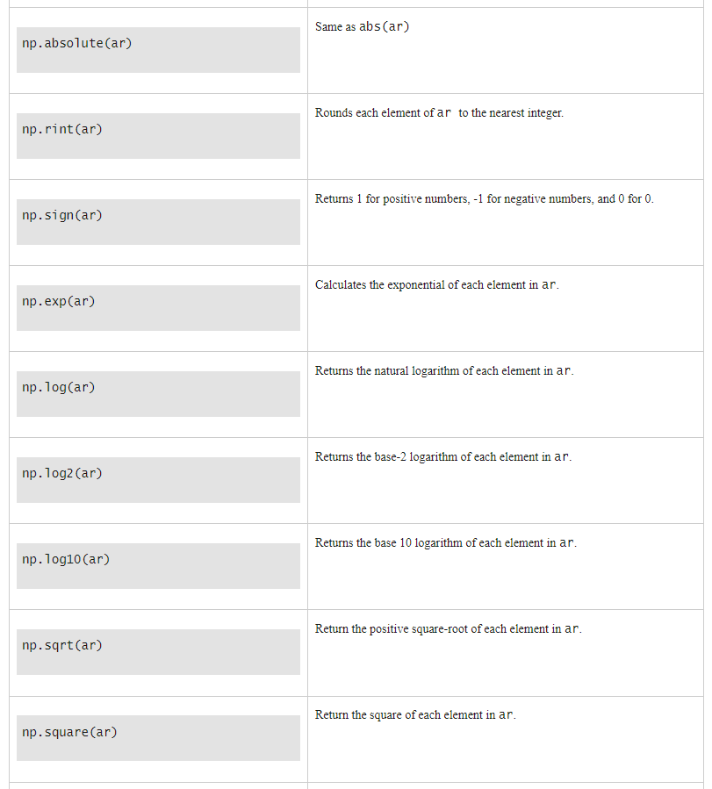

Slide 16
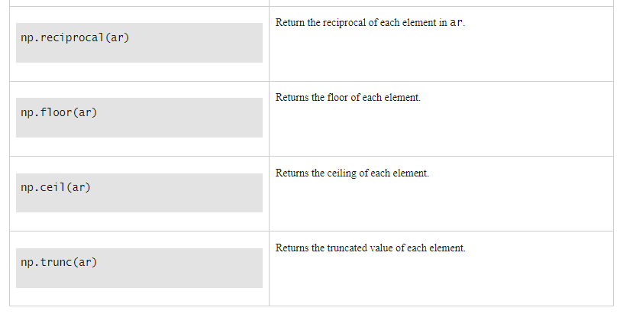

Slide 17
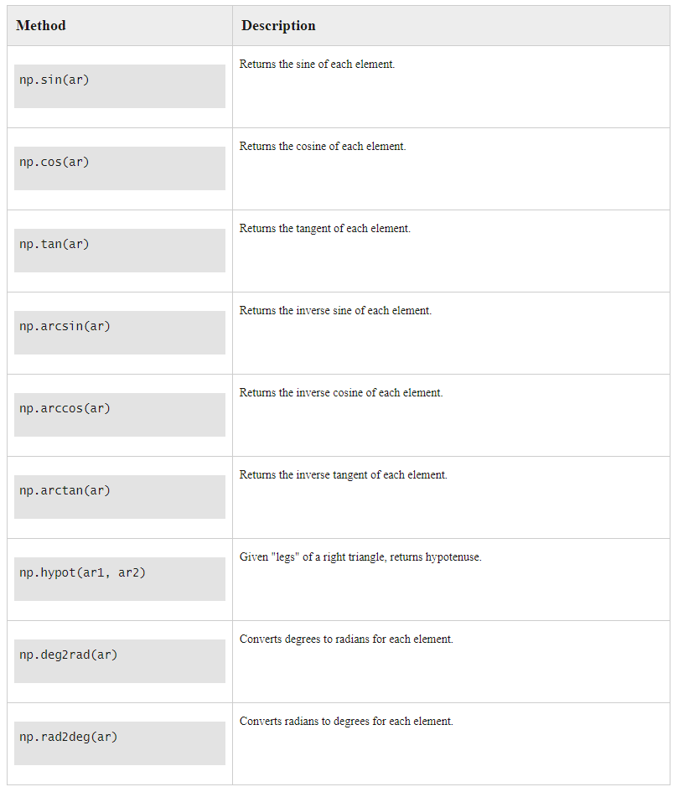
Element-wise trigonometric methods

Slide 18
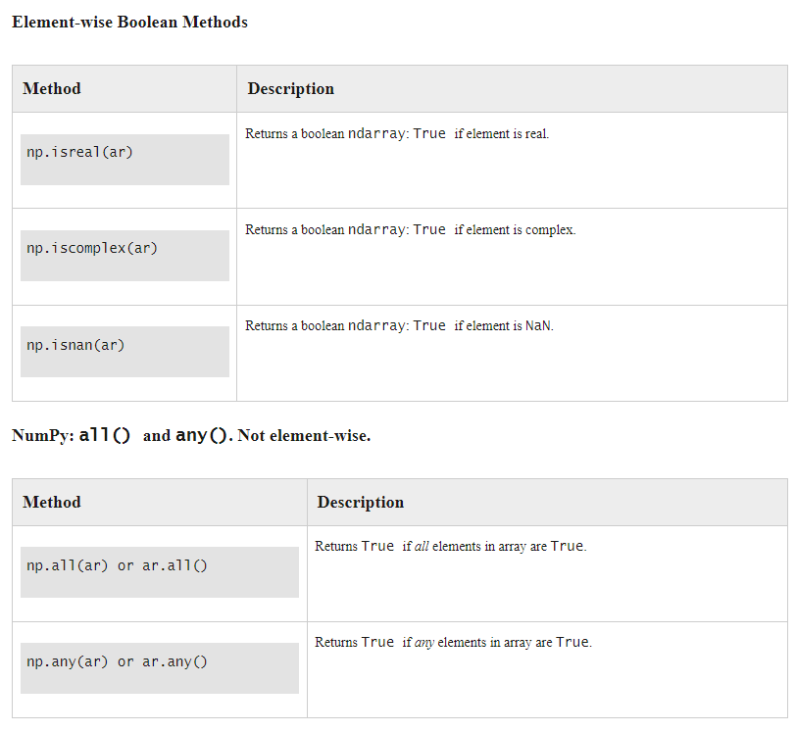

Slide 19
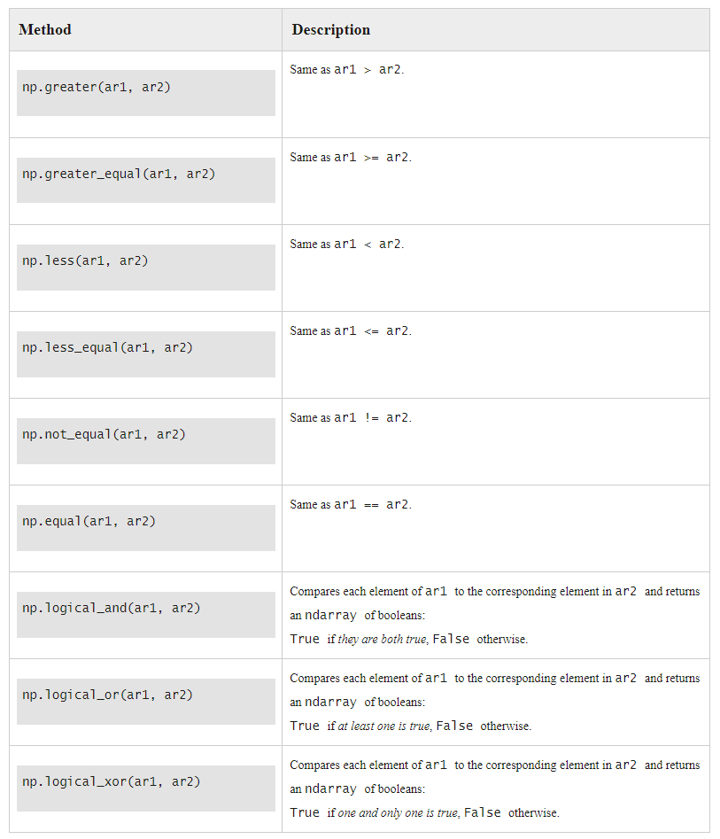



Slide 20
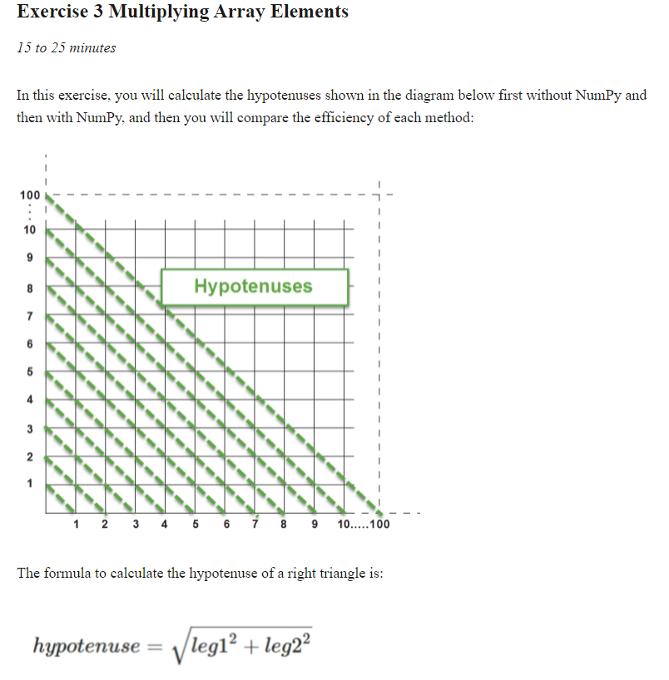
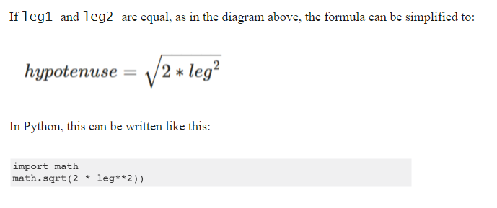
Import math, numpy, timeit
Calculate for leg=range(1,101)
Use a list hypotenuses = [] and append the values
Print them
Calculate with numpy
Make the legs with np.arange
Use np.hypot to calculate
Check difference with timeit

Slide 21
