Slide 1
Kubernetes
Rode Kruis Ziekenhuis
Beverwijk

Slide 2
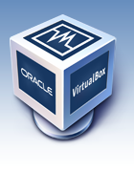
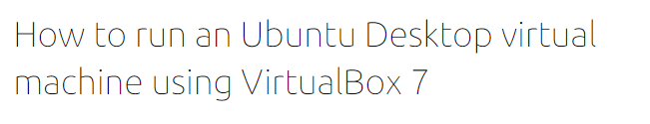
Software needed
VirtualBox.org
Ubuntu
https://ubuntu.com/tutorials/how-to-run-ubuntu-desktop-on-a-virtual-machine-using-virtualbox#1-overview

Slide 3
linux
https://ryanstutorials.net/linuxtutorial/

Slide 4
minikube
Minikube is local Kubernetes, focusing on making it easy to learn and develop for Kubernetes.
All you need is Docker (or similarly compatible) container or a Virtual Machine environment, and Kubernetes is a single command away: minikube start
What you’ll need
2 CPUs or more
2GB of free memory
20GB of free disk space
Internet connection
Container or virtual machine manager, such as: Docker, QEMU, Hyperkit, Hyper-V, KVM, Parallels, Podman, VirtualBox, or VMware Fusion/Workstation
Notes:
https://minikube.sigs.k8s.io/docs/start/
https://kubernetes.io/docs/tutorials/

Slide 5
installation
Download and run the installer with powershell:
New-Item -Path 'c:\' -Name 'minikube' -ItemType Directory -Force
Invoke-WebRequest -OutFile 'c:\minikube\minikube.exe' -Uri 'https://github.com/kubernetes/minikube/releases/latest/download/minikube-windows-amd64.exe' –UseBasicParsing
Add the minikube binary to your PATH, make sure powershell as administrator
$oldPath = [Environment]::GetEnvironmentVariable('Path', [EnvironmentVariableTarget]::Machine)
if ($oldPath.Split(';') -inotcontains 'C:\minikube'){
[Environment]::SetEnvironmentVariable('Path', $('{0};C:\minikube' -f $oldPath), [EnvironmentVariableTarget]::Machine)
}

Slide 6
Start your cluster
From a terminal with administrator access (but not logged in as root), run:
minikube start
If minikube fails to start, see the drivers page for help setting up a compatible container or virtual-machine manager. (https://minikube.sigs.k8s.io/docs/drivers/)
bcdedit /set hypervisorlaunchtype off
And reboot!
minikube start –driver=virtualbox
minikube config set driver virtualbox
minikube get po -A

Slide 7
dashboard
Initially, some services such as the storage-provisioner, may not yet be in a Running state. This is a normal condition during cluster bring-up, and will resolve itself momentarily. For additional insight into your cluster state, minikube bundles the Kubernetes Dashboard, allowing you to get easily acclimated to your new environment:
minikube dashboard

Slide 8
Create a deployment
A Kubernetes Pod is a group of one or more Containers, tied together for the purposes of administration and networking. The Pod in this example has only one Container.
A Kubernetes Deployment checks on the health of your Pod and restarts the Pod's Container if it terminates. Deployments are the recommended way to manage the creation and scaling of Pods.
Use the kubectl create command to create a Deployment that manages a Pod. The Pod runs a Container based on the provided Docker image.
kubectl create deployment hello-node --image=registry.k8s.io/e2e-test-images/agnhost:2.39 -- /agnhost netexec --http-port=8080

Slide 9


View the deployment, view the pod
kubectl get deployments
The output is similar to:
kubectl get pods
The output is similar to:
kubectl get events
kubectl config view

Slide 10
Create a service
By default, the Pod is only accessible by its internal IP address within the Kubernetes cluster. To make the hello-node Container accessible from outside the Kubernetes virtual network, you have to expose the Pod as a Kubernetes Service.
Expose the Pod to the public internet using the kubectl expose command:
kubectl expose deployment hello-node --type=LoadBalancer --port=8080
The --type=LoadBalancer flag indicates that you want to expose your Service outside of the cluster.
The application code inside the test image only listens on TCP port 8080. If you used kubectl expose to expose a different port, clients could not connect to that other port.

Slide 11

View the service
kubectl get services
The output is similar to:
On cloud providers that support load balancers, an external IP address would be provisioned to access the Service. On minikube, the LoadBalancer type makes the Service accessible through the minikube service command.
minikube service hello-node
This opens up a browser window that serves your app and shows the app's response.

Slide 12
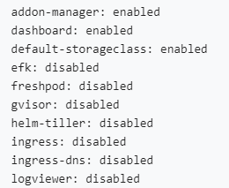
Enable addons
The minikube tool includes a set of built-in addons that can be enabled, disabled and opened in the local Kubernetes environment.
minikube addons list
The output is similar to:

Slide 13
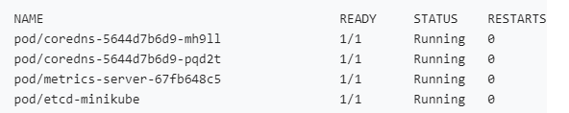
Enable addons
Enable an addon, for example, metrics-server:
minikube addons enable metrics-server
The output is similar to:
The 'metrics-server' addon is enabled
View the Pod and Service you created by installing that addon:
kubectl get pod,svc -n kube-system

Slide 14
Disable addons
Disable metrics-server:
minikube addons disable metrics-server
The output is similar to:
metrics-server was successfully disabled

Slide 15
cleanup
Now you can clean up the resources you created in your cluster:
kubectl delete service hello-node
kubectl delete deployment hello-node
Stop the Minikube cluster
minikube stop
Optionally, delete the Minikube VM:
# Optional
minikube delete

Slide 16
Kubernetes cluster
Kubernetes coordinates a highly available cluster of computers that are connected to work as a single unit. The abstractions in Kubernetes allow you to deploy containerized applications to a cluster without tying them specifically to individual machines.
To make use of this new model of deployment, applications need to be packaged in a way that decouples them from individual hosts: they need to be containerized. Containerized applications are more flexible and available than in past deployment models, where applications were installed directly onto specific machines as packages deeply integrated into the host. Kubernetes automates the distribution and scheduling of application containers across a cluster in a more efficient way. Kubernetes is an open-source platform and is production-ready.

Slide 17
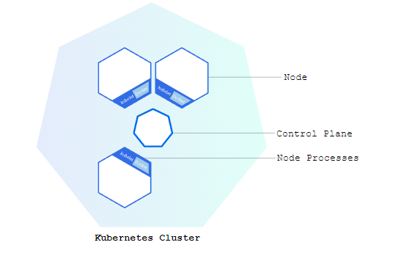
Kubernetes cluster
A Kubernetes cluster consists of two types of resources:
The Control Plane coordinates the cluster
Nodes are the workers that run applications

Slide 18
Control plane
The Control Plane is responsible for managing the cluster.
The Control Plane coordinates all activities in your cluster, such as scheduling applications, maintaining applications' desired state, scaling applications, and rolling out new updates.

Slide 19
node
A node is a VM or a physical computer that serves as a worker machine in a Kubernetes cluster.
Each node has a Kubelet, which is an agent for managing the node and communicating with the Kubernetes control plane. The node should also have tools for handling container operations, such as containerd or CRI-O. A Kubernetes cluster that handles production traffic should have a minimum of three nodes because if one node goes down, both an etcd member and a control plane instance are lost, and redundancy is compromised.
You can mitigate this risk by adding more control plane nodes.

Slide 20
When you deploy applications on Kubernetes, you tell the control plane to start the application containers.
The control plane schedules the containers to run on the cluster's nodes. Node-level components, such as the kubelet, communicate with the control plane using the Kubernetes API, which the control plane exposes. End users can also use the Kubernetes API directly to interact with the cluster.

Slide 21
Kubernetes deployment
Once you have a running Kubernetes cluster, you can deploy your containerized applications on top of it.
To do so, you create a Kubernetes Deployment. The Deployment instructs Kubernetes how to create and update instances of your application. Once you've created a Deployment, the Kubernetes control plane schedules the application instances included in that Deployment to run on individual Nodes in the cluster.
Once the application instances are created, a Kubernetes Deployment controller continuously monitors those instances. If the Node hosting an instance goes down or is deleted, the Deployment controller replaces the instance with an instance on another Node in the cluster. This provides a self-healing mechanism to address machine failure or maintenance.

Slide 22
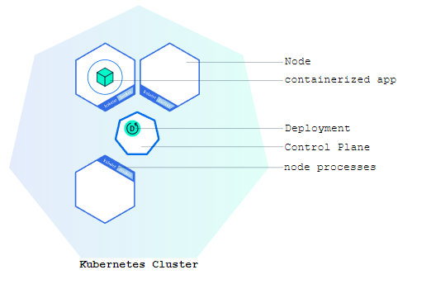
Kubernetes deployment
In a pre-orchestration world, installation scripts would often be used to start applications, but they did not allow recovery from machine failure. By both creating your application instances and keeping them running across Nodes, Kubernetes Deployments provide a fundamentally different approach to application management.

Slide 23
Kubernetes deployment
You can create and manage a Deployment by using the Kubernetes command line interface, kubectl. Kubectl uses the Kubernetes API to interact with the cluster. In this module, you'll learn the most common kubectl commands needed to create Deployments that run your applications on a Kubernetes cluster.
When you create a Deployment, you'll need to specify the container image for your application and the number of replicas that you want to run. You can change that information later by updating your Deployment; Modules 5 and 6 of the bootcamp discuss how you can scale and update your Deployments.

Slide 24
Kubectl basics
The common format of a kubectl command is: kubectl action resource
This performs the specified action (like create, describe or delete) on the specified resource (like node or deployment). You can use --help after the subcommand to get additional info about possible parameters (for example: kubectl get nodes --help).
Check that kubectl is configured to talk to your cluster, by running the kubectl version command.

Slide 25
kubectl
Check that kubectl is installed and you can see both the client and the server versions.
To view the nodes in the cluster, run the kubectl get nodes command.
You see the available nodes. Later, Kubernetes will choose where to deploy our application based on Node available resources.

