Slide 1
TTU CS Blog
James Little
Jason Weber
Patrick Braud
Randall Harper

Slide 2
Introduction
TTU CS Blog will be a community hub where students can reach out to peers seeking advice ranging anywhere from class topics to research. Anyone can visit the forums, but only registered users may post a question to the community. Users will be able to search through the forums for specific topics.

Slide 3
Functional Requirements
User Requirements
R1 Post
R1.1 Registered users shall be able to create posts on the blog
R1.2 The system shall display a 'Post' button which takes the user to a posting template to fill out
R1.3 After creating the post the user is taken to the new page created for their post
R1.4 'Administrator' user has the authority to close and/or move a post
R2 Restrict Access
R2.1 'Guest' users do not have permission to post
R2.2 'Faculty' users will only have permission to post research and articles
R3 Search
R3.1 'Registered', 'Guest', 'Faculty', and 'Administrator' users have the ability to search the blog
R3.2 The System displays any page on the blog domain
R3.3 The user enters their search criteria in the search bar
R3.4 The system displays a list of search results

Slide 4
Functional Requirements Cont.
System Functional Requirements
R4 Manage
R4.1 The System shall maintain a total number of topics
R4.2 The System shall mark each post as 'Answered' or 'Unanswered'
R4.3 The System shall close a post if it remains unanswered after the time out period
R4.4 The System shall close a post if it remains unanswered after the time out period
R5 Reward Points
R5.1 'Registered' users have the ability to mark answers to their posted questions as 'Correct' or 'Helpful'
R5.2 The System will reward points to marked answers
R5.3 The System finds an answer marked as correct and rewards a set amount of points to the account associated to it
R6 Notify
R6.1 The System shall automatically notify a user when someone has answered their post
R4.2 The System Shall automatically notify a user when one of their answers have been marked as 'Correct' or 'Helpful'

Slide 5
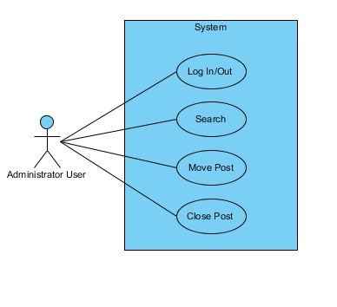
Administrator Use Case

Slide 6
Admin - Close Post
Administrator
Title | Administrator Close Post
Summary | The administrator user has the authority to close a post.
Preconditions | The administrator user is logged in and is located on a thread on the domain.
Post-conditions | The administrator user closes a thread.
Actor : Administrator User | System
 | 0. The system displays any page on the forum domain and an administrator user is logged in.
1. The administrator user selects a thread to be closed. | 2. The system displays "Are you sure?" question on the thread selected by the administrator user.
3. The administrator user selects close thread. | 4. The systems displays page "Thread Closed" with title of thread.

Slide 7
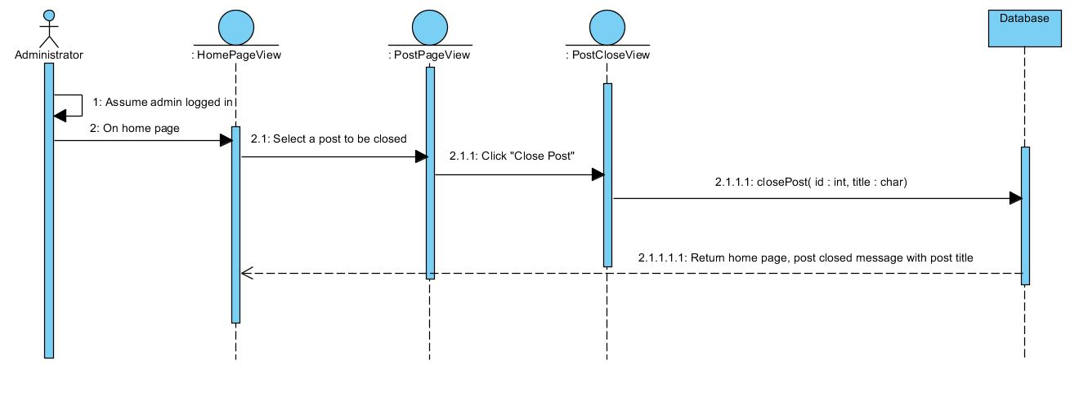
Close Post

Slide 8
Admin - Move Post
Administrator
Title | Administrator Move Post
Summary | The administrator user has the authority to move a post to a different topic/category.
Preconditions | The administrator user is logged in and is located on a thread on the domain.
Post-conditions | The administrator user moves a thread.
Actor : Administrator User | System
 | 0. The system displays any page on the forum domain and an administrator user is logged in.
1. The administrator user selects a thread to be moved. | 2. The system displays "Are you sure?" questions on the thread selected by the administrator user.
3. The administrator user selects move thread. | 4. The system displays page "Thread Moved" with title of thread to new location.

Slide 9
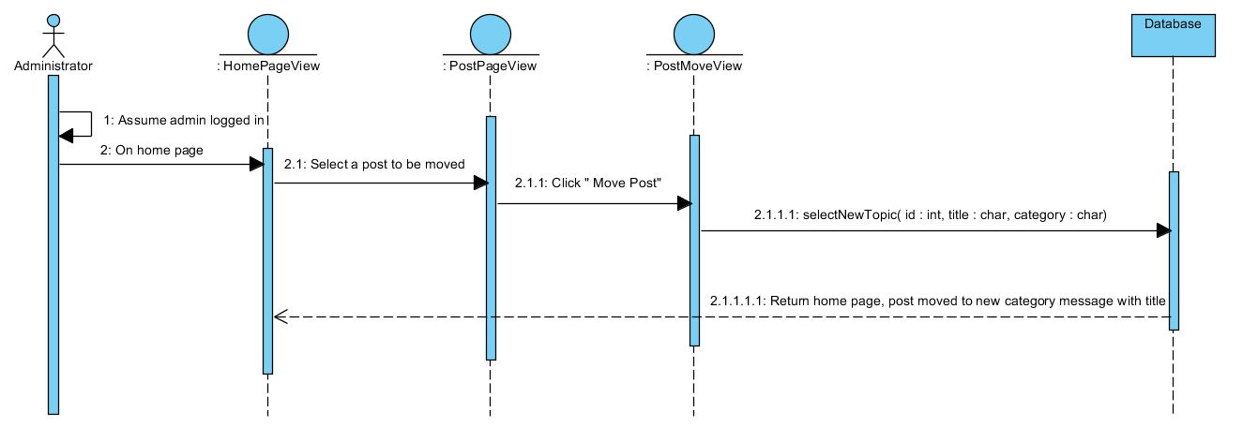
Move Post

Slide 10
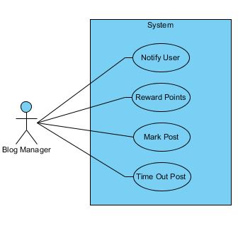
Blog Manager

Slide 11
Blog Manager - Reward Points
Blog Manager
Title | Reward Points
Summary | The system will reward points based on correct answers to posted questions
Preconditions | A user has chosen a correct answer to their post
Post-conditions | The user who answered correctly is rewarded points to their account
Actor : Blog Manager | System
 | 0. The system finds an answer marked as correct
1. The blog manager identifies the user with the correct answer | 2. The system rewards a set number of points to the appropriate account

Slide 12
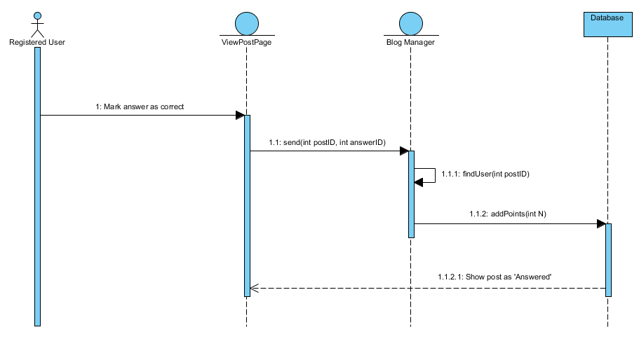
Reward Points

Slide 13
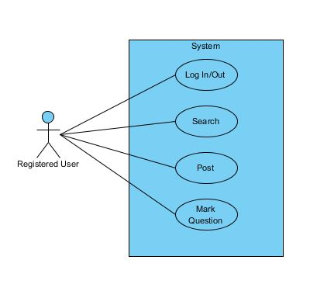
Registered User

Slide 14
Reg. User - Post Question
Registered User
Title | Post Question
Summary | The registered user can post new questions on the blog
Preconditions | The user is registered and logged in
Post-conditions | A new question is posted onto the blog
Actor : Registered User | System
0. The user clicks the 'Post' button | 1. System displays PostTemplate page
2. The user fills out the template for their question | 3. System creates a new post page for the user's question

Slide 15
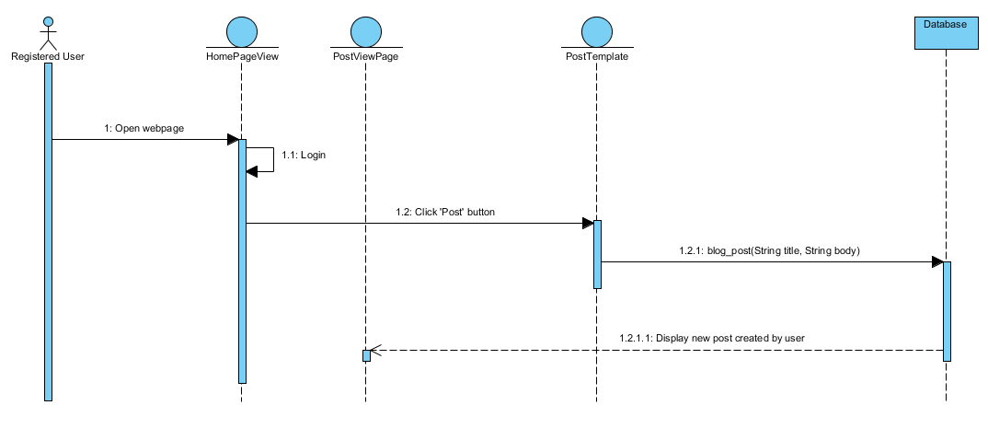
Post Question

Slide 16
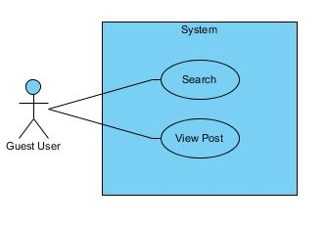
Guest User

Slide 17
Guest User - Search
Guest
Title | Search
Summary | The guest user can search the forums by entering a search criteria in the search bar.
Preconditions | The guest user must be on the forum domain.
Post-conditions | The guest user will have results on the searched criteria.
Actor : Guest | System
 | 0. The system displays any page on the forum domain.
1. The guest user enters a search criteria in the search bar. | 2. The system displays any topics from the given search criteria.
3. The guest user may select from the given results. | 3. The system will display the selected thread.

Slide 18
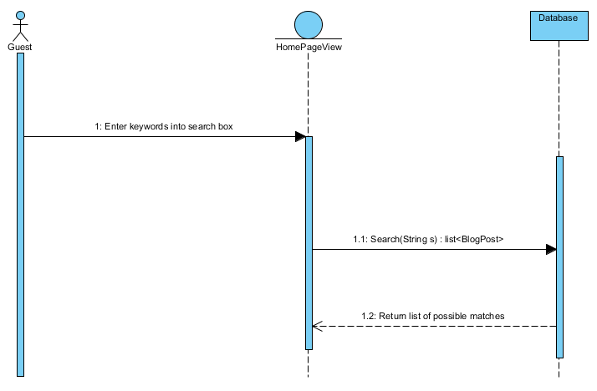
Search

Slide 19
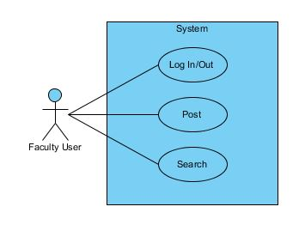
Faculty User

Slide 20
Faculty - Login
Faculty
Title | Login
Summary | Users with accounts can login
Preconditions | The user has account on the blog
Post-conditions | The user logs into the blog
Actor : Registered User | System
0. The user opens the webpage | 1. System displays the blog homepage
2. The user enters their login credentials and clicks 'Login' | 3. System verifies user's login credentials and logs user in

Slide 21
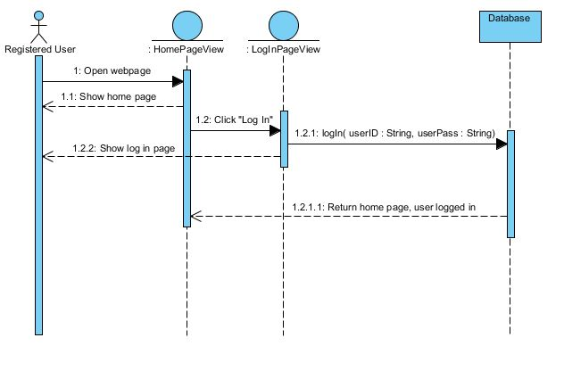
Login

Slide 22
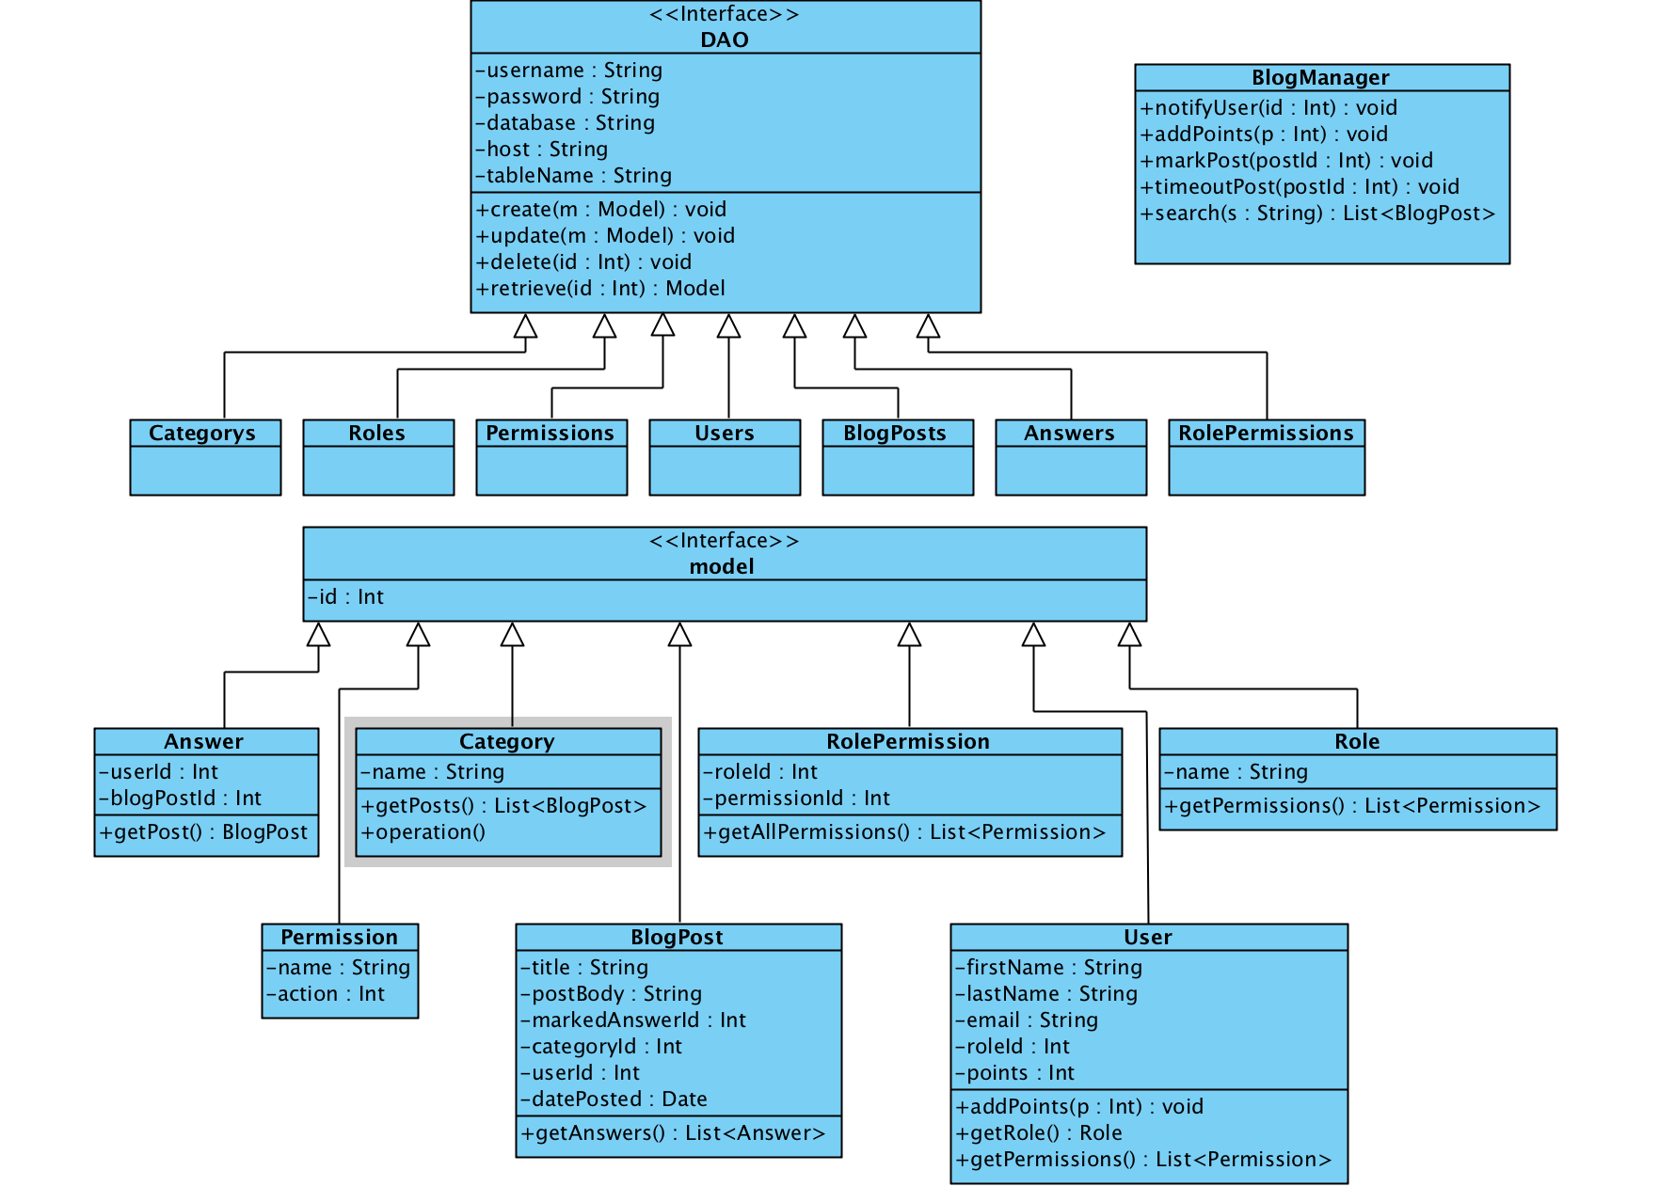
UML Class Diagram

Slide 23
Q&A

