Slide 1


TTU CS Blog
James Little
Patrick Braud
Randall Harper
Jason Weber
1st December 2015

Slide 2
Introduction
TTU CS Blog will be a community hub where students can reach out to peers seeking advice ranging anywhere from class topics to research. Anyone can visit the forums, but only registered users may post a question to the community. Users will be able to search through the forums for specific topics.

Slide 3
Proposal
Terminologies and Abbreviations
  TTU – Texas Tech University
  CS - Computer Science
  WAMP - A Windows Web development environment for Apache, MySQL, and PHP databases
  AWS – Amazon Web Services
  MySQL – an open source relational database management system.
  MAMP – A Macintosh Web development environment for Apache, MySQL, and PHP database

Slide 4
Proposal
Functionality
Actors in the system are labeled as ‘registered user’, ‘guest’, ‘faculty’, or ‘administrator’.
Everyone can post in the forums except for guests.
  Posts will fall under different topics ranging from programming languages to course discussions.
Everyone can search the forums.
Posting questions will run off a points system. Users will need points to post a questions in the forums. Points will be awarded back to users for correct answers.

Slide 5
Requirements - User
R1 Post
R1.1 Registered users shall be able to create posts on the blog.
R1.2 The system shall display a 'Post' button which takes the user to a posting template to fill out
R1.3 After creating the post the user is taken to the new page created for their post
R1.4 'Administrator' user has the authority to close and/or move a post
R2 Restrict Access
R2.1 'Guest' users do not have permission to post
R2.2 'Faculty' users will only have permission to post research and articles
R3 Search
R3.1 'Registered', 'Guest', 'Faculty', and 'Administrator' users have the ability to search the blog
R3.2 The System displays any page on the blog domain
R3.3 The user enters their search criteria in the search bar
R3.4 The system displays a list of search results

Slide 6
Requirements - System
R4 Manage
R4.1 The System shall maintain a total number of topics
R4.2 The System shall mark each post as 'Answered' or 'Unanswered'
R4.3 The System shall close a post if it remains unanswered after the time out period
R4.4 The System shall close a post if it remains unanswered after the time out period
R5 Reward Points
R5.1 'Registered' users have the ability to mark answers to their posted questions as 'Correct' or 'Helpful‘
R5.2 The System will reward points to marked answers
R5.3 The System finds an answer marked as correct and rewards a set amount of points to the account associated to it
R6 Notify
R6.1 The System shall automatically notify a user when someone has answered their post
R4.2 The System Shall automatically notify a user when one of their answers have been marked as 'Correct' or 'Helpful'

Slide 7
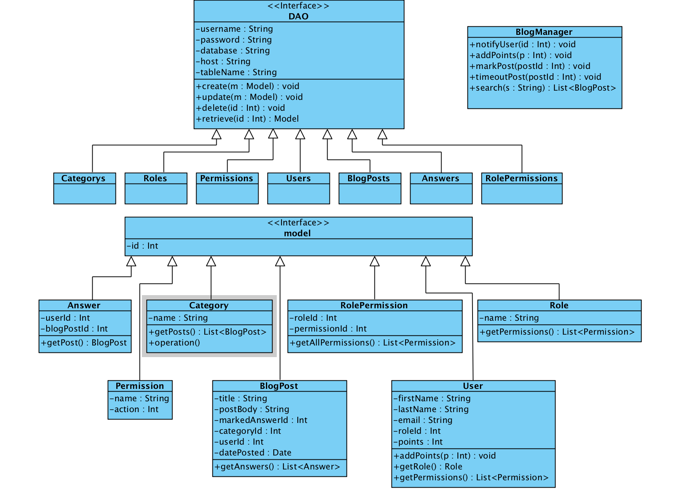
Design – UML Class Diagram

Slide 8

Design

Slide 9
Design

Slide 10
Implementation

Slide 11
Demo

Slide 12


