Slide 1
TTU CS Blog
James Little
Jason Weber
Patrick Braud
Randall Harper

Slide 2
Functional Requirements
User Requirements
The user will be able to make posts under topics.
The user ‘guest’ will not have access to post.
The user ‘faculty’ will only have access to post under the topics research and articles.
The user ‘administrator’ will have the authority to close and/or move a post.
The user ‘registered’ will mark answers on their posted questions as either ‘top answer’, ‘helpful’, or ‘incorrect’.
Users 'guest', 'faculty', 'administrator', and 'registered' have the ability to search the blog.

Slide 3
Functional Requirements Cont.
System Functional Requirements
The system shall maintain a total number of topics.
The system shall grant users credit for correctly answered questions requested by another user. If marked ‘top answer’, the user who answered the question will receive double credit. If marked ‘helpful’, the user will gain the base credit amount. If marked ‘incorrect’, the user will not gain any credit.
The system shall automatically notify the user who made a post when another user has attempted to answer.
The system shall automatically email the user who answered a post when it has been marked by the user who posted the question.
The system shall mark each post as answered or unanswered.
The system shall close a post if it remains unanswered after the time out period.

Slide 4
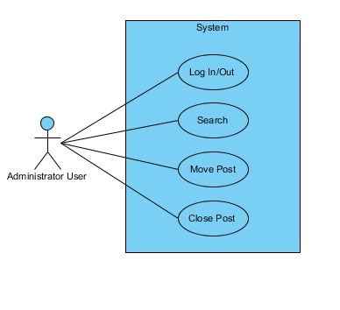
Administrator Use Case

Slide 5
Admin - Close Post
Administrator
Title | Administrator Close Post
Summary | The administrator user has the authority to close a post.
Preconditions | The administrator user is logged in and is located on a thread on the domain.
Post-conditions | The administrator user closes a thread.
Actor : Administrator User | System
 | 0. The system displays any page on the forum domain and an administrator user is logged in.
1. The administrator user selects a thread to be closed. | 2. The system displays "Are you sure?" question on the thread selected by the administrator user.
3. The administrator user selects close thread. | 4. The systems displays page "Thread Closed" with title of thread.

Slide 6
Admin - Move Post
Administrator
Title | Administrator Move Post
Summary | The administrator user has the authority to move a post to a different topic/category.
Preconditions | The administrator user is logged in and is located on a thread on the domain.
Post-conditions | The administrator user moves a thread.
Actor : Administrator User | System
 | 0. The system displays any page on the forum domain and an administrator user is logged in.
1. The administrator user selects a thread to be moved. | 2. The system displays "Are you sure?" questions on the thread selected by the administrator user.
3. The administrator user selects move thread. | 4. The system displays page "Thread Moved" with title of thread to new location.

Slide 7
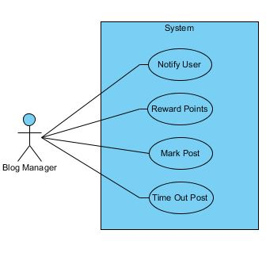
Blog Manager

Slide 8
Blog Manager - Reward Points
Blog Manager
Title | Reward Points
Summary | The system will reward points based on correct answers to posted questions
Preconditions | A user has chosen a correct answer to their post
Post-conditions | The user who answered correctly is rewarded points to their account
Actor : Blog Manager | System
 | 0. The system finds an answer marked as correct
1. The blog manager identifies the user with the correct answer | 2. The system rewards a set number of points to the appropriate account

Slide 9
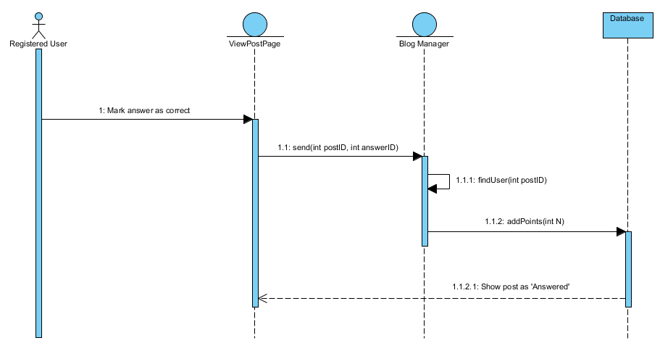
Reward Points

Slide 10
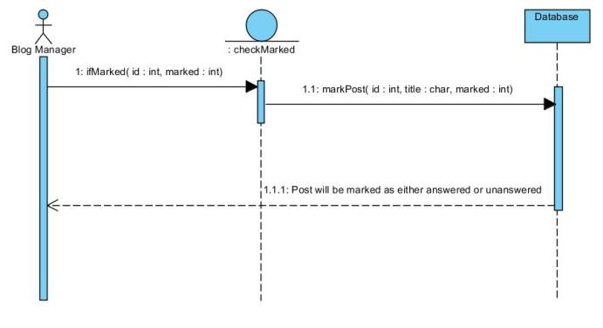
Blog Manager – Move Post

Slide 11
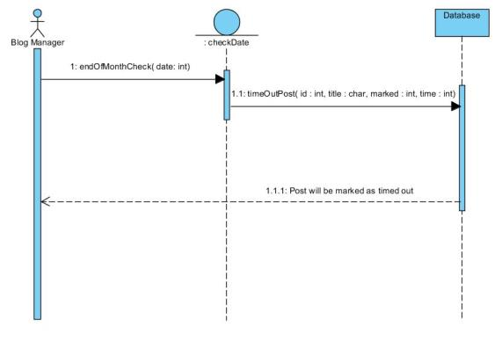
Blog Manager – Time Out Post

Slide 12
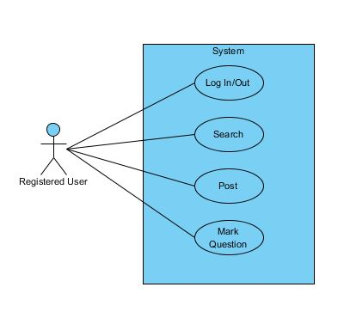
Registered User

Slide 13
Reg. User - Post Question
Registered User
Title | Post Question
Summary | The registered user can post new questions on the blog
Preconditions | The user is registered and logged in
Post-conditions | A new question is posted onto the blog
Actor : Registered User | System
0. The user clicks the 'Post' button | 1. System displays PostTemplate page
2. The user fills out the template for their question | 3. System creates a new post page for the user's question

Slide 14
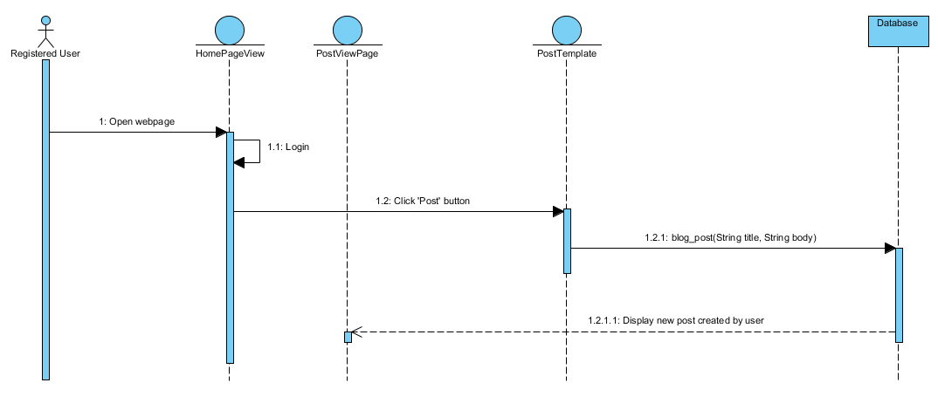
Post Question

Slide 15
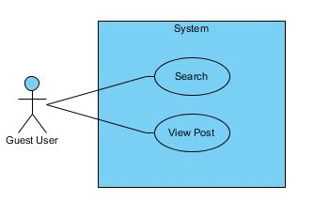
Guest User

Slide 16
Guest User - Search
Guest
Title | Search
Summary | The guest user can search the forums by entering a search criteria in the search bar.
Preconditions | The guest user must be on the forum domain.
Post-conditions | The guest user will have results on the searched criteria.
Actor : Guest | System
 | 0. The system displays any page on the forum domain.
1. The guest user enters a search criteria in the search bar. | 2. The system displays any topics from the given search criteria.
3. The guest user may select from the given results. | 3. The system will display the selected thread.

Slide 17
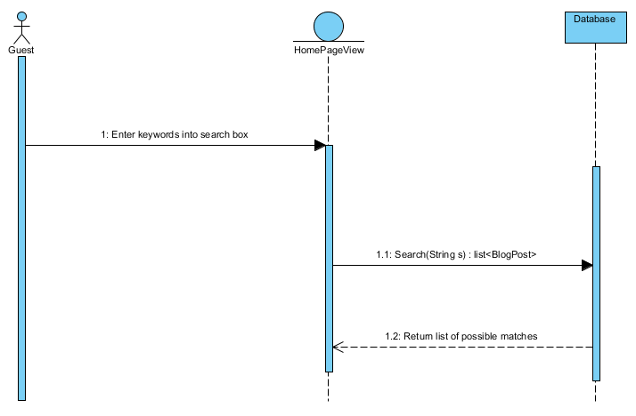
Search

Slide 18
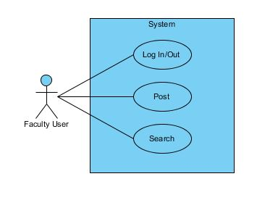
Faculty User

Slide 19
Faculty - Login
Faculty
Title | Login
Summary | Users with accounts can login
Preconditions | The user has account on the blog
Post-conditions | The user logs into the blog
Actor : Registered User | System
0. The user opens the webpage | 1. System displays the blog homepage
2. The user enters their login credentials and clicks 'Login' | 3. System verifies user's login credentials and logs user in

Slide 20
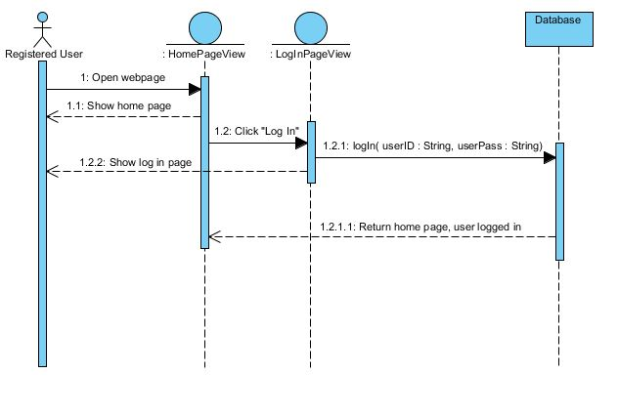
Login

Slide 21
UML Class Diagram

