Slide 1
TTU CS Blog
James Little
Jason Weber
Patrick Braud
Randall Harper

Slide 2
Functional Requirements
User Requirements
The user will be able to make posts under topics.
The user ‘guest’ will not have access to post.
The user ‘faculty’ will only have access to post under the topics research and articles.
The user ‘administrator’ will have the authority to close and/or move a post.
The user ‘registered’ will mark answers on their posted questions as either ‘top answer’, ‘helpful’, or ‘incorrect’.
Users 'guest', 'faculty', 'administrator', and 'registered' have the ability to search the blog.

Slide 3
Functional Requirements Cont.
System Functional Requirements
The system shall maintain a total number of topics.
The system shall grant users credit for correctly answered questions requested by another user. If marked ‘top answer’, the user who answered the question will receive double credit. If marked ‘helpful’, the user will gain the base credit amount. If marked ‘incorrect’, the user will not gain any credit.
The system shall automatically email the user who made a post when another use has attempted to answer.
The system shall automatically email the user who answered a post when it has been marked by the user who posted the question.
The system shall mark each post as answered or unanswered.
The system shall close a post if it remains unanswered after the time out period.

Slide 4
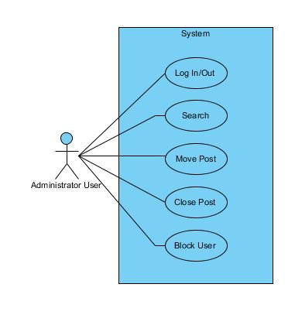
Administrator

Slide 5
Admin Close Post
Administrator
Title | Administrator Close Post
Summary | The administrator user has the authority to close a post.
Preconditions | The administrator user is logged in and is located on a thread on the domain.
Post-conditions | The administrator user closes a thread.
Actor : Administrator User | System
 | 0. The system displays any page on the forum domain and an administrator user is logged in.
1. The administrator user selects a thread to be closed. | 2. The system displays "Are you sure?" question on the thread selected by the administrator user.
3. The administrator user selects close thread. | 4. The systems displays page "Thread Closed" with title of thread.

Slide 6
Admin Move Post
Administrator
Title | Administrator Move Post
Summary | The administrator user has the authority to move a post to a different topic/category.
Preconditions | The administrator user is logged in and is located on a thread on the domain.
Post-conditions | The administrator user moves a thread.
Actor : Administrator User | System
 | 0. The system displays any page on the forum domain and an administrator user is logged in.
1. The administrator user selects a thread to be moved. | 2. The system displays "Are you sure?" questions on the thread selected by the administrator user.
3. The administrator user selects move thread. | 4. The system displays page "Thread Moved" with title of thread to new location.

Slide 7
Blog Manager

Slide 8
Blog Manager Reward Points
Blog Manager
Title | Reward Points
Summary | The system will reward points based on correct answers to posted questions
Preconditions | A user has chosen a correct answer to their post
Post-conditions | The user who answered correctly is rewarded points to their account
Actor : Blog Manager | System
 | 0. The system finds an answer marked as correct
1. The blog manager identifies the user with the correct answer | 2. The system rewards a set number of points to the appropriate account

