Slide 1
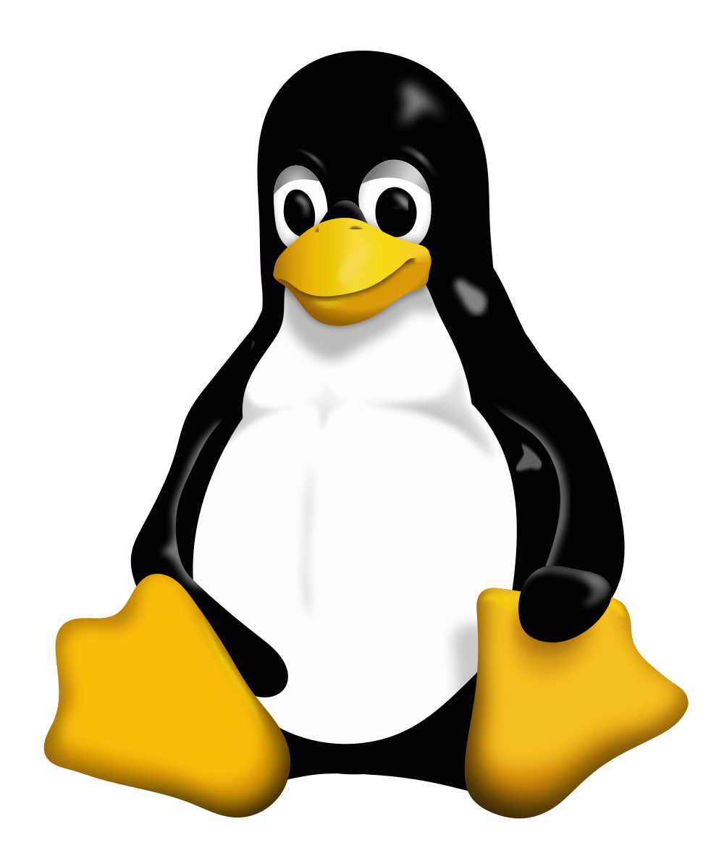
Linux ‒ Just for Fun
Linus Torvalds
Notes:
our subject: Linux and its creator, Linus Torvalds
“Just for Fun”
title of his (auto)biography
he created Linux “just for fun”
but billion-dollar companies such as Google rely on it
you use Linux everyday (the Web runs on Linux, so does Google)

Slide 2
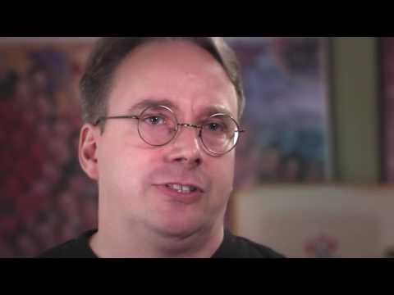
Intro
Notes:
“Let Linus himself do the intro…”

Slide 3
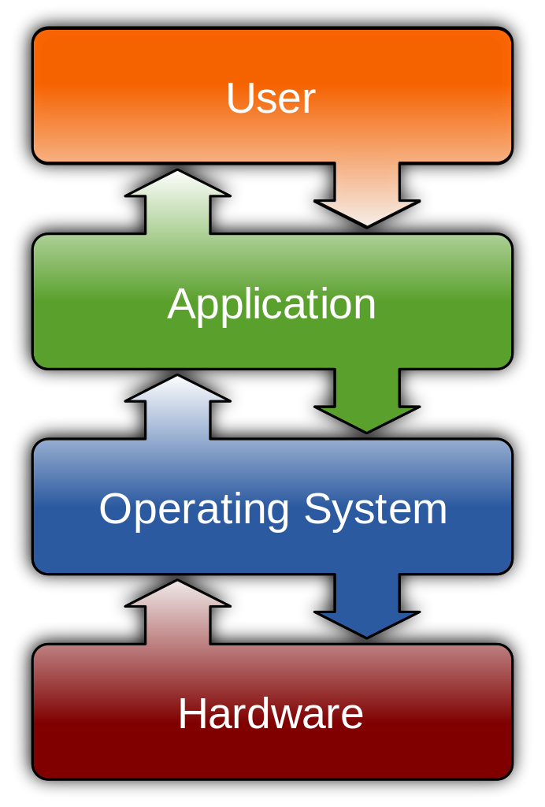
Operating System: Purpose
Manages the programs in a computer (applications)
Word, Internet Explorer, Mail etc.
Communication between Hardware and Software
Running multiple programs at the same time
Handles output and input from attached hardware
Notes:
Es wäre gut, wenn der Begriff “Kernel” hier noch nicht verwendet würde. Dann kann ich den auf der nächsten Folie genauer erläutern.

Slide 4
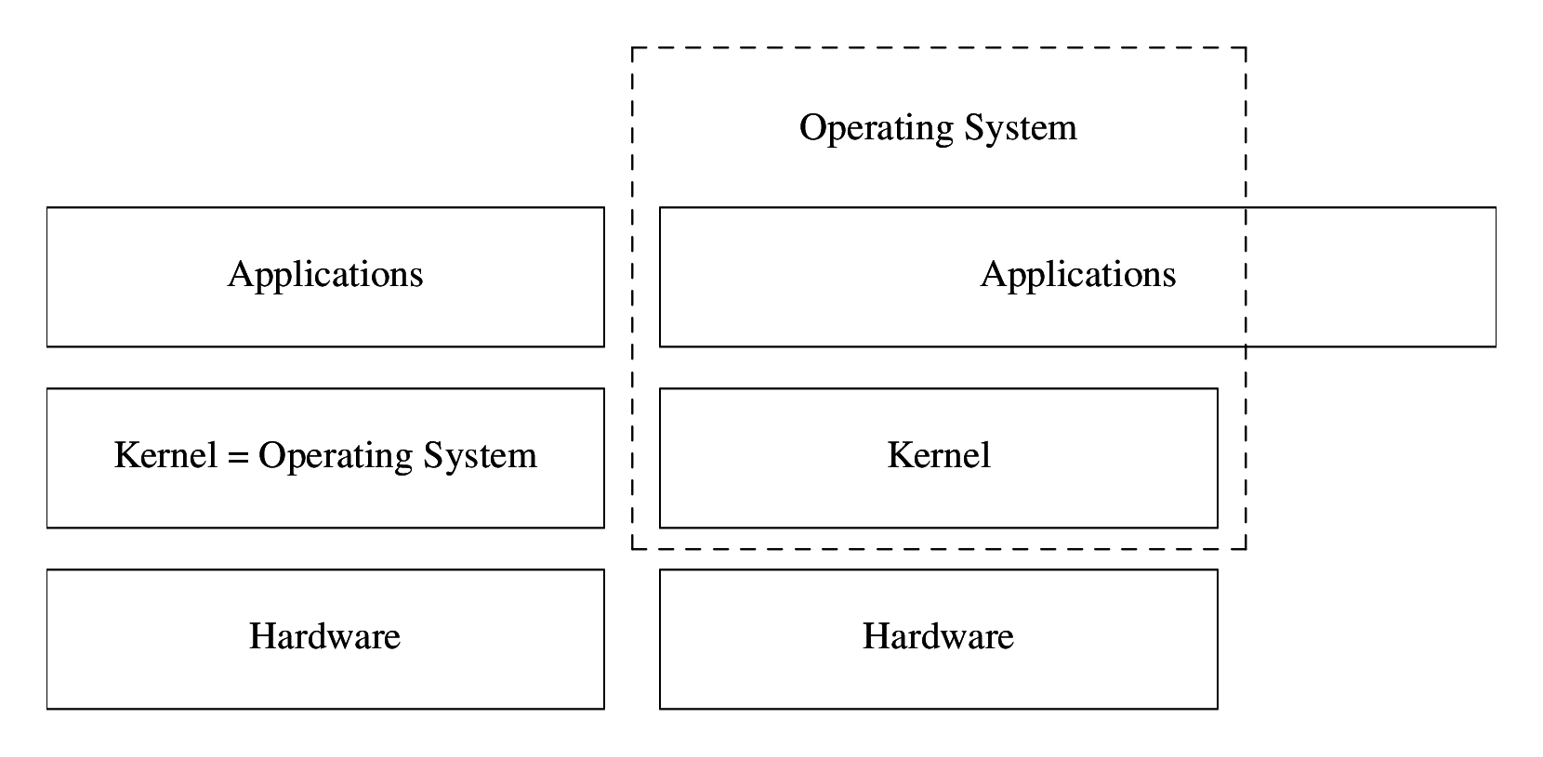
Operating System: Kernel
Notes:
Operating Systems: two notions
“everyday use”
the part between the hardware and the programs you run
plus a couple of applications (User Interface, Web Browser)
“technical use”
the part between the hardware and the programs you run
a.k.a. the Kernel
Linux is a Kernel, not an entire operating system

Slide 5
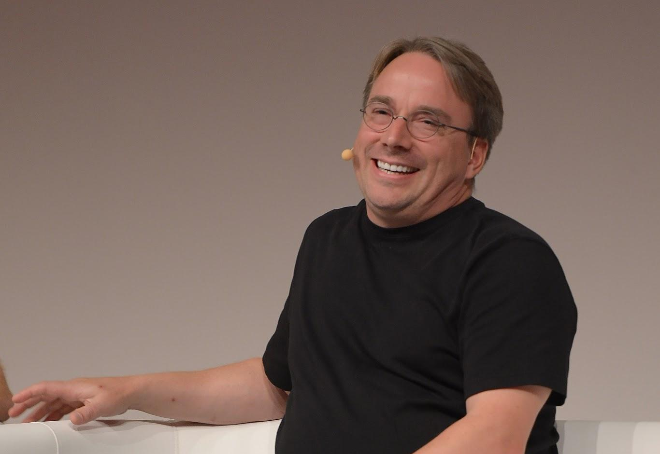
Biography: 1968 - 1991
Linus Torvalds
Born:
December 28, 1968 in Helsinki (Finland)
Parents:
Anna and Nils Torvalds: Journalists
Grandfather:
Leo Törnqvist: professor of statistic
His family belongs to the Swedish-speaking minority in finland

Slide 6
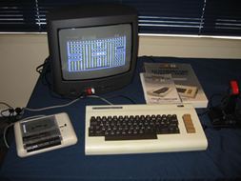
Biography: 1978 - 1986
Commodore VIC-20
First computer from his grandfather
Linus inherited the computer
Wrote his first code

Slide 7
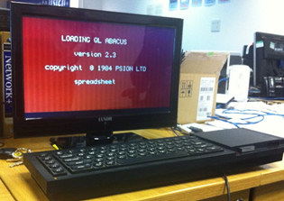
Biography: 1986 - 1991
Sinclair QL
First own computer
Started with programing games
Wrote parts of the operating system on his own.
Had to wait weeks for new software
from England
·

Slide 8

History of UNIX (1)
The original version of UNIX was developed in the 1960s/1970s at AT&T Bell Labs by Ken Thompson (sitting) and Dennis Ritchie (standing).
Notes:
Linux wasn’t a new invention
It’s rather a new kind of UNIX operating system
The original version of UNIX has been created
in the late 1960s/early 1970s
by Ken Thompson and Dennis Ritchie
at the AT&T Bell Labs

Slide 9
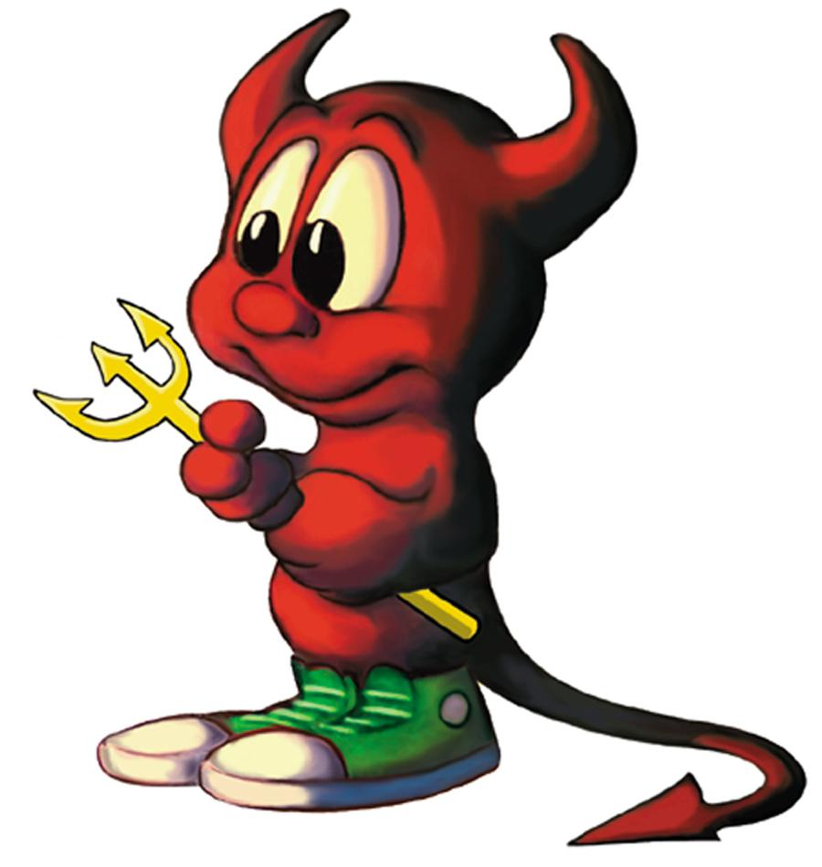
History of UNIX (2)
BSD, the Berkeley Software Distribution is a variation of UNIX first released in 1977 at the University of California in Berkeley.
Notes:
UNIX wasn’t a commercial system
It was a research project
Researchers just shared with each other
it were the 1970s, after all (Hippies, flower power, “make love, not war”)
Researchers at the University of California at Berkeley picked it up
They called their system the “Berkeley Software Distribution”
Logo: the Daemon (still used)
Available as NetBSD, FreeBSD and OpenBSD

Slide 10
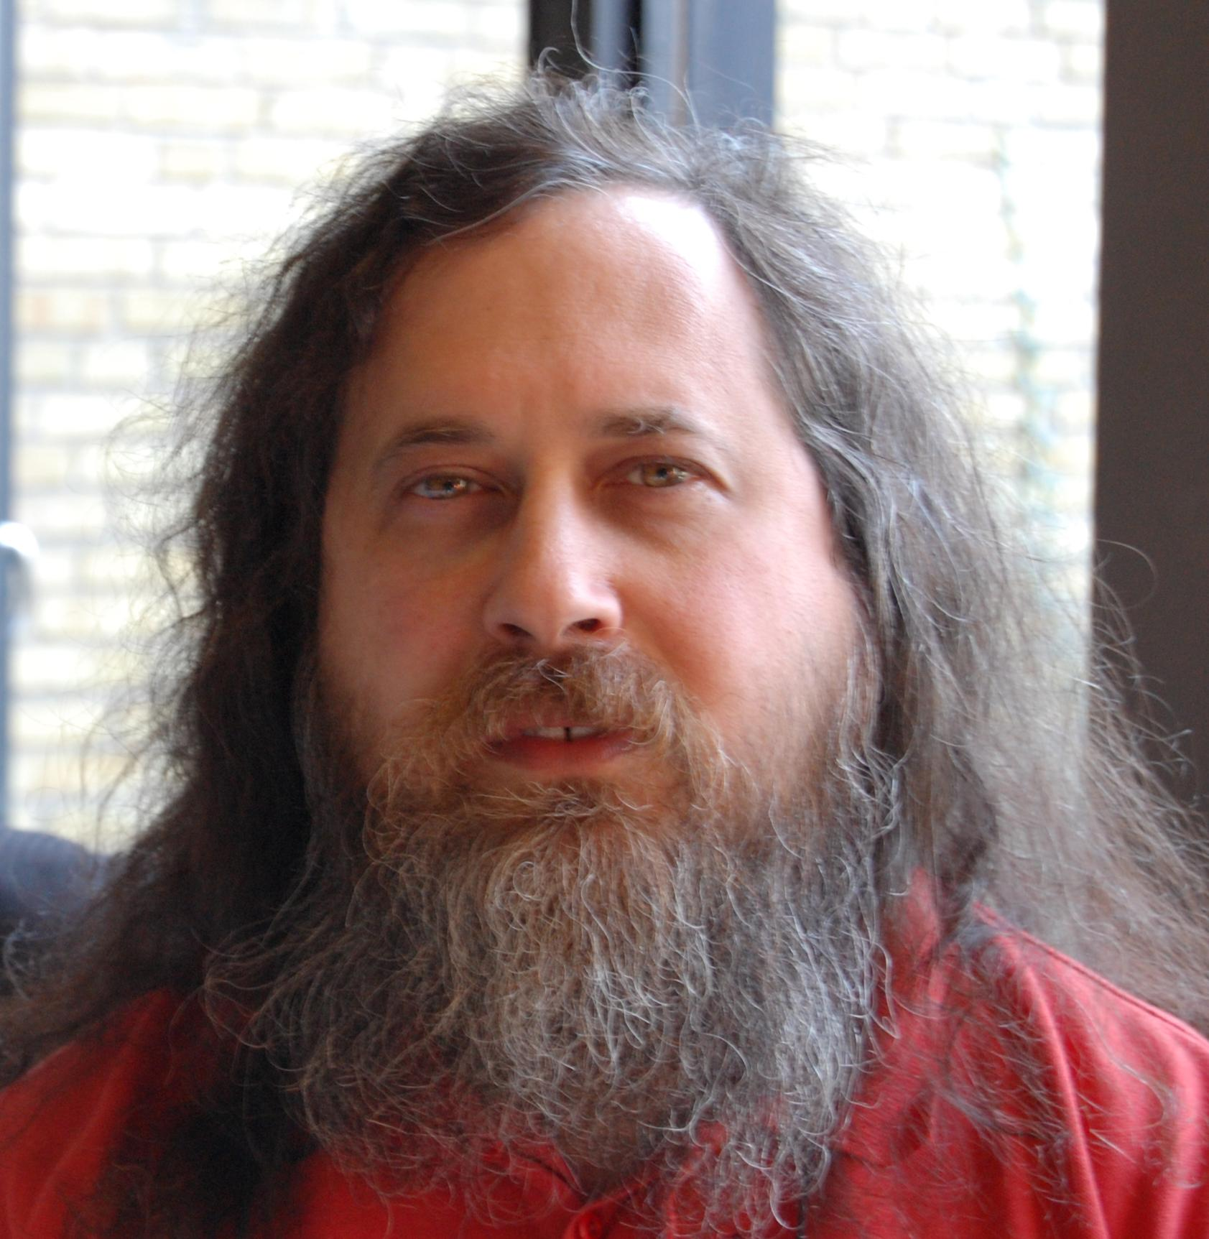
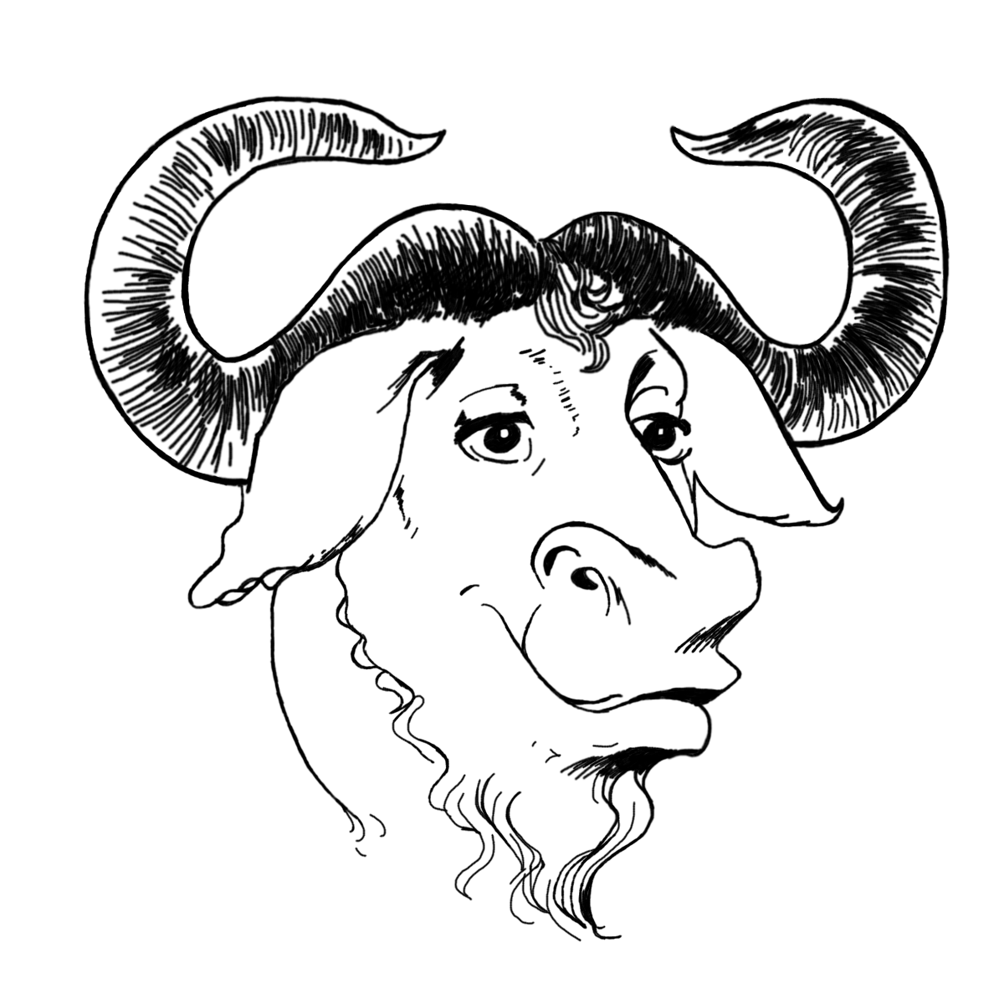
History of UNIX (3)
The GNU project (“GNU’s Not UNIX”) was started in 1984 by Richard Stallman.
Notes:
In the 1980s, companies started to commercialize UNIX
Richard Stallman was doing research on UNIX
he had a problem with a part of the system
he wasn’t allowed to fix it due to license restrictions
he was annoyed
he started the GNU project to implement a “free” version of UNIX in 1984
Everybody should be able to use and modify the system
GNU: “GNU’s not UNIX” (recursive acronym)
by 1991 they had almost an entire Operating System
… except the Kernel (GNU Hurd wasn’t ready)

Slide 11
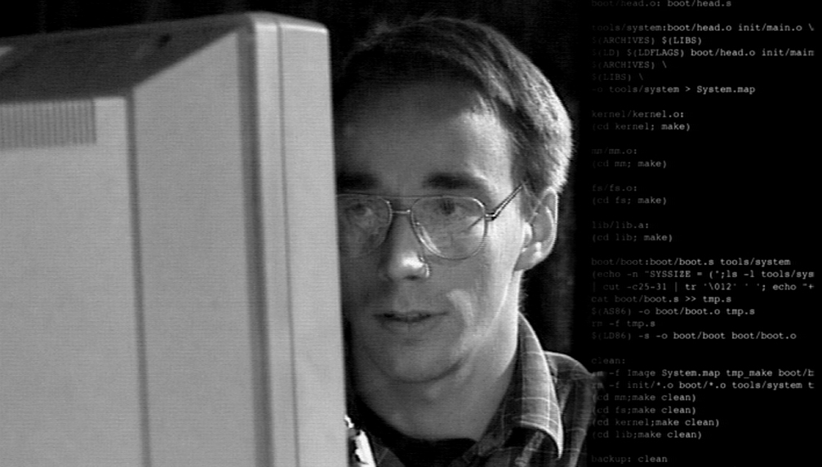
History of UNIX (4)
Linus Torvalds first released the initial version of his Linux Kernel in 1991.
Notes:
Linus Torvalds published the initial version of Linux in 1991
Corina will tell you how that happened

Slide 12
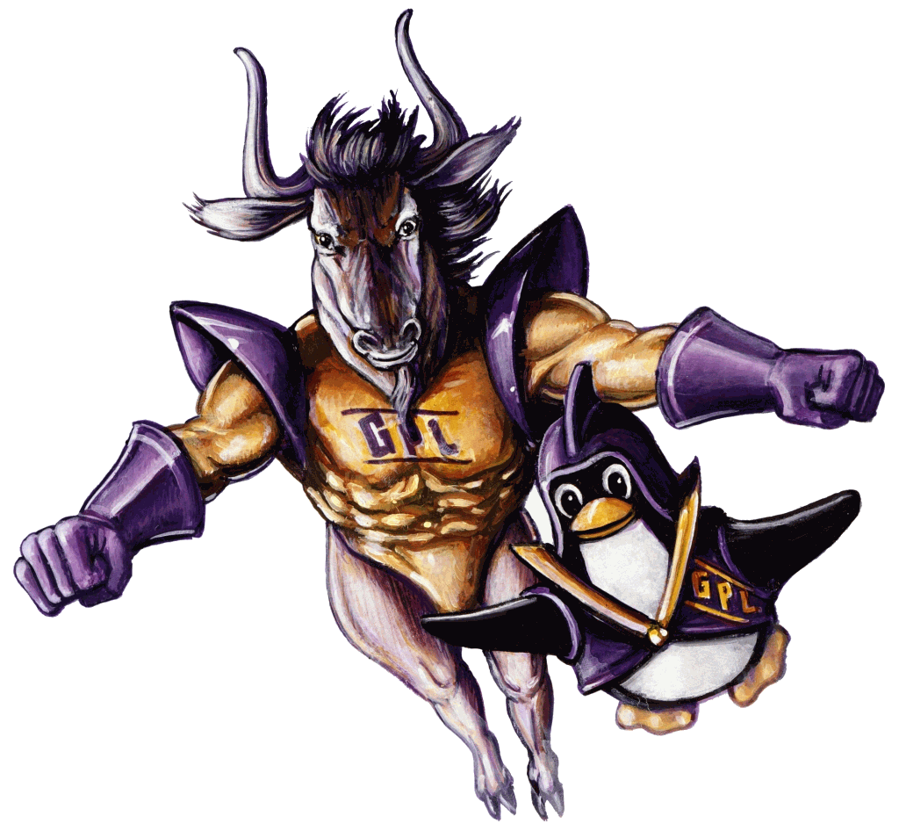
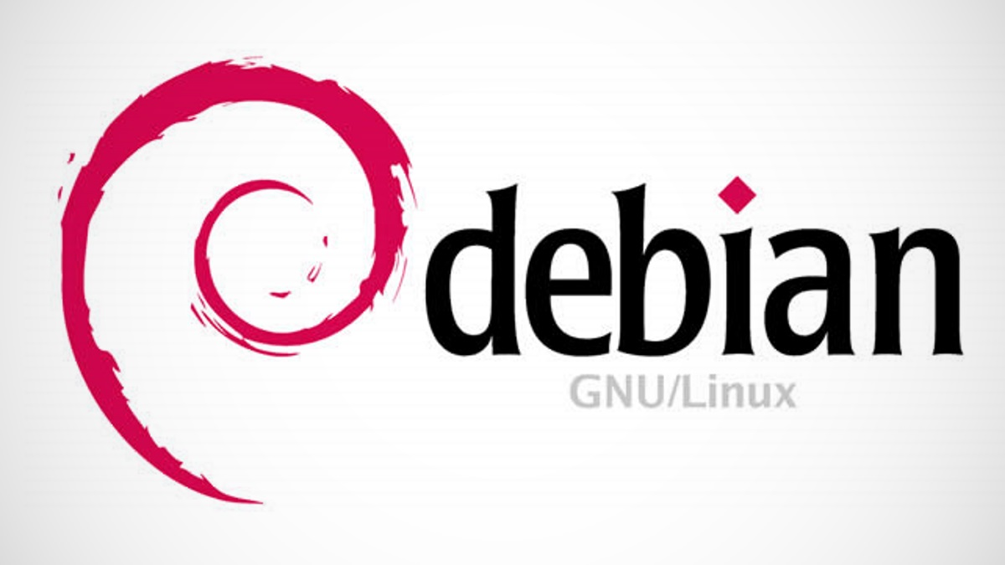
History of UNIX (5)
Notes:
The important thing: there was a complete “free” UNIX-like operating system
The GNU software and the Linux Kernel use the same license
it allows modifications, as long as you publish them under the same terms
Richard Stallman insists on calling it the GNU/Linux system
The Debian distribution does so
Most others don’t

Slide 13
Biography: January - September 1991
January 2, 1991: Bought “No Name” (with his own chosen hardware)
Create his own terminal emulator for connecting to the university computer
Saving files, writing emails….
Linus mentioned to an online audience, that he was up to something big
Wrote his own Shell

Slide 14
Biography: September- November 1991
September 17, 1991: Release of version 0.01
Included shell and terminal
Still required Minix to be installed
Ari Lemke changed the name from Freakx to Linux
Overwrote part of the operating system on his computer
Started to develope Linux as an operating system (as Kernel)
November 1991: Release of version 0.10
Linux could run without Minix
Other people had started to use Linux

Slide 15
Biography: 1992 - 1994
January 1992: Release of version 0.12
Running Linux with lower memory, from an external device
Spring 1992:
Linux supports a graphical user interface and multiple windows
During 1992 Linux became more commercial
November 4, 1993:
Linus held his first speech in the Netherlands about Linux

Slide 16
Biography: 1994 - 2016
March 1994: Release of Version 1.0
A full-fledged operating system with networking
Since then, Linux has grown more and more; programmed by people worldwide
2016: Version 4.88

Slide 17


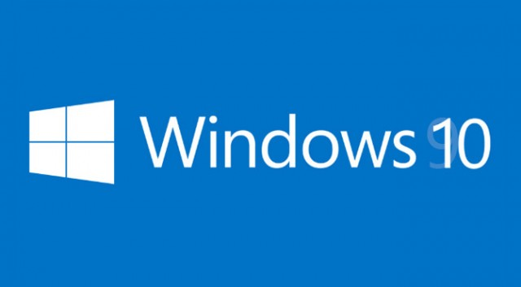
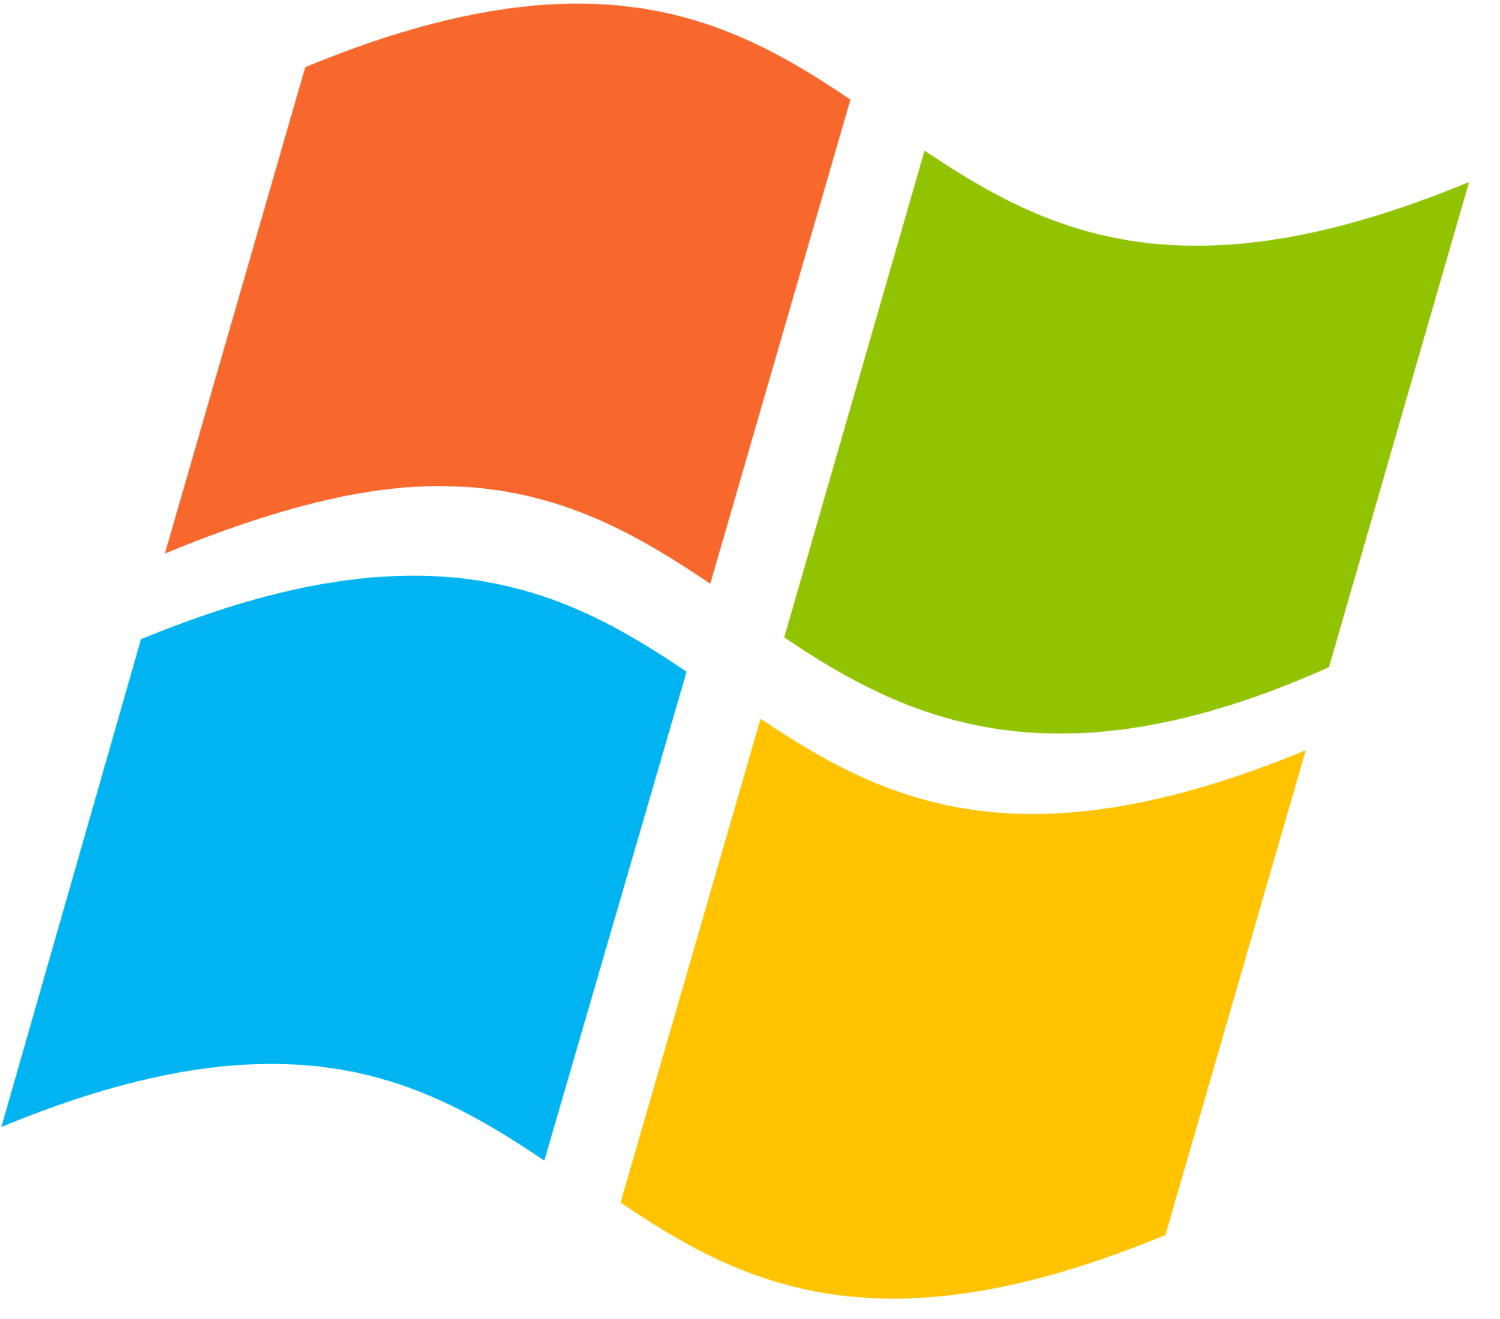
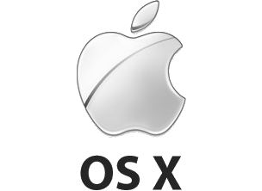

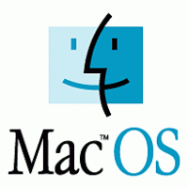
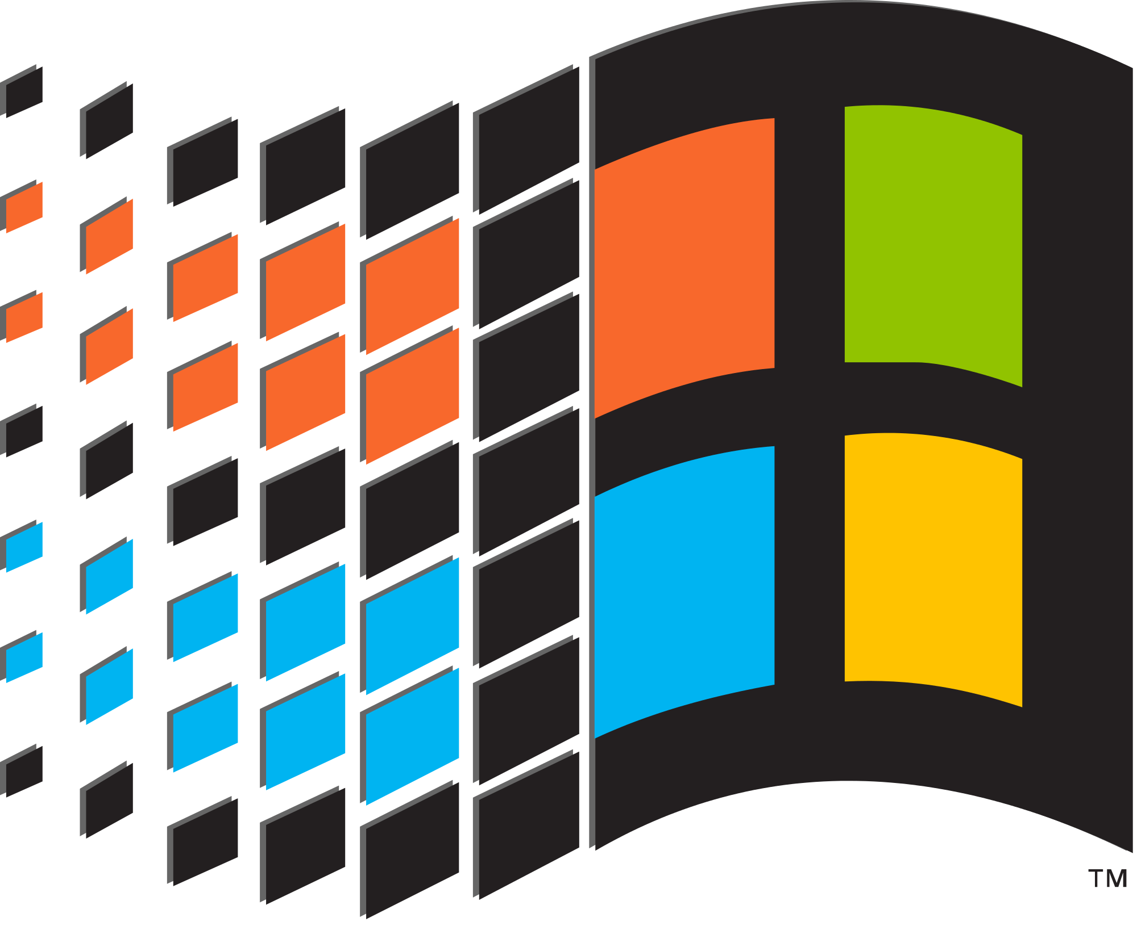

Linux, Windows, Mac OS
Notes:
In the Windows and Mac OS world, you have different versions (and maybe editions)
you buy the software, and everybody ends up with pretty much the same system
In the Linux world, you have different distributions (and versions)
You don’t use Linux, but a Linux distribution
there are hundreds of it
there’s a distribution for everybody
there are different Desktop environments: GNOME, KDE, Xfce, LXDE, …
everybody ends up with the system he wants
if you don’t like something, use another distribution… or change it

Slide 18

Android, iOS
Notes:
In the Windows and Mac OS world, you have different versions (and maybe editions)
you buy the software, and everybody ends up with pretty much the same system
In the Linux world, you have different distributions (and versions)
You don’t use Linux, but a Linux distribution
there are hundreds of it
there’s a distribution for everybody
there are different Desktop environments: GNOME, KDE, Xfce, LXDE, …
everybody ends up with the system he wants
if you don’t like something, use another distribution… or change it

Slide 19
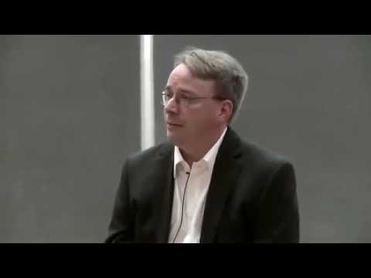
quite frankly…
Notes:
Linus usually talks quite frankly
he sometimes insults other people when he considers them incompetent
he wasn’t afraid to react to Andrew Tannenbaum’s (a famous computer science professor) critical response to the initial Linux version
he’s also not afraid to be rude to multi-billion dollar enterprises such as nVidia.
let’s have a look :-)

