Slide 1
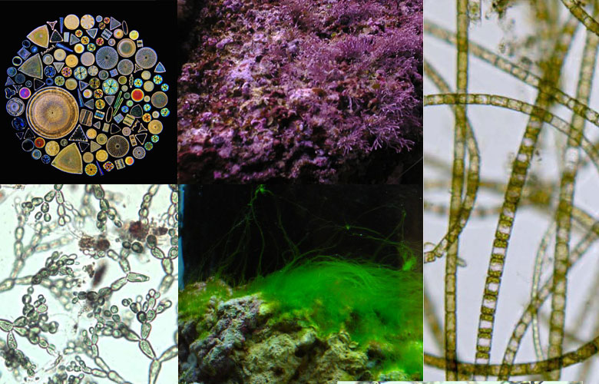
EPA and DHA (omega 3s)

Slide 2
Extraction and Purification of eicosapentaenoic acid and docasehexaenoic acid from microalgae: a criticial review
EPA (eicosapentaenoic acid) and DHA (docosahexaenoic acid) products have been widely applied due to their medical and healthcare value.
EPA and DHA are also beneficial for the human body, particularly in reducing cardiac diseases such as stroke, arrhythmia and high blood pressure
Existing methods to enrich and purify EPA and DHA include winterization [49], urea complexation [97], molecular distillation [98], AgNO3-mediated complexation [31]

Slide 3
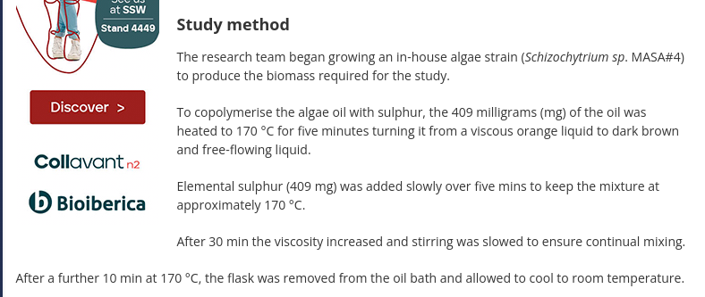
EPA and DHA

Slide 4
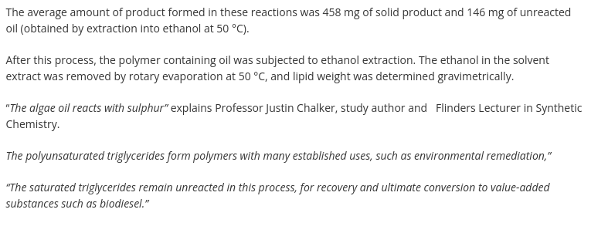
EPA and DHA

Slide 5
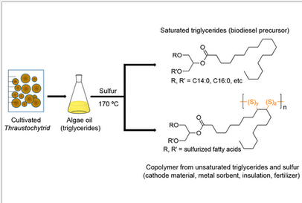
EPA and DHA
Reaction of Sulfur and Sustainable Algae Oil for Polymer Synthesis and Enrichment of Saturated Triglycerides

Slide 6
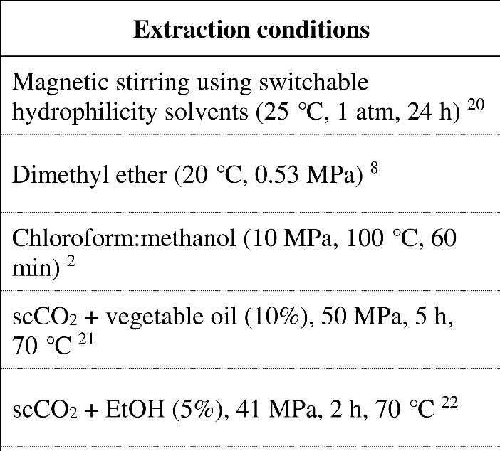
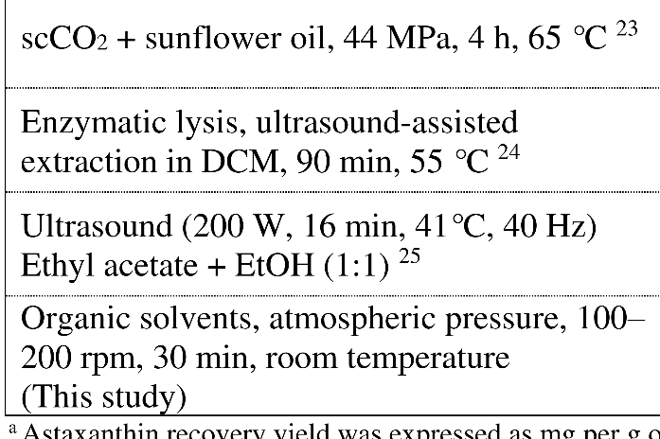
Astaxanthin One pot, simultaneous cell wall disruption and extraction
Astaxanthin is a remarkable antioxidant that acts like a natural sunscreen. It is a carotenoid antioxidant produced by a type of microalgae called Haematococcus pluvialis. This algae produces astaxanthin when its water supply dries up, thereby protecting itself from excessive harmful UV radiation in sunlight.

Slide 7
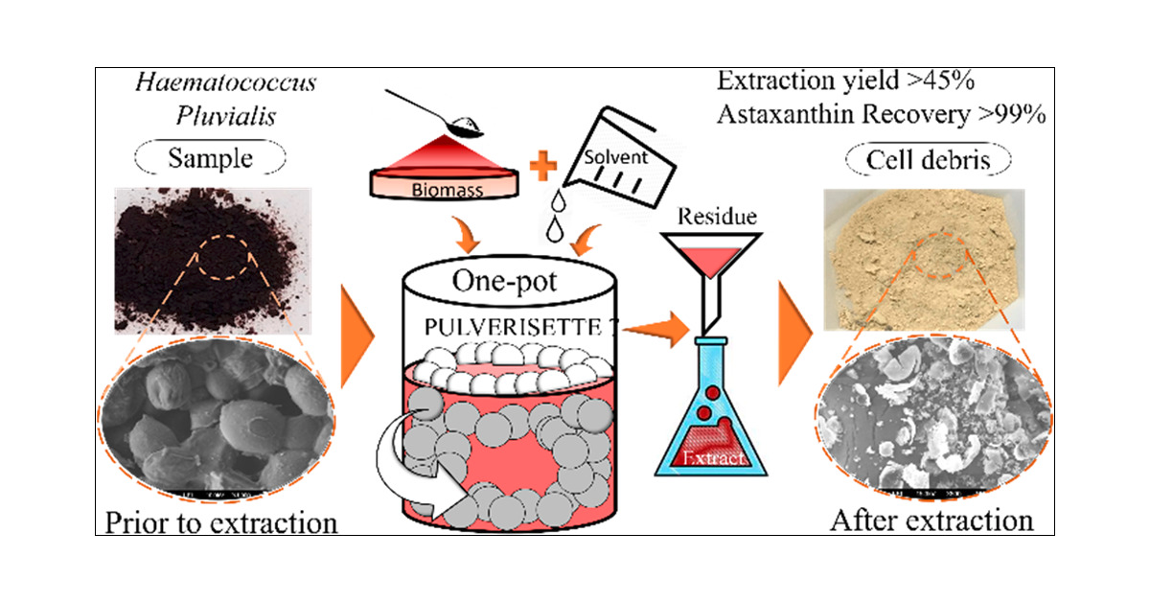

Slide 8
The extraction of antioxidants from Chlorella vulgaris for cosmetics
2.2. Extraction of C. vulgaris
Separation of Chlorella vulgaris from the medium was preceded by centrifugation on 17.000 rpm/min,
the supernatant is Chlorella vulgaris. C. vulgaris diluted on distilled water with various concentrations
0.01; 0.05; 1 and 0.1% w/v, respectively. C. vulgaris was extracted with maceration for 1 hour, then
separated for its filtrate and supernatant, by centrifugation on 6000 rpm for 15 minutes. The filtrate was
used as chlorophyll content.
2.3. Production of chlorophyll powder using maltodextrin
The chlorophyll solution with variation concentration 0.01; 0.05 and 0.1% were blended with
maltodextrin 100 mg/l in each solution. Then, chlorophyll powder was roduced using spray dyer that
operated at condition inlet 120 to 130 ºC, outlet 42 to 44 ºC, blower 1.01m3 /min to 1.04 m3 /min and
atomizing 200 to 230 kPa.

Slide 9
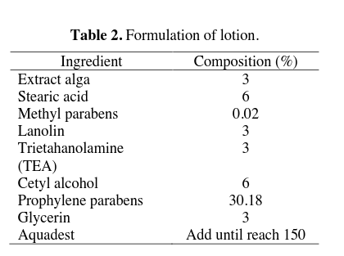
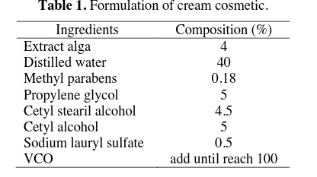
2.4. Determination of antioxidant activity
Antioxidant content was analyzed by Ascorbic acid Equivalent Antioxidant Capacity (AEAC), as the
capacity of sample as antioxidant which react with DPPH as free radical. The samples were mixed with
methanol DPPH then homogenized and stored for 120 minutes. The absorbance was recorded at 517
nm. Distilled water was used as blank and ascorbic acid was served as standard13

Slide 10
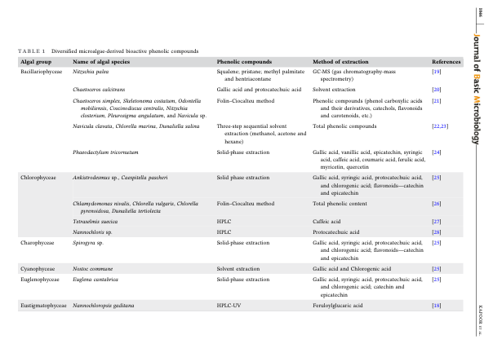
Anti-inflammatory extraction
See Extraction and characterization of microalgae-derived phenolics for pharmaceutical applications: A systematic Review

Slide 11
Polyetherimide/Ulvan
https://www.thomasnet.com/insights/what-is-polyetherimide-pei-/?fbclid=IwAR19EMuwxb3IXxeOa2SuVGNTkTNdSK7WC1YxDyibwNa7BsC1dvrgRQTo4F4
Use of polyetherimide in sodium battery production; seaweed extract produces
Battery that charges 1000x
https://onlinelibrary.wiley.com/doi/epdf/10.1002/adma.202206367?fbclid=IwAR0X3LYaZe3LIqPwJhvubQH4ID3yhaqxH68jTLbBBbzcMvlasMtq8d3EpXw

Slide 12
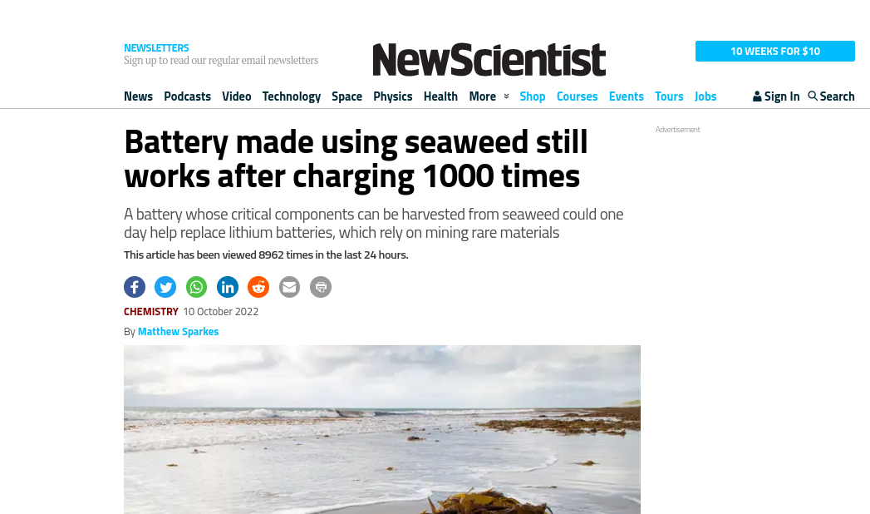

Slide 13
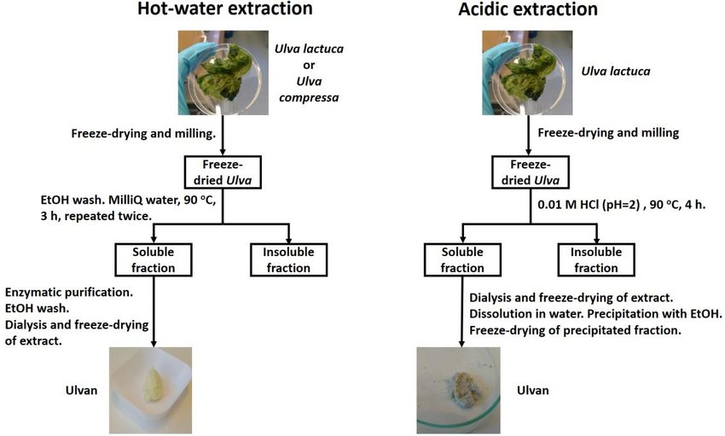
Ulvan (similar to polyetherimide PEI)
Composition and structure of cell wall ulvans recovered from Ulva spp. Along the Swedish west coast

Slide 14
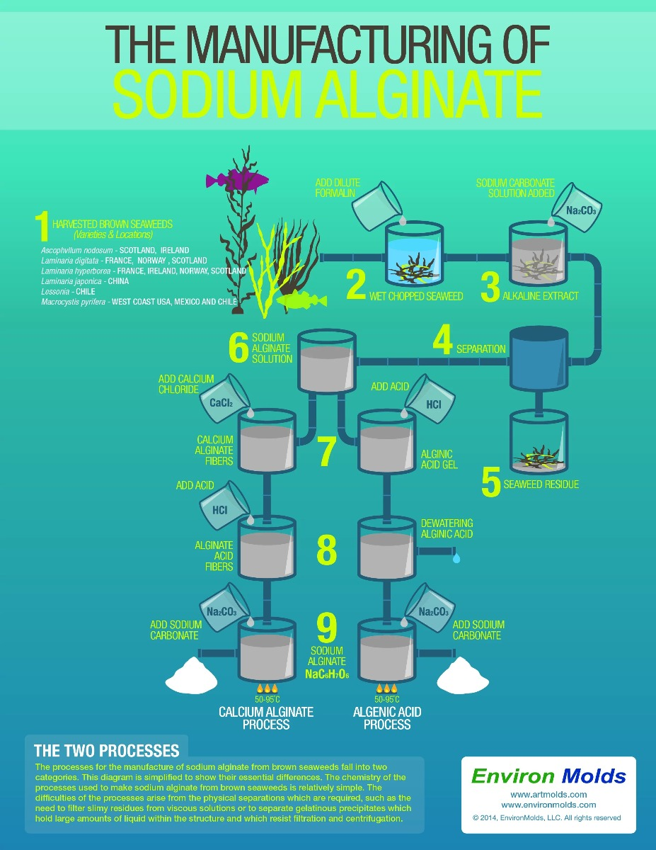
Alginate extraction
Alginate nanoparticles in drug delivery and
Their production--
https://www.ncbi.nlm.nih.gov/pmc/articles/PMC6432598/
https://www.youtube.com/watch?v=NKIZblXJrew&fbclid=IwAR3tRgO5p-SpVPo9npBRIktJRVxLRr3viPVOk0DmmFkNieG8tsdinpGFtmM

Slide 15
These materials can then be resold:
https://www.thomasnet.com/

