Slide 1
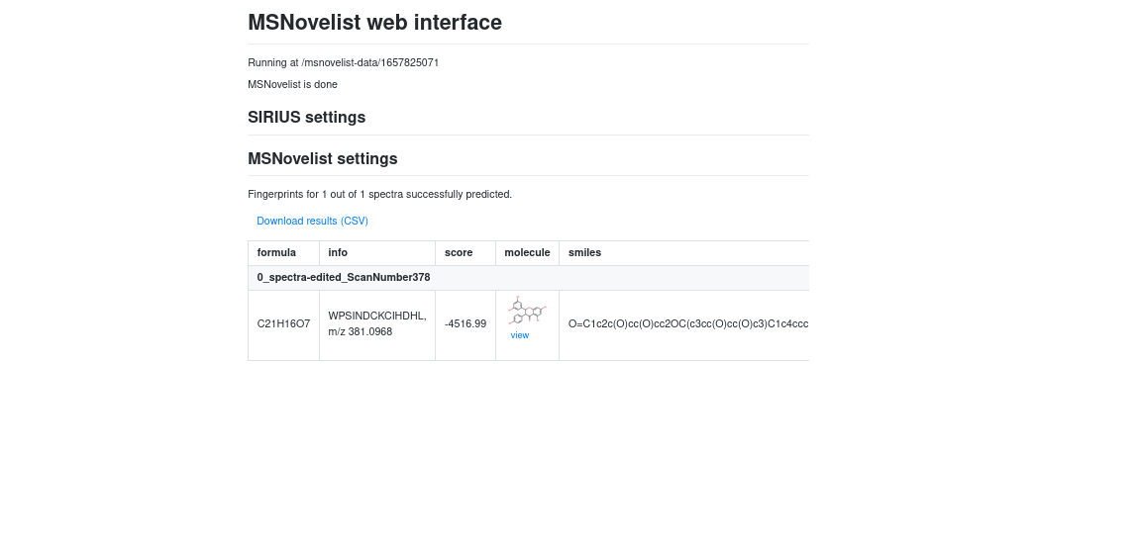
MS Novelist
Top Structure

Slide 2
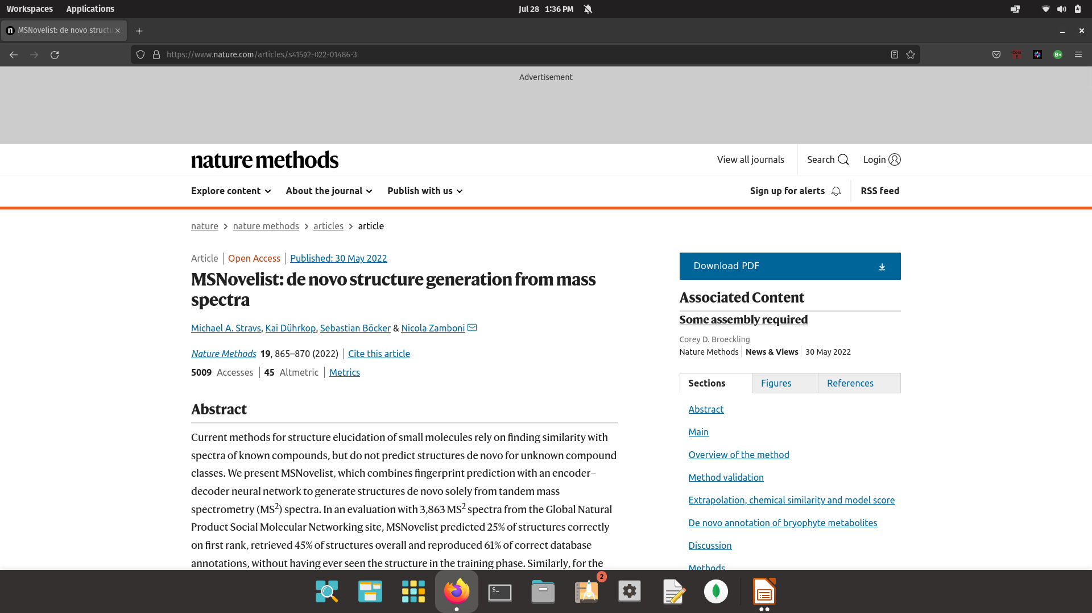
MSNovelist

Slide 3
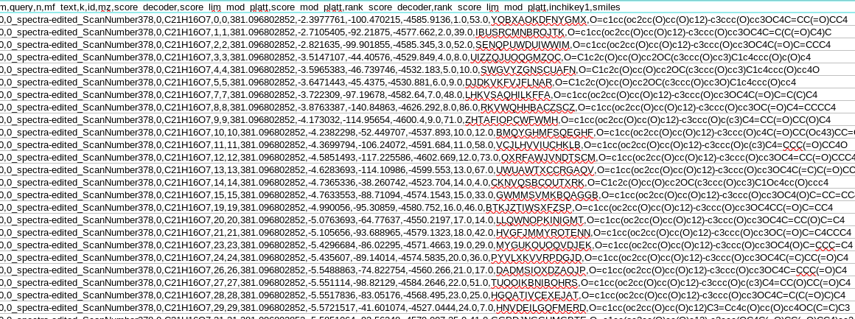
Sample output data

Slide 4
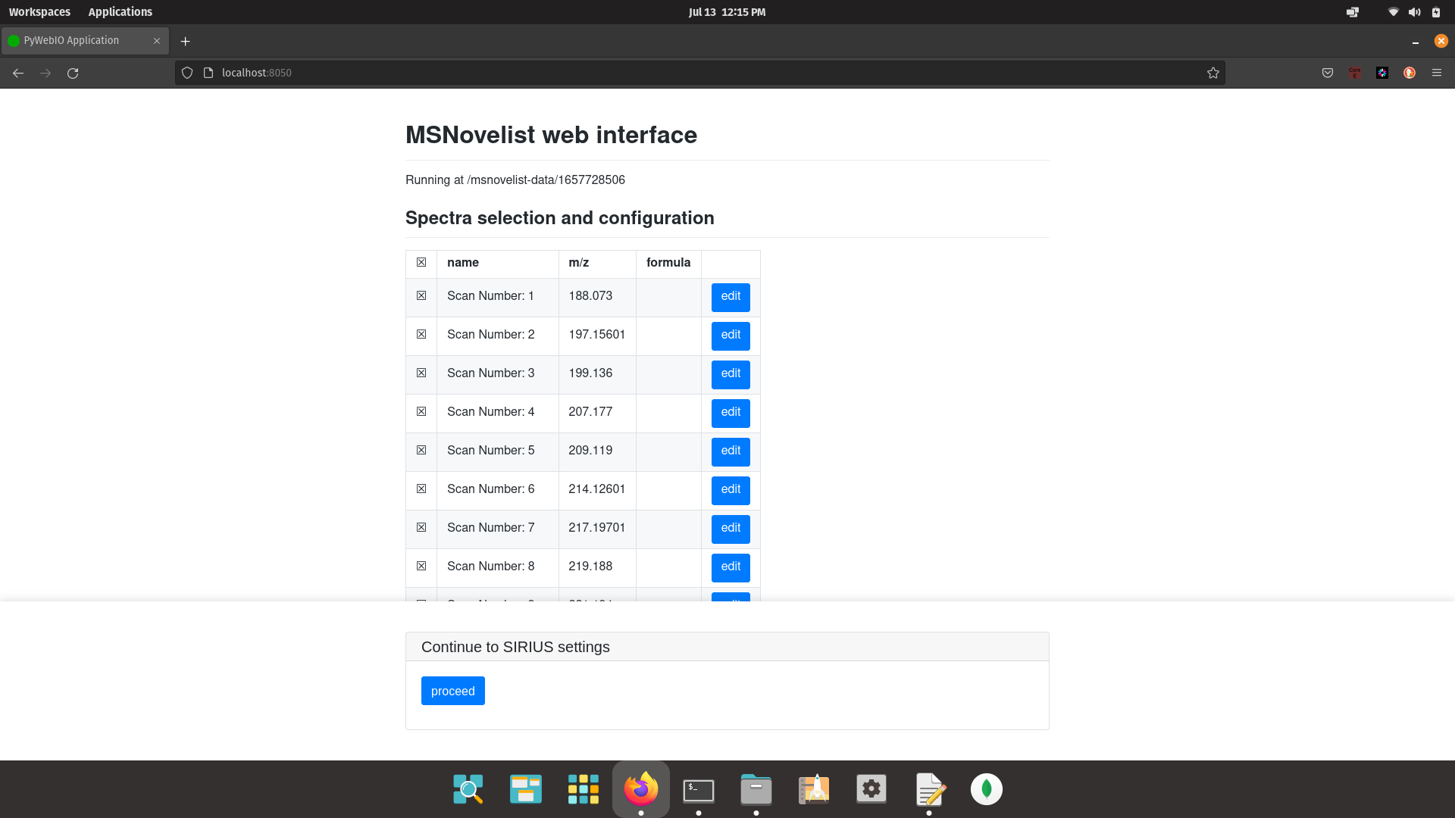
MS Novelist allows you to upload mgf files

Slide 5
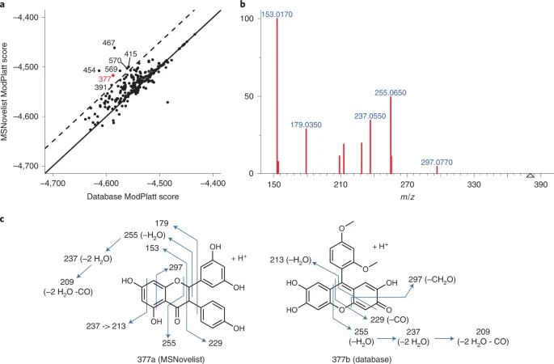
Database candidate
Vs MSNovelist candidate

Slide 6
In an evaluation with 3,863 MS2 spectra from the Global Natural Product Social Molecular Networking site, MSNovelist predicted 25% of structures correctly on first rank, retrieved 45% of structures overall and reproduced 61% of correct database annotations, without having ever seen the structure in the training phase. Similarly, for the CASMI 2016 challenge, MSNovelist correctly predicted 26% and retrieved 57% of structures, recovering 64% of correct database annotations.

Slide 7
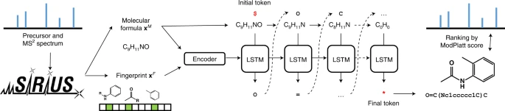
https://www.nature.com/articles/s41592-022-01486-3

Slide 8
Independent Test Set
it was able to come up with predictions on 37/76 pesticides. 12 of the 37 had the exact structure. I'd have to figure out how similar on average the 25 /37 structures were but they're in the ballpark to the original structure. it only takes part of the molecule to bind, so it's still useful even if the structure is not exact.

Slide 9
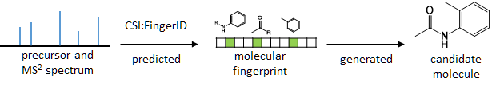
https://metabolomics.blog/2021/07/msnovelist/?fbclid=IwAR075rpbVlNL-fy93sto_xo8c2YQvbz9oSq4tA-bGuu3EgRTw7KBxA1tHqc
De novo indicates the molecular structures are generated directly from MS
Spectra without referring to a database.
A molecular fingerprint is predicted from an MS2 spectrum, and used as input to generate a candidate molecule directly.
there are only some 30’000 training spectra around

Slide 10
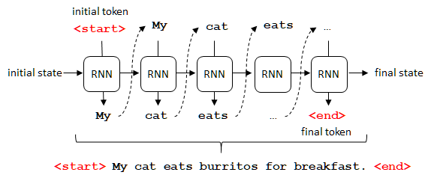
Scheme of an unrolled RNN for a word-level language model
Molecular fingerprints contain information about a molecular structure. All we need to do is reconstruct the structure from the fingerprint.
The fingerprint is an input that can be transformed into a molecule.
A convolutional neural network recognizes the features in an image, resulting in a vector (analogous to our fingerprint). MSNovelist is focused purely on the task of structure generation, and relies completely on upstream tools (in practice, SIRIUS) for molecular formula determination.

Slide 11
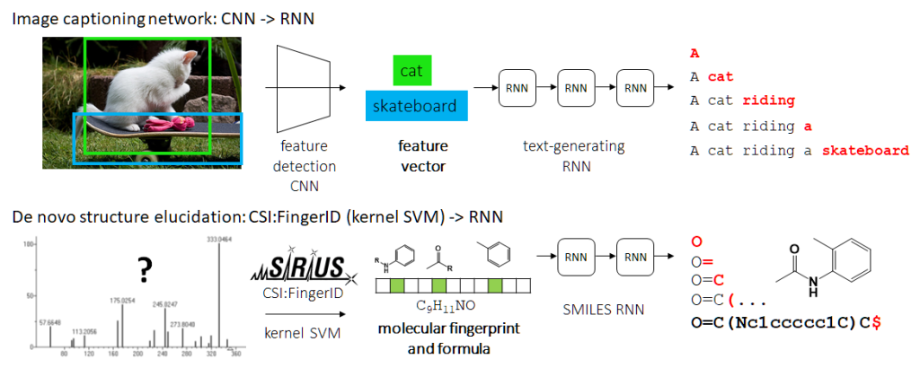
The vector is an input for a RNN decoding it into a sentence describing the image.
MSNovelist uses a LSTM based RNN to generate SMILES code from fingerprints

Slide 12
For every step in the sequence, the model predicts a probability for each possible following token (so, if we have tokens C,N,O,c,n,o,=,(,),1,$,
this gives 11 probabilities that sum up to 1). The token that has the highest probability is selected.
By running the model multiple times, one generates a list of multiple possible sequences arising from the same starting state.
In total, MSNovelist retrieved almost half of the correct structures; 25% were even ranked first.

