Slide 1
Peaks To Properties
Prototype on 4 lasso and elastic regression mz ic50 models, QED prediction in progress with transfromer model

Slide 2
Peaks to Properties Input Example:
R^2 compares test predictions to actual
Pesticides testing aphids:
Lasso lars r^2=1
Elastic r^2 =1
Lasso r^2=1
mz intensity ic50
0 51.022927 2.082268 0
1 63.022927 2.282968 0
2 75.022927 4.838775 0
3 77.038577 1.313632 0
4 90.033826 2.491295 0
... ... ... ...
2618 146.077582 2.636895 100
2619 207.154355 0.797110 100
2620 232.149604 0.753944 100
2621 248.180904 0.788094 100
2622 374.172625 0.878511 100
mglur5:
Lasso lars r^2=1
Elastic r^2 =1
Lasso r^2=1
calpain1:
Lasso lars r^2=1
Elastic r^2 =1
Lasso r^2=1
hsp90a:
Lasso lars r^2=1
Elastic r^2 =1
Lasso r^2=1
These values are on test sets

Slide 3
Elastic Regression in scikit-learn
Linear regression with combined L1 and L2 priors as regularizer.
Minimizes the objective function:
1 / (2 * n_samples) * ||y - Xw||^2_2
+ alpha * l1_ratio * ||w||_1
+ 0.5 * alpha * (1 - l1_ratio) * ||w||^2_2
If you are interested in controlling the L1 and L2 penalty separately, keep in mind that this is equivalent to:
a * ||w||_1 + 0.5 * b * ||w||_2^2
where:
alpha = a + b and l1_ratio = a / (a + b)
https://scikit-learn.org/stable/modules/generated/sklearn.linear_model.ElasticNet.html#sklearn.linear_model.ElasticNet

Slide 4
Lasso Regression in scikit-learn
Linear Model trained with L1 prior as regularizer (aka the Lasso).
The optimization objective for Lasso is:
(1 / (2 * n_samples)) * ||y - Xw||^2_2 + alpha * ||w||_1
Technically the Lasso model is optimizing the same objective function as the Elastic Net with l1_ratio=1.0 (no L2 penalty).
https://scikit-learn.org/stable/modules/generated/sklearn.linear_model.Lasso.html#sklearn.linear_model.Lasso

Slide 5
Ridge Regression in scikit-learn
linear least squares with l2 regularization.
Minimizes the objective function:
||y - Xw||^2_2 + alpha * ||w||^2_2
This model solves a regression model where the loss function is the linear least squares function and regularization is given by the l2-norm. Also known as Ridge Regression or Tikhonov regularization. This estimator has built-in support for multi-variate regression (i.e., when y is a 2d-array of shape (n_samples, n_targets)).

Slide 6
Biosortia has interest in:
1.Antivial
2.Neuro/CNS
3.Inflammation inhibitor
4. pesticides
https://github.com/patrickchirdon/biosortia.git
Training sets, list of Chembl Targets I can build (see email)

Slide 7
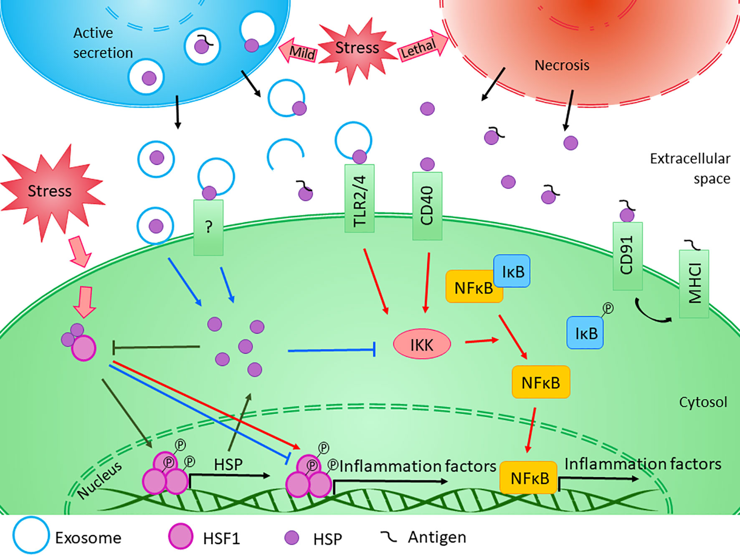
Heat Shock Proteins in Neuroinflammation
https://www.frontiersin.org/articles/10.3389/fphar.2019.00920/full
-HSPs have been associated with neurological diseases in the context of their chaperone activity, as they were found to suppress the aggregation of misfolded toxic protein
-modulating neuronal survival, inflammation, and disease-specific signaling processes
-The expression of HSPs could rapidly increase in response to different acute brain injuries, such as ischemic stroke

Slide 8
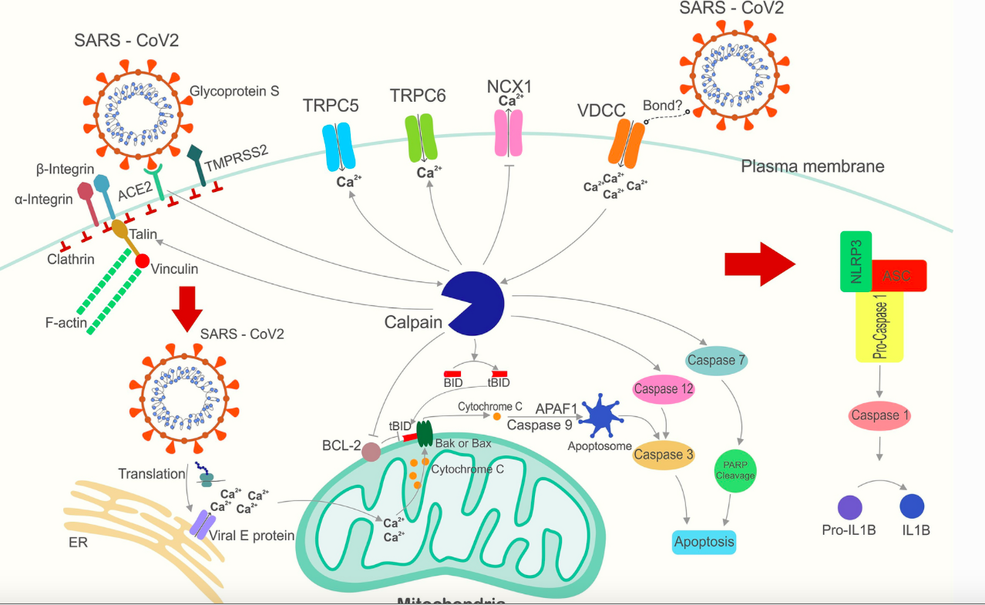
The Key Role of Calpain in COVID-19 as a Therapeutic Strategy
Covid19 virus activates Calpain by altering calcium flow. When Calpain was activated, the virus can enter the target cell. Subsequently, many complications of the disease, such as inflammation, cytokine storm and pulmonary fibrosis, are caused by virus-activated Calpain function. Calpain inhibitors appear to be a potential drug to control the disease and prevent death from COVID-19.
https://link.springer.com/article/10.1007/s10787-022-01002-1

Slide 9
Pesticides
https://ec.europa.eu/food/plant/pesticides/eu-pesticides-database/start/screen/active-substances
Instead of using IC50 as with other models, use mortality percent
I did this for aphids.

Slide 10
From bench to bedside: The mGluR5 system in people with and without Autism Spectrum Disorder and animal model systems
https://www.nature.com/articles/s41398-022-02143-1
H-MRS studies of ASD have reported differences in glutamate levels and GABA responsivity in those with ASD.

Slide 11
MS2Prop
https://www.biorxiv.org/content/10.1101/2022.10.09.511482v2
On compounds excluded from the training set MS2Prop has an average R2 = 0.73 across ten properties, including synthetic accessibility and quantitative drug likeness properties, andÂ R2Â = 0.96 for compounds in the training set

Slide 12
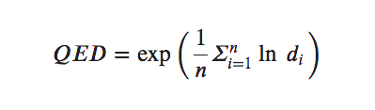
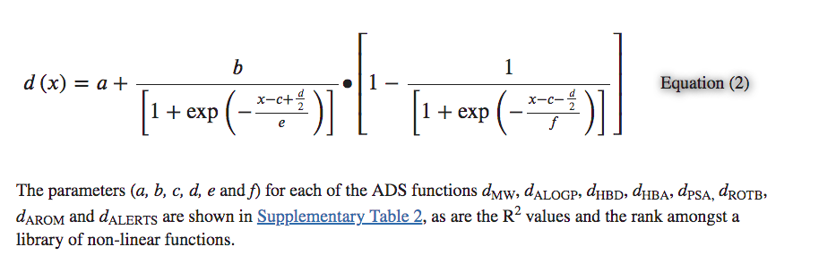
QED
https://www.biorxiv.org/content/10.1101/2022.10.09.511482v2
https://www.ncbi.nlm.nih.gov/pmc/articles/PMC3524573/
https://bioinformaticsreview.com/20220803/how-to-calculate-drug-likeness-using-rdkit/
GNPS datasets:
https://ccms-ucsd.github.io/GNPSDocumentation/gnpslibraries/
Calculate QED using rdkit for the GNPS mass spec database-- ~10 million mz qed pairs
QED molecular descriptors include molecular weight (MW), octanol-water partition coefficient (ALOGP), number of hydrogen bond donors (HBD), number of hydrogen bond acceptors (HBA), polar surface area (PSA), number of rotatable bonds (ROTB), number of aromatic rings (AROM), structural alerts (ALERTS).

Slide 13
Transformer Models
https://github.com/ashishpatel26/Treasure-of-Transformers
The Transformer architecture follows an encoder-decoder structure but does not rely on recurrence and convolutions in order to generate an output.

Slide 14
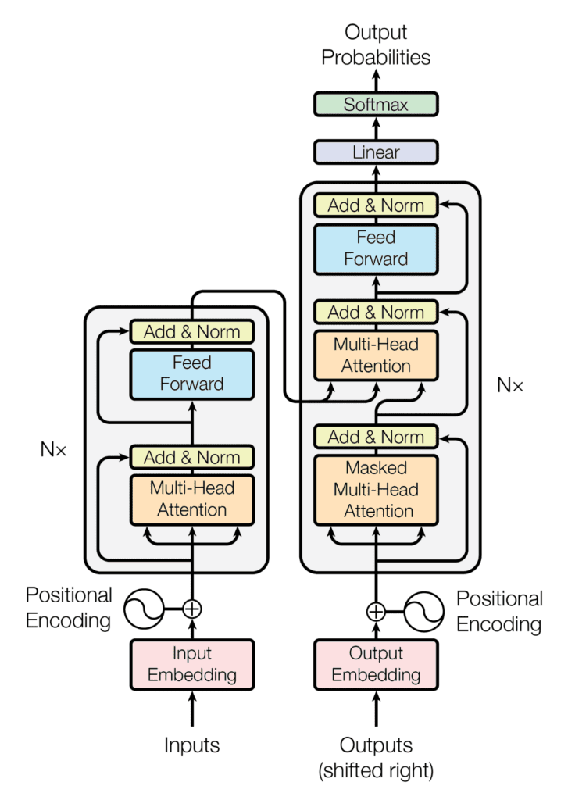
In a nutshell, the task of the encoder, on the left half of the Transformer architecture, is to map an input sequence to a sequence of continuous representations, which is then fed into a decoder.
The decoder, on the right half of the architecture, receives the output of
the encoder together with the decoder output at the previous time step to
generate an output sequence.
At each step the model is auto-regressive, consuming the
previously generated symbols as additional
input when generating the next.
https://machinelearningmastery.com/the-transformer-model/

