Slide 1
Lumibot

Slide 2
MIT License
Copyright (c) 2022 Lumiwealth-Strategies
Permission is hereby granted, free of charge, to any person obtaining a copy
of this software and associated documentation files (the "Software"), to deal
in the Software without restriction, including without limitation the rights
to use, copy, modify, merge, publish, distribute, sublicense, and/or sell
copies of the Software, and to permit persons to whom the Software is
furnished to do so, subject to the following conditions:
The above copyright notice and this permission notice shall be included in all
copies or substantial portions of the Software.
THE SOFTWARE IS PROVIDED "AS IS", WITHOUT WARRANTY OF ANY KIND, EXPRESS OR
IMPLIED, INCLUDING BUT NOT LIMITED TO THE WARRANTIES OF MERCHANTABILITY,
FITNESS FOR A PARTICULAR PURPOSE AND NONINFRINGEMENT. IN NO EVENT SHALL THE
AUTHORS OR COPYRIGHT HOLDERS BE LIABLE FOR ANY CLAIM, DAMAGES OR OTHER
LIABILITY, WHETHER IN AN ACTION OF CONTRACT, TORT OR OTHERWISE, ARISING FROM,
OUT OF OR IN CONNECTION WITH THE SOFTWARE OR THE USE OR OTHER DEALINGS IN THE
SOFTWARE.

Slide 3
Works with
Kucoin
Alpaca
Interactive brokers
Alpha vantage

Slide 4
Custom crypto etf
Must have kucoin account
Works with bitcoin, ethereum, and litecoin
This strategy will buy a few of the top cryptocurrencies and re-balance the portfolio often
Get how many shares we already own, calculate how many shares we need to buy or sell. If quantity is positive then buy, if it’s negative then sell
Backtest or trade live

Slide 5
Crypto double ema trending
This strategy buys crypto that are trending up based on two exponential moving averages EMAs. It sells all the cryptos that are not trending up that it currently owns and buys the cryptos that are trending up that it does not currently own.

Slide 6
Stock buy the dip
This strategy will normally invest in a 60/40 stock/bond ratio, but will change that mix after a big drop in the market
Each day check if we should change the portfolio weighting
If the price has dropped by more than the big drop level, then we should change the portfolio to the dip one.
If the target number of days has passed, rebalance the portfolio

Slide 7
Debt trading
This strategy will buy the two assets in self.portfolio and adjust their proportions based on the change in the debt to gdp ratio in the usa. In a normal situation, where debt to gdp is increasing less than the ‘debt change threshold, then we will own the normal ratio of the first asset, and put the rest of the money into the second asset.
In an increasing debt situation, where debt to gdp is increasing more than the debt change threshold, then we will own the buy sp ratio of the first asset, and put the rest of our money in the second asset.

Slide 8
Diversified leverage
This strategy will buy a few symbols that have 2x or 3x returns (have leverage), but will also diversify and rebalance the portfolio often.

Slide 9
Stock double EMA
This strategy buys stocks that are trending up based on two EMAs. It sells all the stocks that are not trending up that it currently owns and buys the stocks that are trending up that it does not currently own

Slide 10
Stock fast trading
Buys the best performing assets from self.symbols over self.momentum_length number of minutes. For example, if TSLA increased 0.03% in the past two minutes, but SPY, GLD, TLT, and MSFT only increased 0.01% in the past two minutes, then we will buy TSLA

Slide 11
Stock momentum
Buys the best performing asset from self.symbols over self.period number of days. For example, if SPY increased 2% yesterday, but VEU and AGG only increased 1% yesterday then we will buy SPY

Slide 12
Stock technical analysis
This strategy will use the rsi indicator to determine the balance of assets in the portfolio, especially buying low and selling high
In a normal situation, it will divide its money between ‘main_symbol’ and ‘other_symbol’, based on ‘middle_main_symbol_percentage’
In an upper situation (when we hit the upper threshold for RSI), we will only own other symbol and sell all of our main symbol
In a lower situation, when we hit the lower threshold for rsi, we will only own main_symbol and sell all of our other_symbol

Slide 13
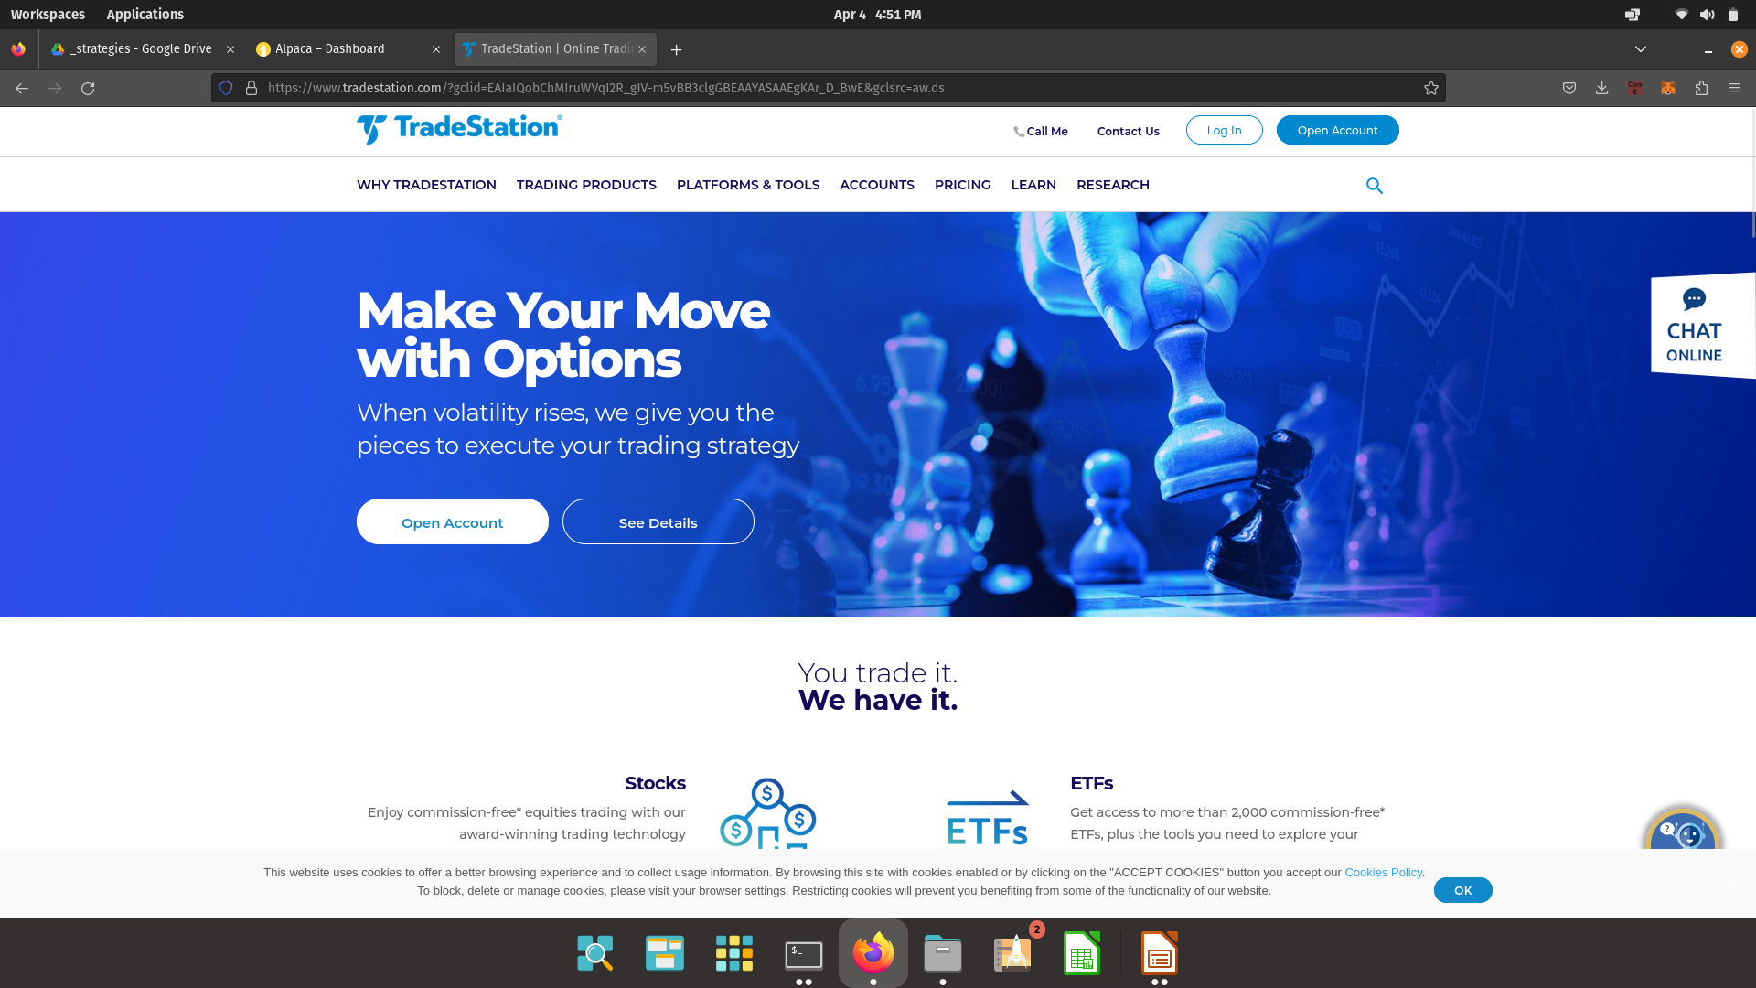

Slide 14
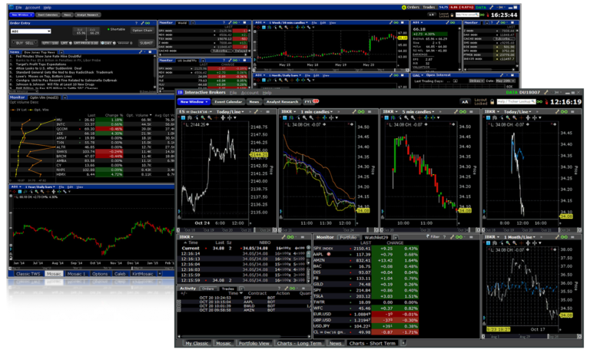

Slide 15
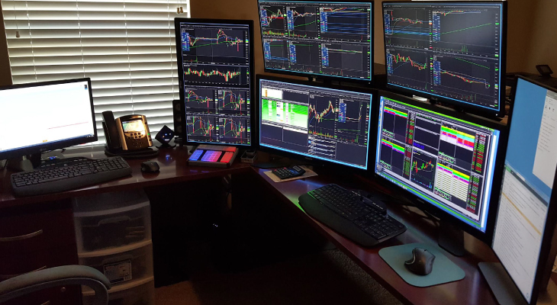
Tradestation

