Slide 1
JavaScript Form Validation

Slide 2
Slides are from:
Dr. Margaret Hamilton, Web Programming Lecture Note from RMIT University
Lecture Note from Utah Valley University | uvu.edu
http://www.w3schools.com/
http://www.tizag.com/

Slide 3
JavaScript Form Validation
Before the submission of an HTML form, you need to make sure the data submitted is valid and in the correct format
JavaScript can be used to validate form inputs in the client side
If the form input is not valid, the form data is not submitted to web server

Slide 4

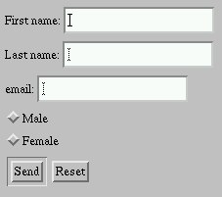

Client Side Form Validation
HTML Form
Web Server
User
JavaScript Form Validation
The user fills in HTML form and clicks submit button
The browser execute JavaScript form validation function
If user input is valid then browser submit form data to web server
If user input is invalid then browser sends an error message to user

Slide 5
What to Validate on a Form?
Some example of form validation
  fields are left empty?
  was a valid e-mail address entered?
  was a valid date entered?
  was a phone number entered in a numeric format?
  did the number entered has a correct range?

Slide 6
How to Validate a Form in JavaScript
Using onChange event handler
Using onSubmit event handler

Slide 7
onChange Validation
The browser checks each field immediately after data entered
Add an onchange event handler to each of the <input> tags in the form
For example: Validate an e-mail address:
<input type="text“ id=“email”
onChange="emailvalidation(‘email’);" >
Event handler
JavaScript Validation Function

Slide 8
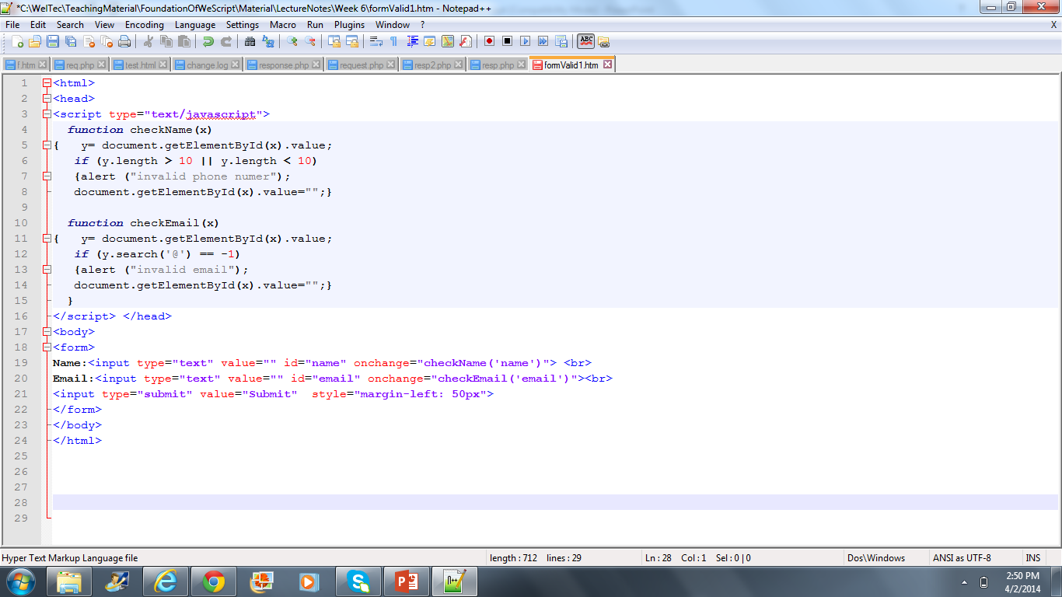
Example
If (y.length != 10)

Slide 9
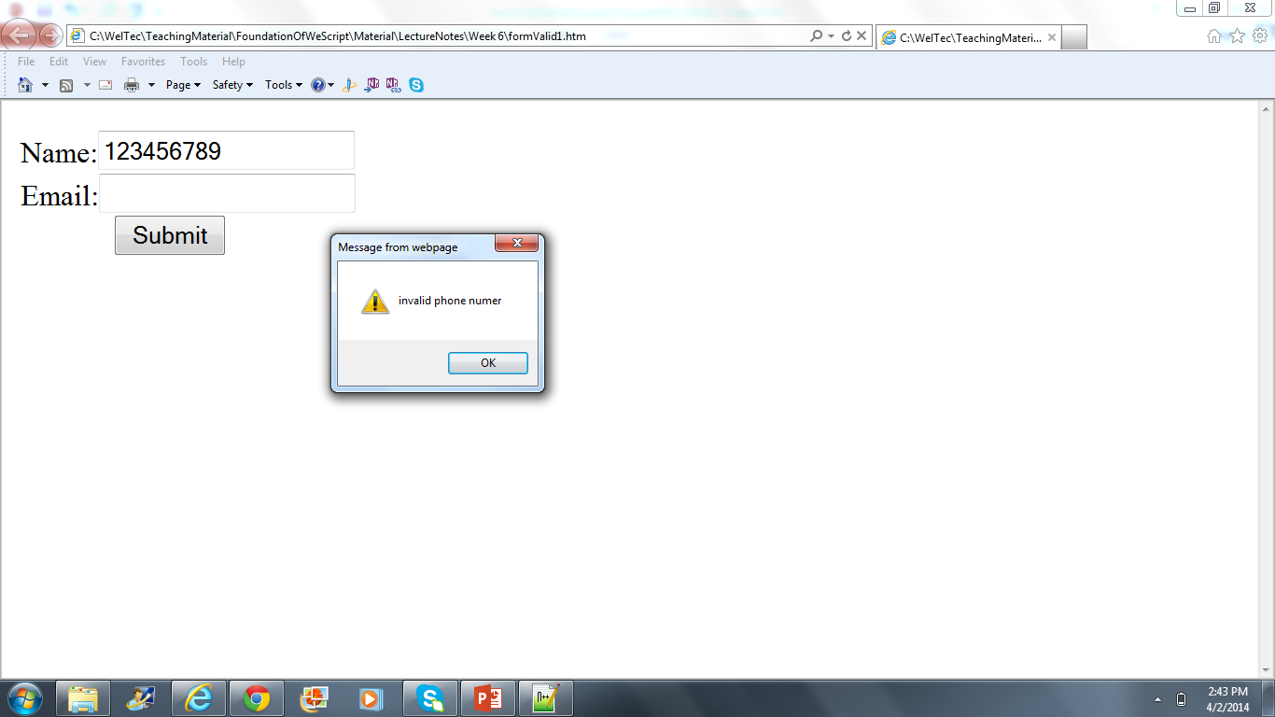
Output: Invalid Phone Number

Slide 10
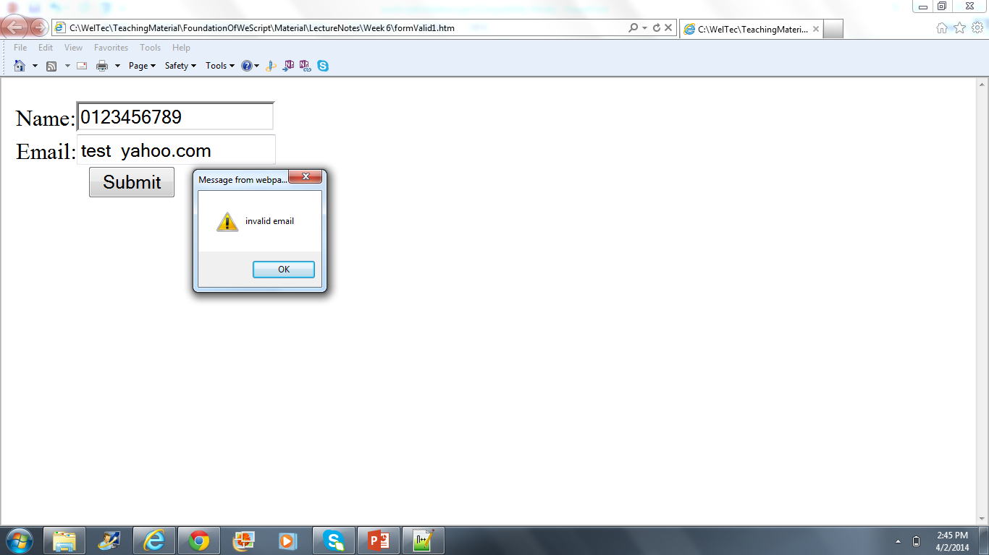
Output: Invalid Email

Slide 11
Problem in onChange validation
When submit button is pressed all the form inputs (either valid or invalid) are sent to web server
Solution: onSubmit validation

Slide 12
onSubmit Validation
When user clicks submit button an onSubmit event will be raised
Use onSubmit event handler to go through and test each form field
If the event onSubmit handler returns false, the form submission will be cancelled, if true the form will be submitted
<form onsubmit="return checkForm();” >
Event handler
JavaScript Validation Function

Slide 13
onSubmit Event Handler
Use a series of if statements to perform each validation test, if test fails so return false and set error message and/or alert message
Finally, return true if no any invalid input

Slide 14
Validation Function for onSubmit
function checkForm() {
if (input1 is invalid) {
alert error message;
return false;}
if (input2 is invalid) {
alert error message;
return= false;}
…..
return true;
}

Slide 15
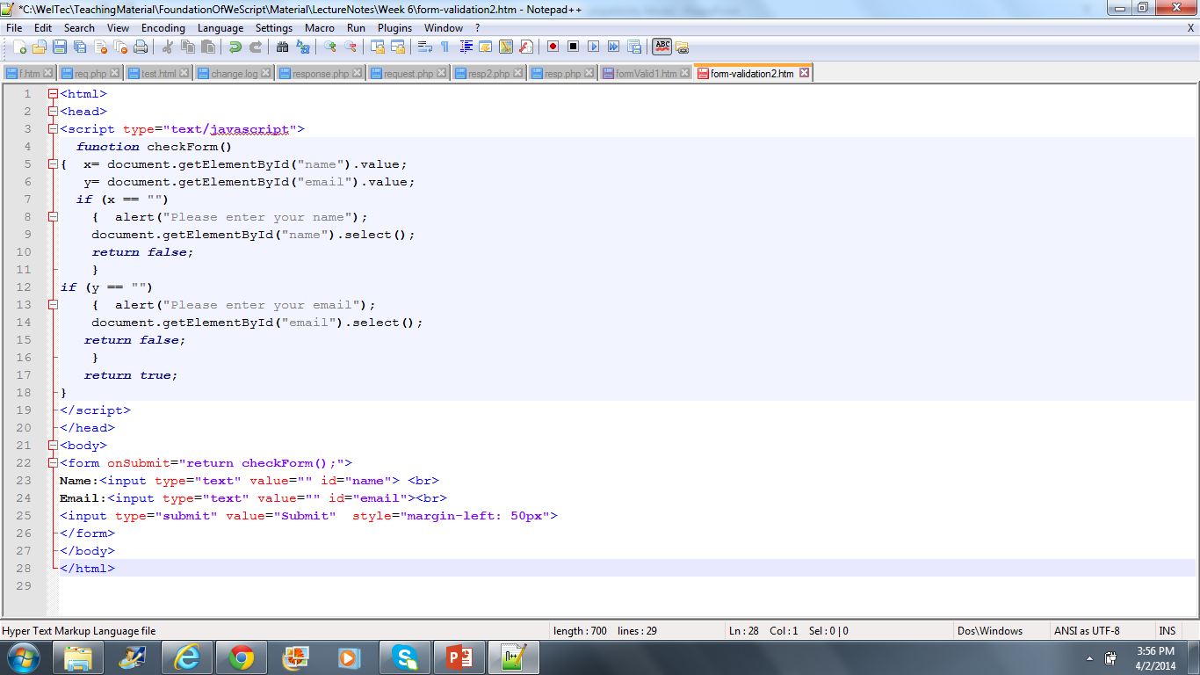
Example

Slide 16
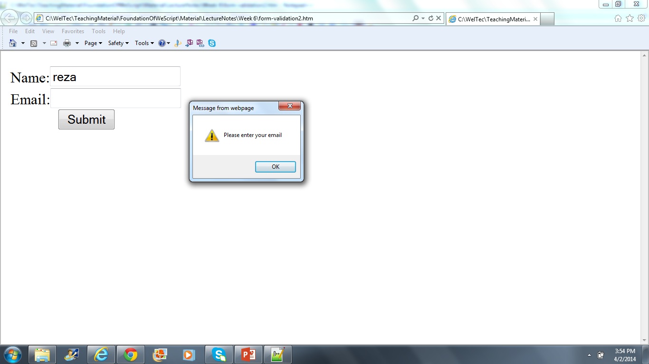
Output

Slide 17
How to have an advanced Validation
How to check if an New Zealand mobile phone number entered by a user is valid
for example 0176205664 is invalid
0213456775 is valid
Solution: Use Regular Expressions
we can check it against a regular expression that describes the pattern followed by New Zealand Mobile phone numbers.
What is this pattern?

Slide 18
What is Regular Expression
a regular expression is a sequence of characters that forms a search pattern, mainly for use in pattern matching with strings [from Wikipedia]
There are many regular expressions available for common tests
  U.S. Phone: /^\(?(\d{3})\)?[- ]?(\d{3})[- ]?(\d{4})$/
  Email: /^[0-9a-zA-Z]+@[0-9a-zA-Z]+[\.]{1}
  [0-9a-zA-Z]+[\.]?[0-9a-zA-Z]+$/
  Currency: /^\s*(\+|-)?((\d+(\.\d\d)?)|(\.\d\d))\s*$/

Slide 19
JavaScript Regular Expression
A JavaScript regular expression is an object that describes a pattern of characters.
Syntax:
patt = /pattern/modifier;

Slide 20
Pattern in Regular Expression
Pattern: Describes a sequence of characters that can be used in form input
  Example: a pattern for Email address:
  /^[0-9a-zA-Z]+@[0-9a-zA-Z]+[\.]{1}[0-9a-zA-Z]+$/

Slide 21
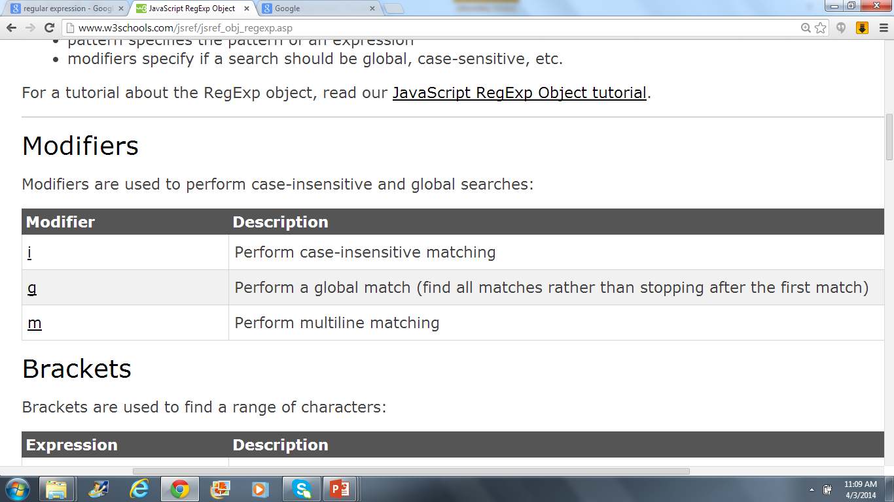
Modifiers
Modifiers are used to perform case-insensitive and global searches
  Example:
  Patt = /^[0-9a-z]+@[0-9a-z]+[\.]{1}[0-9a-z]+$/i

Slide 22
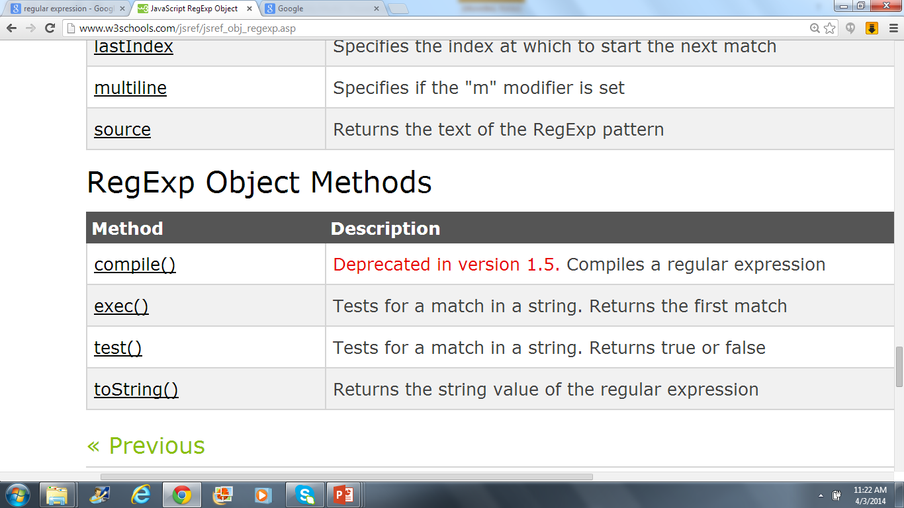
Regular Expression Methods
patt = /w3schools/i;
document.write(patt.test("Visit W3Schools");
Output: true
document.write(patt.exec("Visit W3Schools");
Output: W3Schools

Slide 23
Example
<html>
<body>
<script type="text/javascript">
var patt = /w3schools/;
document.write(patt.test("Visit W3Schools"));
</script>
</body>
</html>
Output: false

Slide 24
Example 2
<html>
<body>
<script type="text/javascript">
var patt1 = /^[0-9a-z]+@[0-9a-z]+[\.]{1}[0-9a-z]+$/i;
document.write(patt1.test("rezAA@YAhoo.com"));
</script>
</body>
</html>
Output: True

Slide 25
Example 3
<html>
<body>
<script type="text/javascript">
var patt1 = /^[0-9a-z]+@[0-9a-z]+[\.]{1}[0-9a-z]+$/i;
document.write(patt1.test("rez_AA@yahoo.com"));
</script>
</body>
</html>
Output: false because of ‘_’ after ‘z’

Slide 26
PATTERN

Slide 27
Wildcard
The dot character . matches any single character except
newline or line terminator
<html>
<body>
<script type="text/javascript">
patt = /.at/;
document.write(patt.test('cat'));
</script>
</body>
</html>

Slide 28
Character sets
You can specify that a single character must come from a particular subset.
You can list out the subset between square brackets.
For example:
[a-z]
  matches a single character between a and z.
[aeiou]
matches a single .
[A-Za-z0-9]
matches any letter or digit.

Slide 29
Example
<html>
<body>
<script type="text/javascript">
patt = /[0-9a-z]/;
document.write(patt.test(‘@#%'));
</script>
</body>
</html>
Output: false

Slide 30
Not matching sets
You can specify that a character cannot be a member of a set.
To do this, use the caret character inside the square brackets, in front of the set.
For example:
[^0-9]
means the character cannot be a digit

Slide 31
Example
<html>
<body>
<script type="text/javascript">
patt = /[^abcd]/;
document.write(patt.test('d'));
</script>
</body>
</html>
Output: False

Slide 32
Repetition
You can specify the possible numbers of repetitions with two special characters
* means zero or more
+ means one or more
[a-zA-Z0-9]+
means one or more alphanumeric characters

Slide 33
Example
<html>
<body>
<script type="text/javascript">
patt = /[abcd]+/;
document.write(patt.test('bewiorwiu'));
</script>
</body>
</html>
Output: True

Slide 34
Sub expression
You can put parts of the regular expression next to each other to form a longer expression.
Example:
(very )* large
This will match "large", "very large", "very very large", and so on.

Slide 35
Example
<html>
<body>
<script type="text/javascript">
patt = /(web)+/;
document.write(patt.test('webwebweb'));
</script>
</body>
</html>
Output: True

Slide 36
Example
<html>
<body>
<script type="text/javascript">
patt = /(web)+/;
document.write(patt.test('wejhgjh'));
</script>
</body>
</html>
Output: false

Slide 37
Exact numbers of repetitions
You can also specify an exact number of repetitions. Put numbers or ranges in curly brackets. For example:
{3} means exactly 3 times
{2, } means 2 or more times
{2, 4} means between 2 and 4 times.
“(very ){2, 4} large” matches
very very large
very very very large
very very very very large

Slide 38
Anchoring to the start or end
You can specify that a particular pattern must appear at the start or end of a string.
^ matches the start
$ matches the end
For example:
^bob matches bob at start of a string
com$ matches com at end of a string
^[a-zA-z0-9]*$
matches a string of any length that contains only letters and numbers.

Slide 39
Example
<html>
<body>
<script type="text/javascript">
patt = /^[0-9a-z]+@(com)$/;
document.write(patt.test('sgfsdjh8374687@com'));
</script>
</body>
</html>
Output: True

Slide 40
Branching
You can give choices using the pipe character | (read it as OR)
For example:
(com) | (edu) | (org) | (net)
matches com or edu or org or net

Slide 41
Example
<html>
<body>
<script type="text/javascript">
patt = /^[0-9a-z]+@[(com)|(edu)]$/;
document.write(patt.test('sgfsdjh8374687@comedu'));
</script>
</body>
</html>
Output: false

Slide 42
Special characters
If you want to match a character that has some special meaning
( . * + [ ] $ ^ () )
Put a back slash in front of it: \.
If you want to match a back slash you need two slashes: \\

Slide 43
More Characters
http://www.w3schools.com/jsref/jsref_obj_regexp.asp

Slide 44
Slides are from:
Dr Margaret Hamilton, Web Programming Lecture Note from RMIT University
Lecture Note from Utah Valley University | uvu.edu
http://www.w3schools.com/
http://www.tizag.com/

