Slide 1
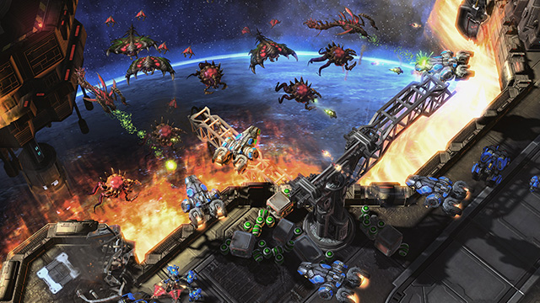
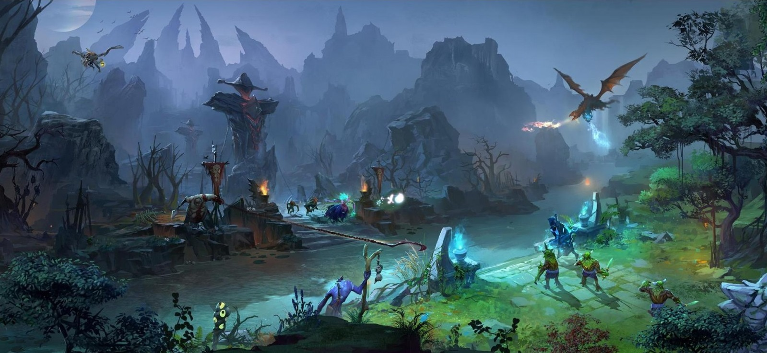
Bayesian Search Theory to Determine Opposing Army Location in Gaming
Patrick Hackett,
Bayesian Statistics ISYE 6420 Spring 2019
Notes:
Building Artificial Intelligence for video games that can successfully compete with professional players has become a measuring stick for the advancement of AI, with Google’s DeepMind recently beating pro Starcraft II players in constrained conditions, and OpenAI recently defeating a professional DOTA 2 team (a top down 5 on 5 battleground game where each player controls their own character). In this project, I explore the use of Bayesian Search Theory as a potential tool to direct AI search for enemy units across a map in Starcraft 2.

Slide 2
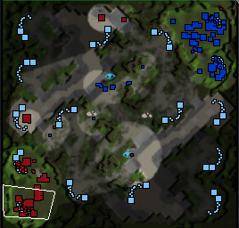
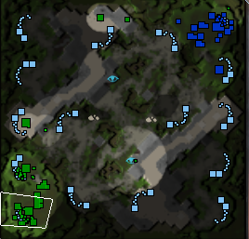
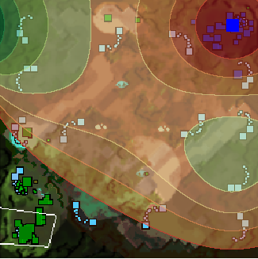
Bayesian Search using a Simulated In-Game Mini-map
Location of units
Hero: Bottom Left in Red
Enemy Base: Top Right in Blue
Enemy Army: Circled in Blue
Prior PDF of Army Location
Highest probability: In opponent base or between two bases
Hero’s PoV (Fog of War)
Hero in Green
Enemy’s Buildings in Blue
A
B
Notes:
Bayesian search theory was first known to be developed and used in WWII by the US Navy to search for German submarines and, in at least one case, a hydrogen bomb lost at sea. In more recent events, Bayesian search theory has been used to try and locate airplanes lost at sea.
In my project, I used game replay data from Starcraft 2. Starcraft 2 is a real time strategy game where opponents gather resources to make buildings and armies, battling it out until a players units are all destroyed. Using a snapshot of a game at a particular time, I looked at the minimap which shows all the unit locations for both players. In the left most image, you can see our hero is in the bottom left corner denoted by red squares, and our opponent is in the top right corner in blue. As you can see, circled in blue is the enemy’s army advancing across the map.
In the second image, we can only see our heros in-game perspective, where the enemy’s army is hidden by the “fog of war” which just means we don’t have any units looking in that area.
So I Used Bayesian search theory to create a prior distribution of probabilities across the grid, using assumptions to determine the probability that the army exists in each location.
Based on the parts of the map already explored by our hero by this point in the game, we used a beta function to assign probabilities of the location of the enemy army across the map, based on proximity to the known location of the enemy base which would have a higher likelihood of the army being there.

Slide 3
Bayesian Search Algorithm
Prior: Beta (a, b, scale, size)
Sampling data: Whether army is present in search area * P (failure)
Updated posterior: P (Army is present | prob. of success when present) α P (prob of success when present) * P (Army is present)
Notes:
Then, the algorithm samples data in the grid with the highest probability, mimicking an in-game “scanner sweep” where a player is able to view a portion of the map for a few seconds. Based on whether the army was found or not, an updated posterior distribution of probabilities is created; factoring in a chance of failure to find the object even if the right grid is searched. In this scenario, I use a chance of failure to account for possible army movement between searches, whereas in real life situations, failure of search in the correct grid could be due to any number of factors, for example, the difficulty of finding an object in the ocean.
Then, after the search sample is collected, an updated posterior probability density map is generated, basically changing the searched area from a high probability area to a very low one, and updating the rest of the areas in a normalized manner. The algorithm iteratively searches again in the new highest probability area. This is repeated until the army is found.

Slide 4
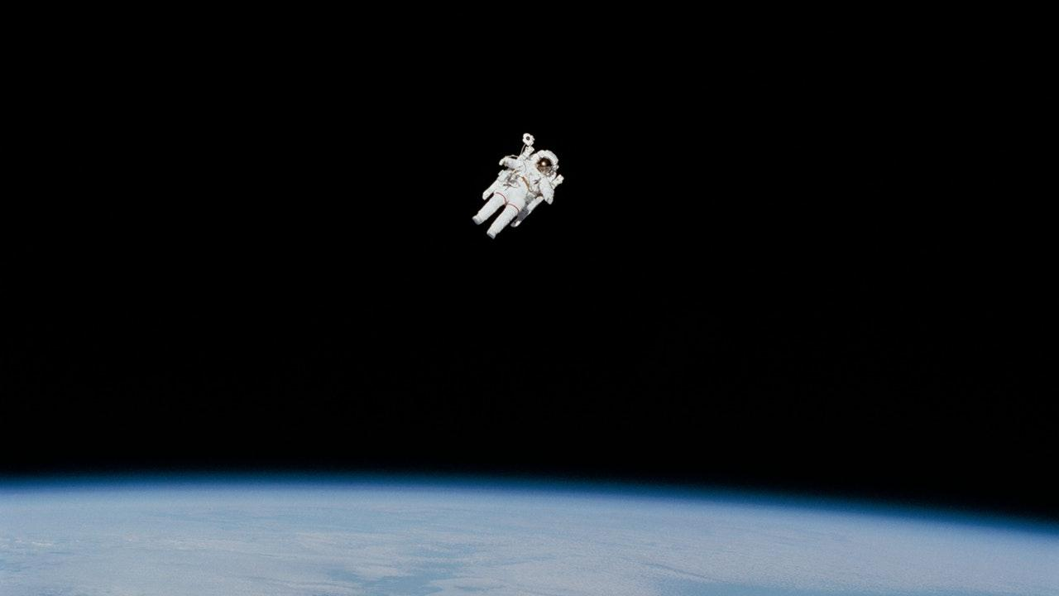
Conclusions and Lessons Learned
Assumptions and constraints
Comparison to a greedy grid search
Rate of discovery at different in-game snapshots greatly differed
Other potential models to be incorporated
Next steps for this model, and implications for AI
Notes:
So, Conclusions and lessons learned.
First off, we were definitely working under some assumptions and constraints that are important to consider – this was just a model of a search, it was not working in real time and therefore didn’t have to deal with actual time lag and moving army issues and integration with the rest of an AI. Also, in game mechanics don’t actually allow unlimited searches, and there are other in game search mechanisms like dispatching a unit that are more complicated.
Next potential steps for this model would be add more information to inform the prior distribution, which was actually where my model struggled as the search would get stuck in other far distant spots from the base. It would also be a big improvement to train the prior distribution on historical replays and games, allowing the prior probabilistic map to cater to map selection, in game behavior, even to specific opponents. The goal would be to incorporate this in a real time AI that has to deal with moving armies and in-game learning
This specific example is very interesting when taken to scale and brings to mind not just current such as with helping find downed planes, but some of the darker sides of where AI can be used, such as directing automated drones on search and destroy missions. I think as data scientists and engineers it is important to always consider the great potential for good and for misuse of what we create, and to realize we are the ones who are going to be driving these models and what they are built for in the future. Thank you

Slide 5
References
https://stats.stackexchange.com/questions/323269/simple-real-world-examples-for-teaching-bayesian-statistics
StarCraft II: A New Challenge for Reinforcement Learning - DeepMind
https://www.r-bloggers.com/bayesian-search-models/
https://stats.stackexchange.com/questions/119952/how-to-apply-bayes-theorem-to-the-search-for-a-fisherman-lost-at-sea
https://subsubroutine.wordpress.com/2014/05/18/a-bayesian-search-for-hannibals-marauding-army-during-the-second-punic-war/
https://github.com/GraylinKim/sc2reader
https://itnext.io/how-to-locate-and-select-units-in-pysc2-2bb1c81f2ad3
https://github.com/deepmind/pysc2/blob/master/docs/environment.md
https://matplotlib.org/tutorials/introductory/pyplot.html

