Slide 1
RT
Estimated SE Statistic p
(Intercept) 0.502614 0.012029 41.784 <2e-16 ***
Number Size 0.006468 0.014600 0.443 0.658
Key Side -0.014411 0.014643 -0.984 0.326
---
N 32
Observation 3,200
Marginal R2/conditional R2 -0.0021/0.0026

Slide 2
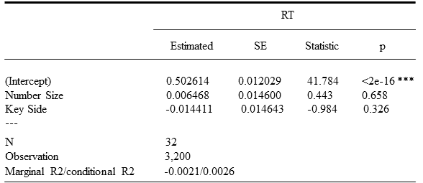

Slide 3
Df Sum Sq Mean Sq F value Pr(>F)
Number Size 1 0.0028 0.0027584 0.1258 0.7230
Key Side 1 0.0212 0.0212317 0.9686 0.3256
Residuals 412 9.0310 0.0219200

Slide 4
