Slide 1
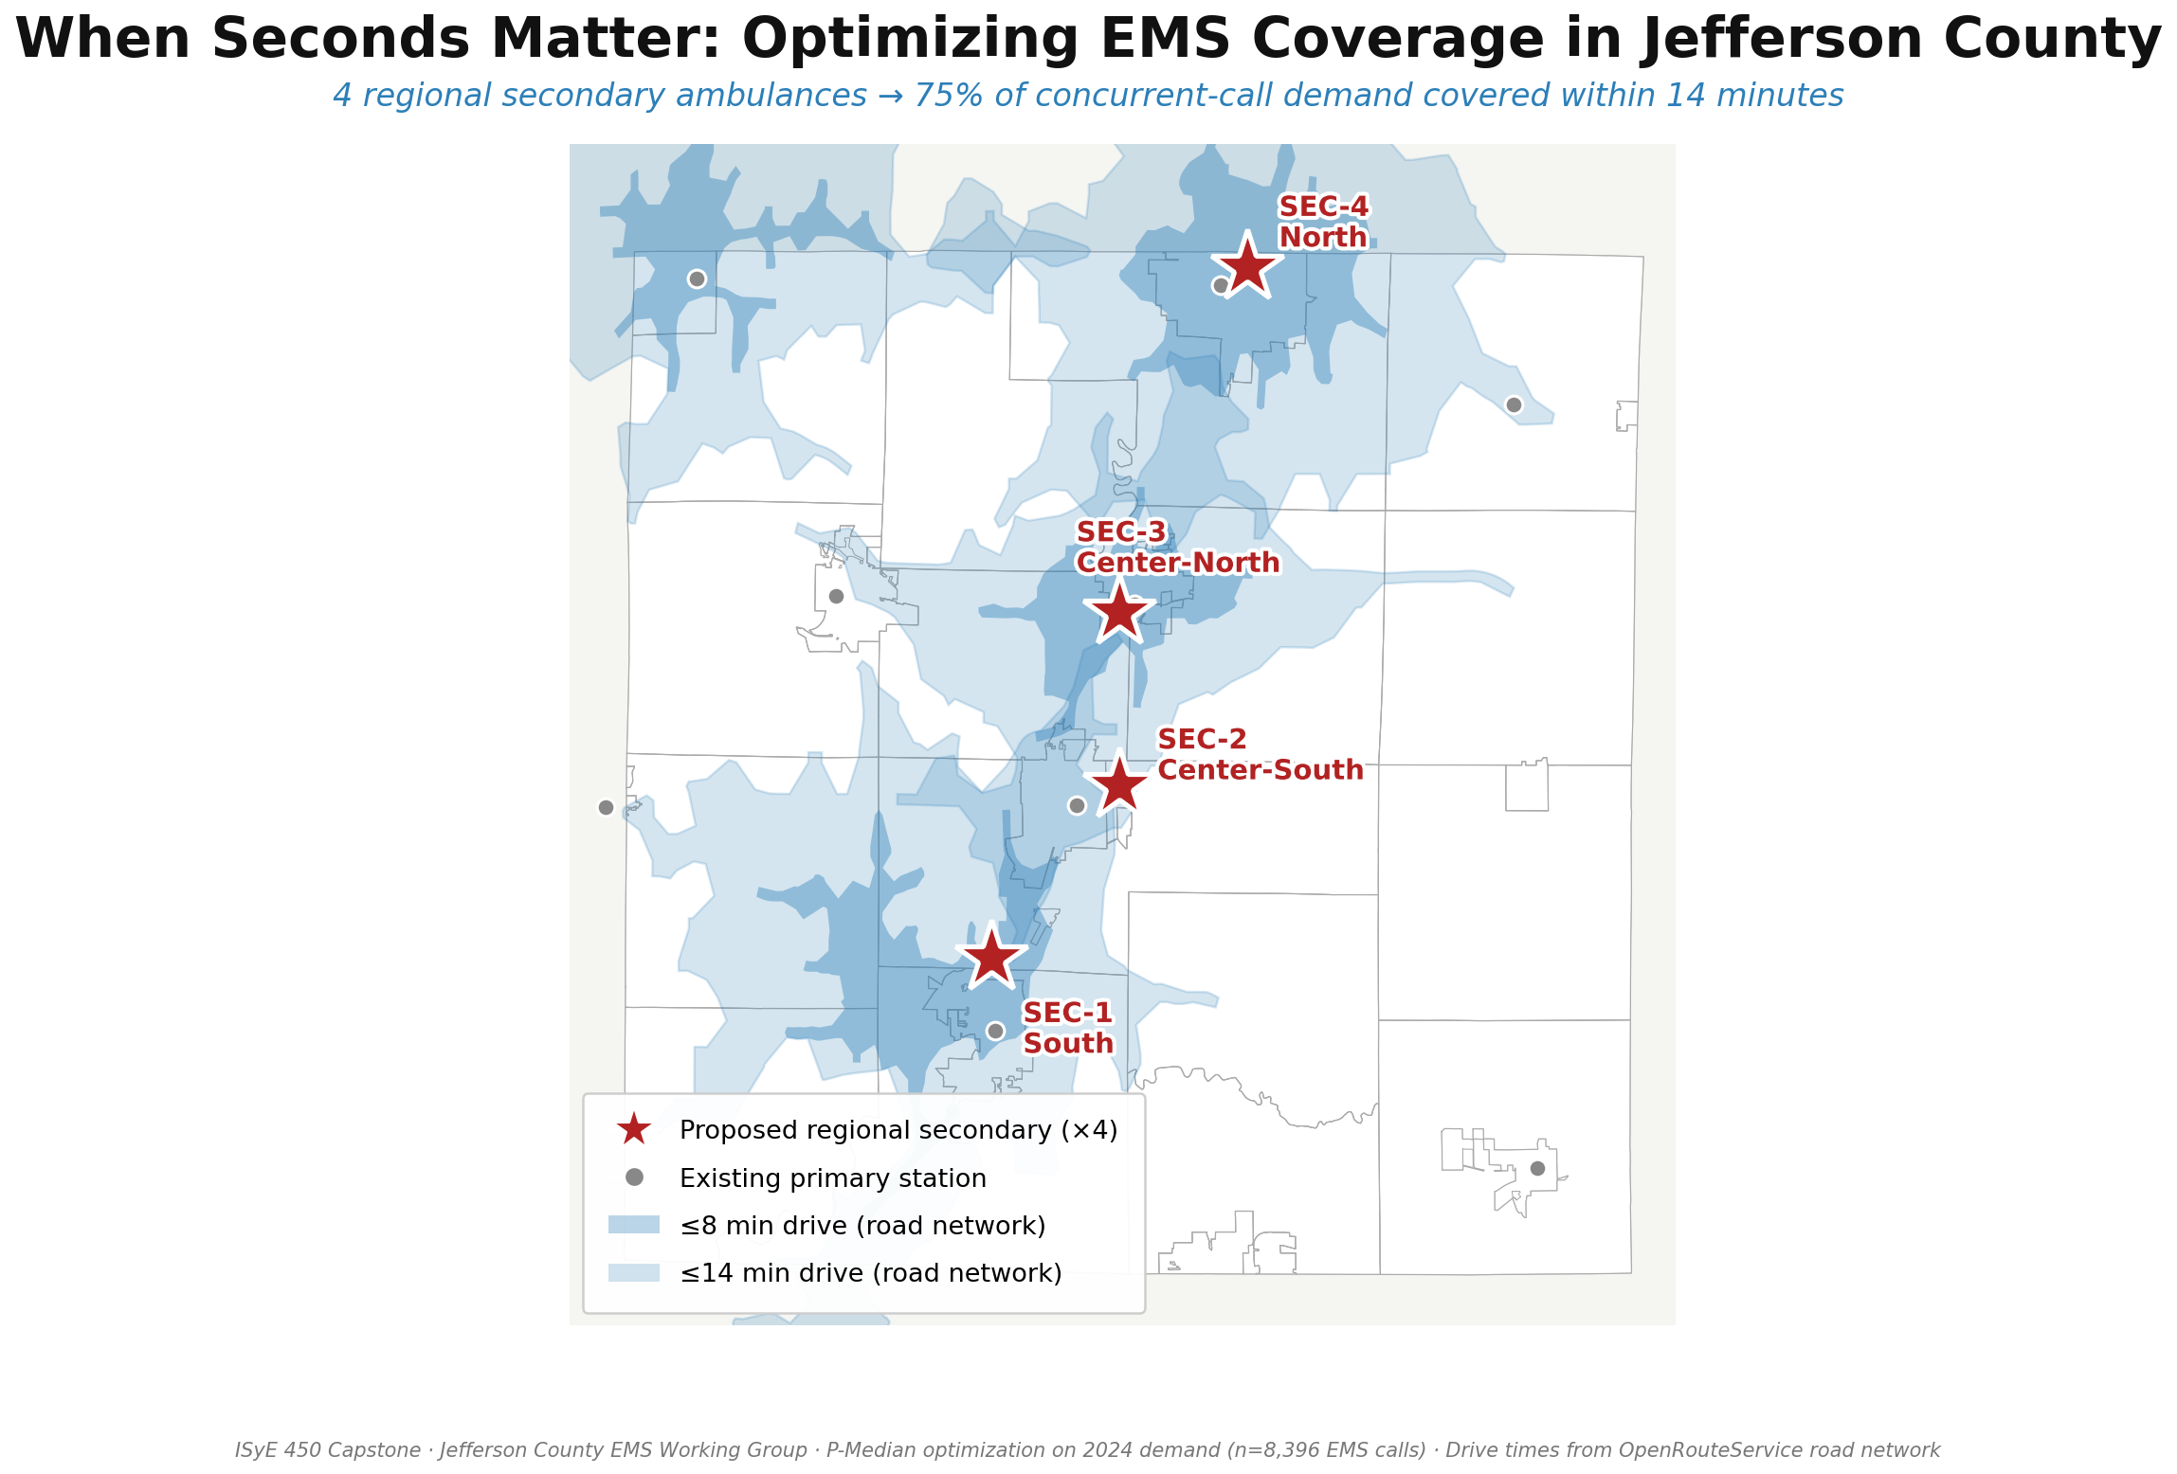
ISyE 450 Capstone — Jefferson County EMS
Team: [Your names here]
Data: CY2024 NFIRS (n=8,396 EMS calls, Jefferson geography) · P-Median optimization · OpenRouteService road-network isochrones

Slide 2
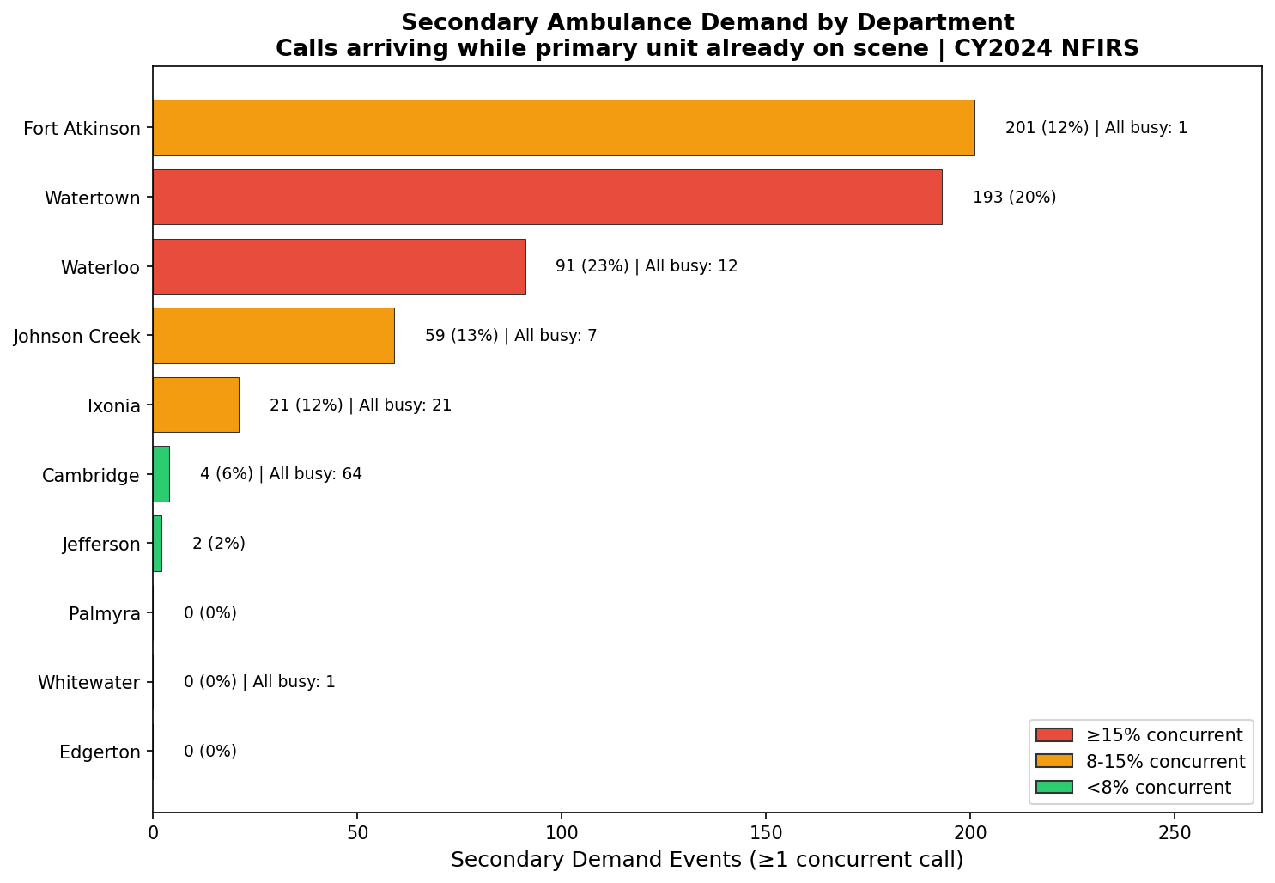
The Bottleneck: 12 Half-Empty Systems
Each of Jefferson County's 12 departments funds its own backup ambulance — used 10–15% of the time, yet still leaving 41 coverage gaps per year.
THE KEY NUMBERS
21
all-busy events / year in Ixonia (≈ once / 2.5 weeks)
12
all-busy events / year in Waterloo
41
countywide — NO ambulance was available for that 911 call
Source: CY2024 NFIRS concurrent-call analysis · Jefferson County geography only

Slide 3
The IE Intervention: Hybrid Local + Regional
Primaries stay local. Secondaries go regional. Dispatch routes whichever unit reaches the patient fastest.
TODAY
PROPOSED
12 independent departments
Local primaries + 4 shared regional secondaries
Dept A
Dept B
Dept C
Dept D
Dept E
Dept A
Dept B
Dept C
Dept D
Dept E
Primary
Primary
Primary
Primary
Primary
Primaries stay local — autonomy preserved
Backup
Backup
Backup
Backup
Backup
SEC-1
SEC-2
SEC-3
SEC-4
Each department funds its own backup. Still 41 all-busy events per year.
4 shared regional secondaries. Dispatch routes the closest unit — regardless of town lines.
Methodology: P-Median facility location (Amazon logistics) · Erlang-C queuing (call-center staffing) · OpenRouteService drive-time validation

Slide 4
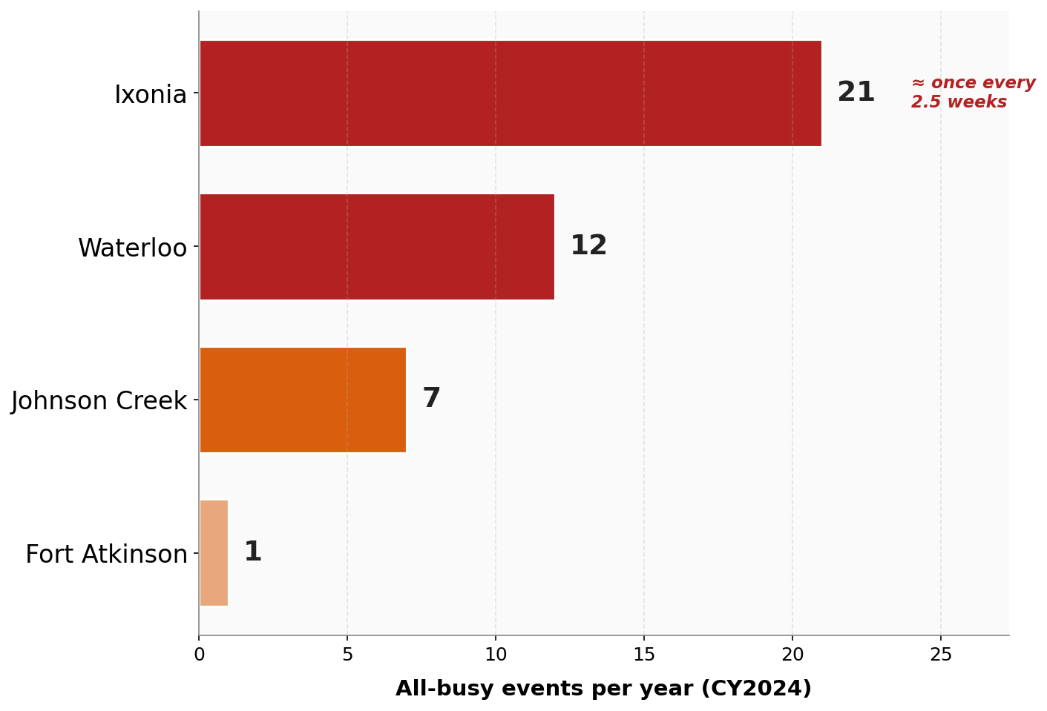
From Fragmented Backup to Regional Resilience
BEFORE — Fragmented coverage
AFTER — K=4 Regional Network
41 times in 2024, a caller's primary ambulance was busy AND the department had no backup.
4 regional secondary stations overlay existing primaries.
Demand covered ≤14 min
Today: 32%
K=4: 75%
+43 pts
Avg secondary response time
Today: 16.6 min
K=4: 10.8 min
−5.8 min
All-busy events closed by overflow
Today: 41 / yr
K=4: ≤5 / yr
−36 events
Before: K=2 MCLP T=10 baseline for current fragmented mutual-aid · After: K=4 P-Median optimization, total demand

Slide 5
The Bottom Line — For the Patient
In the language that matters to a 911 caller
TIME
QUALITY
COVERAGE
−5.8 MIN
1
41 → 5
Faster response during concurrent calls
Unified medical protocol, county-wide
All-busy events closed per year
16.6 min → 10.8 min. In cardiac arrest, this is the difference that matters.
Today: 12 separate protocols. Tomorrow: every patient gets the same standard of care.
No Jefferson County resident waits for mutual aid from another county.
We're not asking for funding. We're asking for partnership as the Jefferson County EMS Working Group moves into implementation.

Slide 6
The Business Case: Same Spend, Dramatically Better Care
Built on Chief Peterson's 24/7 ALS single-unit cost model (6 FTEs, 24/48 schedule, 700 calls/yr)
TODAY — Fragmented
TOMORROW — Regional (K=4)
★ RECOMMENDED
Current distributed overhead
Scenario A
Scenario B
Scenario C
$2.36M
All 4 stations 24/7 ALS
All 4 peak-only (8 AM–8 PM)
Hybrid: 1×24/7 + 3×peak
Same budget
per year, across 7 departments
$1.00M
$851K
$902K
net / year
net / year
net / year
What that buys today:
• 12 independent backup ambulances
• 10–15% utilization per unit
• 41 all-busy gaps per year
• Only 32% of concurrent demand covered ≤14 min
Operating: $2.87M
Revenue: $1.86M
29 FTE
Operating: $2.06M
Revenue: $1.21M
19 FTE
Operating: $2.33M
Revenue: $1.43M
22 FTE
Maximum coverage. Higher cost; delivers ≤14-min coverage to 75% of demand.
Peak-hour focus — covers 90% of call volume during the 12-hour daytime window.
Recommended balance. 24/7 anchor + peak-only coverage where demand spikes.
The hybrid regional network costs ≈ $900K net — within the envelope the county already spends on fragmented backup.
Source: Chief Peterson 24/7 ALS cost projection (6 FTEs, 700 calls/yr) scaled to K=4 · Current distributed overhead estimated from 7-dept staffing data

Slide 7
Thank You.
Partnership and feedback as the Jefferson County EMS Working Group moves into implementation.
ISyE 450 Capstone Team
[Team member 1] [Team member 2] [Team member 3] [Team member 4]
Questions? We have backup slides on sensitivity, staffing scenarios, and dispatch protocols.
University of Wisconsin–Madison · ISyE 450 · April 2026

