Slide 1
CP1404 Module 9 Inheritance

Slide 2


Slide 3
Learning outcomes - you will be able to:
Create derived classes from base classes using inheritance
Override methods with new functionality
Build larger programs that model systems with similarities encoded using class relationships like inheritance, association and composition

Slide 4

Do this now
Create a Person class:
Name
Date of birth
method to get age
Notes:
We will use this throughout lecture, and make subclasses later

Slide 5
Real-world objects are often specialised versions of more general objects
Grasshoppers and bees are specialised types of insect. In addition to the general insect characteristics, they have unique characteristics:
Grasshoppers can jump
Bees can sting, make honey, and build hives

Slide 6
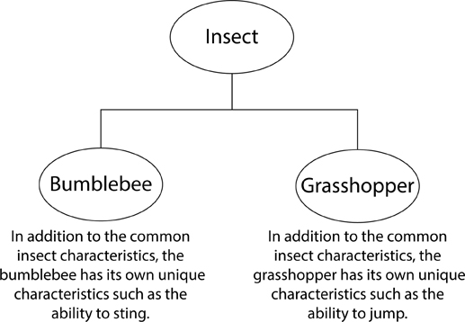
Real-world objects are often specialised versions of more general objects

Slide 7
We often create programs with classes that are similar to each other
Person, Student, Lecturer
Vehicle, Car, Truck
Shape, Circle, Triangle, Square, Rectangle
Widget, Button, Label, Window, Slider, TextBox

Slide 8
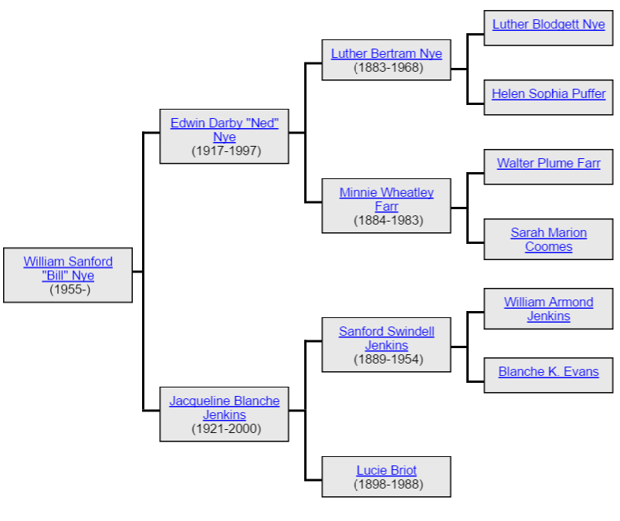
We can use inheritance to create a new class from an existing class
Specialised object has all the characteristics of the general object plus unique characteristics
Inheritance in code is similar to family trees:
The traits of the parent are inherited by the child
Notes:
Python supports multiple inheritance, however this is beyond the scope of CP1404!

Slide 9
Inheritance is an “is a” relationship
General / base class / parent class / superclass
Specialised / derived class / child class / subclass
An extended class inherits attributes and methods of the superclass
New attributes and methods can be added

Slide 10
Inheritance is an “is a” relationship
Rectangle is a Shape
Daisy is a Flower
Elf is a Character
The following are NOT examples of inheritance: Wheel is a Car, Leg is a Person, Band is a Musician…
These are composition… the "has a" relationship: Car has a Wheel, Person has a Leg, Band is composed of Musicians
We might say "Bob is a Person", but Bob is just an instance

Slide 11
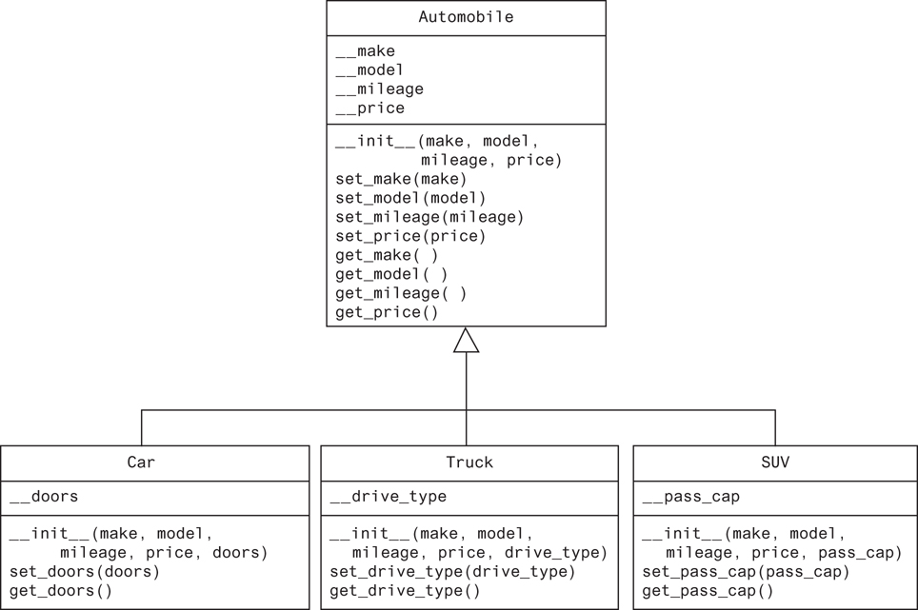
UML (Unified Modelling Language) can be used to show class relationships
Inheritance is shown with an open arrowhead from subclass to superclass
Notes:
Direction is how you say it, "subclass is a superclass"

Slide 12
Let's write some (inherited) classes

Slide 13
How do we define a subclass in Python?
To indicate inheritance, the superclass name is placed in parentheses after subclass name
class Car(Automobile):
The constructor of a subclass calls the constructor of the superclass and then initialises the new data attributes
Add new method definitions for new methods
Override (replace) method definitions for special versions of existing methods

Slide 14
Here's a class that represents a “shape”
class Shape:
def __init__(self, x=0, y=0):
self.x = x
self.y = y
def move(self, x_amount, y_amount):
self.x += x_amount
self.y += y_amount
def __str__(self):
return f"Shape at ({self.x}, {self.y})"
Notes:
Note: since we are not using underscore (e.g. _x), this code implies to the reader that the member fields are not to be treated as hidden inside the class

Slide 15
Here's how we might use this new type...
from shape import Shape
shape = Shape(0, 0)
shape.move(10, 10)
print(shape) # displays "Shape at (10, 10)"

Slide 16
Rectangle is a derived version of Shape "Rectangle is a Shape"
from shape import Shape
class Rectangle(Shape):
def __init__(self, x=0, y=0, width=1, height=1):
self.x = x
self.y = y
self.width = width
self.height = height
def area(self):
return self.width * self.height

Slide 17
First bring the base class into scope using import
from shape import Shape
class Rectangle(Shape):
def __init__(self, x=0, y=0, width=1, height=1):
self.x = x
self.y = y
self.width = width
self.height = height
def area(self):
return self.width * self.height

Slide 18
Specify the base class when defining derived class
from shape import Shape
class Rectangle(Shape):
def __init__(self, x=0, y=0, width=1, height=1):
self.x = x
self.y = y
self.width = width
self.height = height
def area(self):
return self.width * self.height
Notes:
“object” is the default base class, if none specified

Slide 19
The derived __init__ method defines new fields in addition to the existing fields
from shape import Shape
class Rectangle(Shape):
def __init__(self, x=0, y=0, width=1, height=1):
self.x = x
self.y = y
self.width = width
self.height = height
def area(self):
return self.width * self.height

Slide 20
New methods can be created in a derived class
from shape import Shape
class Rectangle(Shape):
def __init__(self, x=0, y=0, width=1, height=1):
self.x = x
self.y = y
self.width = width
self.height = height
def area(self):
return self.width * self.height
Notes:
Why didn't we have the area function in Shape?
This naming style: "area" is a noun so it sounds like a field, but is really a method... is not uncommon. It's a bit like len() or upper() (instead of get_length or get_upper)

Slide 21
Base class methods are automatically available for instances of the derived class
from rectangle import Rectangle
rectangle = Rectangle(0, 0, 3, 2)
rectangle.move(5, 15)
print(rectangle) # displays "Shape at (5, 15)"
print(rectangle.area()) # displays 6

Slide 22
A single base class can be used to create any number of derived classes
from math import pi
from shape import Shape
class Circle(Shape):
def __init__(self, x=0, y=0, radius=1):
self.x = x
self.y = y
self.radius = radius
def area(self):
return self.radius ** 2 * pi
Rectangle, Circle, Triangle, Square, ...

Slide 23
You can inherit multiple levels
You can extend classes that extend other classes… and build an inheritance hierarchy
Anything you add to a base class is inherited all the way down
Physical Object
Living thing
Inanimate Object
Stone
Asteroid
Mammal
Insect
Cat
Dog
Bee

Slide 24
Student is a Person
Also has an id and a course

Slide 25
Inheritance allows reuse, saves duplication
Superclass code contains general code that is applicable to multiple subclasses
Subclasses use superclass code (via sharing) but specialise code for themselves when necessary
Any improvements made to the superclass are inherited by all subclasses

Slide 26
Normal method calls are called bound methods
Bound methods have an instance in front of the method call and automatically pass self
my_car = Car(180) my_car.drive(30)
my_car is an instance, so the method is bound

Slide 27
Unbound methods are uncommon
It is possible to call a method without Python binding self. In that case, the programmer does it explicitly.
my_car = Car(180) Car.drive(my_car, 30)
self is passed explicitly (here as my_car)
Do NOT use unbound methods unless you have to
E.g., use name.upper() not str.upper(name)

Slide 28
Do we ever use unbound methods?
When we create a specialised subclass, we want to ensure that we initialise our new class instances the way they are supposed to, by calling __init__ of the super class
class SubClass(SuperClass):

Slide 29
Why call the super class init?
If we don't explicitly say so, our class may inherit stuff from the super class, but we must make sure we call it in the proper context. For example, our __init__ would be:
class SubClass(SuperClass): def __init__(self): SuperClass.__init__(self) # do anything special to SubClass
Notes:
Note that here we are subclassing a builtin class

Slide 30
Explicit calls to the super in the subclass
We explicitly call the super class constructor using an unbound method
Then, after it completes, we can do anything special for our new class
We specialise the new class but inherit most of the work from the super
Notes:
Why not? Because no instance of the super class exists here.

Slide 31
Before: repeating ourselves
DRY = Surely there's a better way?
class Circle(Shape):
def __init__(self, x=0, y=0, radius=1):
self.x = x
self.y = y self.radius = radius
def area(self):
return self.radius ** 2 * pi

Slide 32
Use super() to simplify derived class __init__
super() returns a proxy object that delegates method calls to the parent
This is useful for accessing inherited methods that have been overridden in a class
class Circle(Shape):
def __init__(self, x=0, y=0, radius=1):
super().__init__(x, y)
self.radius = radius
def area(self):
return self.radius ** 2 * pi
Notes:
super() can also be used in any derived class method to give you access to the base class
super() returns a proxy object that delegates method calls to a parent or sibling class of type. This is useful for accessing inherited methods that have been overridden in a class.

Slide 33
Use **kwargs to further simplify derived __init__
Instead of passing positional arguments explicitly, we can pass all arguments using **kwargs
kwargs = keyword arguments = a dictionary of all the arguments
class Circle(Shape):
def __init__(self, radius=1, **kwargs): super().__init__(**kwargs) self.radius = radius c = Circle(x=3, y=4, radius=5)
Notes:
In the previous example, we passed x, y as positional arguments because we knew the form of the parent constructor (and it wouldn't change)
Here, we pass all arguments we get passed on to the parent class constructor
Note that we now specify the arguments by name in the call

Slide 34
Let's update our derived (from Person) classes

Slide 35
Do this now - create the following classes
Employee - derived from Person
also has salary attribute
Musician - derived from Person
also has style attribute and play(duration) method

Slide 36
All new classes inherit everything from object

Slide 37
What is x.y ?
Look for the attribute (y) in the object (x)
If not in the object, look to the object's class for the attribute
If not in the object's class, look up the hierarchy (parent classes) for the attribute
If you hit object and it's not there, then the attribute does not exist, so raise an exception

Slide 38
Inheritance gives us a way to organise code
Reuse
Use code from super classes (without rewriting) to get that behaviour in our class.
Override
change super class behavior to be specific to a subclass
Specialise
A subclass can inherit code from its superclass, but modify anything that is particular to that subclass

Slide 39
Polymorphism allows us to treat similar classes similarly
If you have a list of objects that are not all the same type (class), but they all have the same method name defined, you can call that method on each element in the exact same way:
performers = [dancer, comedian, musician] for performer in performers: performer.perform()
Each performer is an object of a different class.
perform() does different things for each class.

Slide 40
Notes:
Each alien might be a different subclass, but all behave similarly

