Slide 1


Clinical Research
at the Cutting Edge
Scaling Family Systems Research with Machine Intelligence
Presentation 3 of 5
Notes:
TITLE SLIDE
"Clinical Research at the Cutting Edge"
Presentation 3 of 5. Duration: 45 minutes (11:15-12:00).
Format: Conversational, low resolution, room for questions throughout.
Follows: SARF Intro (framework) and Why Family (catastrophes).

Slide 2
I
Connecting to
This Morning
5 minutes
Notes:
SECTION I: CONNECTING TO THIS MORNING (5 min)

Slide 3

Without measurement, we can't tell
when we're making it worse.
Harmful Practices
Unchecked Beliefs
No Accountability
Practices that harmed the people they intended to help
Professions swept up in beliefs that destroyed lives
No one asked: "What if this is making things worse?"
Cambridge-Somerville Study: Caring intervention. Treatment group had more crime, more addiction, earlier death.
Notes:
WITHOUT MEASUREMENT, WE CAN'T TELL WHEN WE'RE MAKING IT WORSE.
This morning we saw:
- Practices that harmed the people they intended to help
- Professions swept up in beliefs that destroyed lives
- No one asked: "What if this is making things worse?"
Cambridge-Somerville: Caring intervention. Treatment group had more crime, more addiction, earlier death.
"How would we know?"
This presentation is the answer to that question.

Slide 4
II
The Scaling
Problem
10 minutes
Notes:
SECTION II: THE SCALING PROBLEM (10 min)

Slide 5


Big Data vs. Small Data
Big Data
Small Data
Millions of records
Simple variables
Machine-readable
Insurance claims, lab results
Rich qualitative information
Requires interpretation
Requires intelligent inference
Clinical interviews, family history
Our problem is small data.
Notes:
BIG DATA VS. SMALL DATA
Big Data: Millions of records, simple variables, machine-readable (insurance claims, lab results).
Small Data: Rich qualitative information, requires interpretation, requires intelligent inference (clinical interviews, family history).
Our problem is small data.
THE CODING PROBLEM: To test SARF, someone has to code cases—read/listen to clinical interviews, identify shifts in S, A, R, F, record them on a timeline. Previously: humans doing this tediously, by hand.

Slide 6


Why This Research Never Happened
Hypothetical model with simple but deep concepts
Requires skilled human coders
Coding doesn't scale
Can't get funding without someone's day job
The bottleneck was human coding capacity.
Notes:
WHY THIS RESEARCH NEVER HAPPENED
- Hypothetical model with simple but deep concepts
- Requires skilled human coders
- Coding doesn't scale
- Can't get funding or momentum unless it's someone's day job
The bottleneck was human coding capacity.

Slide 7



What Changed
Machine automation now makes intelligent inference possible at scale.
Generate
Test
Iterate
Synthetic clinical discussions for training
Automated coding against human judgment
Faster than ever before
We built this.
Notes:
WHAT CHANGED
Machine automation now makes intelligent inference possible at scale.
- Generate synthetic clinical discussions for training
- Test automated coding against human judgment
- Iterate faster than ever before
"We built this."

Slide 8
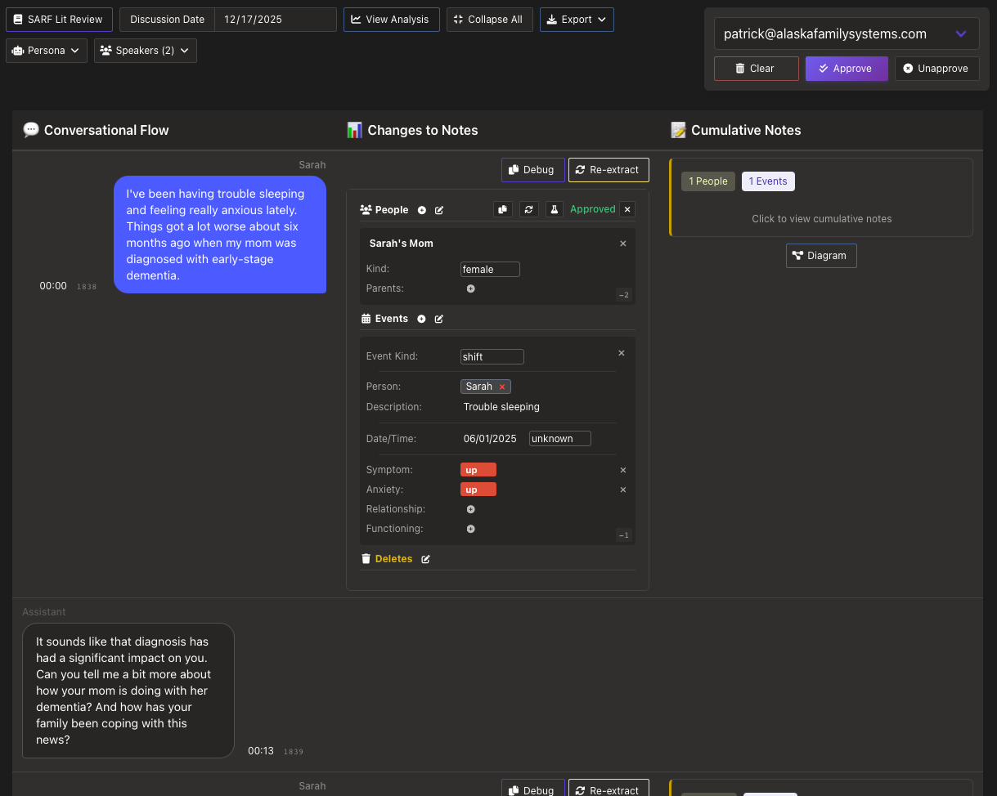
SARF Editor
Notes:
SARF EDITOR
Screenshot of the SARF coding editor interface. This is the tool used to code cases — identify shifts in S, A, R, F and record them on a timeline.
This is what made the research possible. Machine automation now makes intelligent inference possible at scale.

Slide 9
III
Domain-Expert
Ground Truth
10 minutes
Notes:
SECTION III: DOMAIN-EXPERT GROUND TRUTH (10 min)

Slide 10
Ground Truth = What the Experts Agreed On
1
Train
2
Code Blindly
Human experts learn SARF coding
Independent coding of cases
3
Measure Agreement
4
Ground Truth
Inter-Rater Reliability (IRR)
Cases where experts agree
The humans set the standard.
Notes:
GROUND TRUTH = WHAT THE DOMAIN EXPERTS AGREED ON
1. Train human experts on SARF
2. Have them code cases independently (blind)
3. Measure agreement (Inter-Rater Reliability)
4. Cases where they agree = ground truth
"The humans set the standard."
WHY GROUND TRUTH MATTERS: The machines don't decide what's correct. Humans do. Software learns to replicate human expert judgment. Every output can be reviewed and corrected. Domain experts remain the authority.
"Ground truth is human truth."

Slide 11
The Killer Combo: IRR + AI
All AI needs is IRR.
What AI Requires | What IRR Provides
Labeled examples | Human-coded cases
Consistent labels | Agreement-verified coding
Scale | Growing database
IRR + AI = the breakthrough.
Notes:
THE KILLER COMBO: IRR + AI
"All AI needs is IRR."
What AI Requires → What IRR Provides:
Labeled examples → Human-coded cases
Consistent labels → Agreement-verified coding
Scale → Growing database
A dataset with sufficient agreement IS ground truth.
"IRR + AI = the breakthrough."

Slide 12
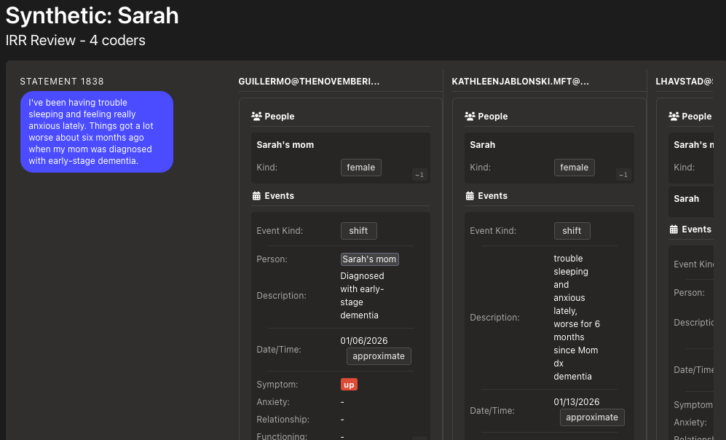
IRR Review
Notes:
IRR REVIEW
Screenshot of the Inter-Rater Reliability review interface. This is where human expert codings are compared — measuring agreement between independent coders.
Cases where experts agree become ground truth. The humans set the standard.

Slide 13
IV
Discoveries
10 minutes
Notes:
SECTION IV: DISCOVERIES (10 min)

Slide 14


Key Discoveries
Mutual Discovery
Synthetic Data Trains Faster
You can't survey for this data like a knee problem.
Real recordings are the goal. Synthetic data accelerates getting there.
Therapist must be in mutual discovery with client
Not extracting answers—exploring together
The relationship affects what emerges
Working group learned SARF coding faster on synthetic data
Cleaner examples with known ground truth
Faster iteration cycles
Notes:
KEY DISCOVERIES
MUTUAL DISCOVERY: You can't survey for this data like a knee problem. The therapist must be in mutual discovery with the client. Not extracting answers—exploring together. The relationship affects what emerges. "If you just interrogate, you don't get the data you need."
SYNTHETIC DATA TRAINS FASTER: Working group learned SARF coding faster on synthetic data than real cases. Cleaner examples, known ground truth, faster iteration. "Real recordings are the goal. Synthetic data accelerates getting there."

Slide 15
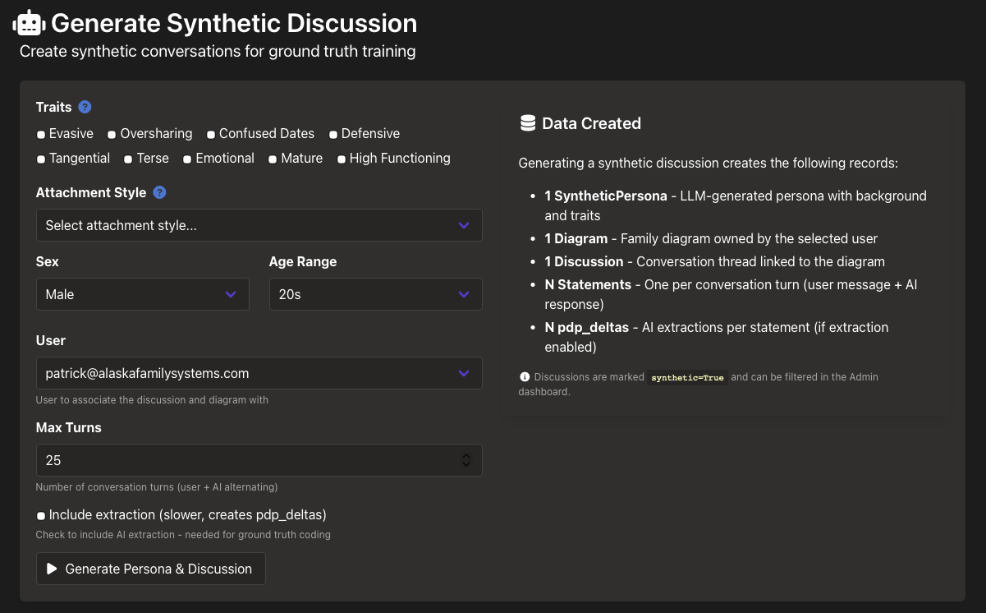
Synthetic Data
Notes:
SYNTHETIC DATA
Screenshot of the synthetic clinical discussion generator. Synthetic data accelerates training — cleaner examples with known ground truth, faster iteration cycles.
Real recordings are the goal. Synthetic data accelerates getting there.

Slide 16
Timelines Cluster by Emotional Salience
Timeline data naturally clusters into ~3–5 notable periods.
The client has a "sampling bias" — they report what's emotionally salient to them
They don't give you an even history; they give you the periods that matter
These clusters typically follow a nodal/triggering event
The clustering itself is the emotional process — you don't have to know what to look for
The client's own selection bias is the data.
Notes:
DISCOVERY: TIMELINES CLUSTER BY EMOTIONAL SALIENCE
Timeline data naturally clusters into ~3-5 notable periods.
- The client has a "sampling bias"—they report what's emotionally salient to them
- They don't give you an even history; they give you the periods that matter
- These clusters typically follow a nodal/triggering event
- The clustering itself IS the emotional process—you don't have to know what to look for
"The client's own selection bias is the data."

Slide 17
The Responsibility Pattern
Two 45-minute interviews. Person sees for the first time:
Pattern of constantly picking up responsibility
Saying yes to everything, no filter
Anxiety going up and up
No downs.
Just seeing the data organized was the breakthrough.
Notes:
THE RESPONSIBILITY PATTERN
Two 45-minute interviews. Person sees for the first time:
- Pattern of constantly picking up responsibility
- Saying yes to everything, no filter
- Anxiety going up and up
- No downs.
"Just seeing the data organized was the breakthrough."

Slide 18
V
What Becomes
Possible
5 minutes
Notes:
SECTION V: WHAT BECOMES POSSIBLE (5 min)

Slide 19
Two Eras
Era 1: AI Learns from Humans
Era 2: AI Discovers Patterns
IRR establishes ground truth
AI replicates what humans agreed on
Scales human judgment
Ground truth database accumulates
AI finds correlations humans couldn't see
New hypotheses for humans to test
▶
We're building Era 1. Era 2 follows.
Notes:
TWO ERAS
Era 1: AI Learns from Humans — IRR establishes ground truth, AI replicates what humans agreed on, scales human judgment.
Era 2: AI Discovers New Patterns — Ground truth database accumulates, AI finds correlations humans couldn't see, new hypotheses for humans to test.
"We're building Era 1. Era 2 follows."

Slide 20
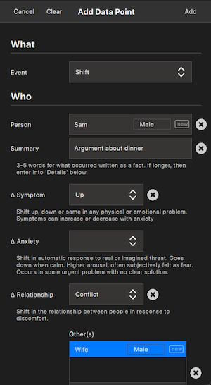
Pro App — Add Data
Notes:
PRO APP — ADD DATA
Screenshot of the Pro app's data entry form. This is what clinicians use to code cases — the single coding form that feeds everything downstream.
Design the data model right, and everything else falls into place.

Slide 21


If This Works
Certification
Standardized Training
Objective competency testing — compare trainee coding to ground truth
Measurable outcomes, curriculum based on validated method
Aggregate Research
Tooling
Data across practitioners, statistical patterns emerge
Vertically integrated pro/personal app ecosystem, novel clinical model
Design the data model right, and everything else falls into place.
Notes:
IF THIS WORKS
- Certification: Objective competency testing—compare trainee coding to ground truth
- Standardized training: Measurable outcomes, curriculum based on validated method
- Aggregate research: Data across practitioners, statistical patterns emerge
- Tooling: Vertically integrated pro/personal app ecosystem, novel clinical model
WHY IT SCALES (VERTICAL ALIGNMENT): One simple coding form gives you everything. Design the data model right, and everything else falls into place.
GETTING INVOLVED: "More on this at day's end." This needs people: clinicians testing the model, researchers contributing cases, developers building tools.

Slide 22
VI
Honest State
+ Close
5 minutes
Notes:
SECTION VI: HONEST STATE + CLOSE (5 min)

Slide 23
Where We Are
Early stage. Showing the process.
Tool | Status
Pro App | Released — timeline + diagram
Personal App | In development — structured intake
IRR System | In use — research infrastructure
First IRR Meeting | Next week
Synthetic Data | Working
Real Recordings | Exploring
This is what real R&D looks like.
Notes:
WHERE WE ARE
Early stage. Showing the process.
- Pro App: Released — timeline + diagram
- Personal App: In development — structured intake
- IRR System: In use — research infrastructure
- First IRR meeting: next week
- Synthetic data: working
- Real recordings: exploring
"This is what real R&D looks like."

Slide 24


The Human Remains Central
Ground truth is set by domain experts
Software replicates human judgment
Every output reviewable and correctable
Technology scales. Humans validate.
Notes:
THE HUMAN REMAINS CENTRAL
- Ground truth is set by domain experts
- Software replicates human judgment
- Every output reviewable and correctable
"Technology scales. Humans validate."
KEY LINES FOR THE DAY:
"Without measurement, we can't tell when we're making it worse."
"All AI needs is IRR."
"The machines don't decide what's correct. Humans do."
"Design the data model right, and everything else falls into place."

Slide 25
Clinical Research
at the Cutting Edge
alaskafamilysystems.com
This needs people: clinicians testing the model,
researchers contributing cases, developers building tools.
Notes:
CLOSING
alaskafamilysystems.com
This needs people: clinicians testing the model, researchers contributing cases, developers building tools.
RISKS TO WATCH:
- Redundancy with Pres 5: this version is institutional outcomes; Pres 5 centers on the experience of thinking differently
- Too technical: keep low resolution, use analogies, leave room for questions
- Pitch-y on tools: keep tools secondary to the research story

