Slide 1
SE101: 2018-09-18
Engineering Disasters

Slide 2
This Week’s LKML News
Linus Torvalds wrote this Sunday (16 Sep 2018):
[...]
“This is my reality. I am not an emotionally empathetic kind of person and that probably doesn't come as a big surprise to anybody. Least of all me. The fact that I then misread people and don't realize (for years) how badly I've judged a situation and contributed to an unprofessional environment is not good.
https://lore.kernel.org/lkml/CA+55aFy+Hv9O5citAawS+mVZO+ywCKd9NQ2wxUmGsz9ZJzqgJQ@mail.gmail.com/

Slide 3
This Week’s LKML News
This week people in our community confronted me about my lifetime of not understanding emotions. My flippant attacks in emails have been both unprofessional and uncalled for. Especially at times when I made it personal. In my quest for a better patch, this made sense to me. I know now this was not OK and I am truly sorry.

Slide 4
This Week’s LKML News
The above is basically a long-winded way to get to the somewhat painful personal admission that hey, I need to change some of my behavior, and I want to apologize to the people that my personal behavior hurt and possibly drove away from kernel development entirely.”

Slide 5
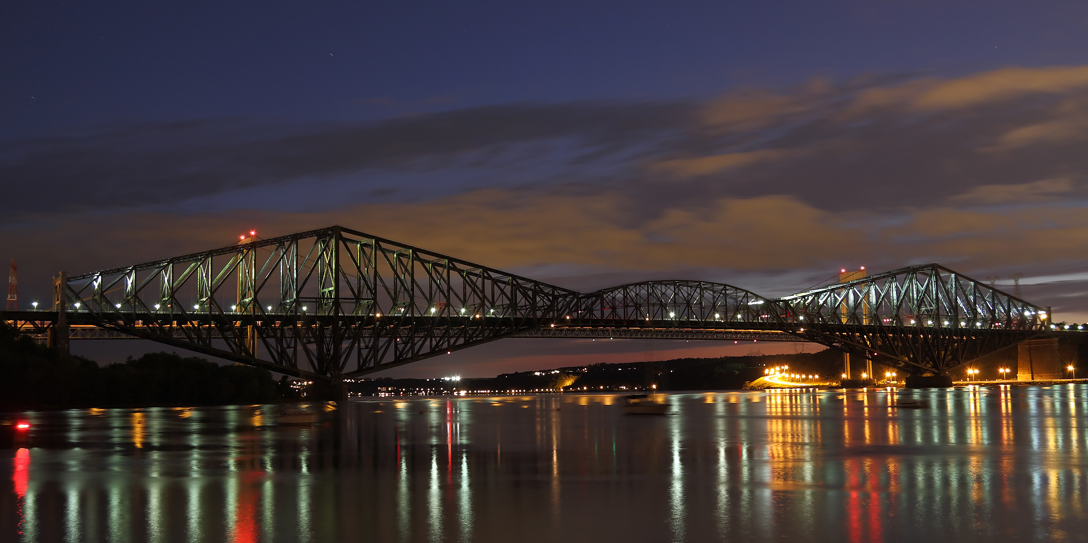
Pont de Québec
credit: Canonnica, Wikimedia Commons, CC BY-SA 3.0

Slide 6
Quebec City Bridge
549m between piers, 987m total length
Longest cantilever bridge in the world (still)
Was longest bridge in the world until 1929
National Historic Site of Canada (1995)

Slide 7
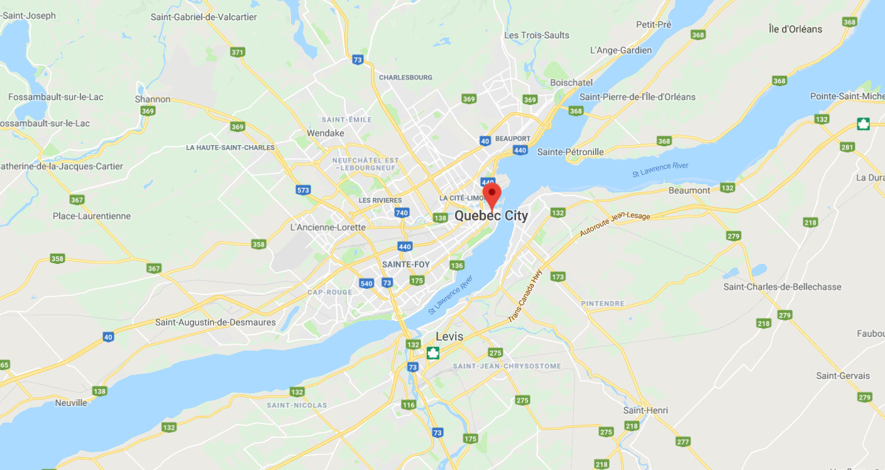
Google Maps

Slide 8
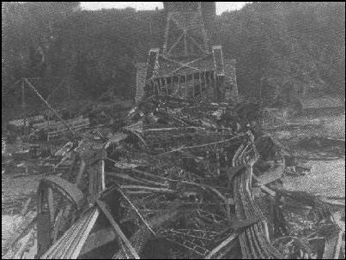
Quebec City Bridge, 1907

Slide 9
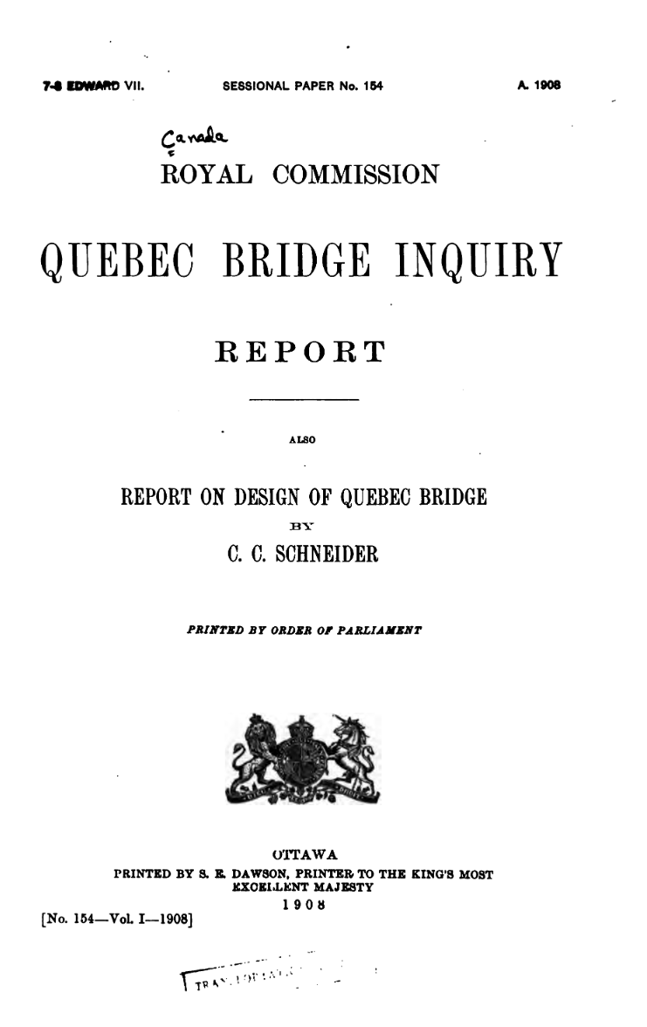

Slide 10
Royal Commission Conclusions
Causes of the collapse:
  “Failure of the lower chords in the anchor arm near main pier... due to their defective design”
  “Failure cannot be attributed directly to any cause other than errors in judgment on the part of engineers [Cooper and Szlapka]”

Slide 11
Royal Commission Conclusions
  “The ability of the two engineers was tried in one of the most difficult professional problems of the day and proved to be insufficient for the task.”
  “The failure to appoint an experienced bridge engineer to the position of chief engineer was a mistake.”

Slide 12
What Happened?
  Consulting engineer: Theodore Cooper of New York
    “few equals on the continent”
    worked remotely from New York
    didn’t charge enough to support a staff

Slide 13
Responsibility and Requirements
  Cooper had ultimate responsibility for the bridge.
    [extensive correspondence w/government]
  Changed length of center span from 1600’ to 1800’.

Slide 14
Engineering Calculations
  Load calculations done by engineer
  Peter L. Szlapka
  Actual weight exceeded estimated weight by 8MM lbs
    [bad data informed estimates]
  Cooper gave go-ahead anyway: used safety margin.

Slide 15
What happened on-site
  Chief engineer on-site (EA Hoare) was good manager, but not an experienced bridge engineer.
  Workers observed misalignment in chord splices.
    (on several occasions)
  Final stop-work order didn’t make it in time.

Slide 16
Bridge Collapse
  Cantilever arm and partially-constructed span
  fell into the St. Lawrence River in 15 seconds.
  75 of 86 workmen on-site died,
  33 Mohawk steelworkers from Kanhawake.
  Damage over $1.5MM ($40MM in 2018 dollars)

Slide 17
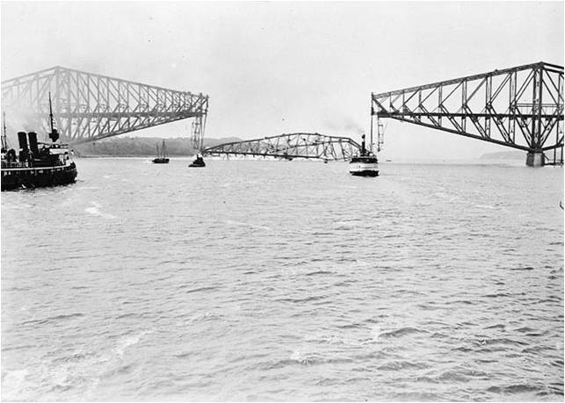
Quebec City Bridge, 1916

Slide 18
Different Day, Different Story
1916 design was still cantilevered and still at 549m.
More steel in plan, plus invention of K-trusses.
100,000 spectators for span-raising day.

Slide 19
Second Failure
While lifting the span,
it broke off its supports and fell into the river.
13 worker deaths, 14 injuries.
Cause:
Failure of the concrete in the erection equipment.
[First guess—buckled span—was wrong.]

Slide 20
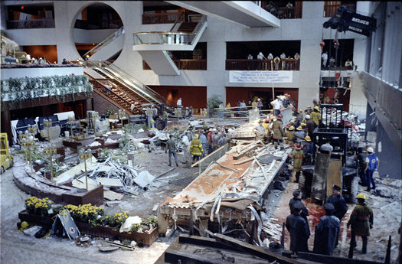
Hyatt Hotel Lobby Walkway, 1981
Worst structural failure in US history
114 fatalities
Builder didn‘t follow design
Engineer failed to supervise
Collapsed on opening day

Slide 21
Eventual success
This time, much less collateral damage.
Plan was still sound.
One year later, bridge successfully completed.
125,000 people came to the span-raising.
credit: Canonnica, Wikimedia Commons, CC BY-SA 3.0

Slide 22
Postscript: Rust
Bridge is currently owned by CN.
Some media reports about rust concerns.
credit: Canonnica, Wikimedia Commons, CC BY-SA 3.0

Slide 23
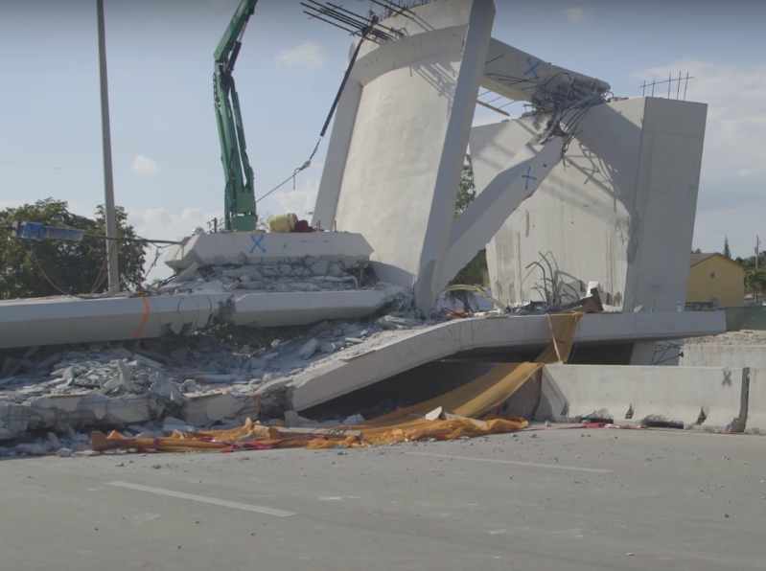
FIU Pedestrian Bridge, March '18
Links Florida Intl U campus
to town of Sweetwater.
Collapsed during construction
4 deaths, 10 injuries.
Under NTSB investigation.

Slide 24
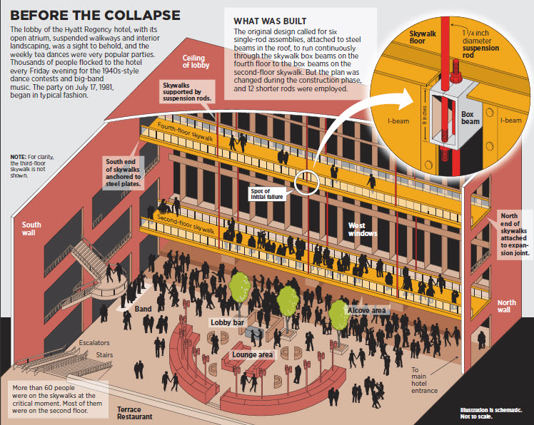
Hyatt Hotel Lobby Walkway (Kansas City), 1981
114 dead,
over 200 injured

Slide 25
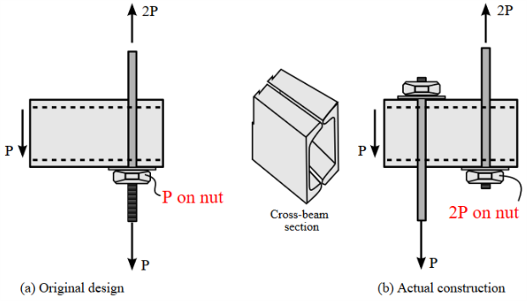
Design Changes
Original Design
Actually Built
Problem: fastener overloaded
(though even original design didn’t meet code)

Slide 26
Communication Issues
Contributing to the disaster:
design changes
poor communications
poor/no calculations
general negligence
No record of consultation re: changes
(maybe approved over phone).

Slide 27

Diagnose: Playground Bubble
What is wrong with this design?
How could it be better?

Slide 28

Bike Bus: a joyous ride to daycare
Seats 6 kids
Fun!
Design flaw ...

Slide 29
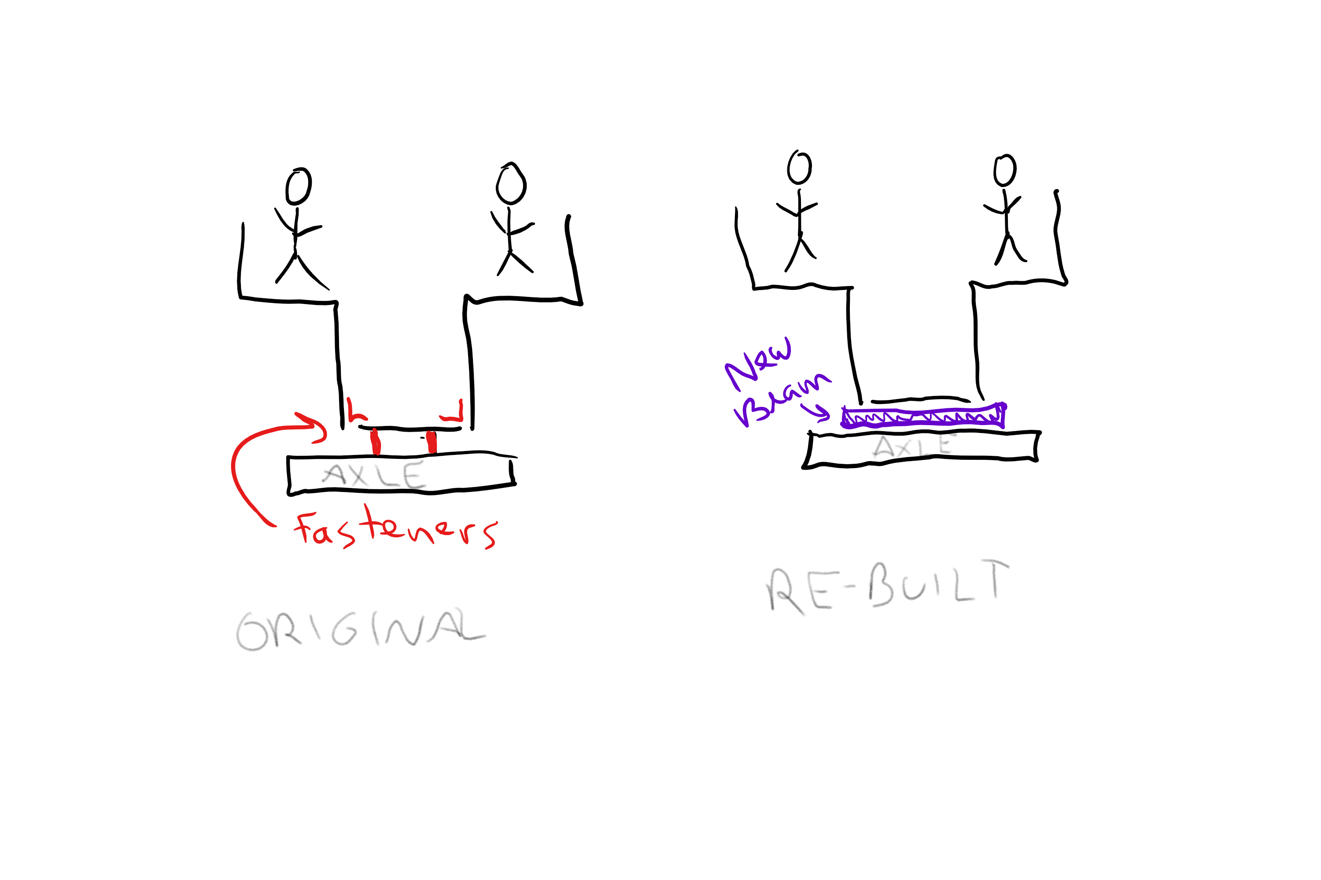
Bike Bus – Original + Re-built

Slide 30
Engineering Mistakes Everywhere
Keep your eyes open
Design it right
Build it right
Analyze
Review
Test
Verify

Slide 31
Software Disasters ...
Concurrency
  Therac 25 radiation machine (1985)
  Power grid 50M people (2003)
Correctness
  Intel Pentium division bug, $500M (1994)
  California releases 450 violent inmates (2011)
  Mars Orbiter (1998)
Data breaches
  Equifax (2017)
  Yahoo (2016)
  Ashley Madison (2015)
  Home Depot (2014)
  Target (2014)
  Etc.

Slide 32
Harms caused by software
Volkswagen scandal
Facebook-mediated election meddling
911 system outages

Slide 33
The Future ...
More software
  Cars
  Stock exchanges
  Businesses
  Government
  Medical devices
  Etc.
You!
  Responsibility
  Professionalism
  Do the right thing

