Slide 1
SE101 Lecture 8:
Volkswagen
Patrick Lam
Thursday, October 25, 2018
https://docs.google.com/presentation/d/1kkzlwOr_mO1XtMRuXe597EvH7_5Nayp0EiMHaOjuoHM/

Slide 2
Context

Slide 3


Slide 4
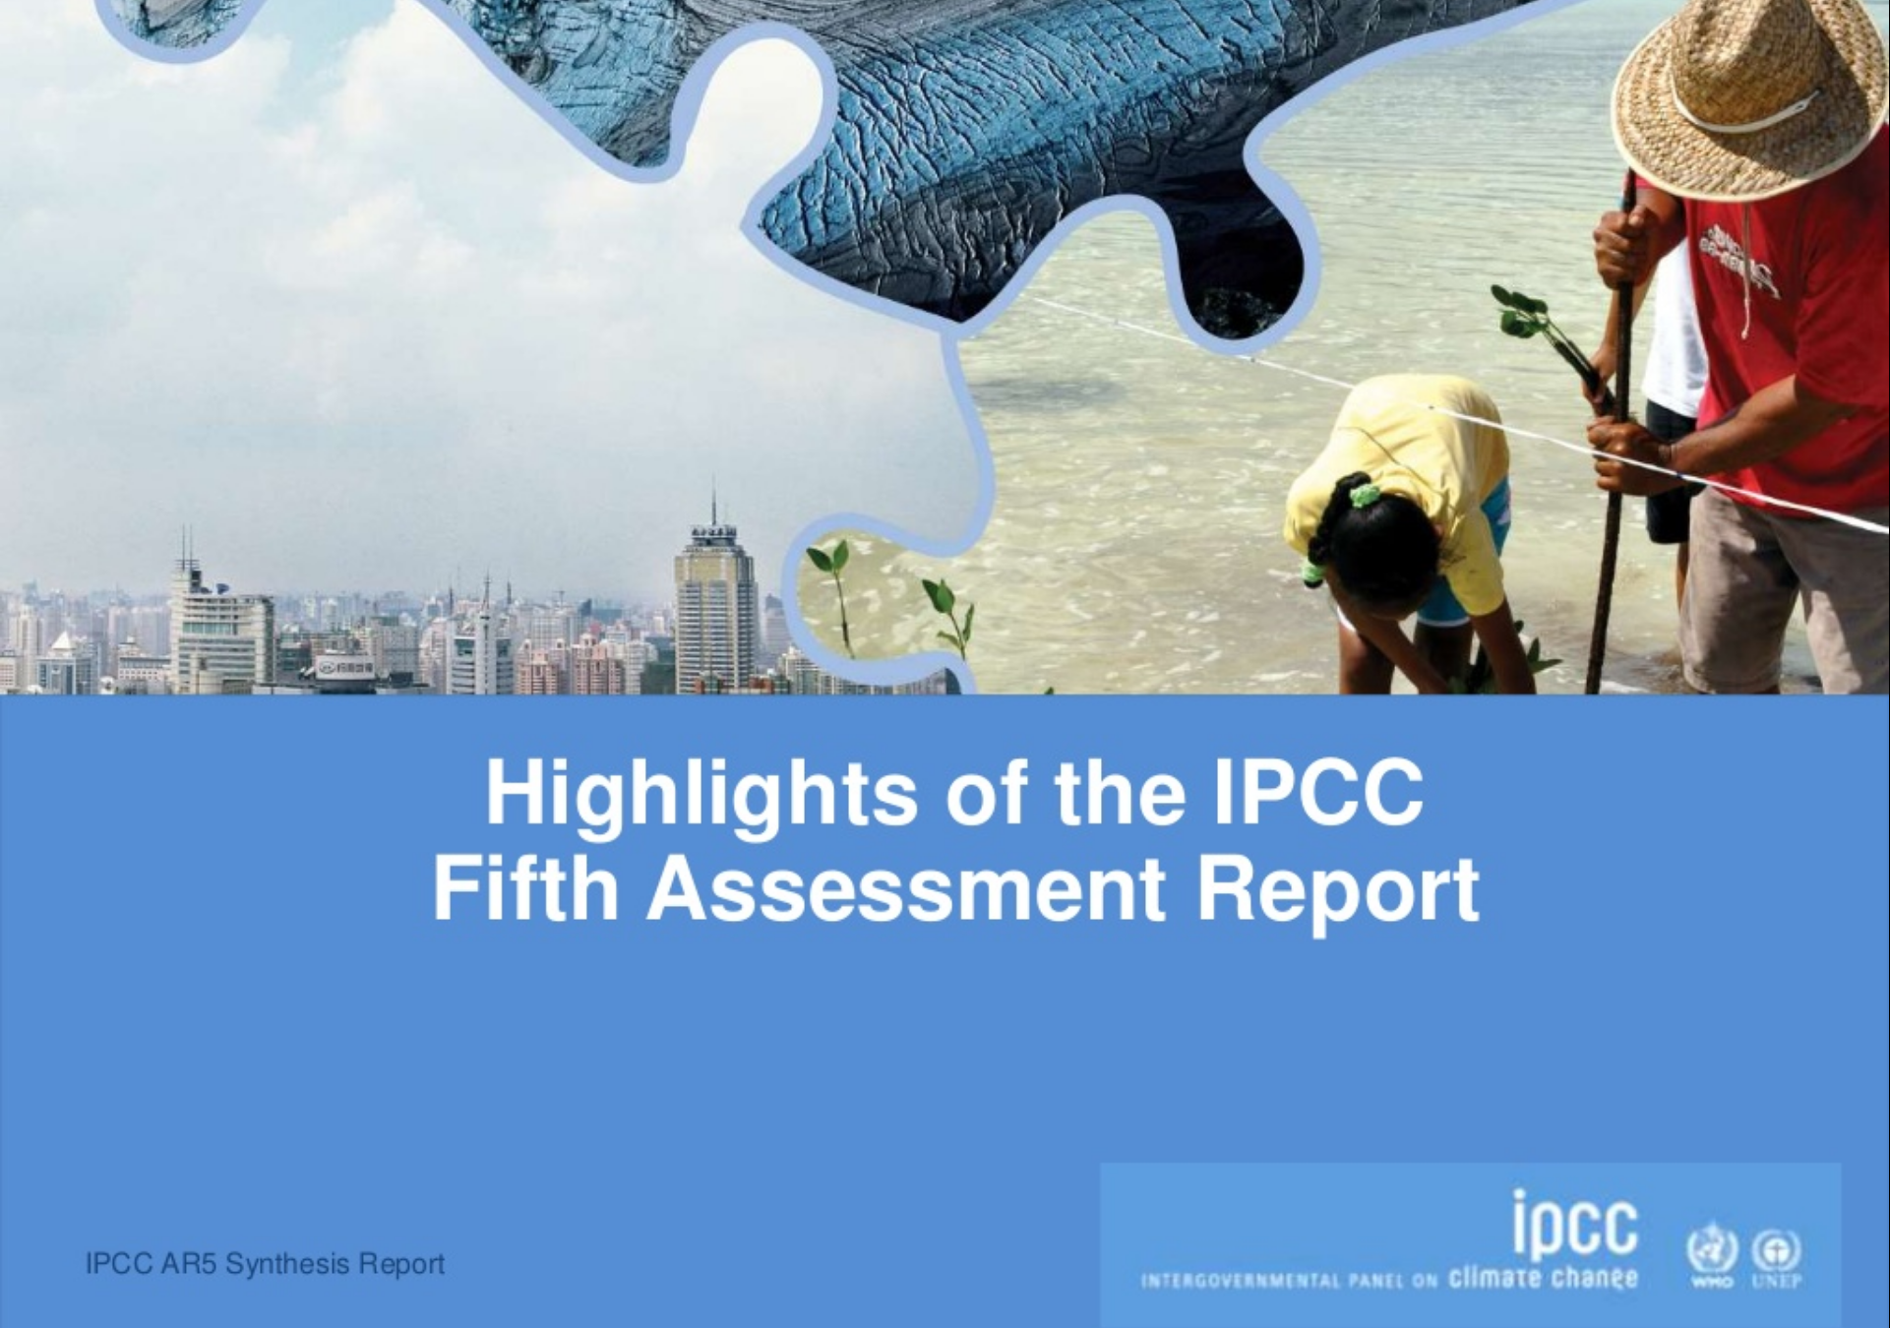

Slide 5
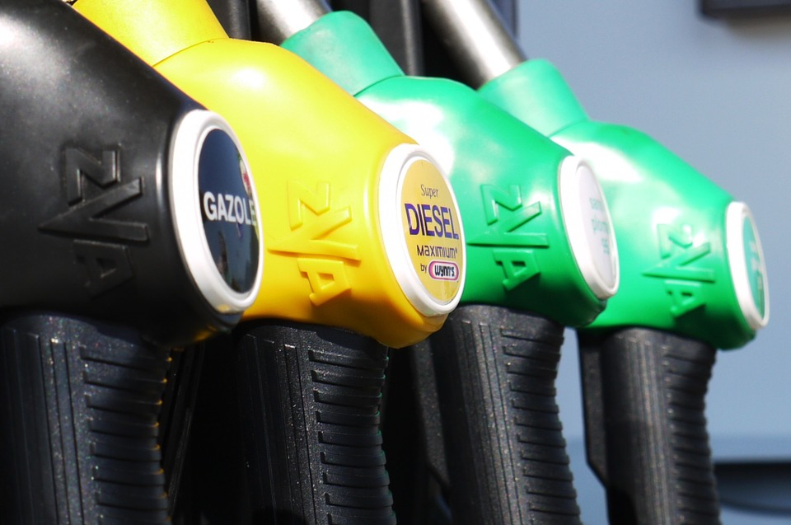
Notes:
https://pixabay.com/en/gasoline-diesel-petrol-gas-fuel-175122/ CC0 no attribution required

Slide 6
Diesel: pluses and minuses
+ 10-20% less CO₂/km
+ more torque
- more NO_{x}
- more PMs (soot)

Slide 7
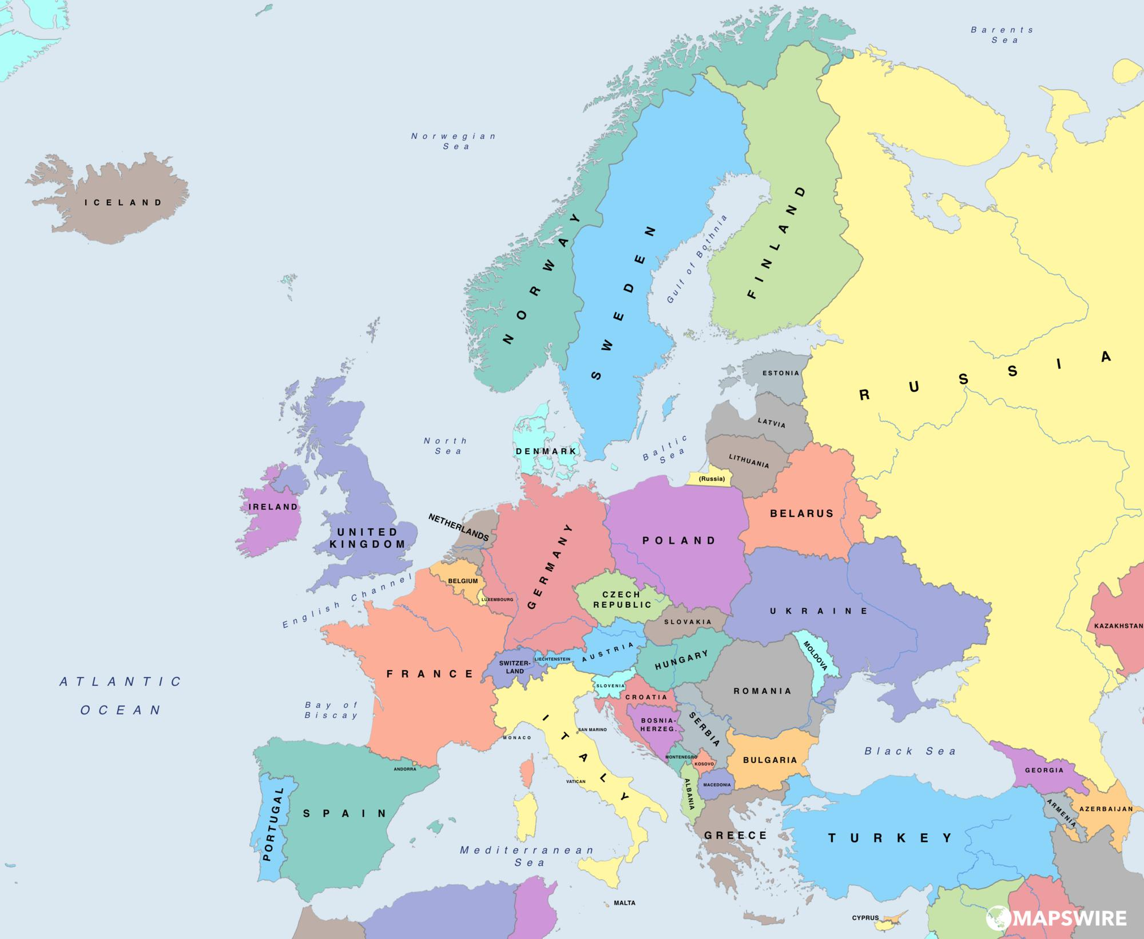
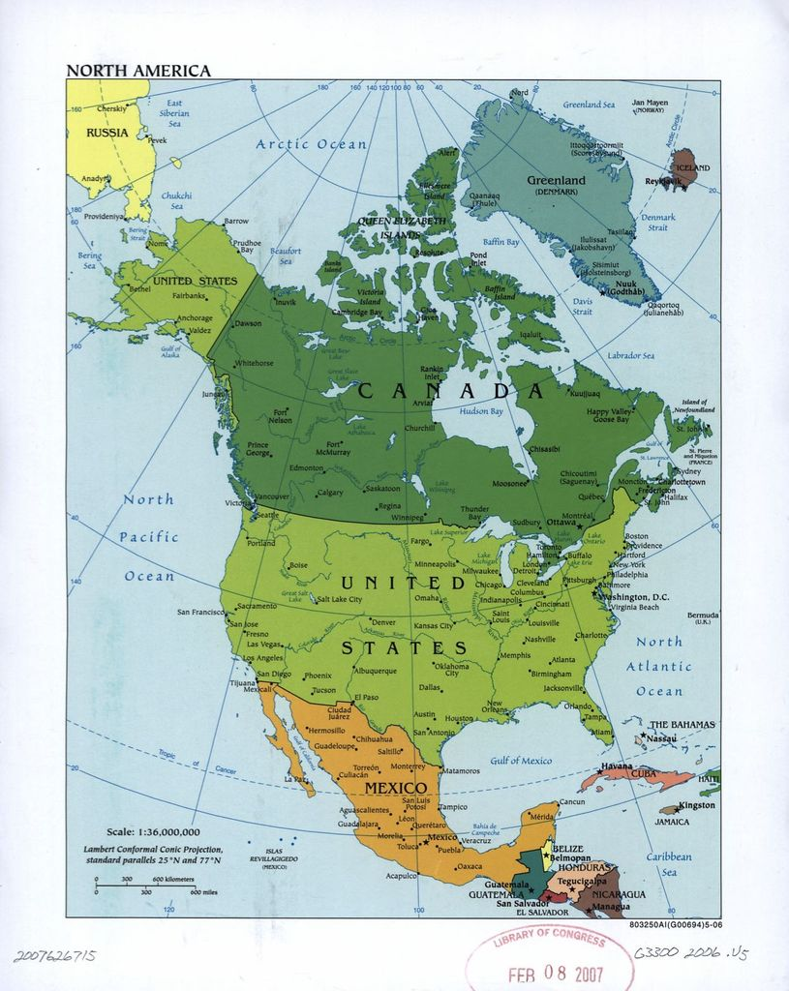
Do People Drive Diesels?
reached 50% of market
peaked at 3% of market
Notes:
https://mapswire.com/europe/political-maps/, CIA World Factbook

Slide 8
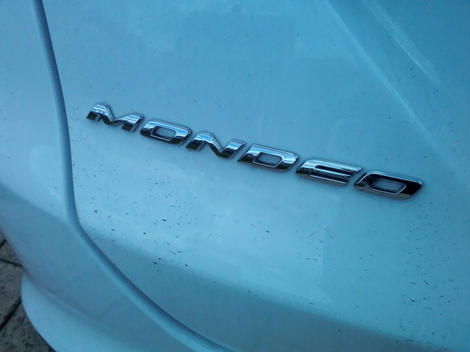
… and yet.
https://notalotofpeopleknowthat.wordpress.com/2015/06/28/black-soot-on-my-car/

Slide 9

Paris also suspicious of diesel...
Mayor Anne Hidalgo called for a ban pre-scandal.

Slide 10
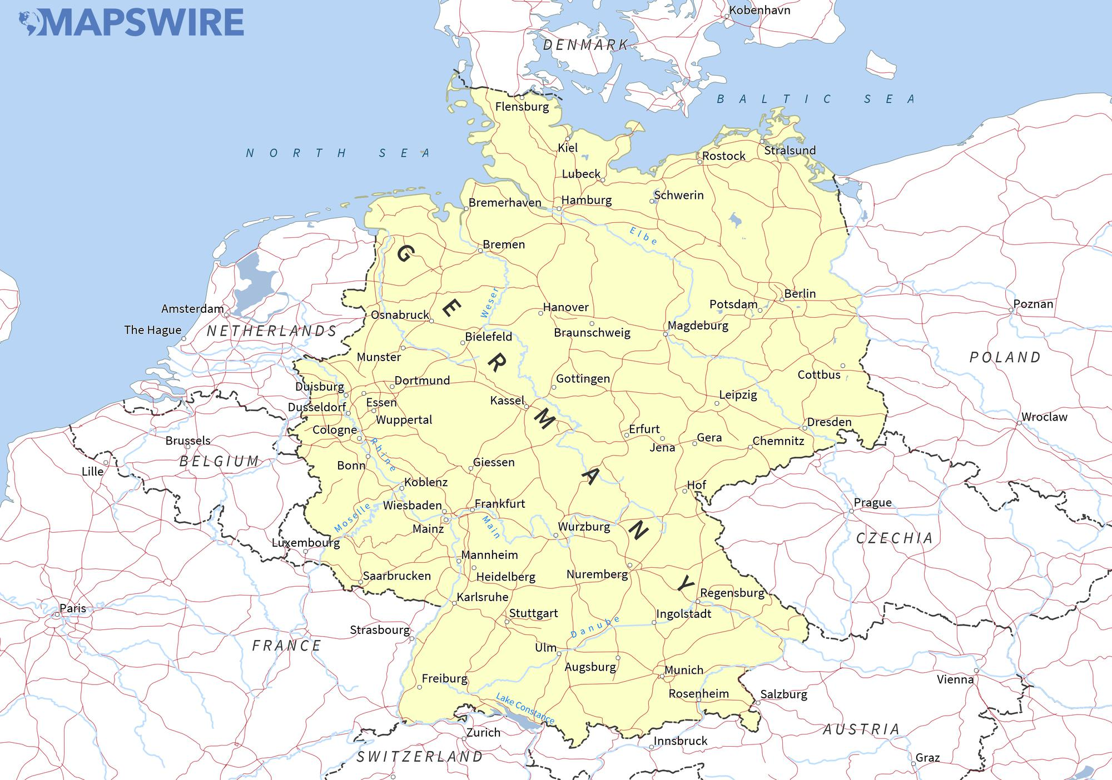
Proposed diesel bans in 2018

Slide 11
The Issue

Slide 12
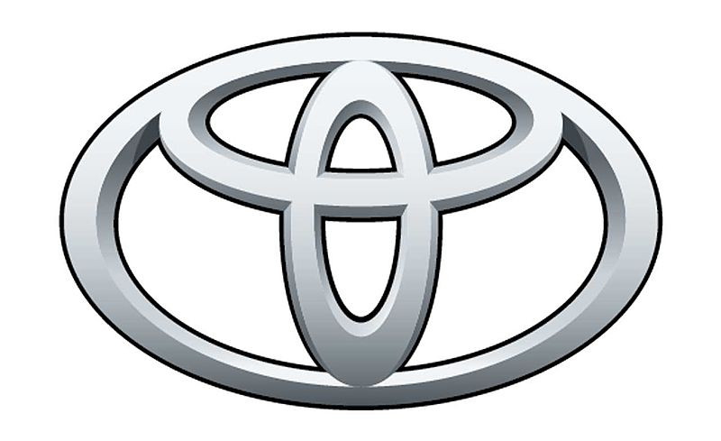
The Goal:
>

Slide 13
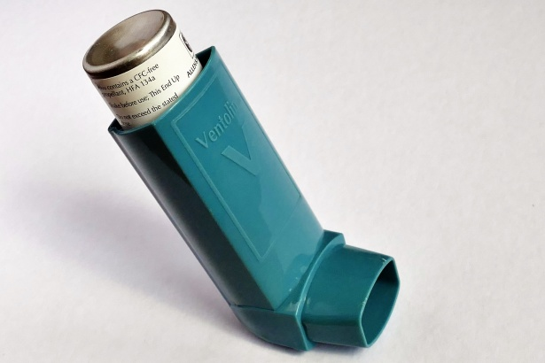
United States Law:
because
NO_{x}
Notes:
https://www.publicdomainpictures.net/en/view-image.php?image=228294&picture=asthma-inhaler public domain

Slide 14
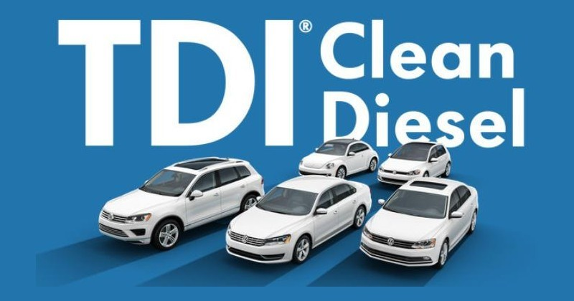

Slide 15
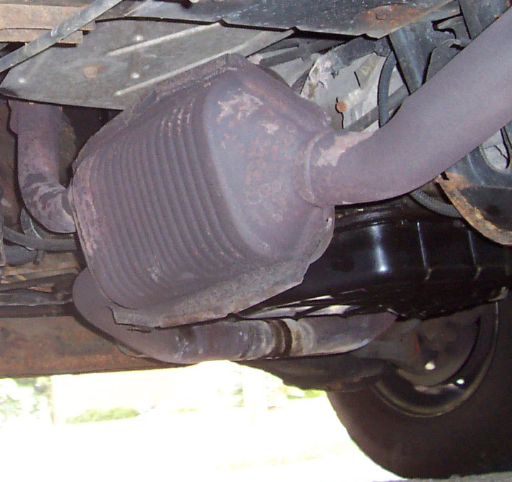
How?
NO_{x}
via
Notes:
https://en.wikipedia.org/wiki/Catalytic_converter#/media/File:DodgeCatCon.jpg

Slide 16
But...
Catalytic converters only work on gas engines!

Slide 17
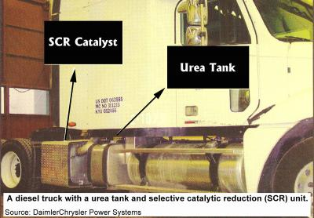
Alternative for diesel: SCR

Slide 18
Engineering Tradeoffs...
Fuel Efficiency
Power
NO_{x}

Slide 19
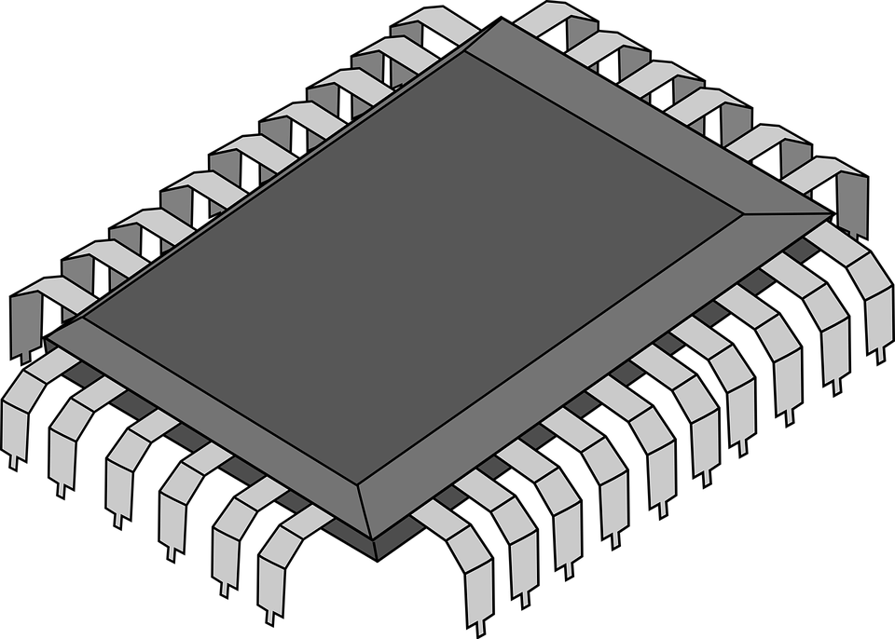
mediated by...
Fuel Efficiency
Power
NO_{x}
(Because it’s 2018!)
Notes:
https://pixabay.com/en/chip-computer-technology-circuit-308574/ CC0

Slide 20
Discovery

Slide 21
How do US cars satisfy emissions rules?
more strict!
less strict

Slide 22
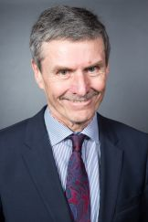
Professor Dr. Ferdinand Dudenhöffer
Hmm...
Notes:
https://www.uni-due.de/car/dudenhoeffer.php

Slide 23
Afterwards:
They must have known that it's impossible, or else it's not possible they have degrees as engineers.

Slide 24


hires
(West Virginia University)

Slide 25

In-Lab
On-Road
✅
❌
5✕-35✕ over target!
✅
✅

Slide 26

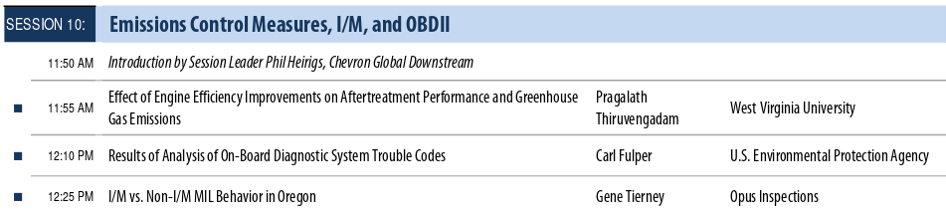

Slide 27
Regulators & Consequences

Slide 28


Slide 29
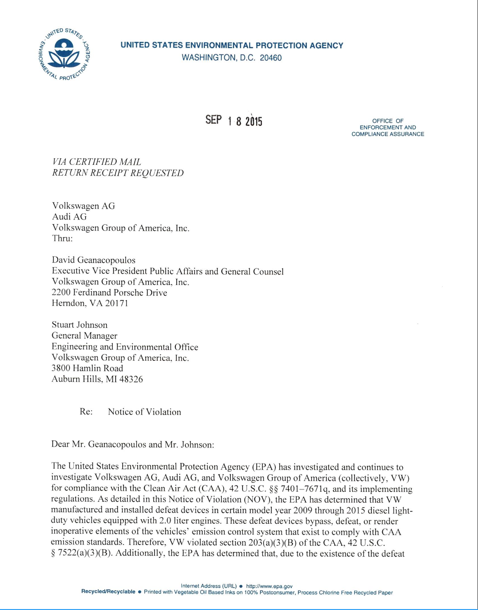

Slide 30
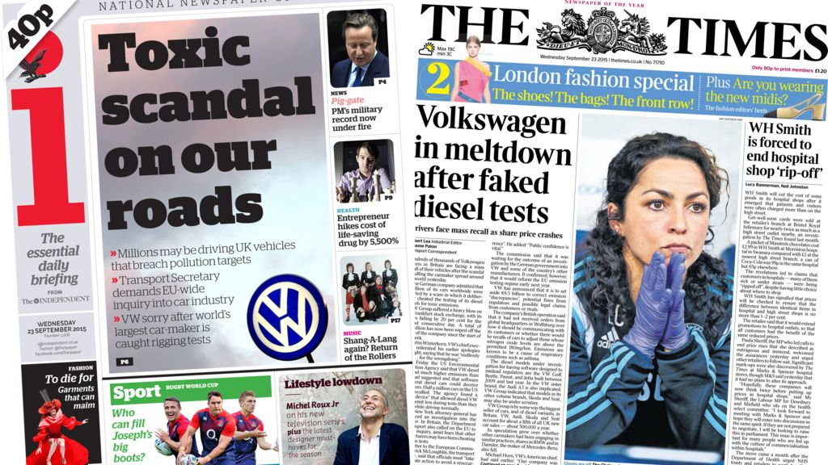
Notes:
http://ichef-1.bbci.co.uk/news/1024/cpsprodpb/2043/production/_85695280_index.jpg

Slide 31
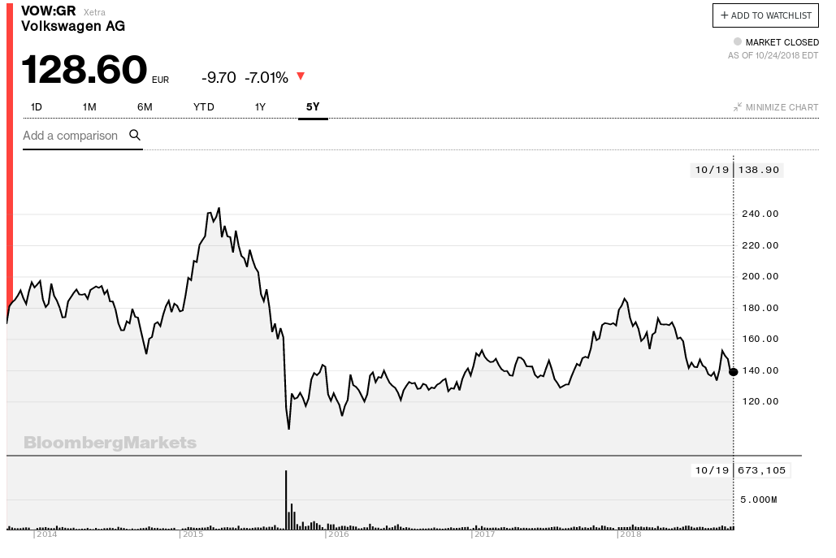
Notes:
sales, new CEO, stock, raids

Slide 32
Engineering Discussion

Slide 33
How?
Software included “dyno calibration mode”:
IF it looks like car is being tested, THEN
↓ emissions, but also
↓ torque and ↓ efficiency
Written by software engineers with
engine designers.

Slide 34
Deeper Causes
Regulators: “objective” testing scheme,
but possible to hack.
Engineering trade-off:
urea tanks vs torque vs fuel efficiency

Slide 35
Deeper Causes
Senior management:
set specifications that were unachievable;
blamed rogue engineers.
VW is engineering focussed; claims of rogue engineers not credible.

