Slide 1
SE101: 2018-11-06
Quest 3: Dynamic

Slide 2
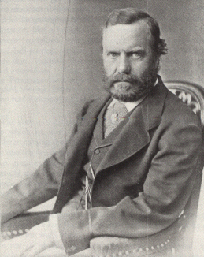
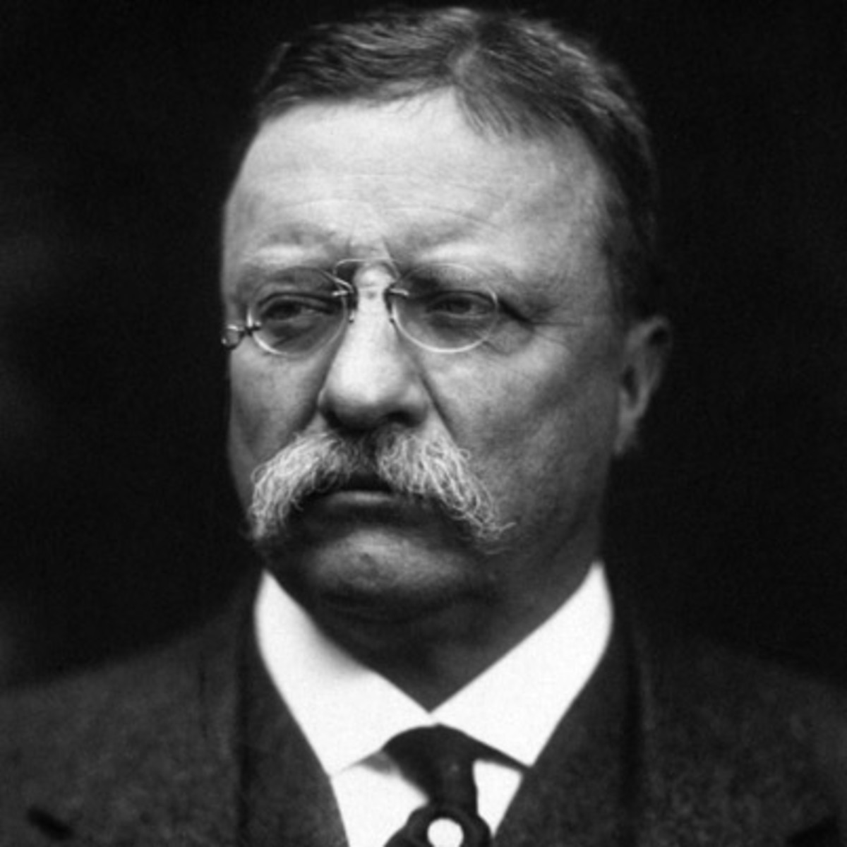
Theodore Roosevelt Sr, to Jr:
“You have the mind but you have not the body, and without the help of the body the mind cannot go as far as it should. You must make your body. It is hard drudgery to make one's body, but I know you will do it.”
-- Sr said to Jr, approx age 10
TR Sr
1831-1878
TR Jr
1858-1919
US President
1901-1909

Slide 3
4 Stages of Somatic Enlightenment
Introduction to the Peripatetic Life
Introduction to the Manual Life
Introduction to the Active Life
Introduction to the Rhythmic Life

Slide 4

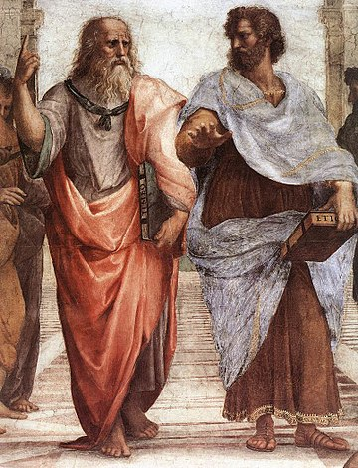
The Peripatetic School of Athens
Go for a walk
With a friend (or two)
Across the creek
Discuss Ideas
Phones off (obviously).
Live in the moment.
Be present with
nature, your friend(s),
and ideas.

Slide 5

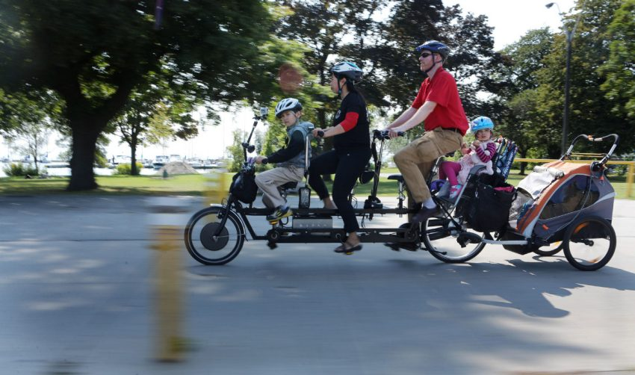
Active Transportation: Walk & Bike
Addresses major global challenges with inexpensive, proven tech:
  Climate change
  Chronic disease
  Inequity
Saves tax dollars
  Cheaper infrastructure
  Reduced healthcare
Plan your adult life to bike to work!

Slide 6
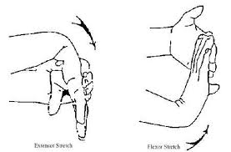
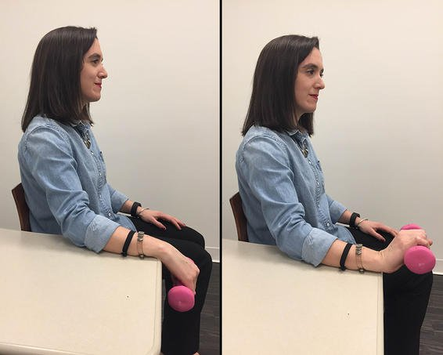
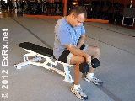
Hand Health
You work with your hands!
Take care of them.
Stay strong
Stay flexible
Avoid RSI
  Repetitive Strain Injury
  e.g., Carpal Tunnel Syndrome
https://www.prevention.com/fitness/5-stretches-that-can-ease-your-carpal-tunnel-pain

Slide 7
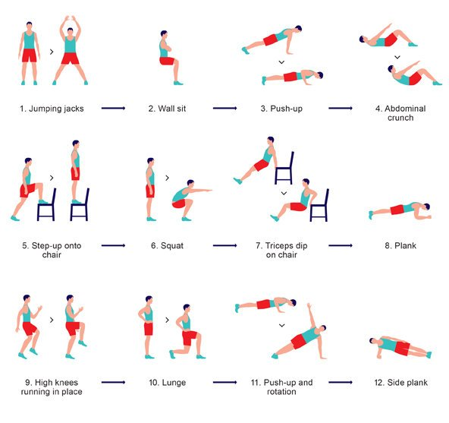
The 7 Minute Workout
Works entire body
Just 7 minutes
Equipment: a chair
Lots of apps
Lots of variations
Try it once!
https://well.blogs.nytimes.com/2013/05/09/the-scientific-7-minute-workout/

Slide 8
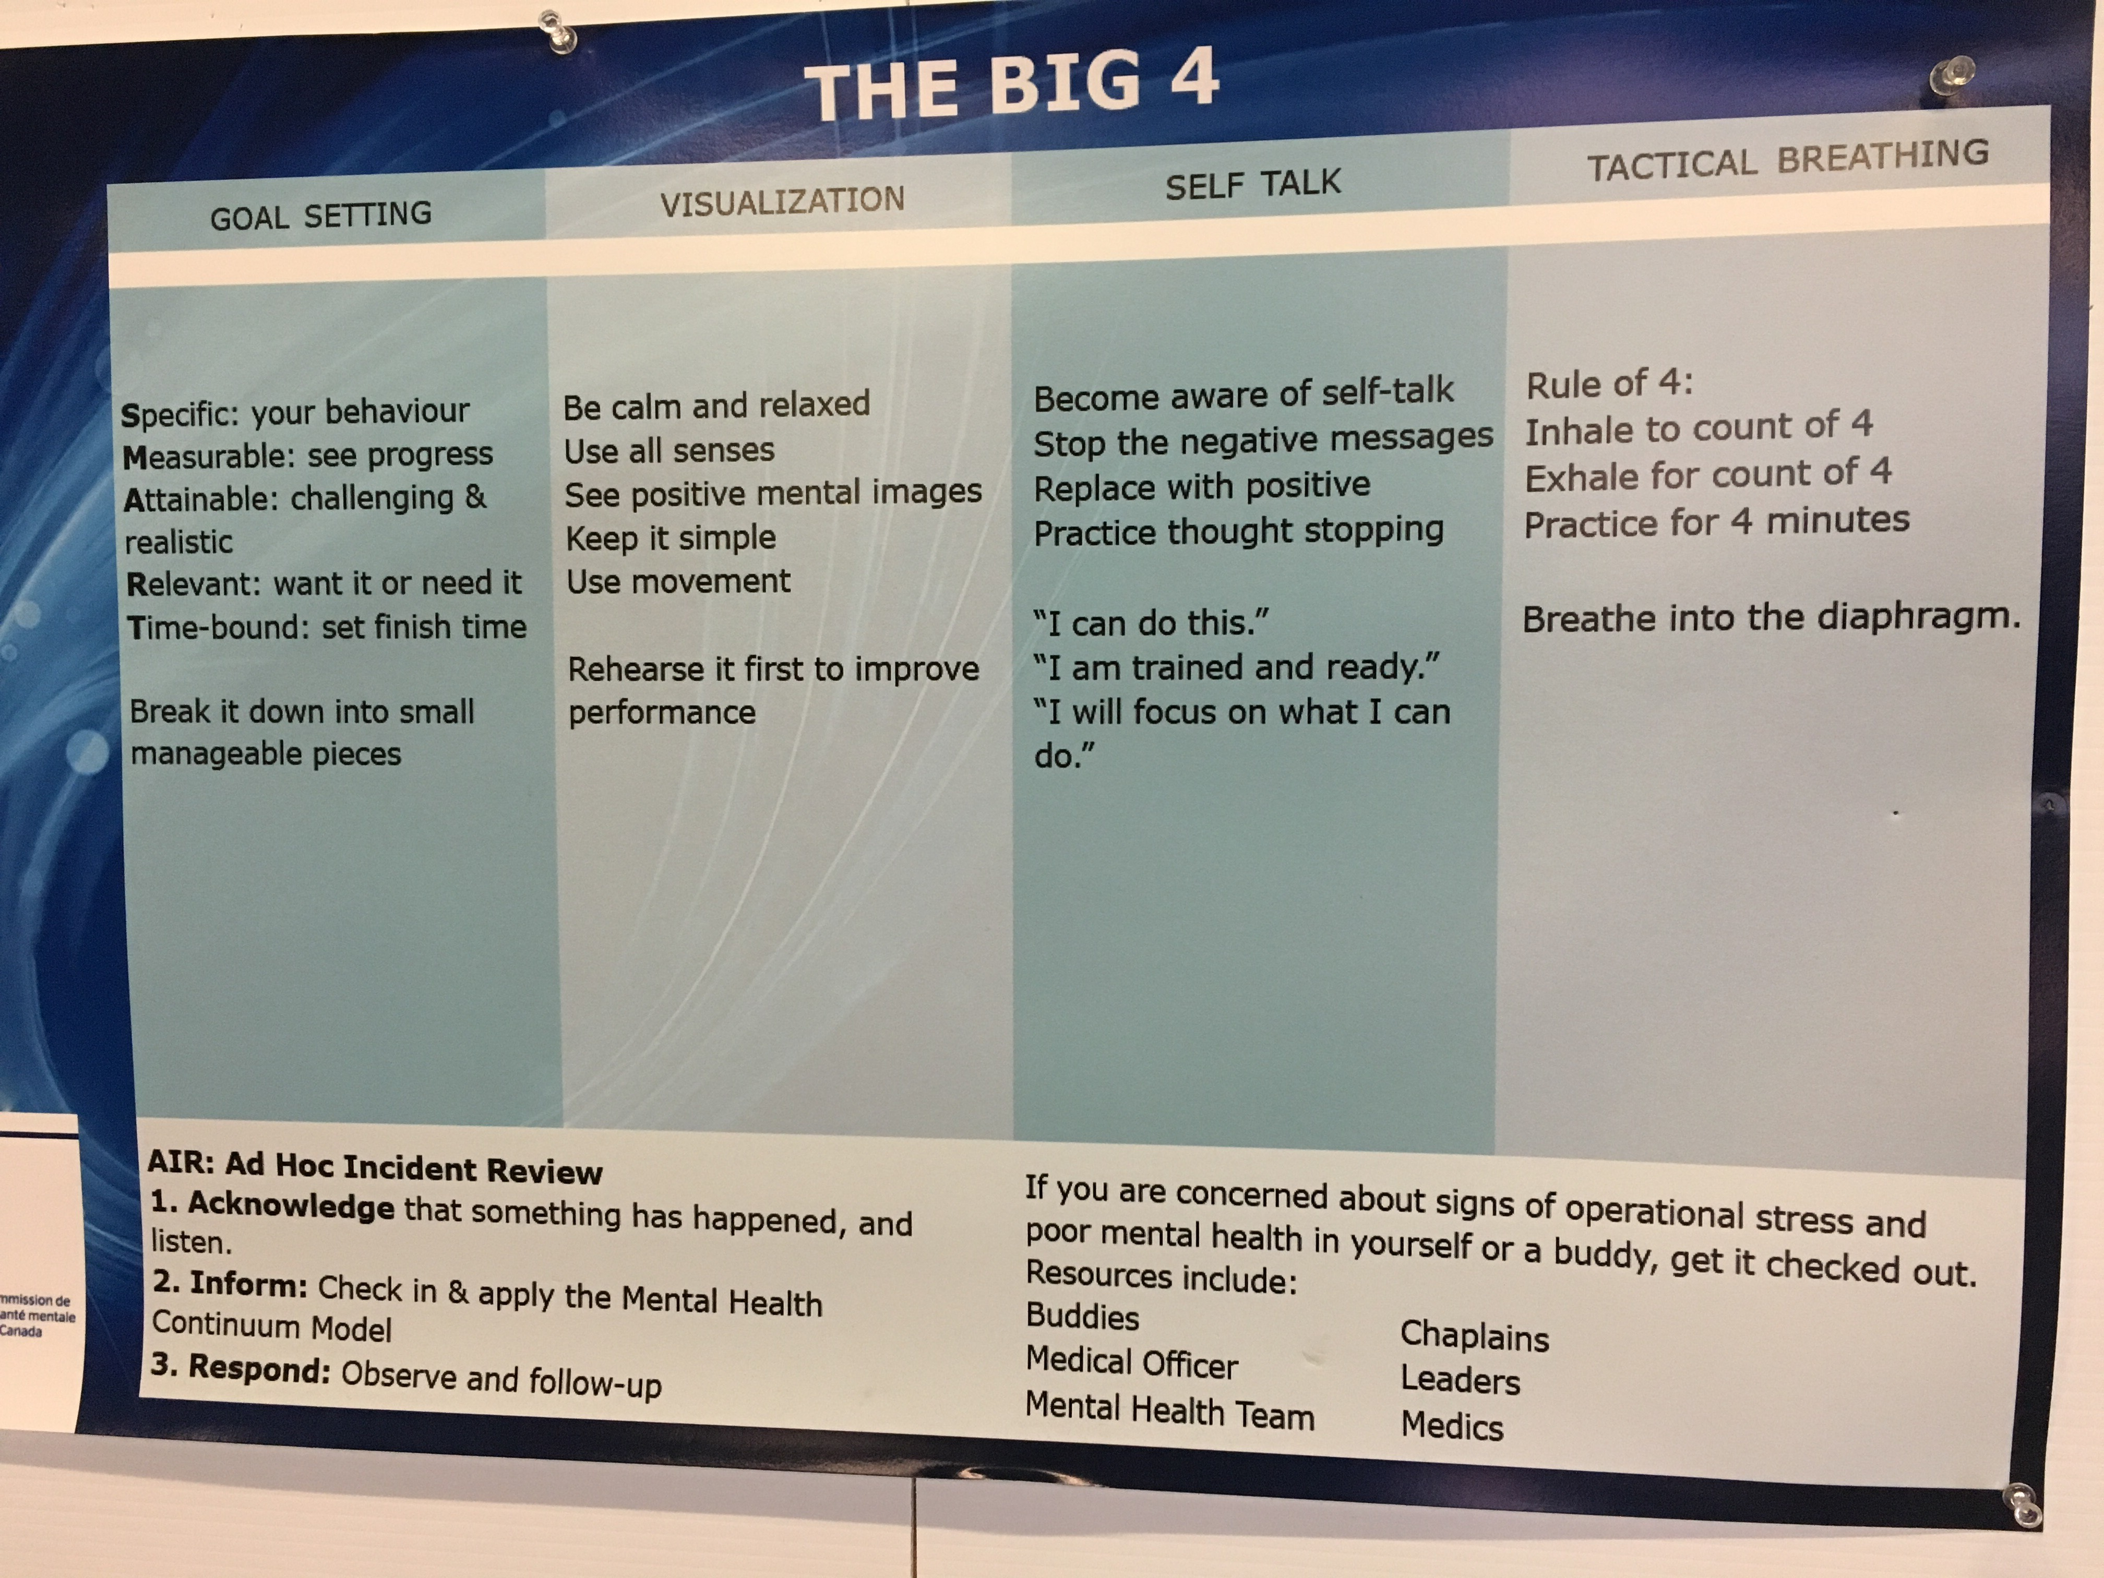
Tactical Breathing
Poster at Ontario
Police College
Inhale
Hold
Exhale
Combat: 4-4-4
Meditation: 4-7-8

Slide 9
Quest 3: Dynamic
Walk + Talk
Hand stretches + exercises
7-minute workout
Tactical breathing
1 time (across the creek)
3 times (3 different days)
1 time
3 times (3 different days)
You demonstrate your professional
honesty and integrity by telling us
when you have completed
each step of the Quest.

Slide 10
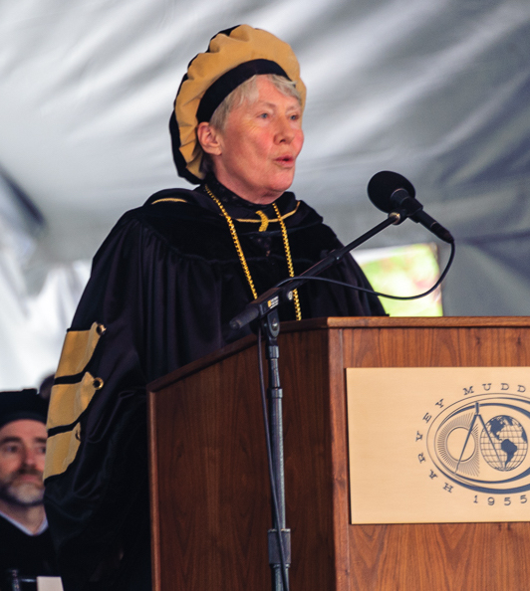
Maria Klawe
Computer scientist from Canada
research in discrete math, functional analysis, etc...
first female:
+ head of CS, dean of science at UBC
+ dean of engineering at Princeton
+ president of Harvey Mudd College
honourary DMath from Waterloo

Slide 11
Appendix
Hagiography of Theodore Roosevelt Sr.

Slide 12
T. Roosevelt Sr (1838-1871)
Founder and/or Director:
New York City Children's Aid Society
New York Children's Orthopaedic Hospital
Metropolitan Museum of Art
American Museum of Natural History

Slide 13
Theodore Roosevelt Jr, on Sr:
“My father, Theodore Roosevelt Sr, was the best man I ever knew. He combined strength and courage with gentleness, tenderness, and great unselfishness. He would not tolerate in us children selfishness or cruelty, idleness, cowardice, or untruthfulness. As we grew older, he made us understand that the same standard of clean living was demanded the boys as for the girls.”

