Slide 1
SE101: 2018-09-13
How Things Work

Slide 2
How UW Works, 2017–18
Income:
$425M tuition
$232M grants
$716M total
Expenses:
$511M salaries (thanks!)
$53M student support
Province funds universities
(which are nonprofit).
Grants have dropped since 1995.
Tuition has gone up.

Slide 3
How SE Works: SE = CS + ECE
Computer Science
Math Faculty
Largest CS Dept in Canada + largest faculty
Elec & Comp. Engineering
Engineering Faculty
Largest ECE Dept in Canada + largest faculty
Every prof works for either CS or ECE.
SE is a collaboration.

Slide 4
Facts about SE
Small vs CS, ECE:
  Class of 2023: 125 students
  on-stream: 351 students
  off-stream: 217 students
ECE 1A = 372; CS 1A = 185*
* many CS students join later

Slide 5
SE Graduation Rates
Typical class size at graduation: 80-100.
  class of 2018 = 144
Total BSE degrees granted = 1123.
Graduation rates:
  BSE 65-81%
  BSE/BCS 71-85%
  B.any 75-85%

Slide 6
How Term Promotion Works
SE follows Engineering rules:
  need term average >= 59.5%
  to pass a course, need mark >= 50%
Failure rates (must repeat a term):
  first year 7-14%,
  second year 5-7%
  upper years ~ 0
About 25% of graduating students have failed a course.

Slide 7
How SE Students Work Post-Grad
Class of 2018:
  88% full-time tech, 4% full-time non-tech, 3% grad school
  4% Waterloo, 11% Ontario ex-KW, 3% Canada ex-Ontario
  80% USA
  Starting base salary: US = C$150k, Canada = C$94k

Slide 8
Other SE18 Thoughts
On-campus SE program met my expectations:
  D = 3, d = 6, n = 9, a = 56, A = 22
Co-op SE program met my expectations:
  D = 0, d = 1, n = 2, a = 12, A = 81
Would recommend my program to prospective students:
  D = 1, d = 2, n = 8, a = 35, A = 50
Plan to work towards PEng?
yes 16%, no 84%

Slide 9
How Bodies Work
Sleep
Eat
Exercise

Slide 10
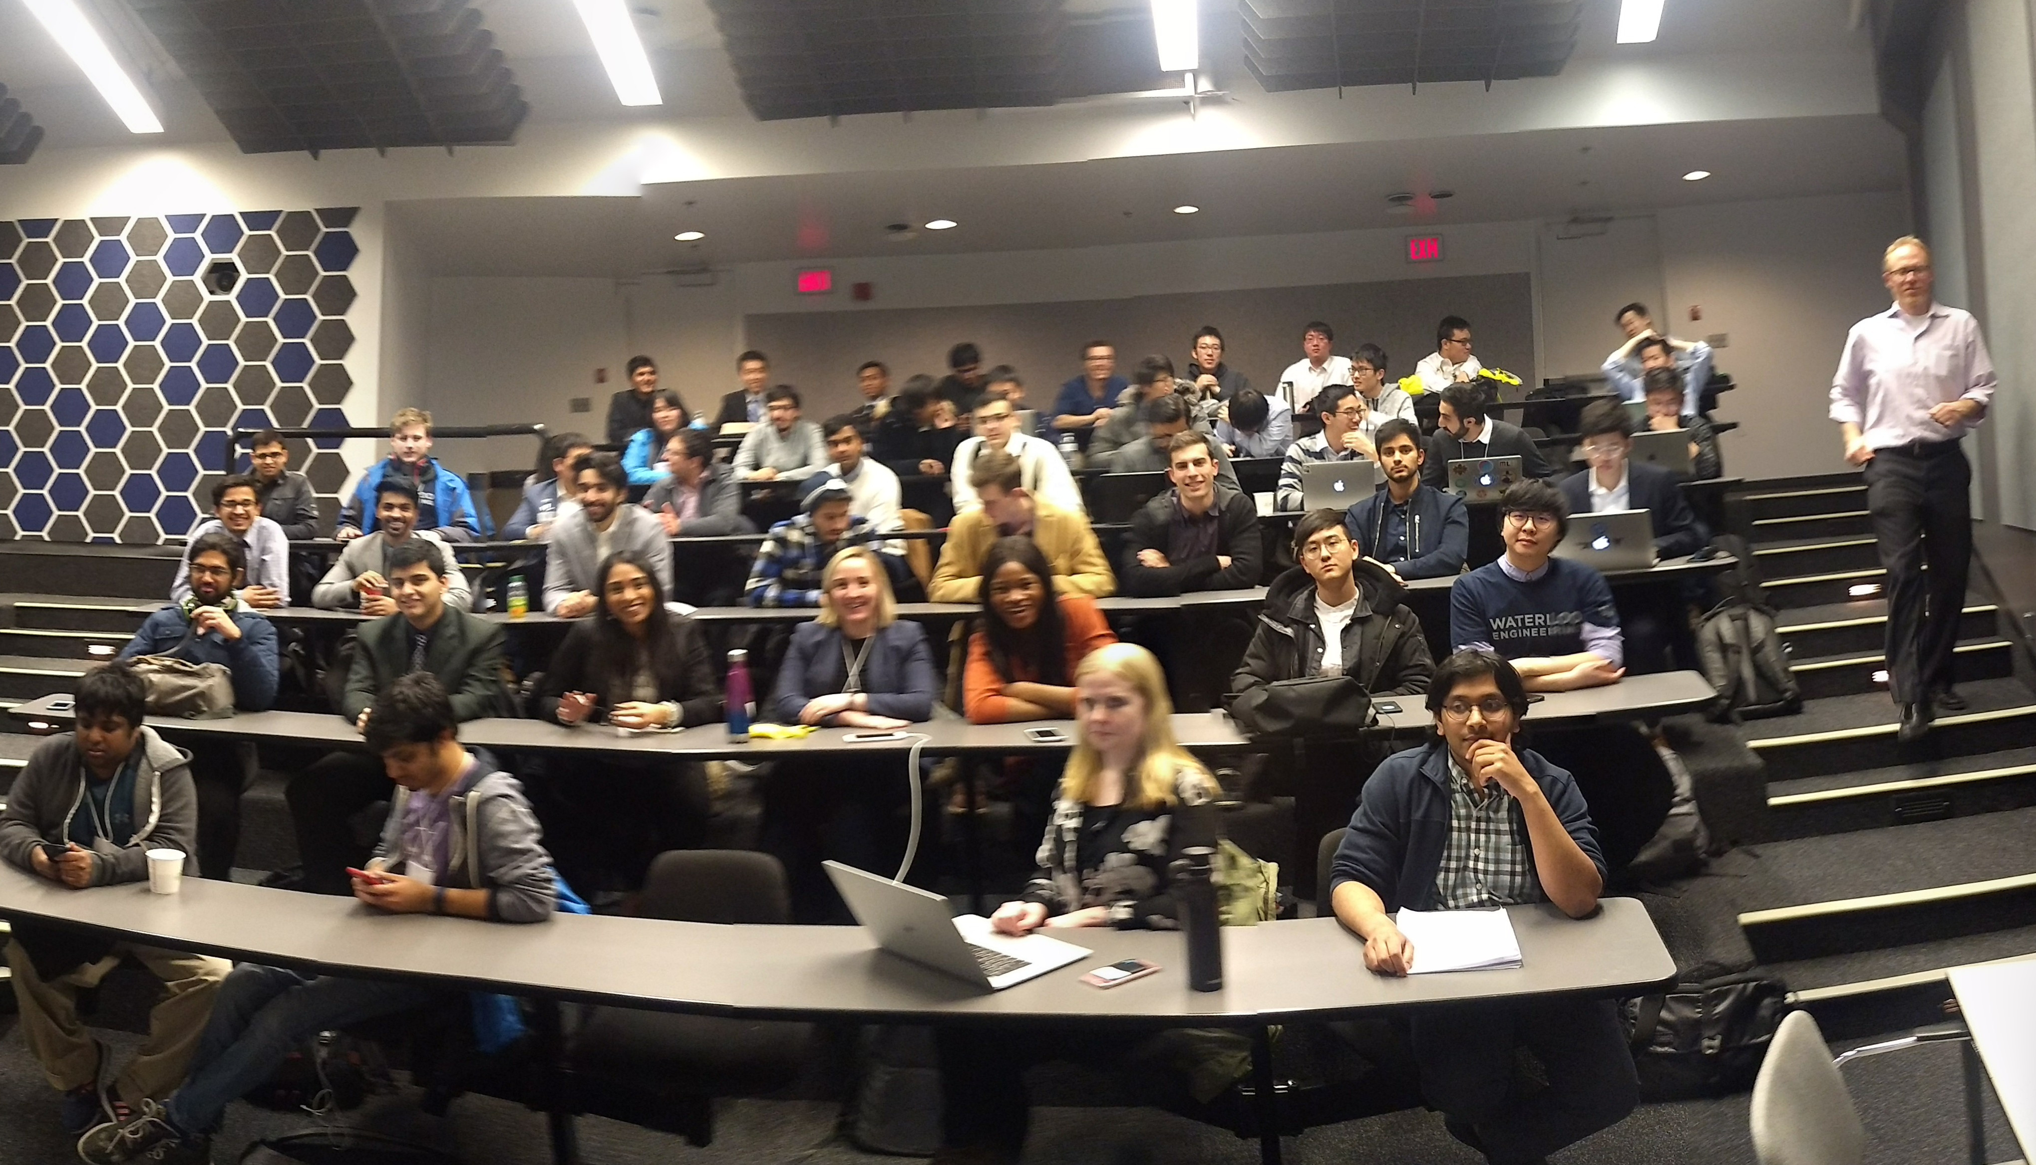
How Etiquette Works
Shower regularly!
SE 2018 FYDP

Slide 11
How Etiquette Works
Wait till previous class is mostly out
before you try to enter the classroom!
SE 2018 FYDP

Slide 12
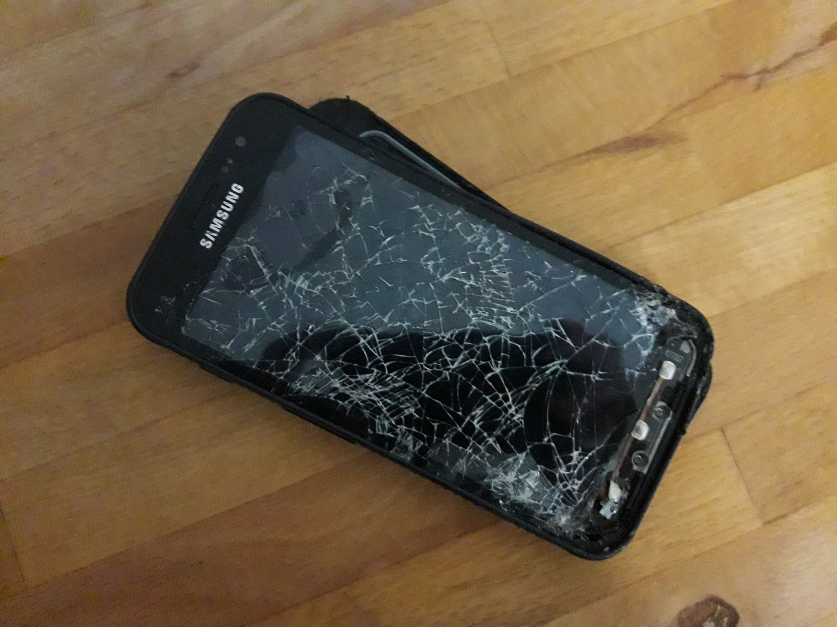
How Etiquette Works
Phones on silent!
Rottweiler/phone encounter
image by Gus Alexandropoulos

Slide 13
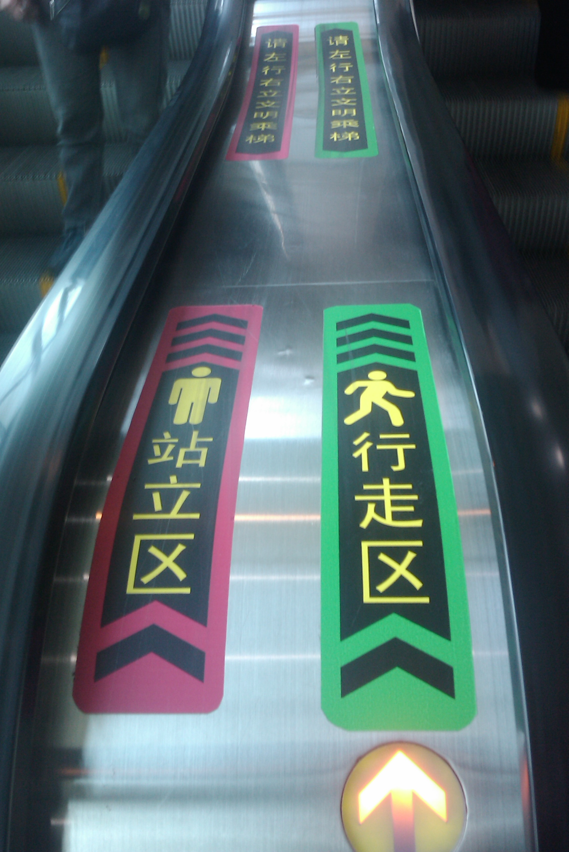
How Etiquette Works
Walk right, stand left?
… just don't stand
in the middle of hallways!
image CC-BY 2.0 John Pasden via flickr

Slide 14
How Emails Work
From: you@edu.uwaterloo.ca
Subject: [ECE 105] Squirrel mechanics question
Dear Prof. X,
I am a student in the SE section of your ECE 105 class. I would like to make an appointment to ask questions about squirrel mechanics. I am available on Wednesdays at 11:30 and Mondays at 2:30; if either of those times do not work for you, you can find my schedule here:
https://uwaterloo.ca/software-engineering/sites/ca.software-engineering/files/uploads/files/1aschedule_0.pdf
Thank you,
Y (ID xxx)

Slide 15
How Titles Work
Safe default = Prof. X.
Many instructors have PhDs,
so Dr. X usually OK.
Not OK: Mr. X, Mrs. X.
(You can call me Patrick.)

Slide 16
How Office Hours Work
Office Hours = time specifically set aside
for student questions.
Pro tip: Use them!

Slide 17
How Asking for Help Works
Academic resources for you:
  instructors
  TAs
  program administration (me, Derek, Shaz)
  Student Success Office
  AccessAbility

Slide 18
How Asking for Help Works
Counselling Services offers mental health resources:
  Study/coping skills workshops
  Engineering counselling
  MATES

Slide 19
How Not Plagiarizing Works
You can look,
but don't write anything while looking.

Slide 20
How Universities Work: Who's Who
Students
  Undergraduate (you)
  Graduate (MASc/MMath,
  PhD)
Teaching Assistants (TAs)
Professors
Medical Staff
  Doctors
  Counsellors
Admin Staff
  Registrar, etc
Plant Operations Staff
  Keep the lights on.

Slide 21
What do Professors do?
Teaching
  Undergraduate
  Graduate
Internal Service
  SE Director
  SE Associate Director
External Service
  Peer review articles
  Organize conferences
Research
  With grad students

Slide 22

SE Society (SE Soc)
Organizes events for SE students:
  student-led résumé critiques
  mixers (today! 6-9! E5-3101!)
  “What I wish I knew in 1B”
Helps with class swag orders;
Develops SE student life in general.

Slide 23

Math Student Society (MathSoc)
Social events
Board game rentals
T-shirts etc.
C&D (Coffee & Donut shop)
Lounge (Comfy)
Exam Bank
Endowment Fund (MEF)

Slide 24

Engineering Society (EngSoc)
Social events
Board game rentals
T-shirts etc.
C&D (Coffee & Donut shop)
Lounge (POETS)
Exam Bank
Endowment Fund (WEEF)

Slide 25

UW Federation of Students
Social events
Intramural sports
Clubs (> 200)
Orientation week
Student representation to
  UW Administration
  Government
Services: MATES, Womens’ Centre, Co-op Connection

