Slide 1
Countdown Game
Patrick Mackin - 40405643

Slide 2
Introduction
Countdown is a fun game involving forming words often shown on TV on the popular Channel 4 show ‘Countdown’, which is currently presented by Colin Murray. I have used this TV show as inspiration to recreate the game using HTML, CSS and JavaScript.

Slide 3
Game Objectives
The competitor is given to be given 9 letters and they get the choice of how may vowels and consonant letters they would like.
Once they have been given their 9 letter, the user will then have 30 seconds to make as many words from these letters as they possibly can, with words using more letters rewarding the competitor with a higher score for that word.

Slide 4
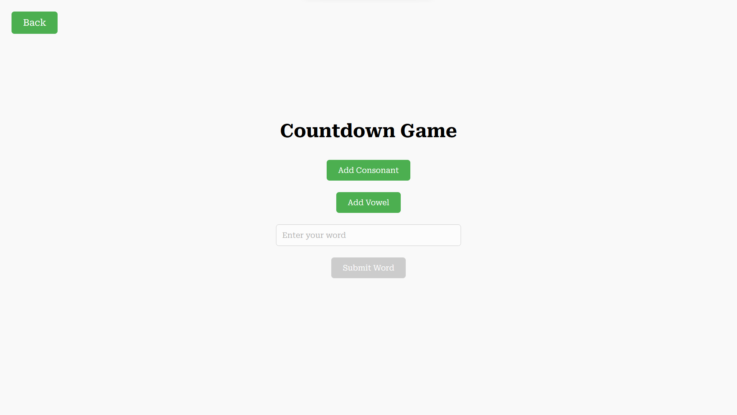
User Interface

Slide 5
User Interface
As you can see from the previous slide, there is a clear vowel, consonant and back button, along with an entry field for words and a submit word button, which is greyed out as the game hasn’t begun yet.
When the game begins, there will also be a timer below the submit word button showing the user how long they have until the game is over.
Game has been primarily designed vertically to make it easily portable onto another platform, like mobile.

Slide 6
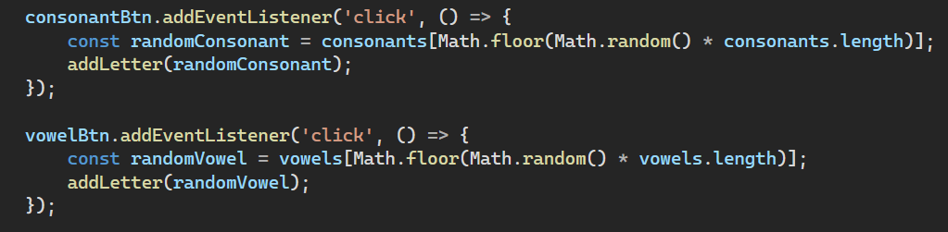
Adding Letters
User can easily click the vowel or consonant button to add a random vowel or consonant to their list of available letters, just like in the TV show when the player calls out what type of letter they want next.
Below is the logic for doing this:

Slide 7
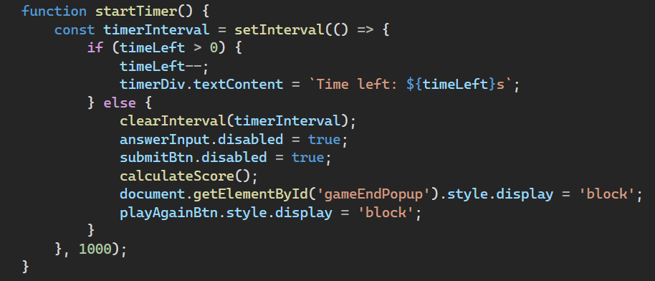
Countdown Timer
As soon as the user has picked all their letters, the game will begin, and the user will have 30 seconds to enter as many letters as possible before the game ends, when a display will appear showing the user how much score they have got.
Here is the code to complete this task:

Slide 8
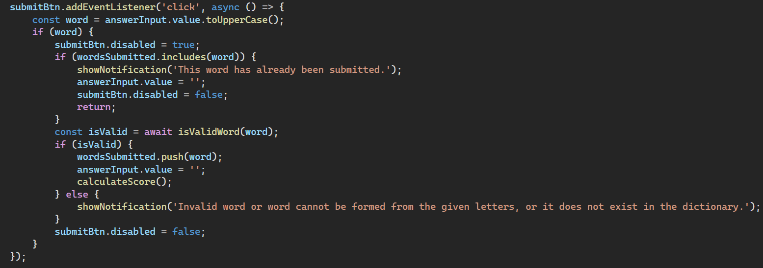
Word Submission
When the user enters a word into the entry field and hits submit, the word will be added into a submitted words list and a score will be calculated for that submitted word and added to the total, provided the word hasn’t already been entered and is valid.
Here’s the code to complete this task:

Slide 9
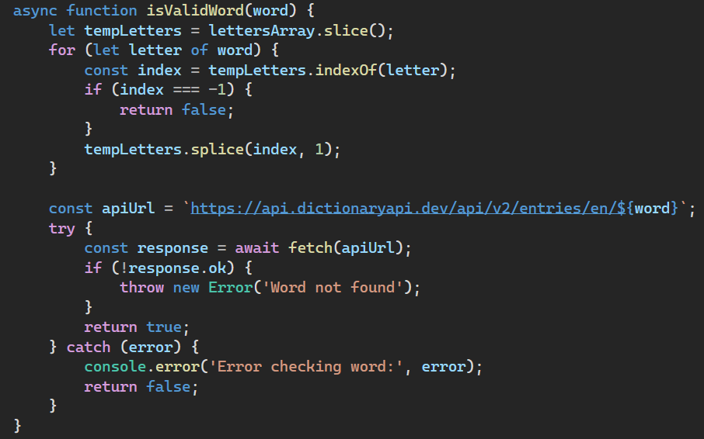
Word Validation
In the word submission, it was mentioned the word must be valid to be submitted. This is done by checking that both the letters used belong to the letters the user can enter, and they have used each letter they have at most once (unless they have duplicates available and that the word exists, by checking if it exists in the dictionary.
Here’s how the system checks that:

Slide 10
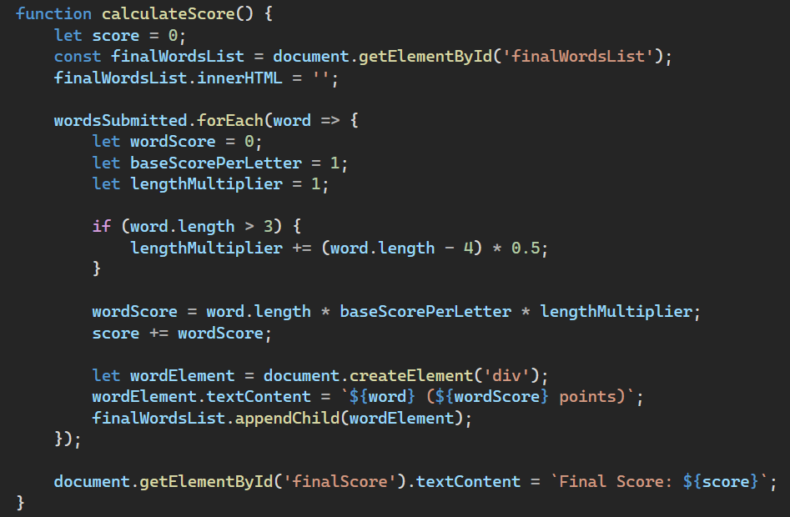
Scoring System
For scoring, I decided to give 1 point per letter used in each word submitted but I wanted to incentivise longer words, so I added a length multiplier for submitted words that are 4 letters or longer so words longer than 3 letters get an additional 0.5 multiplier for each letter above 4.
This is how I achieved this in the program:

Slide 11
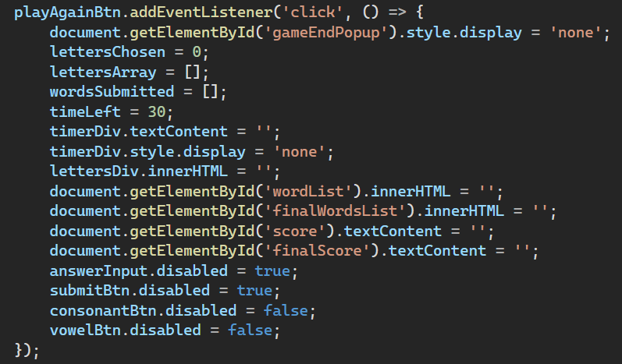
Game Ending and Restart
When the timer expires, a ‘game over’ screen appears showing the user the list of words submitted, the score they got for each word they submitted and their final score. The user also has the option to play again, which restarts the game.
Here’s how I achieved this:

Slide 12
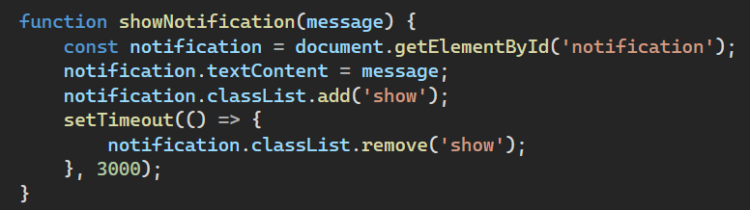
User Experience
Initially, if a user entered a word they couldn’t submit, the system gave a JavaScript alert, however this paused the timer and could allow the user to cheat, so I changed this to instead show a notification in the top right-hand side of the screen telling the user they can’t submit that word.
Here’s how I display this message to the user:

Slide 13
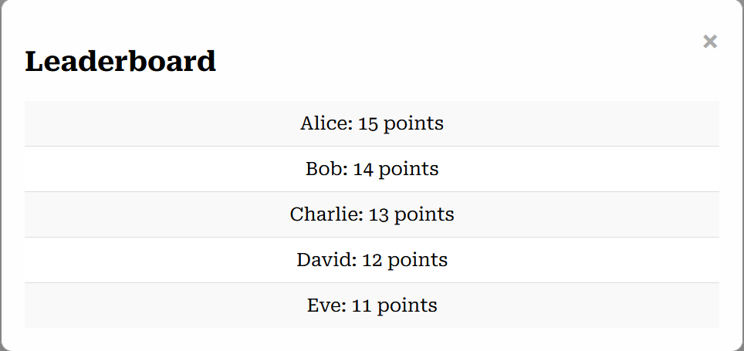
Leaderboard
I created a leaderboard to display the top 5 best scores, here’s what it looks like:

Slide 14
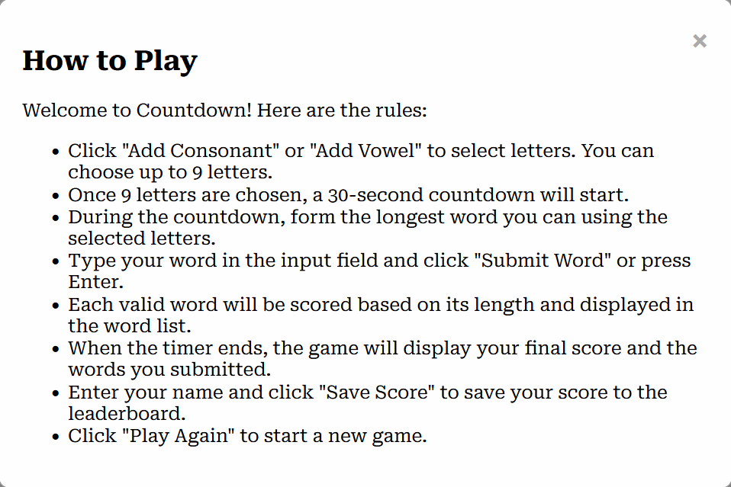
How to play
I also created a screen to show the user the rules of the game. That looks like this:

Slide 15
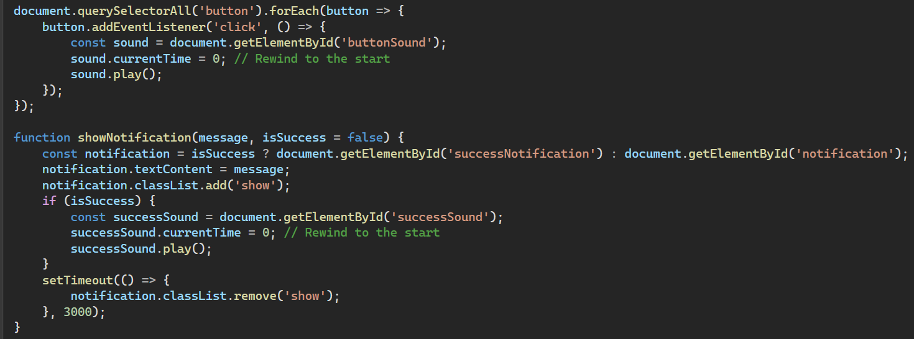
Sound Effects
I’ve added a sound effect for button presses as well as for successful word entries. Here’s how I did it:

Slide 16
Problem Faced
New scores cannot be added to the leaderboard from the game as to implement this, I would need to create a server-side script and run it using Node JS which is a framework, the use of which is discouraged in this project.
I have elected not to implement this, and so when a user saves their score in the systems current state, they will receive a status 405 method not allowed, however the functionality is there and this problem could be easily fixed later down the line if needed.

Slide 17
Thank You

