Slide 1



BOSTON BUILDING EMISSIONS ANALYSIS
COURSE
MISM6210 - Info Visual/Dashboard Business
BERDO Retrofit Prioritization Dashboard
TEAM 4
Alejandro Calalpa Garcia, Patrick Medek, Seifallah Bouslama, Syed Sajjaed, Sairaj V Khandare
A focused visual story about where Boston should retrofit first — and why.
INFO VISUALS DASHBOARD DESIGN FINAL PROJECT

Slide 2


WHY THIS PROBLEM MATTERS
Boston’s buildings produce 70% of its emissions
BERDO requires 3,271 large buildings to cut greenhouse gas emissions, turning retrofit prioritization into a city-scale decision problem.
3,271
$763M
75%
buildings in scope for BERDO action
annual energy spend across the covered portfolio
already past the compliance deadline
Research question: Which buildings should be retrofitted first for the greatest impact?
BOSTON BUILDING STOCK AND RETROFIT CONTEXT

Slide 3

HOW THE RANKING WORKS
A clean dataset made the prioritization credible
3,271
29
0
buildings
attributes
null values
The analysis moved from raw BERDO records to a filtered, scored, and validated shortlist of retrofit priorities.
STEP 01
STEP 02
STEP 03
STEP 04
Score the opportunity
Sort the portfolio
Validate the pattern
Turn it into dashboards
EUI, emissions, floor area, and Energy Star performance shape the Opportunity Score.
Buildings are grouped into Tier 1, Tier 2, and Tier 3 for action sequencing.
K-means clustering checks that the ranking matches the structure of the data.
Four dashboard views make the priority logic visible and decision-ready.
Result: a clear, explainable system for identifying where Boston should retrofit first.

Slide 4

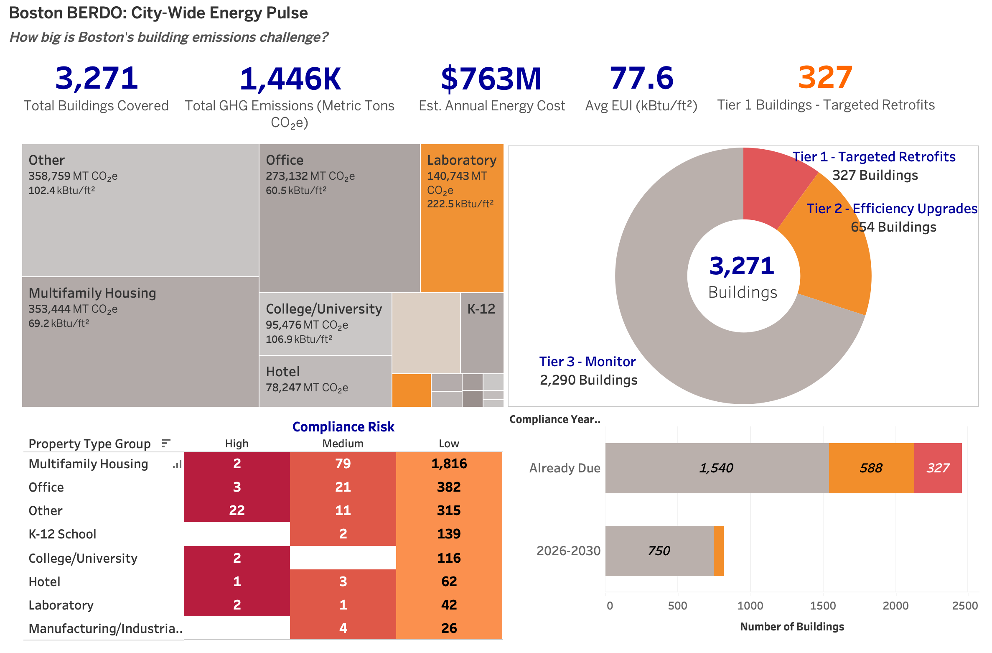
DASHBOARD 1
City-Wide Energy Pulse
Tree map to show total emissions vs. energy intensity in one view.
Donut for the 10/20/70 tier split.
Heatmap to cross-reference compliance risk by sector.
Stacked bar to reveal compliance urgency over time.
INSERT DASHBOARD SCREENSHOT HERE

Slide 5

INSIGHT 01
Size alone picks the wrong buildings
Absolute emissions show scale. They do not automatically show where the most wasteful or urgent retrofit opportunities sit.
EVIDENCE 1
EVIDENCE 2
EVIDENCE 3
358,759
222.5
100%
The “Other” sector dominates total emissions
Laboratories expose the real waste signal
Tier 1 buildings are already late
Energy intensity shows that some smaller sectors are far more inefficient.
The highest-priority group is not theoretical — it is already in compliance trouble.
That makes it big — but not necessarily the smartest first target.
Boston should retrofit where intensity, urgency, and savings potential intersect — not simply where buildings are largest.

Slide 6
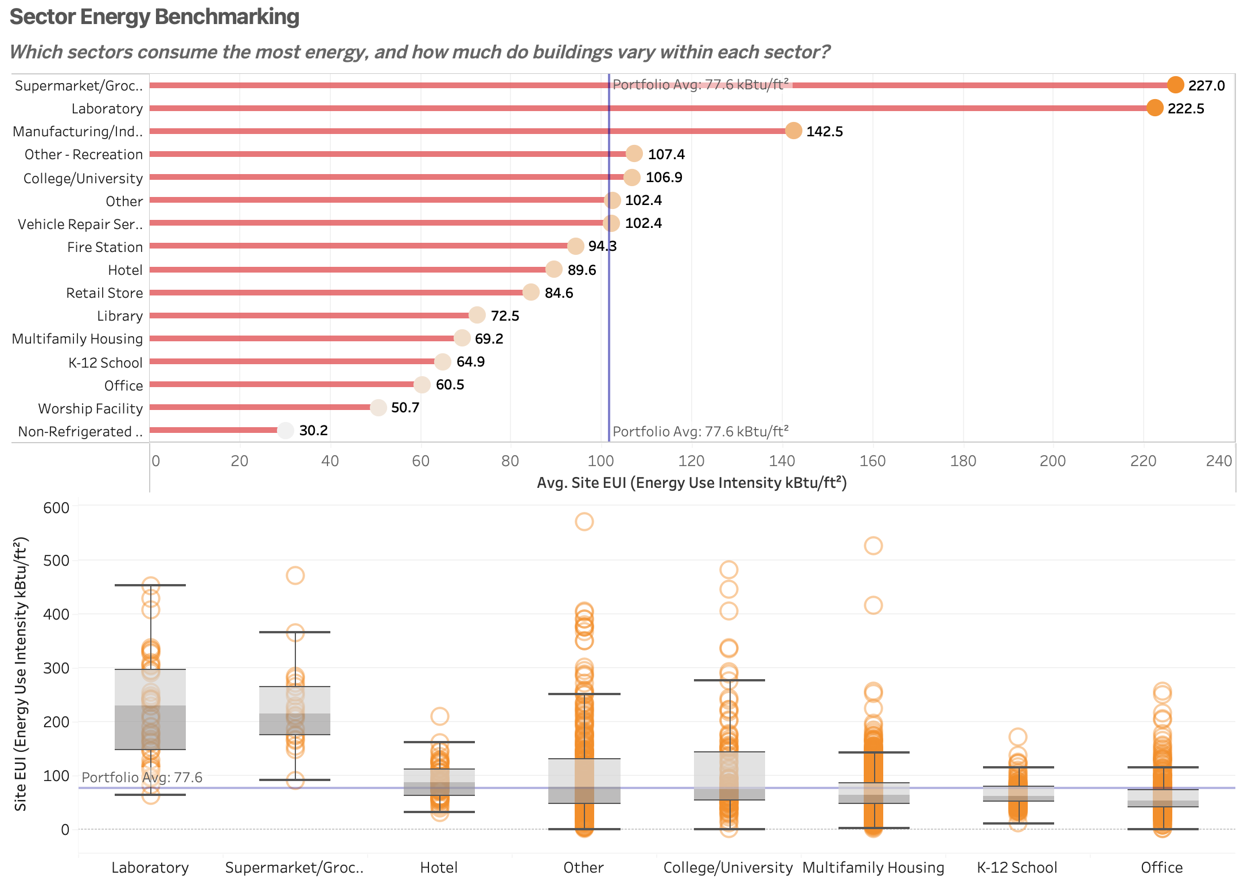
DASHBOARD 2
Sector Energy Benchmarking
Lollipop chart to rank sectors with less visual clutter than bar charts.
Box plot to expose the outliers that sector averages hide.
INSERT DASHBOARD SCREENSHOT HERE

Slide 7

INSIGHT 02
Averages hide the buildings that matter most
Sector benchmarking is useful, but Boston still needs to zoom into the specific buildings that sit far beyond the norm.
77.6
~3x
Supermarkets and laboratories sit at nearly three
times the benchmark.
PORTFOLIO BENCHMARK
They are structurally high-intensity sectors and
This is the citywide reference point — but it does not show the extreme tail of underperformance.
immediate candidates for scrutiny.
450+
Some multifamily buildings still exceed 450
kBtu/ft².
That means a normal-looking sector average can
still hide major retrofit opportunities.
Conclusion: Boston should benchmark by sector but prioritize by building-level outlier performance.

Slide 8
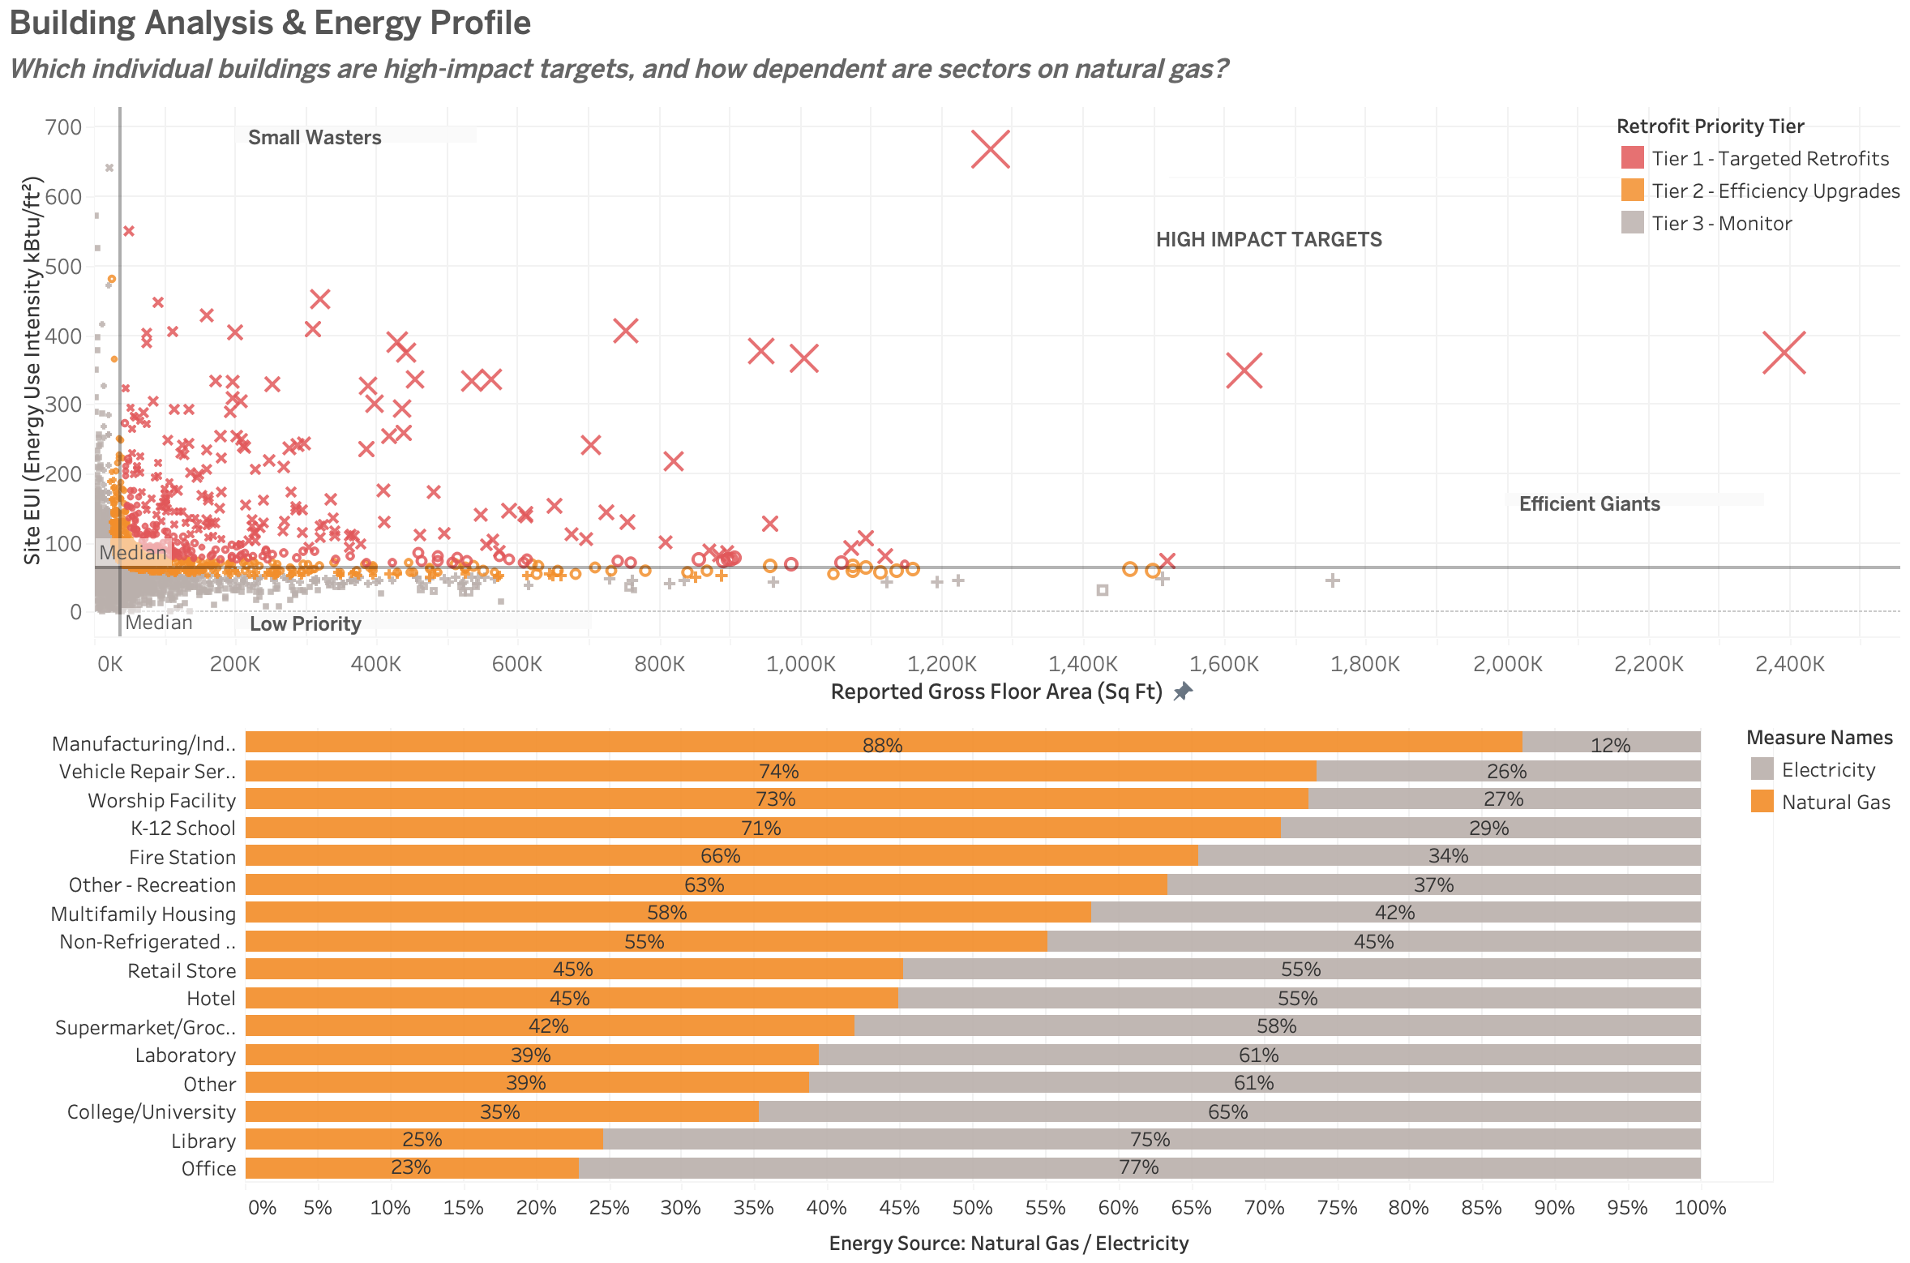
DASHBOARD 3
Building Analysis & Energy Profile
Scatter plot to map two continuous variables (floor area × EUI) at building level — the only chart that can do this.
100% stacked bar to compare gas vs. electricity dependency across sectors.
INSERT DASHBOARD SCREENSHOT HERE

Slide 9

INSIGHT 03
The highest-ROI buildings are easy to spot
Extreme intensity, high cost, and fossil dependence point to the clearest retrofit targets.
TOP BUILDING SIGNAL
88% / 73% / 58%
667.7
Gas still dominates
Manufacturing, Worship, and Multifamily remain heavily gas-dependent.
20 Gillette Park stands alone.
It combines very high energy intensity with about $25.4M in annual energy cost.
Action implication
Efficiency upgrades should be paired with electrification where gas use is still high.
Boston should move first on buildings where waste and decarbonization upside are both unusually high.

Slide 10
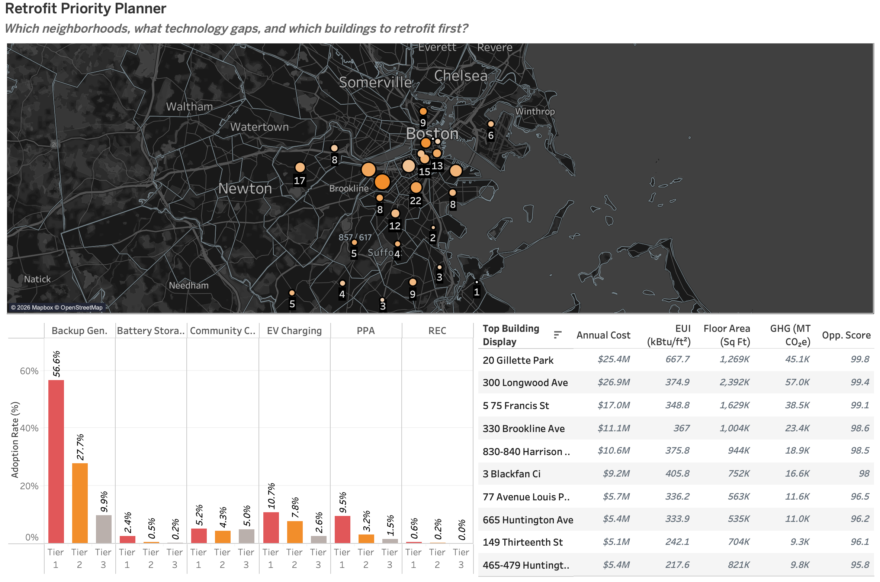
DASHBOARD 4
Retrofit Priority Planner
Symbol map to reveal geographic clustering invisible in tables.
Grouped bar to compare green tech adoption across tiers.
Ranked table to give decision-makers specific building names and costs.
INSERT DASHBOARD SCREENSHOT HERE

Slide 11

INSIGHT 04
The planner view reveals not just which buildings matter, but where action can scale fastest and generate the strongest return.
Act where density and savings overlap
48%
57%
$121.8M
Tier 1 buildings cluster in five zip codes
Green features can hide deeper inefficiency
The top 10 already carry huge energy spend
That concentration makes neighborhood-based rollout faster and easier to coordinate.
Visible sustainability add-ons do not guarantee that the building is actually performing well.
That concentration points to an estimated $40–60M annual savings opportunity.
Boston should start where priority density, implementation ease, and savings potential already reinforce one another.

Slide 12


This analysis shows that effective retrofit prioritization requires looking beyond totals and averages. Building-level intensity, compliance urgency, energy source dependency, and geographic concentration together reveal where limited resources will have the greatest impact.
Thank You
COURSE
PRESENTED BY
MISM6210 - Info Visual/Dashboard Business
Team 4

