Slide 1
Optimizing Fund Allocation For Emissions Reduction
04.12.25
By Akash Alaparthi, Connor Breslin, William Geary, Nora Mehler, Patrick Medek, and Ryan Jiang
MATH4025 - Final Presentation

Slide 2
Our Question
For a given level of government expenditure, what is the optimal distribution of spending on EV subsidies and renewable energy generation for the greatest reduction in carbon emissions?

Slide 3
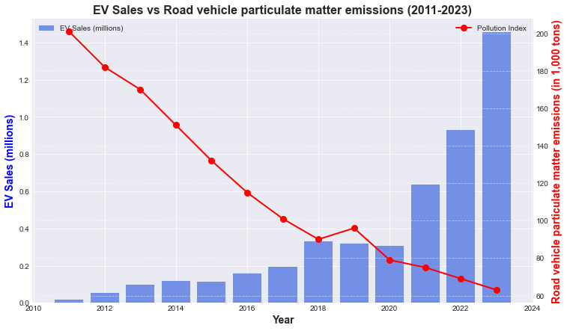
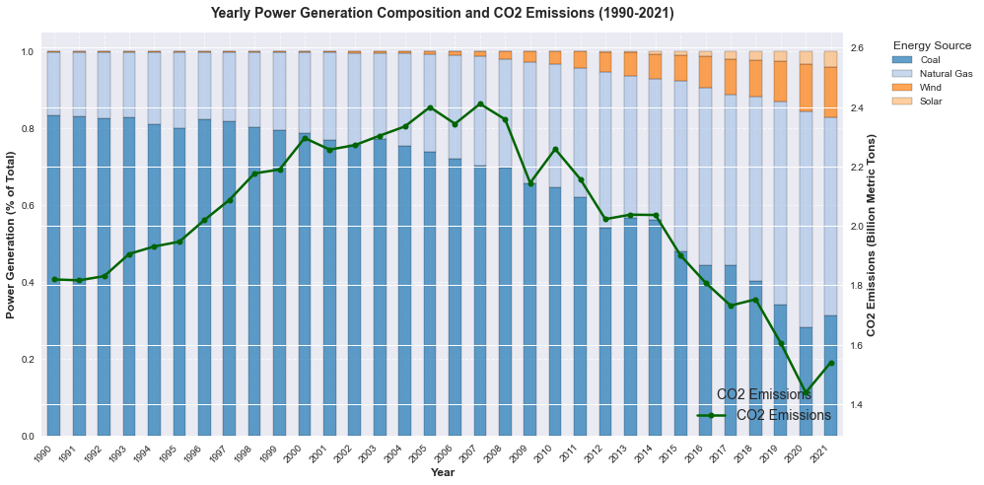
Background Information
The U.S. released 6,343 metric tons of greenhouse gasses into the atmosphere in 2022; 79.7% of that was CO₂
The transportation sector is the largest contributor to carbon emissions - responsible for 28% of direct greenhouse gas emissions in the U.S.
We modeled the negative correlation between EV sales and vehicular particulate matter emissions, as well as the relationship between the composition of the U.S. power grid and CO₂ emissions

Slide 4
Data Collection
Relied heavily on data from organizations such as the U.S. Department of Energy (DOE), U.S. Energy Information Administration (EIA), International Energy Agency (IEA), Environmental Protection Agency (EPA), and National Renewable Energy Laboratory (NREL)
Used Statista for emissions data, capacity factors, and vehicle sales
Compiled vehicle weight and gas mileage data from manufacturers for use in our visualizations

Slide 5
Calculation Methods
Vehicle subsidies - calculated as an amortizing loan based on a series of cash flows, incorporating maintenance, insurance, and fuel costs
  Our equation breaks down the cost delta of the 4 factors per month and discounts them at the appropriate cost of capital in order to find the present value difference between ICE and EV of our 3 different classifications, Sedan, SUV, Truck
Levelized Cost of Energy (LCOE)
  LCOE is the present value of the cost of generating a unit of electricity

Slide 6
Estimating Breakeven EV Subsidy
Calculated the subsidy required for a consumer to be indifferent between an ICE vehicle and its EV counterpart
Principle idea is asset replication, assets with identical payoffs should have identical prices. (payoff is miles traveled)
Considered cost of fuel (ICE) and charging (EV), financing, maintenance, and insurance
Calculated as the present value of a series of monthly cash flows discounted back at the risk-free rate
Sedan: $11,045.17
SUV: $20,759.66
Truck: $15,174.49

Slide 7
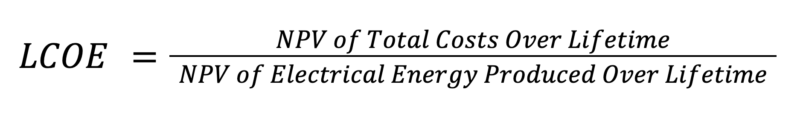
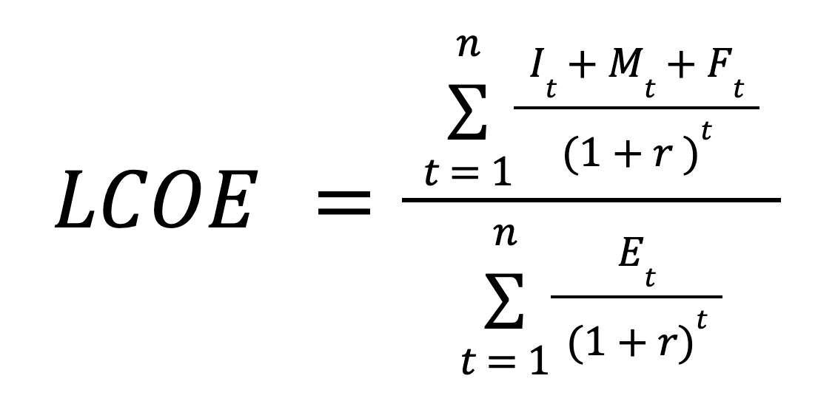
Estimating Cost of Energy Generation
n : Lifespan of the energy system (in years)
I_{t} : Investment expenditure in year t
M_{t} : Operation and maintenance expenditure in year t
F_{t} : Fuel expenditure in year t *
E_{t} : Electricity generation in year t
r : Discount rate
*F_{t} = 0 for wind and solar

Slide 8
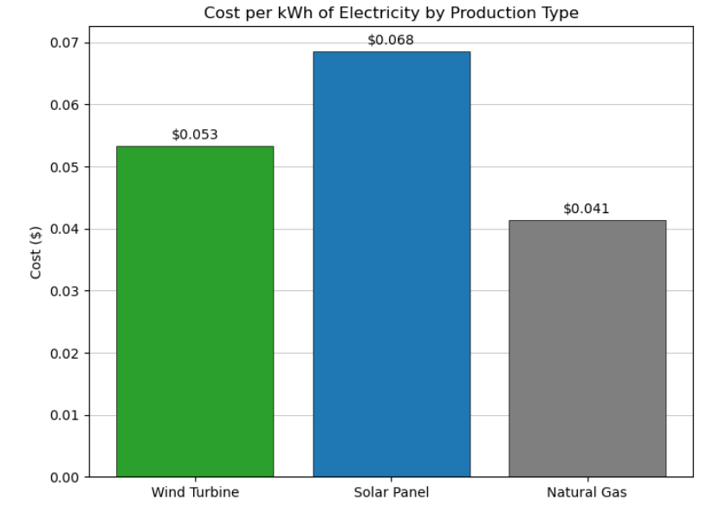
Estimating Cost of Energy Generation
The Levelized Cost of Energy (LCOE) considers a power plant’s initial construction cost, as well as the lifetime maintenance, operation, and fuel cost
Calculated the present value of the LCOE for natural gas, land-based wind, and solar from the given equation, multiplied by the capacity factor for each energy source
Natural Gas: $41.42/MWh
Land-Based Wind: $53.31/MWh
Solar: $68.49/MWh

Slide 9
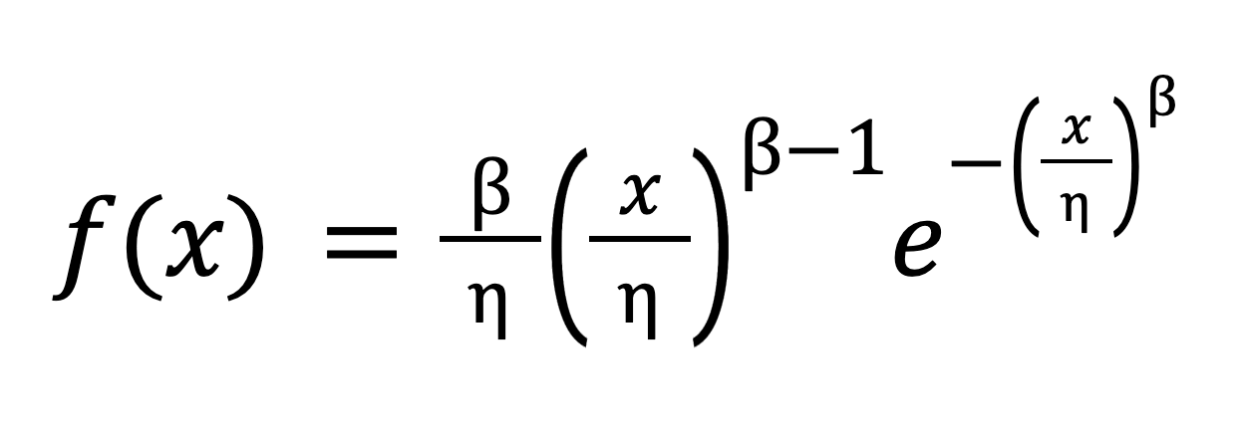
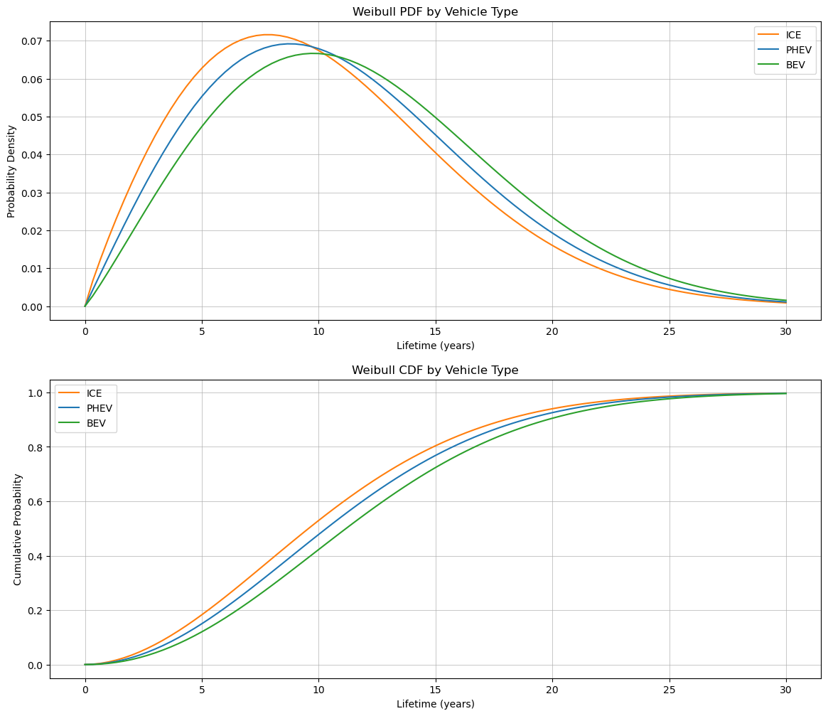
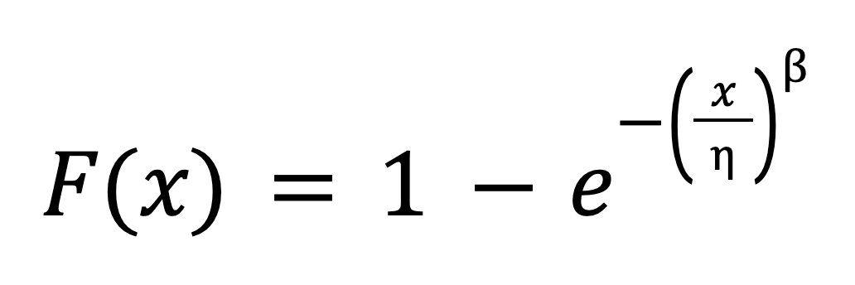
Vehicle Lifetime Model - Weibull Function
Pdf equation:
Cdf equation:
Parameters:
Gasoline (ICE)
η = 11.6
β = 1.9
Hybrid (PHEV)
η = 12.4
β = 2.0
Electric (BEV)
η = 13.3
β = 2.1
Notes:
Patrick

Slide 10

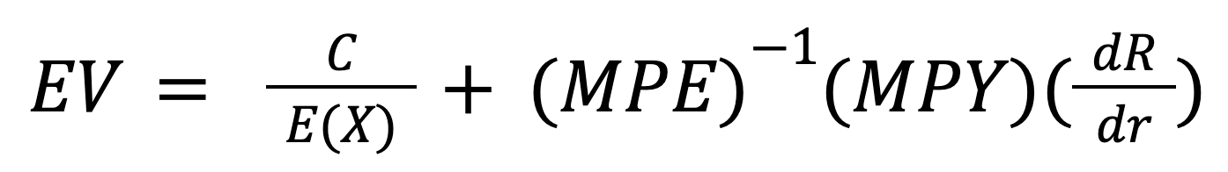
Lifetime Emissions Functions
C : Initial manufacturing emissions
E(X) : Expected number of years until failure
MPG : Miles per gallon of each vehicle
MPY : Miles driven per year
OilCoef : Amount of carbon emissions per gallon of oil consumed
MPE : Miles per unit of electricity
dR/dr : Carbon emissions of the electric grid per unit of energy
Notes:
Patrick

Slide 11
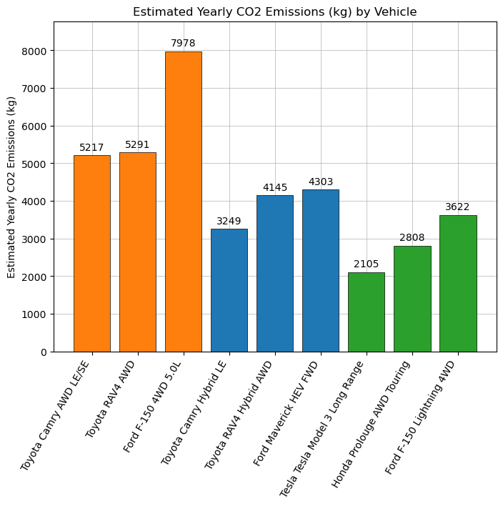
Comparison of Yearly Emissions by Vehicle
Using the estimated lifespan of each vehicle from the Weibull function, and the lifetime emissions equations, we calculated the estimated yearly emissions
Despite ICE vehicles producing less CO2 emissions during the production stage than comparative PHEV or BEV vehicles, their estimated yearly CO2 emissions more than double that of BEV vehicles
Yearly emissions of PHEV vehicles much more similarly resemble those of BEV vehicles than ICE vehicles
Orange = ICE, Blue = PHEV, Green = BEV

Slide 12
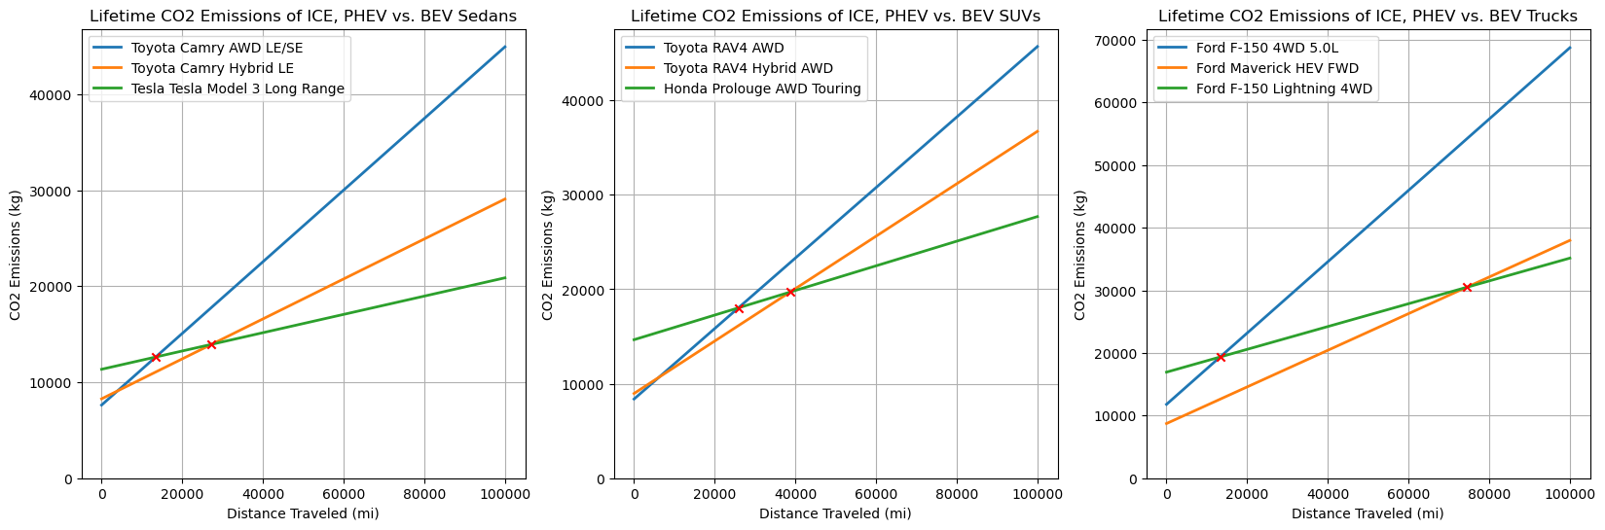
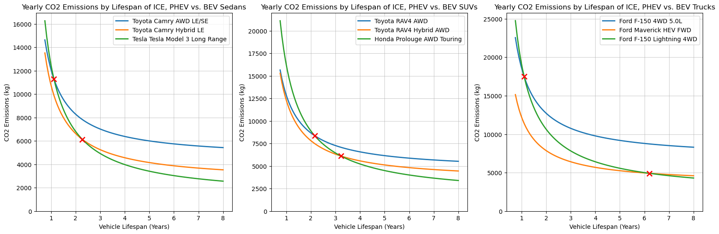
Comparison of Vehicle Emissions by Mileage and Lifespan
As mileage and lifespan increase, ICE vehicles emit significantly more CO₂ than PHEVs and EVs across all classes. EVs’ higher initial value is associated with their production emissions, specifically in battery manufacturing.
Average yearly CO₂ emissions by vehicle lifespan, showing EV break- even points with PHEVs and ICE vehicles.

Slide 13
Results
Calculated the weighted average LCOE of the energy grid under ~450 scenarios, in which shares of solar and land-based wind increase and shares of fossil fuels decrease, then found the additional subsidy required to implement each energy mix and the resulting reduction in carbon emissions, modeled as a marginal cost curve
Calculated the lifetime emissions as a constant for ICE vehicles (55,160.7 kg CO₂ for sedans and SUVs; 84,192.63 kg CO₂ for trucks) and under every energy composition scenario for EVs, and found the carbon savings per vehicle as the difference between the two
  Lifetime emissions for ICE sedans and SUVs are the same because they have the same MPG; differences in production emissions is factored into the ICE-EV delta used to create the array of EV CO₂ reductions in all possible electricity composition scenarios
Used the calculated energy subsidies to find the reduction per dollar in vehicular carbon emissions, also modeled as a marginal cost curve

Slide 14
Results, continued
We considered three versions of energy grid modification:
The government perfectly phases out all coal, then all natural gas in favor of solar power and land-based wind
Coal and natural gas are phased out in favor of renewables simultaneously, in proportion to their initial weighting in the energy grid
The government has some control over which fossil fuels are phased out in favor of renewables, modeled by a random walk where p = 0.75 is the chance of a reduction in coal in each iteration with 1-p = 0.25 is the chance of a reduction in natural gas in each iteration.
Each iteration of the three scenarios represents a 1/10th of 1% change in the composition of the energy grid

Slide 15
Optimization
Constructed CO₂ reduction matrices (for the composition of the energy grid and EV adoption) and cost matrices (for electricity generation costs and EV subsidy costs)
Filtered out values that were too expensive/fell outside the given level of government expenditure
Used the index of the greatest reduction in CO₂ emissions from the carbon reduction matrix in the cost matrices to determine the optimal distribution of spending on EV subsidies and renewable energy generation, as well as the total level of government expenditure necessary for this reduction in emissions

Slide 16
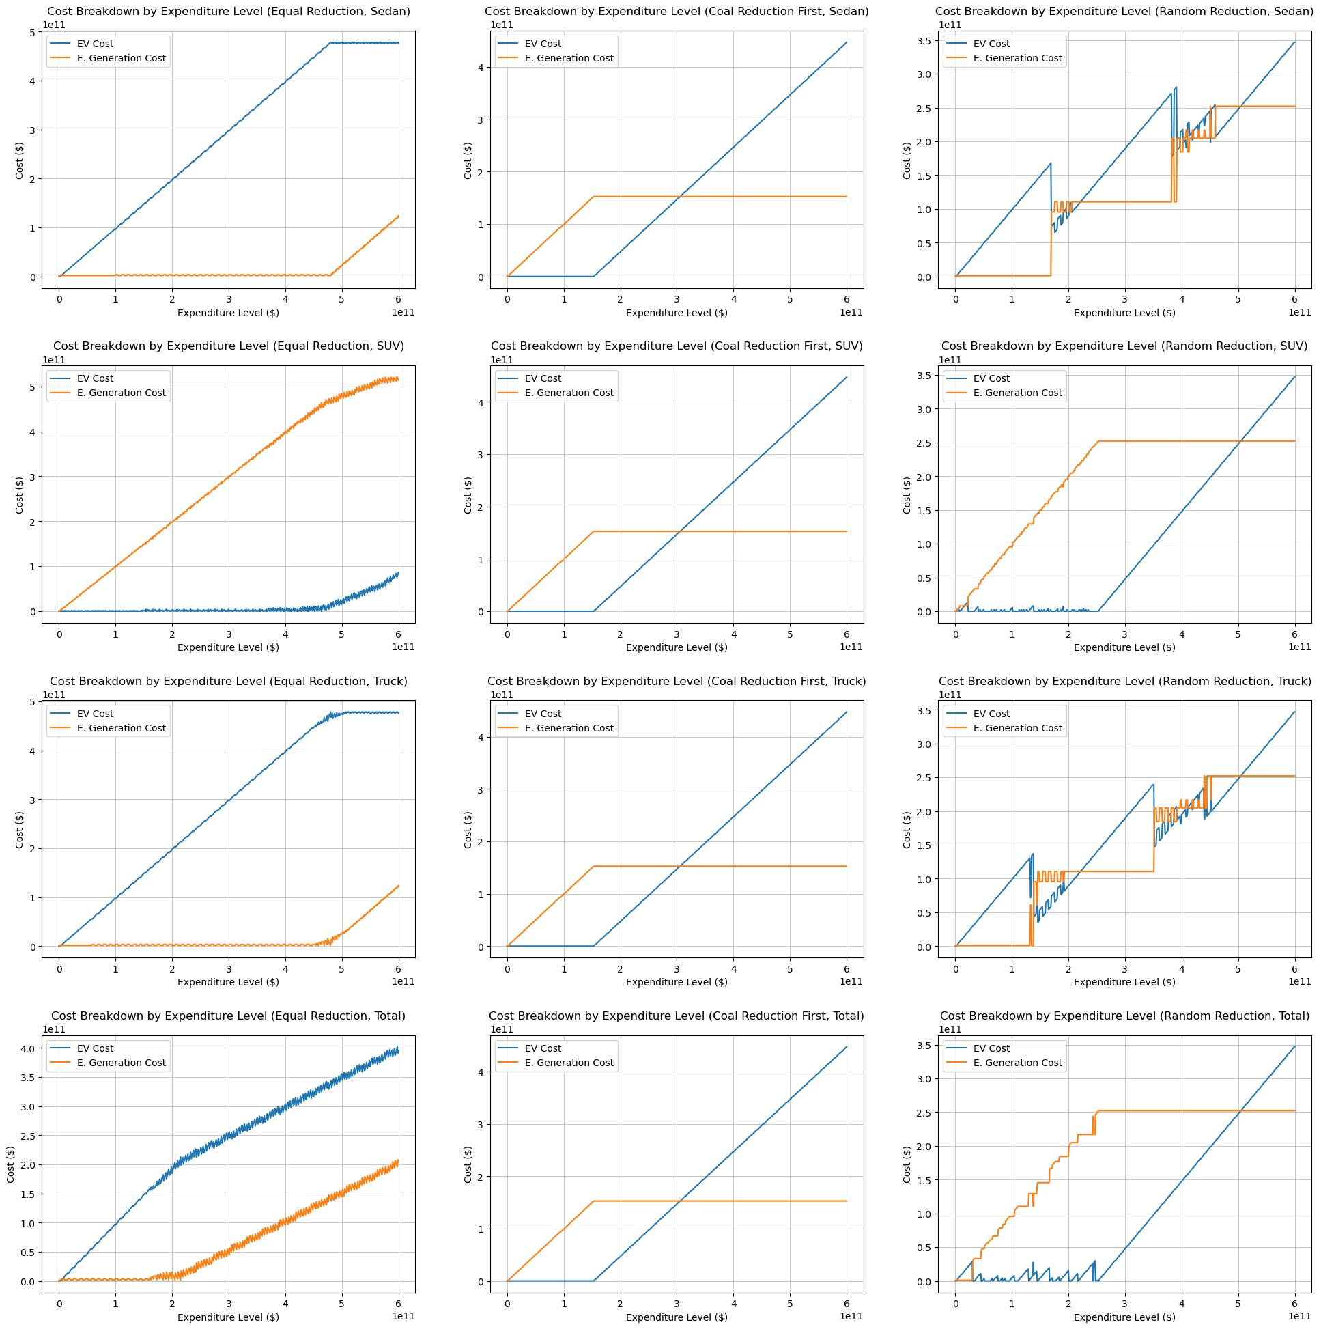
Optimization,
continued
Each column represents one of the three modeled energy reduction scenarios
  coal-first reduction
  equal type reduction
  random type reduction
Each row represents one of the three vehicle categories, with the final row as the weighted average
  Sedans
  SUVs
  Trucks
  Weighted Average: Sedans (15.8%), SUVs (48.3%), Trucks (35.9%)

Slide 17
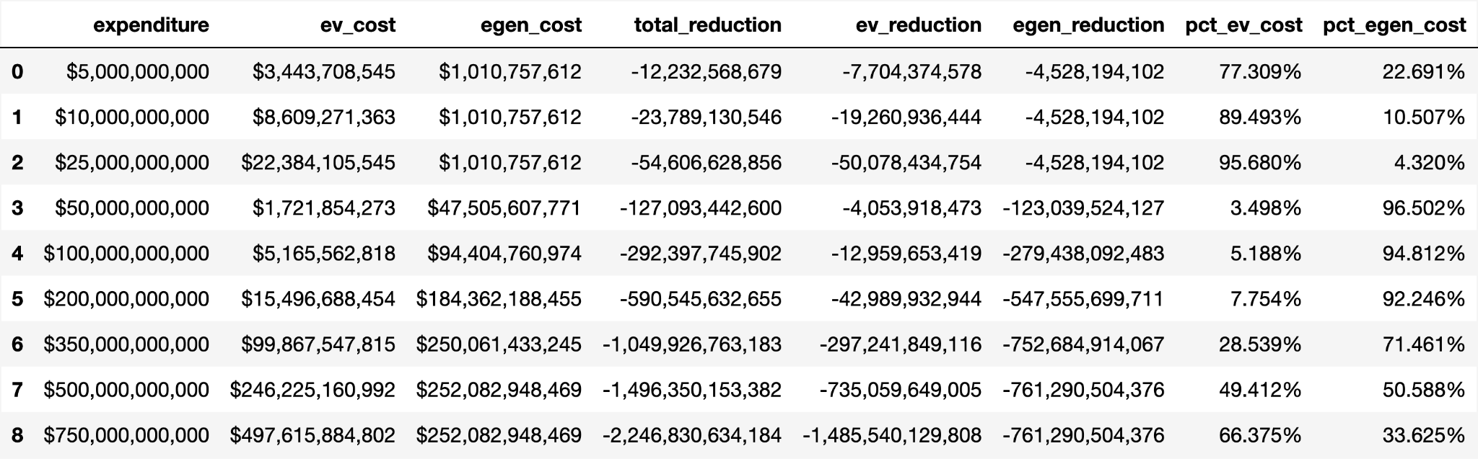
Conclusion
Under scenario 3 (modeled by the modified random walk), at small and very large levels of government expenditure, most funding should go towards EV subsidies; at intermediate levels of expenditure, most funding should go towards renewable energy generation
This table shows the dollar and percentage allocation of funds, split between subsidizing EVs and renewable energy, at nine levels of government expenditure

Slide 18
Conclusion, example
While exact spending is difficult to quantify, the government allocates billions of dollars each year towards emissions reduction efforts. The Inflation Reduction Act (2022) will commit $393.7 billion on emissions reduction over the next decade (McKinsey, 2022), while the Bipartisan Infrastructure Law (2021) allocates $100 billion towards clean infrastructure over five years.
To understand how effective spending is on emissions reductions, the United States produces roughly 6.343 billion metric tons of greenhouse gasses each year, with 5.053 billion metric tons (79.66%) due to CO₂ emissions (EPA, 2024).
Assuming the government spends roughly $100 billion on carbon emissions reductions, our projections assume a reduction of 0.2924 billion metric tons of CO₂ yearly, about 4.61% of total greenhouse emissions, and 5.79% of CO₂ related emissions.

Slide 19
Data Sources
Lifetime Emissions Data
Carbon Dioxide Emissions Coefficients by Fuel
Emission factors in kg CO2-equivalent per unit
Carbon footprint distributions of lithium-ion batteries and their materials
Energy Generation & Pricing
Projected Costs of Generating Electricity 2020 – Analysis - IEA
Electricity Data Browser
Renewables Generation Cost
2025 Solar Panel Cost
2022 Cost of Wind Energy Review
Life Cycle Assessment of Greenhouse Gas Emissions for Floating Offshore Wind Energy in California

