Slide 1
Springboard Data Science Intensive Capstone Project
Patrick Long
May, 2017

Slide 2
The Problem to be Addressed
Patient hospital experience plays a central role in patient well-being yet is an all too often neglected facet of our healthcare system.
While some hospital systems are highly attentive to the first-hand experiences of patients, it is difficult as patients – the healthcare consumer – to identify hospitals that excel at this dimension of patient care.
Moreover, many hospitals lack strong metrics to predict the quality of patient experience within their organization, which stifles clinical care.
Image from: https://blog.cbecompanies.com/2017/02/17/the-5-things-you-must-know-about-healthcare-rcm/ accessed 5/26/2017
Notes:
Image from: https://blog.cbecompanies.com/2017/02/17/the-5-things-you-must-know-about-healthcare-rcm/ accessed 5/26/2017

Slide 3
The Proposed Solution:
Hospital performance metrics are publically available through Medicare’s Hospital Compare Database.
The goal of this study will be to twofold:
Develop a model to accurately predict patient hospital experience using Medicare Hospital data.
Identify a subset of key hospital attributes that provide the greatest value toward predicting patient hospital experience.
Image from: https://blog.cbecompanies.com/2017/02/17/the-5-things-you-must-know-about-healthcare-rcm/ accessed 5/26/2017
Notes:
Image from: https://blog.cbecompanies.com/2017/02/17/the-5-things-you-must-know-about-healthcare-rcm/ accessed 5/26/2017

Slide 4

Overview of Medicare Data used for this Study
General Hospital Information
Location, ownership model, the inclusion of various clinical services (e.g. electronic health records, emergency care, medical imaging).
Hospital readmission metrics
Number of readmissions, discharges, level of readmissions relative to hospitals treating similar patient populations.
Medicare Spending per Beneficiary/Patient (MSPB)
Level of Medicare reimbursement per patient relative to the national average for Medicare reimbursement.
Patient experience ratings used in this analysis are derived from Medicare’s Hospital Consumer Assessment of Healthcare Providers and Systems Survey (CAHPS®).
Data from a total of 2,208 hospitals were used in this study.

Slide 5
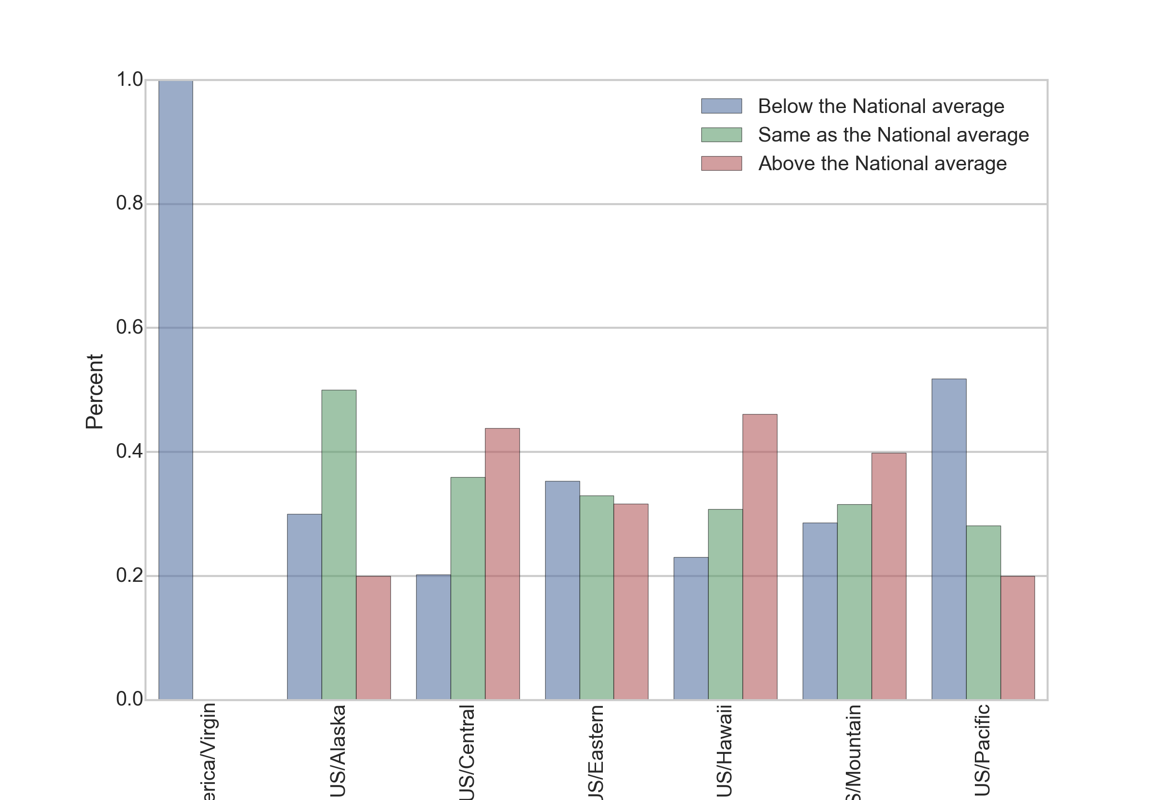
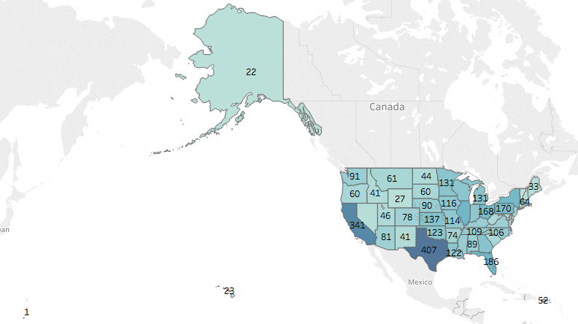
Patient Experience Varies by Geography
Take Home
Hospitals in this data set are concentrated in large populous states like California and Texas.
Regions with highest ratings for patient experience are in the central, mountain and US/Hawaii time zones.
Regions with low patient experience ratings are in the Virgin Islands and the US/Pacific time zone.

Slide 6
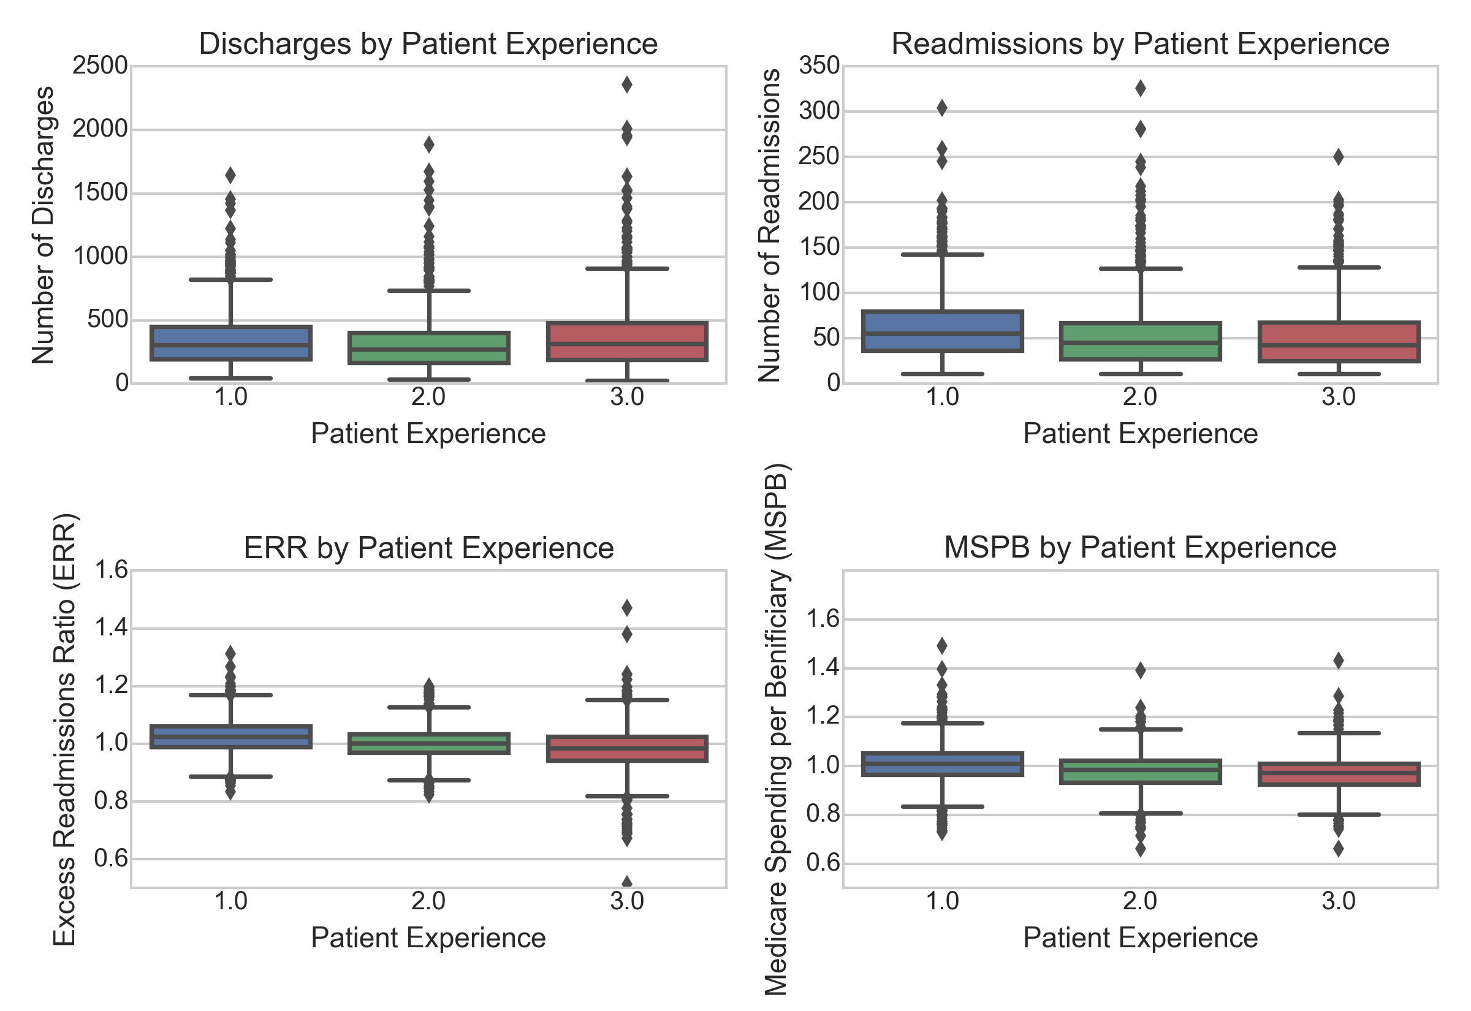
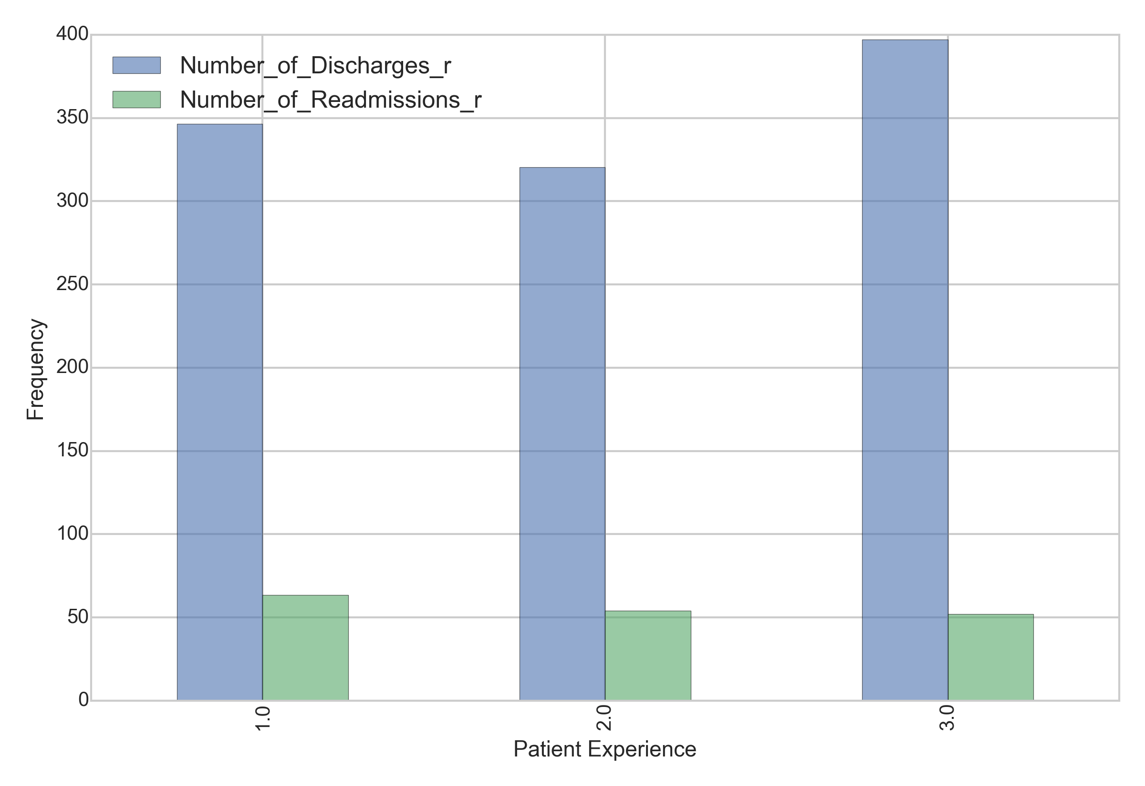
Patient Experience Varies by Readmissions Metrics
Discharge and Readmission Number by Patient Experience
Take Home
Hospitals with 'above the national average' rating in patient experience have the highest number of discharges yet the lowest number of readmissions. This trend is reflected it the hospital ERR, as well.
MSPB inversely correlates with ratings of patient experience. This suggests that highly rated hospital receive less Medicare reimbursement as measured by MSPB relative to the national average for similar hospitals.

Slide 7
Patient Experience Varies by Medicare Spending per Patient
Take Home
Hospitals with “Above the national average” rating in patient experience have the highest number of discharges yet the lowest number of readmissions. This trend is reflected it the hospital ERR, as well.
MSPB inversely correlates with ratings of patient experience. This suggests that highly rated hospital receive less Medicare reimbursement as measured by MSPB relative to the national average for similar hospitals.

Slide 8
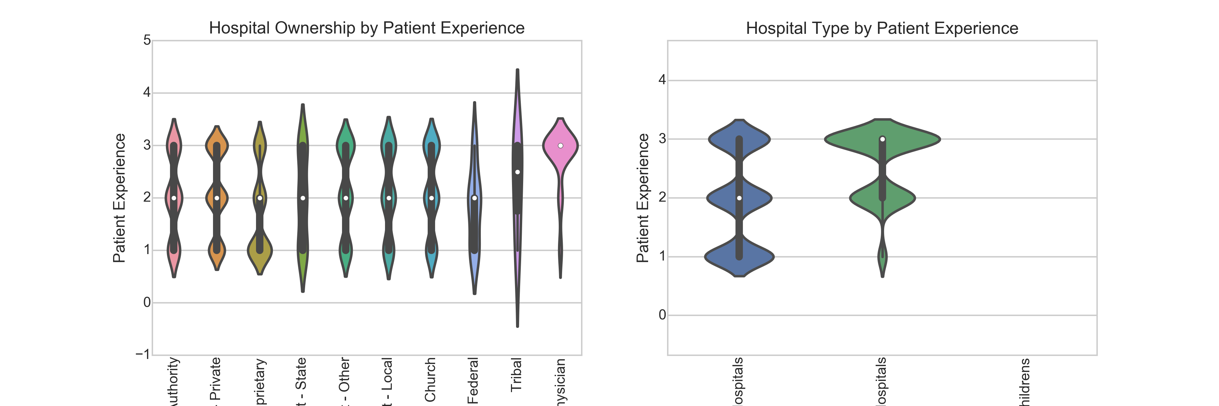
Patient Experience Varies by Hospital Ownership and Type
Take Home
Physician run hospitals show the highest level of patient satisfaction, while proprietary hospital ownership is associated with poor patient satisfaction.
For hospital type, critical access hospitals have more favorable patient experience ratings relative to acute care hospitals.
None of the children's hospitals have patient experience ratings and will thus be not be used for machine learning predictions of patient experience.

Slide 9
Key Questions
Can patient hospital experience be predicted using Medicare Hospital Compare Data?
What key hospital attributes are most effective at predicting patient experience?
Approach
Test various machine learning models to see how accurately one can predict patient experience.
Identify the key hospital attributes responsible for machine learning predictive accuracy.

Slide 10
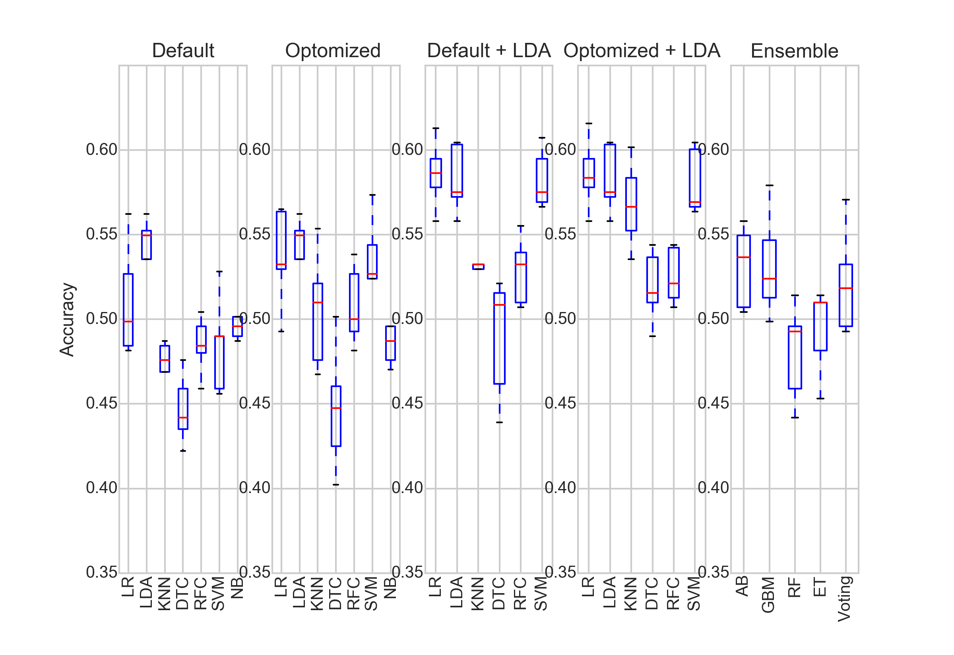
What Models are Most Accurately Predict Patient Hospital Experience?
Model Optimization
Logistic regression (LR) was consistently among the most accurate algorithms at predicting patient hospital experience using Medicare Hospital Compare data during the model optimization state of this analysis.

Slide 11
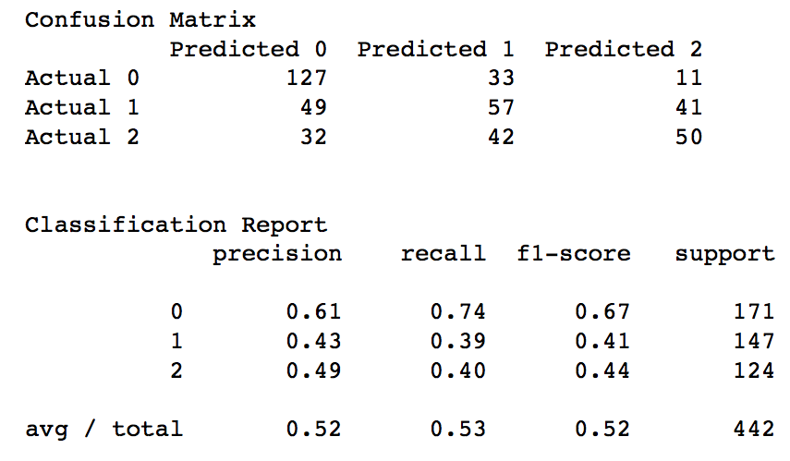
How Does Logistic Regression Perform as a Predictive Model of Patient Hospital Experience?
Model Validation
This LR has about 52% accuracy in predicting patient hospital experience.
This LR shows greatest precision when predicting poor patient experiences (61%).
This LR shows greatest recall when predicting poor patient experiences (74%).
accuracy= True Positives / All Instances
precision = True Positives / (True Positives
+ False Positives)
recall= True Positives / (True Positives
+ False Negatives)

Slide 12
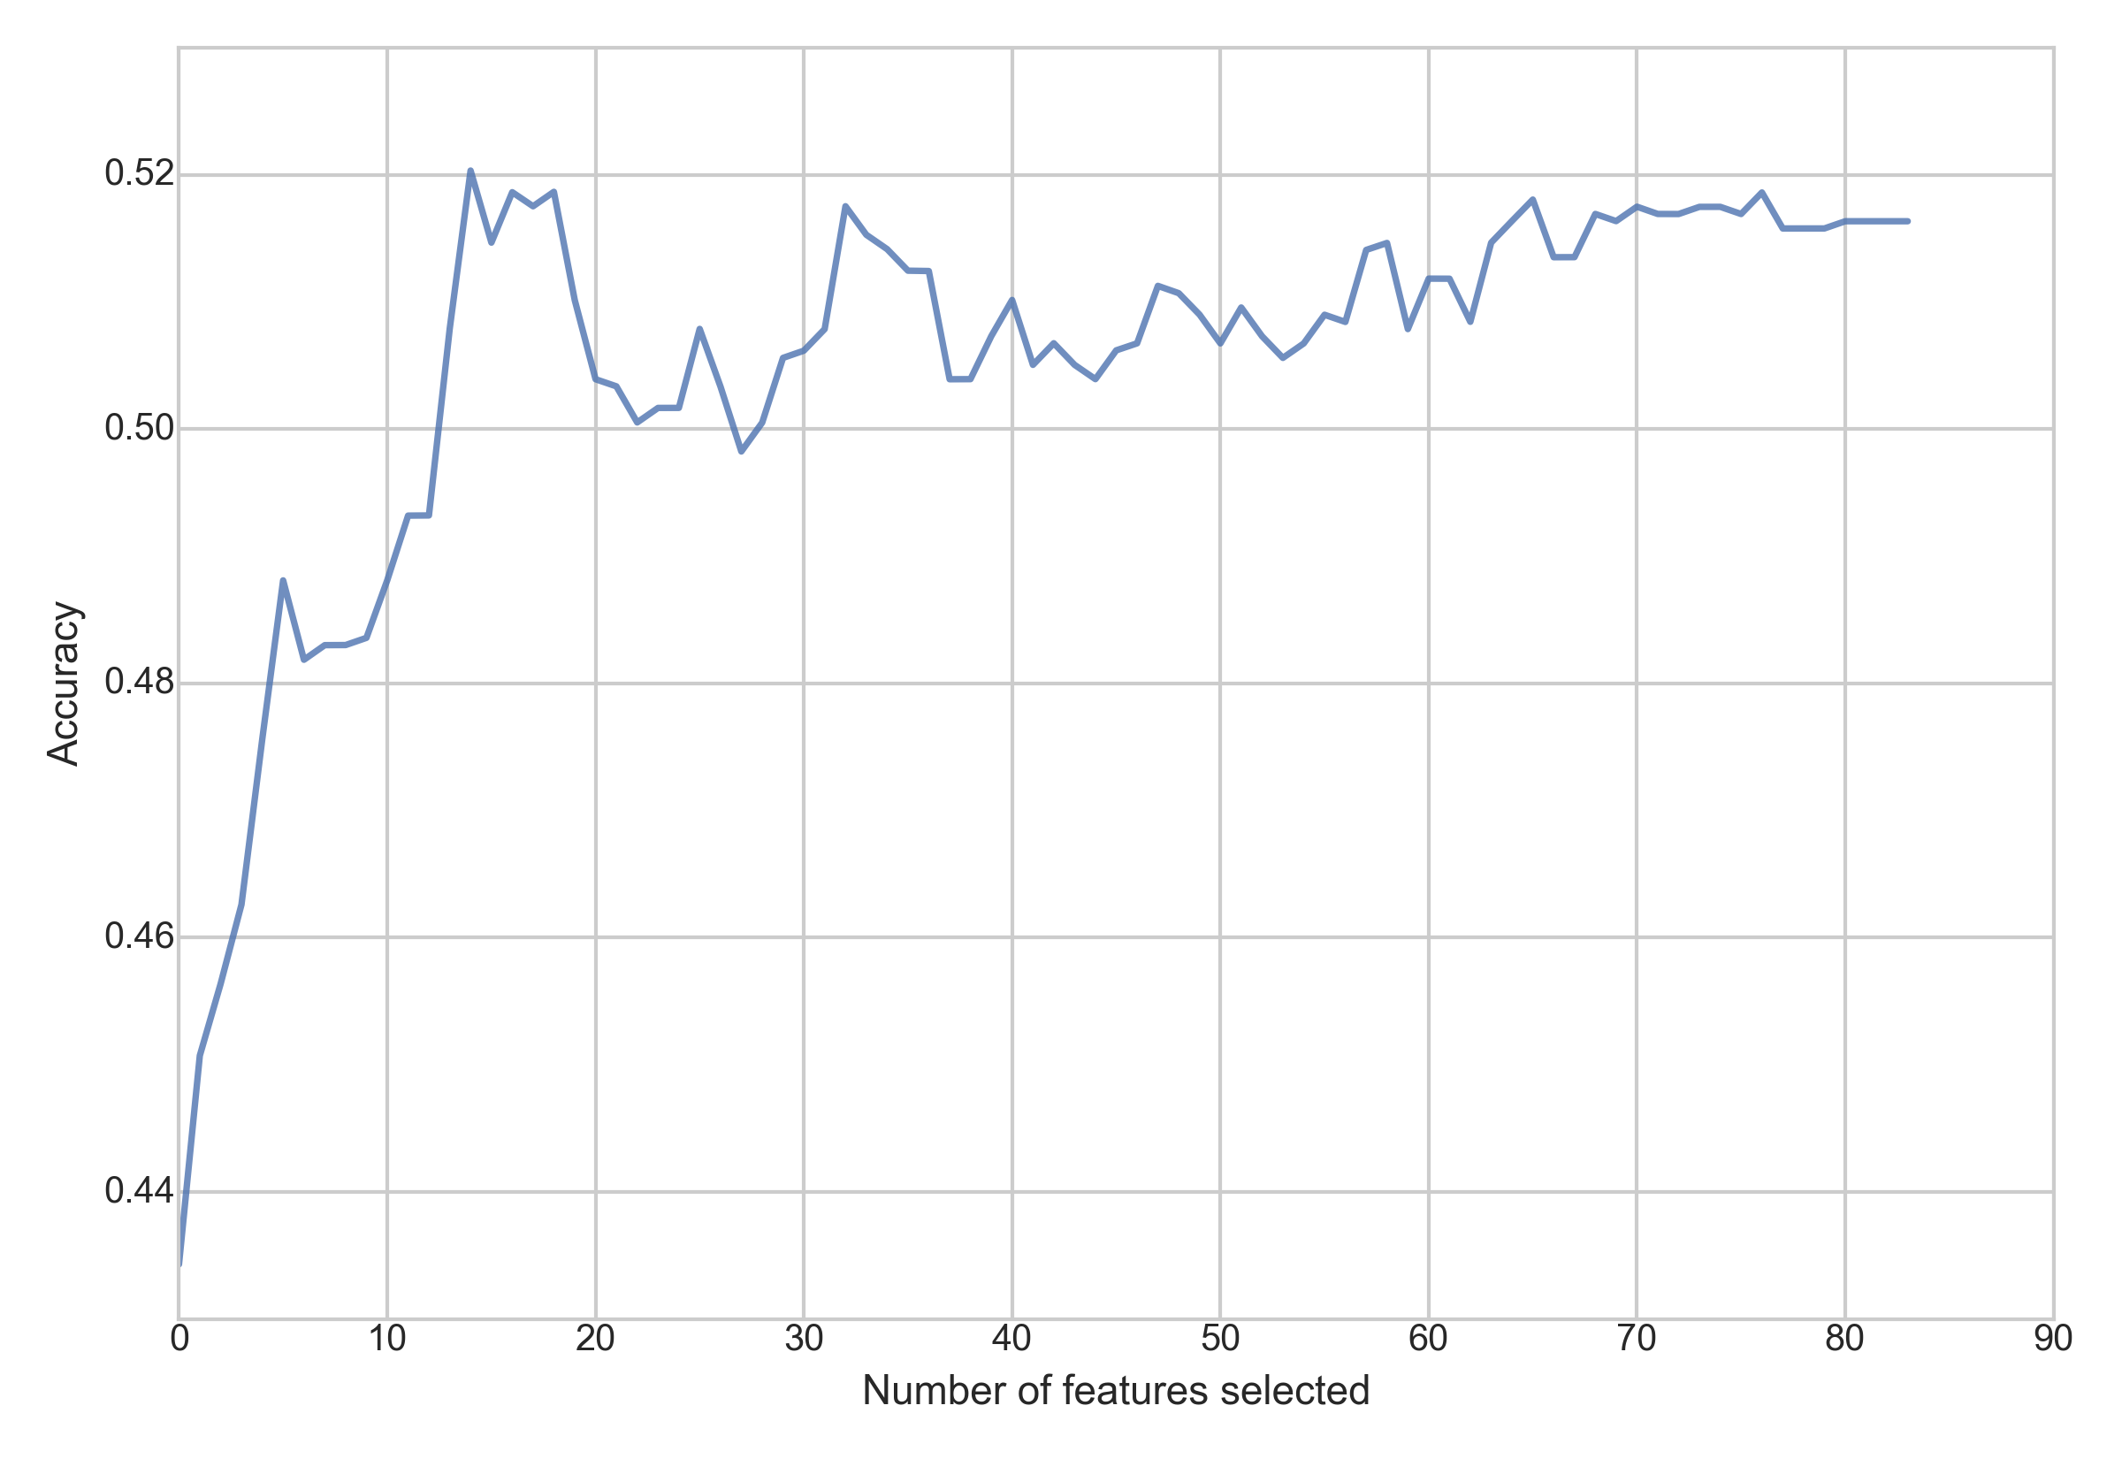
What Hospital Attributes/Features Most Accurately Predict Patient Hospital Experience?
Optimal Feature Number
15 of 84 features were identified as important to predictive patient hospital experience:
Number of Discharges
Number of Readmissions
MSPB
Proprietary Hospital Ownership
“Below National Average” Timeliness of Care
Hospital Location in 1 of 10 states/districts:
AR, DC, LA, NE, NH, NM, NY, SC, SD, WI

Slide 13
Summary of Key Findings
Patient hospital experience can be predicted with approximately 52% accuracy using publically available Medicare Hospital Compare Data.
This represents a ~20% improvement over random guess (i.e. 33% likelihood of a correct guess).
Fifteen hospital attributes were identified that account for predictive accuracy of patient experience.
These include readmissions metrics, Medicare spending per patient, hospital ownership model, timeliness of care, and hospital geography.

Slide 14
Key Recommendations
When predicting and/or improving patient hospital experience, attention should focus on readmissions metrics, spending per patient, ownership model, timeliness of care, and hospital geography.
While the Medicare Hospital Compare data utilized in this study increased increase in predictive accuracy ~ 20% over a random guess, it is advisable to investigate additional hospital attributes that could provide greater predictive accuracy.
Reliably detecting negative and positive patient experiences may be of greatest value to both the patient/healthcare consumer and healthcare provider than distinguishing identifying neutral patient experiences. Using a binary classification system for the quality of patient experience system is recommended.

Slide 15
Appendix

Slide 16
Key Terms
Number of Discharges: Number of patients discharged over 30-day period for heart attack, heart failure, and pneumonia.
Number of Readmissions: Number of patients readmitted over 30-day period for heart attack, heart failure, and pneumonia.
Excess Readmission Ratio (ERR): This ratio is created by dividing a hospital’s number of “predicted” 30-day readmissions for heart attack, heart failure, and pneumonia by the number that would be “expected,” based on an average hospital with similar patients. A ratio greater than 1 indicates excess readmissions.
MSPB: The Medicare hospital spending per patient (Medicare Spending per Beneficiary, MSPB) measure indicates whether Medicare spends more, less or about the same per Medicare patient treated in a specific hospital, compared to how much Medicare spends per patient nationally. This measure includes any Medicare Part A and Part B payments made for services provided to a patient during the 3 days prior to the hospital stay, during the stay, and during the 30 days after discharge from the hospital.
EHR: The use of electronic health records (EHR).
Hospital Type: Hospital Type i.e. critical access, acute care, children's’.
Hospital Ownership: Model of hospital ownership e.g. government run, proprietary, volunteer/non-profit.
Emergency Services: Meets emergency services criteria.
Safety of Care: Safety of care ratings for a hospital (below, same as, or above national average).
Effectiveness of Care: Effectiveness of care ratings for a hospital (below, same as, or above national average).
Timeliness of Care: Timeliness of care ratings for a hospital (below, same as, or above national average).
Efficient use of Medical Imaging: Medicare score of medical imaging use.
Hospital Overall rating: An aggregate score of hospital rating from low to high (1 - 5) derived from the above measures. Will be used for data exploration but not prediction of patient experience.

