Slide 1
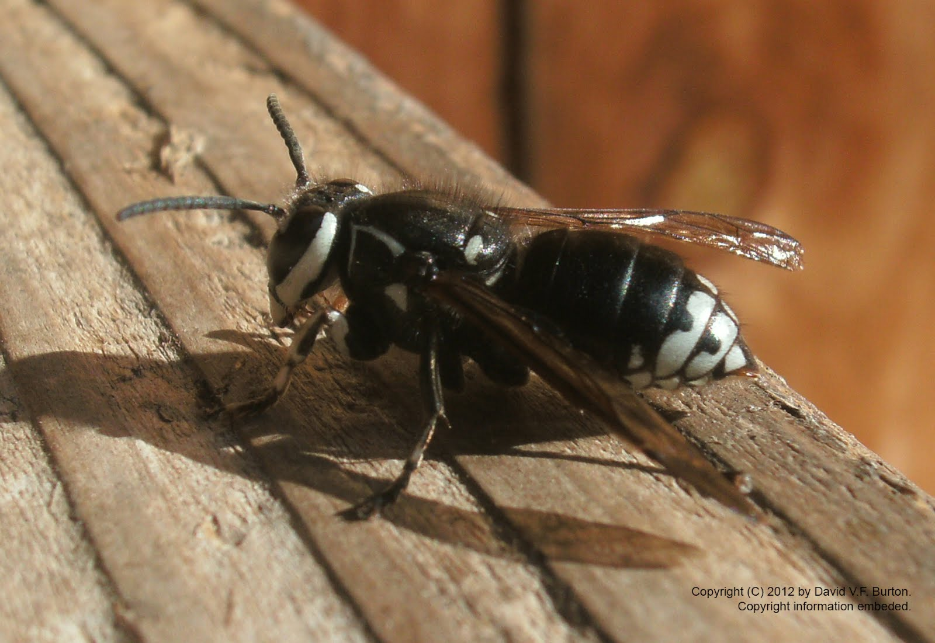
Insects

Slide 2
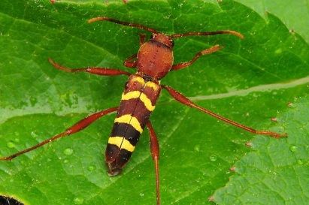
Characteristics
Exoskeleton 6 Legs

Slide 3
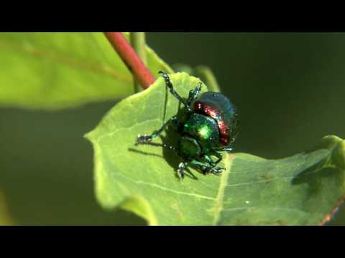
EVEN MORE CHARACTERISTICS
3 body parts compound eye

Slide 4
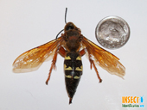
More Characteristics
Antennae Segmented body

Slide 5
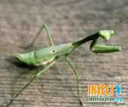
Behaviors
Fly
Sting
bite

Slide 6
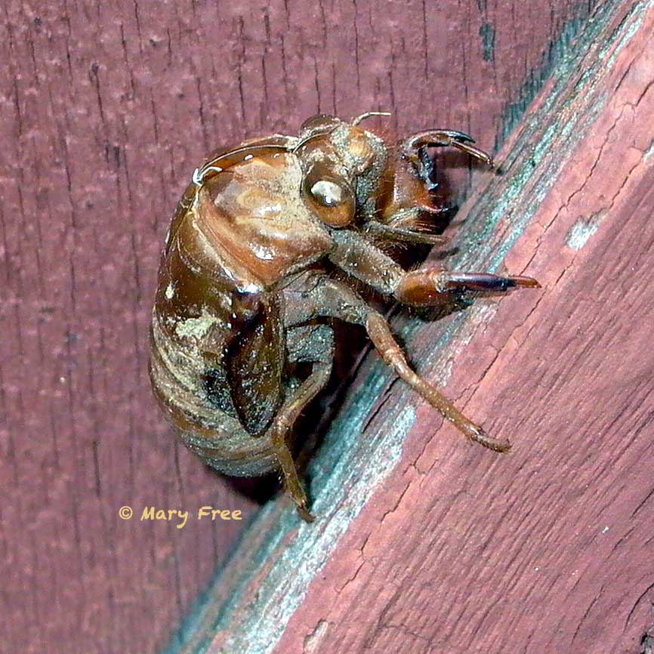
Environments
Some bugs live in beds
Houses
“nests”
Trees
In the ground

Slide 7
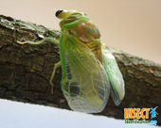
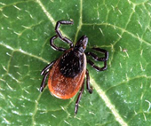
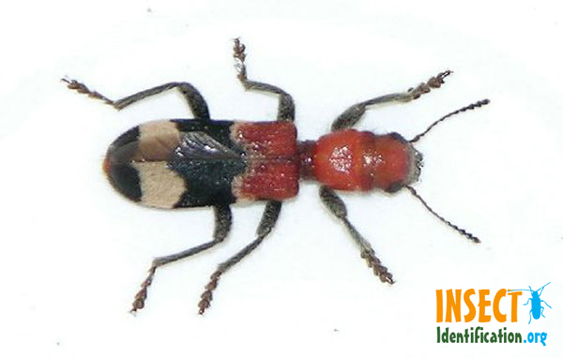
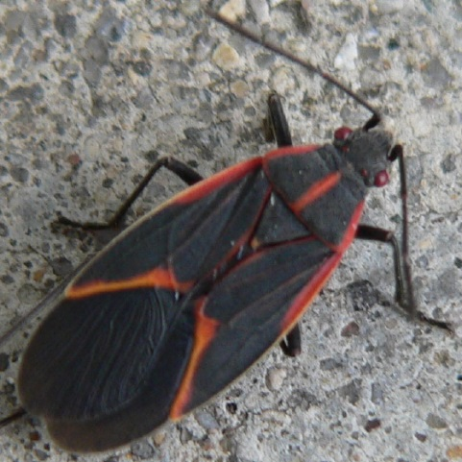
5 Bugs that live in VT

