Slide 1
predicting healthcare utilization

Slide 2
Project Overview
Goal
Based on the California Health Interview Survey (CHIS) dataset, can I predict high utilizers of healthcare (those with >12 doctors visits in a given year) based on the demographic (Age, Household Size, Income, etc.) and health information (Diabetes, Asthma, Heart Disease, Time Walked, BMI, etc.) provided?
Why?
High utilizers of health could be placed in care management programs to improve a patient’s health/experience and reduce a health system’s cost

Slide 3
Data Overview
Source Data: California Health Interview Survey (CHIS)
Description:
Cross-sectional survey of California’s population
Approximately 20k individuals are surveyed each year
Each record represents a single individual’s responses
Over 350 data points collected on individuals
Data points cover: demographics; general health and behaviors with specific questions around heart disease, diabetes, and asthma; mental health; health utilization; health insurance; and employment and socioeconomic
Data going back to the early 2000’s; however the survey is not longitudinal
UCLA performs imputation so data is reasonably ‘clean’

Slide 4
Data Overview
My Manipulation of the Data
Concatenated data from 2009-2014 surveys (~130k records)
Over 350 fields of data; however, I selected ~35 that I assumed were the most pertinent to my question (mostly for data cleansing reasons) and were included in all survey years
Example fields: Age, BMI, AstmaFLG, HeartDiseaseFLG, ERVisitFLG, etc.
Caveats to the Analyses
Events are not timestamped so I don’t know the order of features / responses
I do not take into account CHIS weights of individual records to extrapolate the sample to the population (adjust for sampling bias)
A health system might not have access to all of the data points when making predictions

Slide 5
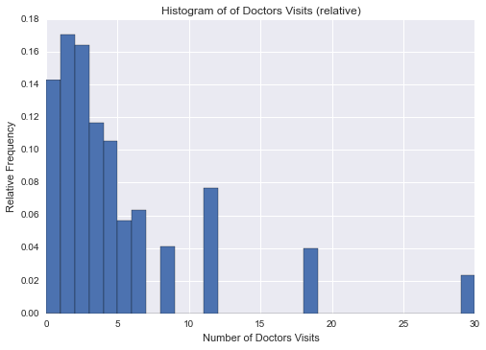
Exploratory analyses

Slide 6
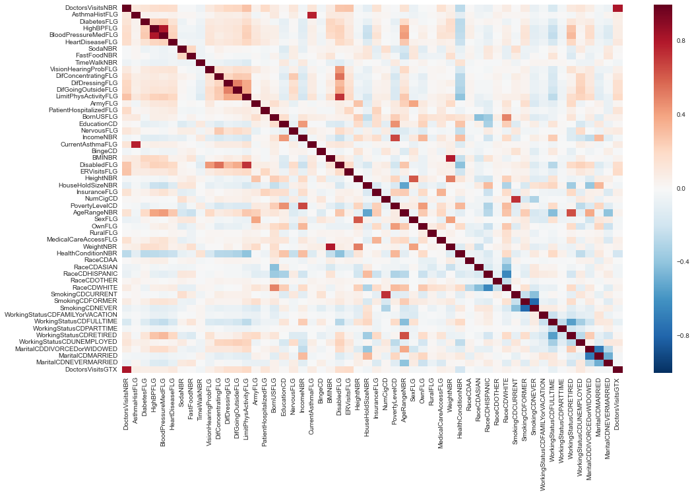

Slide 7
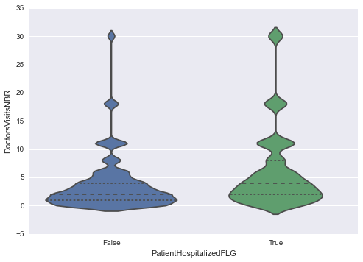
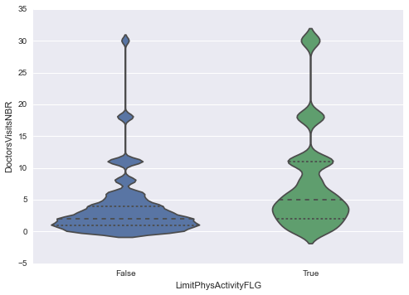
Exploratory analyses

Slide 8
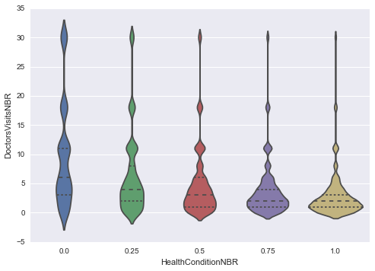
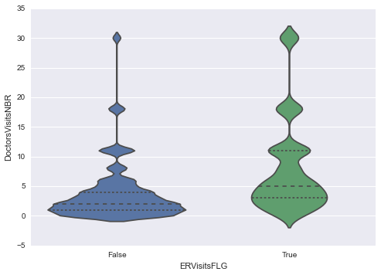
Exploratory analyses

Slide 9
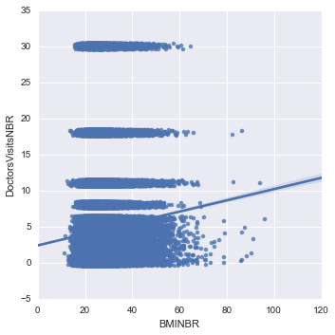
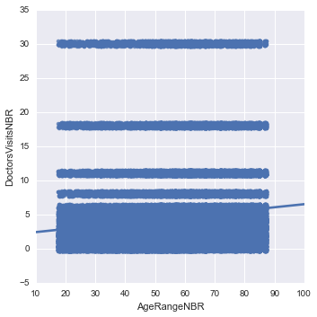
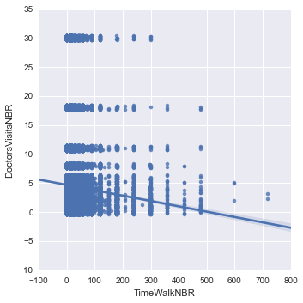
Exploratory analyses

Slide 10
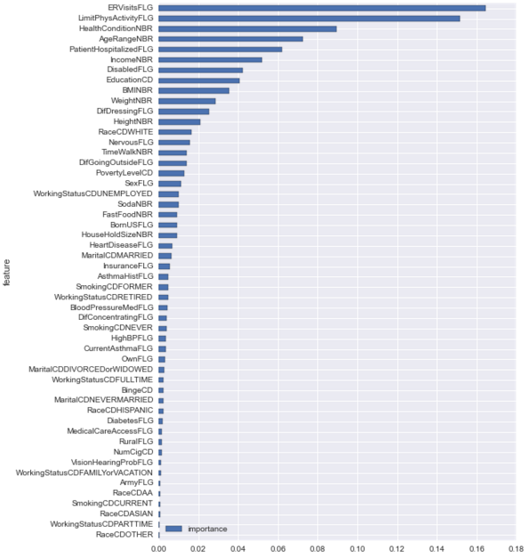
MODELS
Feature Importance (RF)
ER Visit
Limited Physical Activity
Health Condition
Age
Patient Hospitalized
Income
Disabled
Education
BMI
Difficulty Dressing
Nervous
Time Walked

Slide 11
MODELS
Presenting the Question as a Binary Classification Problem
In this specific care management example, I am assuming that a health system can assign a care management individual to ~10% of their population. Given this, what I care about is should the person be put in the care management program (Yes or no answer)
Given this, I care about ‘high utilizers’, so I segmented the data into individuals with greater than 12 doctors visits and individuals with less than or equal to 12 doctors visits
Note: 93.679% of individuals had less than 12 doctors visits (~6.3% has more than 12 doctor’s visits)
Issues:
Accuracy versus ROC AUC?
Unbalanced classifier

Slide 12
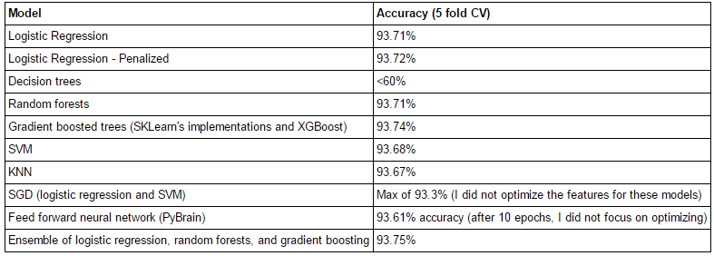
MODELS
Model Results (Accuracy)
Note: Dummy answer of less than or equal to 12 doctors visits would result in 93.679% accuracy
Note: I also looked at maximizing AUC and some class weight adjustments, led to similar results

Slide 13
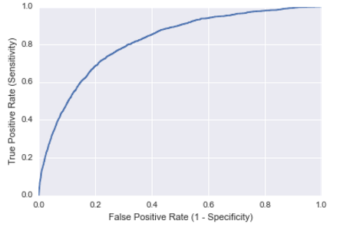
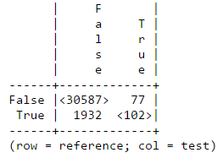
MODELS
Gradient Boosted Trees Specifics
AUC of .818
Percent of Total Predicted True: 0.55%
TPR (Sensitivity) rate: 5.01%
Specificity rate: 99.75%
Accuracy rate: 93.86% (test data)

Slide 14
Model use case
I want to vary the threshold in order to get a higher True Positive Rate (Sensitivity)
In the specific care management example, I am assuming that a health system can assign a care management individual to ~10% of their population
If this is the case, at the 10% rate, I want to know what ratio of those that are actually high utilizers are predicted as high utilizers (i.e. the True Positive Rate).

Slide 15
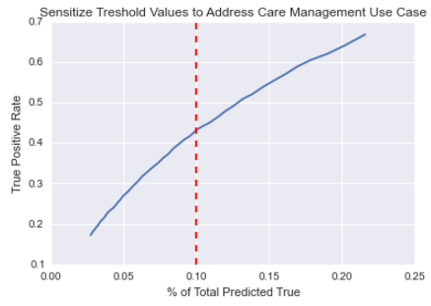
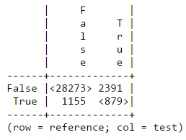
Model use case
Adjusted Threshold Results
Percent of Total Predicted True: 10.0%
TPR (Sensitivity) rate: 43.2%
Specificity rate: 92.2%
Accuracy rate: 89.2%

Slide 16
Conclusion and next steps
Personal Thoughts
I am somewhat satisfied with the final results – possibly applicable in real world
Challenges
Size of data made parameter tuning a lengthy process (12+ hours in a lot of cases)
Unbalanced classifier issue
Number of features X number of models X parameter tuning X size of data = lots of time to test out all cases. I did not perform much feature engineering

Slide 17
Conclusion and next steps
Next Steps
Additional feature engineering besides data cleaning (i.e. feature exclusion)
Further adjustments to take into account unbalanced classifier
Only analyze features that a health system would have access to
Other use cases for the data (heart disease, diabetes, asthma)
Review similar data sets (NHIS, MEPS)
This is most exciting to me. There could be real world use cases for these insights
Initial framework for care management models
Benchmarking datasets

