Slide 1
The Boyne Island smelter: a case study
Patrick O’Callaghan and John Mangan
AIBE, University of Queensland

Slide 2

Economic Modelling with Sector-specific Euler Equations ``emsee’’ model overview

Slide 3
CGE model with forward-looking dynamics:
Supply = Demand (output = med + con + inv + xpo) at each time
Output is a function of capital, labour, intermediates (with imports) and a fixed factor.
Capital depreciates and is optimally replenished to grow the economy.
Balanced growth paths: each sector grows in range 1% to 2%
Solve as a sequence of overlapping nonlinear dynamic programs
Sector-specific Euler Eq’ns:
Testable condition: ``value capital today’’ = ``expected value of capital in the future’’
When the SEE hold, capital is optimally allocated across sectors
Absent in intersectoral models: CoPS; Atalay; Cesa-Bianchi et al; Baqaee and Farhi
Transition to net zero: some SEE may fail to hold and, in this case:
sectoral shocks are more likely to spill over/propagate to other sectors
the economy has more capacity for adaptation: chance to nudge economy to new equilibria

Slide 4
Aluminium Industry and Boyne Smelters Limited (BSL)

Slide 5

Australia: energy-abundant and fully integrated Aluminium supply chain
One of only three countries in the world along with Brazil and Venezuela.
Qld: Weipa Bauxite Gladstone for AlOx refining and Al smelting at BSL
Gladstone Bauxite imports less than half of Weipa production
QAL and Yarwun: Alumina sales to BSL is 15% of total output
No obvious major threats to overall supply chain: Rio Tinto is majority owner
BSL: consumes 1/8 of Qld’s electricity; large energy subsidy ($250m+)
Like other smelters it is in close proximity of energy resources
Recent Smelter closure: Kurri Kurri smelter, closed in 2012
Tiwai Point smelter, New Zealand almost closed in 2020-2021:
Qld Energy and Jobs Plan:
Sustaining heavy industry in Qld is a key part of the transition
Notes:
To give context, the Gladstone Power Station has the capacity to supply one-sixth of Queensland’s power

Slide 6
Gladstone, Central Queensland

Slide 7
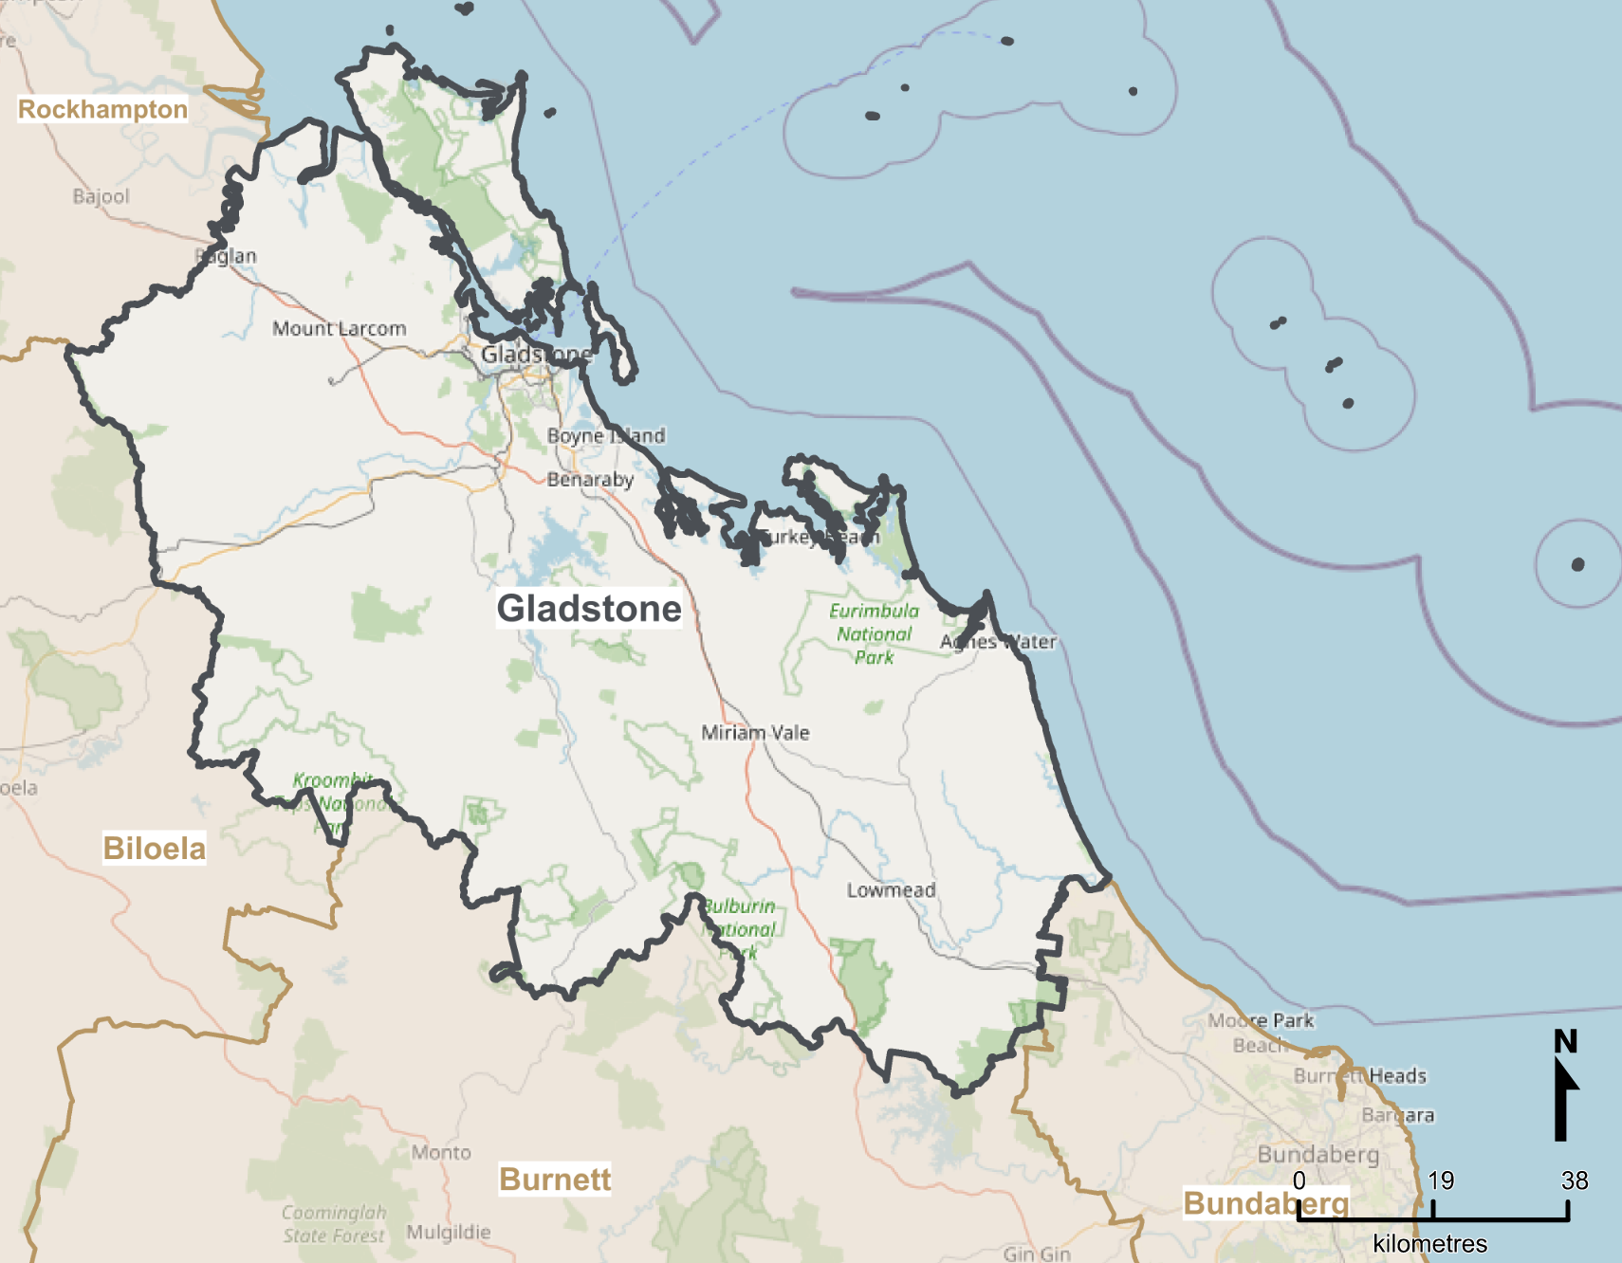

Gladstone (2018-19 economy, SA3/LGA):
$15.5bn aggregate output: approx. 25% of Central Qld, 2% Qld
29k FTE: approx. 28% of Central Qld, 1.3% of Qld
63k population: highly skilled, but aging with 0.7% growth
Multi-commodity deep-water port plus rail and road infrastructure
Gladstone is Qld’s regional manufacturing hub:
$5.5bn to $6bn Manufacturing output: of which approx. $1bn is BSL
4k to 4.5k Manufacturing FTE employees: of which 1k at BSL
BSL represents approx. ¼ of Manufacturing activity except in energy consumption
Other Heavy industry: Ammonia, Cement, LNG, Oil refinery
Growth industries: ag-tech, AlOx for batteries, aquaculture, Mining Serv., green {…}

Slide 8
Data sources

Slide 9
Using data we specialise the model to the Gladstone region with 19 ANZSIC divisions
Jobs in Australia ABS data: labour per sector for Gladstone 2019.
Input-output flows between sectors: ABS tables 5 and 8 for Australia
Investment flows between sectors: following Atalay (2017)
Adapt investment flows tables from the US Bureau of Economic Analysis
ABS Gross Fixed Capital Formation by Industry by type of Asset
BLADE (and Remplan): for output per sector for Gladstone 2019
Gladstone Port data for Bauxite, Alumina, Aluminium and Coal
Eg. Bauxite imports
Rio Tinto accounts
Studies on aluminium production e.g.
Gagne and Nappi 2000
Best Available Techniques 2017

Slide 10
Experiments and shocks

Slide 11
Experiment Type (1):
1st phase: tune parameters to regionalise, all 20 SEE hold
2nd phase: capital evolves towards a balanced growth path
3rd phase: continue along same path and generate
``status quo’’ path
``shock’’ (BSL closure) path
Experiment Type (2):
1st phase: tune parameters to regionalise; not all 20 SEE hold
2nd phase: capital evolves towards a balanced growth path
3rd phase: continue along same path and generate
``status quo’’ path
``shock’’ (BSL closure) path
Shock type (a): one-off “MIT shock” agents don’t see coming
1/4 decrease in Manufacturing productivity, capital and exports
5/6 decrease in Utilities (energy + water) purchases by Manufacturing
No exogenous decommissioning or replacement activity

Slide 12


Experiment (1a) Summary of Results
Shock is sector-specific
Utilities prices by 4%
Agriculture, Consumption
But Gladstone is connected to NEM …
Manufacturing employment 6%:
At 32% lower pay as economy strives to preserve current equilibrium.
Experiment (2a) an example of Results
Shock is more dispersed
Prices: Utilities 10%, Manuf. 3%
Agriculture, Mining, … Consumption
But Gladstone is connected to NEM …
Employment: Manuf. 1.5%:
At 19% lower pay.
Agric. employment 5%, Mining more
Aggregate Output -$1.7bn
Manufacturing | Others
-$1.59bn | -$0.1bn
Aggregate Output -$0.85bn
Manufacturing | Others
-$1.14bn | +$0.29bn

Slide 13
Comparison of experiments: (1a) (2a) All 20 SEE hold Not all 20 SEE hold

Slide 14
Experiment-shock (1a): % change relative to status quo,
Aggregates
Experiment-shock (2a): % change relative to status quo,
Aggregates
Aggregate Capital permanently down by 1.6-1.7%
Aggregate Output permanently down by 11% or $1.7bn
Consumption falls as aggregate price levels rise
Aggregate Capital is higher than status quo after 7 years
Output initially falls by 6% or $0.85bn before rising; Consumption is 3.5% higher in the long run.

Slide 15
Experiment-shock (1a): % change relative to status quo,
Manufacturing
Experiment-shock (2a): % change relative to status quo,
Manufacturing
Manufacturing capital quickly recovers
Manufacturing output down by 27% or $1.5bn
Consumption falls as Manufacturing prices rise.
Manufacturing capital slowly recovers
Manufacturing output down by 20% or $1.1bn
Consumption rises as Manufacturing prices fall.

Slide 16
Experiment-shock (1a): % change relative to status quo,
Utilities
Experiment-shock (2a): % change relative to status quo,
Utilities
Capital down by 9% in the long run.
Utilities (Energy and Water) price initially fall by 4%;
Consumption up compensating for falls elsewhere;
Capital down by 6% in the long run;
Utilities price down by 10% and remains there;
Consumption up and remains there

Slide 17
Experiment-shock (1a): % change relative to status quo,
Agriculture (Similar pictures for Mining.)
Experiment-shock (2a): % change relative to status quo,
Agriculture
Cheaper energy and water prices cause
Capital up, Output up and consumption down
Similar, but more extreme:
Capital up by over 15% in the long run.

Slide 18
Key takeaways

Slide 19
BSL is important to Gladstone’s economy and Qld’s Al/AlOx supply chain
Transition needs to be handled with care: major consumer of energy and energy prices
Gladstone Aluminium: internationally competitive (given right energy transition)
June 2022: Rio Tinto calls for clean Gladstone Aluminium by 2030.
September 2022, Qld Energy Plan: supergrid can keep Gladstone in proximity of power supply
Economic modelling with SEE:
Testable equations with long history in macroeconomics / finance (absent in CGE)
If the SEE hold, then the shock is more sector-specific (less macroeconomic)
Transition: the SEE unlikely to hold (given uncertainty and out-of-date capital)
Greater propagation of shocks, but also greater opportunity for change
Policy implications:
We can estimate how the SEE fail and identify paths of least resistance for transforming the economy

Slide 20
References

Slide 21
Short list of Articles:
Atalay, E. (2017). How important are sectoral shocks?. American Economic Journal: Macroeconomics, 9(4), 254-80.
Baqaee, D. R., & Farhi, E. (2019). The macroeconomic impact of microeconomic shocks: Beyond Hulten's theorem. Econometrica, 87(4), 1155-1203.
Cai, Y., & Judd, K. L. (2021). A Simple but Powerful Simulated Certainty Equivalent Approximation Method for Dynamic Stochastic Problems (No. w28502). National Bureau of Economic Research.
Cusano, G., Rodrigo Gonzalo, M., Farrell, F., Remus, R., Roudier, S., Delgado Sancho, L. (2017). Best Available Techniques (BAT) Reference Document for the Non-Ferrous Metals Industries. Industrial Emissions Directive 2010/75/EU (Integrated Pollution Prevention and Control) (No. JRC107041). Joint Research Centre (Seville site).
Dixon, P., & Rimmer, M. T. (2020). Developing a DSGE consumption function for a CGE model. Centre of Policy Studies (CoPS), Victoria University.
Gagné, R., & Nappi, C. (2000). The cost and technological structure of aluminium smelters worldwide. Journal of Applied Econometrics, 15(4), 417-432.
Na, S., Anitescu, M., & Kolar, M. (2021). A fast temporal decomposition procedure for long-horizon nonlinear dynamic programming. arXiv preprint arXiv:2107.11560.
Data:
Australian Bureau of Statistics (ABS), 2018-2019. Tables 5 and 8: Industry by Industry Flow Table. Released May 2021.
Australian Bureau of Statistics, Business Longitudinal Analysis Data Environment (BLADE), 2018-2019, https://www.abs.gov.au/about/data-services/data-integration/integrated-data/business-longitudinal-analysis-data-environment-blade
Bureau of Economic Analysis (2003). Capital flow data for 1997. https://www.bea.gov/news/2003/capital-flows-us-economy-1997
Gladstone Regional Council. https://www.gladstone.qld.gov.au/downloads/file/3466/gladstone-region-investment-prospectus . Retrieved October 2022
Queensland Government (2022). Energy and Jobs Plan. https://www.epw.qld.gov.au/energyandjobsplan . Retrieved October 2022
Queensland Government. https://yoursayhpw.engagementhq.com/understand-qrez/news_feed/central . Retrieved October 2022
Port of Gladstone, “Trade Statistics Data,” https://www.gpcl.com.au/trade-statistics . Retrieved April 2020
Rio Tinto, (2019). Annual Report Production, Reserves and Operations. Retrieved in April 2020.

