Slide 1
The Boyne Island smelter: economic impact on the Gladstone region
Patrick O’Callaghan and John Mangan
AIBE, University of Queensland

Slide 2
Aluminium Industry and Boyne Smelters Limited (BSL)

Slide 3

Australia: energy-abundant and fully integrated Aluminium supply chain
One of only three countries in the world along with Brazil and Venezuela.
Qld: Weipa Bauxite Gladstone for AlOx refining and Al smelting at BSL
Gladstone Bauxite imports less than half of Weipa production
QAL and Yarwun: Alumina sales to BSL is 15% of total output
No obvious major threats to overall supply chain: Rio Tinto is majority owner
BSL: consumes 1/8 of Qld’s electricity; large energy subsidy ($250m+)
Like other smelters it is in close proximity of energy resources
Recent Smelter closure: Kurri Kurri smelter, closed in 2012
Tiwai Point smelter, New Zealand almost closed in 2020-2021:
Qld Energy and Jobs Plan:
Sustaining heavy industry in Qld is a key part of the transition
Notes:
To give context, the Gladstone Power Station has the capacity to supply one-sixth of Queensland’s power

Slide 4
Gladstone, Central Queensland

Slide 5
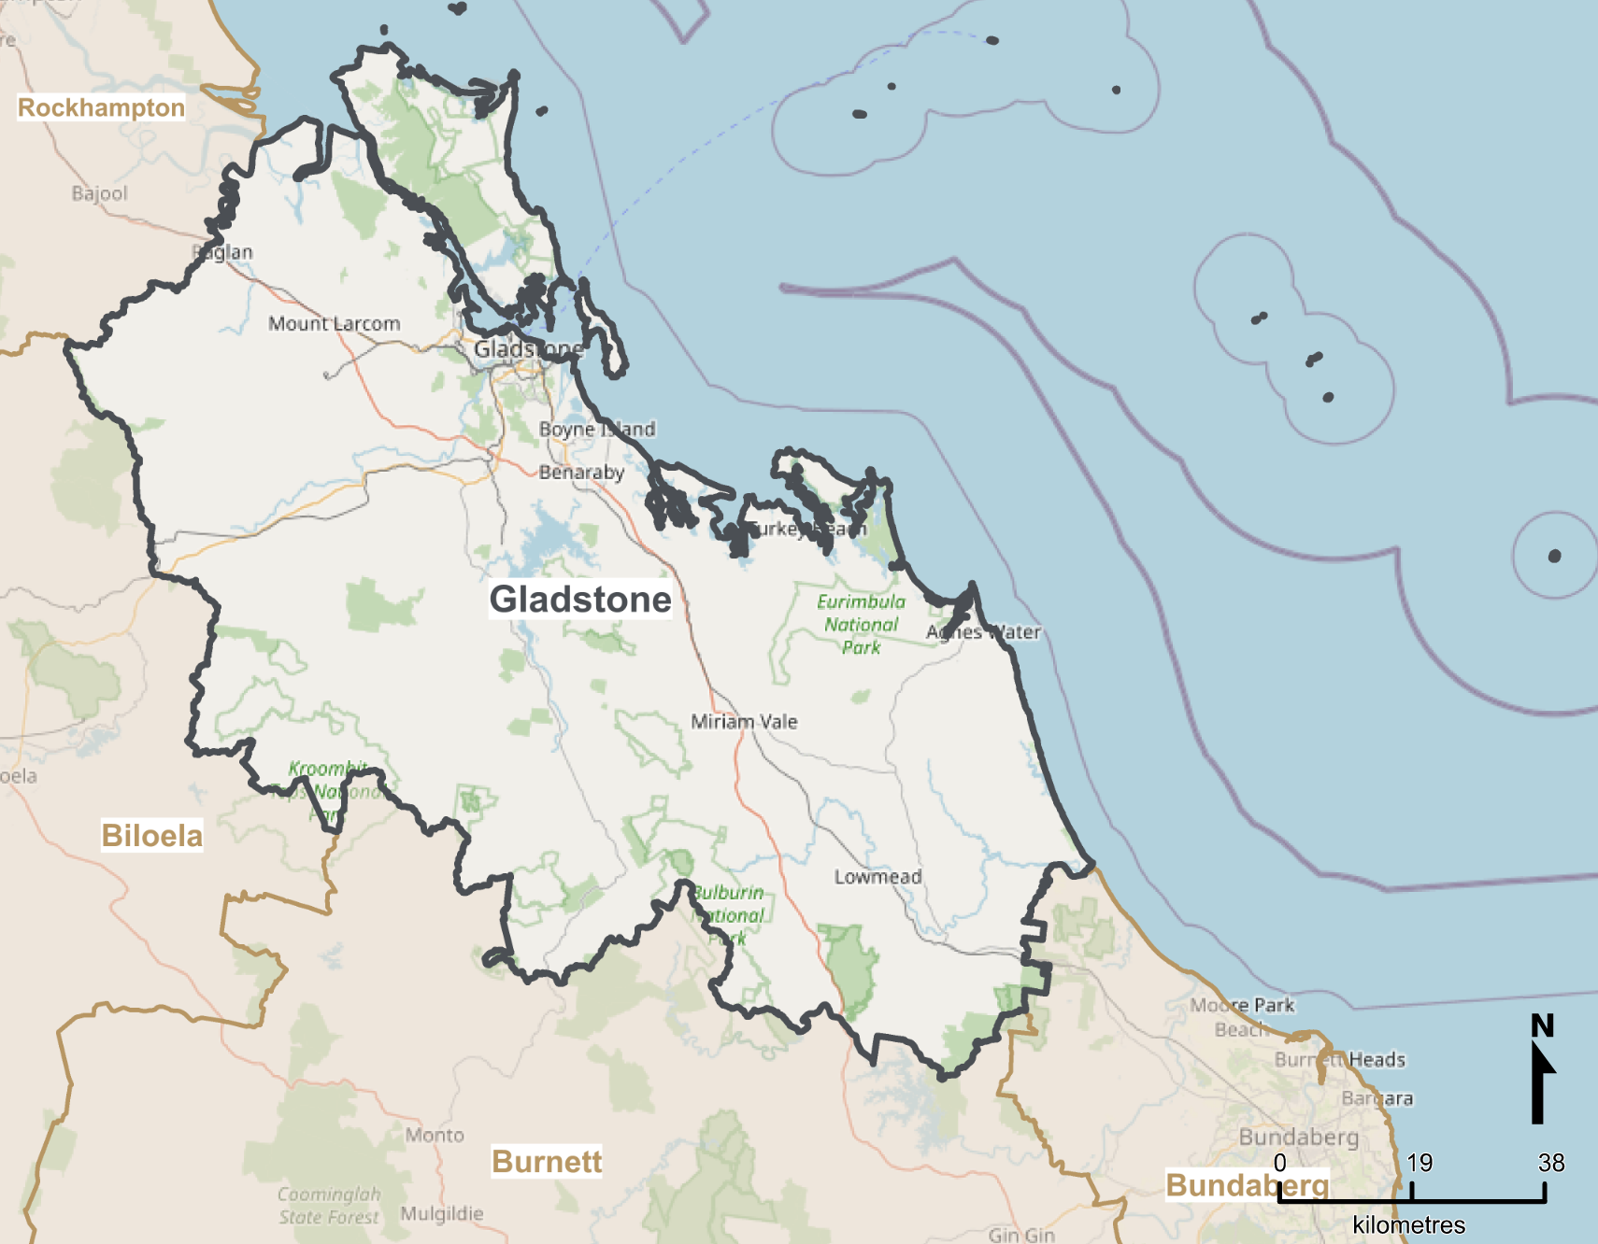

Gladstone (2018-19 economy, SA3/LGA):
$15.5bn aggregate output: approx. 25% of Central Qld, 2% Qld
29k FTE: approx. 28% of Central Qld, 1.3% of Qld
63k population: highly skilled, but aging with 0.7% growth
Multi-commodity deep-water port plus rail and road infrastructure
Gladstone is Qld’s regional manufacturing hub:
$5.5bn to $6bn Manufacturing output: of which approx. $1bn is BSL
4k to 4.5k Manufacturing FTE employees: of which 1k at BSL
BSL represents approx. ¼ of Manufacturing activity except in energy consumption
Other Heavy industry: Ammonia, Cement, LNG, Oil refinery
Growth industries: ag-tech, AlOx for batteries, aquaculture, Mining Serv., green {…}

Slide 6

Economic Modelling with Sector-specific Euler Equations ``emsee’’ model overview

Slide 7
CGE model with forward-looking dynamics: 19 ANZSIC divisions, Gladstone region:
Solve as a sequence of overlapping nonlinear dynamic programs
Supply = Demand (output = med + con + inv + xpo) at each time
Output is a function of capital, labour, intermediates (with imports) and a fixed factor.
Capital depreciates and is optimally replenished to grow the economy.
Balanced growth paths: each sector grows in range 1% to 2%
Sector-specific Euler Eq’ns:
Testable condition: ``value capital today’’ = ``expected value of capital in the future’’
When the SEE hold, capital is optimally allocated across sectors
Absent in intersectoral models: CoPS; Atalay; Cesa-Bianchi et al; Baqaee and Farhi
Transition to net zero: some SEE may fail to hold and, in this case:
sectoral shocks are more likely to spill over/propagate to other sectors
the economy has more capacity for adaptation: chance to nudge economy to new equilibria
Notes:
Forward-looking dynamics:
For each sector and point in time: med = “sum of intermediate flows to all 19 sectors”; con = “consumption”; inv = “sum of investment flows to all 19 sectors”; xpo = “exports”; kap = “capital” evolves according to the standard dynamic equation $k_{t+1}=\left(1−δ\right)$ $k_{t}+{inv}_{t}$ where $\left(1−δ\right)$ $k_{t}$ is current capital depreciated at rate $δ$and ${inv}_{t}$ is an optimal, forward-looking composite of flows from all 19 sectors.
Balanced Growth Paths:
Technological progress augments the fixed factor making our time at work more productive and the economy to converge to an approximately balanced growth path. Over time, the economy converges to a balanced growth path arises when all sectors experience a stable rate of year-on-year growth. Here we assume this rate to be similar across sectors.
Optimality:
The model depends on many parameters such as elasticities of substitution, productivity parameters, technical coefficients (a.k.a. sectoral shares). For every parameterisation, optimal means not only that the market clearing and dynamic equations hold, but also a no-arbitrage condition holds for investment across sectors. These conditions hold regardless of whether the economy is on a balanced growth path or whether the Euler eq’ns hold.
Euler Equations:
At the sectoral level, the intertemporal Euler equations provide a more refined notion of optimality that hold only for certain parametrisations. These equations ensure that capital is on the right trajectory, the one that ensures the marginal value of consumption today is equal to the expected discounted marginal value of future consumption. This calculation of expected value is made by economic agents who try to make sense of uncertainty about future states of the world.
Consider a simple example with two states. In state 1, Queensland transitions to net zero by 2050. In state 2 it does not (perhaps because climate change is not a concern). In state 2, current capital would probably satisfy the Euler equations as the current stock of capital is fit-for-purpose. In state 1 on the other hand, the stock of capital is already out-of-date and finding the right path for future capital is hard. Regions and sectors with a dependence on coal are on the front line.
In this paper, we look at the implications for a shock of whether (or not) the Euler equations hold at the sectoral level. We find that these equations do indeed affect the way a sectoral shock propagates across the economy. As we show in the results section, when the equations hold, the closure of BSL does not propagate to other sectors to the same degree. The explanation is that they are already well-stocked and therefore robust to external shocks.

Slide 8
The data

Slide 9
Data sources:
Jobs in Australia ABS data: labour per sector for Gladstone 2019.
Input-output flows between sectors: ABS tables 5 and 8 for Australia
Investment flows between sectors:
investment flows tables from the US Bureau of Economic Analysis
ABS Gross Fixed Capital Formation by Industry by type of Asset
BLADE (and Remplan): for output per sector for Gladstone 2019
Gladstone Port data for Bauxite, Alumina, Aluminium and Coal
Eg. Bauxite imports
Rio Tinto accounts
Studies on aluminium production e.g.
Gagne and Nappi 2000, Best Available Techniques 2017

Slide 10
Experiments and shocks

Slide 11
Experiment Type (1):
1st phase: tune parameters to regionalise, all 20 SEE hold
2nd phase: capital evolves towards a balanced growth path
3rd phase: continue along same path and generate
``status quo’’ path
``shock’’ (BSL closure) path
Experiment Type (2):
1st phase: tune parameters to regionalise; not all 20 SEE hold
2nd phase: capital evolves towards a balanced growth path
3rd phase: continue along same path and generate
``status quo’’ path
``shock’’ (BSL closure) path
Shock type (a): one-off “MIT shock” agents don’t see coming
1/4 decrease in Manufacturing productivity, capital and exports
5/6 decrease in Utilities (energy + water) purchases by Manufacturing
No exogenous decommissioning or replacement activity

Slide 12
Experiment (1a) Results Summary
When the SEE hold, the shock is sector-specific
Closure causes Utilities (energy and water) prices to fall
This stimulates Agriculture, Mining and Consumption.
In practice, Gladstone is connected to NEM, so actual fall in energy prices would be less significant as benefits are spread over a much larger region.
Sectoral breakdown of initial -$1.7bn drop in Aggregate Output
Manufacturing | Utilities | Construction | Transport | Others
-$1.59bn | -$47m | -$24m | -$8m | -$27m

Slide 13
Comparison of experiments: (1a) (2a) All 20 SEE hold Not all 20 SEE hold

Slide 14
Experiment-shock (1a): % change relative to status quo,
Aggregates
Experiment-shock (2a): % change relative to status quo,
Aggregates
Aggregate Output permanently down by 10% or $1.6bn
in accordance with productivity shock
Aggregate Capital permanently down by 1.6-1.7%
Output falls by 1% or $0.15bn before converging to 0; impact is transitory (unlike the productivity shock).
Consumption is up by 1% in the long run

Slide 15
Experiment-shock (1a): % change relative to status quo,
Manufacturing
Experiment-shock (2a): % change relative to status quo,
Manufacturing
Aggregate Output permanently down by 27% or $1.5bn
in accordance with productivity shock
Manufacturing capital quickly returns back to previous no-shock levels: a quick response is optimal.
Manufacturing capital slowly returns to no-shock levels as they were not entirely efficient.
Consumption rises as Manufacturing prices fall.

Slide 16
Experiment-shock (1a): % change relative to status quo,
Utilities
Experiment-shock (2a): % change relative to status quo,
Utilities
Utilities (Energy and Water) price initially fall by 4%;
Consumption up compensating for falls elsewhere;
Capital down by 9% in the long run.
Utilities price down by 10% and remains there;
Capital down by 6% in the long run;
As prop’n of output: imports down from 12.5% to 8%

Slide 17
Experiment-shock (1a): % change relative to status quo,
Agriculture (Similar pictures for Mining.)
Experiment-shock (2a): % change relative to status quo,
Agriculture
Cheaper energy and water prices cause Capital, Output, Exports and Imports to rise.
Consumption falls due to increases in other demand.
Similar, but more extreme:
Capital up by over 15% in the long run.
As prop’n of output: imports up from 10% to 15%

Slide 18
Key takeaways

Slide 19
Economic modelling with SEE:
The SEE are testable conditions with long history in macroeconomics and finance: absent in CGE
If the SEE hold, then the shock is more sector-specific (less macroeconomic).
Transition: uncertainty and out-of-date capital, so the SEE are unlikely to hold
greater propagation of shocks, but also opportunity for change
Policy implications: by estimating how the SEE fail to hold, we can
identify paths of least resistance for transforming the economy
BSL is important to Gladstone’s economy and Qld’s Al/AlOx supply chain
Transition needs to be handled with care as it is a major consumer of energy
Needs a large backup supply of energy (currently Gladstone Power Station)
Quick decisions are valuable: e.g. Kurri Kurri closure 2012; power station approval 2021
With right energy transition, Gladstone Aluminium can be internationally competitive
June 2022: Rio Tinto calls for clean Gladstone Aluminium by 2030.
September 2022, Qld Energy Plan: supergrid can keep Gladstone in proximity of power supply

Slide 20
References

Slide 21
Short list of Articles:
Atalay, E. (2017). How important are sectoral shocks?. American Economic Journal: Macroeconomics, 9(4), 254-80.
Baqaee, D. R., & Farhi, E. (2019). The macroeconomic impact of microeconomic shocks: Beyond Hulten's theorem. Econometrica, 87(4), 1155-1203.
Cai, Y., & Judd, K. L. (2021). A Simple but Powerful Simulated Certainty Equivalent Approximation Method for Dynamic Stochastic Problems (No. w28502). National Bureau of Economic Research.
Cusano, G., Rodrigo Gonzalo, M., Farrell, F., Remus, R., Roudier, S., Delgado Sancho, L. (2017). Best Available Techniques (BAT) Reference Document for the Non-Ferrous Metals Industries. Industrial Emissions Directive 2010/75/EU (Integrated Pollution Prevention and Control) (No. JRC107041). Joint Research Centre (Seville site).
Dixon, P., & Rimmer, M. T. (2020). Developing a DSGE consumption function for a CGE model. Centre of Policy Studies (CoPS), Victoria University.
Gagné, R., & Nappi, C. (2000). The cost and technological structure of aluminium smelters worldwide. Journal of Applied Econometrics, 15(4), 417-432.
Na, S., Anitescu, M., & Kolar, M. (2021). A fast temporal decomposition procedure for long-horizon nonlinear dynamic programming. arXiv preprint arXiv:2107.11560.
Data:
Australian Bureau of Statistics (ABS), 2018-2019. Tables 5 and 8: Industry by Industry Flow Table. Released May 2021.
Australian Bureau of Statistics, Business Longitudinal Analysis Data Environment (BLADE), 2018-2019, https://www.abs.gov.au/about/data-services/data-integration/integrated-data/business-longitudinal-analysis-data-environment-blade
Bureau of Economic Analysis (2003). Capital flow data for 1997. https://www.bea.gov/news/2003/capital-flows-us-economy-1997
Gladstone Regional Council. https://www.gladstone.qld.gov.au/downloads/file/3466/gladstone-region-investment-prospectus . Retrieved October 2022
Queensland Government (2022). Energy and Jobs Plan. https://www.epw.qld.gov.au/energyandjobsplan . Retrieved October 2022
Queensland Government. https://yoursayhpw.engagementhq.com/understand-qrez/news_feed/central . Retrieved October 2022
Port of Gladstone, “Trade Statistics Data,” https://www.gpcl.com.au/trade-statistics . Retrieved April 2020
Rio Tinto, (2019). Annual Report Production, Reserves and Operations. Retrieved in April 2020.

